Slide 1
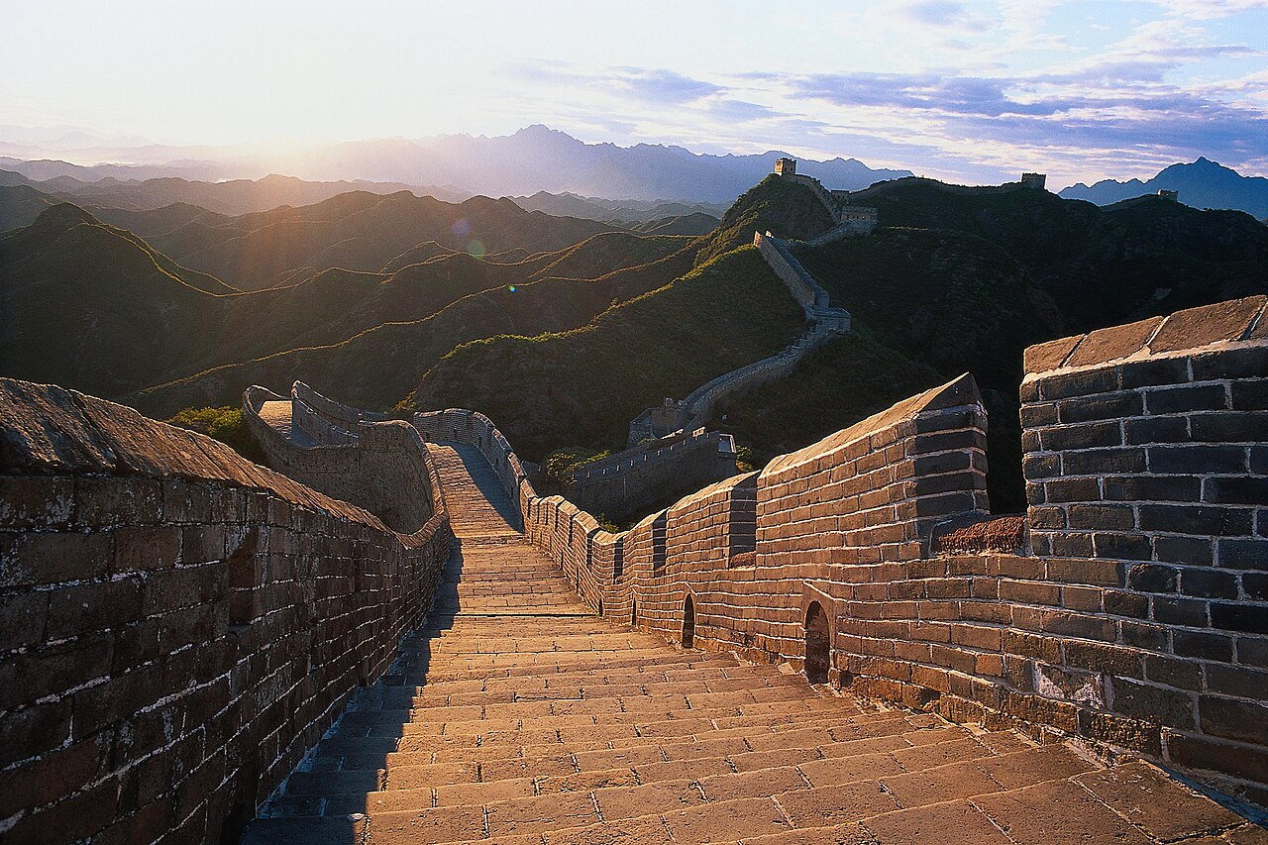
WIKIPEDIA · WORLD HERITAGE SERIES
THE GREAT WALL
OF CHINA
21,196 km of fortifications · 2,000+ years of history · A UNESCO World Heritage Site since 1987
Source: Wikipedia — “Great Wall of China”

Slide 2
OVERVIEW
A Monument Across Time
01
History
From 7th-century BC rammed-earth walls to the brick fortifications of the Ming dynasty.
02
Architecture
Watchtowers, signal beacons, barracks and sticky-rice mortar that bound the stones together.
03
Condition
22% of the Ming wall has vanished; conservation remains a global challenge.
04
From Space
A myth examined — can the Great Wall really be seen from the Moon?
05
World Heritage
Inscribed by UNESCO in 1987; voted one of the New 7 Wonders in 2007.
THE GREAT WALL OF CHINA
02

Slide 3
KEY FACTS
The Wall in Numbers
Field | Value
Type | Fortification
Location | China
Coordinates | 40°25′53″N 116°33′52″E
Official name | The Great Wall
UNESCO Criteria | Cultural: i, ii, iii, iv, vi
UNESCO Reference | 438
Inscription | 1987 (11th Session)
Area | 2,151.55 ha (5,316.6 acres)
Buffer zone | 4,800.8 ha (11,863 acres)
Total length | 21,196.18 km (13,170.70 mi)
THE GREAT WALL OF CHINA
03

Slide 4
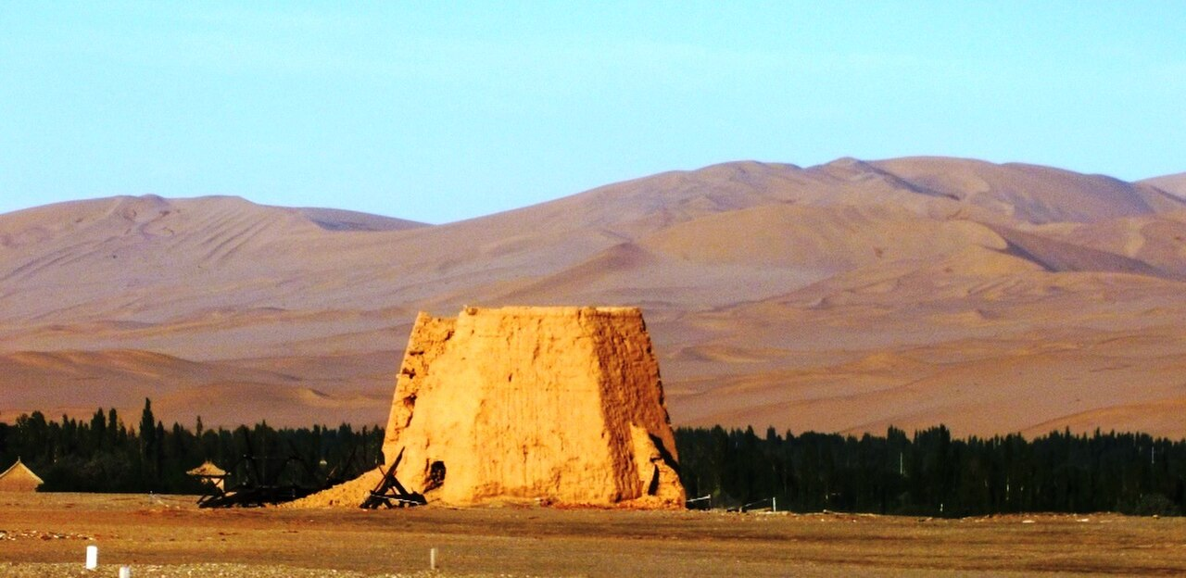
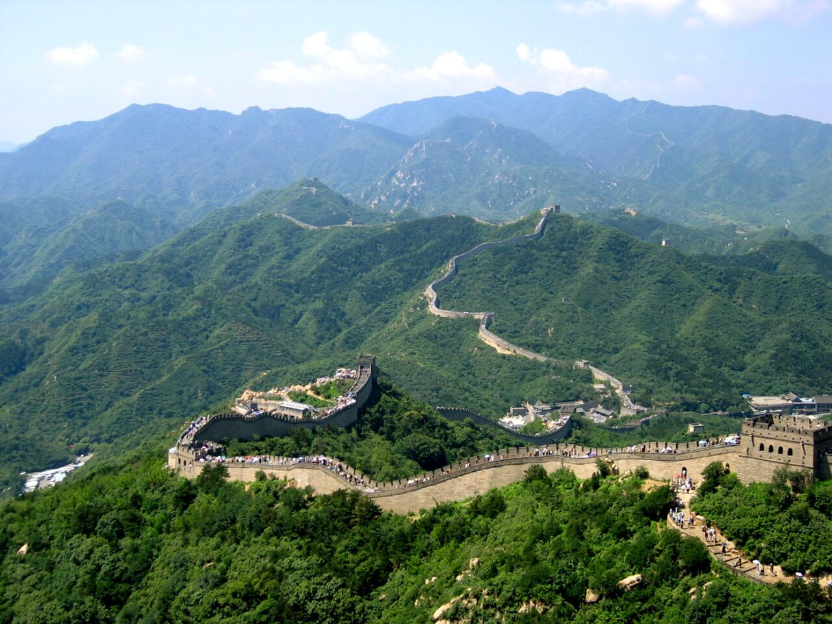
HISTORY · PART I
Early Walls & the Qin Unification
The Chinese were already masters of wall-building by the Spring and Autumn period (8th–5th century BC). During the Warring States era, the states of Zheng, Chu, Qin, Wei, Zhao, Qi, Lu, Han, Yan, Zhongshan and Zhou all raised extensive fortifications to defend their borders.
In 221 BC the state of Qin triumphed and its ruler — the First Emperor of a unified China — ordered the destruction of internal walls and the building of new ones to connect the remaining fortifications along the northern frontier against the Xiongnu. “Build and move on” was the guiding principle: the wall was never a permanently fixed border.
Remains of a beacon tower near Yumenguan, 2011
Builders always used local resources — stone in the mountains, rammed earth on the plains. Later the Han, the Northern dynasties and the Sui all repaired, rebuilt or expanded the wall at great cost.
The Great Wall at Badaling
THE GREAT WALL OF CHINA
04

Slide 5
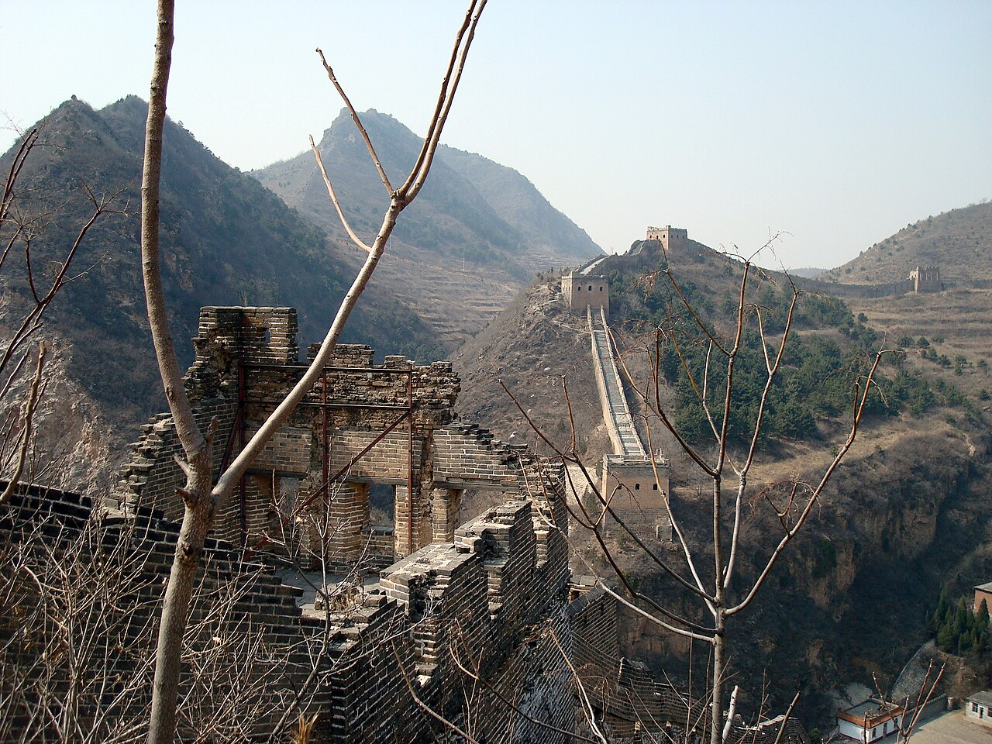
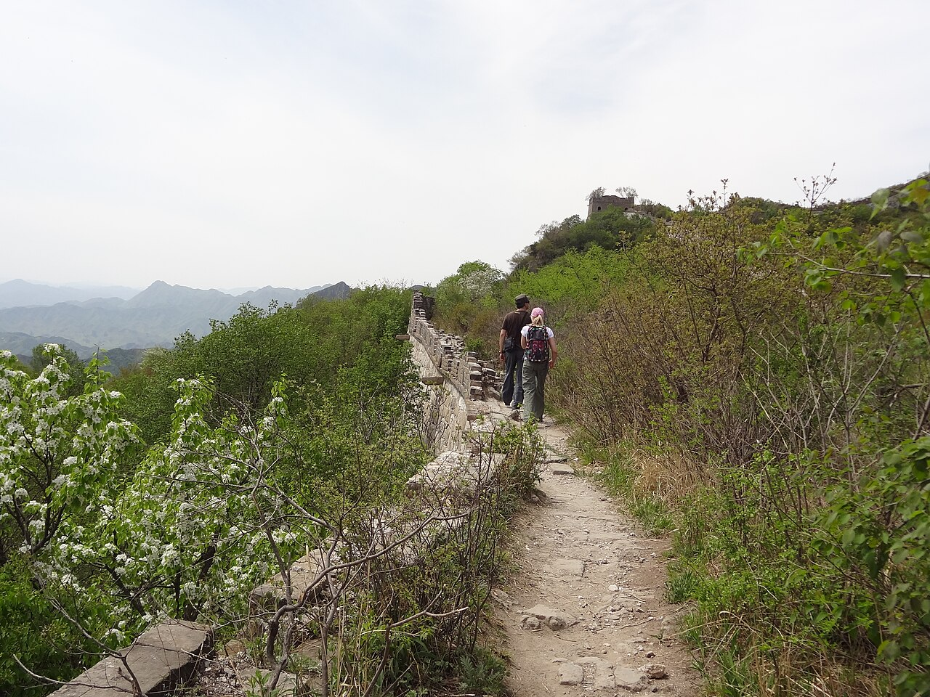
HISTORY · PART II
The Ming Dynasty & the Modern Wall
After the defeat at the Battle of Tumu, the Ming dynasty (1368–1644) adopted a new strategy: walls along the northern border. Unlike earlier fortifications, Ming construction was stronger and more elaborate, using bricks and stone instead of rammed earth. Up to 25,000 watchtowers were built.
Under General Qi Jiguang, 1,200 watchtowers were raised from Shanhaiguan Pass to Changping between 1567 and 1570, and rammed-earth sections were faced with bricks. The wall helped hold the Manchu invasions around 1600 — the Ming army held the fortified Shanhai Pass, keeping the Manchus from the Chinese heartland.
Ming Great Wall at Simatai, overlooking the gorge
The best-known sections of the Great Wall today — those of brick and stone — were built by the Ming dynasty.
Mutianyu — an unrestored wild section
THE GREAT WALL OF CHINA
05

Slide 6
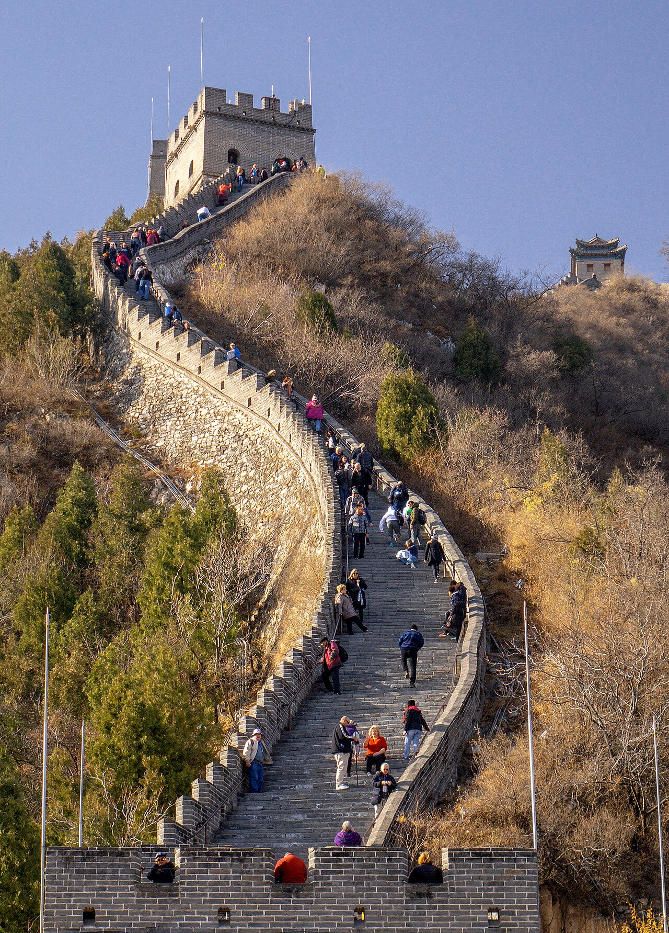
ARCHITECTURE
Materials, Mortar & Watchtowers
Before bricks, the wall was built from rammed earth, stones and wood. During the Ming, bricks were used heavily — lighter and easier to work with, they quickened construction and bore more weight. Stone was cut into rectangular blocks for foundations, brims and gateways.
Battlements line the top of most of the wall, with defensive gaps about 30 cm tall and 23 cm wide. Sticky-rice mortar — sticky rice soup mixed with slaked lime — held the bricks together. No human bones were ever used, contrary to urban legend.
Signal towers on hilltops relayed warnings and reinforcements along the wall; wooden gates could trap attackers. Barracks, stables and armories stood near the inner face.
The Juyongguan area of the Great Wall
THE GREAT WALL OF CHINA
06

Slide 7
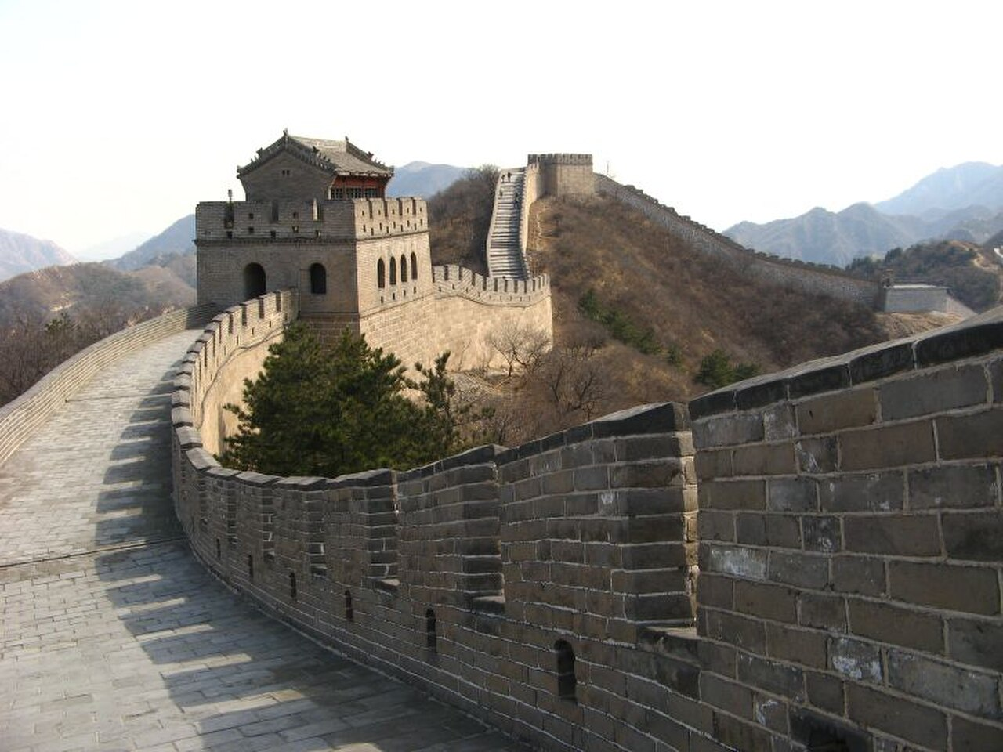
CONDITION & CONSERVATION
A Wall Under Threat
While sections north of Beijing and near tourist centres have been preserved and even renovated, much of the wall is in disrepair. It has been a source of stones for houses and roads, and is prone to graffiti, vandalism and the pilfering of inscribed bricks.
Statistic | Value
Ming wall disappeared (2012 report) | 22% · 1,961 km
Gansu wall at risk (2007 estimate) | > 60 km in 20 years
Height reduced in some places | from > 5 m to < 2 m
Ming watchtowers (estimate) | up to 25,000
2023 Shanxi damage | gap widened by excavator
Badaling Great Wall during winter
THE GREAT WALL OF CHINA
07

Slide 8
MYTH & REALITY
Can You See the Wall from Space?
Popular culture claims the Great Wall can be seen from space with the naked eye — but the truth is more subtle. Although the wall is long enough, it is far too narrow. Astronauts report that, being made of local materials, the wall blends into its surroundings in a natural camouflage effect.
From the Moon, the wall is far beyond the limit of human vision. From low Earth orbit, it is only occasionally visible under ideal conditions — and even then it is not the distinctive ribbon of legend.
The myth endures, but the wall’s true wonder lies in its scale: 21,196 km of human engineering across mountains, deserts and steppe.
The Great Wall at dawn — by Hao Wei
THE GREAT WALL OF CHINA
08

Slide 9
TIMELINE
Two Thousand Years of Building
Period | Era | Contribution
8th–5th c. BC | Spring & Autumn | First state fortifications built
221 BC | Qin dynasty | Walls joined under the First Emperor
206 BC–220 AD | Han dynasty | Expansion along the Silk Road frontier
1368–1644 | Ming dynasty | Brick & stone; the best-known sections
1644–1912 | Qing dynasty | Maintenance; the wall loses its role
1987 | Modern era | UNESCO World Heritage inscription
2007 | Modern era | Voted one of the New 7 Wonders
THE GREAT WALL OF CHINA
09

Slide 10
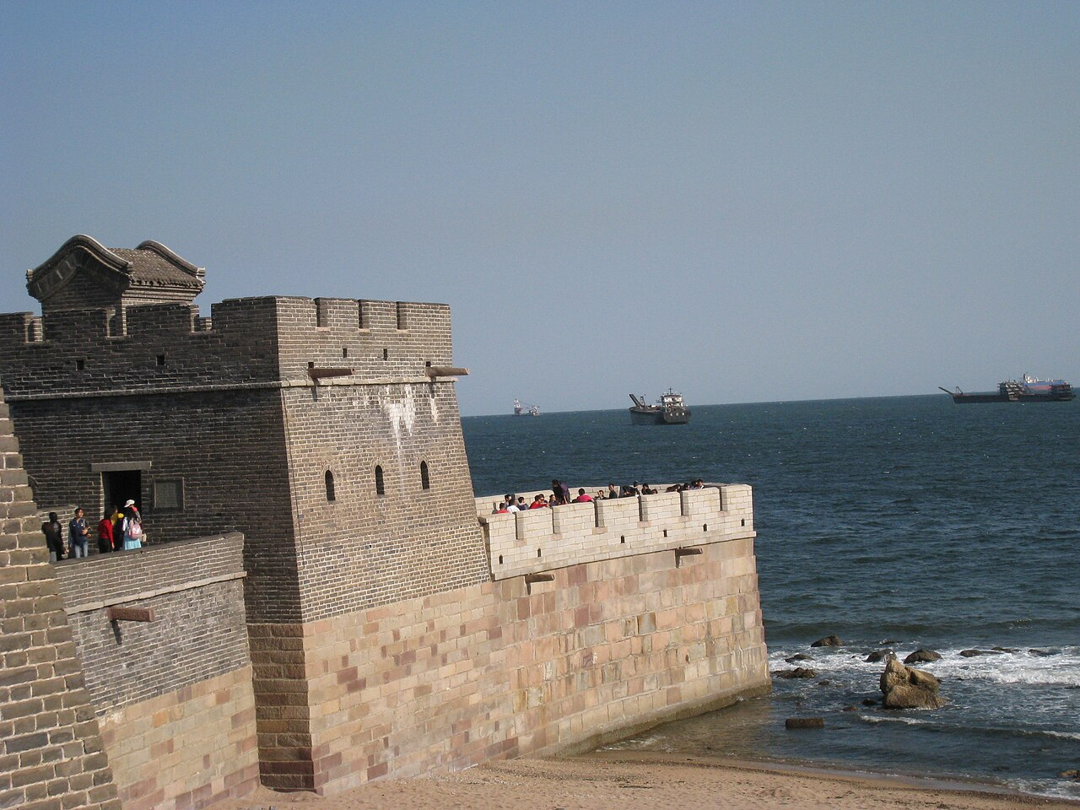
GALLERY
Faces of the Great Wall
Badaling — the most visited section
Simatai — over the gorge
Mutianyu — wild section
Old Dragon Head — meets the sea
Beacon tower near Yumenguan
Badaling in winter
THE GREAT WALL OF CHINA
10

Slide 11
“The Great Wall is one of the most impressive architectural feats in history.”
— UNESCO World Heritage Centre
Thank You
Content extracted from Wikipedia · Images © their respective authors (Wikimedia Commons)

