Slide 1
Schizophrenia
Schizophrenia is a chronic remitting and relapsing or progressive psychotic syndrome
affects 1% of the population in all races and culture
associated with significant impairment in social interactions and occupational functioning
the onset of schizophrenia is in the late teens - early twenties
and an average reduction of lifespan of 15 to 25 years

Slide 2
Positive Symptoms
disturbance of reality perception
Hallucinations (false perceptions: hearing voices others do not hear; Seeing, feeling, or smelling things other do not)
Delusions (false beliefs: Intense suspicion; Thoughts controlled by Martians; Radios implanted in teeth)
Disorganized Speech and behavior (Loose associations, Word salad, Flight of Ideas)
Negative Symptoms
inappropriate or diminished affect (mood)
Apathy, social withdrawal, anhedonia, emotional blunting, extreme inattentiveness or lack of motivation to interact with the environment
(Negative symptoms are progressive and less responsive to therapy)
Cognitive impairment
Cognitive deficits and deficits in attention and executive function

Slide 3
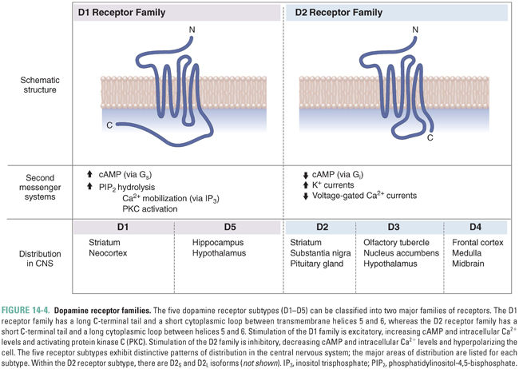
Dopamine Receptors family
 | D1 | D5 |  | D2 | D3-4
Striatum | ++ |  |  | ++
Prefrontal Cortex | ++ |  |  |  | +
Limbic system | ++ | + |  | ++ | +
Hypothalamus | ++
Pituitary gland |  |  |  | ++

Slide 4
Typical Antipsychotic drugs
All are equally effective but differ in their tolerability
All show a significant delay before they become effective
All produce significant adverse effects (EPS occurs at clinically effective doses)
Limited efficacy against negative symptoms
A substantial portion of patients (25% to 40%) respond poorly to treatment
Drug interaction with additive effects with sedatives, anticholinergic, antihistaminergics, alfa receptor blocking agents
Efficacious for positive symptoms
Low-cost
Notes:
All block one or more types of dopamine receptor, but differ in their other neurochemical effects

Slide 5
Atypical antipsychotic drugs
Are effective against positive and negative symptoms with some improvement in cognition
Are effective in patients refractory to typical neuroleptics
Greatly reduced or absent EPS
Disadvantage: Expensive

Slide 6
Antipsychotics: receptor order of potency
TYPICAL
Chlorpromazine | α₁ = 5-HT₂ = D₂ > D₁ > M > α₂
Haloperidol | D₂ > D₁ = D₄ > α₁ > 5-HT₂ >H₁>M = α₂
Clozapine | D₄ = α₁ > 5-HT₂ = M > D₂ = D₁ = α₂ ; H₁
ATYPICAL
Quetiapine | 5-HT₂ = D₂ = α₁ = α₂ ; H₁
Risperidone | 5-HT₂ >> α₁ > H₁ > D₂ > α₂ >> D₁
Sertindole | 5-HT₂ > D₂ = α₁

Slide 7
Atypical Antipsychotics:
Drug/Receptor Characteristics
All atypical neuroleptics have affinities for D1, D3, D4, histamine, and α-AR receptors and display balanced D2/D1 and 5-HT2 receptors antagonism
Due to the modulatory role of 5-HT on dopaminergic neurons, atypical antipsychotic drugs with 5-HT receptors affinity contributes to:
🔻 the antipsychotic action (Blockade of 5-HT2A receptors in the mesocortical pathway enhances the release of both dopamine and glutamate)
🔻 the low risk of producing EPS (Blockade of 5-HT2A receptors in the nigro-striatal pathway enhances dopamine release)
🔻 the ability to improve cognition (5-HT6 and 7 antagonists exert pro-cognitive effect

Slide 8
 | POSITIVE SYMPTOMS | NEGATIVE SYMPTOMS | SIDE EFFECTS | NOTE
CLOZAPINE | + | +/- | Sedation, hypotension, diabete | Seizure Agranulocytosis
RISPERIDONE | + | +/- | Elevated prolactin levels, EPS
OLANZAPINE | + | +/- | Diabetes
ZIPRASIDONE | +/- | + | Weight gain Uncontrolled movements
QUIETAPINE | +/- | + | Sedation Also for depression
ARIPRIPAZOLE | - | +/- | Uncontrolled movements

