Slide 1
Lab 1: Environment Setup Prepared & Presented by Will Claybaugh

Slide 2
Warmup
Windows:
Open anaconda prompt
Type conda –V
If you get an error, install Anaconda: https://docs.anaconda.com/anaconda/install/windows/
#8 is important: DO NOT add to your path
If no error, consider upgrading conda:
conda update conda
Clone https://github.com/Harvard-IACS/2019-CS109B (or pull the latest if you’ve already cloned)
Mac:
Open a terminal
Type conda –V
If you get an error, install Anaconda: https://docs.anaconda.com/anaconda/install/mac-os/
If no error, consider upgrading conda:
conda update conda
Clone https://github.com/Harvard-IACS/2019-CS109B (or pull the latest if you’ve already cloned)

Slide 3

Goals (Who this lab is for)
Set up the tools you’ll need for CS109b
In a way that won’t mess up your other classes
Teach a workflow that will keep your installs tidy
User-level understanding of why ‘environments’ are helpful
Stretch: Ability to produce conda environments for future projects
TL;DR: Set up a conda environment with the packages listed in 109b.yml
If you already know how to do that, you can skip the lab

Slide 4
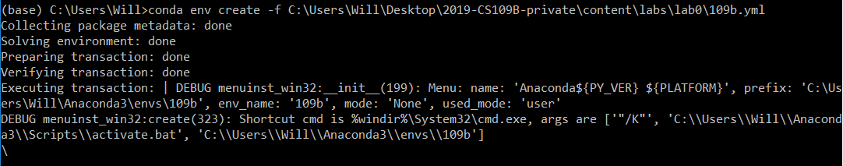
Jumpstart
Locate the file 2019-cs109b/content/labs/lab1/109b.yml
Run conda env create -f [path]/109b.yml
Windows: use \ instead of /, delete the “- pyjags” line from the file
pyjags has no plans to support windows : (
Setup may take a few minutes
While we wait: Introductions + Norms

Slide 5

Me
For a scavenger hunt, teamed with college friends to write an end-rhyme rapping Markov Chain
M.C. MCMC
Later released mix[ing] tape “d/dt: Derivative with respect to rhyme”
Taught AP Calc; finally understood abstract algebra via tutoring a former student over the phone

Slide 6
Norms
But it’s not about me; it’s about you
Most time will be yours to work on exercises
TFs in the room and on Zoom to answer questions
You might finish the exercise easily, or you might get stuck
Either way, please be patient
We’ll (quickly?) go over the solutions after each exercise
Now, what was that code doing?

Slide 7
[Ana]conda

Slide 8
Python, Anaconda, and Conda, oh my!
We’re creating a separate set of Python language files and packages for cs109
Installs/updates for other classes won’t break cs109
cs109 won’t break other classes
Can use different versions of Python (we’re using 3.6, even though 3.7 is newly released)
CONDA is the tool that manages these environments
Anaconda is the name for a useful set of [data] science packages, including conda itself
Notes:
MCMC constantly breaking; sub in project/team for ‘class’

Slide 9

The Circle of Life

Slide 10
Environment workflow
Create (once): conda env create -f [path]
Turn on an environment
Windows: conda activate [envname]
Mac: source activate [envname]
Use the environment (write/save code, upgrade/install packages)
Switch back to the global environment, named (base):
Windows: conda deactivate
Mac: source deactivate
Destroy (once): conda remove --name [envname] --all

Slide 11

Python, Anaconda, and Conda, oh my!
FAQs
Can still access all existing files, no matter what environment you activate
Conda guarantees you get the correct versions of each package
Can (and should!) have lots of environments; they share what they can safely share and don’t take up much space
Can install new things to an environment or just burn it down and build a new one

Slide 12
Exercise
Exercise:
In the 109b environment, install autodiff_group3 from pip. Verify that you can’t import autodiff in your base environment
Notes on combining pip and conda: [here]
TL;DR: conda’s update doesn’t always know about things installed via pip; try to do all conda things first, then all pip things
Also in the 109b environment, open the r_setup.ipynb notebook and run the cells. This will:
Verify the installed packages (especially Keras) will load
Download and some packages in the R language we’ll call on later in the course

Slide 13

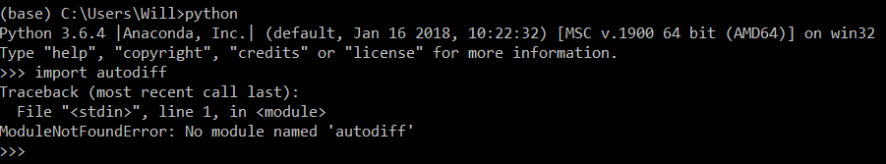
Solutions
Solutions:

Slide 14
Solutions
Solutions:
2.
Use notebook as usual

Slide 15
REVIEW

Slide 16
Review
Environments keep different package/language versions separate
Ideally: create an environment for each class or project
Minimally: do all 109b work in the 109b environment
Remember how?
Create (once): conda env create -f [path]
Turn on an environment
Windows: conda activate [envname]
Mac: source activate [envname]
Use the environment (write/save code, upgrade/install packages)
Switch back to the global environment, named (base):
Windows: conda deactivate
Mac: source deactivate
Destroy (once): conda remove --name [envname] –all
Environments can also be managed via the Anaconda Navigator

Slide 17
Jupyterhub

Slide 18

JupyterHub
Poll: How many people used JupyterHub for 109a?
JupyterHub:
We're paying Amazon to use their CPUs/GPUs/RAM/Disk
Useful lie: think of it as a (powerful) remote computer
No GUI operating system installed; some tasks must be done on command line
Turns off after 1h of idle time
WILL NOT shut down while code is running
WILL shut down without saving your results! You’ll have to re-run the notebook
Cannot complete your projects without it!!

Slide 19
Exercise
Exercise:
Log in to JupyterHub via the 109b Canvas page
If you see the familiar Jupyter Home, you succeeded.
Upload the r_setup.ipynb notebook
Run the notebook to download the courses’ R packages
Download a copy of the updated notebook via File->Download as

Slide 20
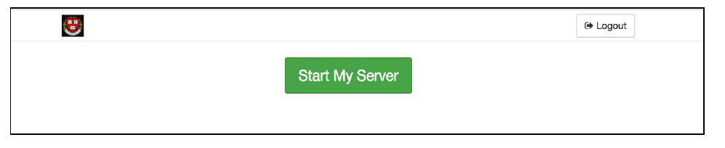
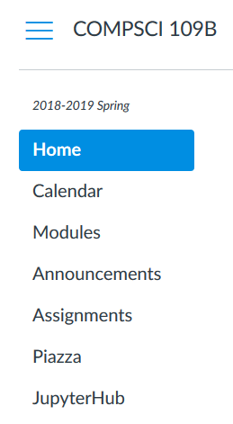

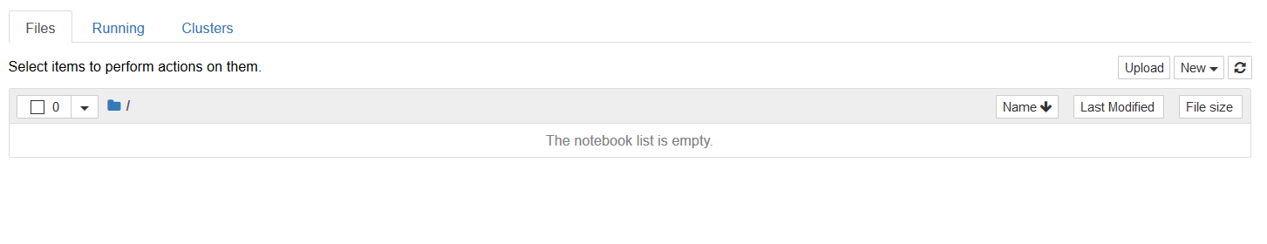
Solutions
Solutions
1.

Slide 21
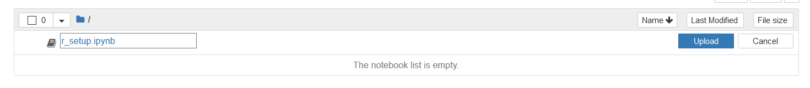
Solutions
Solutions
2.
Use notebook as usual

Slide 22
Solutions
3. Trivial- Run the notebook as you normally would

Slide 23
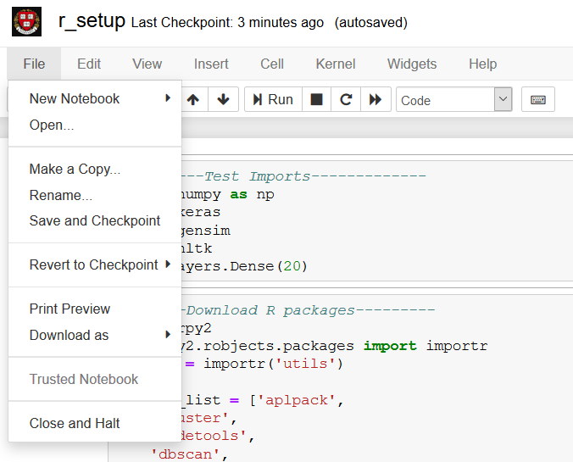
Solutions
Solutions
4.
Use notebook as usual

Slide 24
Exercise
Exercise:
Open a terminal on the jupyterhub server (On the home screen: New->Terminal)
Use ls to view all files in the directory
Google “linux count lines in file” and determine how many lines are in the r_setup notebook
Close the terminal (See the “Running” tab on the home screen)

Slide 25
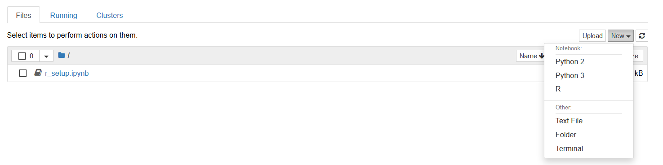
Solutions
1.

Slide 26
Solutions
2.

Slide 27
Solutions
3.

Slide 28
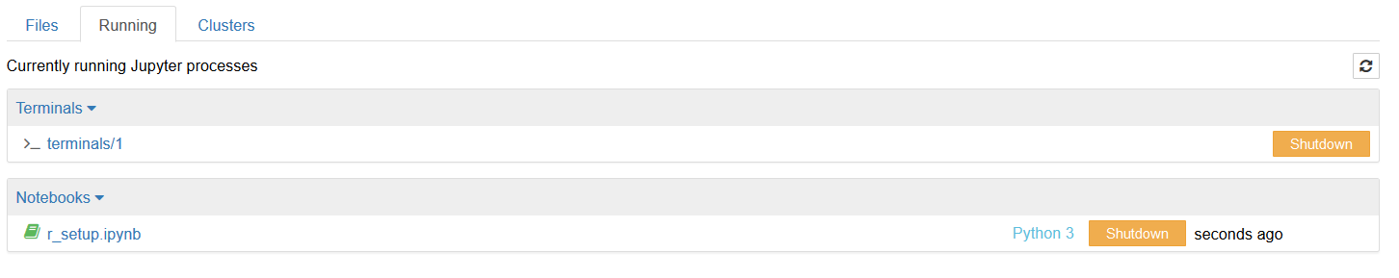
Solutions
4.

Slide 29
Appendix

Slide 30
Contents of 109b.yml:
name: 109b
dependencies:
- python=3.6
- r-base
- anaconda
- seaborn
- gensim
- nltk
- rpy2
- pip:
- tensorflow
- keras
- pyjags
Can you tell how to add more packages, or specify/change version numbers?

