Slide 1
Advanced Section #4: Methods of Dimensionality Reduction: Principal Component Analysis (PCA)
Cedric Flamant

Slide 2
Outline
Introduction:
Why Dimensionality Reduction?
Linear Algebra (Recap).
Statistics (Recap).
Principal Component Analysis:
Foundation.
Assumptions & Limitations.
Kernel PCA for nonlinear dimensionality reduction.

Slide 3
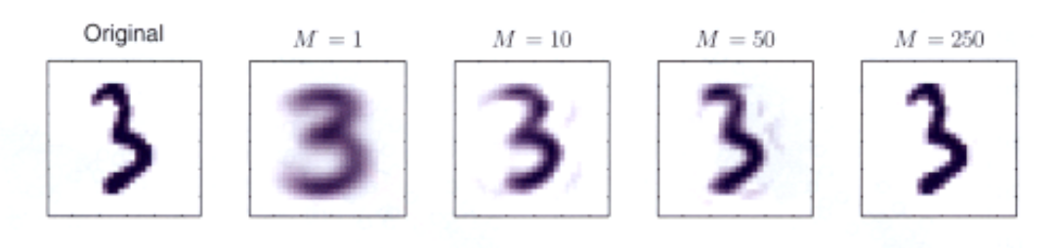

Dimensionality Reduction, why?
A process of reducing the number of predictor variables under consideration.
To find a more meaningful basis to express our data filtering the noise and revealing the hidden structure.
C. Bishop, Pattern Recognition and Machine Learning, Springer (2008).

Slide 4
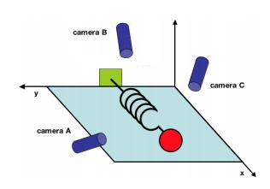
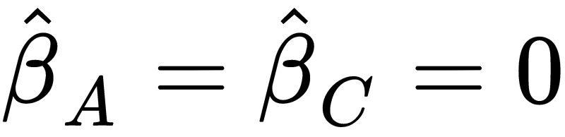
A simple example taken from Physics
Consider an ideal spring-mass system oscillating along x.
Seeking the pressure Y that spring exerts on the wall.
LASSO regression model:
LASSO variable selection:
J. Shlens, A Tutorial on Principal Component Analysis, (2003).

Slide 5
Principal Component Analysis versus LASSO
LASSO
LASSO simply selects one of the arbitrary directions, scientifically unsatisfactory.
We want to use all the measurements to situate the position of mass.
We want to find a lower-dimensional manifold of predictors on which data lie.
X
X
Principal Component Analysis (PCA): A powerful Statistical tool for analyzing data sets and is formulated in the context of Linear Algebra.
Notes:
We ll see a review on Statistics and LA concepts since you have seen them in previous adv. sections.

Slide 6
Linear Algebra (Recap)

Slide 7





Symmetric matrices
Consider a design (or data) matrix consists of n observations and p predictors:
Then is a symmetric matrix.
Symmetric:
Using that :
Similar for

Slide 8

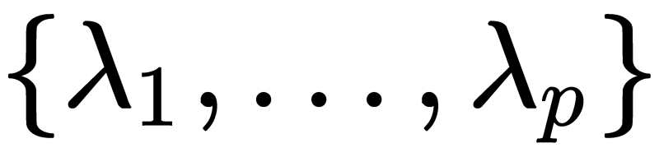



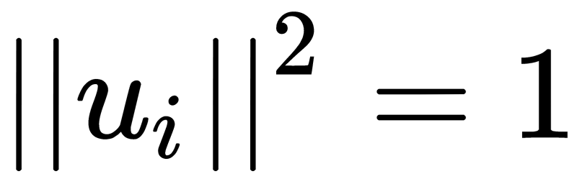
Eigenvalues and Eigenvectors
For a real and symmetric matrix:
There exists a unique set of real eigenvalues: and the associated eigenvectors:
such that:
(orthogonal)
(normalized)
Hence, they form an orthonormal basis.

Slide 9
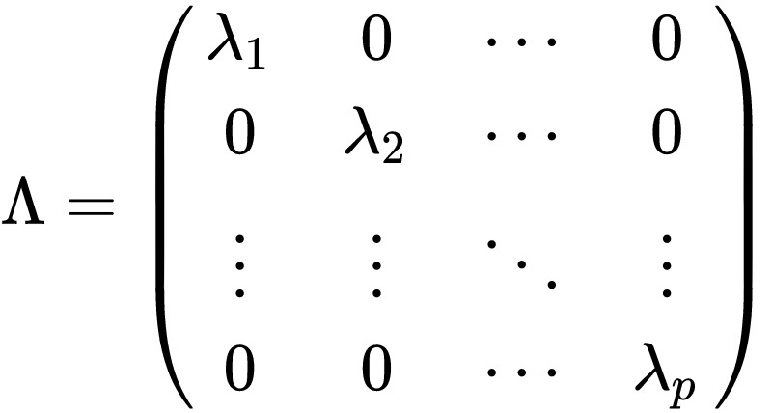
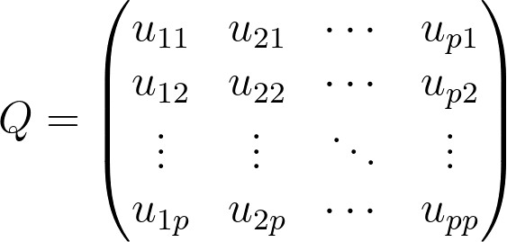



Spectrum and Eigen-decomposition
Spectrum:
Orthogonal Matrix:
Eigen-decomposition:

Slide 10
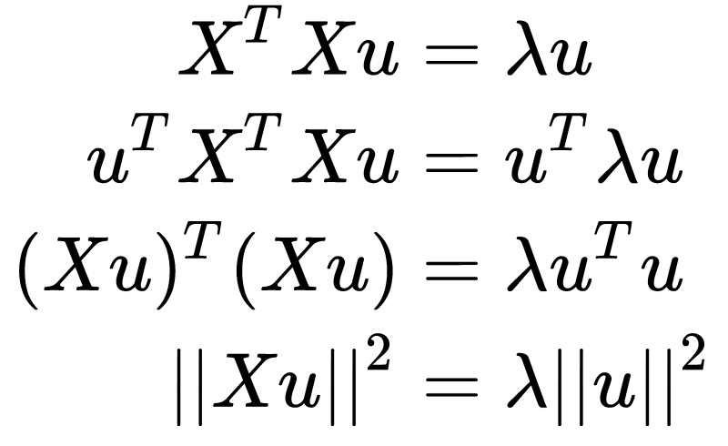

Real & Positive Eigenvalues: Gram Matrix
The eigenvalues of are non-negative real numbers:
Similar for
Hence, and are positive-semidefinite .
Notes:
Group the terms

Slide 11
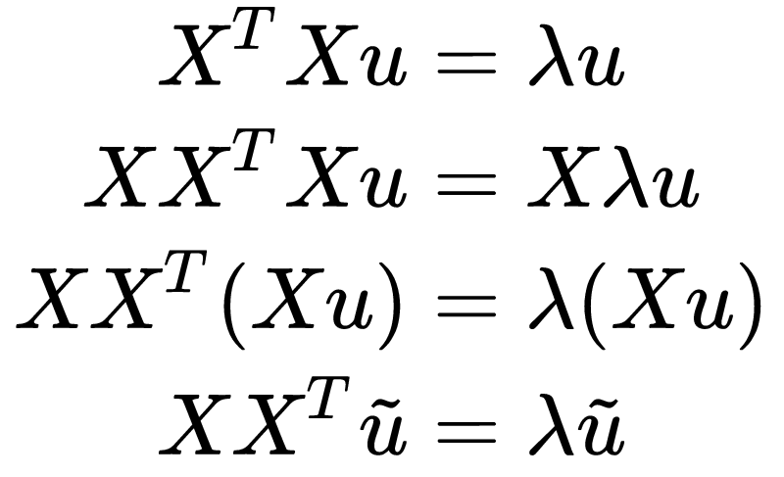

Same eigenvalues
and share the same eigenvalues:
Same eigenvalues.
Transformed eigenvectors:
Notes:
group the terms
the eigenvalues are unchanged

Slide 12
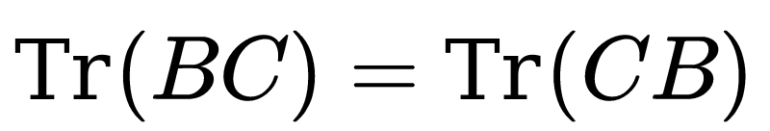
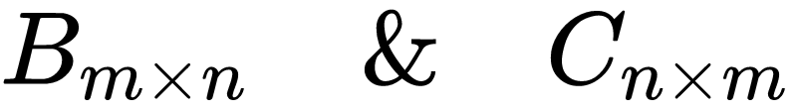
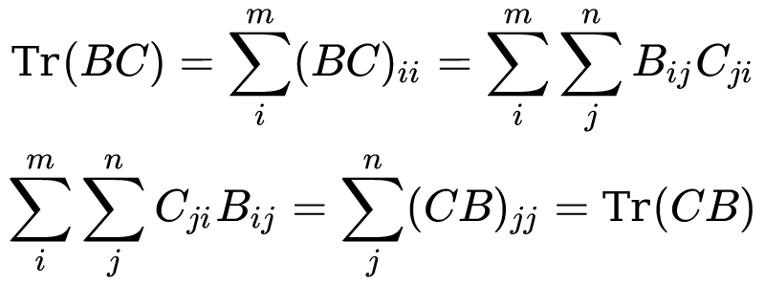
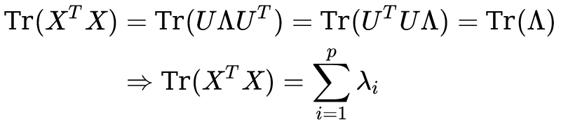

The sum of eigenvalues of is equal to its trace
Cyclic Property of Trace: Suppose the matrices:
The trace of a Gram matrix is the sum of its eigenvalues.

Slide 13
Statistics (Recap)

Slide 14
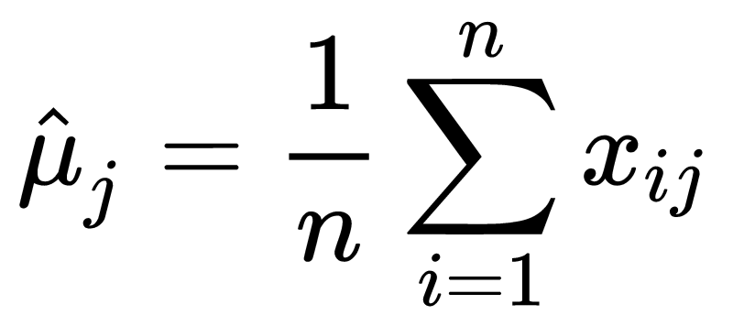

Centered Model Matrix
Consider the model (data) matrix
We make the predictors centered (each column has zero expectation) by subtracting the sample mean:
Centered Model Matrix:
Notes:
each of the n rows represents a different repetition of the experiment, and each of the p columns gives a particular kind of feature

Slide 15
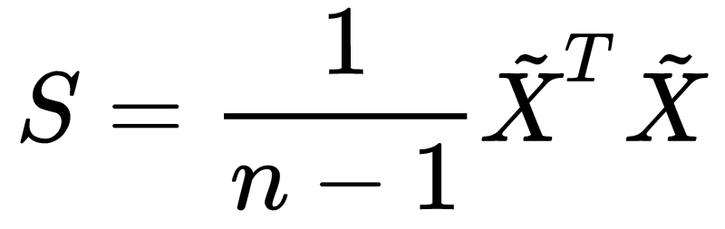
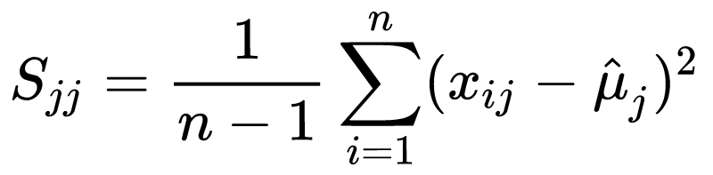
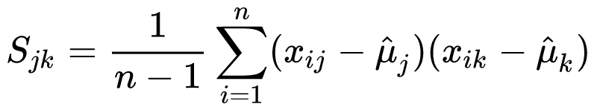
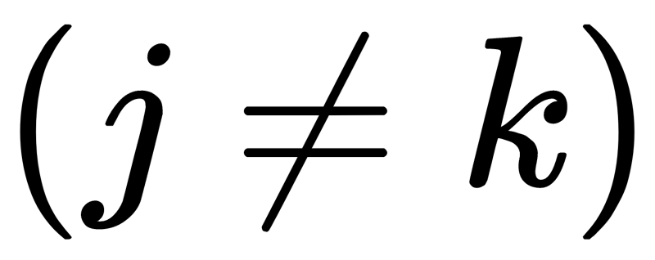
Sample Covariance Matrix
Consider the Covariance matrix:
Inspecting the terms:
The diagonal terms are the sample variances:
The non-diagonal terms are the sample covariances:

Slide 16
Principal Components Analysis (PCA)
Notes:
With the above preliminaries, the actual methodology of PCA is now quite simple. The idea is to remove as much redundancy in our predictors as possible. The redundancy is defined through the correlation between the predictors.

Slide 17
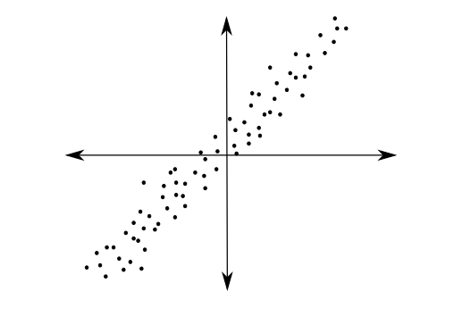
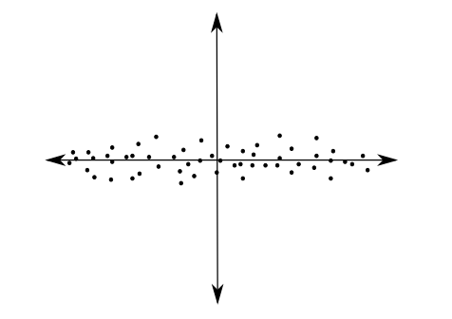
PCA
PCA tries to fit an ellipsoid to the data.
PCA is a linear transformation that transforms data to a new coordinate system.
The data with the greatest variance lie on the first axis (first principal component) and so on.
PCA reduces the dimensions by throwing away the low variance principal components.
J. Jauregui (2012)
Notes:
Using Linear Algebra

Slide 18

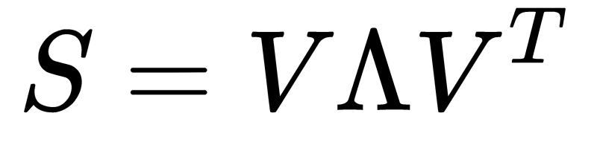

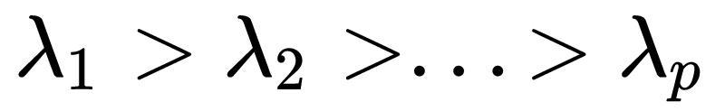


PCA foundation
Note that the covariance matrix is symmetric, so it permits an orthonormal eigenbasis:
The eigenvalues can be sorted in as:
The eigenvector is called the ith principal component of
Notes:
Using Linear Algebra

Slide 19
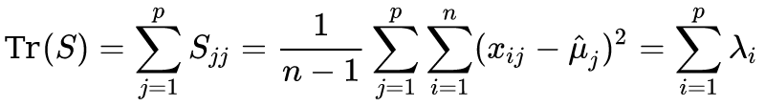
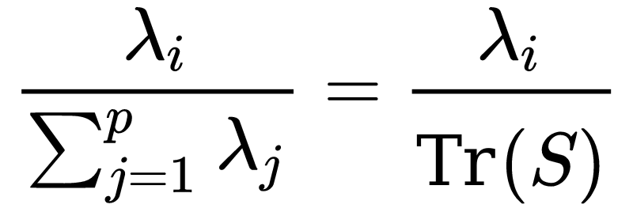

Measure the importance of the principal components
The total sample variance of the predictors:
The fraction of the total sample variance that corresponds to :
so, indicates the “importance” of the ith principal component.

Slide 20
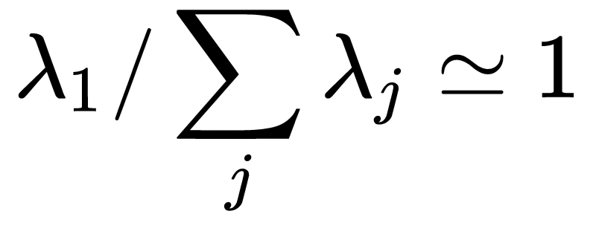
Back to spring-mass example
PCA finds:
revealing the one-degree of freedom.
Hence, PCA indicates that there may be fewer variables that are essentially responsible for the variability of the response.

Slide 21
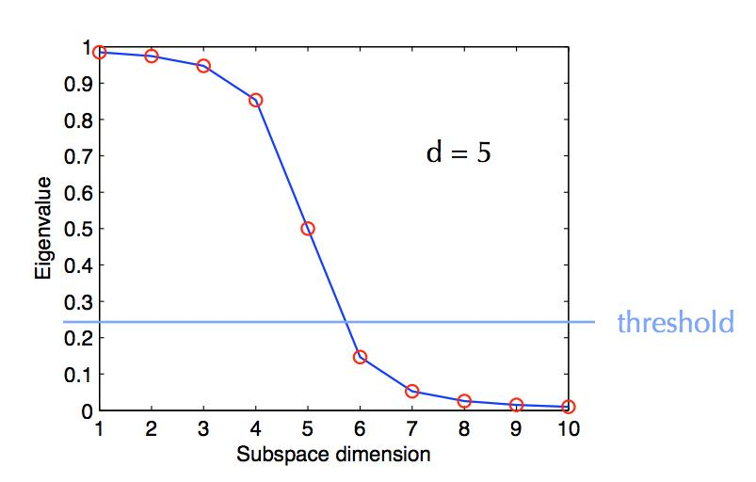
PCA Dimensionality Reduction
The Spectrum represents the dimensionality reduction by PCA.
Notes:
Usually the first eigenvalue are orders of magnitude greater than the others because the data may have fewer degrees of freedom than the number of the predictors.

Slide 22
PCA Dimensionality Reduction
There is no rule in how many eigenvalues to keep, but it is generally clear and left to the analyst’s discretion.
C. Bishop, Pattern Recognition and Machine Learning, Springer (2008).
Notes:
Usually the first eigenvalue are orders of magnitude greater than the others because the data may have fewer degrees of freedom than the number of the predictors.
How many eigenvalues to keep is left in teh

Slide 23

PCA Dimensionality Reduction
An example on leaves (thanks to Chris Rycroft, AM205)
Notes:
Usually the first eigenvalue are orders of magnitude greater than the others because the data may have fewer degrees of freedom than the number of the predictors.
How many eigenvalues to keep is left in teh

Slide 24

PCA Dimensionality Reduction
The average leaf
(Why do we need this again?)
Notes:
Usually the first eigenvalue are orders of magnitude greater than the others because the data may have fewer degrees of freedom than the number of the predictors.
How many eigenvalues to keep is left in teh

Slide 25






PCA Dimensionality Reduction
First three principal components
positive
negative
Notes:
Usually the first eigenvalue are orders of magnitude greater than the others because the data may have fewer degrees of freedom than the number of the predictors.
How many eigenvalues to keep is left in teh

Slide 26


















PCA Dimensionality Reduction – Keeping up to k Components
Notes:
Usually the first eigenvalue are orders of magnitude greater than the others because the data may have fewer degrees of freedom than the number of the predictors.
How many eigenvalues to keep is left in teh

Slide 27
Assumptions of PCA
Although PCA is a powerful tool for dimension reduction, it is based on some strong assumptions.
The assumptions are reasonable, but they must be checked in practice before drawing conclusions from PCA.
When PCA assumptions fail, we need to use other Linear or Nonlinear dimension reduction methods.

Slide 28
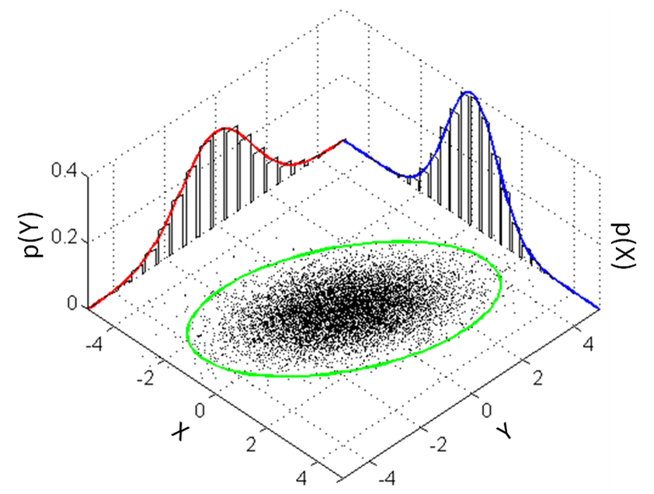
Mean/Variance are sufficient
In applying PCA, we assume that means and covariance matrix are sufficient for describing the distributions of the predictors.
This is only exactly true if the predictors are drawn from a multivariable Normal distribution, but works approximately for many situations.
When a predictor deviates heavily from being Normally distributed, an appropriate nonlinear transformation may solve this problem.
Wikipedia – multivariate normal distribution

Slide 29
High Variance indicates importance
Assumption: The eigenvalue is measures the “importance” of the i^{th} principal component.
It is intuitively reasonable that lower variability components describe the data less, but it is not always true.

Slide 30
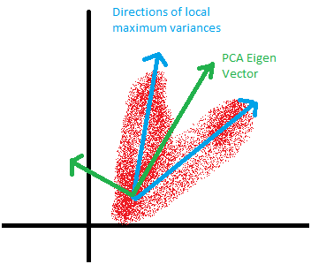
Principal Components are orthogonal
PCA assumes that the intrinsic dimensions are orthogonal.
When this assumption fails, we need to assume non-orthogonal components which are not compatible with PCA.
Balaji Pitchai Kannu (on Quora)

Slide 31
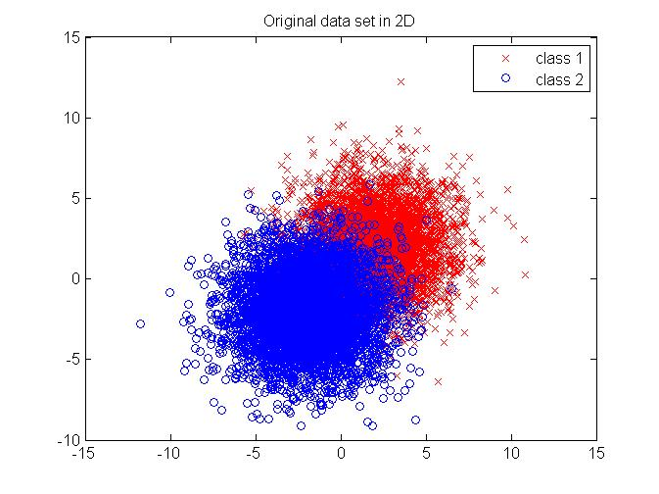
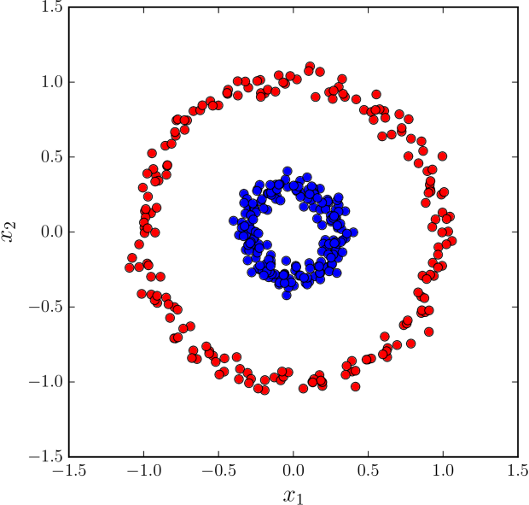
Linear Change of Basis
PCA assumes that data lie on a lower dimensional linear manifold.
vs
projectrhea.org
Alexsei Tiulpin
When the data lie on a nonlinear manifold in the predictor space, then linear methods are likely to be ineffective.

Slide 32


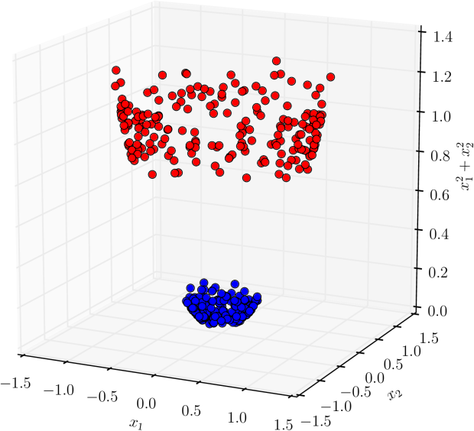

Kernel PCA for Nonlinear Dimensionality Reduction
Applying a nonlinear map Φ (called feature map) on data yields PCA kernel:
Centered nonlinear representation:
Apply PCA to the modified Kernel:
Alexsei Tiulpin

Slide 33
Summary
Dimensionality Reduction Methods
A process of reducing the number of predictor variables under consideration.
To find a more meaningful basis to express our data filtering the noise and revealing the hidden structure.
Principal Component Analysis
A powerful Statistical tool for analyzing data sets and is formulated in the context of Linear Algebra.
Spectral decomposition: We reduce the dimension of predictors by reducing the number of principal components and their eigenvalues.
PCA is based on strong assumptions that we need to check.
Kernel PCA for nonlinear dimensionality reduction.

Slide 34
Advanced Section 4: Dimensionality Reduction, PCA
Thank you

