Slide 1
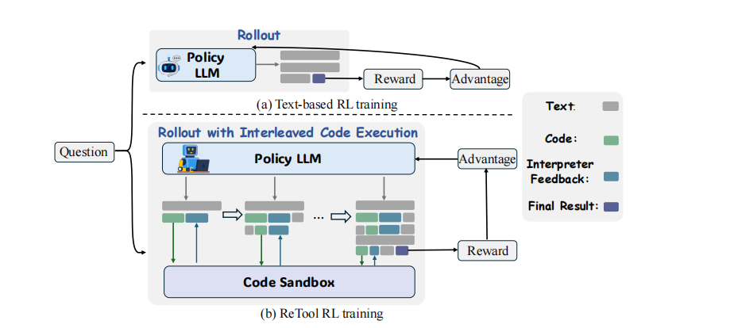
TOOL-AUGMENTED REASONING WITH GROUP RELATIVE POLICY OPTIMIZATION
Teaching LLMs to Strategically Use Code Tools Through Reinforcement Learning
Advanced AI · May 10, 2026
Yueyang Cheng · Wenzhe Dong · Jian Lv · Xin Chen · Haoyu Lu

Slide 2
Motivation
Method
Experiments
Takeaways
Team
Motivation: Why Tools?
The Problem
The Solution
LLMs are bad at precise numerical computation (sqrt, sin, iterative solving)
Multi-step reasoning accumulates errors — "drift"
No way to self-verify intermediate results
Give the model a Python interpreter
Let it write code → execute → see results → iterate
Like using scratch paper during an exam
Visual idea: What model thinks (wrong calculation) vs. What code returns (correct result)
2/18

Slide 3
Motivation
Method
Experiments
Takeaways
Team
The Core Idea
1. User asks a math problem
2. Model decides to use code tool
3. Code executes in sandbox
4. Model reads results & concludes
Key insight: The model learns STRATEGY (when to call tools, how many times, how to interpret results), not just code-writing.
Example: User: "Find all real roots of x³ - 7x + 6 = 0" → Model writes Python code → Tool returns: 1, 2, -3 → Answer: \boxed{-3, 1, 2}
3/18

Slide 4
Motivation
Method
Experiments
Takeaways
Team
Why Not Just SFT?
Aspect | Tool-Specific SFT Only | Tool SFT + GRPO
Code formatting | ✓ Learns from demos | ✓ Inherits from SFT
When to call tool | ✗ Imitates dataset bias | ✓ Learns optimal timing
How many turns | ✗ Fixed pattern | ✓ Adaptive per problem
Debug failed code | ✗ Not in training data | ✓ Learns from feedback
Try alternative | ✗ Single path | ✓ Explores strategies
Bottom line: Tool-specific SFT gives the model a recipe book. GRPO teaches it to be a chef.
4/18

Slide 5
Motivation
Method
Experiments
Takeaways
Team
Training Pipeline Overview
Stage 0
Stage 1: Tool SFT
Stage 2: GRPO
Base Model
Cold Start
Reinforcement Learning
Qwen2.5-3B-Instruct
General-purpose instruct model, never seen tool-calling format
Train on multi-turn code-execution trajectories (6 epochs)
Output: Model knows HOW to format tool calls
Sample 8 responses, execute code, group-normalize advantages
Output: Model knows WHEN & WHY to use tools
GRPO Details
Sample 8 responses per problem
Execute code in sandbox, get results
Reward: correct answer = +1, wrong = softened penalty
Group-normalize advantages, update policy
Tool-specific SFT provides the behavioral bootstrap; GRPO optimizes the strategy.
5/18

Slide 6

Motivation
Method
Experiments
Takeaways
Team
Why GRPO Instead of PPO?
PPO (Proximal Policy Optimization)
GRPO (Group Relative Policy Optimization)
Needs a Critic network (Value function) — 50% more parameters
Advantage computed via GAE: needs λ, γ tuning
Value estimation for math: "How likely am I to solve this?" — very hard to estimate!
No critic network — saves memory, simplifies training
For each problem, sample 8 answers
Advantage = (your score − group average) / group std
Natural "internal competition" — best answer wins
$$A_{j}=\frac{r_{j}−mean(r)}{std(r)}$$
6/18

Slide 7
Motivation
Method
Experiments
Takeaways
Team
Asymmetric Clipping
Be Aggressive with Success, Cautious with Failure
The Problem
Our Solution
Math: most attempts fail (wrong answer), few succeed
Standard PPO: symmetric clip at ±0.2
Treats success and failure equally
clip_ratio_low = 0.2 (conservative on failure)
clip_ratio_high = 0.38 (aggressive on success)
Asymmetric bounds maximize rare success signals
-0.2
0
+0.38
Failure zone (conservative)
Success zone (aggressive)
Intuition: When the model finally solves a hard problem correctly, we want to MAXIMIZE learning from that rare event.
7/18

Slide 8
Motivation
Method
Experiments
Takeaways
Team
Tool Reward Shaping
Problem with binary rewards: "Tried 10 approaches, almost got it" = −1, "Didn't even try, random guess" = −1. Binary reward can't tell them apart → model has no incentive to use tools!
Our Reward Formula
If correct: score = +1
If wrong: penalty = −1 + 0.05 × (num_turns − 2), capped at −0.6
Turns | Penalty | Interpretation
2 turns (minimum) | −1.0 | Full penalty
6 turns | −0.8 | Softened
10+ turns | −0.6 | Max softening
Key Message
Failing after serious effort > failing without trying
Just 5 lines of code change produces qualitatively different behavior
8/18

Slide 9
Motivation
Method
Experiments
Takeaways
Team
Code Execution Sandbox
Why build our own? Model-generated code can be anything — including malicious. Need OS-level isolation, not just try/except.
L1
Resource limits — 256MB RAM, 5s CPU, max 8 processes
L2
No privilege escalation — prctl NO_NEW_PRIVS
L3
Syscall filtering — block execve, socket, mount, etc.
L4
Memory monitor — kill on OOM, checks every 50ms
L5
Ephemeral workspace — auto-cleanup per execution
L6
Concurrency cap — max 16 simultaneous executions
Even os.system("rm -rf /") is fully contained.
9/18

Slide 10
Motivation
Method
Experiments
Takeaways
Team
Experimental Design
Three Training Configurations
# | Name | Description
1 | Qwen 3B Instruct | GRPO directly on Qwen2.5-3B-Instruct (skip tool SFT)
2 | Tool-Specific SFT Only | Add tool-use SFT on top of instruct model (RL warm-start)
3 | Tool SFT + GRPO | Full pipeline: Instruct → Tool SFT → GRPO
Four Benchmarks (Increasing Difficulty)
GSM8K
MATH-500
AIME 2024
AIME 2025
Elementary math word problems
1,319 problems
High school competition math
500 problems
Advanced competition
30 problems
Advanced competition
30 problems
Metric: pass@k — generate k answers, at least 1 correct = pass
10/18

Slide 11
Motivation
Method
Experiments
Takeaways
Team
Results: GSM8K & MATH-500
Callout: Tool-specific SFT does the heavy lifting. GRPO adds refinement, especially on harder problems (MATH-500: +3.25% over tool SFT alone).
Configuration | Qwen 3B Instruct | Tool-Specific SFT | Tool SFT + GRPO
MATH-500 | 60.72% | 69.92% | 73.17%
11/18

Slide 12
Motivation
Method
Experiments
Takeaways
Team
Results: AIME (Hard Problems)
Key Observation
Without tool-specific SFT, GRPO is nearly useless on hard problems (4.19% is almost random). Tool-specific SFT provides a 5× boost on AIME 2024.
Benchmark | Qwen 3B | Tool SFT Only | Tool SFT + GRPO
AIME 2024 | 4.19% | 19.52% | 20.28%
12/18

Slide 13
Motivation
Method
Experiments
Takeaways
Team
pass@k Scaling
MATH-500 — More Samples = Much Better Results
Interpretation
pass@16 is nearly 1.5× pass@2
Model has learned DIVERSE strategies
Different samples try different approaches — some work, some don't
This is a sign of healthy RL training (not mode collapse)
SFT+GRPO: 49.85% → 60.78% → 68.44% → 73.17%
13/18

Slide 14
Motivation
Method
Experiments
Takeaways
Team
The AIME 2025 Anomaly
When RL Hurts: Tool SFT vs Tool SFT + GRPO
Our Analysis
1. Distribution Shift
Training data (DAPO-Math-17k) is more similar to AIME 2024 than 2025. RL overfits to training distribution.
2. Catastrophic Forgetting
No KL constraint → policy drifts from SFT. On problems where SFT strategy was decent, RL overwrites it.
pass@2: Tool SFT 4.17% > GRPO 2.83% (RL is WORSE!)
pass@16: Tool SFT 8.82% < GRPO 9.64% (RL recovers)
Lesson learned: KL constraint matters for OOD robustness. Don't discard it lightly.
14/18

Slide 15
Motivation
Method
Experiments
Takeaways
Team
Key Takeaways
1
Tool-specific SFT is the foundation. Without this warm-up, GRPO alone can't get off the ground on hard tasks. The quality of initialization determines the ceiling.
2
GRPO works well for tool-use RL. Group-based advantage is natural for binary-outcome math tasks; no need for a critic network.
3
Reward design is everything. Tool-usage reward shaping is a small code change (5 lines) but produces qualitatively different model behavior.
4
Asymmetric clipping makes sense. When correct paths are rare, aggressive updates on success + conservative updates on failure is the right design.
5
RL is not a silver bullet. The AIME 2025 degradation shows that distribution shift and forgetting are real concerns. KL constraints shouldn't be discarded lightly.
15/18

Slide 16
Motivation
Method
Experiments
Takeaways
Team
Future Work
More Tools
Larger Models
Add SymPy for symbolic math, web search for factual problems, and more specialized computational tools.
Scale from 3B → 7B/14B parameters. Does the SFT+GRPO performance gap widen with model size?
Online RL
Adaptive KL
Generate new problems on-the-fly instead of training on a fixed dataset. Explore curriculum learning strategies.
Start with KL constraint, gradually relax as training stabilizes. Balance exploration and policy drift control.
Multi-Modal Tools
Tool Composition
Geometry diagram understanding, function plotting, and visual reasoning tools for broader problem classes.
Teach the model to chain tools: search → code → verify. Build complex multi-tool reasoning pipelines.
16/18

Slide 17
Motivation
Method
Experiments
Takeaways
Team
Team Contributions
Member | Primary Role
Yueyang Cheng 2025245047 | Algorithm design, GRPO pipeline, reward shaping, RL experiments, result analysis
Wenzhe Dong 2025245048 | SFT data preprocessing, sandbox server, SFT training runs
Jian Lv 2025245046 | Dataset curation, baseline experiments, evaluation framework
Xin Chen 2025245045 | Literature survey, related work analysis, statistical analysis
Haoyu Lu 2025245042 | Checkpoint conversion, experiment logging, visualization
Advanced AI · May 10, 2026
17/18

Slide 18
Thank You!
Questions?
Best Results Summary
Benchmark | Best pass@16
GSM8K | 96.92%
MATH-500 | 73.17%
AIME 2024 | 20.28%
AIME 2025 | 9.64%
Advanced AI · May 10, 2026
Yueyang Cheng · Wenzhe Dong · Jian Lv · Xin Chen · Haoyu Lu
18/18

