Slide 1

Bias and Variance of KDE
Assume that X₁, . . . , X_{n} are IID sample from an unknown density function p.
In the density estimation problem, the parameter of interest is p, the true density function.
To simplify the problem, assume that we focus on a given point x0 and we want to analyze the quality of our estimator

Slide 2
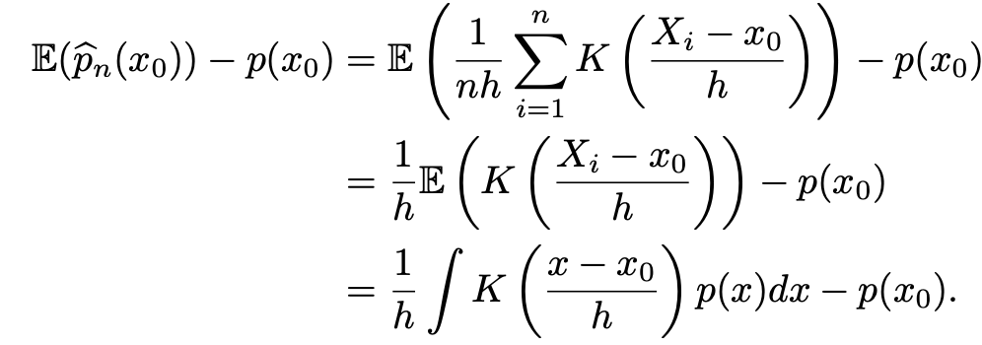

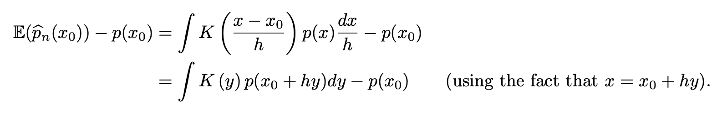
Bias
Change of variable

Slide 3
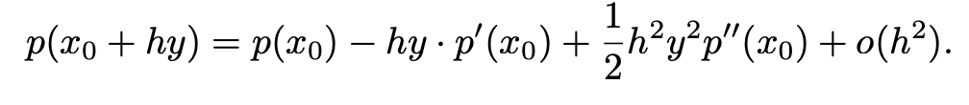
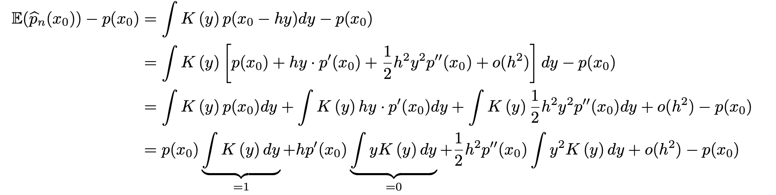
Bias
Taylor expansion
Plug into the previous expression

Slide 4
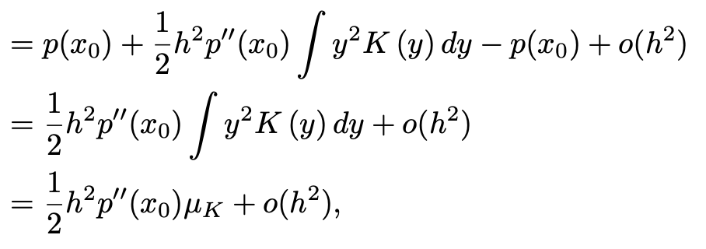
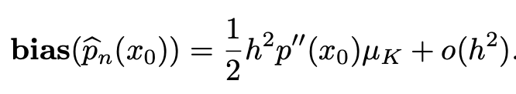
Bias
Cont’d
In conclusion
Observations: 1. h → 0, the bias is shrinking at a rate O(h²)
2. the bias is caused by the curvature (second derivative) of the density function

Slide 5
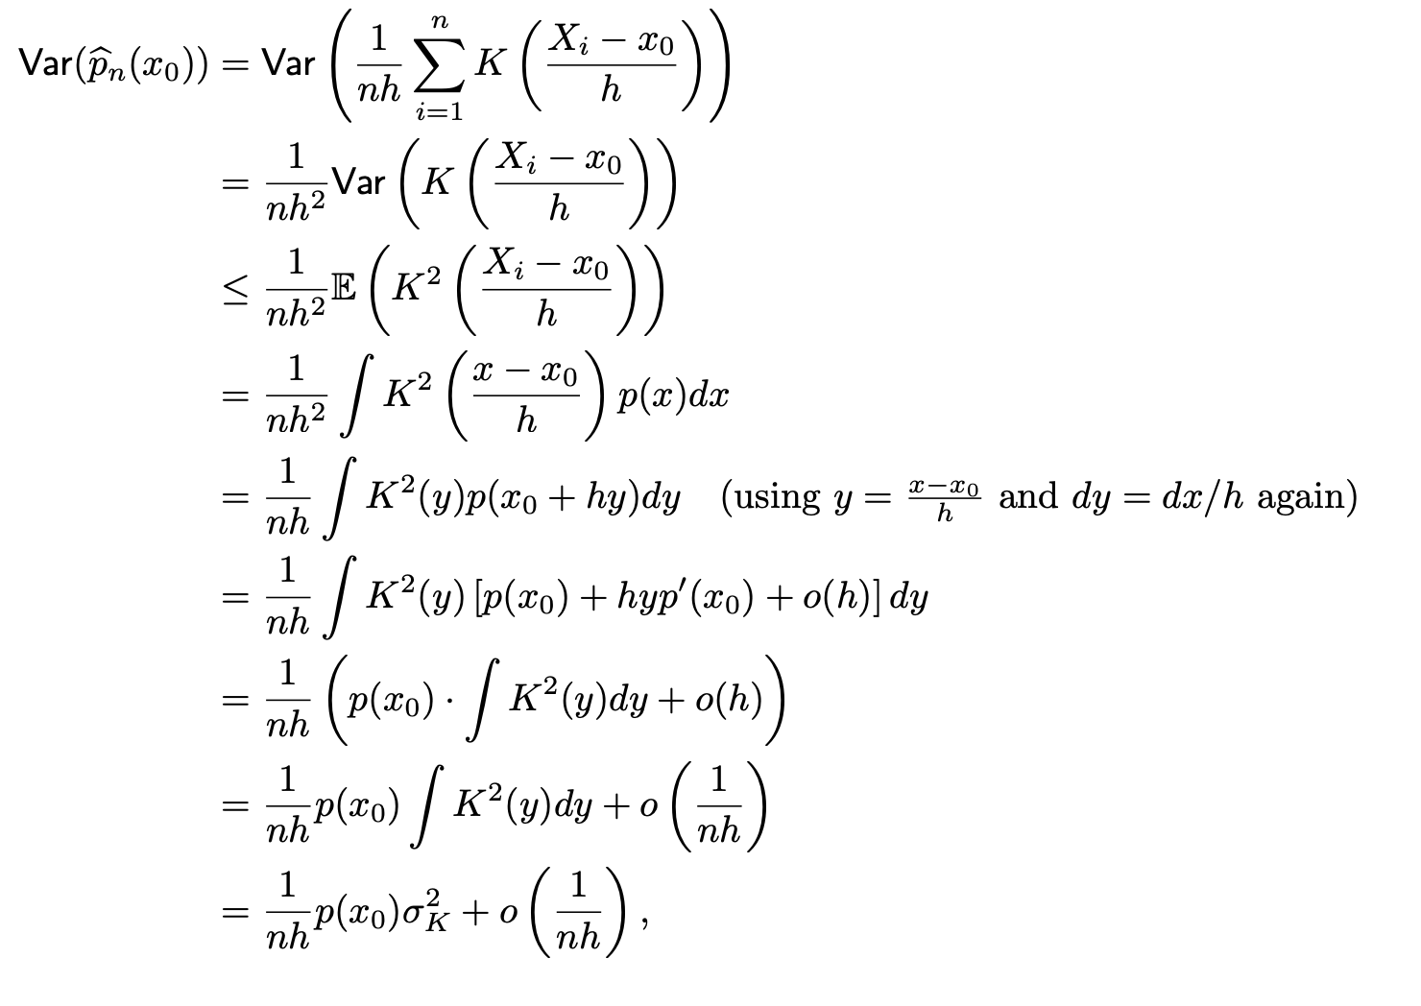
Variance
(Taylor expansion)
Observations:
variance shrinks at rate O( 1/(nh) ) when n → ∞ and h → 0.
The variance is caused by the density value

Slide 6
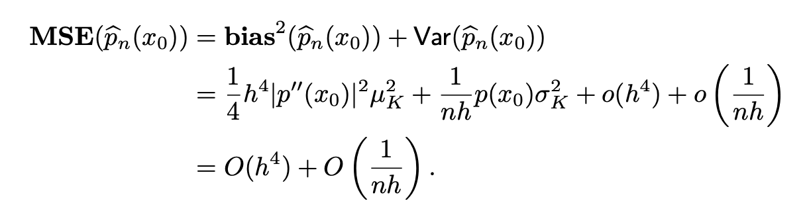

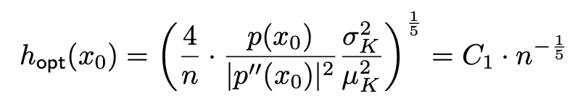

Mean Square Error (MSE)
Consider the first two terms: AMSE

Slide 7
Further reading
http://faculty.washington.edu/yenchic/17Sp_403/Lec7-density.pdf

