Slide 1
PGS results
WIP

Slide 2
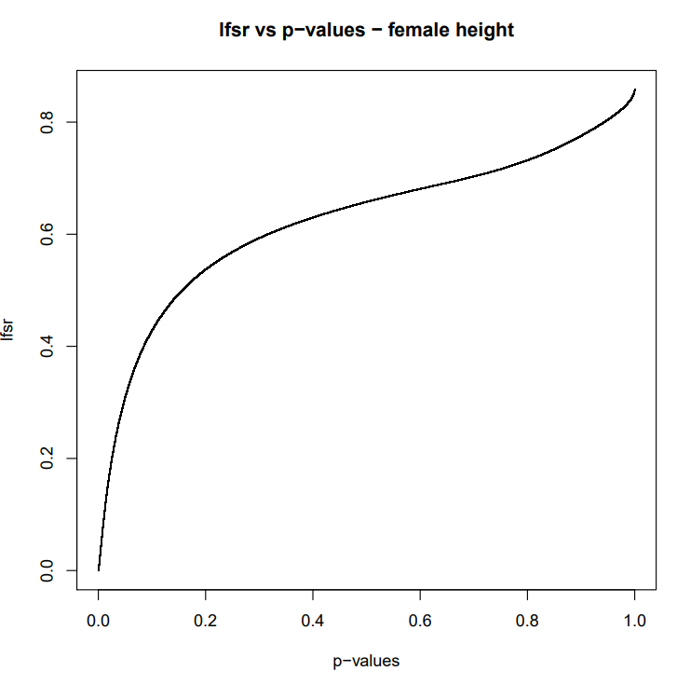
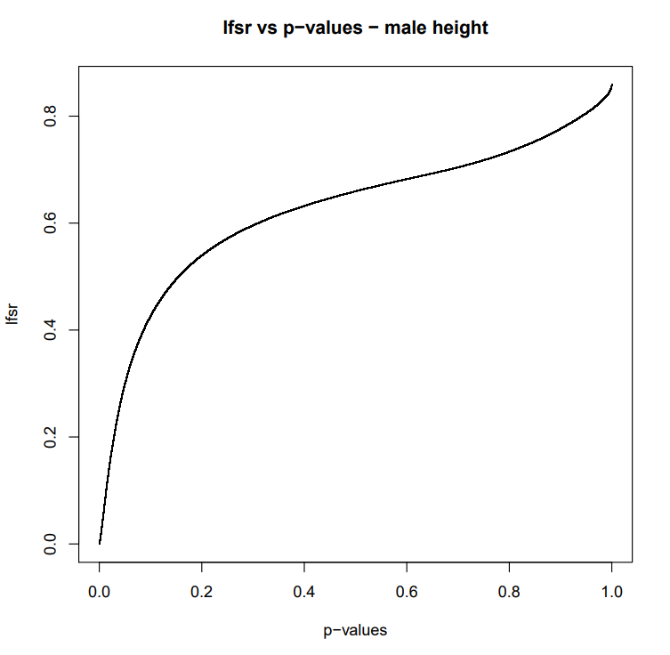

Slide 3
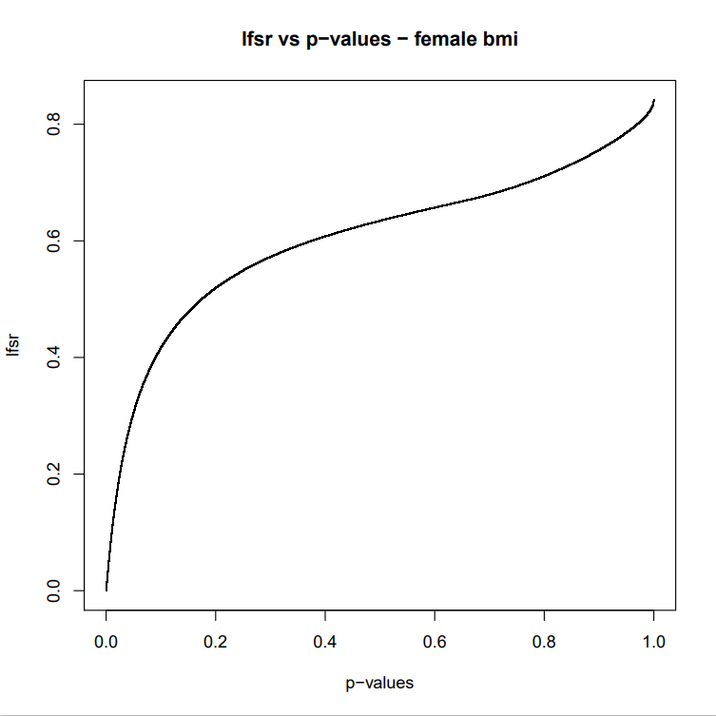
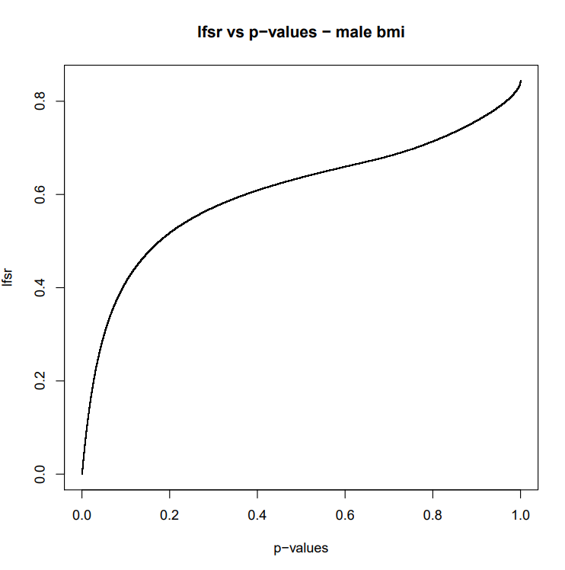

Slide 4
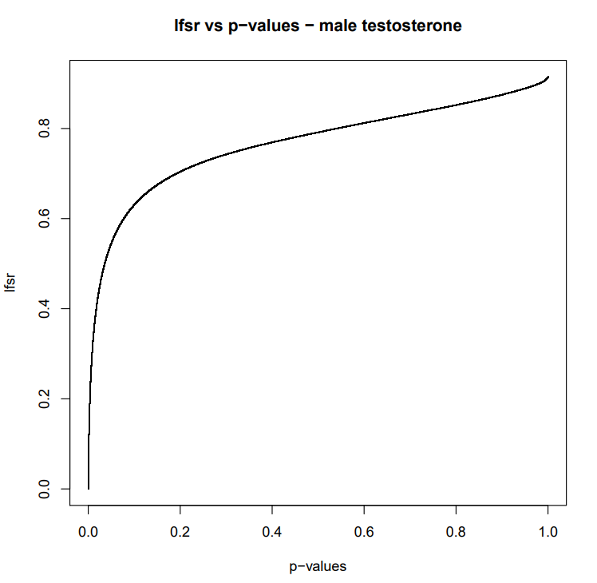
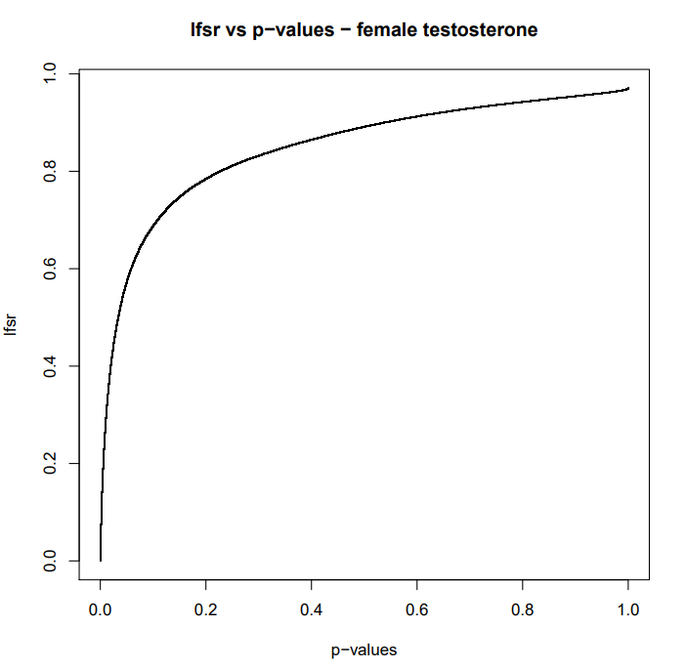

Slide 5
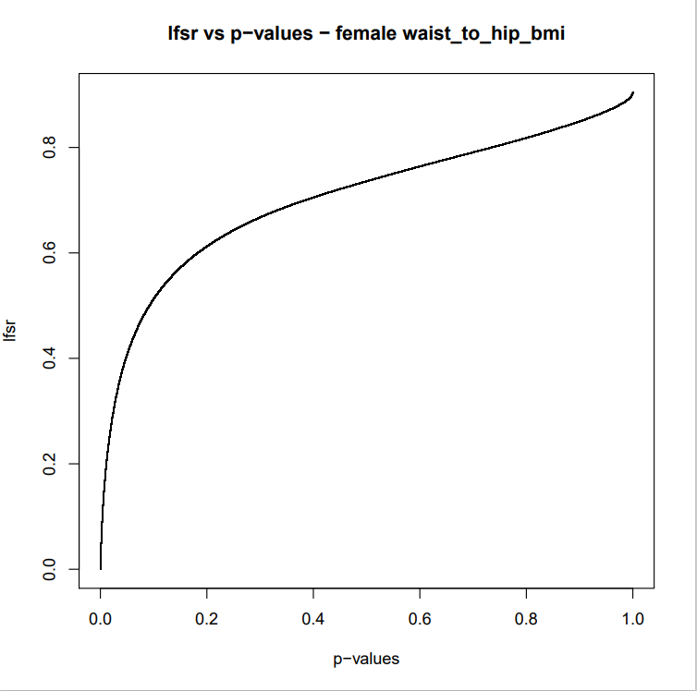


Slide 6
Phenotype | Sex | Additive – both sex |  | Additive – same sex |  | Mash – same sex
 |  | Threshold | Inc R^2 | Threshold | Inc R^2 | Threshold | Inc R^2
Height | Female | 0.01 | 0.2056 | 1e-5 | 0.1590 | 0.02 | 0.2142
 | Male | 0.01 | 0.2075 | 1e-5 | 0.1441 | 0.02 | 0.2028
BMI | Female | 0.01 | 0.0604 | 0.01 | 0.0346 | 1 | 0.0582
 | Male | 0.01 | 0.0546 | 0.01 | 0.0346 | 0.01 | 0.0566
Testosterone | Female | 1e-8 | 0.0005 | 1e-8 | 0.0082 | 1e-8 | 0.0076
 | Male | 1e-5 | 0.0652 | 1e-5 | 0.0636 | 1e-5 | 0.0627
Waist:Hip BMI adj | Female | 1e-5 | 0.0425 | 1e-5 | 0.0516 | 1e-5 | 0.0490
 | Male | 1 | 0.0161 | 0.01 | 0.0135 | 1 | 0.0166

Slide 7
