Slide 1
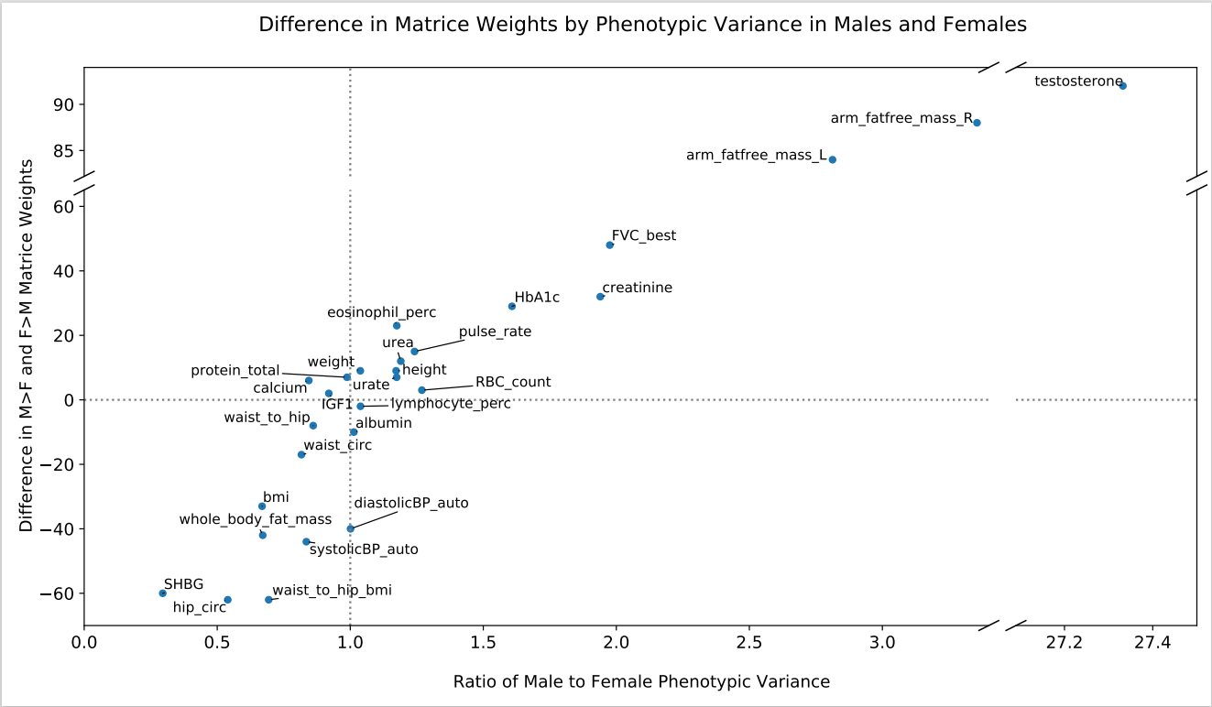

Slide 2
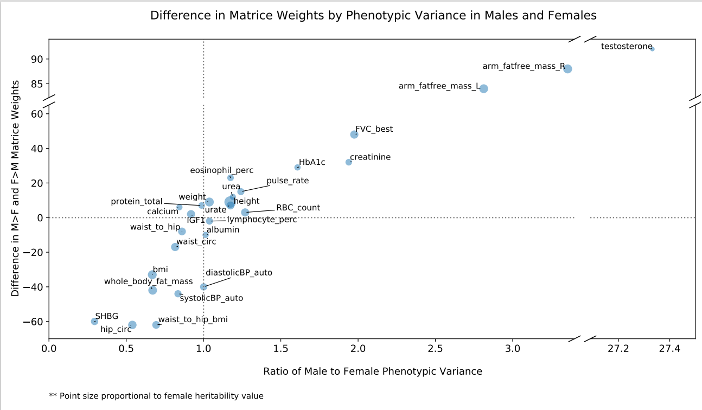

Slide 3


Slide 4
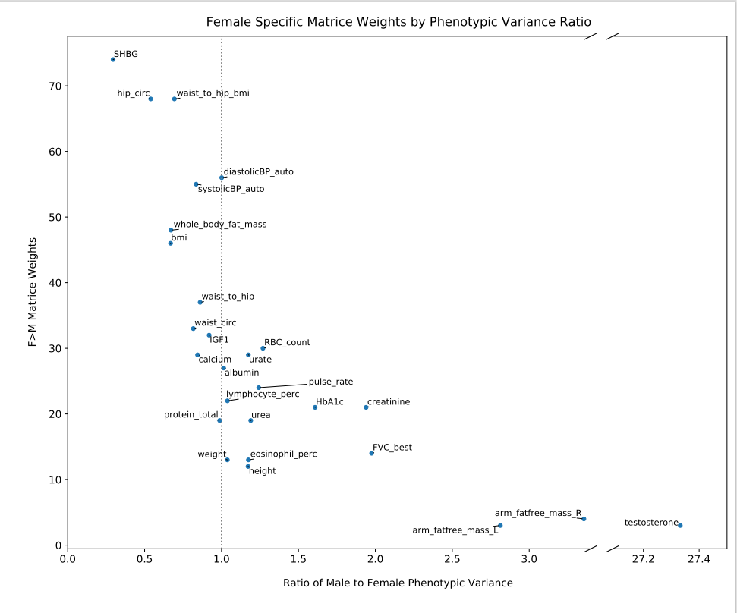
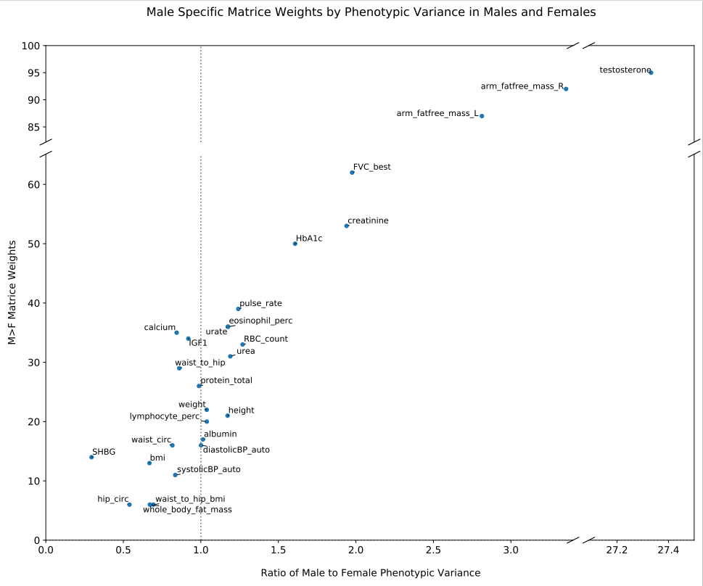

Slide 5
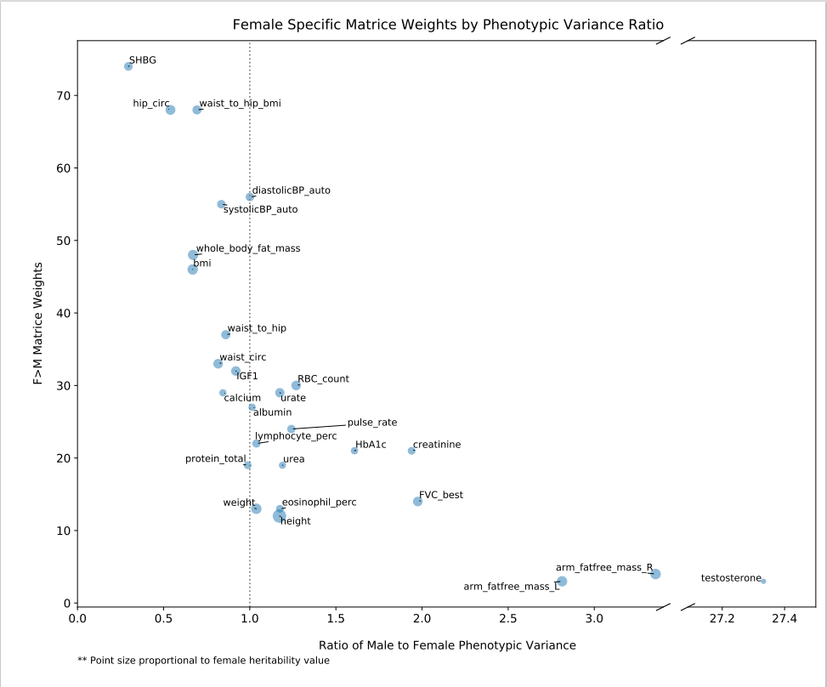
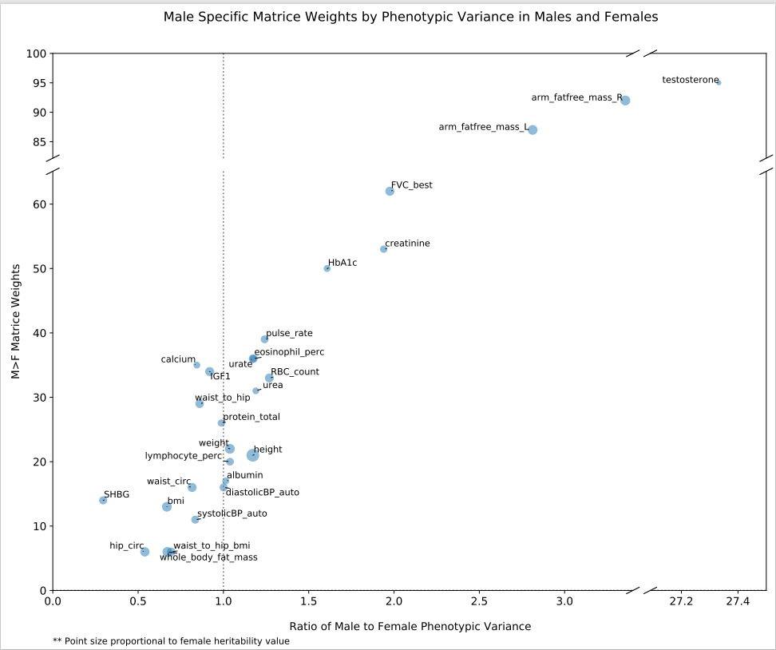

Slide 6
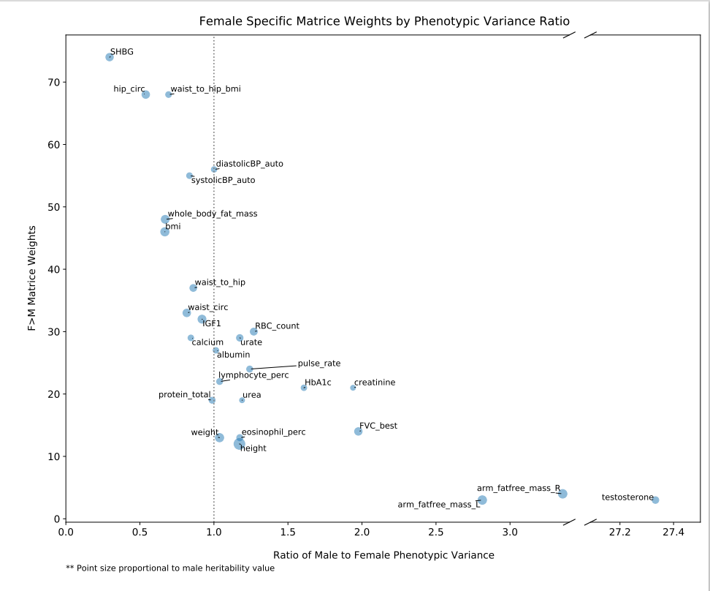
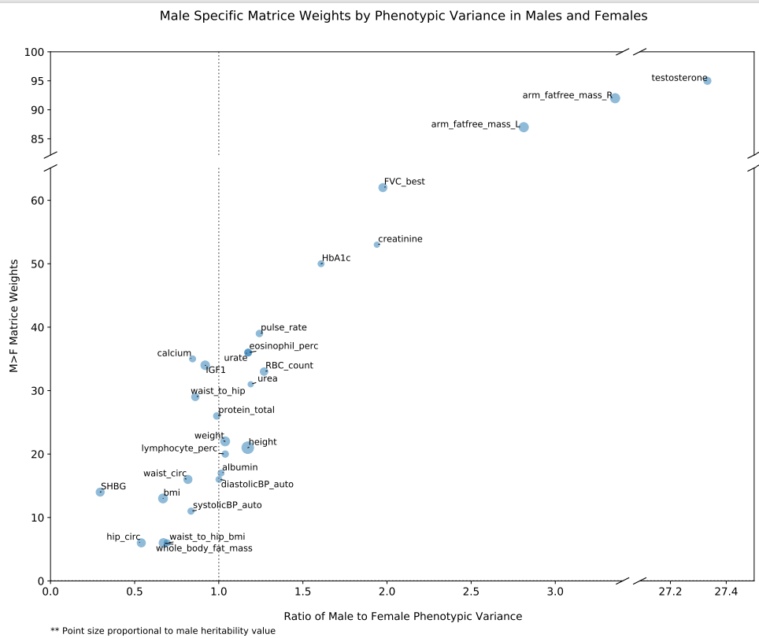

Slide 7
BP and Body Composition
8/11/2021

Slide 8
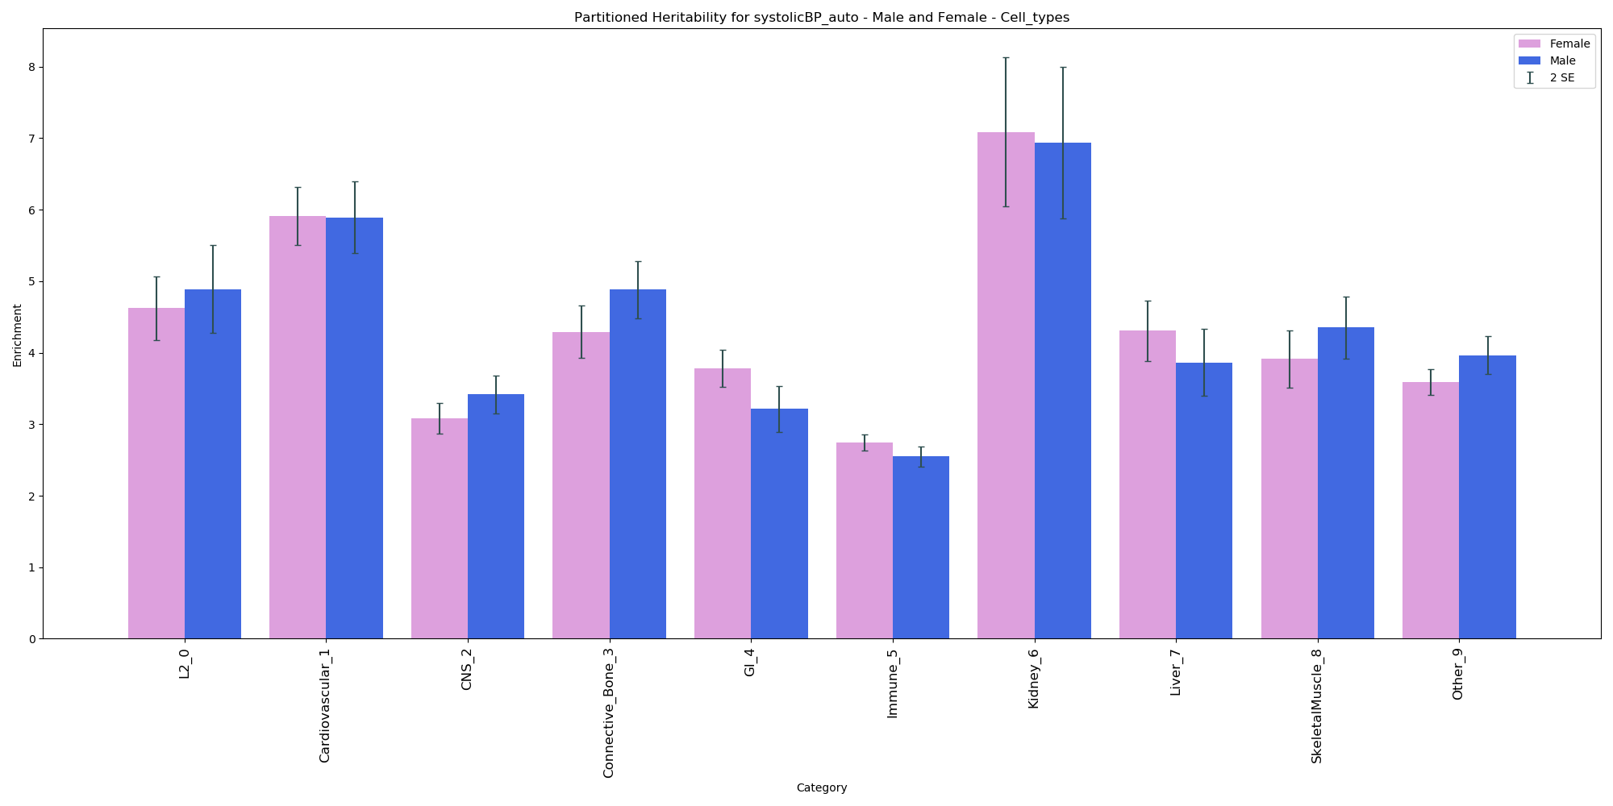
Systolic Blood Pressure

Slide 9
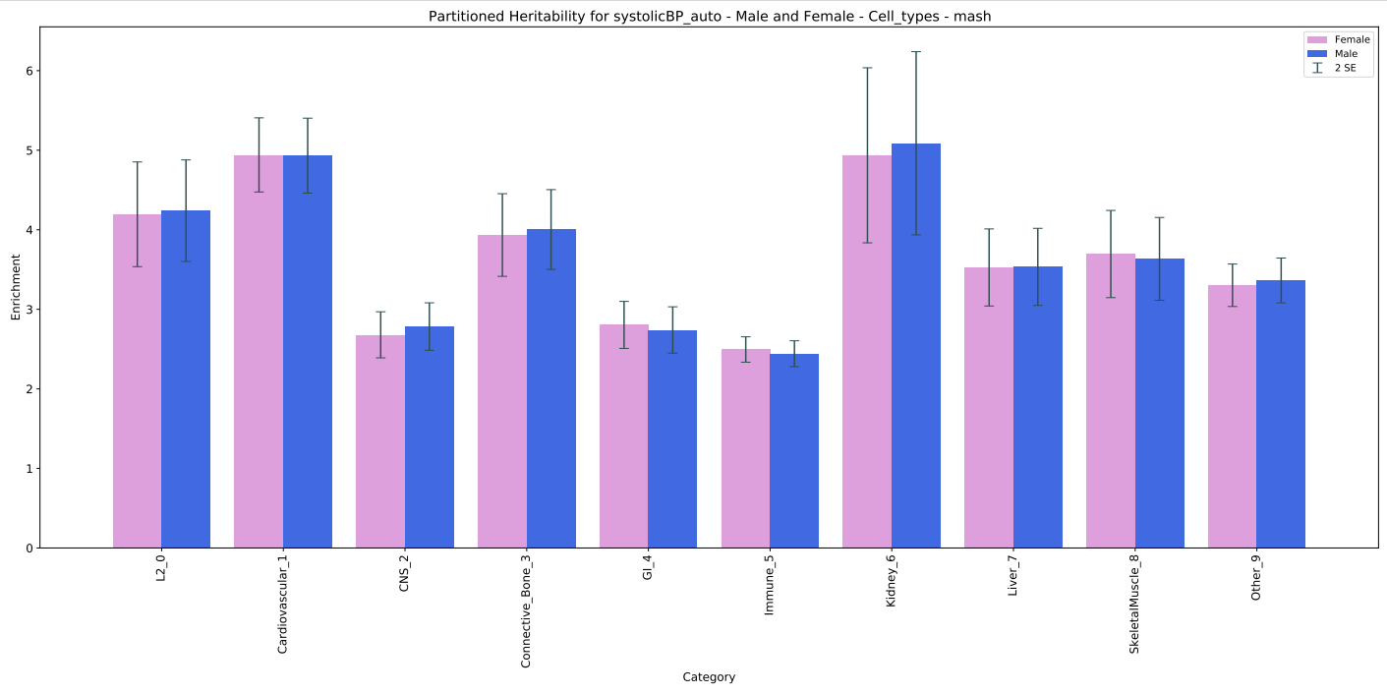
Systolic Blood Pressure - mash

Slide 10
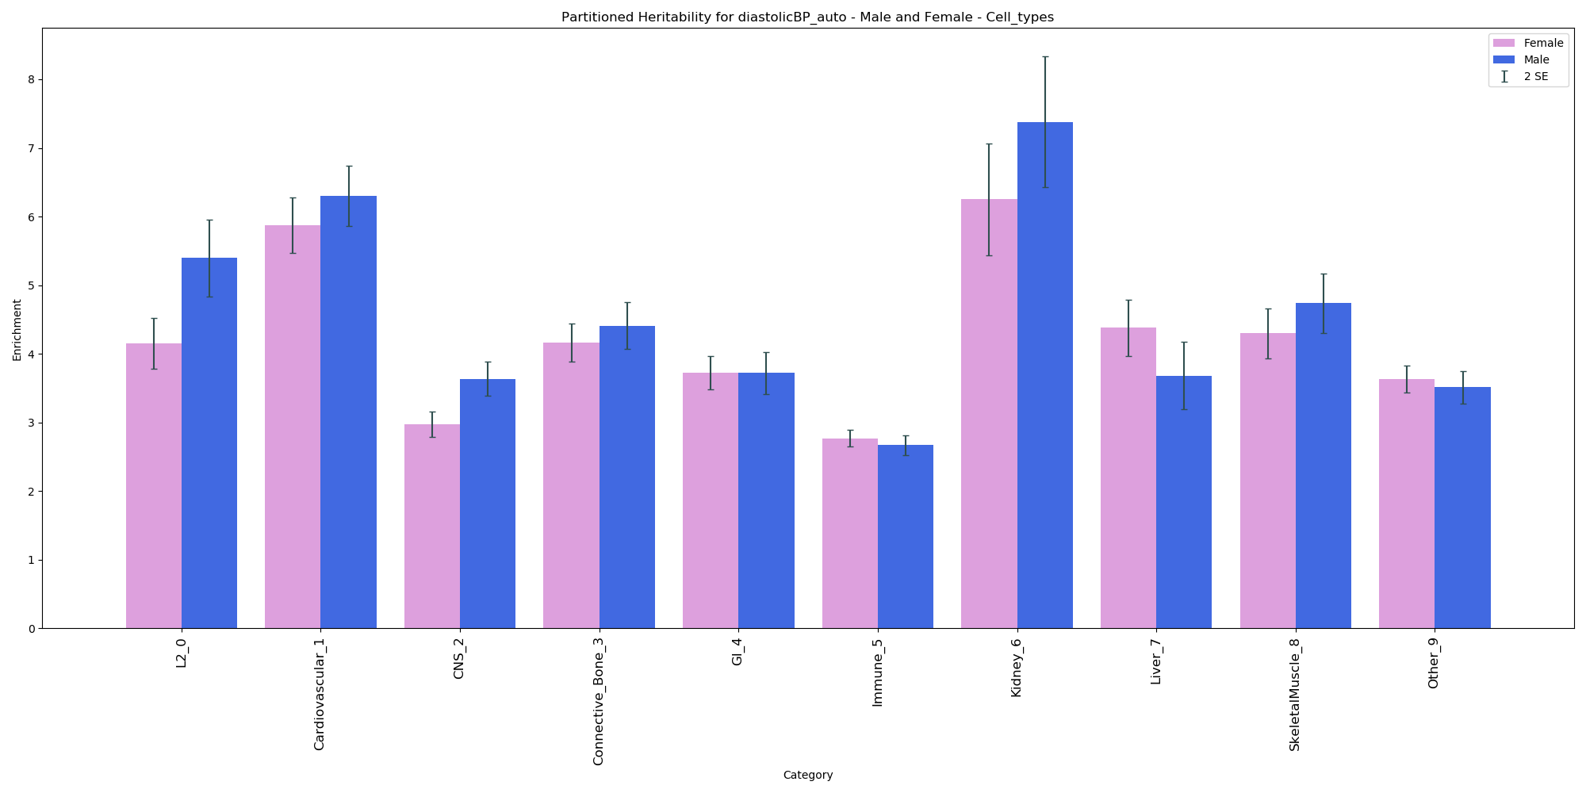
Diastolic Blood Pressure

Slide 11
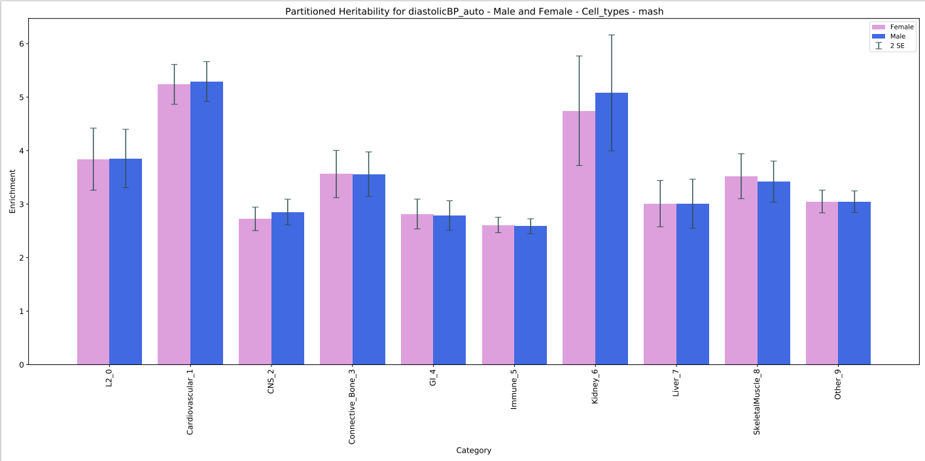
Diastolic Blood Pressure - mash

Slide 12
Blood Pressure
Gender Differences in the Regulation of Blood Pressure | Hypertension (ahajournals.org)
Role of testosterone in BP regulation
positive relationship between testosterone and BP
Shown with puberty in boys; castration, androgen receptor blockage, and testosterone treatment in rats
Kidney and BP
higher BP and aldosterone levels in male than female
Long-term increase in BP occurs due to decreased kidney excretion function
Increase in BP -> increased sodium excretion
Androgen receptor located in proximal tubule segments (most sodium reabsorption)
Positive linear correlation between testosterone and plasma renin activity in rats
Castration in male rats decreases renal angiotensin mRNA, while chronic testosterone treatment increases
Increases in mRNA copies of renal angiotensin cause increase in BP

Slide 13
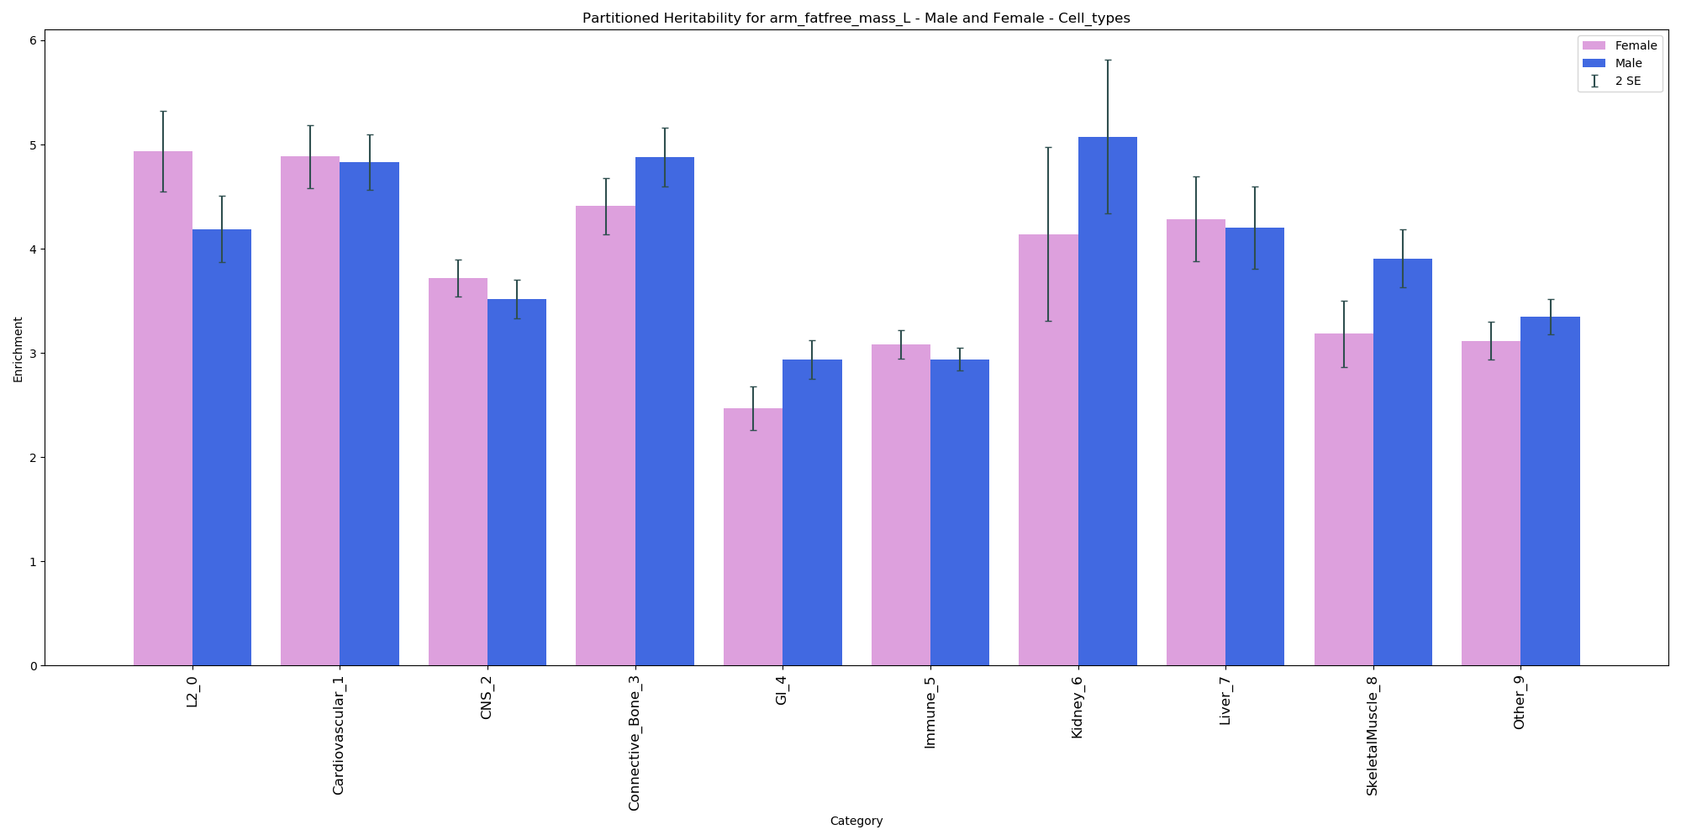
Arm fat-free mass (L)

Slide 14
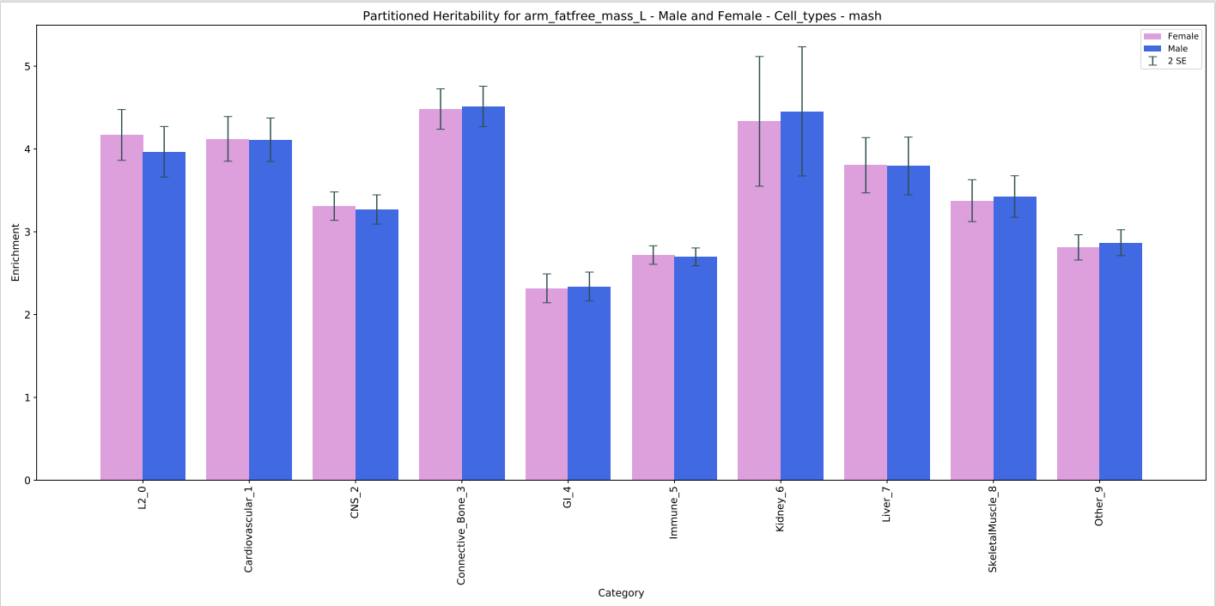
Arm fat-free mass (L) - mash

Slide 15
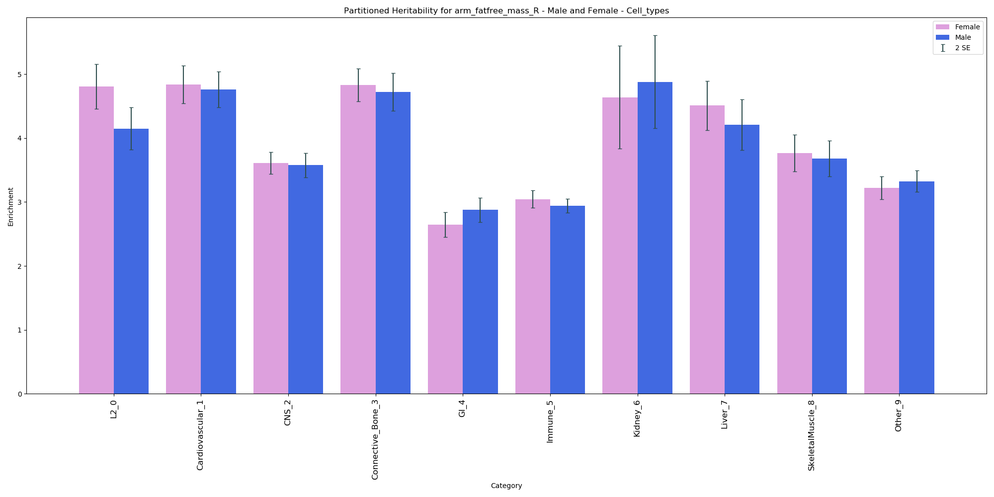
Arm fat-free mass (R)

Slide 16
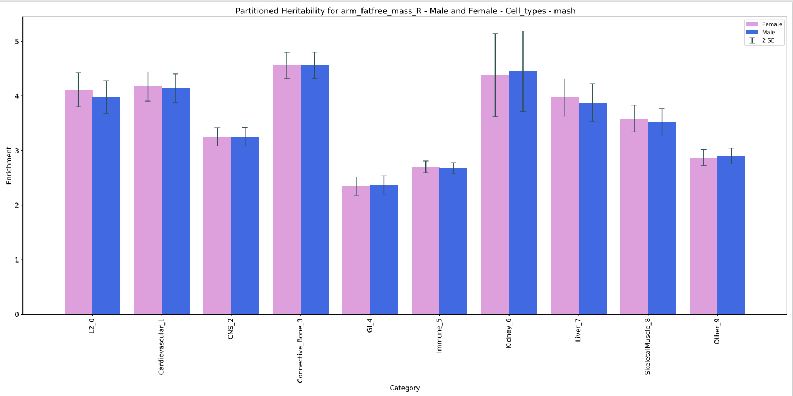
Arm fat-free mass (R) - mash

Slide 17
Lean Mass
Both testosterone and estrogen have anabolic effects on lean mass (skeletal muscle and bone); have different pathways

Slide 18
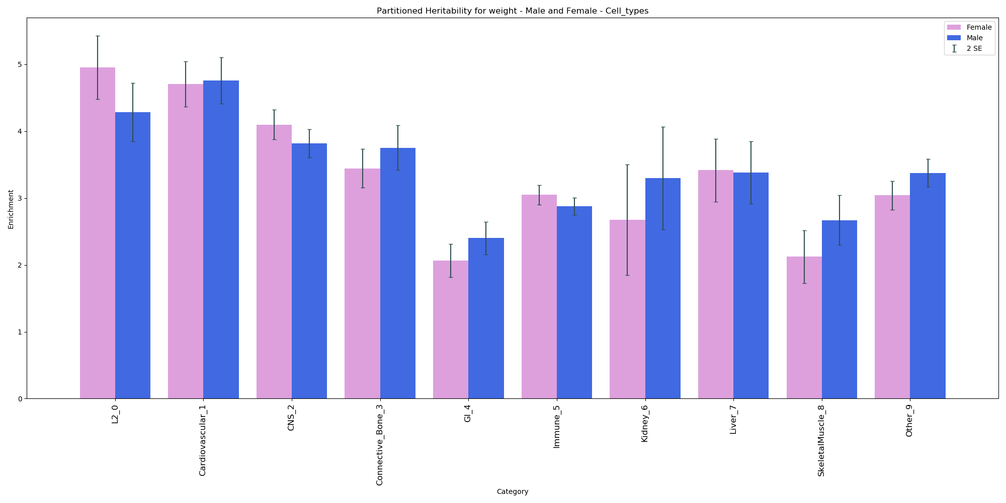
Weight – Cell Types

Slide 19
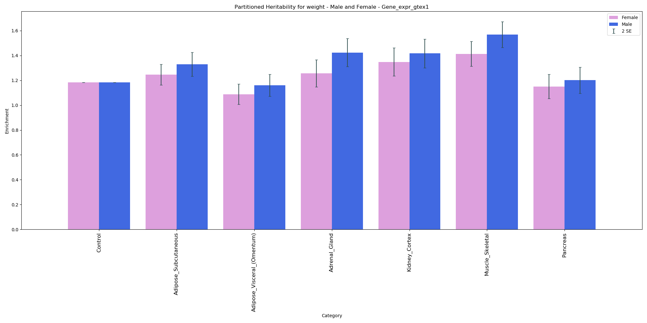
Weight – GTEx

Slide 20
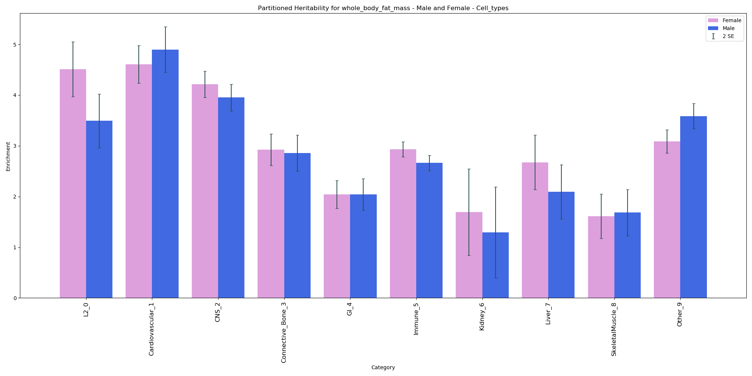
Whole Body Fat Mass

Slide 21
Estrogen and Fat
Sex Differences in Regulation of Body Weight
Inverse relationship between estrogen levels and food intake
Estrogen and leptin have overlapping target nuclei
Leptin levels higher in females compared to males, independent of body composition
Increased subcutaneous fat in females vs males
Estrogen increase lipolysis for visceral fat specifically, increasing fat in subcutaneous region
Leptin levels inversely correlated with testosterone, positively correlated with estrogen
In obese and aging men, there is increase conversion of testosterone to estrogen -> association with increased leptin
leptin activates sympathetic nervous system

Slide 22
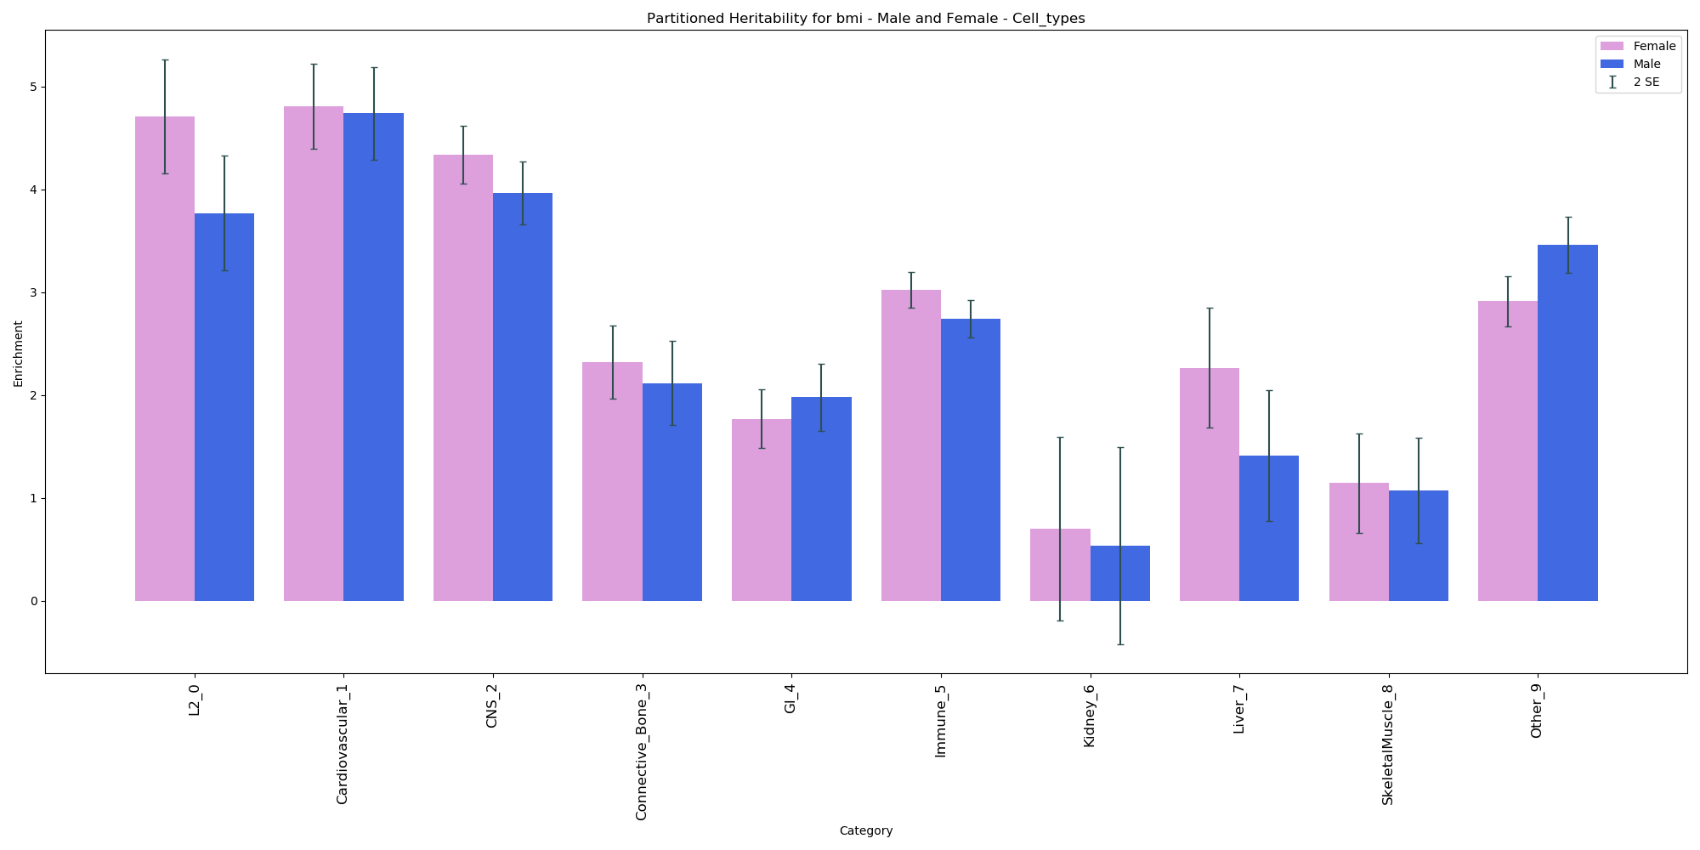
BMI – Cell Types

Slide 23
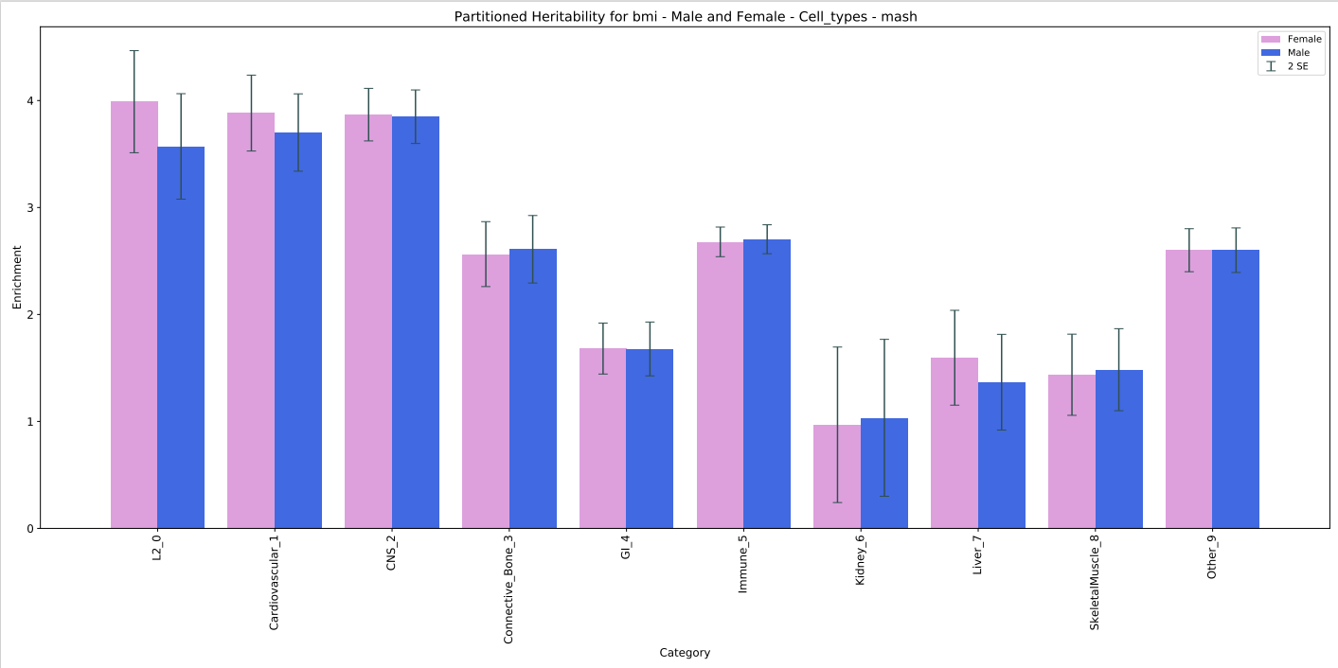
BMI – mash

Slide 24
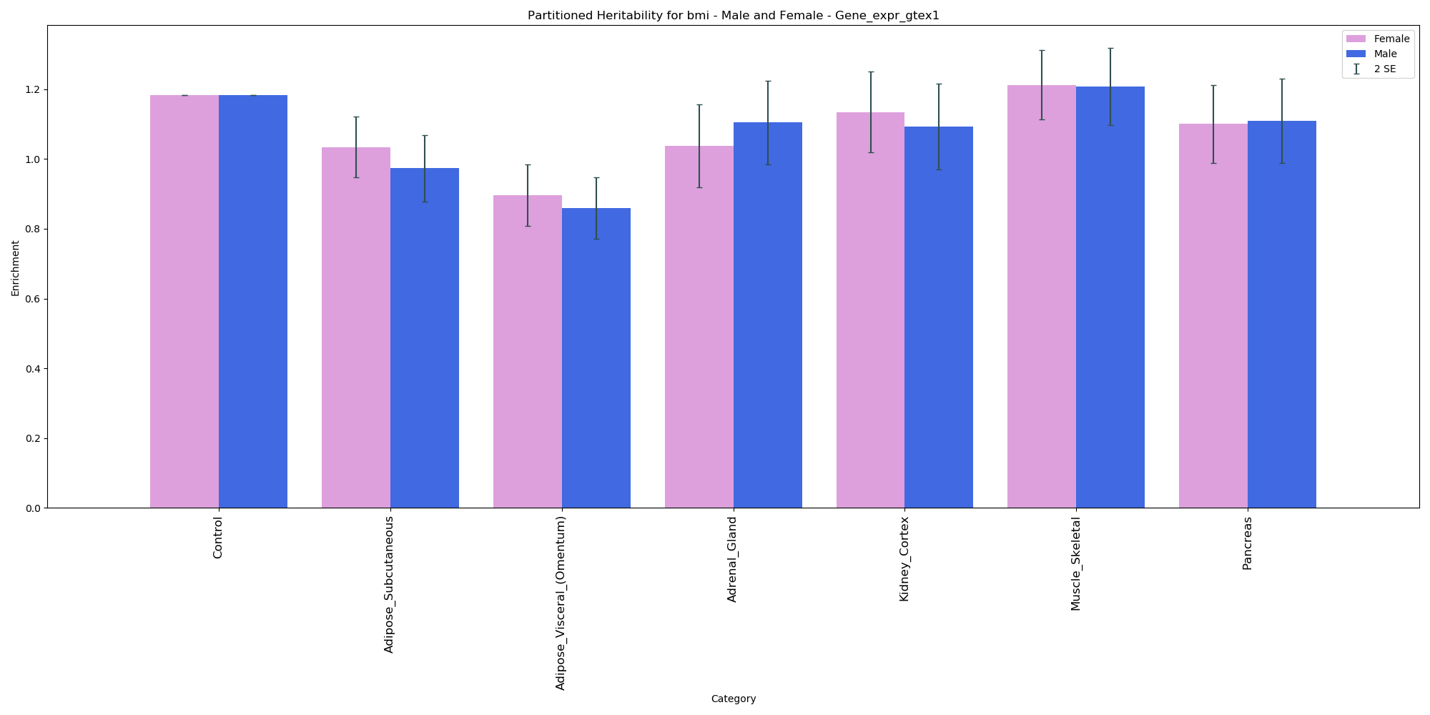
BMI - GTEx

Slide 25
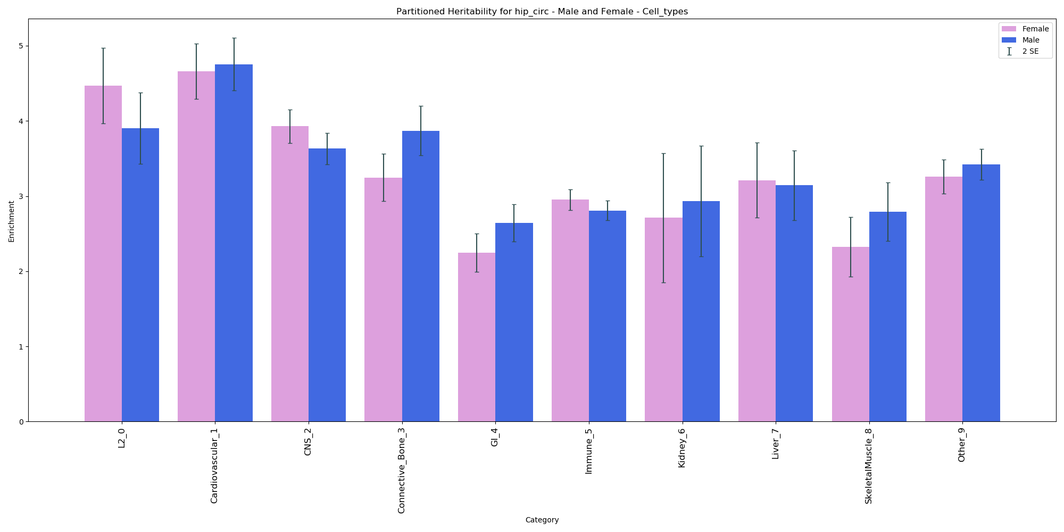
Hip Circumference

Slide 26
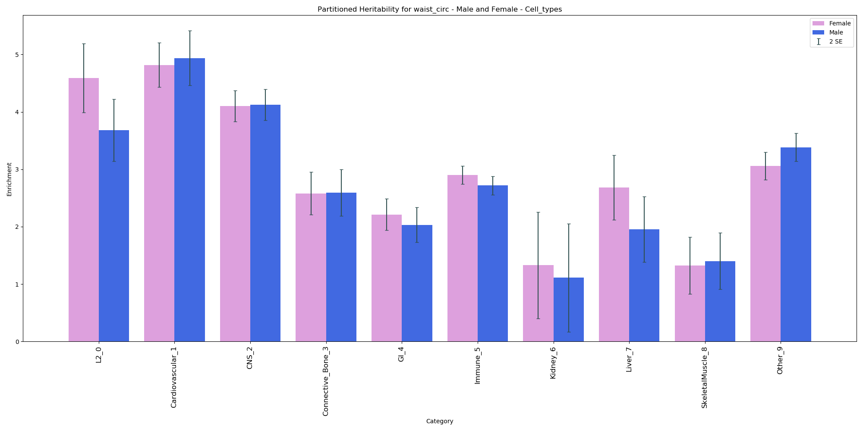
Waist Circumference

Slide 27
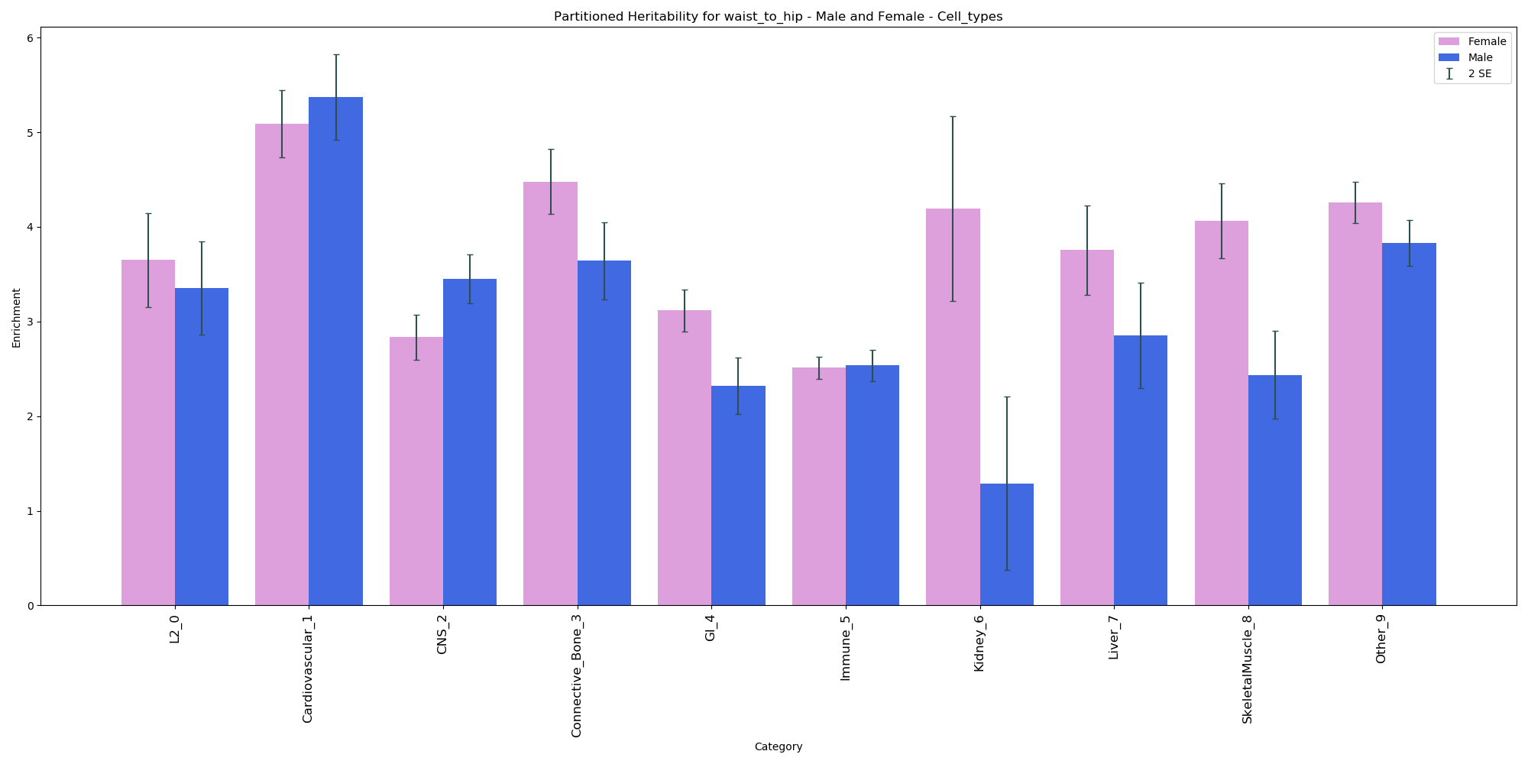
Waist to Hip Ratio

Slide 28
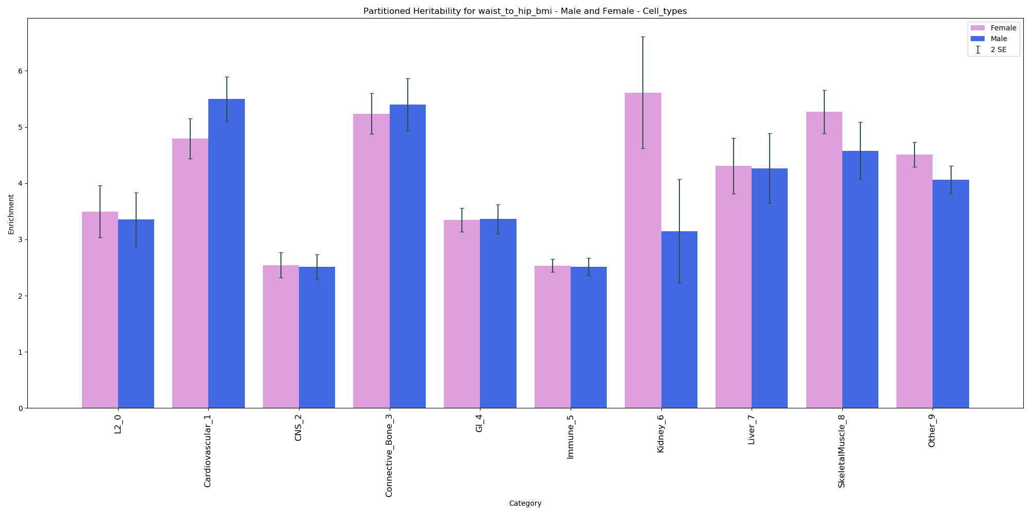
Waist to Hip Ratio (adjusted for BMI) – Cell Types

Slide 29
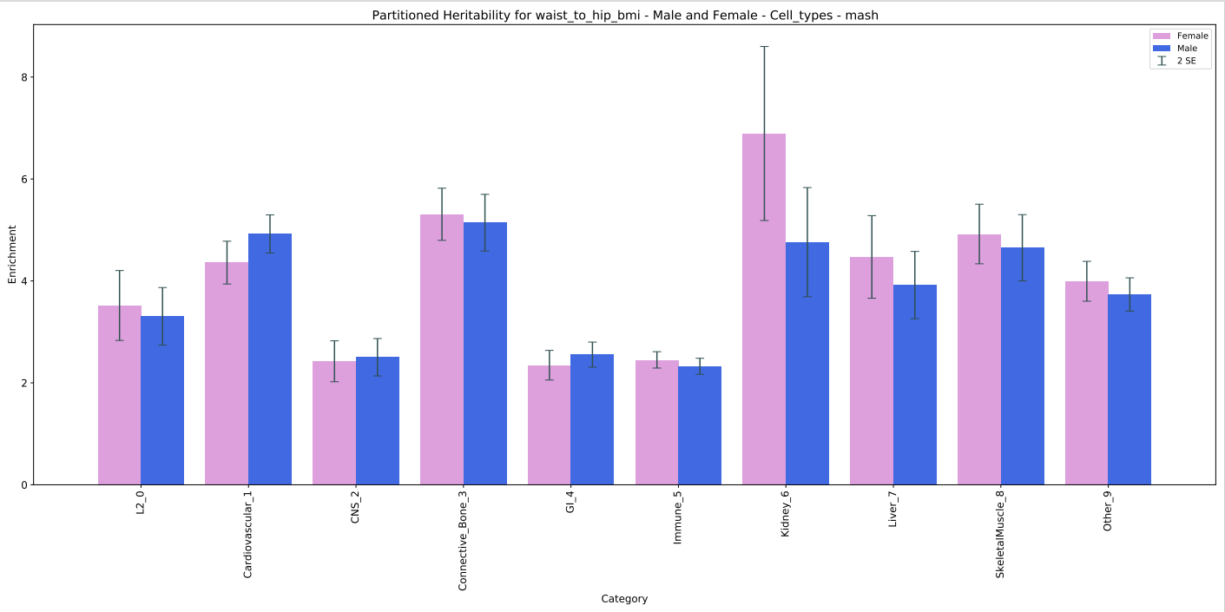
Waist to Hip Ratio (adjusted for BMI) – Cell Types - mash

Slide 30
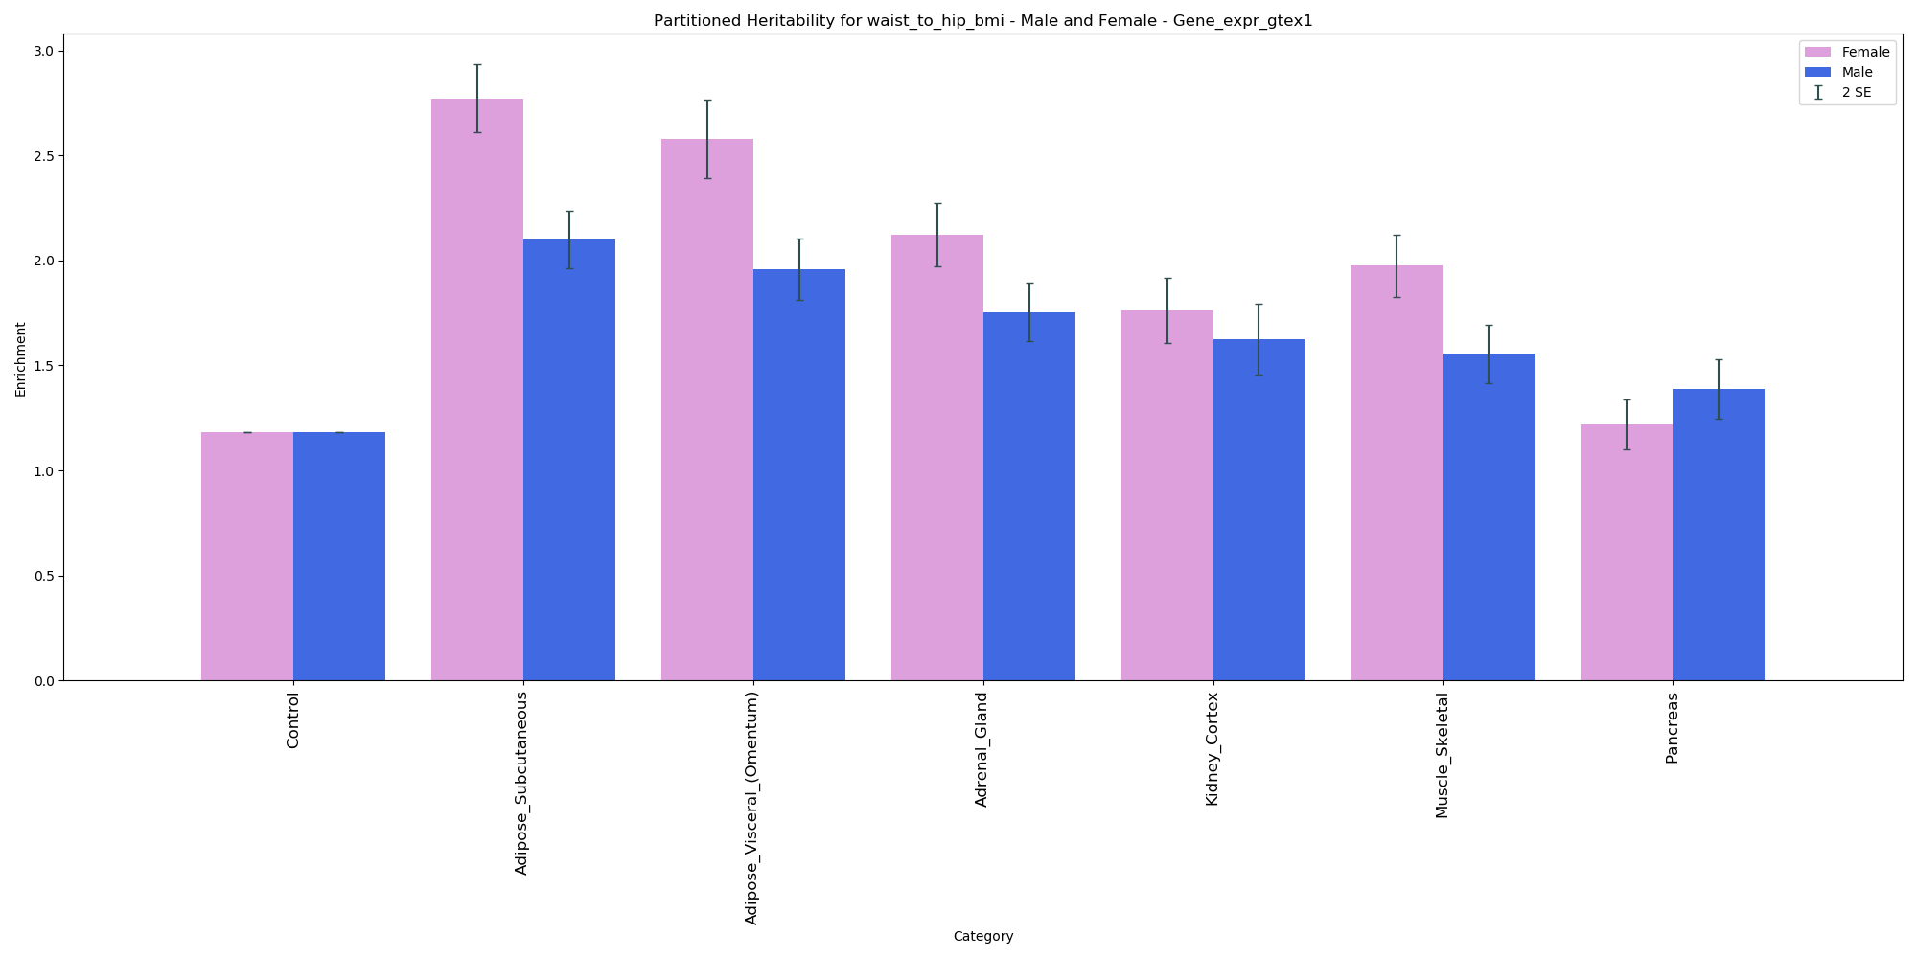
Waist to Hip Ratio (adjusted for BMI) - GTEx

Slide 31
Waist to Hip Ratio and BMI
Waist to Hip Ratio, Body Mass Index and Subsequent Kidney Disease and Death
WHR, but not BMI, is associated with chronic kidney disease and mortality
BMI appears to be protective

Slide 32
mash
 | Size of subset | height | bmi | testosterone | Sum
all | 1703 | 0.0024 | 0.0029 | 0.0034 | 0.0087
5e-2 | 1702 | 0.0037 | 0.0033 | 0.0025 | 0.0095
5e-2 no replace | 1702 | 0.0023 | 0.0028 | 0.0024 | 0.0075
1e-5 | 961 | 0.0037 | 0.0044 | 0.0024 | 0.0105
1e-5 no replace | 961 | 0.0034 | 0.0044 | 0.0031 | 0.0109
5e-8 | 602 | 0.0029 | 0.0037 | 0.0025 | 0.0091
5e-8 no replace | 602 | 0.0033 | 0.0053 | 0.0029 | 0.0115

Slide 33
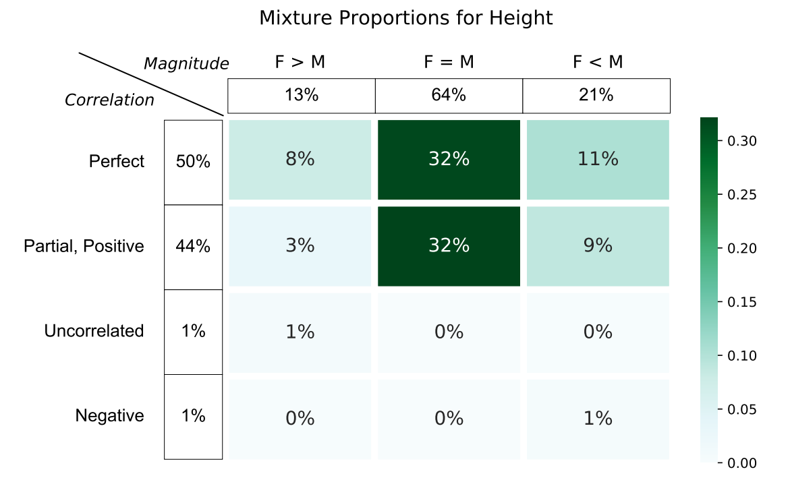
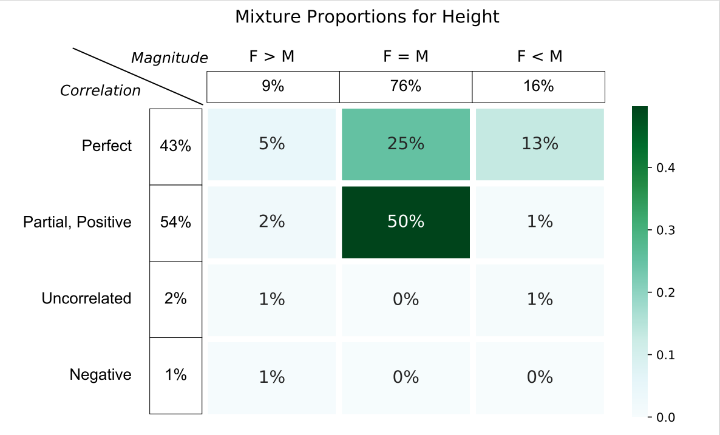
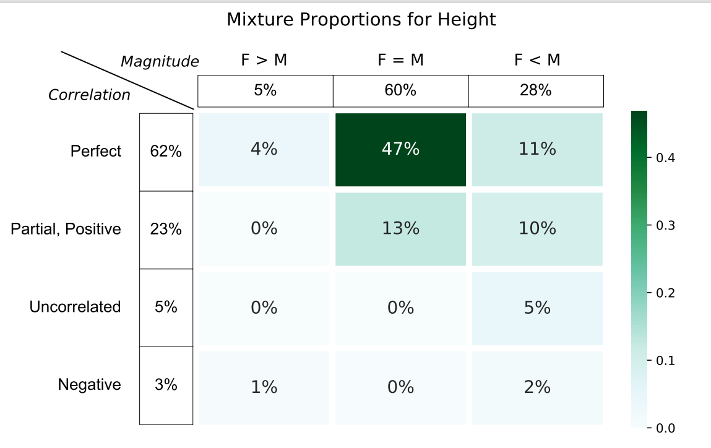
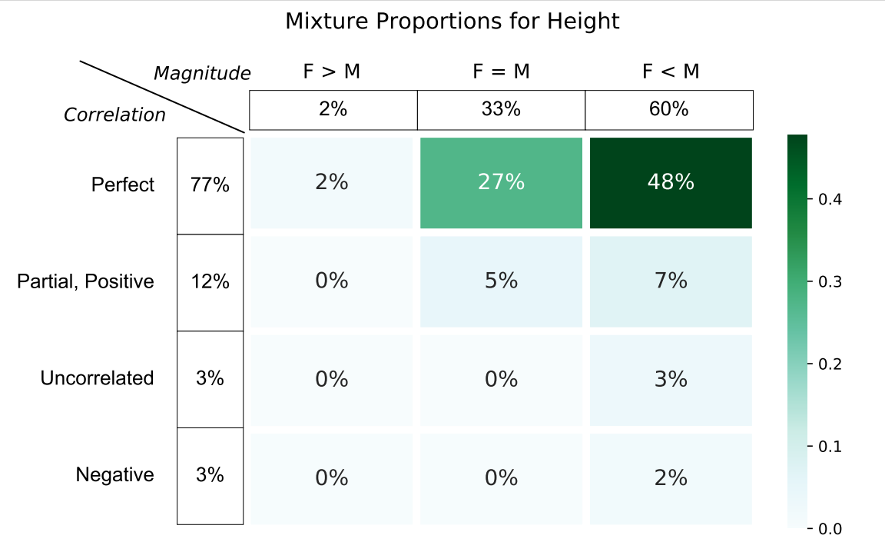
all
5e-2
1e-5
5e-8

Slide 34
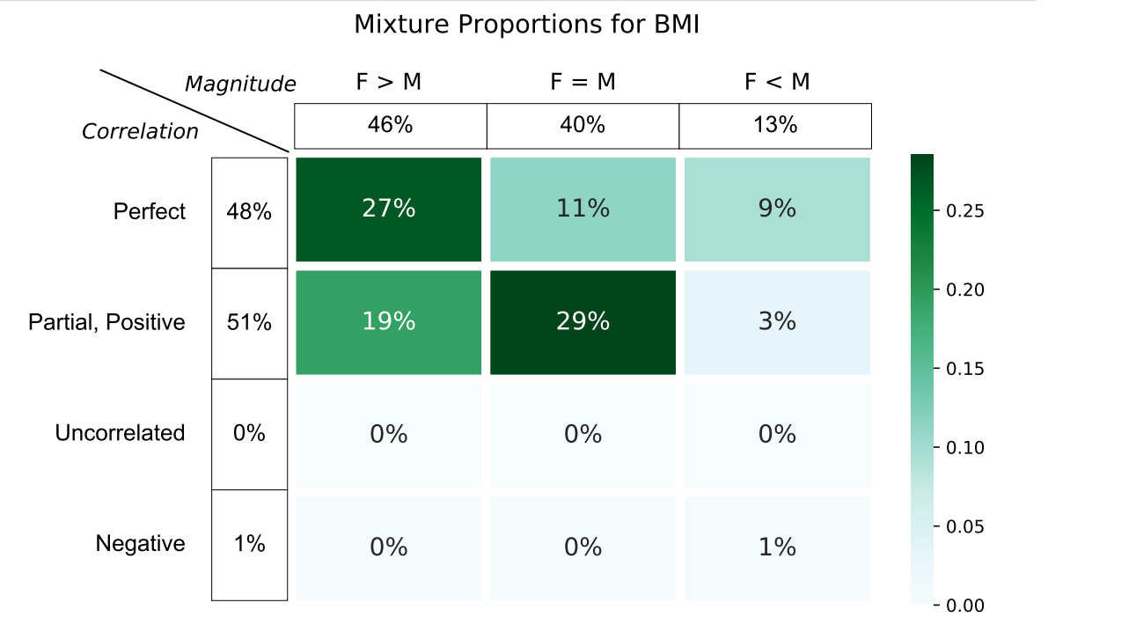
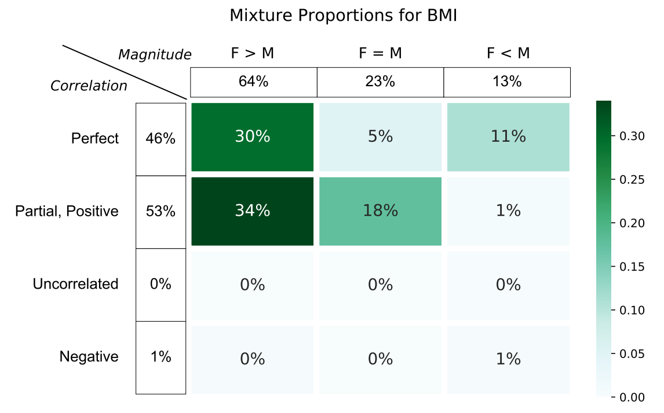
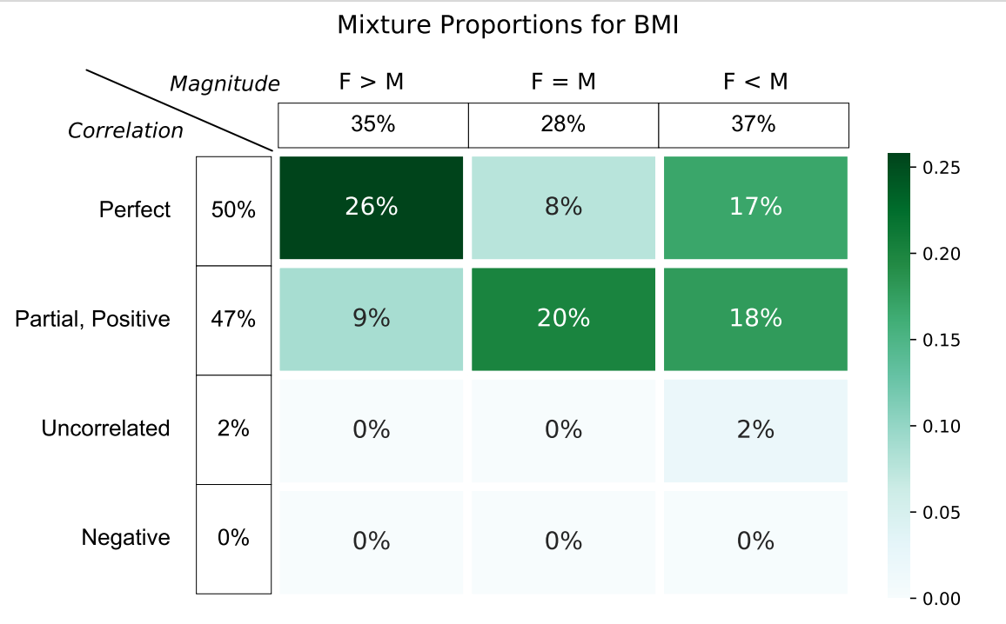
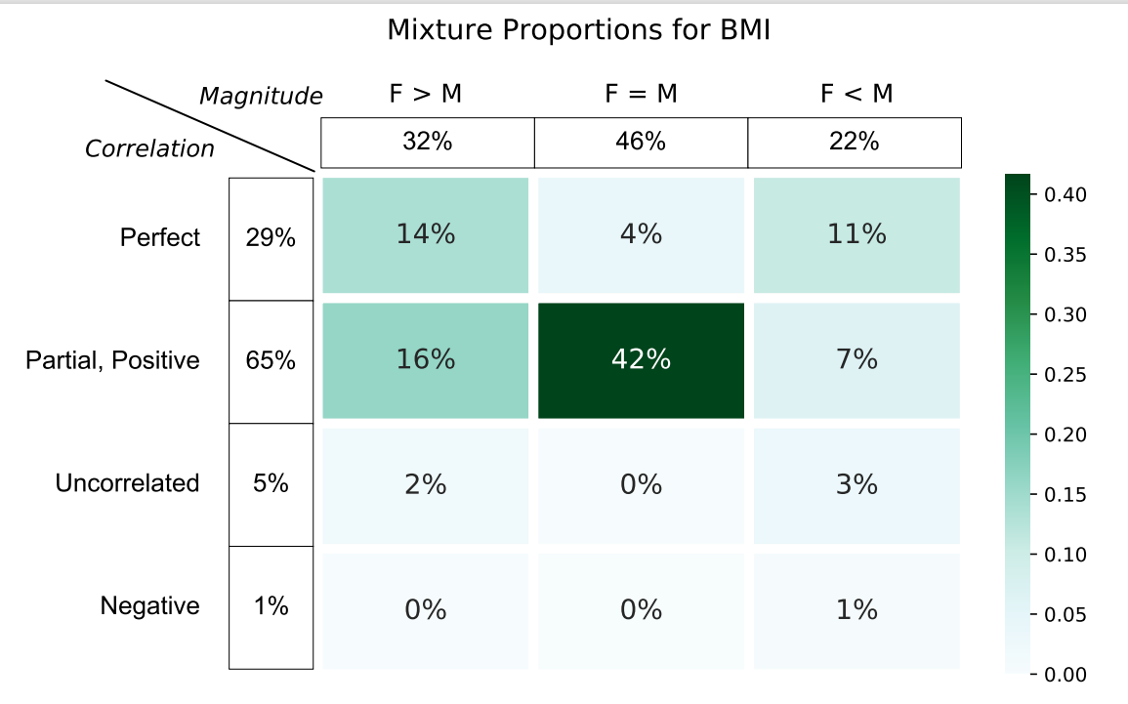
all
5e-2
1e-5
5e-8

Slide 35
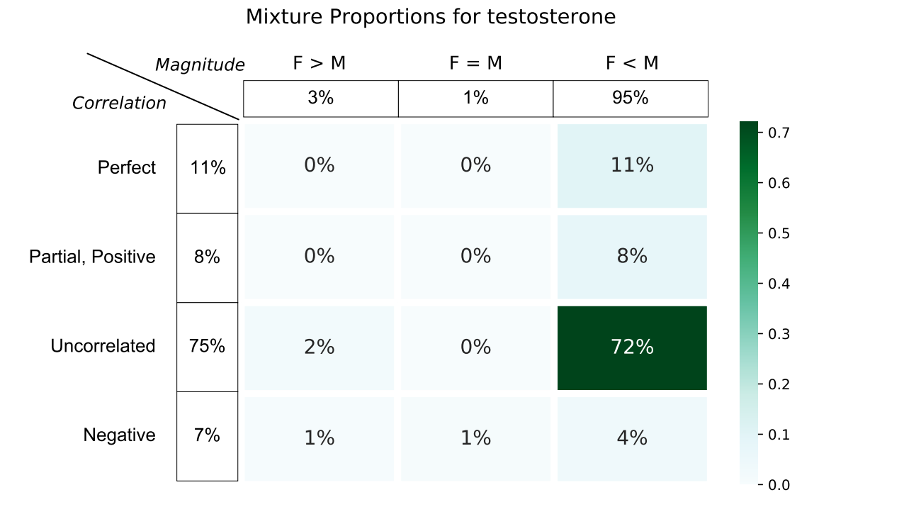
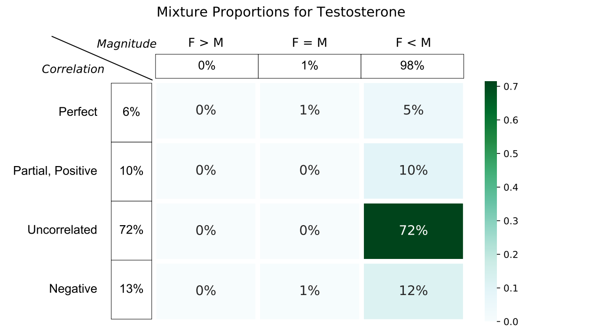
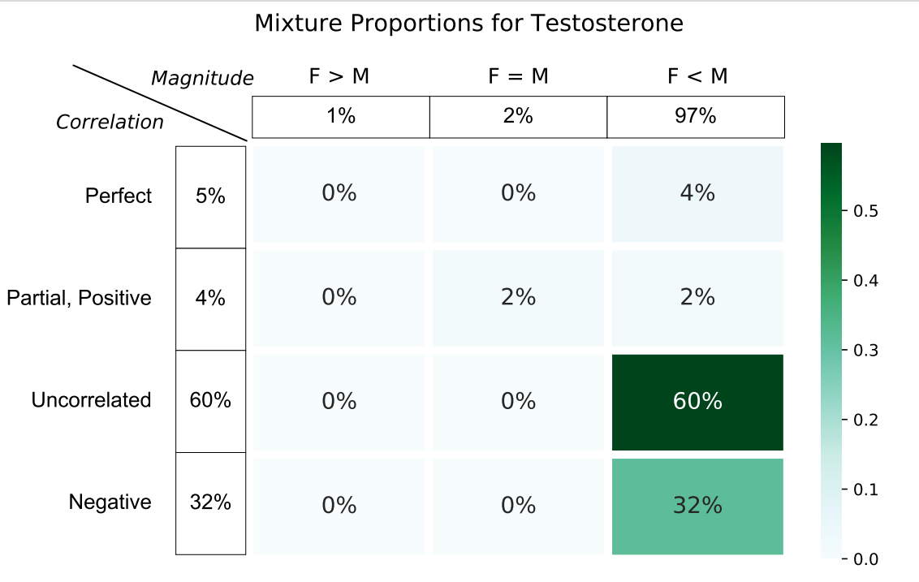
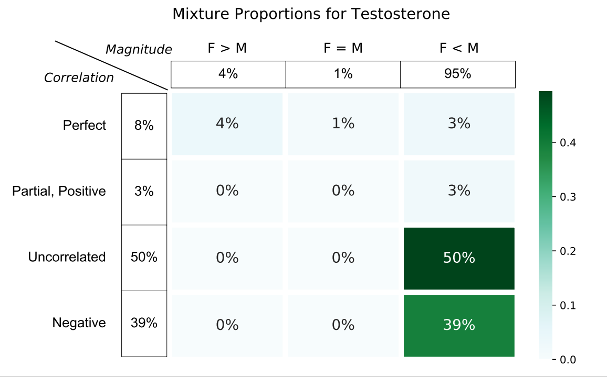
all
5e-2
1e-5
5e-8

