Slide 1
mash
Mixture proportions

Slide 2
Process
Clumping
SNPs with r^2 higher than 0.1 with index SNPs removed
SNPs within 250kb of index SNP considered for clumping
Strong Subset → Data-driven Covariance Matrices
SNPs after clumping with p-value < 0.005
~30k strong SNPs
Random Subset → Canonical and Hypothesis Covariance Matrices
Sample of ~200k SNPs

Slide 3
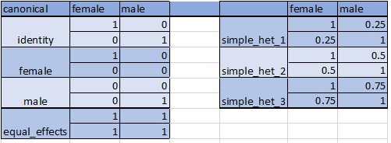
Canonical Matrices

Slide 4
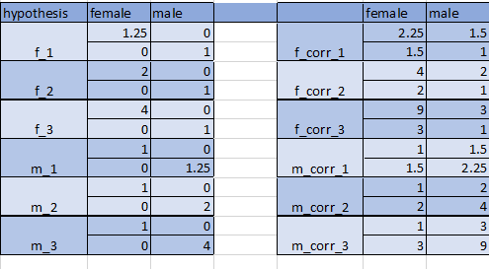
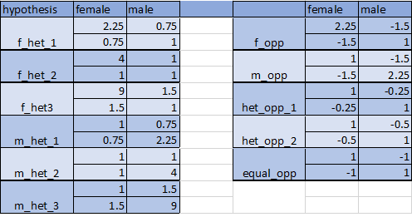
Hypothesis Matrices

Slide 5
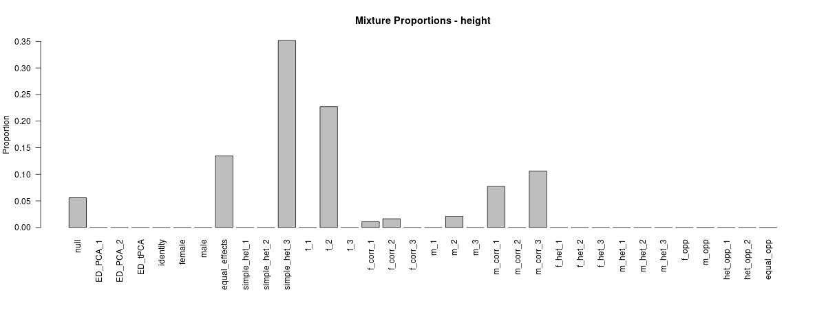
Height

Slide 6
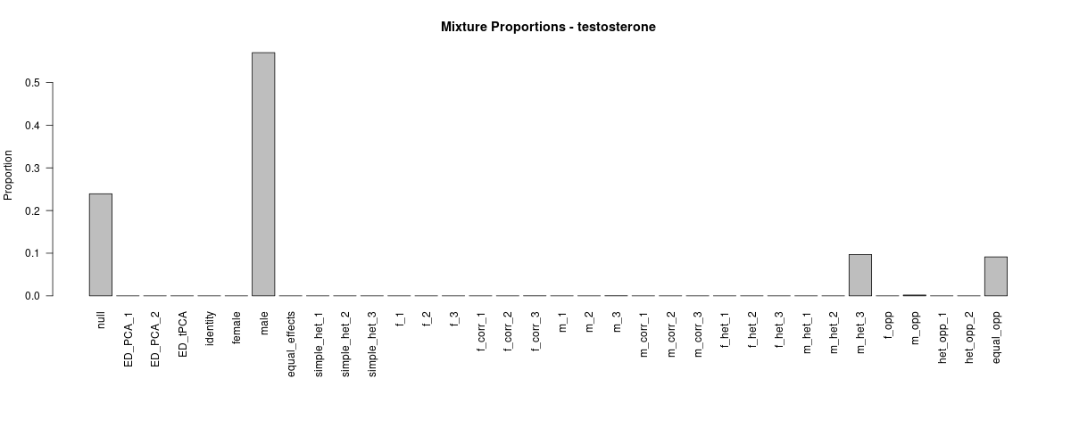
Testosterone

Slide 7
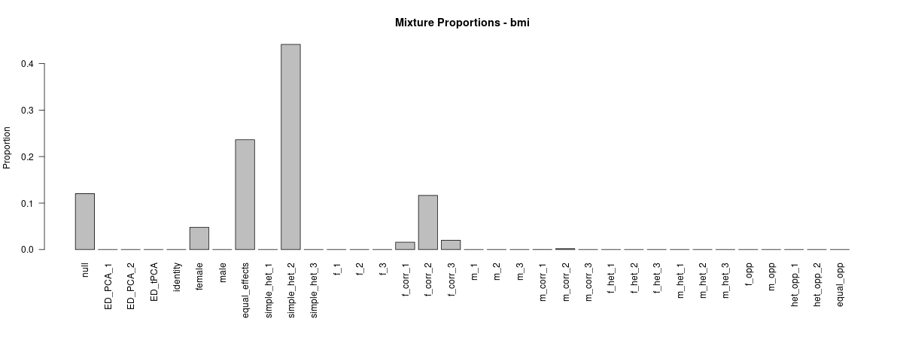
BMI

Slide 8
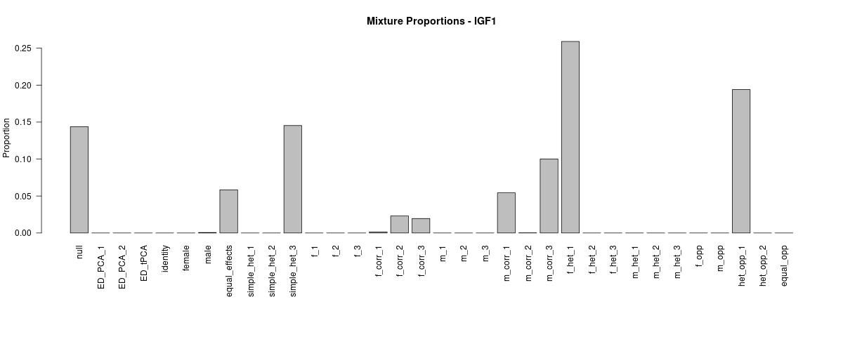
IGF1

Slide 9
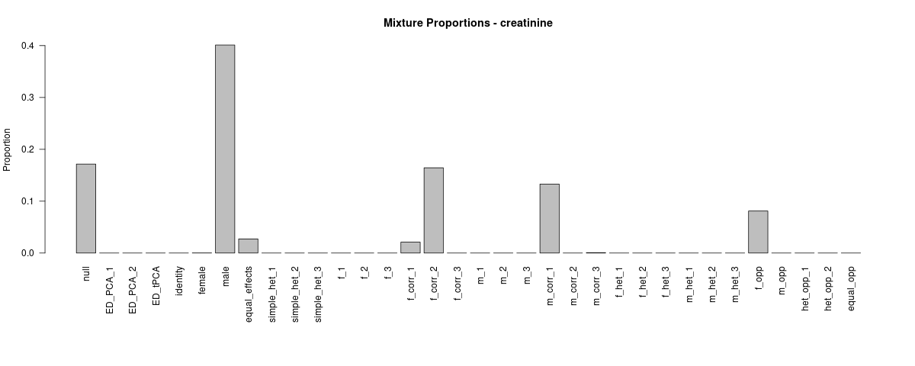
Creatinine

Slide 10
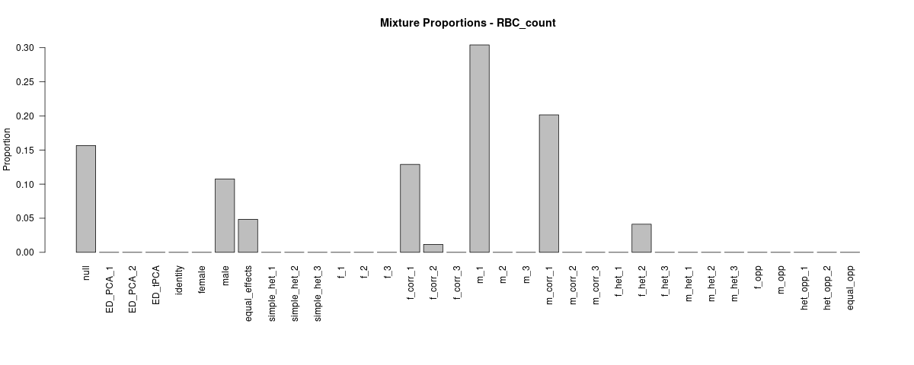
RBC Count

