Slide 1
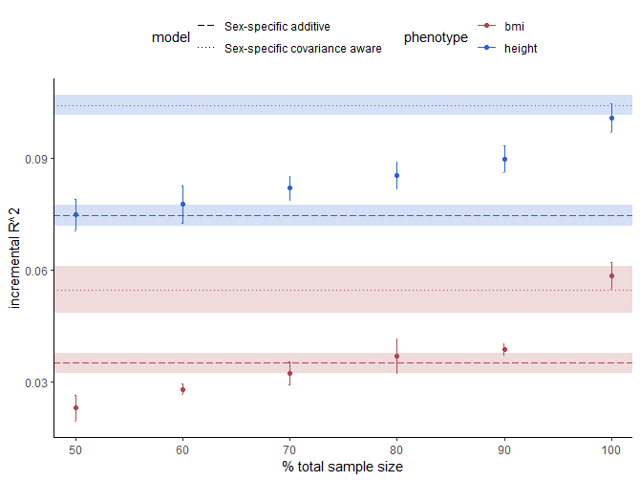

Slide 2
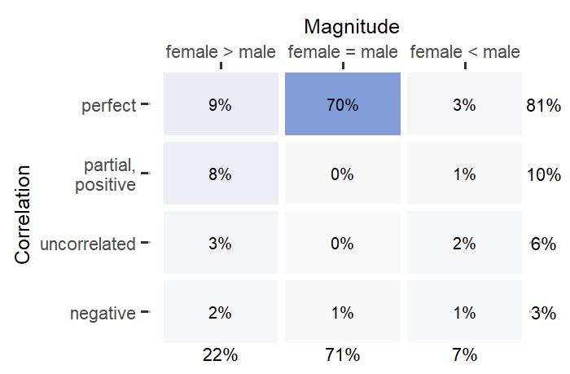
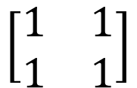
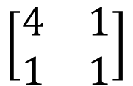
female male
$$\left[\begin{matrix}1 & 1 \\ 1 & 1\end{matrix}\right]$$
female
male
84%
$$\left[\begin{matrix}4 & 1 \\ 1 & 1\end{matrix}\right]$$
16%

Slide 3
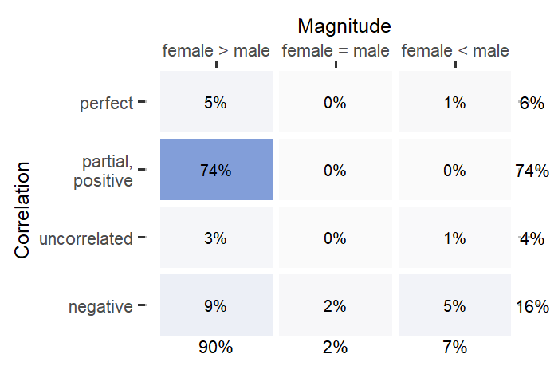
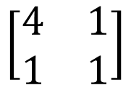
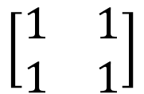
female male
$$\left[\begin{matrix}1 & 1 \\ 1 & 1\end{matrix}\right]$$
female
male
84%
$$\left[\begin{matrix}4 & 1 \\ 1 & 1\end{matrix}\right]$$
16%
Using two-tailed Student’s t-test
threshold: p < 1e-8 resulting sample size: ~120

Slide 4
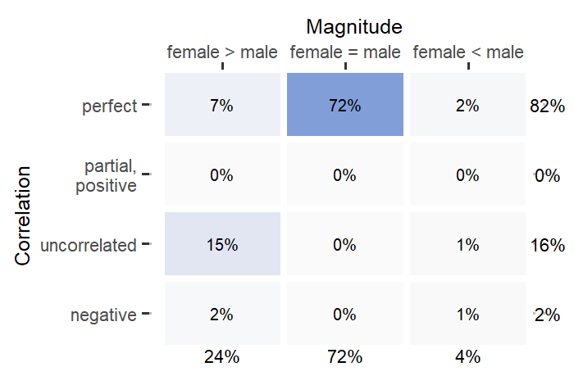

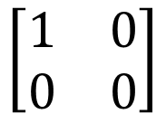
female male
$$\left[\begin{matrix}1 & 1 \\ 1 & 1\end{matrix}\right]$$
female
male
84%
$$\left[\begin{matrix}1 & 0 \\ 0 & 0\end{matrix}\right]$$
16%

Slide 5
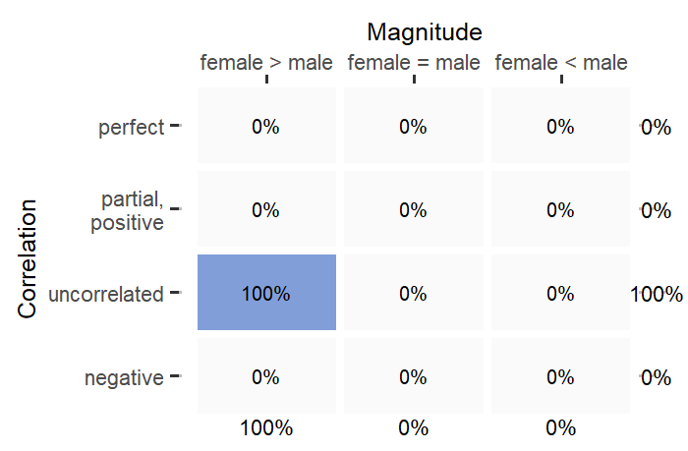

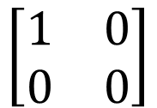
female male
$$\left[\begin{matrix}1 & 1 \\ 1 & 1\end{matrix}\right]$$
female
male
84%
$$\left[\begin{matrix}1 & 0 \\ 0 & 0\end{matrix}\right]$$
16%
Using two-tailed Student’s t-test
threshold: p < 1e-8 resulting sample size: ~80

Slide 6
Environmental variance ratio f/m: 1.2 / 1
snps: 1000
10x
100x

Slide 7
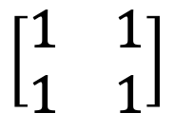
female male
$$\left[\begin{matrix}1 & 1 \\ 1 & 1\end{matrix}\right]$$
female
male
100%

Slide 8
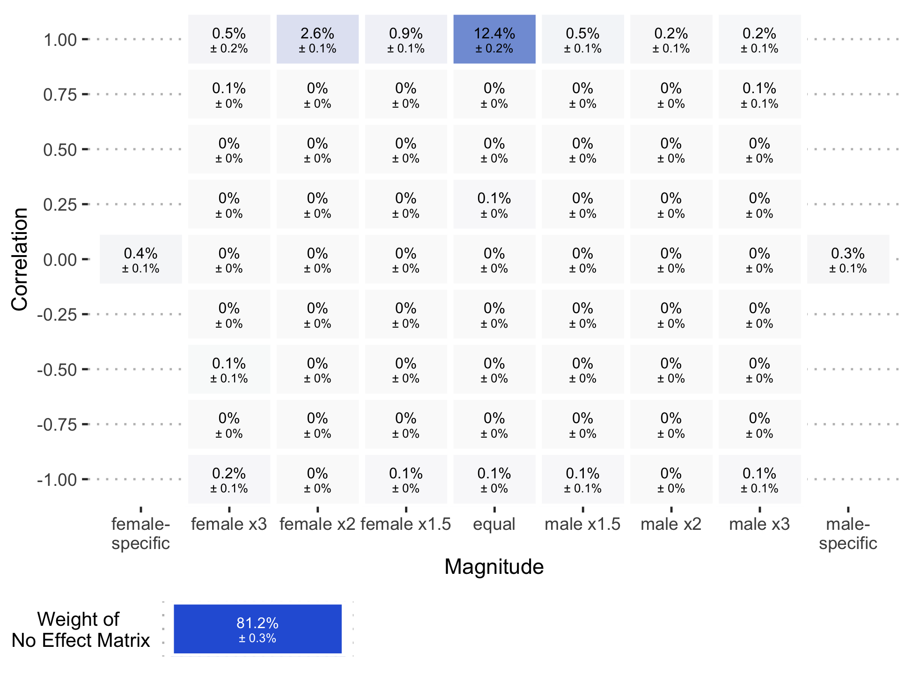
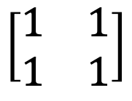
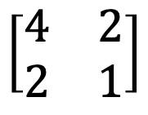
female male
$$\left[\begin{matrix}1 & 1 \\ 1 & 1\end{matrix}\right]$$
female
male
84%
$$\left[\begin{matrix}4 & 2 \\ 2 & 1\end{matrix}\right]$$
16%

Slide 9
 | HEIGHT
 | # sex het SNPs | % effect in one sex | % opposite direction | % same direction
Mean | 208.8 | 37.6% | 12.5% | 49.9%
SE | 4.50 | 0.9% | 0.9% | 1.5%
 | BMI
 | # sex het SNPs | % effect in one sex | % opposite direction | % same direction
Mean | 268.9 | 40.6% | 10.3% | 49.1%
SE | 2.99 | 1.2% | 0.7% | 1.1%

Slide 10
Height
# sex het | % one sex | % opposite direction | % same direction
994.7 | 62.3% | 37.7% | 0.0%
13.72 | 0.6% | 0.6% | 0.0%
BMI
# sex het | % one sex | % opposite direction | % same direction
1527.7 | 53.7% | 27.6% | 21.7%
50.74 | 2.7% | 0.9% | 0.9%

