Slide 1

May 2022
Amplification is the primary mode of Gene-by-Sex interaction in complex human traits
Carrie Zhu^{1,2}, Matthew J Ming^{1,2}, Jared M Cole², Mark Kirkpatrick², Arbel Harpak^{1,2+}
Department of Population Health, The University of Texas at Austin
Department of Integrative Biology, The University of Texas at Austin

Slide 2
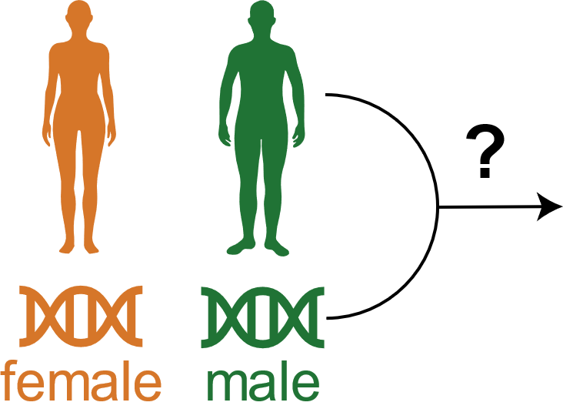
Introduction: Sex as an environment
Sexual dimorphism observed in many complex traits
Role/mode of gene-by-environment interaction (GxE)?
Sex as an environment, minimizes problems caused by
Confounding
Reverse causality between phenotype and sex
Recruitment bias
Notes:
One species, two very distinct characteristics between males and females
For example, morphology, physiology, disease prevalence and risk, despite having similar distributions of autosomal allele frequencies
Traditionally, view sex differences as stemming from the sex chromosomes
However, the vast majority of genetic effects come from autosomes, and autosomes compose a large part of the heritability
For complex traits, it is important to understand the interaction between gene and environment, in which case sex is the environment, and the role it plays in sexual dimorphism
Defined as a different effect of a genotype on a traits in individuals of different sex
In humans, current findings on the genetic basis of GxSex are lacking – often focusing of individual loci or estimating genetic correlations
In other species such as flies or plants, environments can be easily manipulated, but we can’t do that in humans
Therefore, we first consider sex as the environmental variable, which offers some advantages
Almost always measured, so easier incorporation in future studies
GxE correlation, when exposure to environmental conditions depends on the genotype (ex. Educational attainment – correlate to different conditions)
Minimize problems in study participation biases such as relationships to genetic ancestry and other confounder
Work by Piratsu et al find AF diff may reflect sex-specific recruitment biases, Kong et al find no evidence of sex-specific genetic association with UKB participation
And Kasimatis et al find that many apparent associations are primarily due to mismapping to sex chromosome – which we correct for in our evolutionary analysis

Slide 3
Setup: UK Biobank
~300K individuals of White British ancestry
Conduct GWAS stratified by sex for 27 continuous traits
$$phenotype_{M}=covariates+β_{M}SNP+e_{M}$$
$$phenotype_{F}=covariates+β_{F}SNP+e_{F}$$
Notes:
~ 9 million variants
Aged 40-69 at recruitment
Covariates include: birthyear, sex, first 10 principal components,
- GWAS for each trait in females only, males only, and both sexes combined

Slide 4
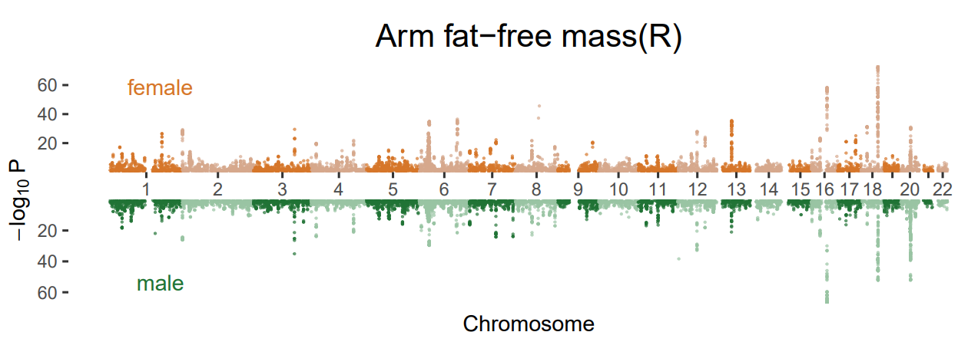
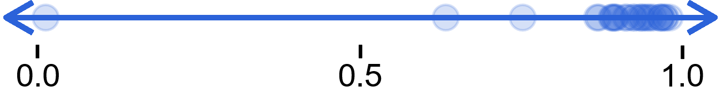
Motivation and Previous Studies
Single nucleotide studies
Testosterone is an exception
Substantial agreement in top associations
Heritability and genetic correlation estimates
>0.9 genetic correlation in 17/27 traits
Notes:
First follow previous studies
Single nucleotide studies, examine top associations in males and females separately
For most traits, other that testosterone and bmi-adjusted waist:hip, top loci are largely overlapping even with traits with apparent differences at the phenotypic level
Although it aids biological interpretation, given the polygenic nature of these traits, studies lack the ability to characterize GxSex and mainly productive for few traits
Other tools involving heritability estimates and genetic correlation do keep the polygenic nature of these traits in mind
Scaleless, uncertain thresholds
We find most traits have high genetic correlation – meaning a substantial sharing of signal
Don’t define how GxSex is acting as well
Another mode haven’t considered:
Both studies don’t sufficiently capture or quantify amplification of polygenic effects – greater magnitudes of effect sizes in one sex over the other

Slide 5
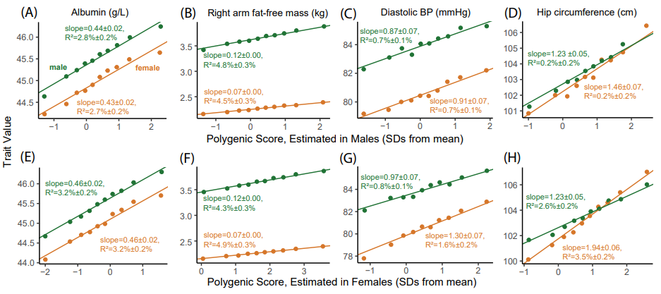
Evidence of systematic amplification
Regress trait values on polygenic scores to examine genetic effect on a trait in males and females
Notes:
Set out to examine evidence of systematic amplification.
We regress trait values, separated by sex, on polygenic scores estimated in males and females separately
Polygenic score summarizes the genetic effect on a trait
We see PGS is predictive in both sexes, regardless of how the PGS calculated
Under systemic amplification model, direction and identity of variants are shared
For the sex in which the magnitude of genetic effects are larger, we should see a larger effect of PGS
In albumin, effect of PGS on trait are nearly the same
For hip circumference and arm fat-free mass, effect is larger in one sex
Interestingly in diastolic BP, sex having the larger effect depends on PGS
Thought there is more to unpack with this amplification, so why not measure the full covariance of genetic effects

Slide 6
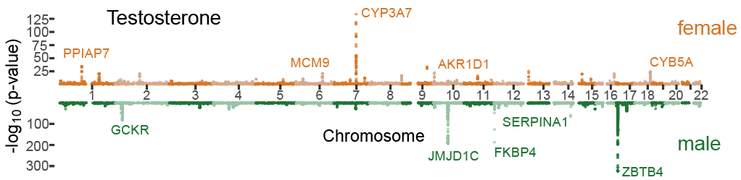
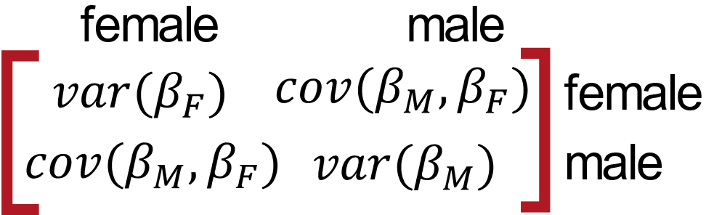
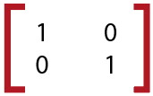
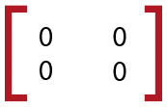
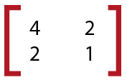
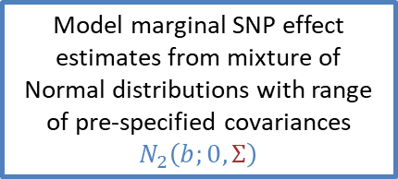
Investigating covariance structure using multivariate adaptive shrinkage (mash)
Model marginal SNP effect estimates from mixture of Normal distributions with range of pre-specified covariances $N_{2}\left(b;0,Σ\right)$
Sex-specific SNP effect estimates and standard errors
Estimate the weight for each pre-specified matrix
Pre-specified hypothesis covariance matrices represent various levels of magnitudes and correlations
Notes:
Take SNP effect estimates, two conditions; as sampled, model from mixture
Hypothesis matrices represent patterns that can occur in the data
Matrices cover a range of amplification and correlation relationships
- identity, no effect; female greater perfect correlation
Each weight corresponds to the relative frequency the matrix is represented in the data

Slide 7
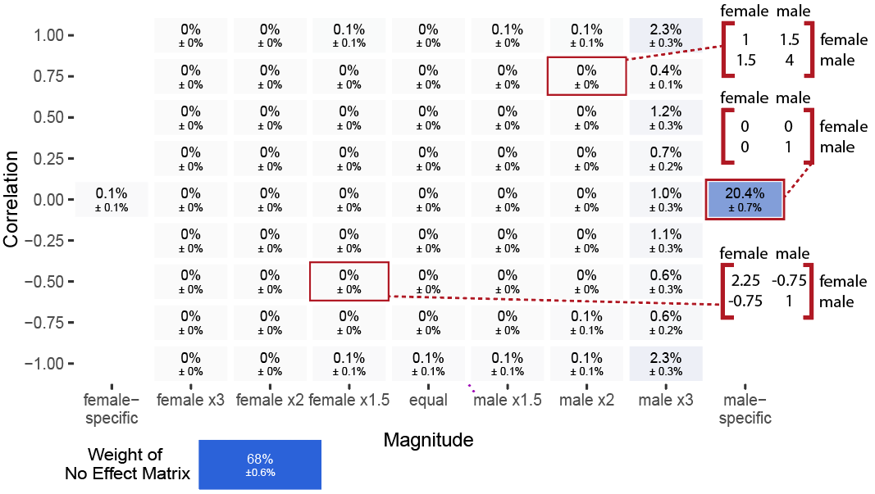
Amplification as a primary mode of GxSex
Testosterone
Notes:
Testosterone, most weight on male only, uncorrelated effects.

Slide 8
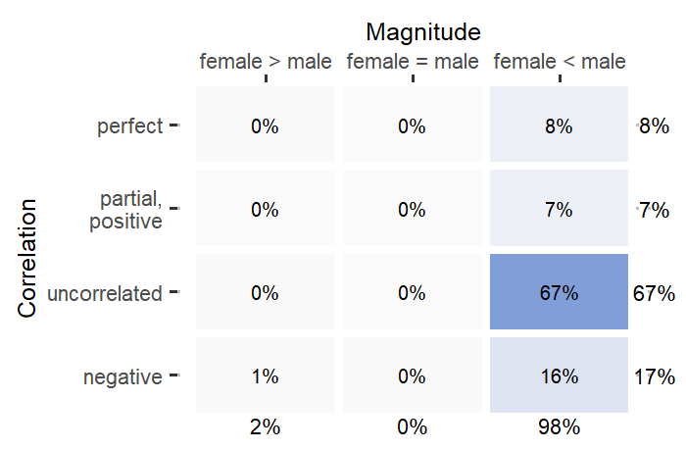
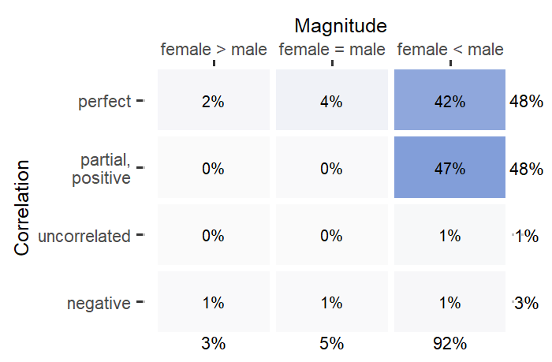
Compact representation of covariance of genetic effects
Testosterone
Arm fat-free mass (R)

Slide 9
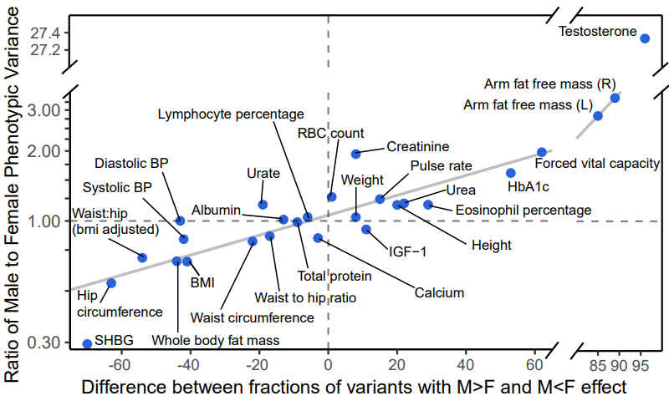
Phenotypic variance is strongly correlated with amplification
Notes:
Pervasive amplification across traits can point to its importance or role in sexual dimorphism
We find that phenotypic variance is strongly correlated with amplification (r=0.873, excluding testosterone)
Also find that amplification and phenotypic mean is associated, so not conclusive on what is the causal factor

Slide 10
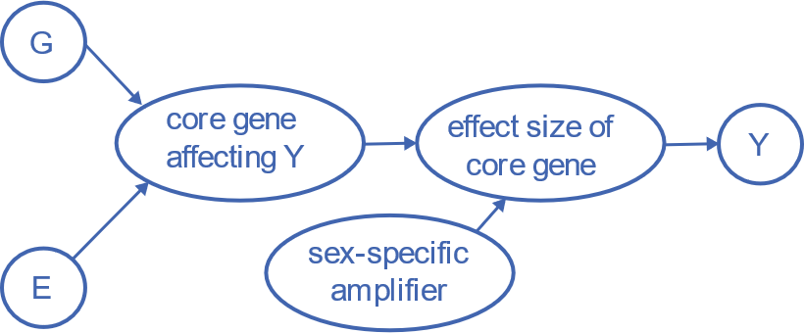
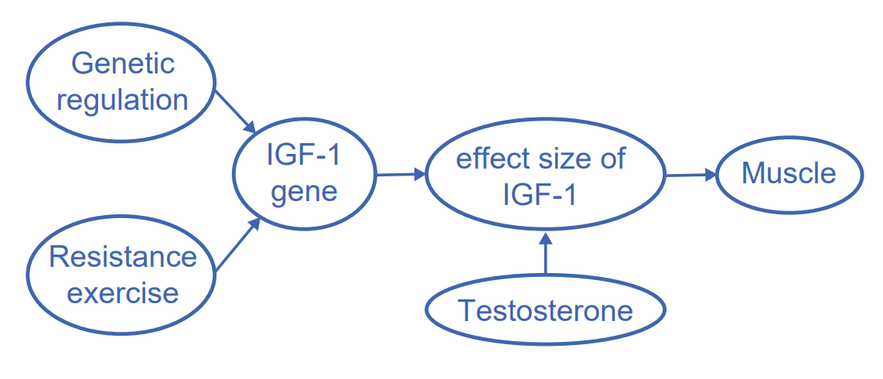
Model of shared amplification
Do the same modulators of amplification of genetic effect also act on environmental effects?
Suggest sharing of pathways
Possible underliers such as testosterone, and other sex hormones
Example:
Notes:
What underlies amplification, and does that same underlier for genetic effects also influence environmental effects?
Propose model in which amplifier is equal for both – suggest sharing of pathways

Slide 11
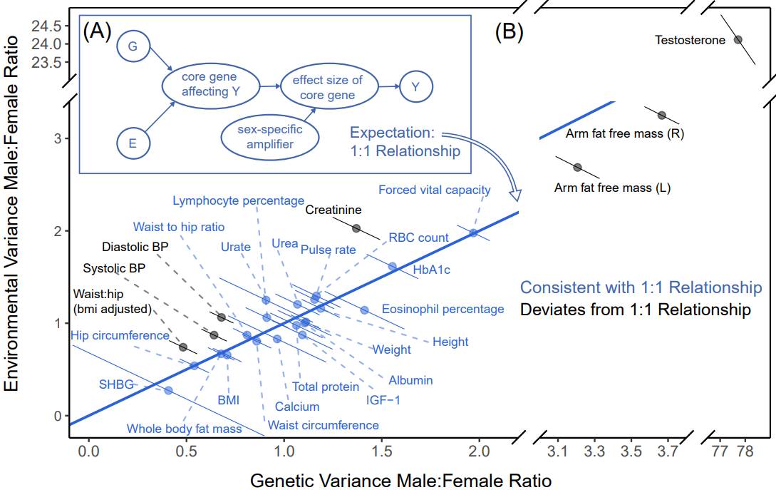
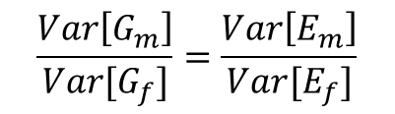
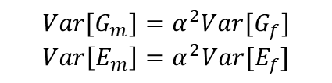
Model of shared amplification
$$Var[G_{m}]=α^{2}Var[G_{f}]$$
$$Var\left[E_{m}\right]=α^{2}Var[E_{f}]$$
$$\frac{Var\left[G_{m}\right]}{Var[G_{f}]}=\frac{Var\left[E_{m}\right]}{Var[E_{f}]}$$
Notes:
In model of equal amplification, ratio of M:F environmental variance equal to ratio of M:F genetic variance
Indicated by blue line, 20/27 traits consistent

Slide 12
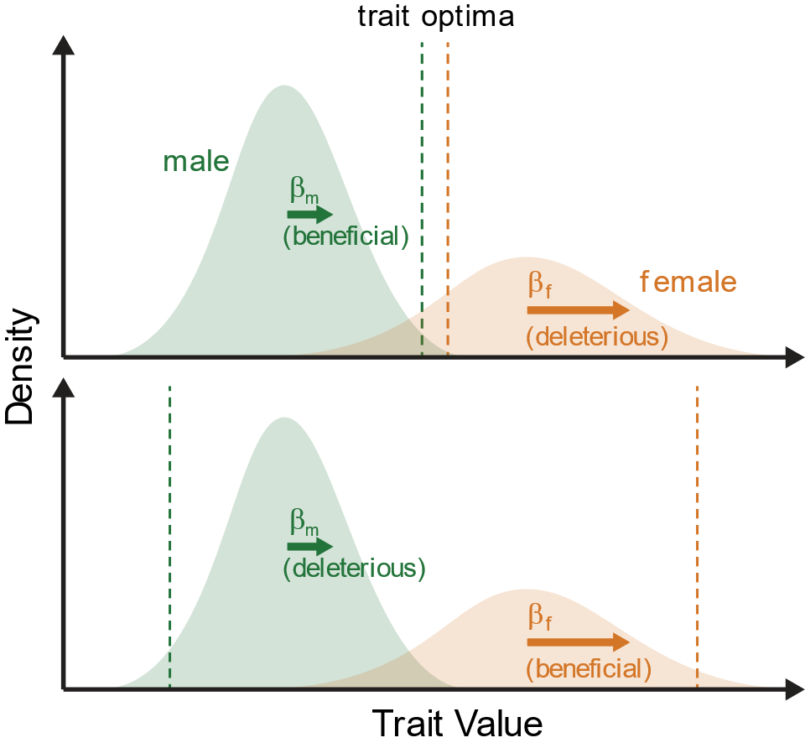
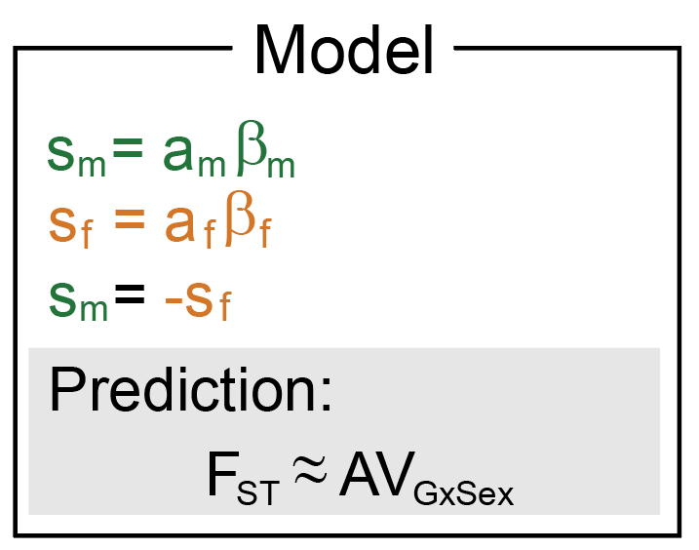
Sexually antagonistic selection
Relate sex differences in genetic effects to sexually antagonistic selection
Applicable in both cases where trait optima are distinct and similar
Notes:
We relate sex differences in additive genetic effects to divergence in AF – sexually antagonistic selection.
In sexually-antagonistic selection, some alleles are beneficial in one sex, but deleterious in the other
Our amplification model suggest that variant effect on traits have the same signs, different magnitude
Alleles can experience sexually-antagonistic selection in both the case where the trait optima is similar and distinct in males and females
Assumptions:
Selection coefficients, s, are linear with the additive effect on trait. Measure relative strength of selection acting against a genotype
Under sexually antagonistic selection, they are equal and opposite at every loci

Slide 13
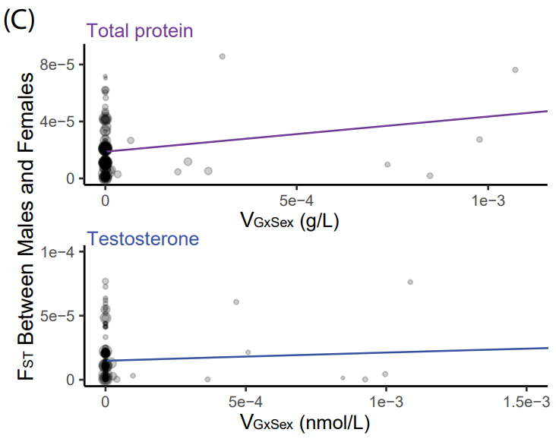
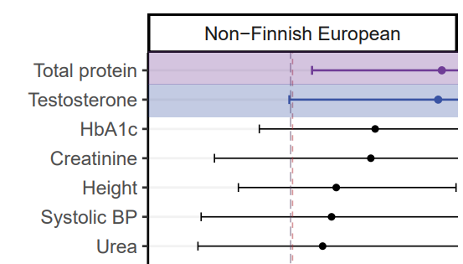
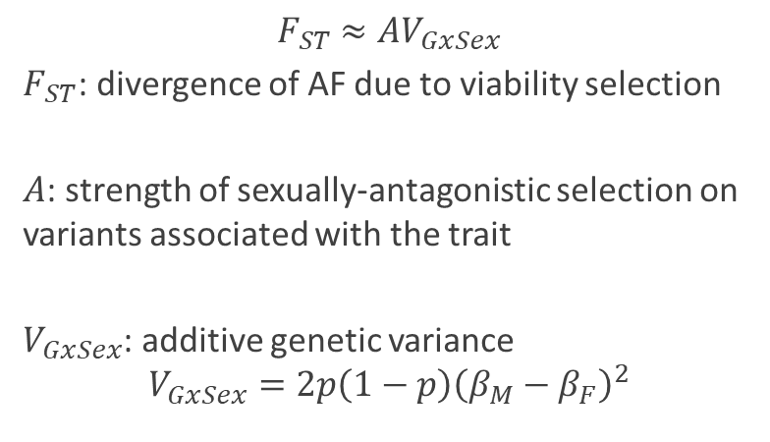

Sexually antagonistic selection
$$F_{ST}≈ΑV_{GxSex}$$
$F_{ST}$: divergence of AF due to viability selection
$Α$: strength of sexually-antagonistic selection on variants associated with the trait
$V_{GxSex}$: additive genetic variance
$$V_{GxSex}=2p\left(1−p\right){\left(β_{M}−β_{F}\right)}^{2}$$
= $2p\left(1−p\right){\left(β_{M}−β_{F}\right)}^{2}$
Notes:
We examine AF differences in the current generations, since autosomal AF are equalized at conception from mendelian inheritance (random segregation of alleles)
Use these differences to estimate the strength of viability selection
Divergence of AF between males and females measured as FST due to viability selection from conception to time of sampling
Proportion of heterozygosity due to AF divergences between sexes
A is a constant shared across all variants and interpreted as the strength of sexually antagonistic selection on genetic variation
Relates contribution of V due to differentiation in AF
V is measure of genetic variance
Careful with
Is allele is associated with trait related to differential recruitment; genetics of trait may be tagged with study participation

Slide 14
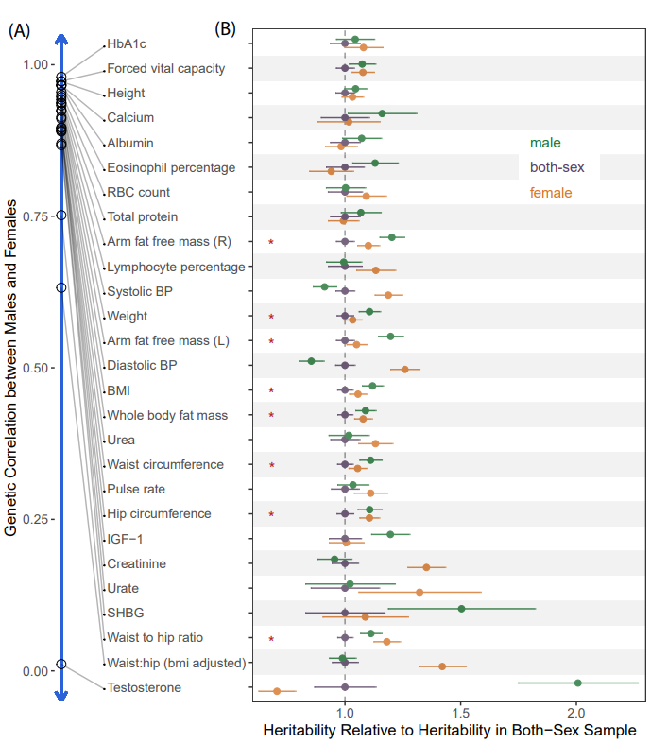
Appendix

Slide 15
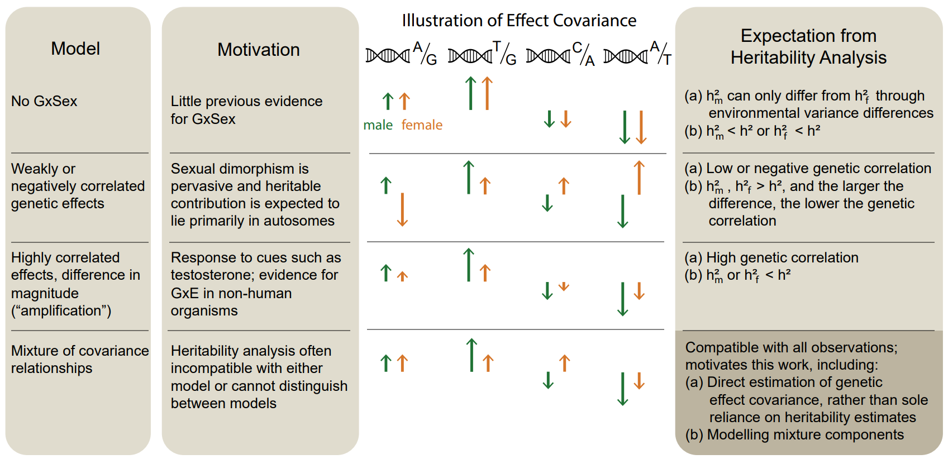
Appendix: Polygenic models of GxSex

Slide 16
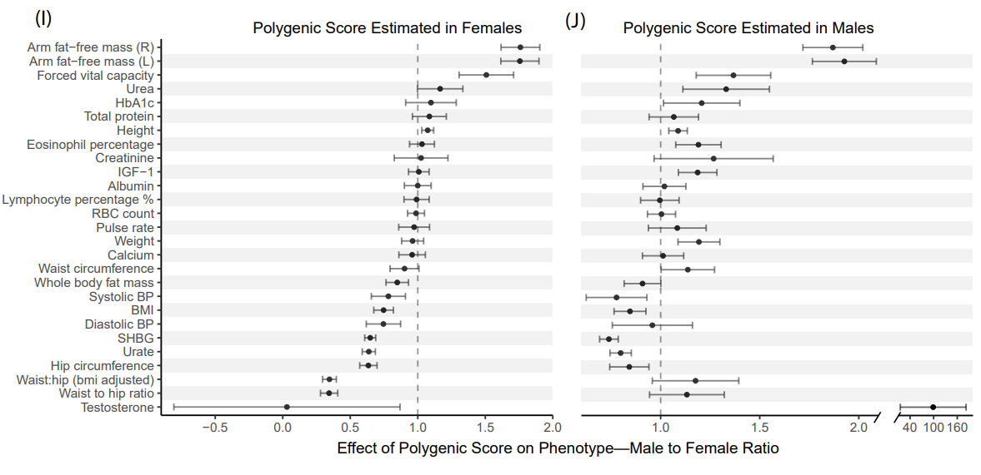
Appendix: Ratio of effect of polygenic score

Slide 17
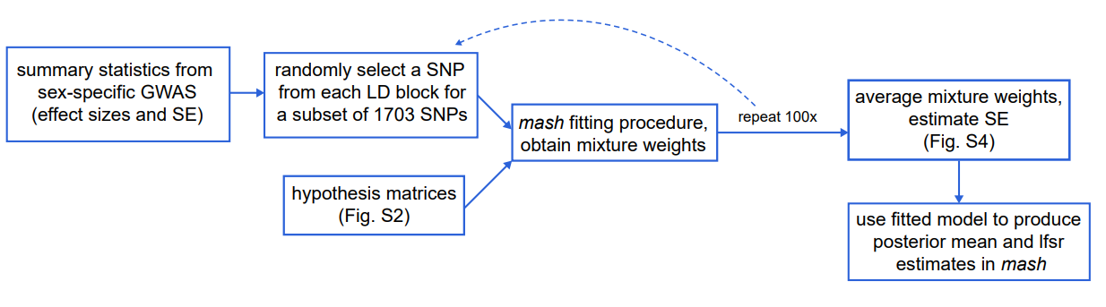
Appendix: mash

Slide 18
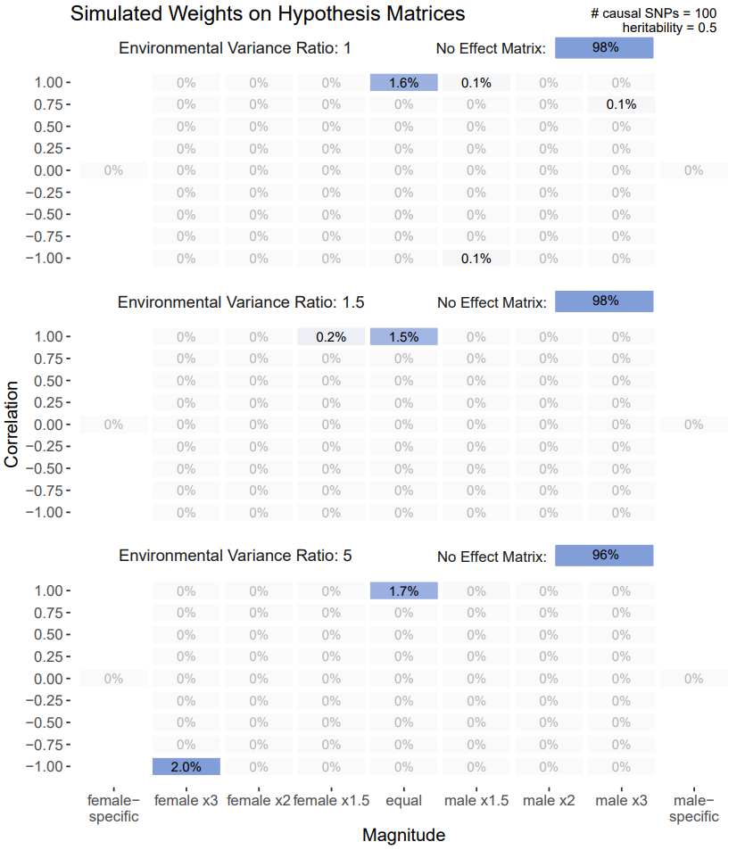
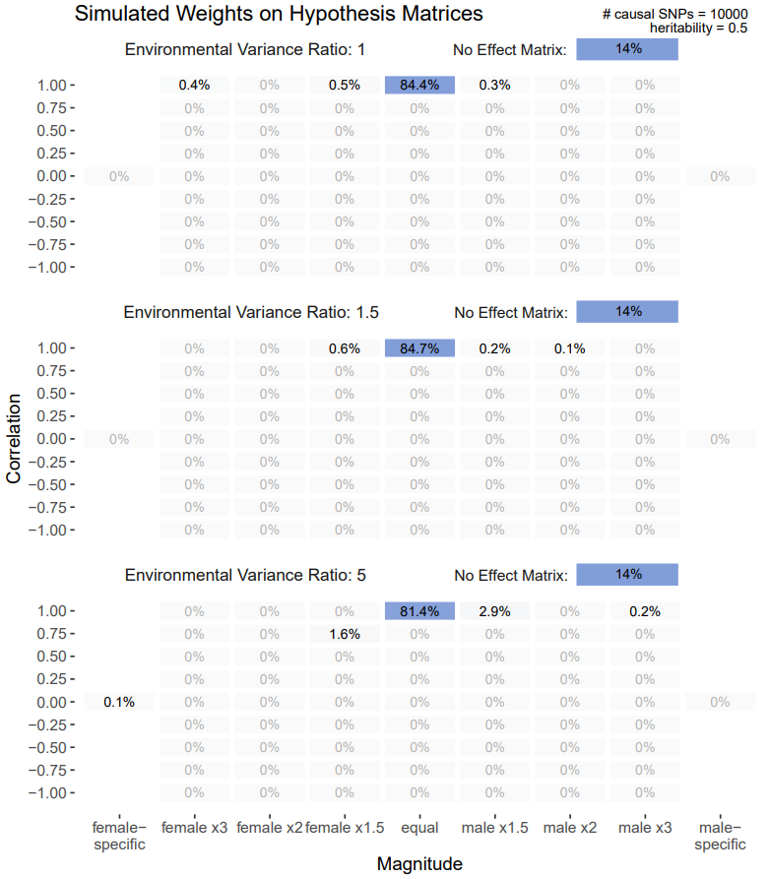
Appendix: Environmental Variance Simulation

Slide 19
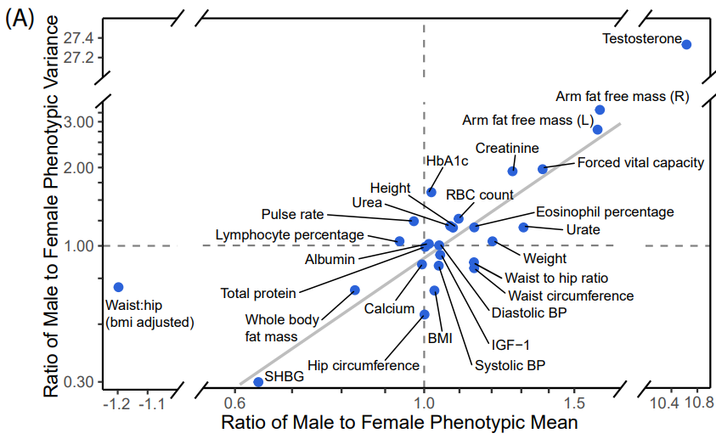
Appendix: Phenotypic variance ratio and mean ratio

Slide 20
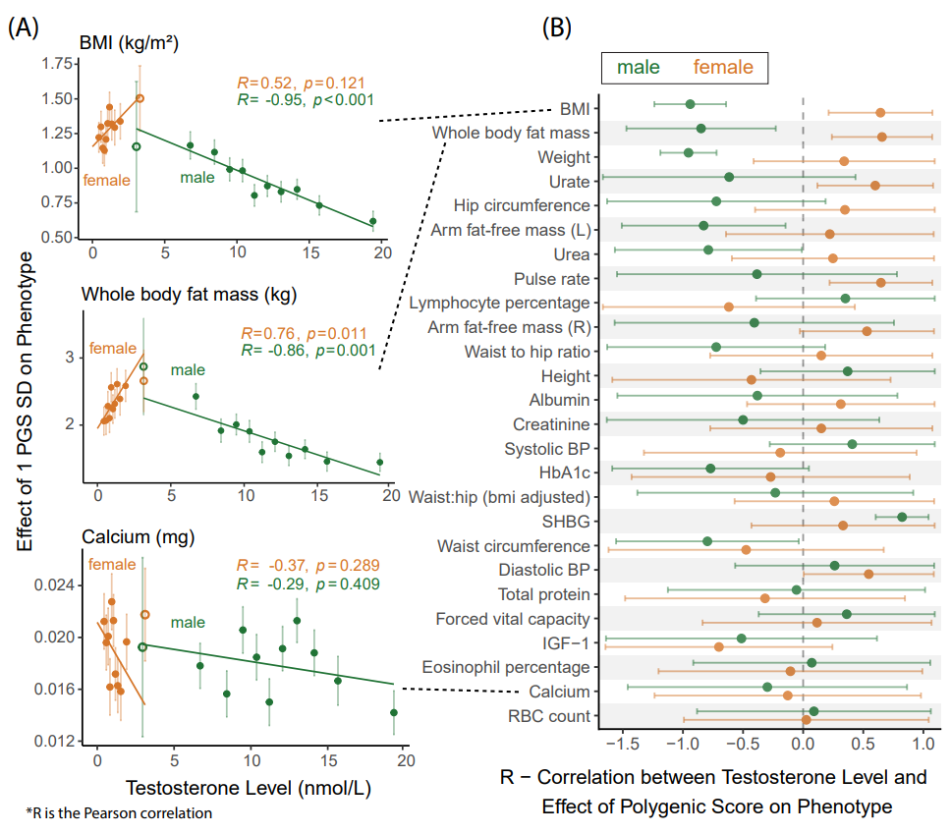
Appendix: Amplification of total genetic effect in relation to testosterone levels

Slide 21
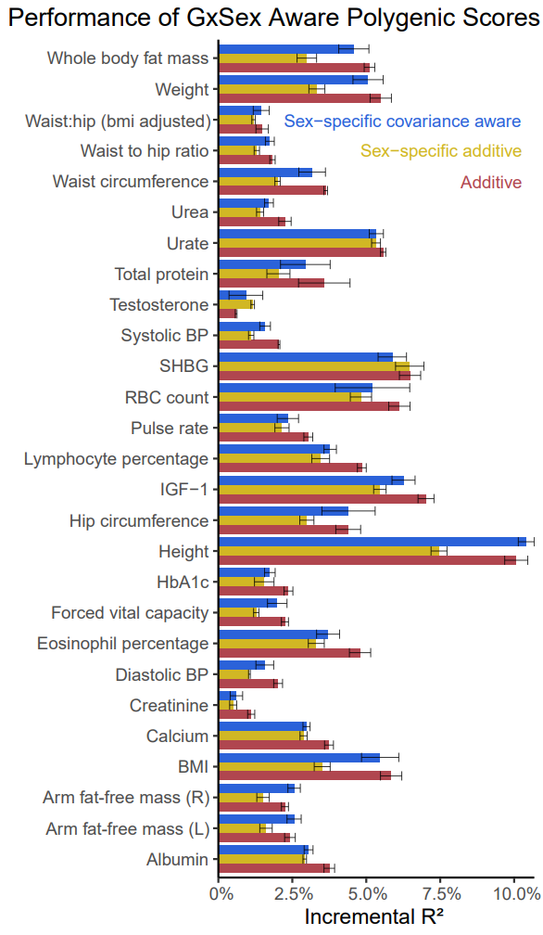
Appendix: Performance of GxSex aware polygenic scores

