Slide 1
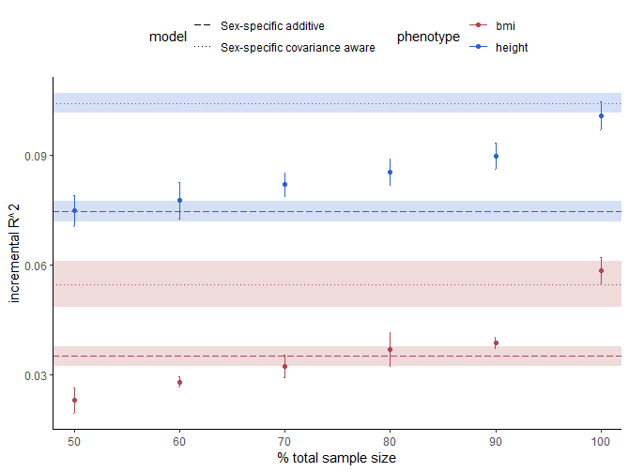

Slide 2
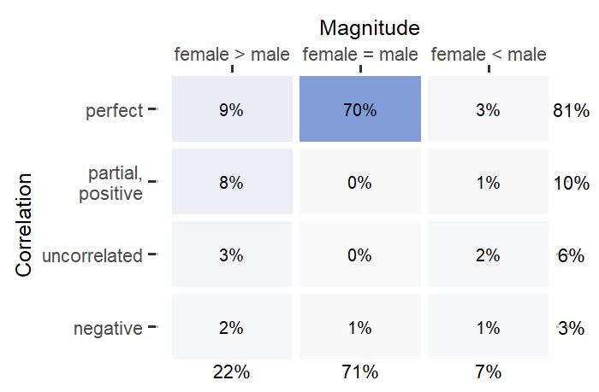
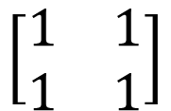
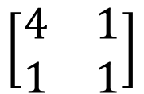
female male
$$\left[\begin{matrix}1 & 1 \\ 1 & 1\end{matrix}\right]$$
female
male
84%
$$\left[\begin{matrix}4 & 1 \\ 1 & 1\end{matrix}\right]$$
16%

Slide 3
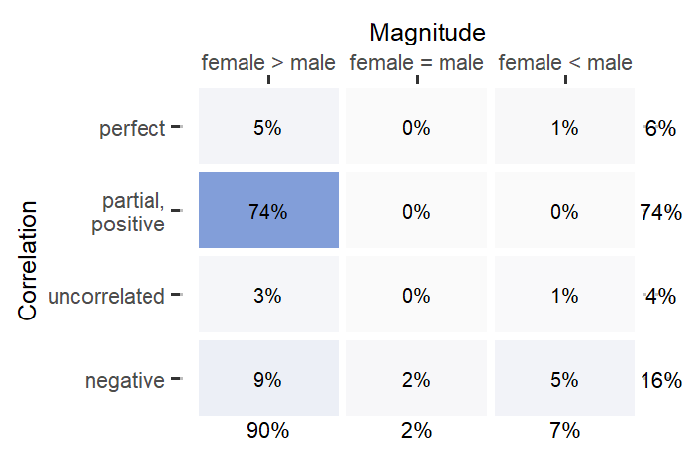
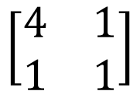
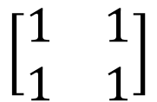
female male
$$\left[\begin{matrix}1 & 1 \\ 1 & 1\end{matrix}\right]$$
female
male
84%
$$\left[\begin{matrix}4 & 1 \\ 1 & 1\end{matrix}\right]$$
16%
Using two-tailed Student’s t-test
threshold: p < 1e-8 resulting sample size: ~120

Slide 4
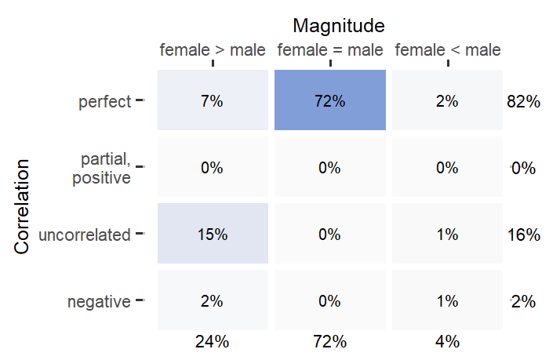

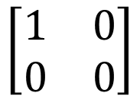
female male
$$\left[\begin{matrix}1 & 1 \\ 1 & 1\end{matrix}\right]$$
female
male
84%
$$\left[\begin{matrix}1 & 0 \\ 0 & 0\end{matrix}\right]$$
16%

Slide 5
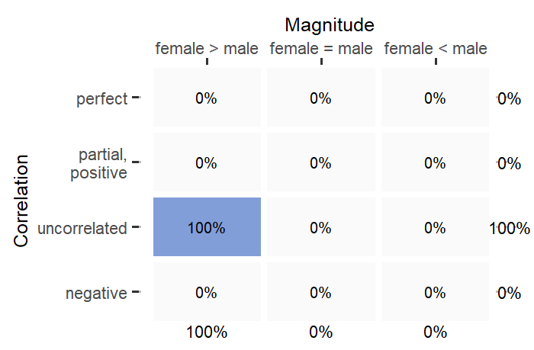

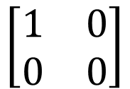
female male
$$\left[\begin{matrix}1 & 1 \\ 1 & 1\end{matrix}\right]$$
female
male
84%
$$\left[\begin{matrix}1 & 0 \\ 0 & 0\end{matrix}\right]$$
16%
Using two-tailed Student’s t-test
threshold: p < 1e-8 resulting sample size: ~80

