Slide 1
Entity - Relationship Model

Slide 2

Review
An entity is a collection of objects with the same properties:
Students (student name, student id, age, sex, etc. )
Courses (course id, section id, course description, location, etc..)
A primary key is an attribute whose value is unique in each instance:
Student id in the students entity
A relationship is an association among entities:
Students take courses (take is a relationship)
Cardinalities describe the number of instances that participate in a relationship
Notes:
Last time we discussed ER diagrams.

Slide 3
Outline
Step-by-step procedure for converting narrative data into Entity-Relationship Diagram
Application of the procedure for designing a DB for water-utility company
Common problems with ER Design

Slide 4
Steps of Narrative problem analysis
The procedure for analysis:
Identify entities and attributes
Determine primary keys
Identify relationships
Determine relationship cardinalities
Refine the ERD

Slide 5
Example: Water-Utility Database
Customer database for a municipal water utility
Business Narrative:
Customer has number, name, billing address, type, applicable rate, collection of meters.
Available meter data is number, address, size, model.
Employee periodically reads each meter. Reading has meter reading number, timestamp, consumption level, and employee number.
Bills are based on most recent meter readings and applicable rates.
Rate has rate number, description, fixed and variable dollar amounts, consumption threshold.

Slide 6

Step 1: Identify Entities and Attributes
For entities, find nouns that describe people, places, things, and events
For attributes, look for details about the entities
Difficult decision: Attributes vs. Entities
Simplicity principal: consider as an attribute unless other details are presented.
Example from the IMDB database: Should we include director in the Movie table? Or in a separate table?
OR
Notes:
For example, which one of the two should we choose?

Slide 7
Step 2: Determine primary keys
Stable: never change after assigned
Good choice: automatically generated values
StudentId, CourseId
Notes:
SSN: immigrants (outside US) don’t have one. PPl lose it . PPl don’t want to share their SSN.

Slide 8
Water utility DB: Entities & attributes
Customer has number, name, billing address, type, applicable rate, collection of meters.
Available meter data is number, address, size, model.
Employee periodically reads each meter. Reading has meter reading number, timestamp, consumption level, and employee number.
Bills are based on most recent meter readings and applicable rates.
Rate has rate number, description, fixed and variable dollar amounts, consumption threshold.

Slide 9
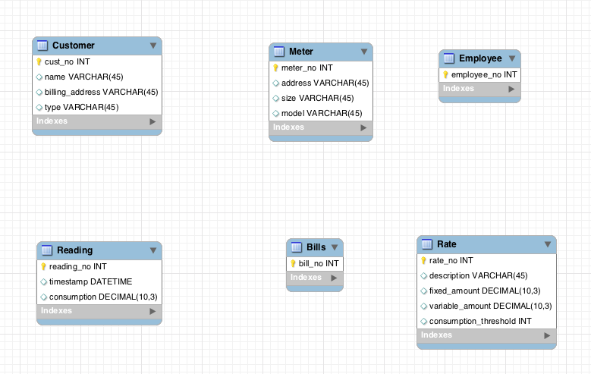
Entities & Attributes

Slide 10
Step 3: Identify Relationships
Identify relationships connecting previously identified entity types
Relationships = associations among nouns representing entity types

Slide 11
Step 4: Determine Cardinalities
Identify maximum cardinalities and minimum cardinalities
Identify missing specifications

Slide 12
Identify Relationships
Customer has number, name, billing address, type, applicable rate, collection of meters.
Available meter data is number, address, size, model.
Employee periodically reads each meter. Reading has meter reading number, timestamp, consumption level, and employee number.
Bills are based on most recent meter readings and applicable rates.
Rate has rate number, description, fixed and variable dollar amounts, consumption threshold.

Slide 13
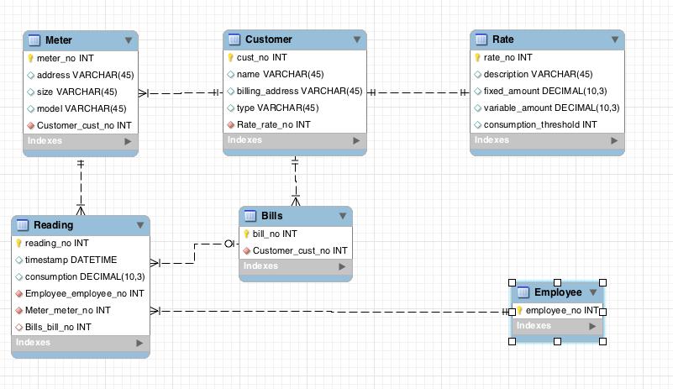
Water Utility: Relationships & Cardinalities

Slide 14
ERD refinements
We constructed initial ERD
However, several refinements can be made
Typical list of refinements:
Attributes -> Entities
Splitting compound attributes

Slide 15
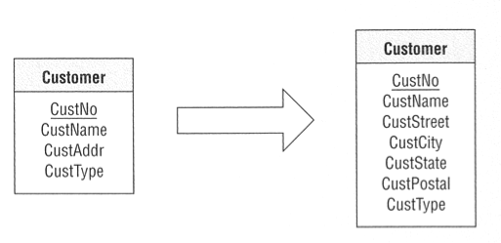
Splitting attributes
Customer Address is a compound attribute. Maybe we need to search by city?

Slide 16
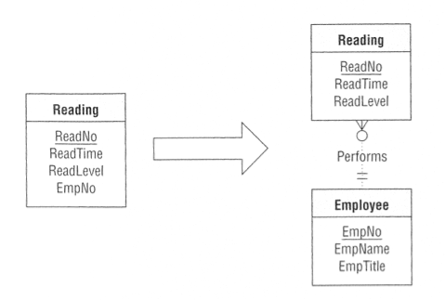
Attributes -> Entities
Readings are done by employees. What if we know something about them (e.g. name, title)?

Slide 17
Add Employee attributes
Name
Address
Age
etc..

Slide 18
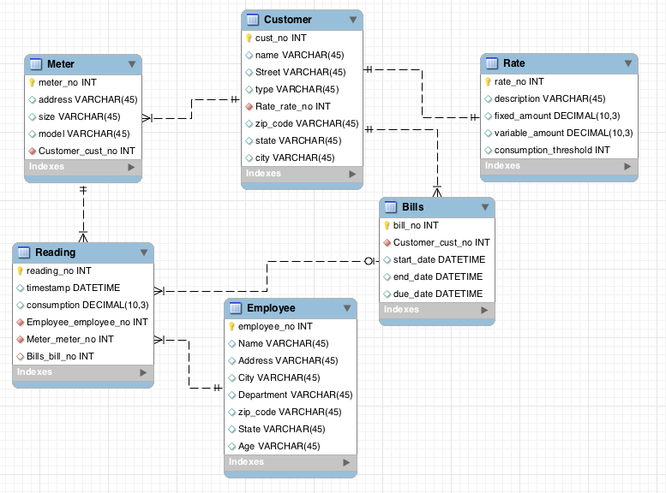
Final ERD

Slide 19
Common Design Errors
Misplaced relationships and missing relationships: examine implications of requirements
Incorrect cardinalities and incomplete requirements: inferences beyond the requirements
Redundant relationships: examine relationship cycles for derived relationships

Slide 20
Database Development process
Problem
(e.g., Manage student registration)
Requirement Analysis
Requirement Specification
Natural
Language
Conceptual Data Modeling
Conceptual
Model (ERD)
Diagrams
Logical Design
Relational
Model
Formal
Statements
Physical Design
Database
Notes:
So last time, we spoke about ER design. Remember we were talking about entities, which describe places, persons or events, relationships that describe associations between entities, primary keys which uniquely describe instances in entities and cardinalities, which capture how many instances from an entity are associated with how many entities from the other entity. Recall this diagram….Today we will discuss how we can transform the ER diagrams, to a real database. We will call these databases relational databases, because they describe relations between data.

Slide 21
Relational Model
35 years old
Foundation of DBMs
Spawned a multi-billion dollar industry
Used by all commercial database systems
Very Simple
Query with high-level languages
Efficient implementations

Slide 22
ER Diagram → Relational Model
Step 0: Identify:
Entities
Relationships (many-to-many, one-to-many, one-to-one)
Special attributes (primary key)
Step 1: Entities
Step 2: Many-to-many relationships
Step 3: One-to-many relationships
Step 4: One-to-one relationships

Slide 23
Example - Water Utility

Slide 24
Step 0
Entities
Relationships
Primary Keys

Slide 25
Entities map to Tables
Each entity maps to a table
Each attribute maps to a column in the table
The primary key of the entity maps to the primary key of the table
Primary keys are underlined

Slide 26
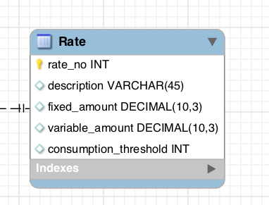
Step 1: Water Utility Entities
Rate
Customer
Meter
Reading
Employee
Bill
Rate
Rate_no | Description | Fixed amount | Variable amount | Consumption Threshold
R1278 | Rate descr 1 | 40 | 10 | 0.7
R982 | Rate descr 3 | 70 | 20 | 0.7
R1908 | Rate descr 7 | 120 | Null | Null

Slide 27
Step 2: Many to many relationships
Each Many-to-Many relationship becomes a separate table (bridge table)
The primary key of the bridge table is the combination of the primary keys of the entity types participating in the relationship
Each of the primary keys stored in the bridge table is a foreign key, pointing to the original entity table

Slide 28
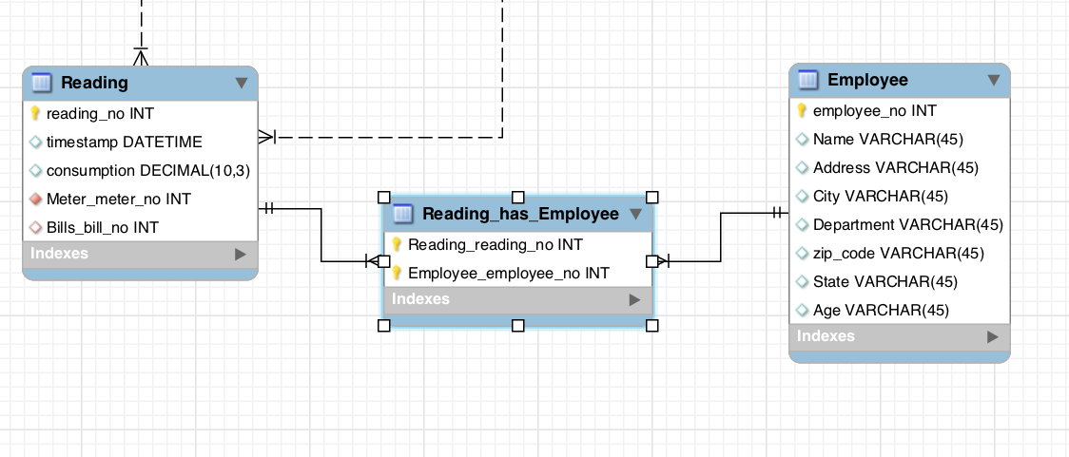
Step 2: Example
Lets assume that a reading can be done by many employees
Reading No | Employee No
Reading No | Timestamp | …
Employee No | Name | …

Slide 29
Step 3: One to many relationships
For each One-to-Many relationship
DO NOT need to introduce a separate table
Add a foreign key (FK)
to the table corresponding to the “many” entity

Slide 30
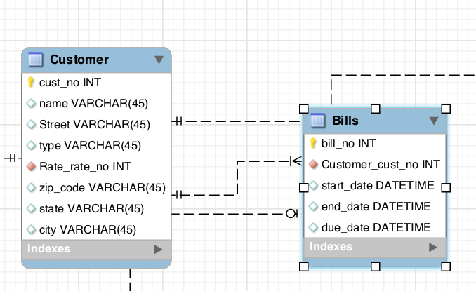
Step 3: Example
Foreign Key

Slide 31
Step 4: One to one Relationships
We treat One-to-One relationship similarly as we treat One-to-Many relationship
2 options! We may add a Foreign Key to either table

Slide 32
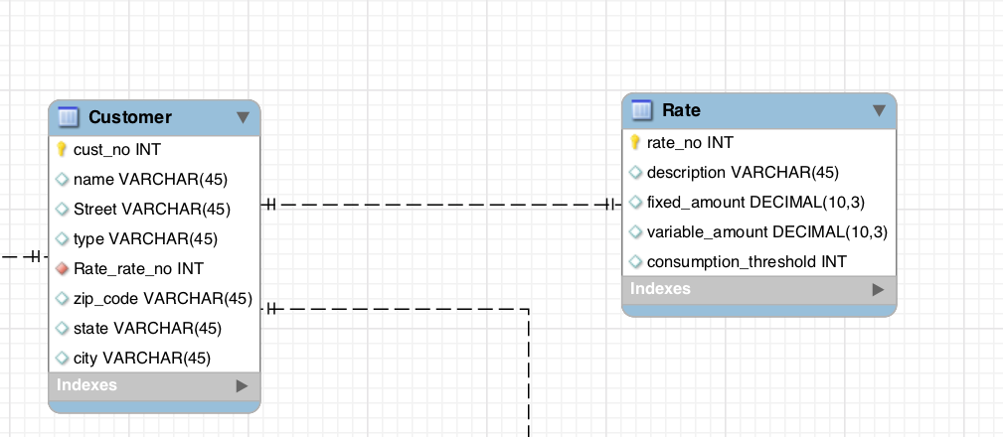
Step 4: Example
Foreign Key

Slide 33
Final Results
Meter (meter_no, address, size, model, cust_no)
Customer (cust_no, name, street, type, rate_no, zip_code, state, city)
Rate (rate_no, description, fixed_amount, variable_amount, consumption_threshold)
Reading (reading_no,timestamp,consumption, meter_no, bill_no)
Reading_has_Employee (reading_no, employee_no)
Employee (employee_no, name, address, city, dept, zip_code, state, age)
Bills (bill_no, cust_no, start_date, end_date, due_date)

Slide 34
In practice
MySQL Workbench many of these steps for you:
Create the ER diagram
Go to Database -> Forward Egineer -> Follow the instructions
Your database schema is (almost) ready!
Often, you need to fine-tune the output based on what we learned

Slide 35
Simple examples (in class)
A painter can paint many paintings; each painting is painted by one painter. A gallery can have many paintings. A painting can be exhibited by a gallery.
An employee can learn many skills; each skill can be learned by many employees. There are 5 different levels of expertise(L1.. L5).

Slide 36
Complex example (in class)
NoFuture Records has decided to store information about musicians who perform on its albums (as well as other company data) in a database.
Each musician that records at NoFuture has an SSN, a name, an address, and a phone number. Poorly paid musicians often share the same address, and no address has more than one phone.
Each instrument used in songs recorded at NoFuture has a unique identification number, a name (e.g., guitar, synthesizer, ﬂute) and a musical key (e.g., C, B-ﬂat, E-ﬂat).
Each album recorded on the NoFuture label has a unique identification number, a title, a copyright date, a format, and an album identifier.
Each song recorded at NoFuture has a title and an author.
Each musician may play several instruments, and a given instrument may be played by several musicians.
Each album has a number of songs on it, but no song may appear on more than one album.
Each song is performed by one or more musicians, and a musician may perform a number of songs.
Each album has exactly one musician who acts as its producer. A musician may produce several albums.

Slide 37
Summary of ER modeling
ER model is popular for conceptual design
Constructs are expressive, intuitive and graphical.
Basic constructs: entity types, relationships (cardinalities), and attributes
ER modeling is subjective!
There are often many ways to model a given scenario!
Analyzing alternatives is key
ER modeling is iterative!
Resulting diagram should be analyzed and refined further.

