Slide 1
RAPIDESIGN
POWERFUL
CREATIVE
PRETTY
LOGICAL
POWERPOINT
上海锐普广告有限公司
Shanghai Rapidesign Advertising Co.,ltd
适用于各行业工作汇报、总结、展示及相关类别演示
READ MORE

Slide 2
RAPIDESIGN
POWERFUL
CREATIVE
PRETTY
LOGICAL
设计理念
Design Concept
此模板适用于商务汇报、总结、展示及相关类别演示，扁平化风格，颜色清新舒适，版式简洁明了，内页延续封面，使整个PPT统一一致。
模板内颜色可以替换为自己的颜色，图片也可以替换为自己的图片。图表以简单实用、易修改为设计原则，从配色到版式都精益求精，满足您不同场合的需要。字体已经嵌入，请放心使用，祝您成功!

Slide 3
RAPIDESIGN
POWERFUL
CREATIVE
PRETTY
LOGICAL
目录
Contents
1.点击添加标题
Add a title
2.点击添加标题
Add a title
3.点击添加标题
Add a title
4.点击添加标题
Add a title
5.点击添加标题
Add a title

Slide 4
RAPIDESIGN
POWERFUL
CREATIVE
PRETTY
LOGICAL
目录
Contents
1.点击添加标题
Add a title
2.点击添加标题
Add a title
3.点击添加标题
Add a title
4.点击添加标题
Add a title
5.点击添加标题
Add a title

Slide 5
1.点击添加标题
Add a title
点击添加内容
点击添加内容
点击添加内容
上海锐普广告有限公司是中国第一家精品PPT设计机构。拥有国内顶尖的PPT制作技术、顶级的PPT设计团队，坚持精益求精、拒绝平庸的做事精神，帮助您实现美观、精致、严谨、动感的PPT展示效果，让您的PPT创造卓越价值
点击添加标题
5years of making professional PPT, 500 case studies for the classical PPT, make sure you will be satisfied. ……RAPIDPPT differs from the traditional production model, and create a new PPT experience.

Slide 6
1.点击添加标题
Add a title
65%
添加标题
35%
添加标题
89%
添加标题
上海锐普广告有限公司是中国第一家精品PPT设计机构
RAPIDPPT differs from the traditional production model, and create a new PPT experience.

Slide 7
1.点击添加标题
Add a title
上海锐普广告有限公司是中国第一家精品PPT设计机构。拥有国内顶尖的PPT制作技术、顶级的PPT设计团队，坚持精益求精、拒绝平庸的做事精神，帮助您实现美观、精致、严谨、动感的PPT展示效果，让您的PPT创造卓越价值
RAPIDPPT, the leader of professional PPT designer in China.
5years of making professional PPT, 500 case studies for the classical PPT, make sure you will be satisfied. ……RAPIDPPT differs from the traditional production model, and create a new PPT experience.

Slide 8
1.点击添加标题
Add a title
1
1
1
1
2
3
点击添加标题
点击添加标题
点击添加标题
上海锐普广告有限公司是中国第一家精品PPT设计机构。拥有国内顶尖的PPT制作技术、顶级的PPT设计团队，坚持精益求精
上海锐普广告有限公司是中国第一家精品PPT设计机构。拥有国内顶尖的PPT制作技术、顶级的PPT设计团队，坚持精益求精
上海锐普广告有限公司是中国第一家精品PPT设计机构。拥有国内顶尖的PPT制作技术、顶级的PPT设计团队，坚持精益求精

Slide 9



1.点击添加标题
Add a title
1
1
1
1
2
3
添加标题
添加标题
添加标题
拥有国内顶尖的PPT制作技术、顶级的PPT设计团队，坚持精益求精
拥有国内顶尖的PPT制作技术、顶级的PPT设计团队，坚持精益求精
拥有国内顶尖的PPT制作技术、顶级的PPT设计团队，坚持精益求精

Slide 10
RAPIDESIGN
POWERFUL
CREATIVE
PRETTY
LOGICAL
目录
Contents
1.点击添加标题
Add a title
2.点击添加标题
Add a title
3.点击添加标题
Add a title
4.点击添加标题
Add a title
5.点击添加标题
Add a title

Slide 11
2.点击添加标题
Add a title
上海锐普广告有限公司是中国第一家精品PPT设计机构。拥有国内顶尖的PPT制作技术、顶级的PPT设计团队，坚持精益求精、拒绝平庸的做事精神，帮助您实现美观、精致、严谨、动感的PPT展示效果，让您的PPT创造卓越价值
RAPIDPPT, the leader of professional PPT designer in China.
5years of making professional PPT, 500 case studies for the classical PPT, make sure you will be satisfied. ……RAPIDPPT differs from the traditional production model, and create a new PPT experience.
点击添加内容
点击添加内容
点击添加内容
点击添加内容
Add a content
Add a content
Add a content
Add a content

Slide 12
2.点击添加标题
Add a title
点击添加内容
点击添加标题
拥有国内顶尖的PPT制作技术、顶级的PPT设计团队， 坚持精益求精
点击添加内容
点击添加标题
点击添加内容
Add a title
5years of making professional PPT, 500 case studies for the classical PPT, make sure you will be satisfied.
点击添加内容

Slide 13

2.点击添加标题
Add a title
添加标题 Add a title
RAPIDPPT, the leader of professional PPT designer in China.
5years of making professional PPT, 500 case studies for the classical PPT, make sure you will be satisfied. ……RAPIDPPT differs from the traditional production model, and create a new PPT experience.
www.rapidppt.com

Slide 14
2.点击添加标题
Add a title
点击添加内容
上海锐普广告有限公司是中国第一家精品PPT设计机构。拥有国内顶尖的PPT制作技术、顶级的PPT设计团队，坚持精益求精、拒绝平庸的做事精神，帮助您实现美观、精致、严谨、动感的PPT展示效果，让您的PPT创造卓越价值
点击添加内容
5years of making professional PPT, 500 case studies for the classical PPT, make sure you will be satisfied. ……RAPIDPPT differs from the traditional production model, and create a new PPT experience.
?
点击添加内容

Slide 15
RAPIDESIGN
POWERFUL
CREATIVE
PRETTY
LOGICAL
目录
Contents
1.点击添加标题
Add a title
2.点击添加标题
Add a title
3.点击添加标题
Add a title
4.点击添加标题
Add a title
5.点击添加标题
Add a title

Slide 16
3.点击添加标题
Add a title
点击添加标题
Add a title
上海锐普广告有限公司是中国第一家精品PPT设计机构。拥有国内顶尖的PPT制作技术、顶级的PPT设计团队，坚持精益求精、拒绝平庸的做事精神，帮助您实现美观、精致、严谨、动感的PPT展示效果，让您的PPT创造卓越价值
RAPIDPPT, the leader of professional PPT designer in China.
5years of making professional PPT, 500 case studies for the classical PPT, make sure you will be satisfied.
RAPIDPPT differs from the traditional production model, and create a new PPT experience.

Slide 17




3.点击添加标题
Add a title
上海锐普广告有限公司是中国第一家精品PPT设计机构。拥有国内顶尖的PPT制作技术、顶级的PPT设计团队，坚持精益求精、拒绝平庸的做事精神，帮助您实现美观、精致、严谨、动感的PPT展示效果，让您的PPT创造卓越价值
RAPIDPPT, the leader of professional PPT designer in China.
5years of making professional PPT, 500 case studies for the classical PPT, make sure you will be satisfied.
RAPIDPPT differs from the traditional production model, and create a new PPT experience.

Slide 18
3.点击添加标题
Add a title
点击添加标题
拥有国内顶尖的PPT制作技术、顶级的PPT设计团队，坚持精益求精、拒绝平庸的做事精神，帮助您实现美观、精致、严谨、动感的PPT展示效果，让您的PPT创造卓越价值
点击添加标题
点击添加标题
Add a title
500 case studies for the classical PPT, make sure you will be satisfied. ……RAPIDPPT differs from the traditional production model, and create a new PPT experience.
点击添加标题
点击添加标题

Slide 19
3.点击添加标题
Add a title

Slide 20
RAPIDESIGN
POWERFUL
CREATIVE
PRETTY
LOGICAL
目录
Contents
1.点击添加标题
Add a title
2.点击添加标题
Add a title
3.点击添加标题
Add a title
4.点击添加标题
Add a title
5.点击添加标题
Add a title

Slide 21
4.点击添加标题
Add a title
点击添加标题
Add a title
添加标题
添加标题
添加标题
添加标题
Add content
Add content
添加内容
添加内容
添加内容
Add content
添加内容
Add content
拥有国内顶尖的PPT制作技术、顶级的PPT设计团队，坚持精益求精、拒绝平庸的做事精神，帮助您实现美观、精致、严谨、动感的PPT展示效果，让您的PPT创造卓越价值
5years of making professional PPT, 500 case studies for the classical PPT, make sure you will be satisfied. ……RAPIDPPT differs from the traditional production model, and create a new PPT experience.

Slide 22
4.点击添加标题
Add a title
1.点击添加标题
Add a title
拥有国内顶尖的PPT制作技术、顶级的PPT设计团队，坚持精益求精
1
RAPIDPPT differs from the traditional production model, and create a new PPT experience.
2
2.点击添加标题
Add a title
拥有国内顶尖的PPT制作技术、顶级的PPT设计团队，坚持精益求精
RAPIDPPT differs from the traditional production model, and create a new PPT experience.

Slide 23

4.点击添加标题
Add a title
Add a title
RAPIDPPT, the leader of professional PPT designer in China.
5years of making professional PPT, 500 case studies for the classical PPT, make sure you will be satisfied. ……RAPIDPPT differs from the traditional production model, and create a new PPT experience.
点击添加标题
上海锐普广告有限公司是中国第一家精品PPT设计机构。拥有国内顶尖的PPT制作技术、顶级的PPT设计团队，坚持精益求精、拒绝平庸的做事精神，帮助您实现美观、精致、严谨、动感的PPT展示效果，让您的PPT创造卓越价值
www.rapidppt.com

Slide 24
4.点击添加标题
Add a title
添加标题
Add a title
添加内容
添加内容
添加内容
添加内容
拥有国内顶尖的PPT制作技术、顶级的PPT设计团队， 坚持精益求精
拥有国内顶尖的PPT制作技术、顶级的PPT设计团队， 坚持精益求精
RAPIDPPT differs from the traditional production model, and create a new PPT experience.
RAPIDPPT differs from the traditional production model, and create a new PPT experience.
拥有国内顶尖的PPT制作技术、顶级的PPT设计团队， 坚持精益求精
拥有国内顶尖的PPT制作技术、顶级的PPT设计团队， 坚持精益求精
RAPIDPPT differs from the traditional production model, and create a new PPT experience.
RAPIDPPT differs from the traditional production model, and create a new PPT experience.

Slide 25
RAPIDESIGN
POWERFUL
CREATIVE
PRETTY
LOGICAL
目录
Contents
1.点击添加标题
Add a title
2.点击添加标题
Add a title
3.点击添加标题
Add a title
4.点击添加标题
Add a title
5.点击添加标题
Add a title

Slide 26

5.点击添加标题
Add a title
1.拥有国内顶尖的PPT制作技术、顶级的PPT设计团队，坚持精益求精、拒绝平庸的做事精神
2.帮助您实现美观、精致、严谨、动感的PPT展示效果，让您的PPT创造卓越价值
1.RAPIDPPT differs from the traditional production model, and create a new PPT experience.
2.RAPIDPPT differs from the traditional production model, and create a new PPT experience.

Slide 27
5.点击添加标题
Add a title
01
拥有国内顶尖的PPT制作技术、顶级的PPT设计团队，坚持精益求精、拒绝平庸的做事精神，帮助您实现美观、精致、严谨、动感的PPT展示效果，让您的PPT创造卓越价值
02
拥有国内顶尖的PPT制作技术、顶级的PPT设计团队，坚持精益求精、拒绝平庸的做事精神，帮助您实现美观、精致、严谨、动感的PPT展示效果，让您的PPT创造卓越价值
03
拥有国内顶尖的PPT制作技术、顶级的PPT设计团队，坚持精益求精、拒绝平庸的做事精神，帮助您实现美观、精致、严谨、动感的PPT展示效果，让您的PPT创造卓越价值

Slide 28

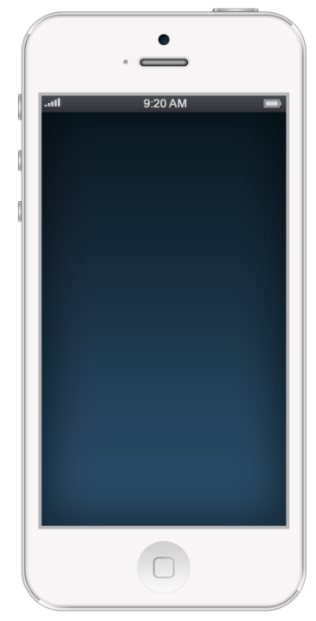
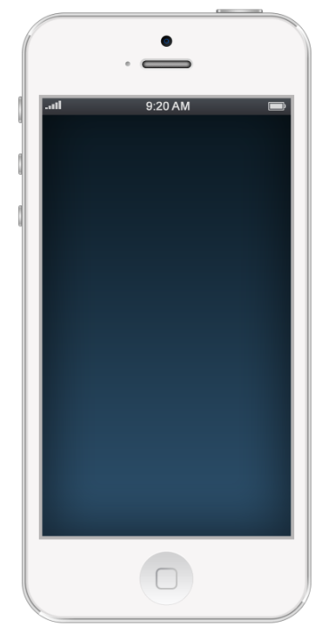


5.点击添加标题
Add a title
添加标题
Add a title
拥有国内顶尖的PPT制作技术、顶级的PPT设计团队，坚持精益求精
5years of making professional PPT, 500 case studies for the classical PPT.

Slide 29
RAPIDESIGN
POWERFUL
CREATIVE
PRETTY
LOGICAL
THANKYOU
谢谢观看

