Slide 1
HMM
Inference

Slide 2
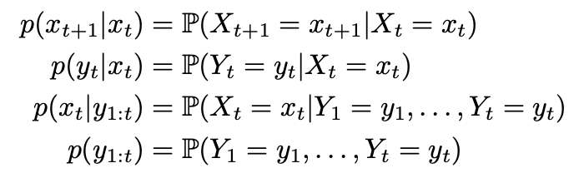
Notation
We will use the following notations:

Slide 3
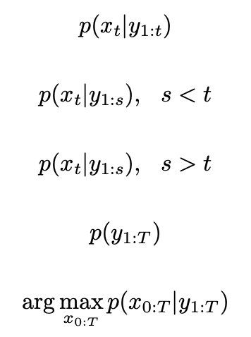
Inference problems
Filtering:
Given measurements up to time t, compute the distribution of Xt.
Prediction:
Given measurements up to time s, compute the distribution of Xt, s<t
Smoothing
Given measurements up to time s, compute the distribution of Xt, s>t
Likelihood
Find the likelihood of Y given the model
Decoding
Find the most likely state history X given the observation history Y

Slide 4
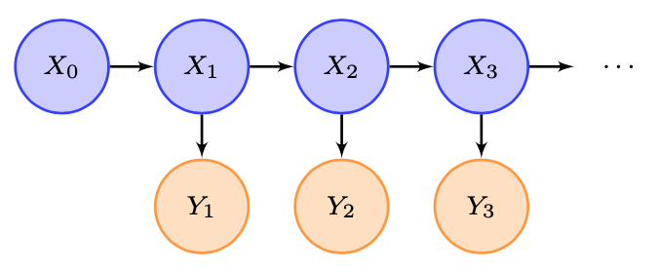
Filtering
Given measurements up to time t, compute the distribution of Xt
E.g. t=2

Slide 5
Prediction
Given measurements up to time s, compute the distribution of Xt, s<t
E.g. s=2
t=3

Slide 6
Smoothing
Given measurements up to time s, compute the distribution of Xt, s>t
E.g. s=2
t=1

Slide 7
Likelihood
Find the likelihood of Y given the model

Slide 8
Decoding
Find the most likely state history X given the observation history Y

Slide 9
Intuition

Slide 10
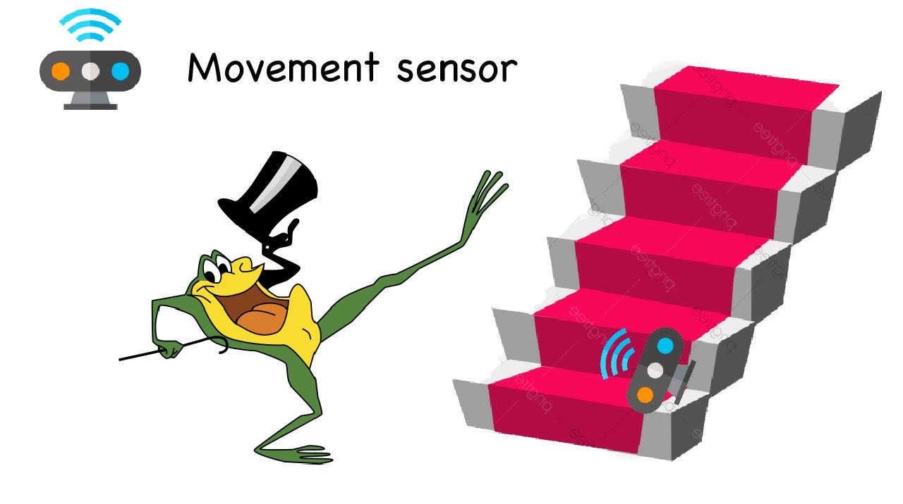
A dancing frog

Slide 11
Prior distribution
Where is the frog at the beginning?
1 | 2 | 3 | 4 | 5 | 6
1/6 | 1/6 | 1/6 | 1/6 | 1/6 | 1/6

Slide 12
Transition probabilities (Matrix A)
Where can the frog jump?
Level to
 | 1 | 2 | 3 | 4 | 5 | 6
1 | 0.4 | 0.6
2 | 0.3 | 0.4 | 0.6
3 |  | 0.3 | 0.4 | 0.6
4 |  |  | 0.3 | 0.4 | 0.6
5 |  |  |  | 0.3 | 0.4 | 0.6
6 | 0.6 |  |  |  | 0.3 | 0.4
Level from

Slide 13
Emission probabilities (Matrix B)
What is the probability to detect the frog?
 | Detection | No detection
1 | 0.9 | 0.1
2 | 0.5 | 0.5
3 | 0.1 | 0.9
4 | 0 | 1
5 | 0 | 1
6 | 0 | 1

Slide 14
Observations
After 14 times, this are the sensor’s results:
1 | 2 | 3 | 4 | 5 | 6 | 7 | 8 | 9 | 10 | 11 | 12 | 13 | 14
0 | 0 | 0 | 0 | 1 | 1 | 0 | 0 | 0 | 0 | 1 | 1 | 0 | 1

Slide 15

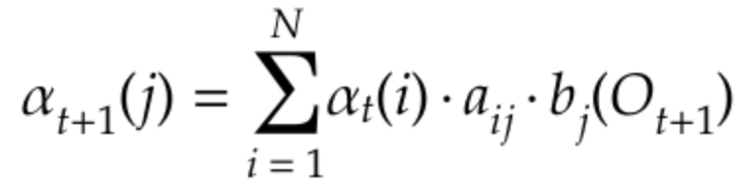
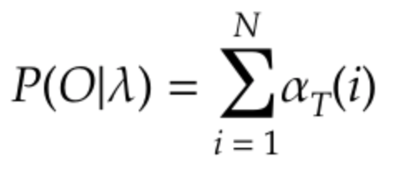
Using filtering algorithm
Inizialization
Recursion
Termination

Slide 16
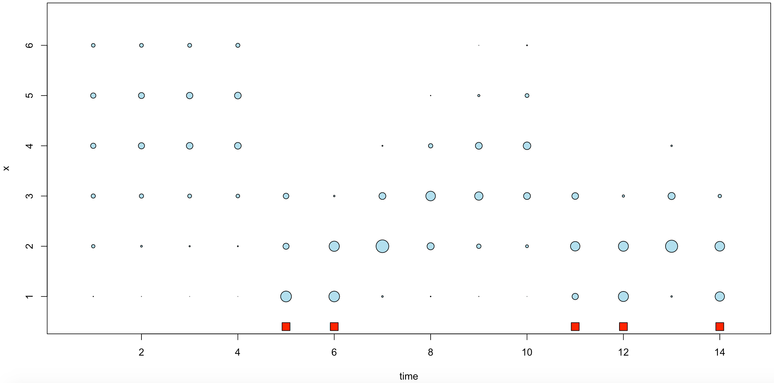
Distribution of X (filtering)

Slide 17
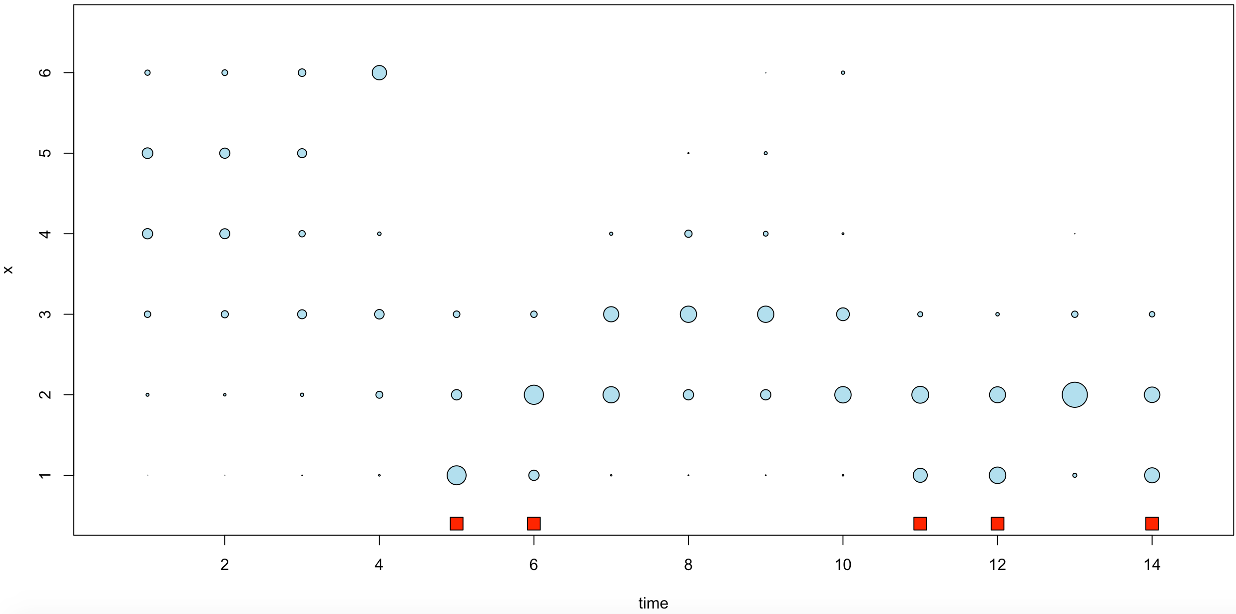
Distribution of X (smoothing)

Slide 18
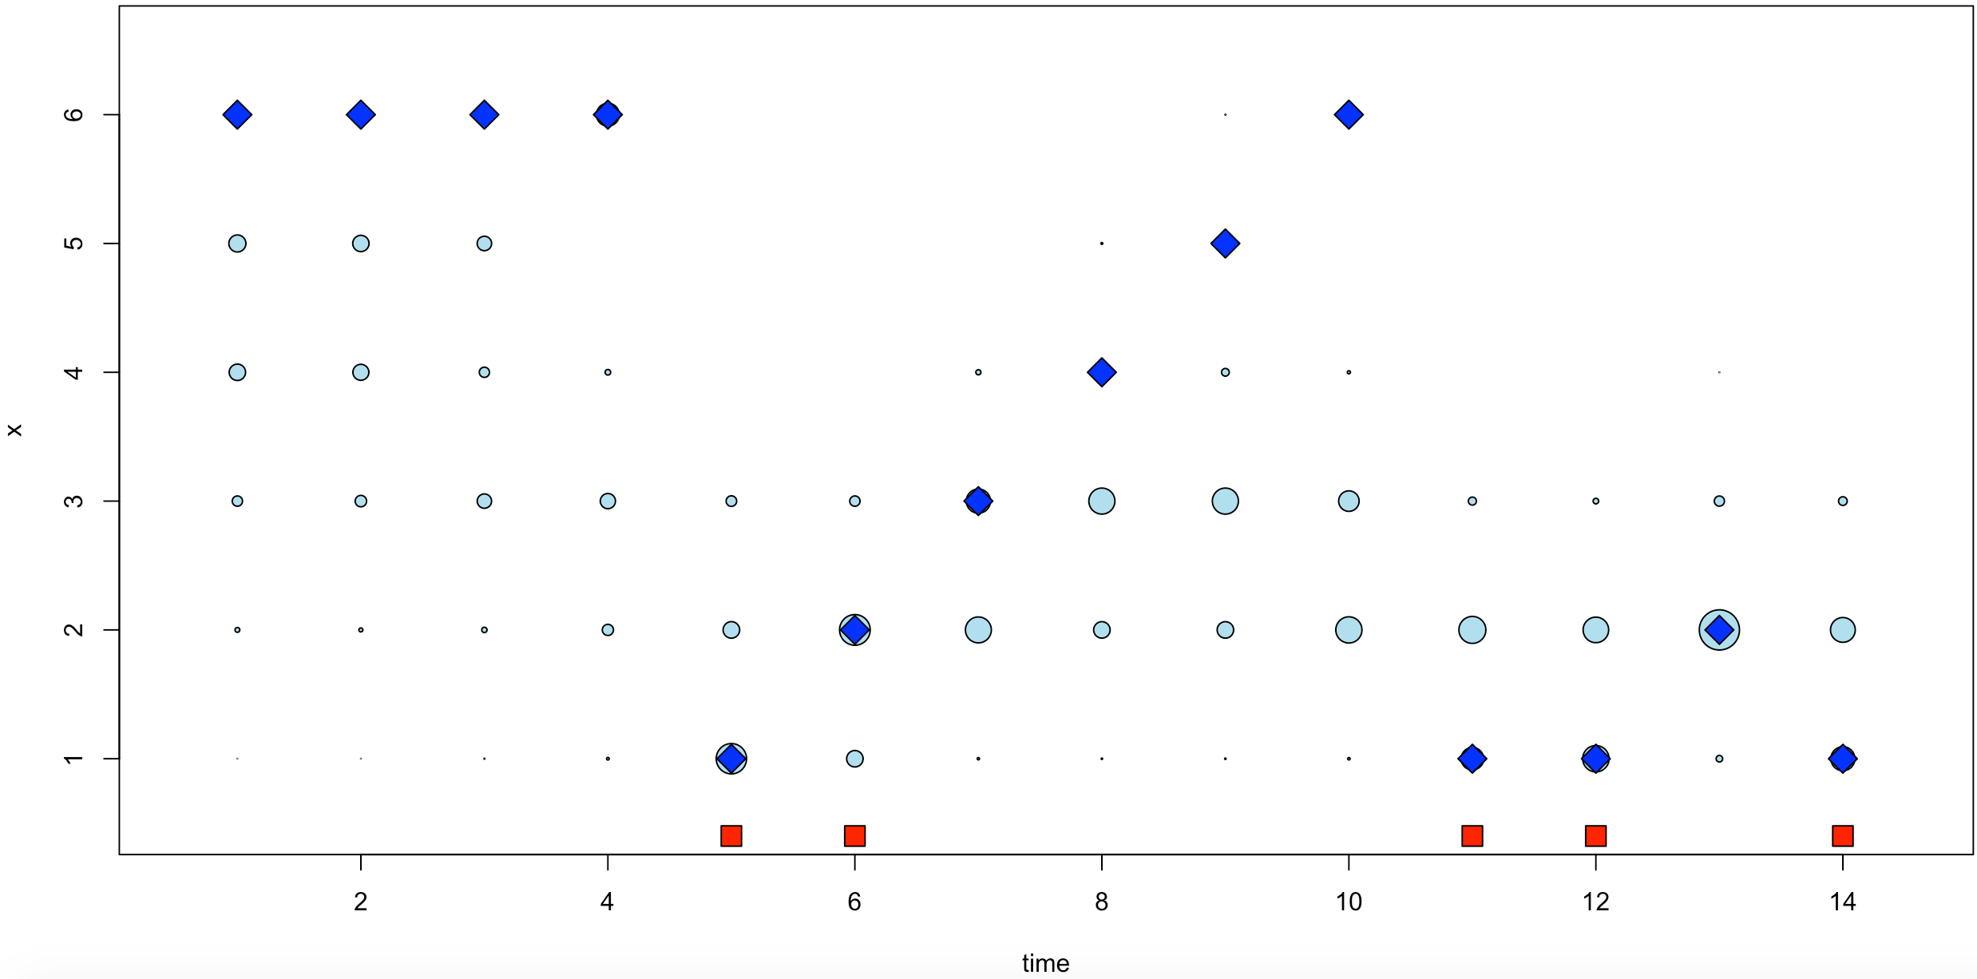
Decoding of X

Slide 19
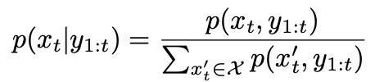
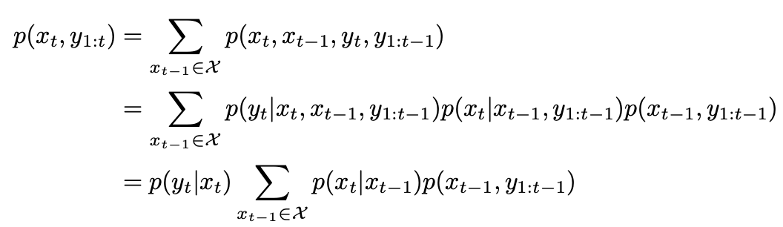


Formal Filtering
We are interested in the conditional probability mass function p(x_{t}|y_{1:t}) of the state X_{t} given the data observed up to time t
We will derive a recursion for
We can define the alpha recursion as:
with:

Slide 20

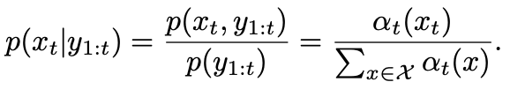
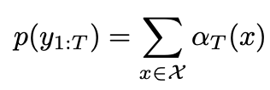
Formal Filtering and likelihood
So, we compute a filtering using:
For t = 1, . . . , T , x_{t} ∈ X:
The filtering pmf is obtained by normalizing as:
The likelihood term p(y1:T ) can be computed from the α-recursion

Slide 21
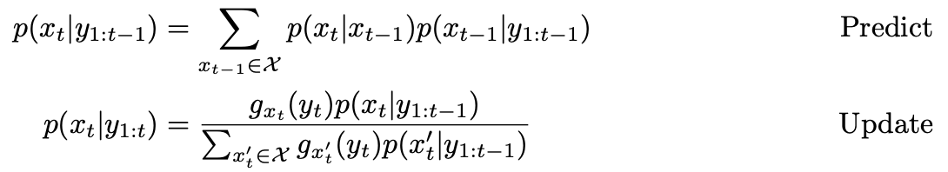
Considerations in Filtering
The computation cost of the whole forward recursion is O(T|X |²)
The proposed recursion may suffer from numerical underflow/overflow, as αt may become very small or very large for large t.
To avoid this, we can normalize αt, or propagate the filtering pmf p(xt|y1:t) instead of αt, using the following two-step predict-update recursion

