Slide 1
Hidden Markov Chains
Marco Julio, Nicol´as, Sebasti´an and C´esar
October 30, 2019
Marco Julio, Nicol´as, Sebasti´an and C´esar
(IT
Hidden Markov Chains
October 30, 2019
<número> / 31

Slide 2





Index
Smoothing
Likelihood
3
Most likely state path/Decoding
4
Continuous-state Hidden Markov Models
5
An example for LGSSM
6
An example for LGSSM
Marco Julio, Nicol´as, Sebasti´an and C´esar
(IT
Hidden Markov Chains
October 30, 2019
<número> / 31

Slide 3
Smoothing
General problem of smoothing:
Given: observations up to time s (i.e. y_{1:s} known),
Problem: compute p(x_{t} |y_{1:s} ) distribution of X_{t} , for t < s.
A particular case is when we know all history of observations:
Smoothing with all history of observations
Given: observations up to time T (i.e. y_{1:T} known),
Problem: compute p(x_{t} |y_{1:T} ) distribution of X_{t} , for t < T .
This case can be solved using a recursive algorithm Forward-backward Smoothing.
Marco Julio, Nicol´as, Sebasti´an and C´esar
(IT
Hidden Markov Chains
October 30, 2019
<número> / 31

Slide 4
Forward-backward Smoothing I
Ideas:
p(x_{t} |y_{1:T} ) can be split as:
p(x_{t}, y_{1:t} ) · p(y_{t+1:T} |x_{t} )
) =
p(x |y
t 1:T
p(y_{1:T} )
p(y_{1:T} ) is a normalization constant (calculation explained in next section).
Algorithm 1 Forward α-recursion can estimate α_{t} (x_{t} ) = p(x_{t}, y_{1:t} ).
We can approach HHM structure to generate a recursion rule for
β_{t} (x_{t} ) := p(y_{t+1:T} |x_{t} )
Marco Julio, Nicol´as, Sebasti´an and C´esar
(IT
Hidden Markov Chains
October 30, 2019
<número> / 31

Slide 5
Forward-backward Smoothing II
Σ
^{p(y}t+1:T ^{|x}t−1⁾
=
p(y
, x |x )
t+1:T t t−1
xt ∈X
Σ
=
)
^{p(y}t ^{|y}t+1:T ^{, x}t^{, x}t−1^{|x}t−1^{)p(y}t+1:T ^{, x}t ^{|x}t−1
xt ∈X
Σ
=
p(y |x , x )p(y |x )
t t−1 t t+1:T t
xt ∈X
Σ
=
p(y_{t} |x_{t} )p(y_{t+1:T} |x_{t} )p(y_{t} |x_{t−1})
xt ∈X
We have a backward recursion for t = T, . . . , 2
Σ
β (x ) = p(y |x )p(x |x
)β (x ), β (x ) = 1
t−1 t−1 t t t t−1 t t T T
xt ∈X
Marco Julio, Nicol´as, Sebasti´an and C´esar
(IT
Hidden Markov Chains
October 30, 2019
<número> / 31

Slide 6
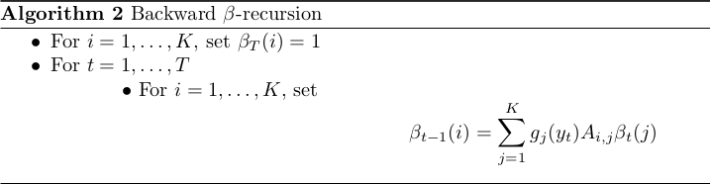
Forward-backward Smoothing III
If X = {1, . . . , K }:
Figure: Backward β-recursion Algorithm
Marco Julio, Nicol´as, Sebasti´an and C´esar
(IT
Hidden Markov Chains
October 30, 2019
<número> / 31

Slide 7
Forward-backward Smoothing III
Backward and Forward Algorithm for smoothing:
Algorithm 1 Forward α-recursion to get α_{t} (x_{t} ) = p(x_{t}, y_{1:t} ). Algorithm 2 Backward β-recursion to get β_{t} (x_{t} ) = p(y_{t+1:T} |x_{t} ). Smoothing probability mass function is estimated as:
p(x_{t}, y_{1:T} ) α_{t} (x_{t} )β_{t} (x_{t} )
p(x_{t} |y_{1:T} ) =
= Σ
p(y )
α (x )β (x )
1:T
xt ∈X
t t t t
Notes: 1) Algorithms 1 y 2 can be run independently, 2) Backward and Forward Algorithm is from order O(T · |X|²)
Marco Julio, Nicol´as, Sebasti´an and C´esar
(IT
Hidden Markov Chains
October 30, 2019
<número> / 31

Slide 8
Likelihood
Given: all observations (i.e. y_{1:T} known),
Problem: compute p(y_{1:T} ) likelihood function of observations.
Ideas:
Notice
Σ
p(y ) = p(x , y ) · p(y
|x )
1:T
t 1:t
t+1:T t
xt ∈X
This implies
Σ
p(y ) = α (x )β (x )
1:T t t t t
xt ∈X
p(y_{1:T} ) can be estimated using algorithm 1 Forward α-recursion and algorithm 2 Backward β-recursion.
Marco Julio, Nicol´as, Sebasti´an and C´esar
(IT
Hidden Markov Chains
October 30, 2019
<número> / 31

Slide 9
Most likely state path/Decoding
Given: history of observations (i.e. y_{1:T} known),
Problem: Find the most likely state history x_{0:T} .
For fixed y_{1:T} , solve MAP problem with conditional distribution:
xˆ₀ = argmax_{x0:T} p(x_{0:T} |y_{1:T} ) Or equivalently with joint distribution:
xˆ₀ = argmax_{x0:T} p(x_{0:T} , y_{1:T} )
Note: unfeasible if number of different state paths |X|^{T +1} is large from optimization point of view!!.
Marco Julio, Nicol´as, Sebasti´an and C´esar
(IT
Hidden Markov Chains
October 30, 2019
<número> / 31

Slide 10

Most likely state path - Viterbi algorithm
However, we can use Viterbi algorithm to do MAP estimation.
Ideas:
Explote structure of HMM do estimations based on backward-forward or forward-backward recursions.
Compute messages from time t to t − 1 (m_{t−1}(x_{t−1}) ← m_{t} (x_{t} )) Use messages to estimate feasible points t − 1 to t (xˆ_{t−1} → xˆ_{t} )
Figure: Scheme of Vitterbi algorithm recursions
Marco Julio, Nicol´as, Sebasti´an and C´esar
(IT
Hidden Markov Chains
October 30, 2019
<número> / 31

Slide 11
What do you mean by messages m_{t} (x_{t} )? Part I
Factorizing p(x_{0:T} , y_{1:T} ):
T
Y
p(x , y
) = p(x ) p(x |x
)p(y |x )
0:T 1:T
0
t t−1 t t
t=1
We can split our optimization problem in different optimization problems:
⇒ max p(x , y ) =
x0:x_{T}
0:T 1:T
.. Σ
Σ
T −1
Y
max p(x₀) p(x_{t} |x_{t−1})p(y_{t} |x_{t} ) max p(x |x
)p(y |x )
x_{T}
T T −1 T T
^{x}0^{:x}T−1
t=1
..
Σ
Σ
T −1
Y
= max p(x₀) p(x_{t} |x_{t−1})p(y_{t} |x_{t} )
^{m}T −1^{(x}T −1⁾
^{x}0^{:x}T−1
t=1
Marco Julio, Nicol´as, Sebasti´an and C´esar
(IT
Hidden Markov Chains
October 30, 2019
<número> / 31

Slide 12
What do you mean by messages m_{t} (x_{t} )? Part II
Continuing this process we can define a set of messages based on iterative optimization problems:
. Σ
T
Y
m (x ) = max
^{x}t:T
p(x_{k} |x_{k−1})p(y_{k} |x_{k} )
m_{T} (x_{T} ) = 1
for t = T − 1, . . . , 1
t−1 t−1
k=t
This satisfies the following recursion:
m (x ) = max p(y |x )p(x |x
)m (x )
t−1 t−1
t t t t−1 t t
xt
Marco Julio, Nicol´as, Sebasti´an and C´esar
(IT
Hidden Markov Chains
October 30, 2019
<número> / 31

Slide 13
What do you mean by messages m_{t} (x_{t} )? Part III
Definitions of messages is good for our problem because:
p(x₀)m₀(x₀) = max p(x_{0:T} , y_{1:T} )
^{x}1:T
. Σ
⇒ xˆ = arg max max p(x , y ) = arg max m (x )p(x )
0
x0
0:T 1:T
x0
0 0 0
^{x}1:T
And also
xˆ = arg max p(xˆ
, x , x
, y )
t
0:t−1 t t+1:T 1:T
xt
= arg max p(xˆ
, x , x , y )
t−1 t t+1:T 1:T
xt
= arg max (m (x )p(y |x )p(x |xˆ ))
t t t t t t−1
xt
Marco Julio, Nicol´as, Sebasti´an and C´esar
(IT
Hidden Markov Chains
October 30, 2019
<número> / 31

Slide 14
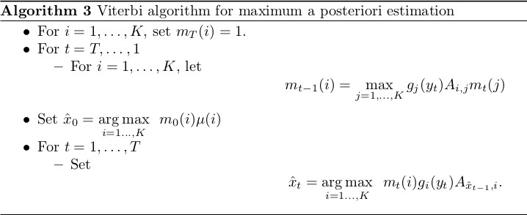
Most likely state path - Viterbi algorithm
Figure: Vitterbi algorithm
Notes: 1) Viterbi algorithm has order O(T |X|²), 2) In practice logarithms are computed to assure numerical stability.
Marco Julio, Nicol´as, Sebasti´an and C´esar
(IT
Hidden Markov Chains
October 30, 2019
<número> / 31

Slide 15
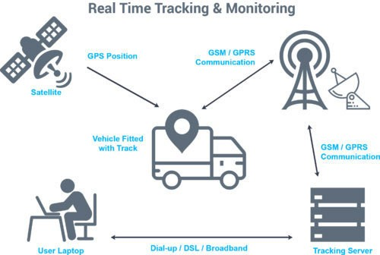
Continuous-state Hidden Markov Models
In many problems often hidden parameters of interest are continuous.
Figure: GPS object tracking; hidden parameters: position + velocity
Marco Julio, Nicol´as, Sebasti´an and C´esar
(IT
Hidden Markov Chains
October 30, 2019
<número> / 31

Slide 16
Continuous-state Hidden Markov Models
Ideas developed for discrete case can be generalized to aboard problems with hidden continuous parameters of interest.
We call these Continuous-state Hidden Markov Models
(CS-HMM), also named as state-space models or dynamical systems.
Let’s focus on a particular subset of CS-HMM: linear Gaussian state-space model (LGSSM).
Marco Julio, Nicol´as, Sebasti´an and C´esar
(IT
Hidden Markov Chains
October 30, 2019
<número> / 31

Slide 17
Linear Gaussian state-space model (LGSSM)
Hidden states: (X₀, . . . , X_{T} ) continuous r.v. taking values in R^{dx}
Observations: (Y₁, . . . , Y_{T} ) continuous r.v. taking values in R^{dy}
(X₀, . . . , X_{T} , Y₁, . . . , Y_{T} ) is LGSSM if has two components such as:
state model: X_{t} is a linear transformation of X_{t−1} plus a linear combination of Gaussian noise.
observation model: Y_{t} is a linear transformation of X_{t} plus Gaussian noise.
Marco Julio, Nicol´as, Sebasti´an and C´esar
(IT
Hidden Markov Chains
October 30, 2019
<número> / 31

Slide 18
Linear Gaussian state-space model (LGSSM)
Definition (LGSSM - State model)
X_{t} = F_{t} X_{t−1} + G_{t} V_{t} for t = 1, . . . , T State model
(1)
X_{t} ∈ R^{dx} hidden state at time t,
F_{t} ∈ R^{dx ×dx} transition state matrix at time t,
G_{t} ∈ R^{dx ×dv} noise transfer matrix,
V_{t} ∈ R^{dv} state noise matrix, V_{t} ∼ N(0, Q_{t} ).
Marco Julio, Nicol´as, Sebasti´an and C´esar
(IT
Hidden Markov Chains
October 30, 2019
<número> / 31

Slide 19
Linear Gaussian state-space model (LGSSM)
Definition (Observation model)
Y_{t} = H_{t} X_{t} + W_{t} for t = 1, . . . , T Observation model
Y_{t} ∈ R^{dy} observation at time t,
H_{t} ∈ R^{dx ×dx} observation matrix at time t,
W_{t} ∈ R^{dv} observation noise, W_{t} ∼ N(0, R_{t} ).
Definition (Other conditions)
(2)
X₀ ∼ N(µ₀, Σ₀),
V_{t} ∼ N(0, Q_{t} ), W_{t} ∼ N(0, R_{t} ), for t = 1, . . . T,
X₀, V₁, . . . V_{T} , W₁, . . . W_{T} are independent.
Marco Julio, Nicol´as, Sebasti´an and C´esar
(IT
Hidden Markov Chains
October 30, 2019
<número> / 31

Slide 20
LGSSM and parametrization of joint pdf
As in discrete case, joint pdf of hidden variables and observation can be described as:
T
Y
p(X , Y ) = p(y |x ) · p(x
_{t−1}|x_{t} ) (3)
0:T 1:T t t
t=1
Using LGSSM structure and properties of multivariate normal distributions it can be shown that if G_{t} Q_{T} G_{T} ∈ R^{dx ×dx} has full rank then:
p(y_{t} |x_{t} ) = N(H_{t}x_{t}, R_{t} ) (4)
p(x_{t} |x_{t−1}) = N(F_{t}x_{t−1}, G_{t} Q_{T} G_{T} ) (5)
Marco Julio, Nicol´as, Sebasti´an and C´esar
(IT
Hidden Markov Chains
October 30, 2019
<número> / 31

Slide 21
Inference in dynamic LGSSM
Let’s consider the following inference problem:
P1: Given observations up to time t find Y₁ = y₁, . . . , Y_{t} = y_{t} , find joint pdf p(x_{t} |y_{1:t} ).
P2: Given all observations Y₁ = y₁, . . . , Y_{T} = y_{T} , find joint pdf
p(x_{t} |y_{1:T} )
Both can be solve by sequentially computation of means and covariance matrices of conditionally distributions: 1) P1 is called Kallman filter, and in 2) P2 is named Kallman smoother.
Marco Julio, Nicol´as, Sebasti´an and C´esar
(IT
Hidden Markov Chains
October 30, 2019
<número> / 31

Slide 22
Inference LGSSM - Kallman filter
P1: Determine p(x_{t} |y_{1:t} ) of the hidden state X_{t} given t observations y_{1:t} .
^{µ}t|t−1 ^{:= E [X}t ^{|Y}1:t ^{= y}1:t−1]
µ_{t|t} := E [X_{t} |Y_{1:t} = y_{1:t} ]
T
^{Σ}t|t−1 ^{:= E [(X}t ^{− µ}t|t−1^{)(X}t ^{− µ}t|t−1^{) |Y}1:t ^{= y}1:t−1]
T
Σ_{t|t} := E [(X_{t} − µ_{t|t} )(X_{t} − µ_{t|t} ) |Y_{1:t} = y_{1:t} ]
(6)
(7)
(8)
(9)
Marco Julio, Nicol´as, Sebasti´an and C´esar
(IT
Hidden Markov Chains
October 30, 2019
<número> / 31

Slide 23
Kallman filter ideas - Prediction
Structure of LGSSM implies p(x_{t} |y_{1:t−1}) = N(µ_{t|t−1}, Σ_{t|t−1}) and the existence of recursive rules:
Prediction (µ_{t−1|t−1} → µ_{t|t−1}) and (Σ_{t−1|t−1} → Σ_{t|t−1}):
^{µ}t|t−1 ^{= F}t^{µ}t−1|t−1,
Σ = F Σ F + G
T T
Q G
t|t−1 t t−1|t−1 t
t t
t
Marco Julio, Nicol´as, Sebasti´an and C´esar
(IT
Hidden Markov Chains
October 30, 2019
<número> / 31

Slide 24
Kallman filter ideas - Update/correction
Again, structure of LGSSM implies p(x_{t} |y_{1:t} ) = N(µ_{t|t}, Σ_{t|t} ) and following recursion rule:
Update/correction (µ_{t|t−1} → µ_{t|t} ) and (Σ_{t|t−1} → Σ_{t|t} ):
^{µ}t|t ^{= µ}t|t−1 ^{+ K}t^{ν}t ,
^{Σ}t|t−1 ^{= (I − K}t ^{H}t ^{)Σ}t−1|t−1
Where ν_{t} = y_{t} − yˆ_{t} , yˆ_{t} = E [Y_{t} |Y_{1:t−1} = y_{1:t−1}] = H_{t}µ_{t|t−1}
^{K}t ^{= Σ}t|t−1^{HT S}t^{−1,}
T
T
S = E [(Y − yˆ )(Y − yˆ ) |Y
= y ] = H Σ H + R
t
t t t t 1:t−1 1:t−1
t t|t−1 t
t
K_{t} is called Kallman gain
Marco Julio, Nicol´as, Sebasti´an and C´esar
(IT
Hidden Markov Chains
October 30, 2019
<número> / 31

Slide 25
Kallman filter ideas
Recursive strategy of Kallman filter
p(x_{t} |y_{1:t} ) can be determined estimating parameters for s ∈ N of:
^{p(x}s ^{|y}1:s−1^{) = N(µ}s|s−1^{, Σ}s|s−1⁾
p(x_{s} |y_{1:s} ) = N(µ_{s|s}, Σ_{s|s} )
as follows:
Predict. Update
(µ , Σ ) −−−−→ (µ , Σ − − → . . .
0 0 1|0 1|0
)
Predict.
. . . −−−−→ (µ
Update
, Σ ) − − →
t−1|t−1 t−1|t−1
Predict.
(µ_{t|t−1}, Σ_{t|t−1}) −−−−→ (µ_{t|t}, Σ_{t|t} ) →− . . .
Marco Julio, Nicol´as, Sebasti´an and C´esar
(IT
Hidden Markov Chains
October 30, 2019
<número> / 31

Slide 26
Inference LGSSM - Kallman Smoother
P2: Determine p(x_{t} |y_{1:T} ) of the hidden state X_{t} given all the observations
^{y}1:T .
µ_{t|T} := E [X_{t} |Y_{1:T} = y_{1:T} ]
T
Σ_{t|T} := E [(X_{t} − µ_{t|T} )(X_{t} − µ_{t|T} ) |Y_{1:T} = t_{1:T} ]
(10)
(11)
Marco Julio, Nicol´as, Sebasti´an and C´esar
(IT
Hidden Markov Chains
October 30, 2019
<número> / 31

Slide 27
Kallman Smoother ideas
Structure of LGSSM implies p(x_{t} |y_{1:T} ) = N(µ_{t|T} , Σ_{t|T} ) and the existence of recursive rules:
Backward recursion:
^{µ}t|T ^{= µ}t|t ^{+ J}t ^{(µ}t+1|T ^{− µ}t+1|t ^{),}
^{Σ}t|T ^{= Σ}t|t ^{+ J}t ^{(Σ}t+1|T ^{− Σ}t+1|t ^{)JT}
t
Where J = Σ F
T
_{Σ}−1
, is called Backwards Kallman gain.
t
t|t t+1
t+1|t
Marco Julio, Nicol´as, Sebasti´an and C´esar
(IT
Hidden Markov Chains
October 30, 2019
<número> / 31

Slide 28
Recursive strategy of Kallman Smoother
p(x_{t} |y_{1:T} ) can be determined estimating parameters as follows:
Compute (µ_{t|t}, Σ_{t|t} ) and (µ_{t+1|t}, Σ_{t+1|t} ) for t, t + 1 ≤ T using Kallman filter.
Use backward recursion until obtain (µ_{t|T} , Σ_{t|T} ).
Marco Julio, Nicol´as, Sebasti´an and C´esar
(IT
Hidden Markov Chains
October 30, 2019
<número> / 31

Slide 29
A example for LGSSM
Let’s consider a toy example for a random walk given by:
X_{t} = X_{t−1} + V_{t}
Y_{t} = X_{t} + W_{t}
Where
X_{t} : trigonometric function plus gaussian noise, for t = 1, . . . , 50.
X₀ = N(0, 1), V_{t} ∼ N(0, Q), W_{t} ∼ N(0, R), with Q = 0.02 and
R = 0.2
Marco Julio, Nicol´as, Sebasti´an and C´esar
(IT
Hidden Markov Chains
October 30, 2019
<número> / 31

Slide 30
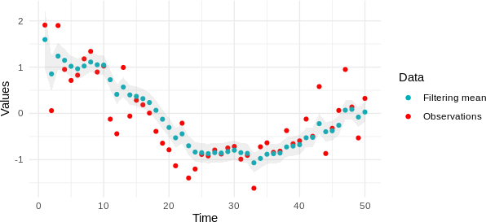
Filtering
Figure: Observations and filtering mean and 99% credible intervals over time.
Marco Julio, Nicol´as, Sebasti´an and C´esar
(IT
Hidden Markov Chains
October 30, 2019
<número> / 31

Slide 31
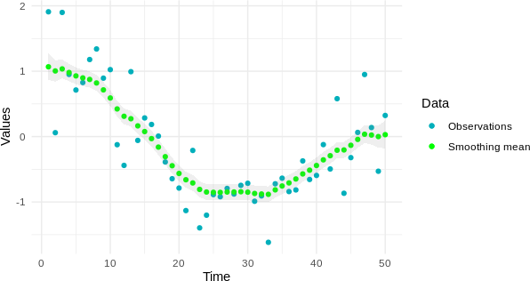
Smoothing
Figure: Observations and smoothing mean and 99% credible intervals over time
Marco Julio, Nicol´as, Sebasti´an and C´esar
(IT
Hidden Markov Chains
October 30, 2019
<número> / 31

