Slide 1
A terminal-based, interactive fiction, Adventure game
Choose Your Own Adventure: Nimbifer
CASSANDRA ZARA
Notes:
In video game culture, an adventure game is a video game in which the player assumes the role of a protagonist in an interactive story driven by exploration and puzzle-solving. The genre's focus on story allows it to draw heavily from other narrative-based media, literature and film, encompassing a wide variety of literary genres. Many adventure games are designed for a single player, since this emphasis on story and character makes multi-player design difficult. Colossal Cave Adventure is identified as the first such adventure game, first released in 1976, while other notable adventure game series include Zork, King's Quest, The Secret of Monkey Island, and Myst.

Slide 2
Features
Game Design
companions
puzzle-solving: Troll riddle, Eagle riddle, Door puzzle
Story/setting: branching narrative, references to literature, humour
dialogue and secret reveal
multiple deaths (primary failure condition)
Ascii art checkpoints
By Source, Fair use, https://en.wikipedia.org/w/index.php?curid=33918430

Slide 3

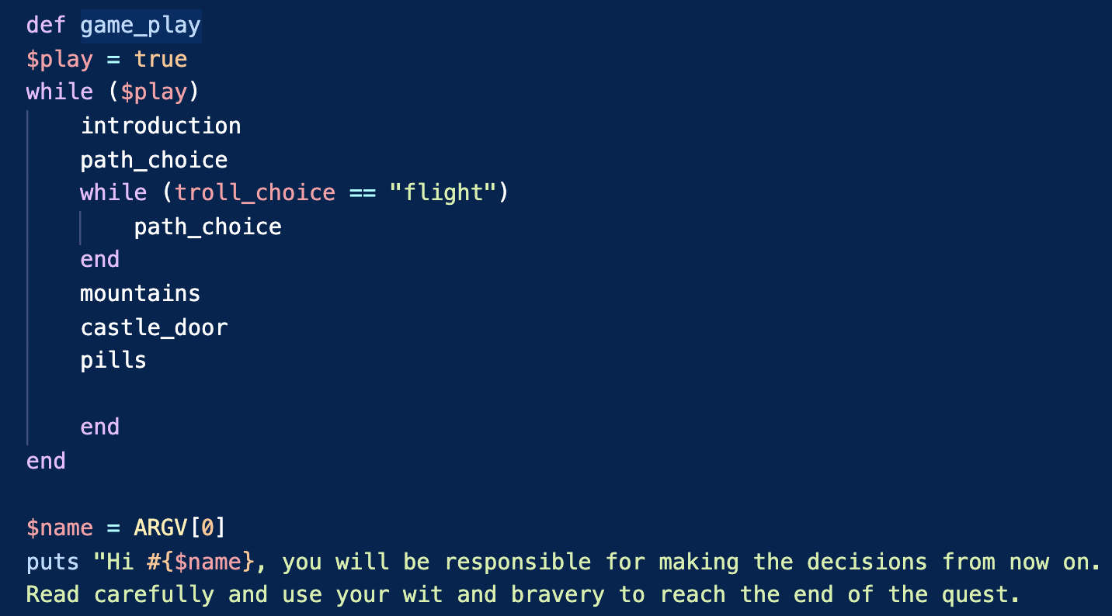
Control Flow
Gems
-Artii
-Faker
-Colorize
-Tty-prompt
Notes:
Consider talking about:
Relationship to other genres

Slide 4
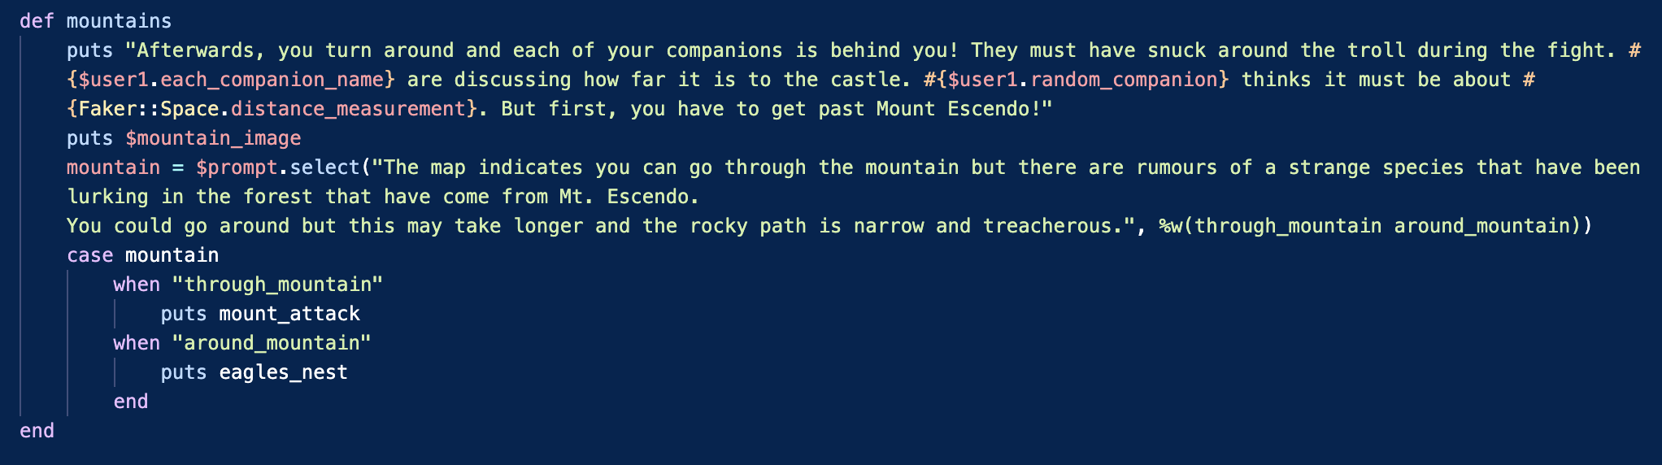
Game design code
Notes:
Consider talking about:
Puzzle-solving
Gathering and using items
Story, setting, and themes
Dialogue and conversation trees
Goals, success and failure

Slide 5
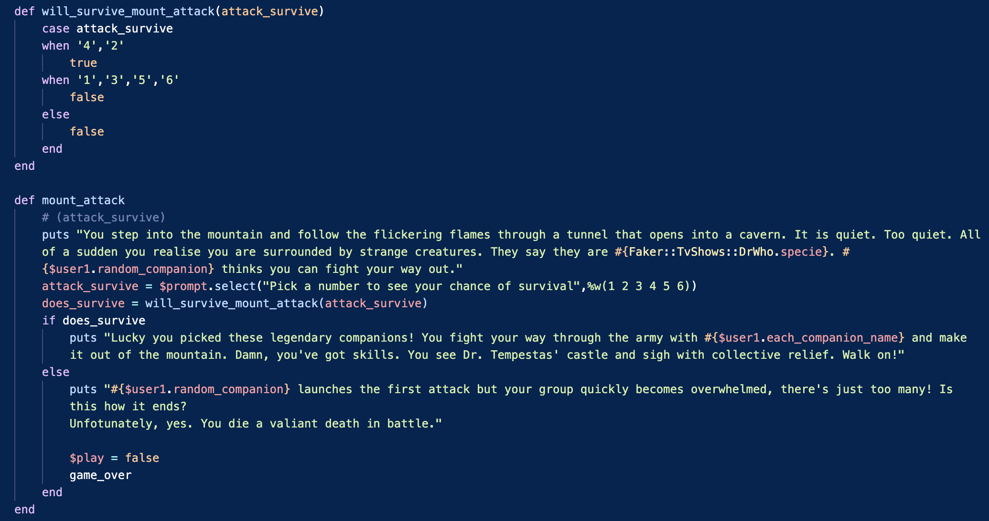
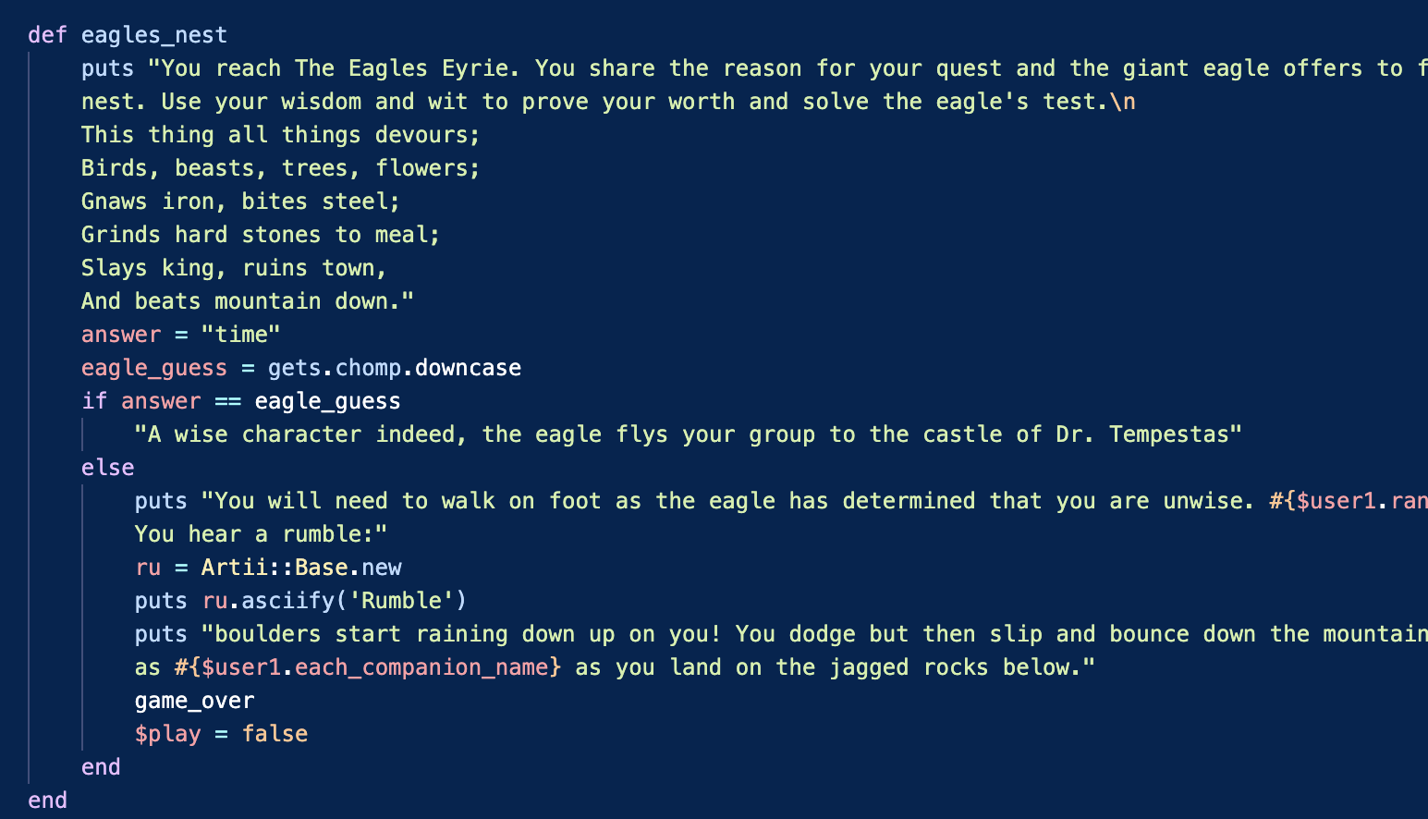

Mountain_ STage
Notes:
Consider talking about:
Text adventures and interactive fiction
Graphic adventure
Visual novel
Interactive movie
Hybrids

Slide 6
Works cited
https://en.wikipedia.org/wiki/Adventure_Gamers

