Slide 1
Technology Review
Ihsan Kahveci, Jacqueline Nugent, Lauren Snyder, Sami Turbeville, and Claire Zarakas

Slide 2
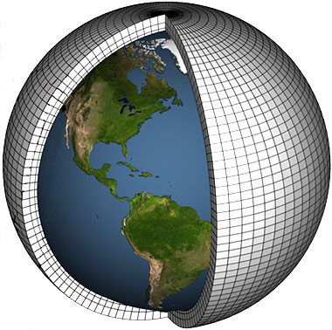
The problem: Climate models and uncertainty in climate projections can be challenging to understand for people who are not familiar with climate science and/or not comfortable coding
Our solution: A simplified tool for users without a technical background to interact with climate model output and visualize uncertainty for a specific location
Data sources:
Climate model output available from the Climate Model Intercomparison Project phase 6
Real historical observations from Berkeley Earth Surface Temperature dataset
Notes:
Claire presenting this: target 1.5 minutes
Image credit: https://str.llnl.gov/december-2017/bader

Slide 3
Use Case - Visualizing climate data
Objective: The user wants to create a climate dashboard for her city to understand climate models and uncertainty
Expected Interactions:
User: inputs latitude and longitude or city of their chosen location
User: selects variables, i.e. temperature and annual mean
Tool: graphs and map update for selections
User: selects scenario
Tool: graphs update for scenario selection
Notes:
Lauren presenting this: target 1.5 minutes

Slide 4
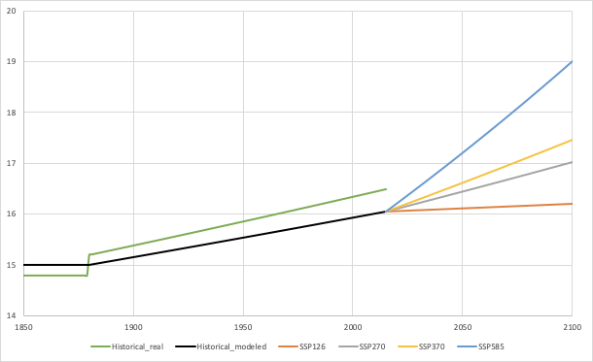
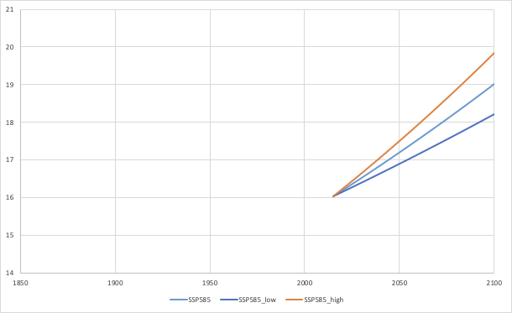
Scenario Uncertainty
User chooses latitude and longitude
* List of cities (drop down or autofill)
* Click on map
* Custom input (sliders or textbox)
Some text with more information about what the plots are showing
* Describe the scenario
* Describe the variables
* Brief model description
User chooses options for what they can look at
* Variable (drop down):
Minimum, maximum, & average temperature
* Time (drop down): Annual mean, January mean, February mean, etc.
Model Uncertainty
Global map of difference between scenario and historical data (model average)
* Dot for the user’s location
* Show grid spacing to see the area it was averaged over
* Select scenario
Notes:
Jacqueline presenting this: target 2 minutes

Slide 5
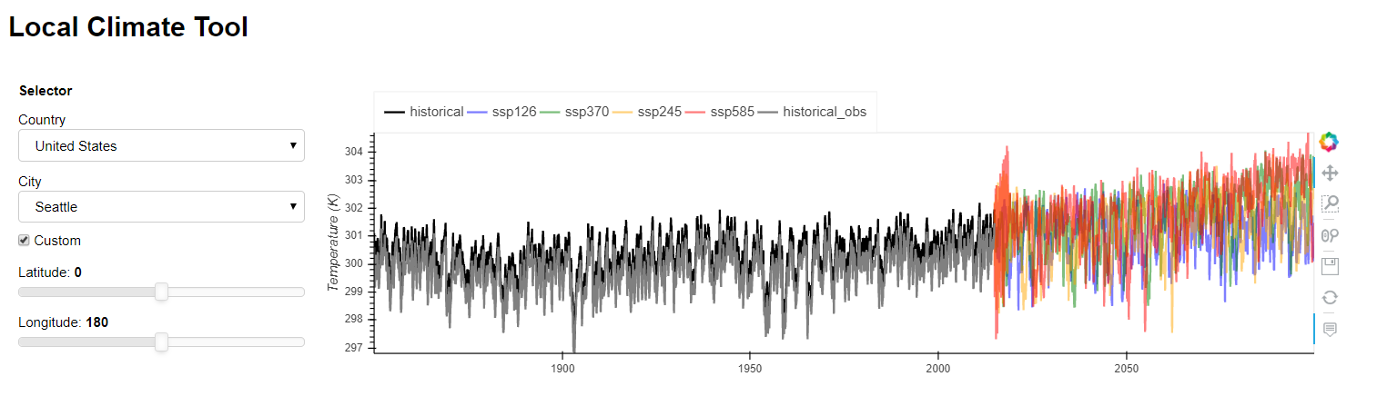
Tech option 1 - Panel
Pros:
Compatible with jupyter notebook, xarray
Control panels and widgets to interact with the inputs
Reactive plotting
Uses Geoviews to show gridded and geospatial data, popular with geoscientists
Cons:
Dash is better at dealing with multiple users
Example:
Notes:
Sami presenting this: target 2 minutes
One slide that describes at least two python libraries that potentially address your technology requirement.

Slide 6
Tech option 2 - Dash
Pros:
Horizontally scalable (can handle lots of data and lots of users on the web using it simultaneously)
Been around a while & lots of support, documentation
Highly customizable but easy to get started
Cons:
Can’t get super fancy using jupyter notebooks (but is fine for basic dashboard)
Does not suitable Xarray indexes
Example: https://dash-gallery.plotly.host/dash-oil-and-gas/
Notes:
Ihsan presenting this: target 2 minutes
One slide that describes at least two python libraries that potentially address your technology requirement.

Slide 7
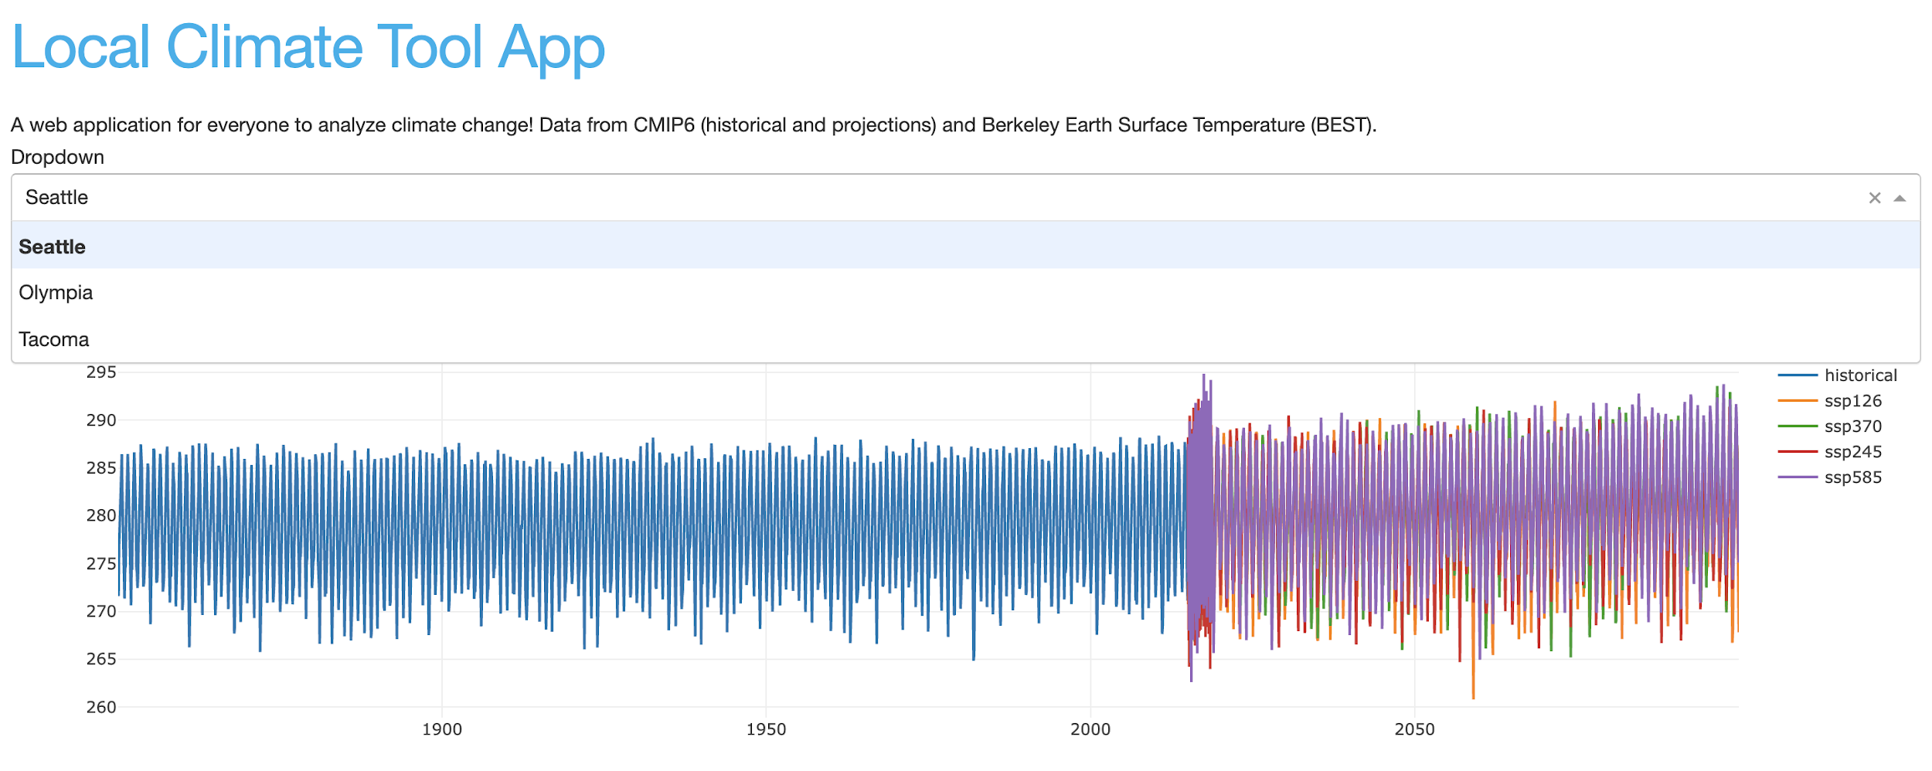
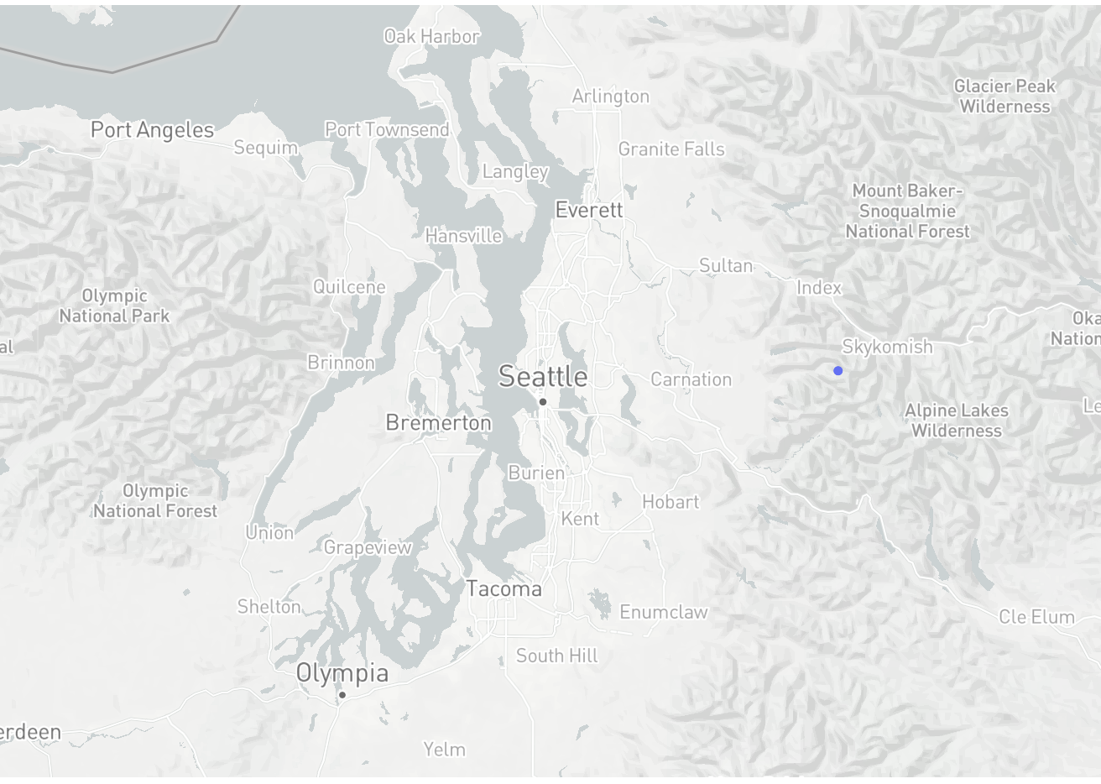

Slide 8
Side by side comparison
we choose Panel!
 | Panel | Dash | Winner
Compatibility with Jupyter | Yes | No | Panel
Ease of using geospatial data and Xarrays | Easy | Possible | Panel
Developer experience | 2 team members already have used | No experience | Panel
Compatibility with climate science community | Preferred by ocean.pangeo.io | Less commonly used | Panel
Quantity of simultaneous users technology can support | Limited | Thousands | Dash
Notes:
Ihsan presenting this: target 2 minutes

