Slide 1

The FORWARD Web Framework for Live Visualizations
Use Cases that will help us make sense if FORWARD’s syntax works
Web and Database Lab

Slide 2
Simple Checkbox
Simple checkbox page without any syntactic sugar
Web and Database Lab

Slide 3
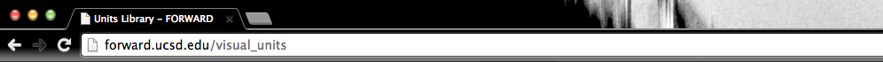
forward.ucsd.edu/demo/index.html
Y
Select all the vehicles you currently own:
Car
Motorcycle
Moped
Truck
Tractor
Skateboard
Long board
Bicycle
Submit

Slide 4
forward.ucsd.edu/demo/index.html
Y
Select all the vehicles you currently own:
Gas powered
Car
Motorcycle
Moped
Truck
Tractor
Human powered
Skateboard
Long board
Bicycle
When a category is selected (e.g Gas Powered, Human powered) all the sub elements are automatically selected
Submit

Slide 6
2nd Demo
An action calls a redirect to a new page. This page includes another template that requires a huge page state
Web and Database Lab

Slide 7
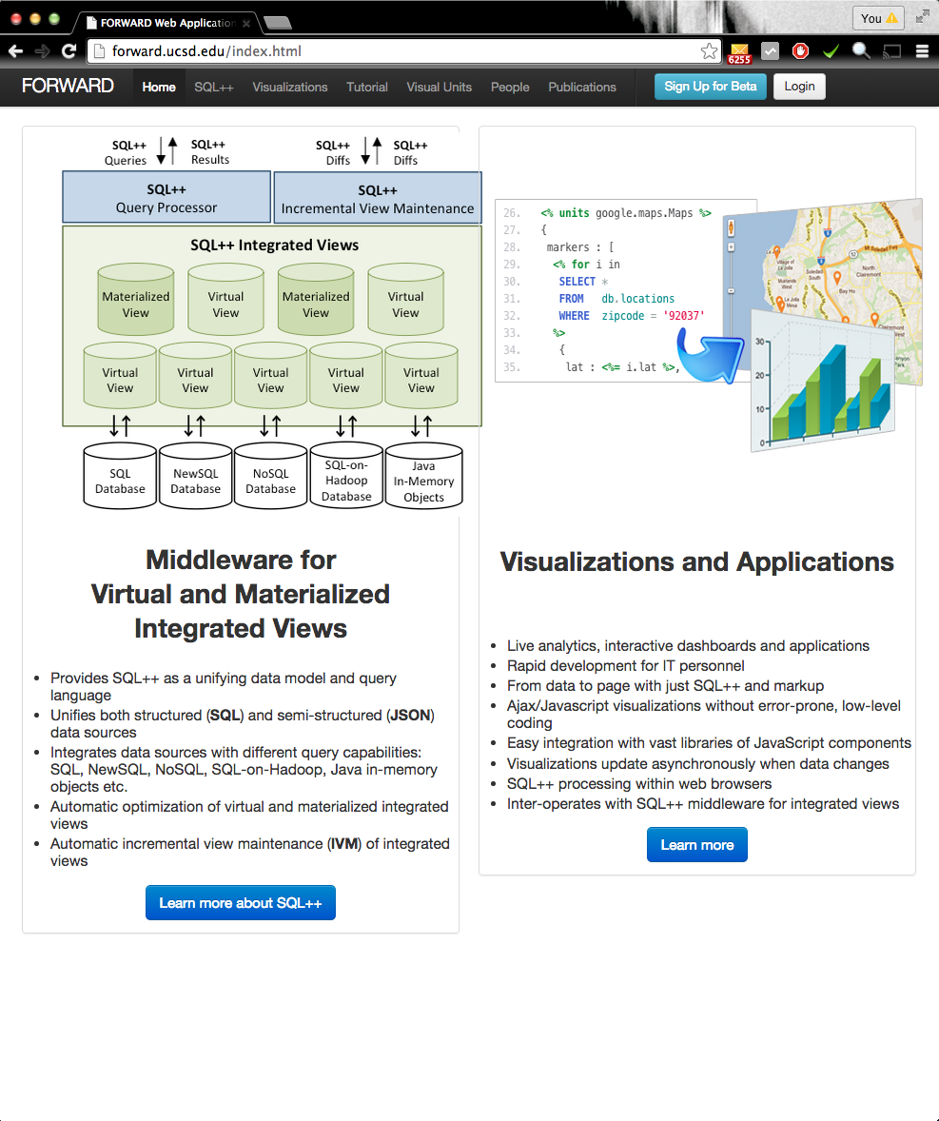

Slide 9

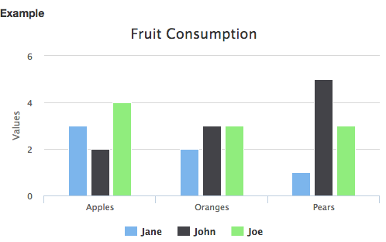
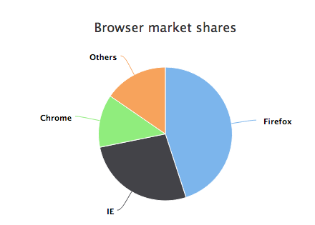
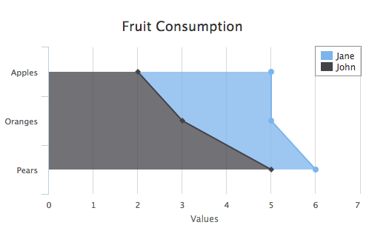

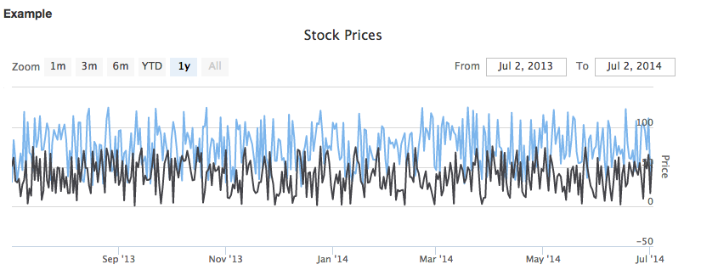


Slide 10
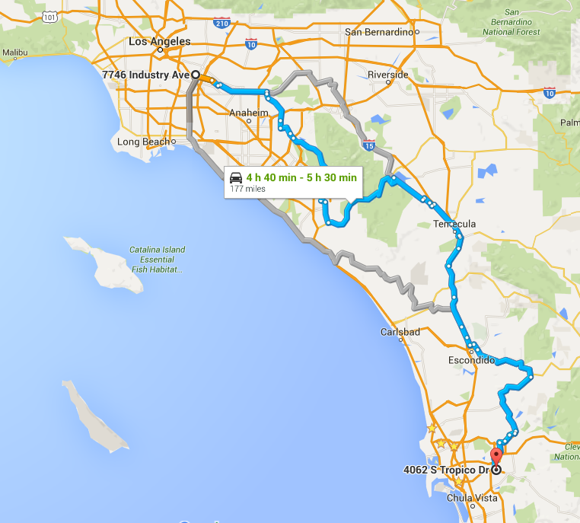

Slide 12
<% template index %>
<% init menu_array_list = ["Home", "SQL++", "Visualizations", "Tutorial", "Visual Units", "People", "Publications"]
<% html %>
<ul class="menu_item">
<% for element in menu_array_list%>
<li>
<a href=“<%= ‘/’+element %>"><%= element %></a>
</li>
<% end for %>
</ul>
<% end html %>
<div>
<!-- Other Static HTML content -->
</div>
<% end template %>

