Slide 1

Shevis Johnson & Albert Pierce
Database Management - Fall 2016
Chapman University

Slide 2


The Problem...
Student based organizations are struggling to motivate students to attend events and organization meetings
Low turnout at on-campus events such as sporting or greek philanthropic events results in low school spirit
Existing event-management systems such as handshake are limited and do very little to encourage student engagement

Slide 3

Our Solution
Create a system that structures all student based organizations and event information in one central database
Allow organizations to track event attendance using an ID card swipe or simple ID number entry as attendees arrive
For each event attendance, students are awarded Ordinem points - points can be cashed in for Panther Bucks or other prizes

Slide 4
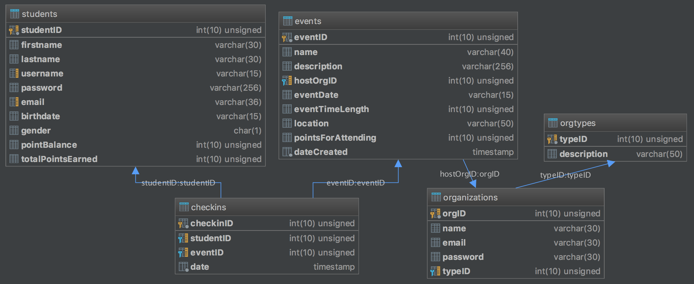
The Database

Slide 5
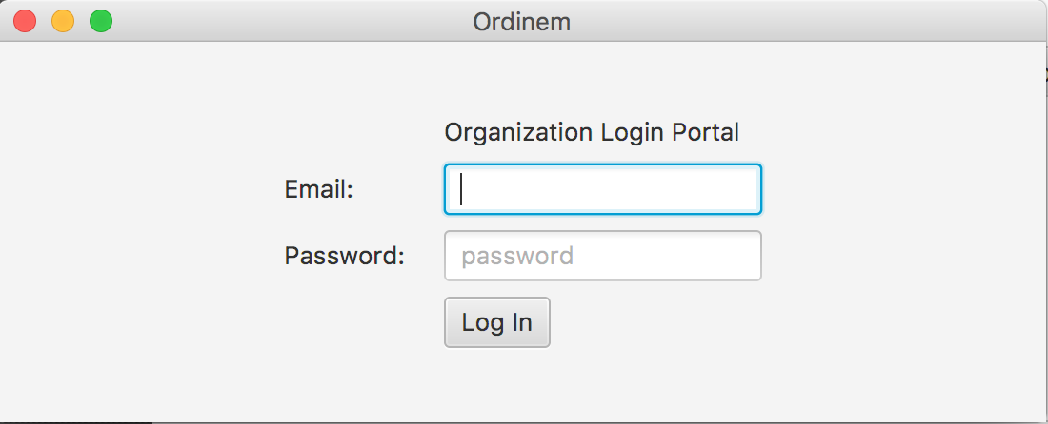
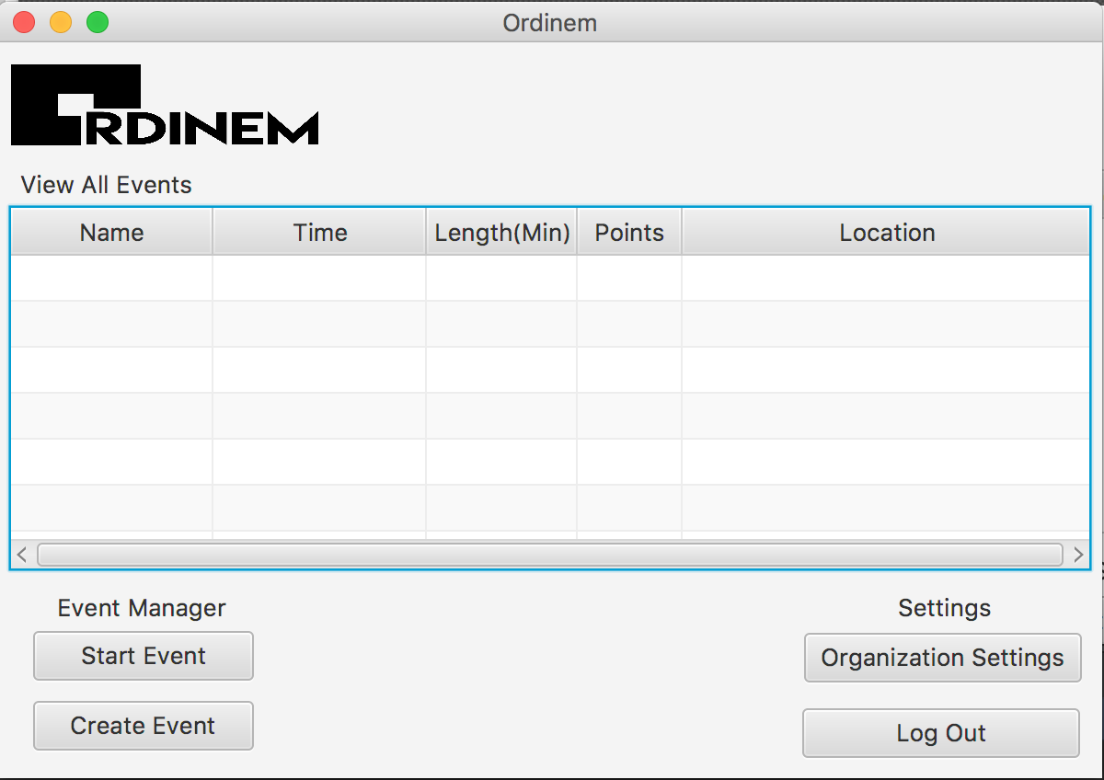
The Organization Portal (Java)
A java program that allows student organizations to plan and create events
When an event is going live, the program can be used to check attendees in as they enter
Eventually, this will also serve as the analytics hub for student organizations

Slide 6
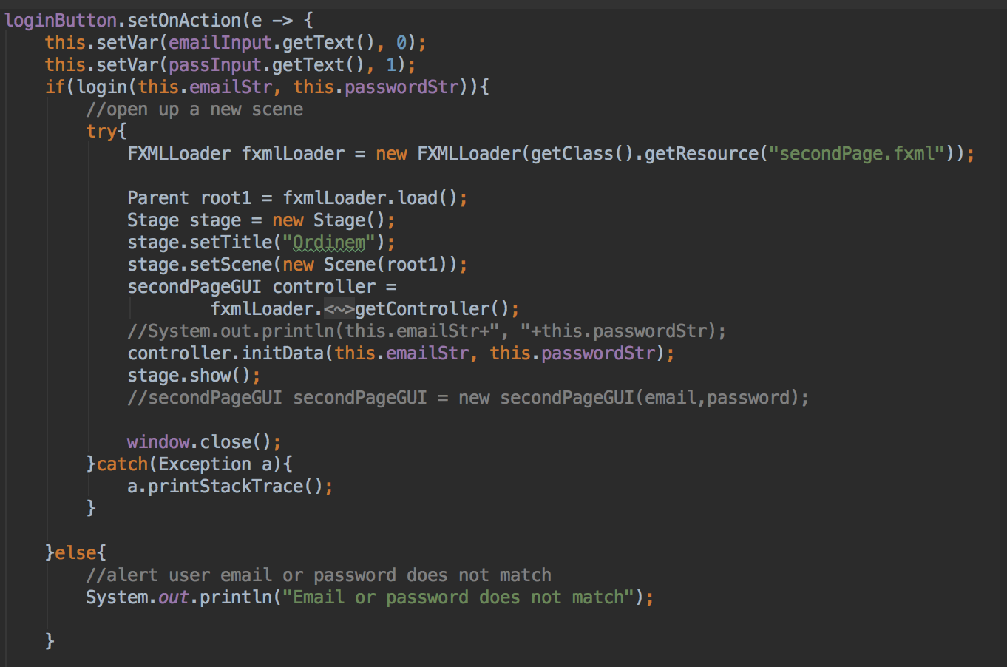
The Organization Portal (Cont.)
Graphical UI was designed using JavaFX and FXML
On login button click, checks the database if user exists
If so, using Javafx commands open up FXML file

Slide 7
The Ordinem API
A LAMP server which serves as an easy way to access the database
Linux
Apache
MySQL
PHP
Hosted on my Raspberry Pi (For now)
This serves as the connection for web interface to communicate with the database

Slide 8

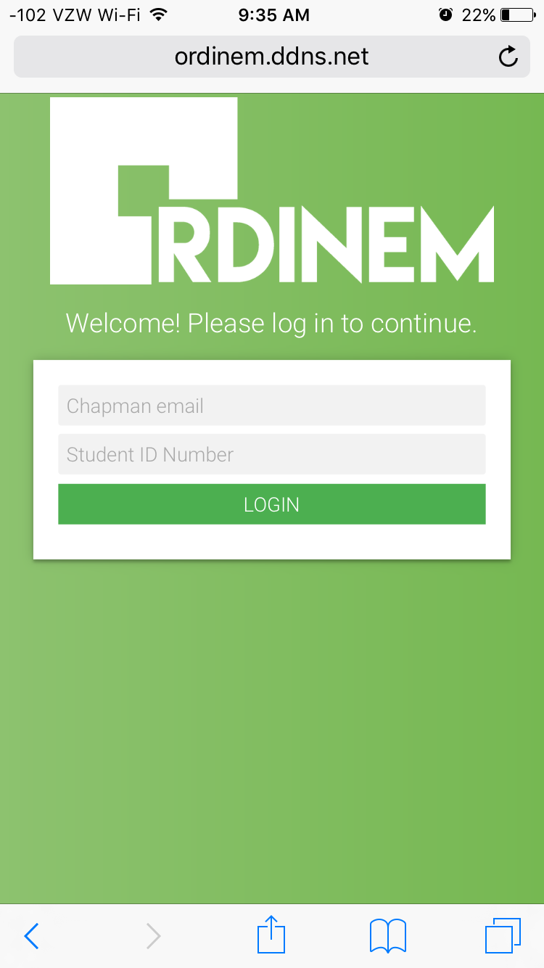
The Student Portal
A way for students to tap into on-campus events and increase student engagement
Allows students to track and cash out their points
BETA VERSION IS LIVE: Go to ordinem.ddns.net and sign in with your email and student ID to test it out!

Slide 9

The Future
Once finished, we intend to sell this software as a subscription software
Starting at Chapman, then expanding to other campuses
Main source of revenue will likely come from data sales
Many valuable insights from combination of demographic and student engagement data

Slide 10
Fin

