Slide 1


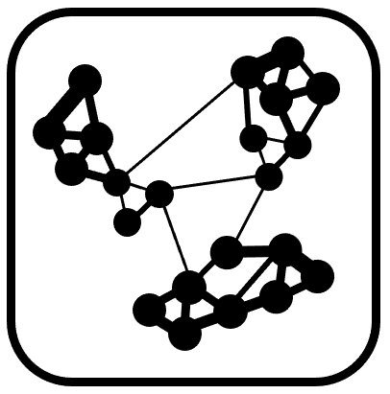









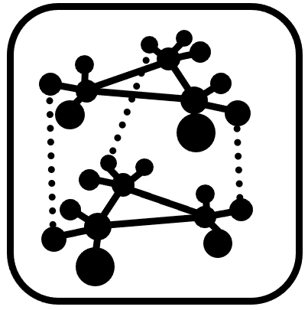
*
PDF
*
*
NATIONAL BIOINFORMATICS
INFRASTRUCTURE SWEDEN
www
***

