Slide 1



CHESS FORGE

Slide 2
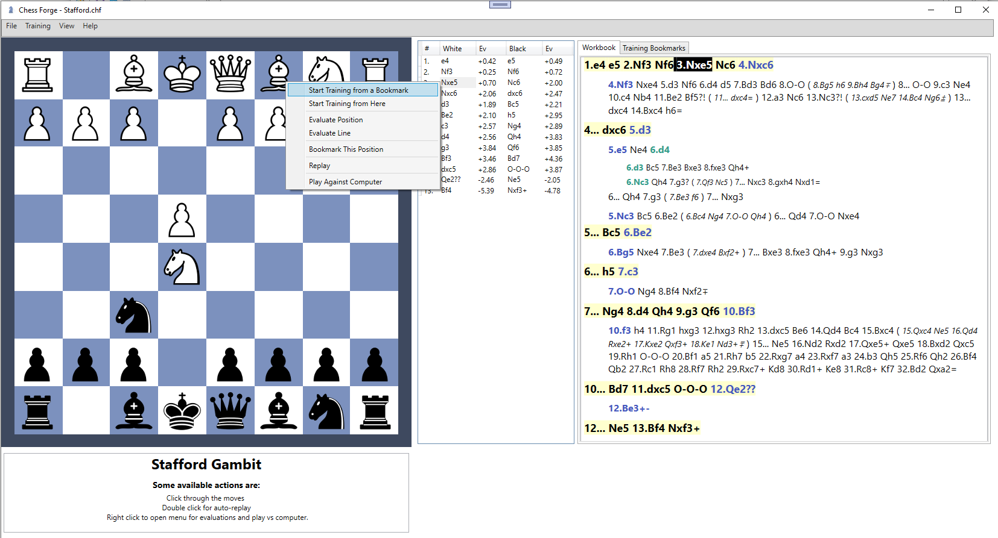
Main Board
Workbook
Messages
Active Line
(with optional evaluations)

Slide 3
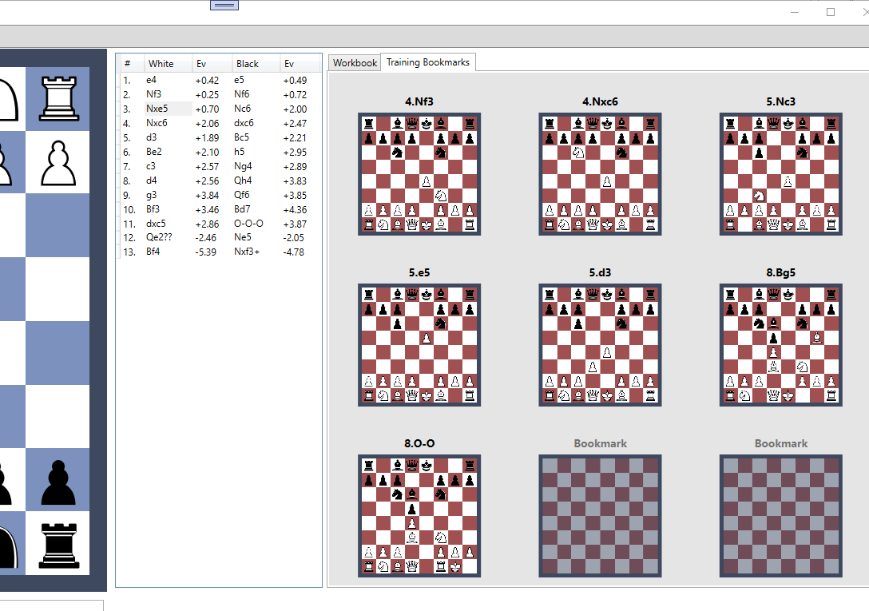
Bookmarks

Slide 4
Idle
Manual Review
Training
Game
Game

