Slide 1
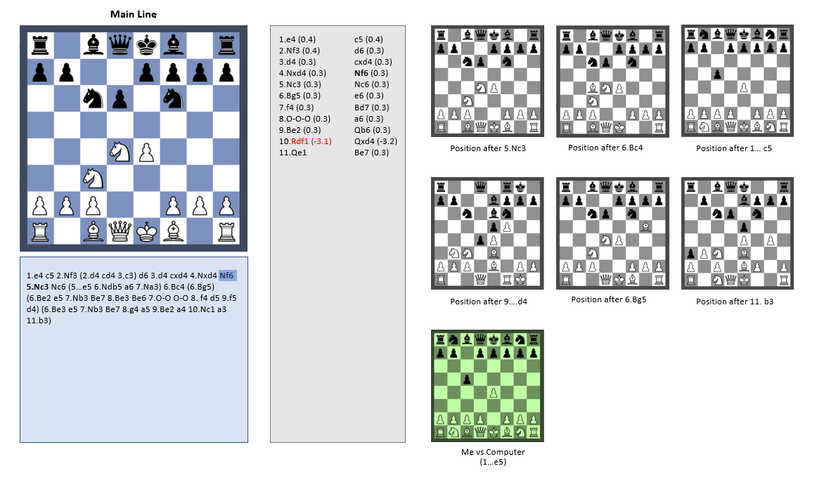
Main Board
Sideboards
Optional sideboard if a training game with the computer is in progress
Full Tree Text
Line on the Main Board
(with optional evaluations)

Slide 2

CHESS FORGE

Slide 3
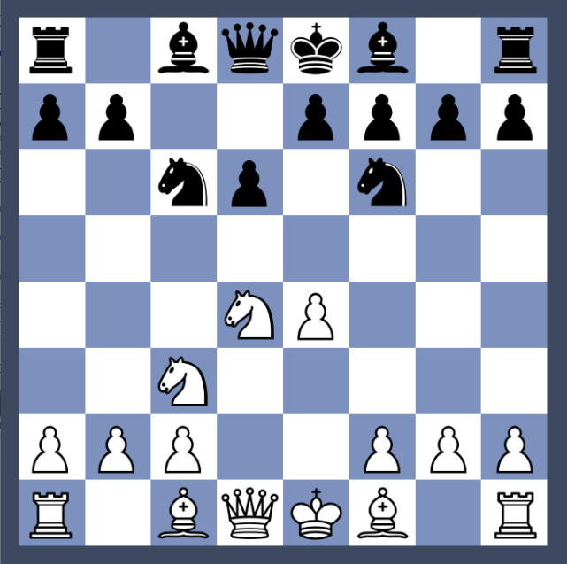
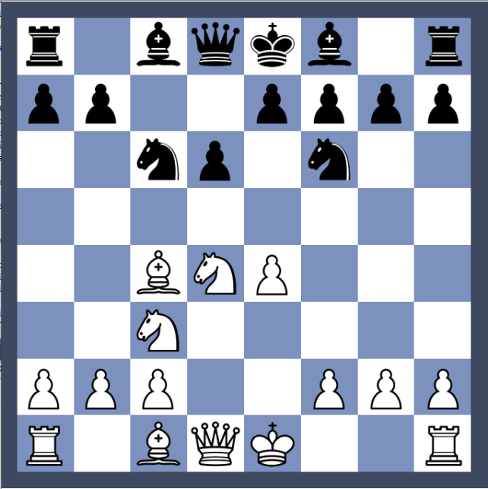
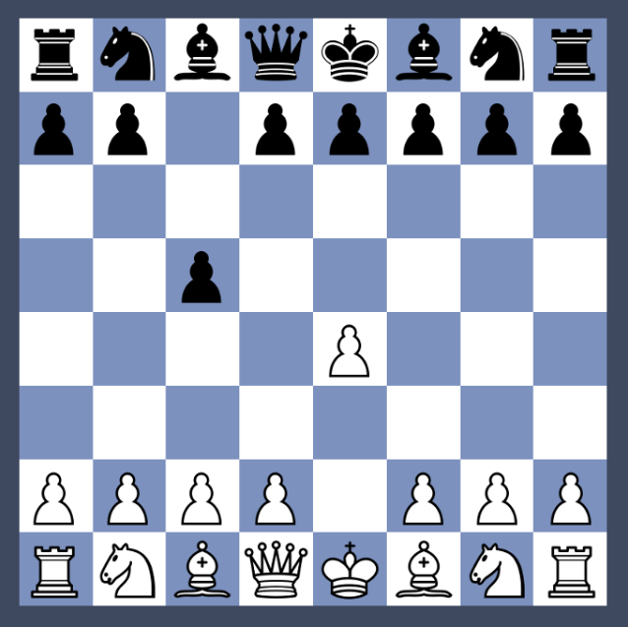
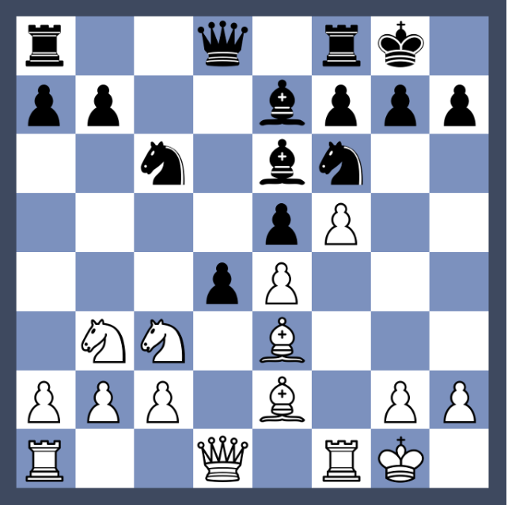
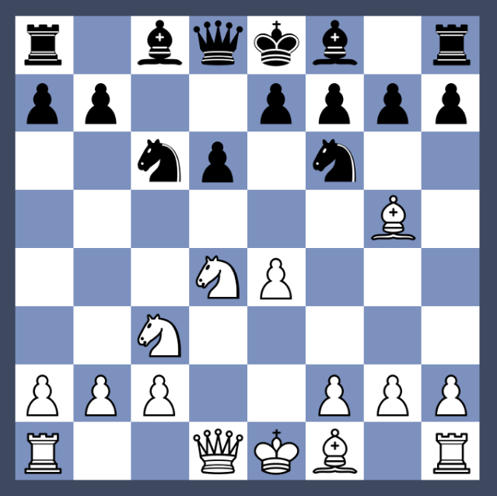
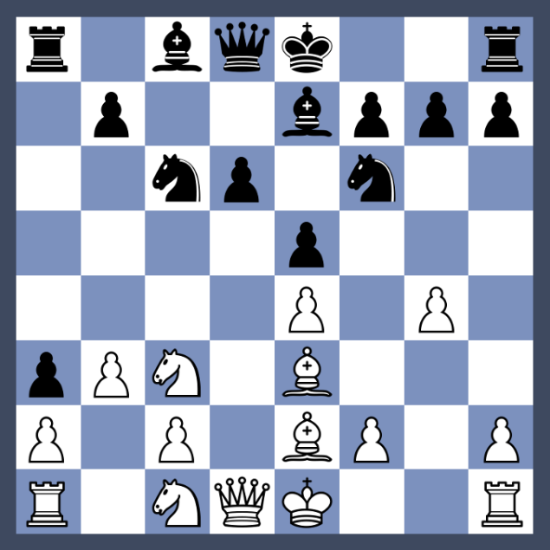
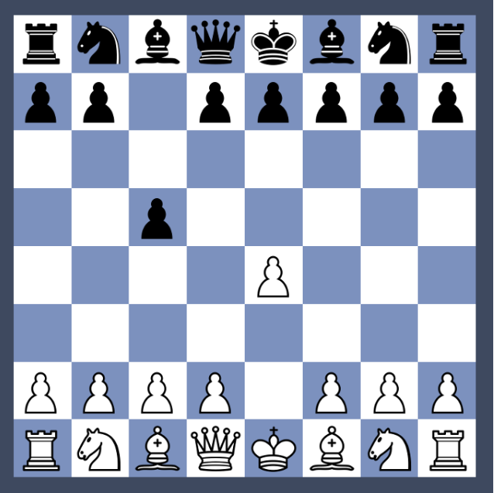
Main Line
1.e4 (0.4)
2.Nf3 (0.4)
3.d4 (0.3)
4.Nxd4 (0.3)
5.Nc3 (0.3)
6.Bg5 (0.3)
7.f4 (0.3)
8.O-O-O (0.3)
9.Be2 (0.3)
10.Rdf1 (-3.1)
11.Qe1
c5 (0.4)
d6 (0.3)
cxd4 (0.3)
Nf6 (0.3)
Nc6 (0.3)
e6 (0.3)
Bd7 (0.3)
a6 (0.3)
Qb6 (0.3)
Qxd4 (-3.2)
Be7 (0.3)
Position after 5.Nc3
Position after 6.Bc4
Position after 1… c5
1.e4 c5 2.Nf3 (2.d4 cd4 3.c3) d6 3.d4 cxd4 4.Nxd4 Nf6 5.Nc3 Nc6 (5…e5 6.Ndb5 a6 7.Na3) 6.Bc4 (6.Bg5) (6.Be2 e5 7.Nb3 Be7 8.Be3 Be6 7.O-O O-O 8. f4 d5 9.f5 d4) (6.Be3 e5 7.Nb3 Be7 8.g4 a5 9.Be2 a4 10.Nc1 a3 11.b3)
Position after 9….d4
Position after 6.Bg5
Position after 11. b3
Me vs Computer
(1…e5)

Slide 4
Sideline 6.Be3
1.e4 (0.4)
2.Nf3 (0.4)
3.d4 (0.3)
4.Nxd4 (0.3)
5.Nc3 (0.3)
6.Be3 (0.3)
7.Nb3 (0.3)
8.g4 (0.3)
9.Be2 (0.3)
10.Nc1 (0.3)
11.b3 (0.3)
c5 (0.4)
d6 (0.3)
cxd4 (0.3)
Nf6 (0.3)
Nc6 (0.3)
e5 (0.3)
Be7 (0.3)
a5 (0.3)
a4 (0.3)
a3 (-3.2)
Be7 (0.3)
Main line after 5.Nc3
Sideline after 6.Bc4
Sideline after 1… c5
1.e4 c5 2.Nf3 (2.d4 cd4 3.c3) d6 3.d4 cxd4 4.Nxd4 Nf6 5.Nc3 Nc6 (5…e5 6.Ndb5 a6 7.Na3) 6.Bc4 (6.Bg5) (6.Be2 e5 7.Nb3 Be7 8.Be3 Be6 7.O-O O-O 8. f4 d5 9.f5 d4) (6.Be3 e5 7.Nb3 Be7 8.g4 a5 9.Be2 a4 10.Nc1 a3 11.b3)
Sideline after 9….d4
Sideline after 6.Bg5
Sideline after 5.Nc3
Me vs Computer
(1…e5)

