Slide 1
DanioDecima x DanioCell: Scaling sequence-to-expression fine-tuning to a richer atlas
Yang-Joon Kim, Mathias Voges
CZ Biohub San Francisco
April 2026

Slide 2
We validated a fine-tuning framework on Zebrahub — can it scale to richer data?
• Framework validated: Same pipeline, same biology — pretrained >> random, no memorization
• Better data in: DanioCell has 3.4x more pseudobulks and 2.5x better cell-type x stage coverage
• Model ready: Gene-level Pearson identical to DanioDecima (0.38); attribution confirms biological signal
Bottom line: DanioCell model is ready for in silico mutagenesis and regulatory design

Slide 3
DanioCell provides 3.4x more pseudobulks and 2.5x denser developmental coverage
Property | Zebrahub | DanioCell | Change
Pseudobulk tracks | 304 | 1,047 | 3.4x
Cell types | 154 | 153 | comparable
Developmental stages | 10 (10hpf-10dpf) | 14 (3-120 hpf) | 1.4x
Cell-type x stage coverage | 19.7% | 48.9% | 2.5x
Total genes | 31,767 | 28,201 | comparable
Test genes | 7,289 | 6,405 | comparable
Key advantage: DanioCell's denser coverage means the model sees more developmental diversity during training

Slide 4
Same architecture and loss — only the atlas and init strategy differ
DanioDecima (Zebrahub) — Mathias
DanioCell Fine-Tuning — Yang-Joon
• 16 experiments: 4 init x 4 replicates
• Random, Mouse-Borzoi, Human-Borzoi, Human-Decima
• 10 timepoints, 304 pseudobulks
• TensorBoard logging, Ray Tune sweep
• 8 experiments: 2 init x 4 replicates
• Random (lr=3e-6), Pretrained Human-Decima (lr=3e-5)
• 14 stage groups, 1,047 pseudobulks
• CSVLogger, deterministic training (CUDA)
Rationale: Used best init strategy (Human-Decima) identified by Mathias's sweep

Slide 5
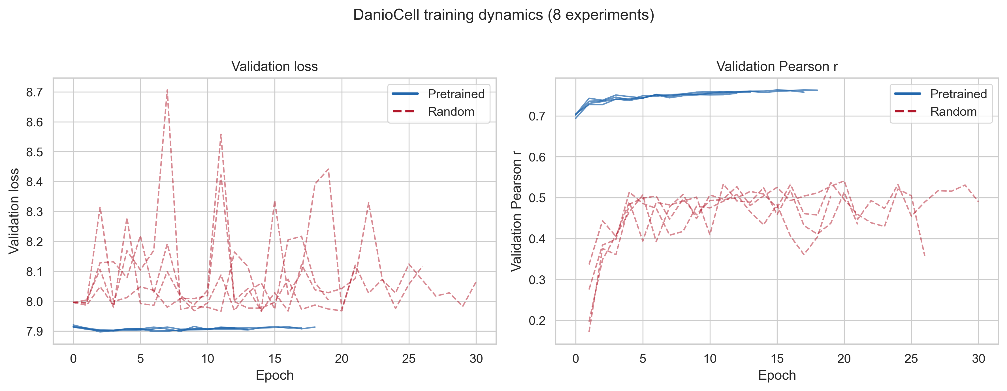
Pretrained models converge in 2-3 epochs; random oscillates through epoch 30
• Pretrained: val_pearson ~0.76, stable from epoch 3
• Random: val_pearson ~0.50, high variance through epoch 30

Slide 6
Gene-level Pearson is identical (0.38); pretrained lift is actually larger (+0.23 vs +0.19)
Metric | Zebrahub | DanioCell
Track Pearson (pretrained) | 0.81 | 0.76 | More rare cell types
Track Pearson (random) | 0.62 | 0.53
Track lift | +0.19 | +0.23 | DanioCell > Zebrahub
Gene Pearson (pretrained) | 0.38 | 0.38 | Identical
Gene Pearson (random) | 0.24 | 0.23
Gene lift | +0.14 | +0.15 | Identical
Interpretation: Lower absolute track Pearson reflects more cell types (incl. rare), but the lift from pretraining is larger — the framework works even better with richer data

Slide 7
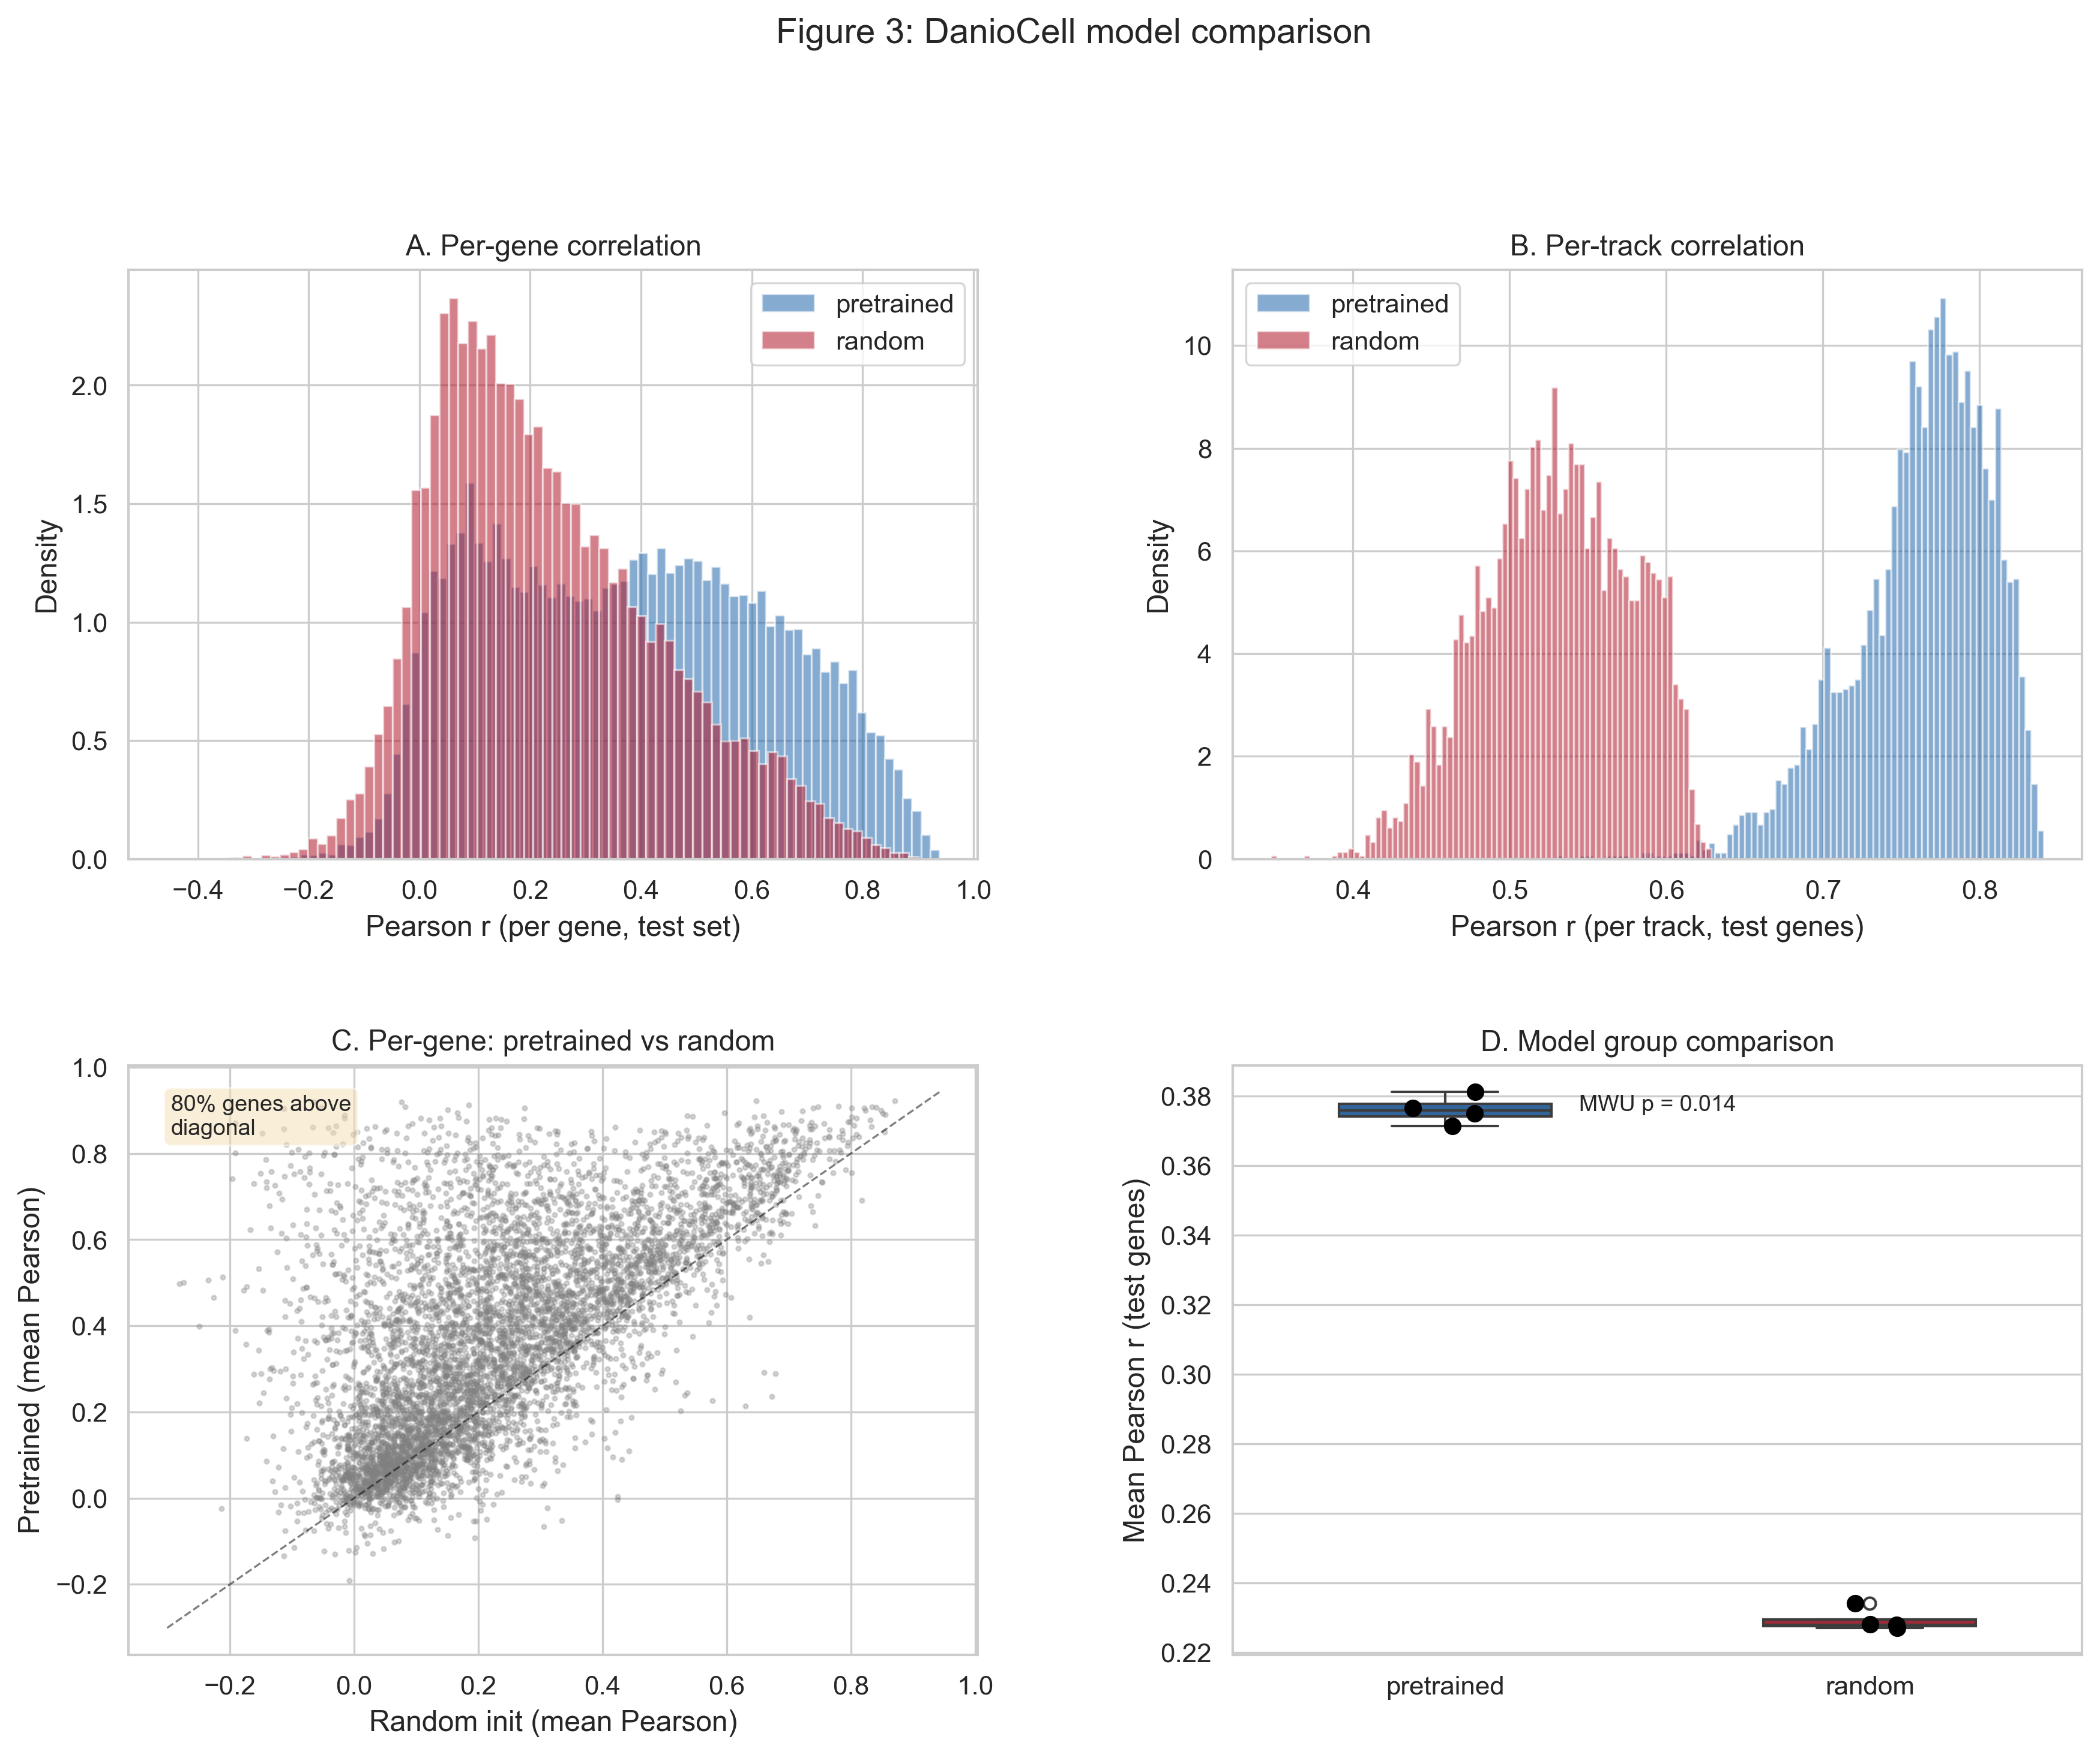
80% of test genes are better predicted by the pretrained model (MWU p=0.014)

Slide 8
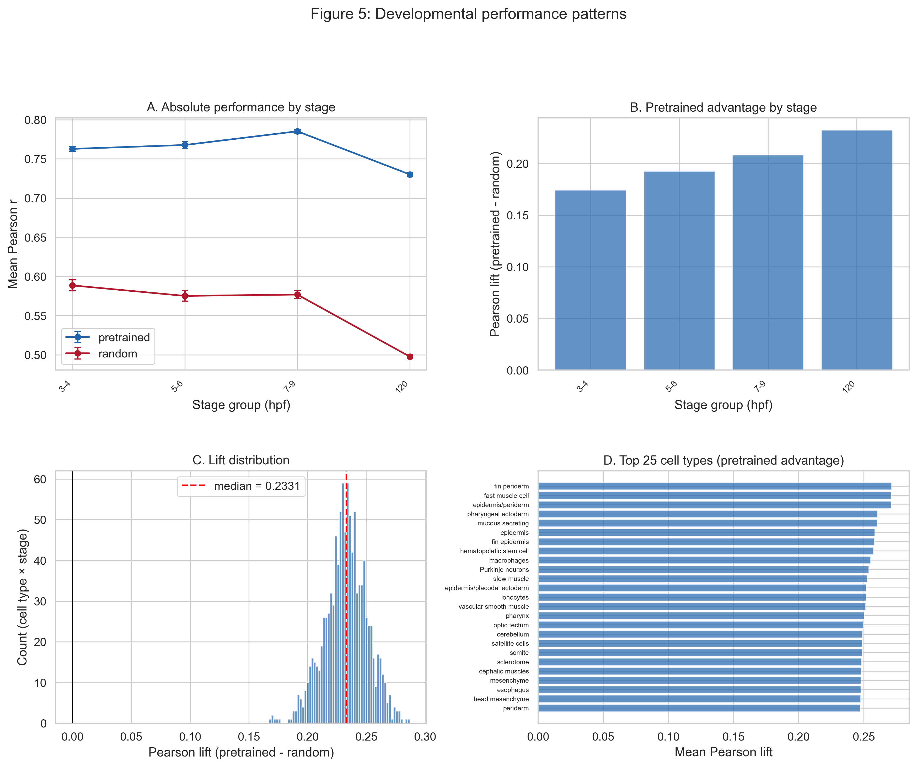
Pretraining helps most where prediction is hardest: late development and specialized cell types

Slide 9
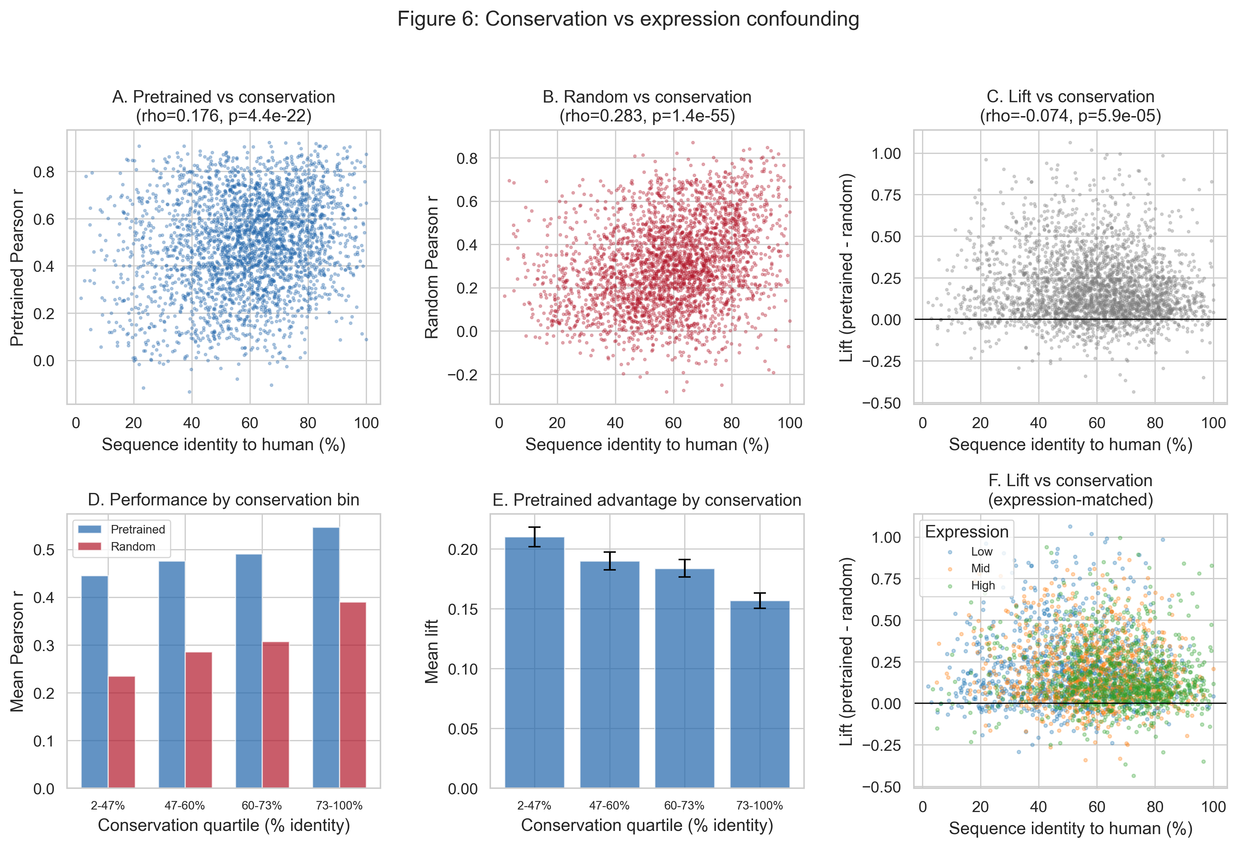
Pretrained lift is independent of gene conservation (rho=-0.07) — not memorizing
Replicates DanioDecima finding: model learned regulatory grammar, not conserved sequences

Slide 10
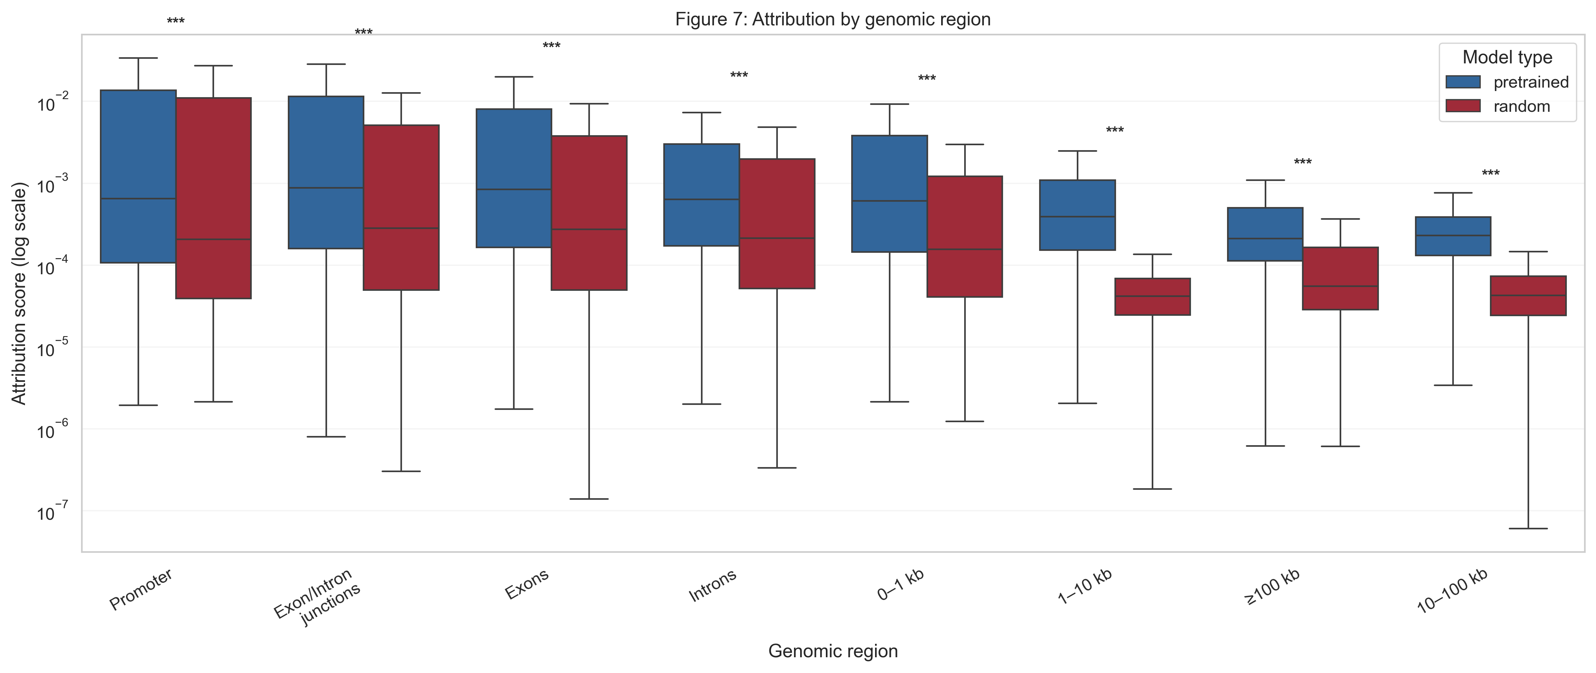
Pretrained model attributes higher importance to regulatory regions (all p < 0.001)
• Promoter >> distal: expected gradient of regulatory importance
• Pretrained >> random: at all 8 regions — learned regulatory grammar

Slide 11
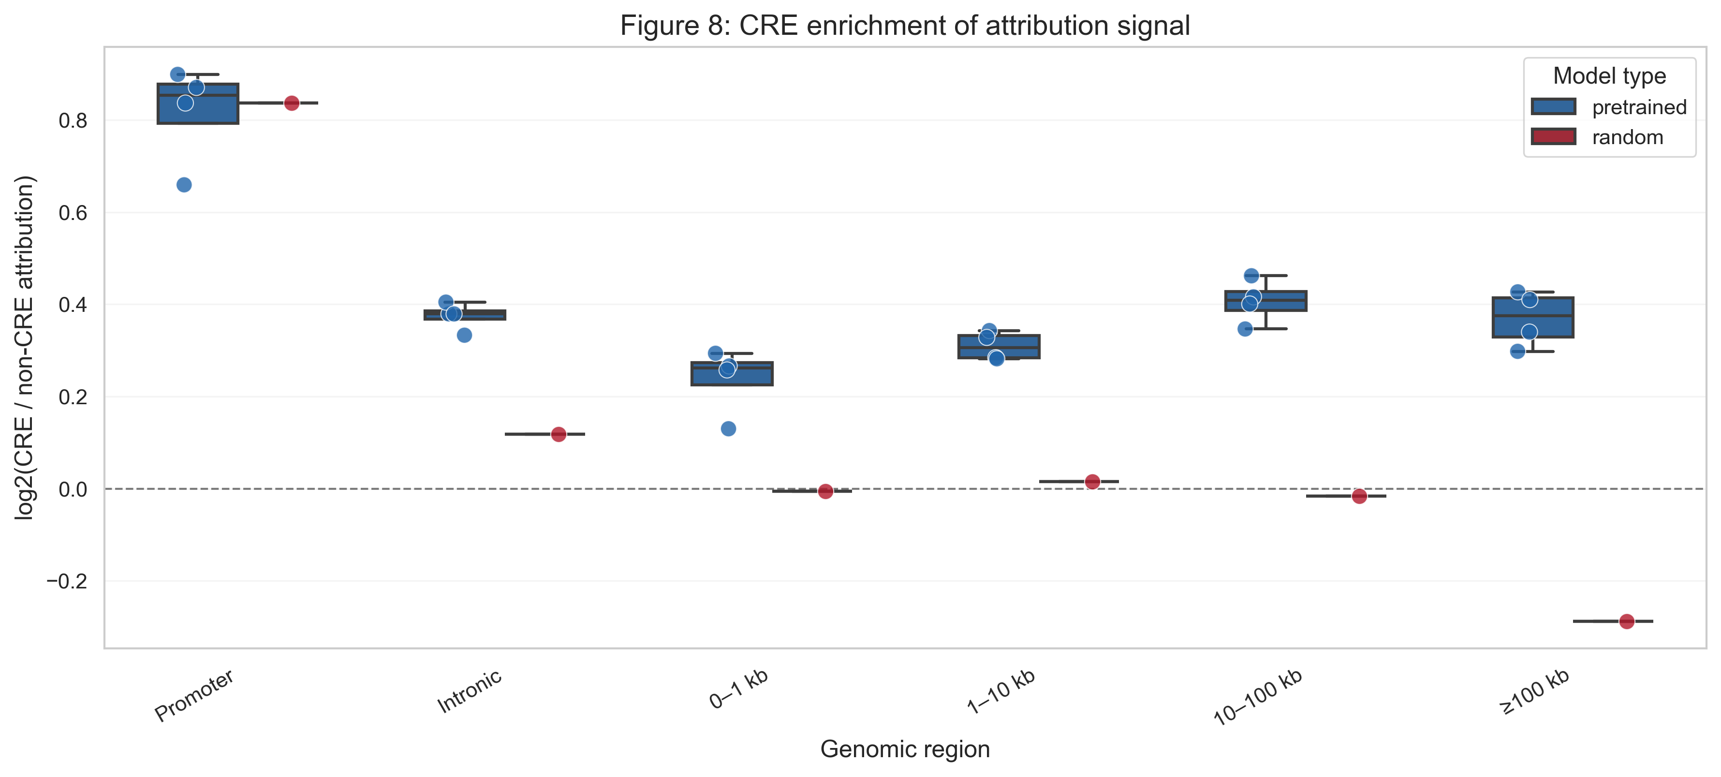
Pretrained model preferentially attributes importance to ATAC-accessible CRE regions
• Promoter CREs: log2 FC ~0.85 — strong enrichment in accessible chromatin
• Random model: near-zero enrichment at distal regions

Slide 12
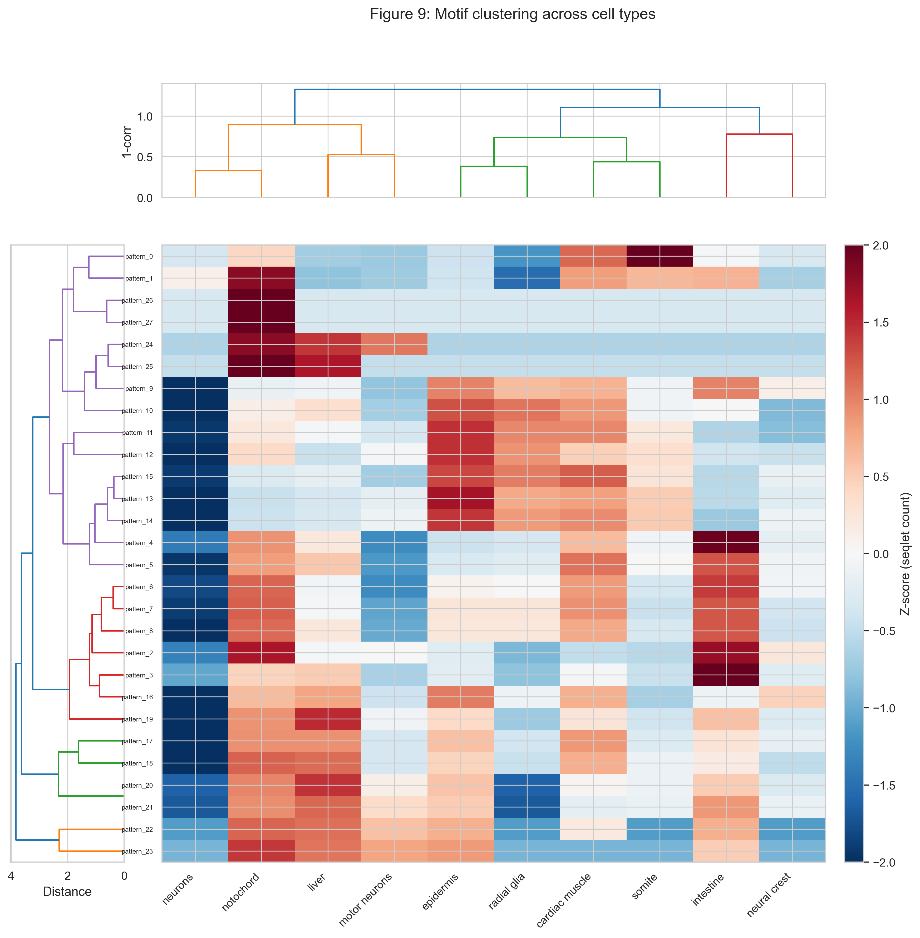
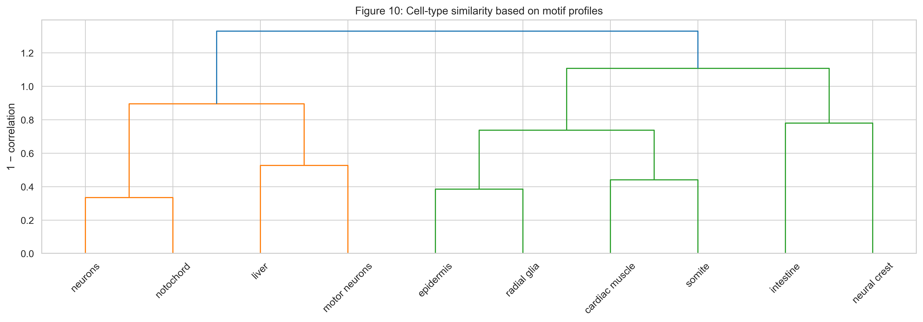
MoDISco recovers lineage-specific motif architectures across 10 focal cell types
Lineage clustering: neurons-notochord, epidermis-radial glia, cardiac muscle-somite

Slide 13
All DanioDecima findings replicate with DanioCell — the framework generalizes
Evaluation | DanioDecima (Zebrahub) | DanioCell | Status
Gene Pearson (pretrained) | 0.38 | 0.38 | Matched
Pretrained >> random | Yes (p < 0.001) | Yes (p = 0.014) | Replicated
Conservation independence | rho ~ 0 | rho = -0.07 | Replicated
Attribution in reg. regions | Promoter >> distal | Promoter >> distal | Replicated
CRE enrichment | ATAC FC > 0 | ATAC FC > 0 | Replicated
Motif clustering by lineage | 25 cell types | 10 focal types | Replicated
Directed evolution designs | Completed | Ready to run | Next step

Slide 14
Next: directed evolution on 153 cell types, then experimental validation
• In silico mutagenesis: Run gReLU design loop on DanioCell model for all 153 cell types
• Marker gene analysis: AUROC/AUPRC per cell type — predicted vs observed marker specificity
• Temporal regulatory dynamics: Leverage 14 stage groups to study regulatory changes across development
• Experimental validation: Select top designed regulatory elements for MPRA/reporter assay
• Model release: Package weights, scripts, and evaluation pipeline for the team

Slide 15
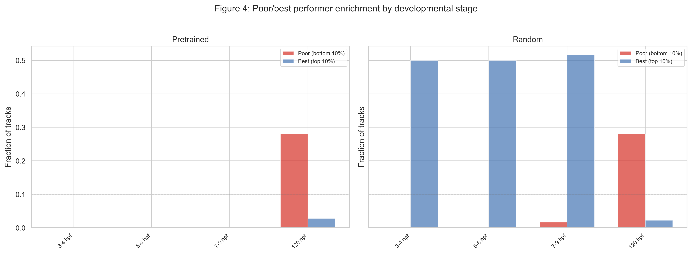
[Backup] 120 hpf is enriched for poor performers; early stages dominate best performers

Slide 16
[Backup] Full metrics for all 8 DanioCell experiments
Experiment | Group | Gene Pearson | Track Pearson
pretrained_rep0 | pretrained | 0.381 | 0.761
pretrained_rep1 | pretrained | 0.371 | 0.755
pretrained_rep2 | pretrained | 0.377 | 0.771
pretrained_rep3 | pretrained | 0.375 | 0.762
random_seed42 | random | 0.228 | 0.496
random_seed43 | random | 0.228 | 0.539
random_seed44 | random | 0.227 | 0.543
random_seed45 | random | 0.234 | 0.541

