Slide 1
We validated a fine-tuning framework on Zebrahub — can it scale to richer data?
• DanioDecima (Zebrahub): Pretrained >> random, conservation-independent, biologically meaningful attributions
• Key question: Does the same framework work with a different, richer atlas (DanioCell)?
• DanioCell advantage: 3.4x more pseudobulks, 2.5x denser cell-type x stage coverage, 14 stage groups
This talk: We show that all DanioDecima findings replicate with DanioCell — the framework generalizes

Slide 2
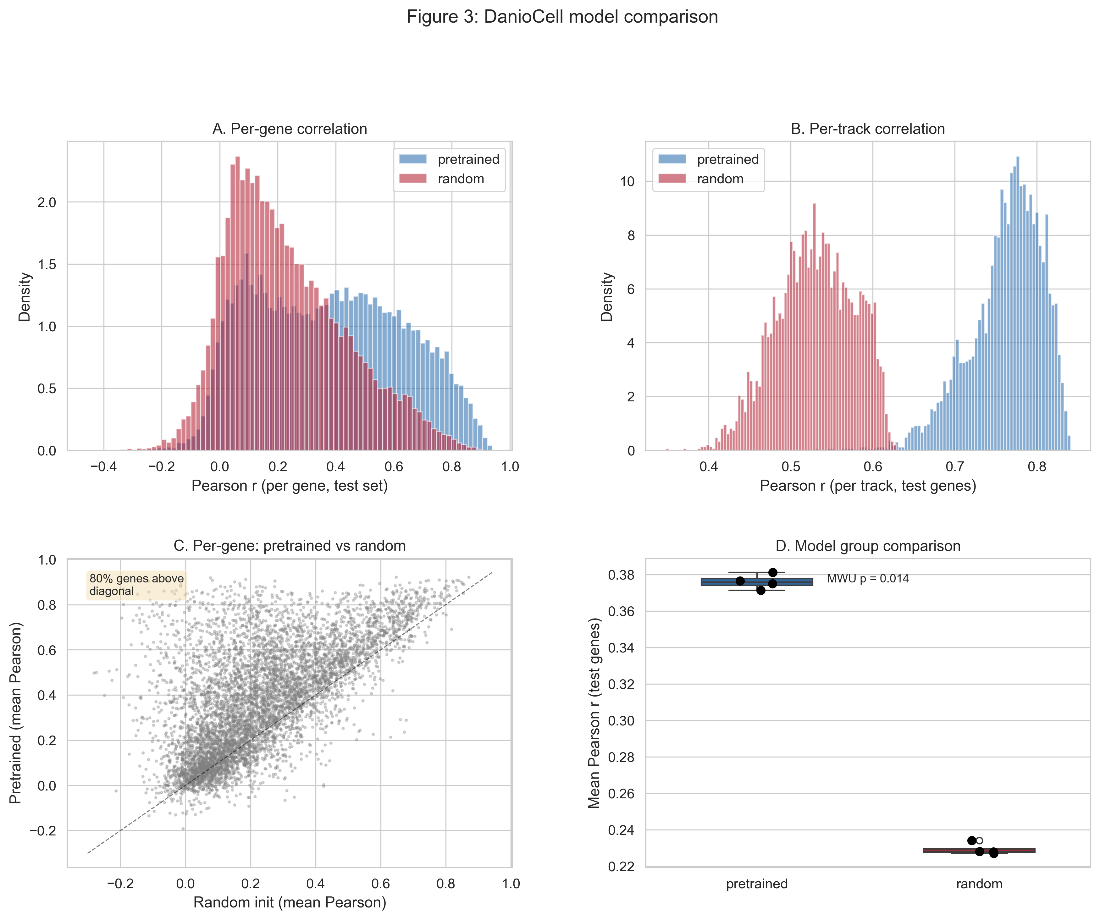
80% of test genes are better predicted by the pretrained model (MWU p=0.014)

Slide 3
Gene-level Pearson is identical (0.38); pretrained lift is actually larger (+0.23 vs +0.19)
Metric | Zebrahub | DanioCell
Track Pearson (pretrained) | 0.81 | 0.76 | More rare cell types
Track Pearson (random) | 0.62 | 0.53
Track lift | +0.19 | +0.23 | DanioCell > Zebrahub
Gene Pearson (pretrained) | 0.38 | 0.38 | Identical
Gene Pearson (random) | 0.24 | 0.23
Gene lift | +0.14 | +0.15 | Identical
Interpretation: Lower absolute track Pearson reflects more cell types (incl. rare), but the lift from pretraining is larger — the framework works even better with richer data

