Slide 1
Invitae hybrid capture sequencing
“HCS”

Slide 2
Background :
Lienna chose 16 RNA samples that were sequenced on seq 029 for Invitae.
Invitae performed hybrid capture sequencing method for these samples.
Purpose of this analysis is to compare invitae sequencing to the ARTIC tagmentation sequencing performed in house.
Invitae ran samples twice (Lane 1 - L001, and Lane 2 - L002) resulting in n = 2 (technical replicates)

Slide 3
How is it different from ARTIC (Both are target enrichment methods)
HCS
ARTIC
ds cDNA
Enrichment
Fragment gDNA And library prep
Multiplex with ARTIC primers
Probe annealing
(Twist respiratory panel)
Tagmentation
Enrichment
Index PCR
streptavidin bead capture and sequencing
Sequencing
Notes:
Generally, genomic DNA is fragmented using enzymatic or mechanical method. Indices are added at this step. The next step is to amplify the gene of interest using probed primers or streptavidin and pulled from the pool (capture step)

Slide 4
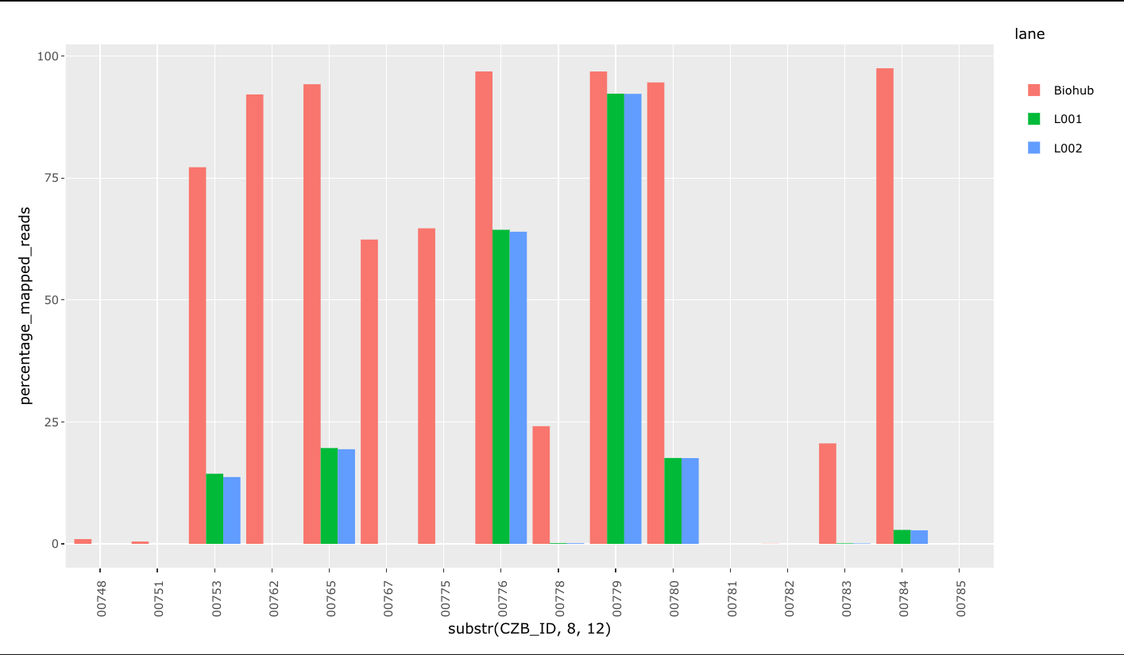
Mapped reads : reads that align to the reference genome (SARS-CoV-2)
Percentage mapped reads normalizes mapped reads to total reads outputted from Illumina sequencer

Slide 5
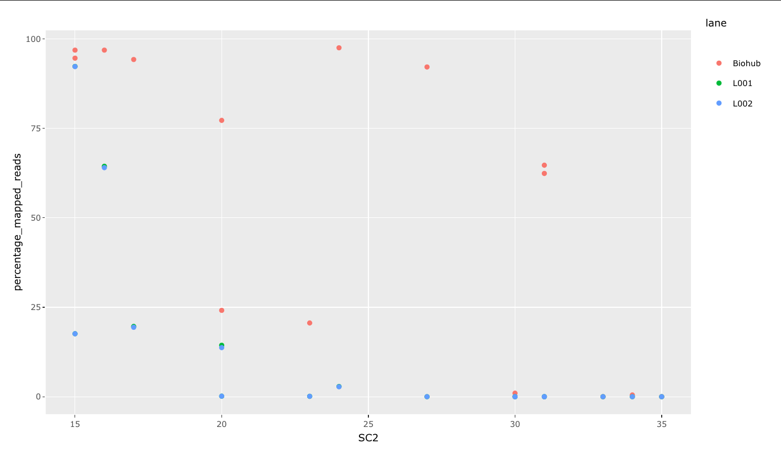
Mapped reads : reads that align to the reference genome (SARS-CoV-2)
HCS overall has significantly less mapped reads than the ARTIC method

Slide 6
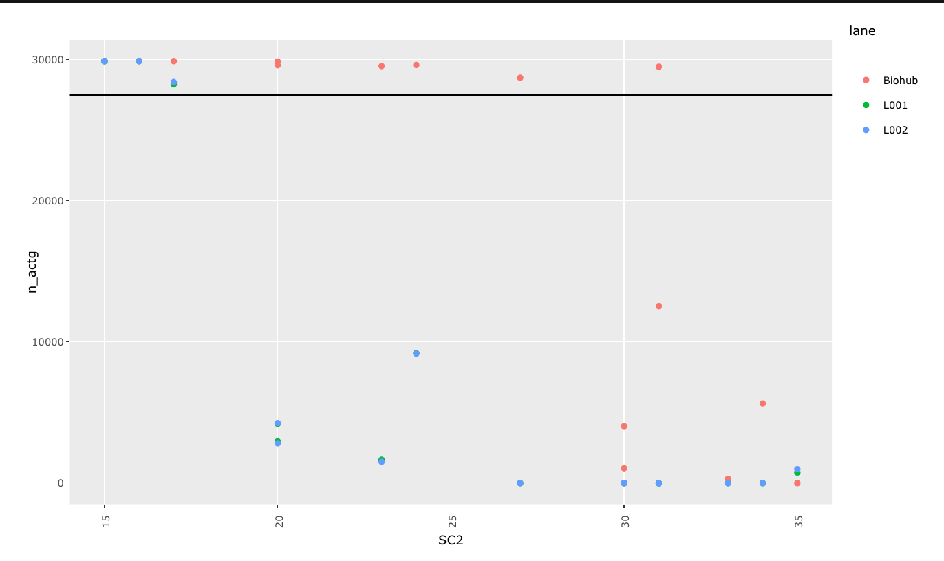
Genome recovery : SARS-CoV-2 bases recovered in consensus generation
HCS overall has significantly less genome recovery than the ARTIC method (HCS pass genomes = 4 vs ARTIC = 10)

Slide 7
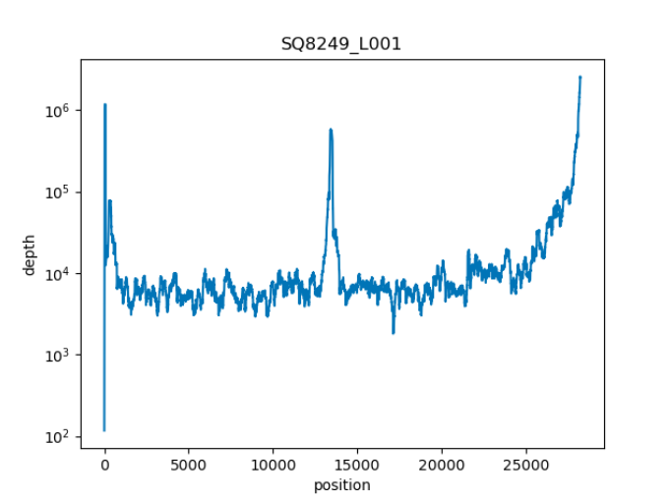

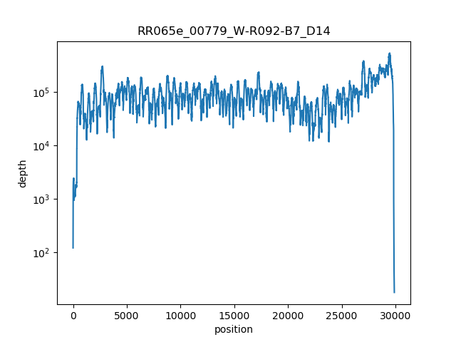
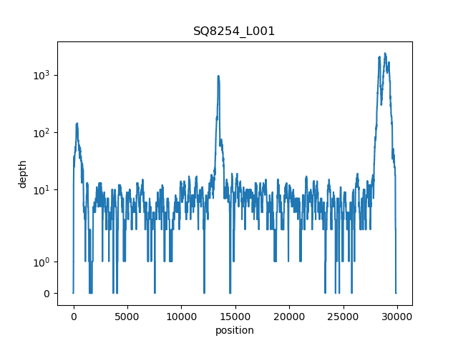
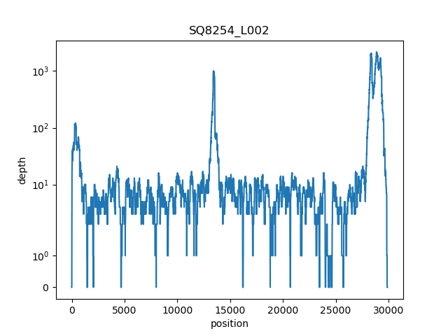
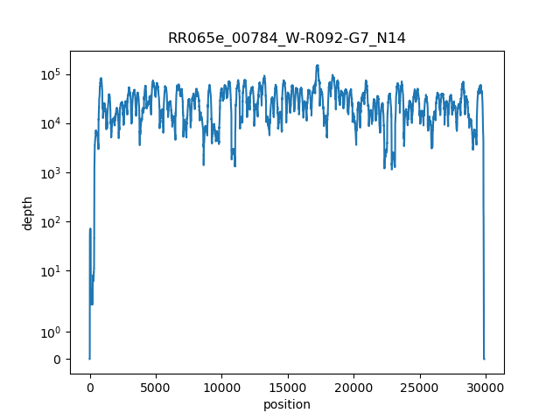
Depth Average : average depth of the reads aligning to SARS-CoV-2 genome HCS shows less coverage than ARTIC tagementation
PASSED > 29K
PASSED > 29K
HCS
Biohub
FAILED ~ 9K
PASSED > 29K
Notes:
Depth average comparison (coverage plot) Comparitive coverage plots for samples that passed , close to pass, and failed

Slide 8

Nextstrain profile:
Ambiguous bases
Missing bases
Consistent. (full genome : ~ 29k)
SNPs
gaps
Non - Consistent. (full genome : ~ 29k each)
Ambiguous bases
Missing bases
SNPs
gaps

Slide 9
ivar consensus is set to 0.9 by default, so the dominant allele must have 90% frequency to be called.
sample | pos | ref % read depth | Alt % read depth
RR065e_00779 | 28760 | 36 | 64
SQ8249_L001 | 28760 | 0.01 | 99.99
SQ8249_L002 | 28760 | 0.01 | 99.99
sample | pos | ref % read depth | Alt % read depth
RR065e_00780 | 28760 | 30 | 70
SQ8250_L001 | 28760 | 0.02 | 99.98
SQ8250_L002 | 28760 | 0.02 | 99.98

