Slide 1
B 1.1.7 variant analysis using sc2-illumina-pipeline

Slide 2
Through our pipeline we have not recorded any B 1.1.7 variant so far.
Run sc2-illumina-pipeline with already existent sra reads of B.1.1.7 variant .
The sample I chose was :
GISAID name : England/ALDP-E2DF4E/2021
Author : Jacquelyn Wynn et al.
Clade : 20I/501Y.V1
Downloaded SRA reads from NCBI for the above sample

Slide 3
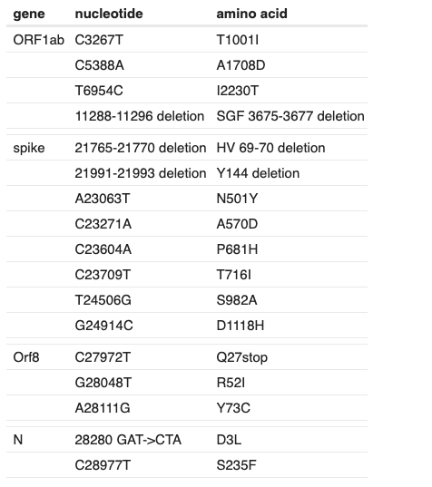
Genomic characterization of B.1.1.7 variant
Report written by Andrew Rambaut, source : here

Slide 4
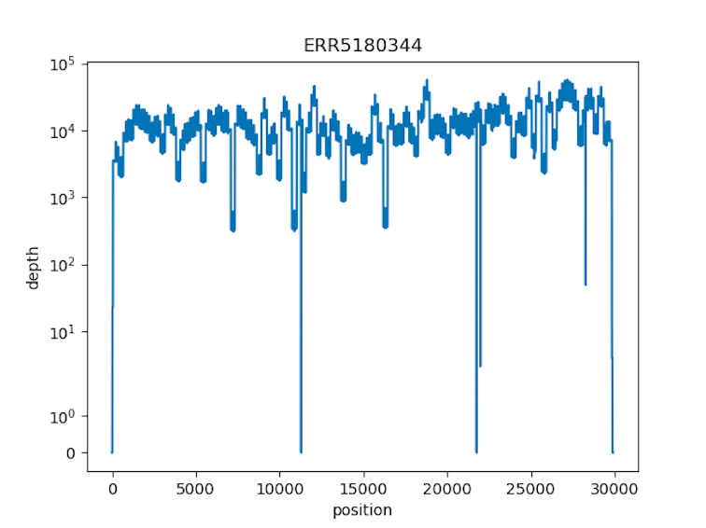
Summary on genome recovery and mapped reads
sample_name | depth_avg | mapped_reads | total_reads | n_actg | ref_snps
ERR5180344 | 11762.315 | 1931829 | 1955362 | 29798 | 31
Report written by Andrew Rambaut, source : here

Slide 5
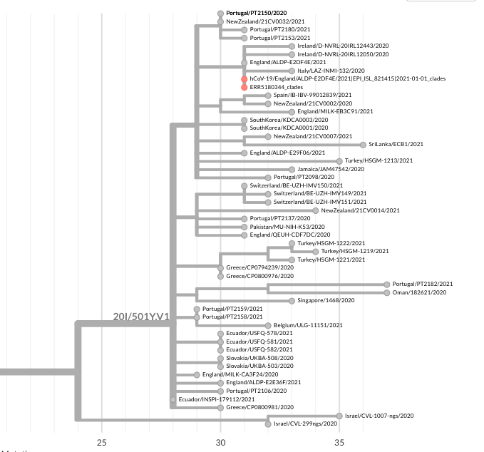
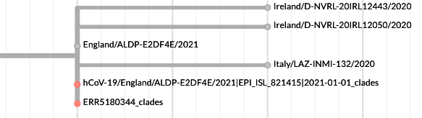
Biohub re-run comparison with the original England/ALDP-E2DF4E/2021 consensus
Consensus downloaded from GISAID
Ambiguous bases
Missing bases
SNPs
gaps
Biohub rerun for England/ALDP-E2DF4E/2021

