Slide 1
ENGI 301 SpotiBox Proposal
2/25/2024
Cameron Erber

Slide 2
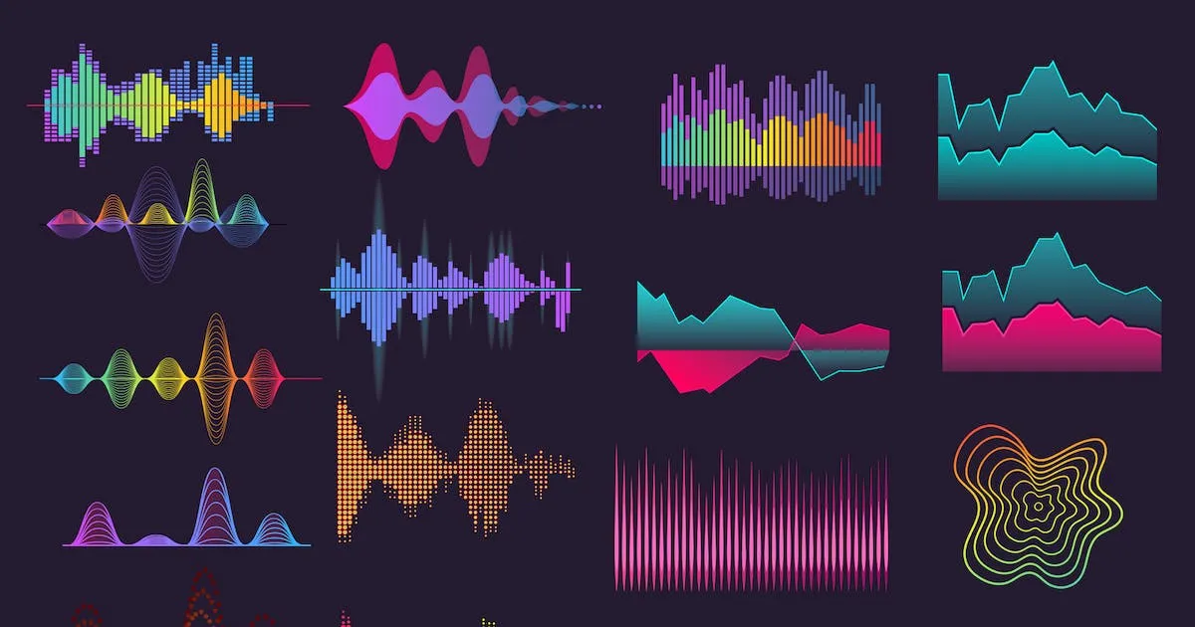
Background Information
Music is a medium that directly influences mood and can transport you to another world. To accentuate the experience that music provides, additional senses can be included. A main sense that has been focused on with success is the creation of a visual complement to the audio. A device can be constructed to create a visual representation
in essence, a music “visualizer”

Slide 3
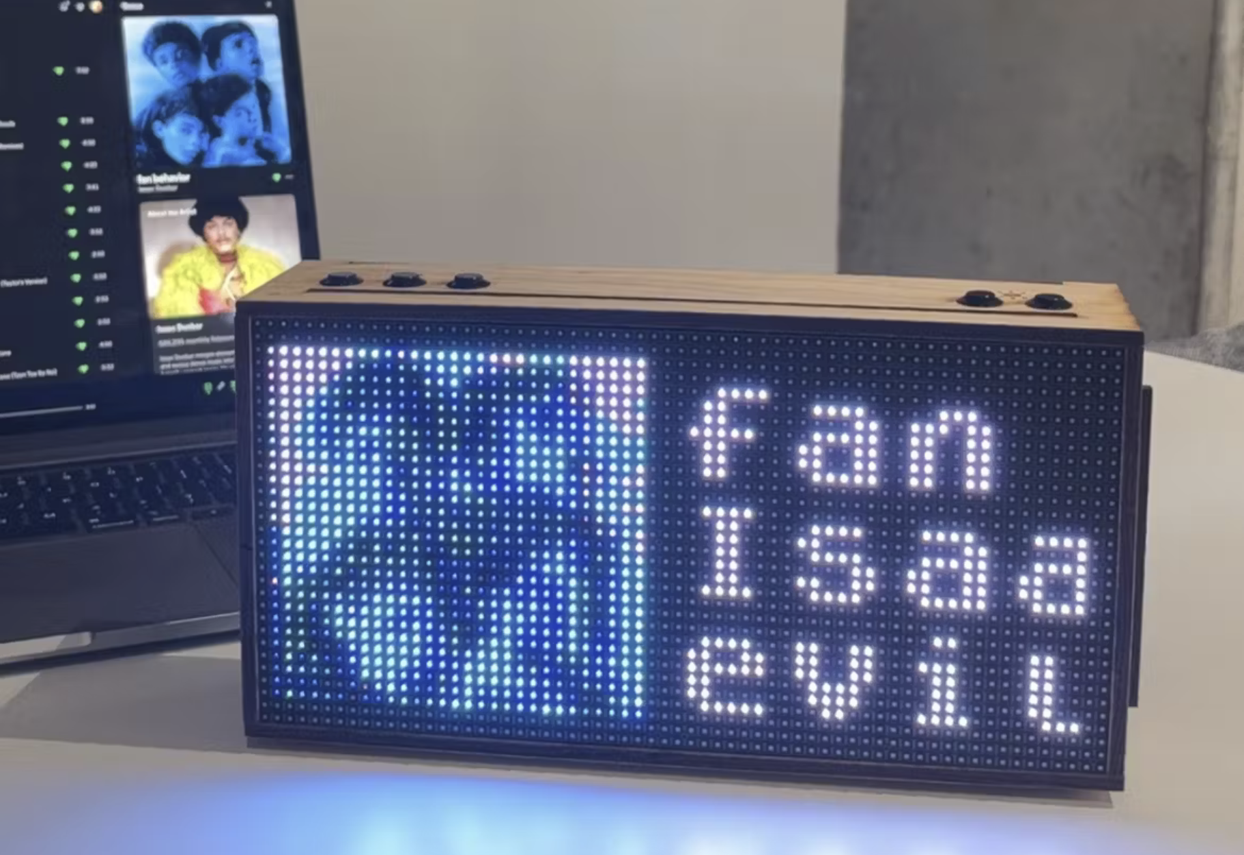
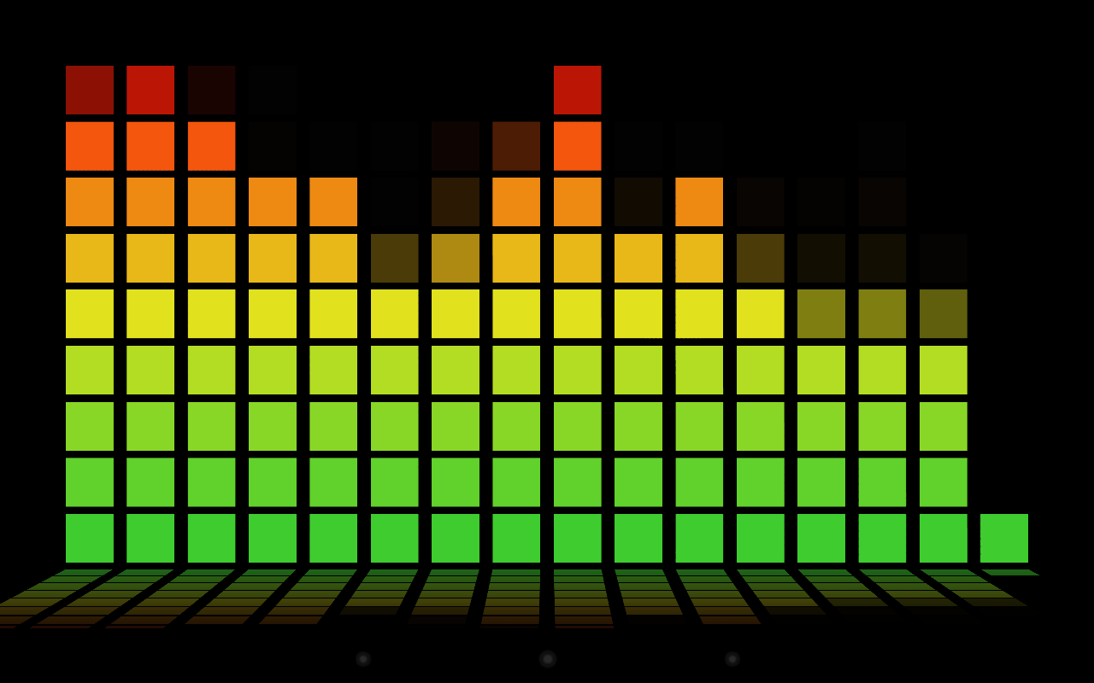
Device Proposal
A dedicated desktop music visualizer with Spotify integration
Builds off of previous ENGI 301 project “TICKER” by Robert Heeter
Project/code: https://www.hackster.io/rcheeter/ticker-led-matrix-widgets-via-wifi-with-a-pocketbeagle-edd915
Added features
Realtime music visualizer
Based on audio frequency composition, tempo, “tatums”, and loudness from Spotify API
Color matching of visualizer and device UI with album art
Auto-brightness (light sensor)

Slide 4
System Block Diagram
Power button
5V Power adapter
USB Wifi adapter
VIN
Shift Register
1
LED Matrix Left
PocketBeagle
Red A
Red A
Blue A
Blue A
GPIO
Red B
Red B
Select A
Select A
Select C
Select C
Clock
Clock
OE
OE
USB Breakout
Shift Register
2
LED Matrix Right
Green A
Green A
Green B
Green B
USB1
GPIO
Select B
Select B
Select D
Select D
Latch
Latch
GPIO
I2C1
SCL
SDA
Play/Pause/Skip/Rewind
Light sensor

Slide 5
Power Block Diagram
Power button
Ground
5V Power adapter
USB Wifi adapter
5V
Ground
5V
VIN
Shift Register
1
LED Matrix Left
PocketBeagle
Ground
VOUT
5V
Ground
Ground
5V
USB Breakout
Shift Register
2
LED Matrix Right
5V
USB1
3.3 V
3.3V
Ground
Ground
GPIO
I2C1
Ground
Ground
Ground
Play/Pause/Skip/Rewind
Light sensor

Slide 6
Components / Budget
Component | ENGI301 to Buy? | Cost
PocketBeagle | N/A | N/A
64x32 RGB LED Matrix - 4mm pitch https://www.adafruit.com/product/2278 | Yes | $39.95
Adafruit BH1750 Light Sensor https://www.adafruit.com/product/4681 | Yes | $4.50
Adafruit 5V / 4A Power supply wall adapter https://www.adafruit.com/product/1466 | Yes | $14.95
TP-Link USB Wifi Adapter https://a.co/d/ig5AckR | Maybe | $9.99
TXS0108E Level Shifter 3.3V / 5V (5 Pack) https://a.co/d/a8qwK6o | N/A | N/A
Female DC Power adapter - 2.1mm jack to screw terminal block https://www.adafruit.com/product/368 | N/A | N/A
RR511D1121 On/off rocker https://www.digikey.com/en/products/detail/e-switch/RR511D1121/2116256 | N/A | N/A
Press button | N/A | N/A
USB Type A Female Breakout | N/A | N/A
N/A = already have / from OEDK

Slide 7
Software
Main points of action:
Power on
Main class
Set display brightness → brightness class
Brightness class
Convert sensor output to RGB brightness level and output
Set welcome display
Initialize spotify token access → spotify_initializer class
Try request access token → if failed, get new and repeat
Display music visualizer → visualizer class
Get track title / album art and display
Get song data, perform fft and display
Button
Always waiting for button press
Single press → play song if paused or pause song if playing
Double press → skip song
Triple press → previous song

Slide 8
SW Flow Diagram
Power on
Receive light sensor output
Convert to LED matrix brightness
Update LED matrix brightness
Display Brightness
Set Welcome Display
Display brightness class
Main class
If false
Spotify initializer
Request access token
Check access token
After 1 hr
Visualizer
If false
Button pressed
Every song
Spotify initializer class
Visualizer class
Button press
Single press
Song playing
Request current song data
Play song
Display track title
Display track art
Double press
Triple press
Pause song
Song paused
Get track audio data
Perform FFT
Display waveforms
Set brightness
Skip song
Previous song

