Slide 1
ENGI 301 SpotiBox Proposal
2/25/2024
Cameron Erber

Slide 2

Background Information
Music is a medium that directly influences mood and can transport you to another world. To accentuate the experience that music provides, additional senses can be included. A main sense that has been focused on with success is the creation of a visual complement to the audio. A device can be constructed to create a visual representation
in essence, a music “visualizer”

Slide 3
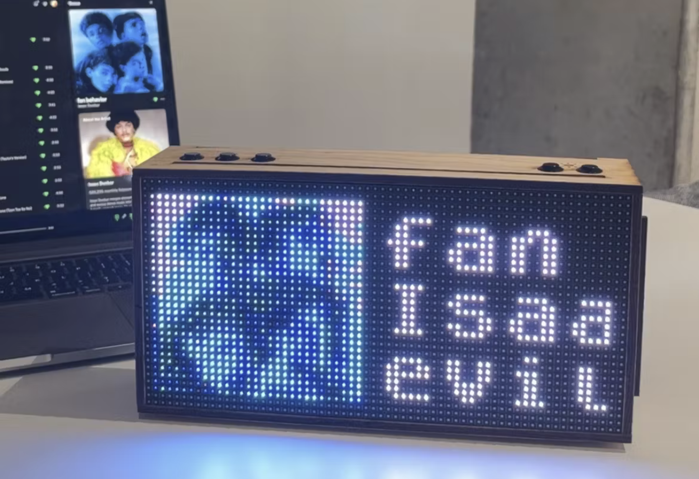

Device Proposal
A dedicated desktop music visualizer with Spotify integration
Builds off of previous ENGI 301 project “TICKER” by Robert Heeter
Project/code: https://www.hackster.io/rcheeter/ticker-led-matrix-widgets-via-wifi-with-a-pocketbeagle-edd915
Added features
Realtime music visualizer
Based on audio frequency composition, tempo, “tatums”, and loudness from Spotify API
Color matching of visualizer and device UI with album art
Auto-brightness (light sensor)

Slide 4
System Block Diagram
Power button
5V Power adapter
USB Wifi adapter
VIN
Shift Register
1
LED Matrix Left
PocketBeagle
Red A
Red A
Blue A
Blue A
GPIO
Red B
Red B
Select A
Select A
Select C
Select C
Clock
Clock
OE
OE
USB Breakout
Shift Register
2
LED Matrix Right
Green A
Green A
Green B
Green B
USB1
GPIO
Select B
Select B
Select D
Select D
Latch
Latch
GPIO
I2C1
SCL
SDA
Play/Pause/Skip/Rewind
Light sensor

Slide 5
Power Block Diagram
Power button
Ground
5V Power adapter
USB Wifi adapter
5V
Ground
5V
VIN
Shift Register
1
LED Matrix Left
PocketBeagle
Ground
VOUT
5V
Ground
Ground
5V
USB Breakout
Shift Register
2
LED Matrix Right
5V
USB1
3.3 V
3.3V
Ground
Ground
GPIO
I2C1
Ground
Ground
Ground
Play/Pause/Skip/Rewind
Light sensor

Slide 6
Components / Budget
Component | ENGI301 to Buy? | Cost
PocketBeagle | N/A | N/A
64x32 RGB LED Matrix - 4mm pitch https://www.adafruit.com/product/2278 | Yes | $39.95
Adafruit BH1750 Light Sensor https://www.adafruit.com/product/4681 | Yes | $4.50
Adafruit 5V / 4A Power supply wall adapter https://www.adafruit.com/product/1466 | Yes | $14.95
TP-Link USB Wifi Adapter https://a.co/d/ig5AckR | Maybe | $9.99
TXS0108E Level Shifter 3.3V / 5V (5 Pack) https://a.co/d/a8qwK6o | N/A | N/A
Female DC Power adapter - 2.1mm jack to screw terminal block https://www.adafruit.com/product/368 | N/A | N/A
RR511D1121 On/off rocker https://www.digikey.com/en/products/detail/e-switch/RR511D1121/2116256 | N/A | N/A
Press button | N/A | N/A
USB Type A Female Breakout | N/A | N/A
N/A = already have / from OEDK

