Slide 1
Model overview
X (B,in_ch,H,W)
X (B,out_ch,H,W)
Variable depth
Variable number of residual blocks
Optional attention blocks in every layer
Variable chanel proportions
In conv
Out conv
T emb
T emb
T emb
T emb
ResNet Block
Attention block (optional)
ResNet Block
Downsampling block
h (B, 2*ch,H,W)
ResNet Block
Attention block (optional)
ResNet Block
h (B,ch,H,W)
h (B,4*ch,H/4,W/4)
h (B,4*ch,H/2,W/2)
T emb
T emb
h (B,2*ch,H/2,W/2)
ResNet Block
ResNet Block
Downsampling block
ResNet Block
ResNet Block
Upsampling block
h (B, ch,H,W)
T emb
T emb
ResNet Block
Attention block
ResNet Block
Upsampling block
h (B,2*ch,H/2,W/2)
T emb
T emb

Slide 2
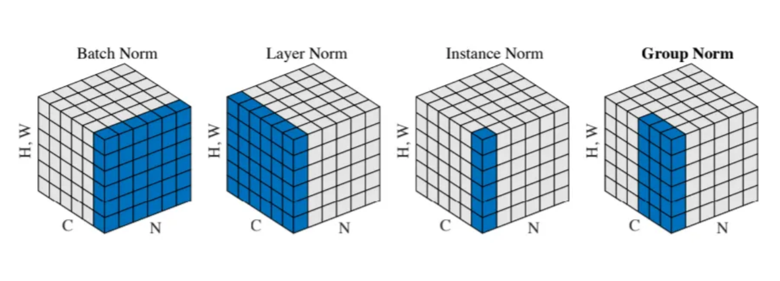
ResNET block overview
X (B,ch,H,W)
Groupnorm
Non. Lin.
Conv2D
Conv2D
Non. Lin.
Non. Lin.
dropout
Y (B,ch,H,W)
T embedding (B, ch)
Conv2D
Non. Lin.
T embedding (B, ch,1,1)
Group norm: https://medium.com/@zljdanceholic/groupnorm-then-batchnorm-instancenorm-layernorm-e2b2a1d350a0

Slide 3
Attention block overview
Input image:
3 chanels, RGB
K_”pixel”_4
K_”pixel”_1
K_”pixel”_2
K_”pixel”_3
- Has residual connection
Attention is performed on each immage seperately
Attention is performed between image pixels
Pixel1 | Pixel2
Pixel3 | Pixel4
Attention matrix:
X (B,ch,H,W)
Y (B,ch,H,W)
Q_”pixel”_1
 | Influence of pixel 2 on pixel 1
Attention block
Q_”pixel”_2
Q_”pixel”_3
Q_”pixel”_4

