Slide 1

ANALYTICS FOR REVENUE GROWTH team BrAVO
DATA SCIENCE AND ECONOMICS
#NewAppliedNow
18-03-2022

Slide 2

AGENDA
Agenda
RECAP:
Business case
Dataset
WHAT:
Context
Business questions
HOW:
Data Exploration
Data Issues
What comes ahead

Slide 3
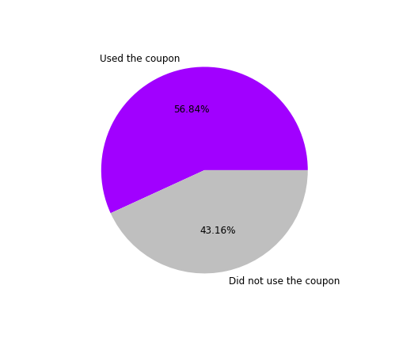
The data we are working with
Data Exploration
The dataset is composed of 12684 rows and 26 columns.
All variables are categorical and deliver relevant information regarding:
Coupon characteristics (coupon type, expiration time)
Context (weather, temperature, time, passenger type)
User demographics (gender, age, income)
Info on the trip (direction compared to the coupon, distance from the coupon, destination)
The dataset is very balanced, 56.84% of surveyed customers would use the coupon

Slide 4
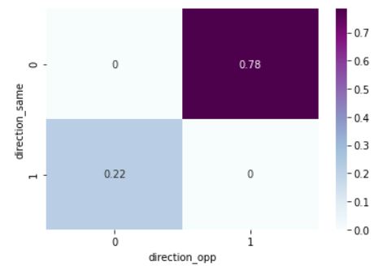
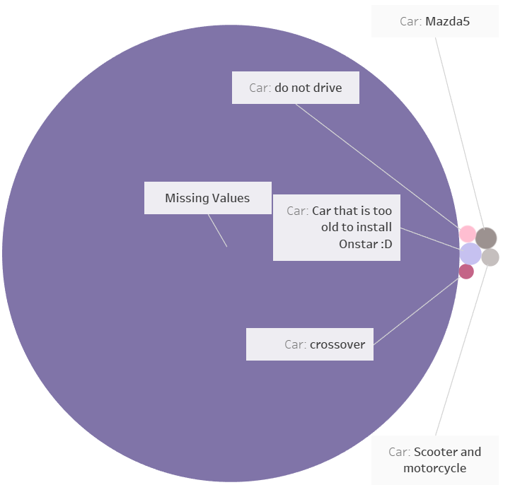
Non-informative variables
The dataset contains two different dummy variables: ‘direction_same’ and ‘direction_opp’ describing the same information.
Without losing info, we dropped one.
"Car" variable is predominantly composed of missing values. The number of contained instances for each of existing category is less than 1% of the total number of observations.
Therefore, we dropped the "car" variable.

Slide 5
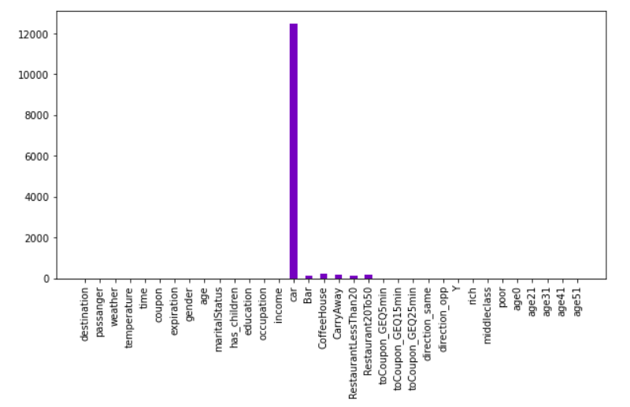


NA Values
NAs
To deal with the remaining NAs, two approaches have been tried and tested:
Dropping all NAs
Filling NAs with “no info” category
However, the two methods resulted in no difference between with regards to the Logistic Regression scores.
We retained the information.

Slide 6
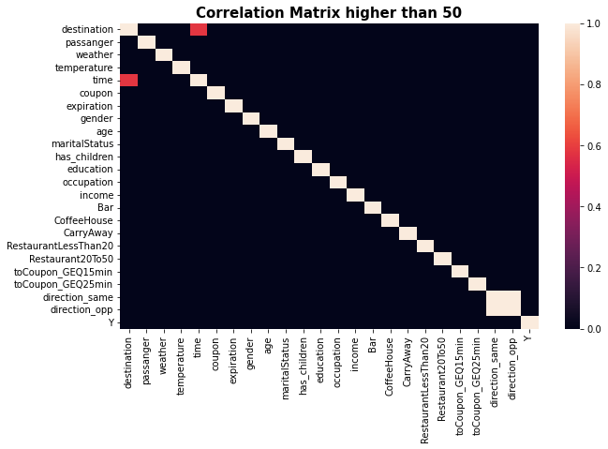

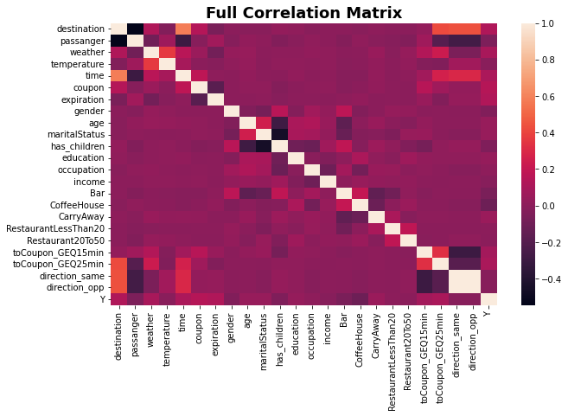
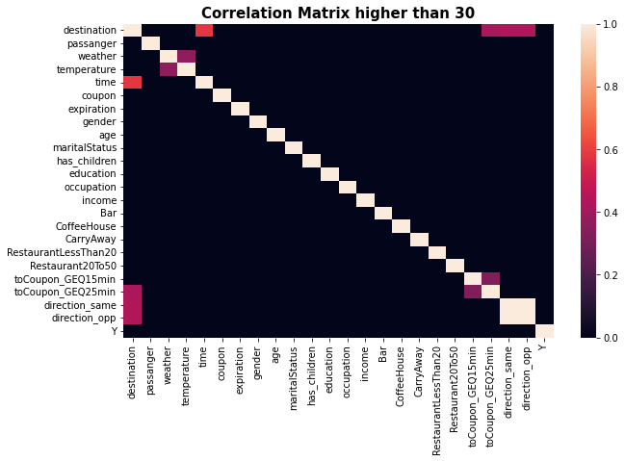
Correlation between variables
It appears there is hardly any correlation between the variables with the vast majority of them having less than 30% of correlation.
Variable Relationships Analysis

Slide 7

Binning of categories
Feature Engineering: Binning
The binning of categories requires to take those variables with a high number of unique values and try and combine them in macro-categories.
The binning technique has been applied to:
Destination (“urgent destination” and “other”)
Passenger (“Alone” and “Not Alone”)
Weather (“Good” and “Bad”)
Income (“Rich”, “Middle Class” and “Poor”)
Time (“Conventional” and “Unconventional”)
Occupation

Slide 8
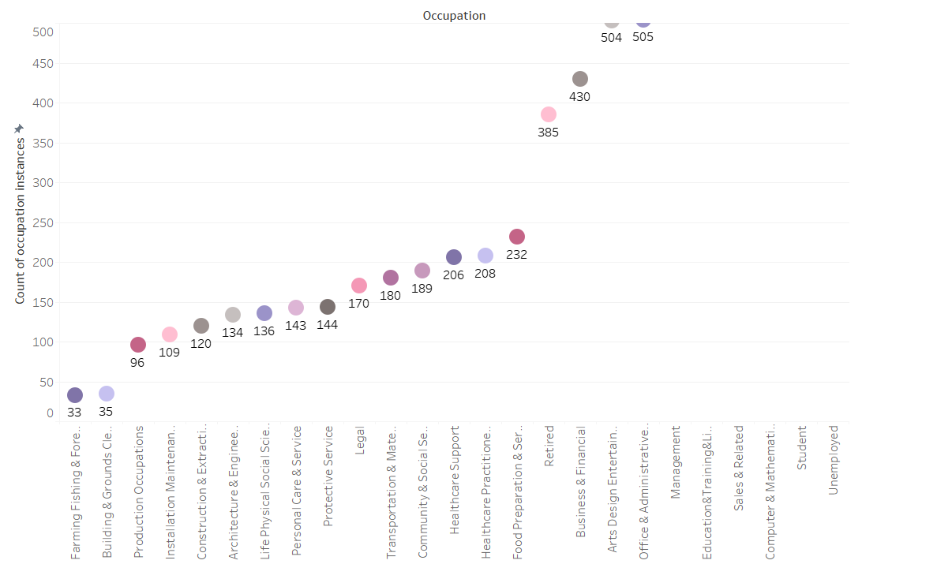
Occupation Binning
"Occupation" feature contains multiple categories, but 3 of them are under-represented (less than 101 observations, identified threshold). They are:
Farming Fishing & Forestry
Building & Grounds Cleaning & Maintenance
Production Occupations
We decided to group them in a new category "no_info_occupation".

Slide 9
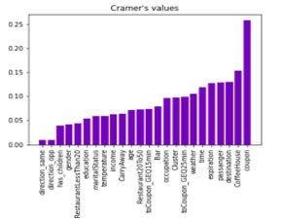

Frequency encoding
Feature Engineering: Frequency Encoding
Frequency encoding is a technique that uses the frequency of the categories as labels.
Supports the model by acting as input for placing the right weight to the various categories.
Frequency Encoding has been applied to strong predictors:
Coupon
Destination
Passenger
Weather

Slide 10
Feature engineering: recap
Feature Engineering: Recap
To improve on future model performances, two different methods of feature engineering have been tried and tested:
Binning of categories
Frequency Encoding
However, the two methods did not support the model performance.

Slide 11
Thank you

Slide 12
Getting to know the features
The weather, the time settings and the company the driver is with can have impact on their decision to use the coupon.
Data Exploration
Some kinds of food places can be preferred during a car trip compared to others.
We expect the eating out habits of the users to line up with their preference on the choice of coupons.
Coupon Characteristics
Type of place the coupon is for
Time from the expiration date
Context
Temperature
Time
Passenger in the car
User Demographic
Weather
Age
Income
Education
Info on the trip
Destination
Direction compared to the coupon
Distance from the coupon
Eating out habits
Users that have no urgent destination can be more inclined to add a stop to a food place.
Users might be more inclined to use the coupon if the outlet is in the same direction of their destination.
The age of the user, his purchasing power, how much he's used to eating out and where play key factors on the willingness of the user to use the coupon

Slide 13
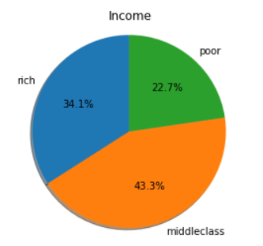
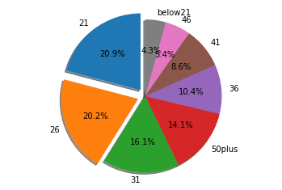
Data distributions
Some demographics are under-represented.
The data from the study might not be exactly describing the behaviour of the whole population on these instances.
Data Exploration
(Exploded slices represent most present categories)
(Values of the original dataset have been assigned to the class according to a given threshold)
Finding: The "below21" demographic is severely under-represented.
This category could be a key demographic of our service.
Finding: Most of the other variables seem to be well differenciated

Slide 14

Dealing with DATA ISSUES
Problem: dataset contains 74 identical rows.
Data Issue
Implications:
0.0058% of total instances are duplicated
Could be misreported data that will bias our analysis
Treatment identified:
Given the categorical nature of the dataset, we assume users have genuinely given the same answers. We retained the data.

Slide 15
DEALING WITH Data ISSUES
Problem: dataset contains missing values.
Data Issue
Implications:
The car column has 99% missing values and is not adding information.
We have to understand the reason behind missing values.
Treatment identified:
The "car" column was dropped. The remaining missing values, probably due to users not willing to respond to certain questions, are also dropped as they are few and the sample size is big enough.

Slide 16



What comes ahead
Next Steps
- Investigating the relationships between features and how they affect the use rate of the coupons
- Extract data insights from variables interactions
- Choosing the features more useful to explain coupons' use
- Creating a model able to recognize which type of customers are more likely to use the coupon

Slide 17
Dealing with categorical variables
Categorical variables take values within a discrete set of values (either nominal or numeric).
In case of nominal levels, the raw format has to be modified in order to be worked by certain machine
learning algorithms (e.g. logistic regression). In the following some techniques are listed:
Converting nominal levels to a range of numbers (drawback: numerical values might not reflect the real relationaship within and across the features. The assigned numbers also implies an ordinal relationship of levels within the feature. It's a possible solution for ordinal variables).
One-Hot Encoding (drawback: a new feature for each level of each categorical variable lead to expansion of the feature space linearly in the number of levels. The presence of lots of categorical variables create a new sparse dataset. Dropping techniques can be exploited to reduce the number of new variables)
Additional implications: increasing the number of features might lead to a multi-collinearity problem to be analysed. Moreover, some categories are barely represented and they might be incorporated into other categories. Additionally, penalized regressions models can be applied for sparse data (e.g. regularization using Lasso or Ridge).

Slide 18
Relevance of features and categories

Slide 19
ANALYTICS FOR REVENUE GROWTH team BrAVO
DATA SCIENCE AND ECONOMICS
#NewAppliedNow
18-03-2022

Slide 20
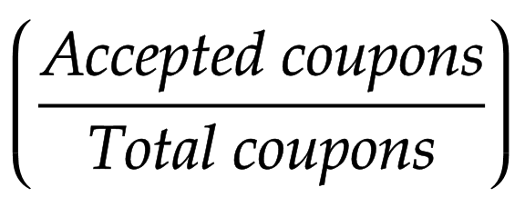
Quick recap
Recap
Our Business Problem: Users are travelling in their vehicle; we suggest them a food place coupon with a discount on their on-board system, which coupons will be accepted?
What comes ahead:
Empirical Relationship Analysis through the Acceptance Rate
The data we're working with:
User demographics and habits information
Context information (weather, temperature, time)
Trip information (direction compared to the coupon, distance from the coupon, destination)
Coupon characteristics (food place, expiration time)
Quantitative Relationship Analysis with technical methods
Acceptance Rate

Slide 21


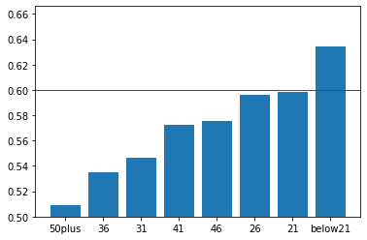
How demographic infos affect acceptance rate
Relationships Analysis
Age:
Income:
Income Bracket | Acceptance Rate​
Lower | 0.58
Middle | 0.58
Upper | 0.53
Youngest age brackets are the best responders in the survey
People with less income seem to be more responsive
- Gender, education and occupation don't seem to have any relevant pattern from a first empirical analysis

Slide 22




Context matters
Relationships Analysis
The time of day:
Users seem to be more responsive to the service when in certain contexts
Time of day | Acceptance Rate
7AM | 0.50
10PM | 0.50
6PM | 0.58
10AM | 0.60
2PM | 0.66
The destination of the trip seems to matter:
when people are not driving to any urgent place rate goes up from 50 to 63
The temperature looks to be an important factor:
on hot days, the rate goes from 53 to 60
The current passenger:
Very good performances
Passenger | Acceptance Rate
Kid(s) | 0.50
Alone | 0.52
Partner | 0.59
Friend(s) | 0.67

Slide 23



Some coupons work, some don't...
Relationships Analysis
The coupon characteristics give us an outline of which coupons users prefer
Clear preference for Coupon Type:
Short Expiration dates are not preferred:
short term expiration dates have acceptance rate <50 while day long coupons have 60.
Coupon Type | Acceptance Rate
Bar | 0.41
Restaurant (20$-50$) | 0.44
Coffee House | 0.49
Restaurant (<20$) | 0.70
Carry out | 0.73
Places that are comfortable to reach are preferred:
Higher distances and changes in direction are less likely to be accepted.
Distance | Same direction | Opposite direction
5 min | 0.62 | 0.60
15 min | 0.56 | 0.53
25 min |  | 0.42

Slide 24

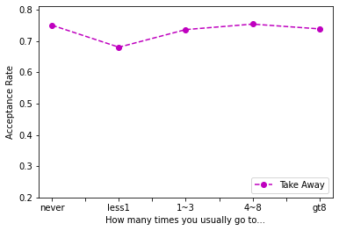
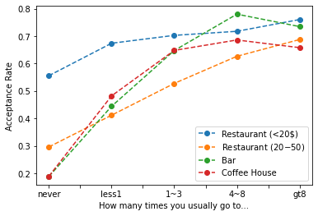
Do habits reflect behaviour?
The habits variables have visible linear relationships with the acceptance rate
This doesn't hold up for the top performer variable "Take Away".
People just love take aways.

Slide 25
NA Values
NAs
To deal with the remaining NAs, two approaches have been tried and tested:
Dropping all NAs
Filling NAs with “no info” category
However, the two methods resulted in no difference between with regards to the Logistic Regression scores.
We retained the information.

Slide 26
Correlation between variables
It appears there is hardly any correlation between the variables with the vast majority of them having less than 30% of correlation.
Variable Relationships Analysis

Slide 27
Binning of categories
Feature Engineering: Binning
The binning of categories requires to take those variables with a high number of unique values and try and combine them in macro-categories.
The binning technique has been applied to:
Destination (“urgent destination” and “other”)
Passenger (“Alone” and “Not Alone”)
Weather (“Good” and “Bad”)
Income (“Rich”, “Middle Class” and “Poor”)
Time (“Conventional” and “Unconventional”)
Occupation

Slide 28
Frequency encoding
Feature Engineering: Frequency Encoding
Frequency encoding is a technique that uses the frequency of the categories as labels.
Supports the model by acting as input for placing the right weight to the various categories.
Frequency Encoding has been applied to strong predictors:
Coupon
Destination
Passenger
Weather

Slide 29
Non-informative variables
The dataset contains two different dummy variables: ‘direction_same’ and ‘direction_opp’ describing the same information.
Without losing info, we dropped one.
"Car" variable is predominantly composed of missing values. The number of contained instances for each of existing category is less than 1% of the total number of observations.
Therefore, we dropped the "car" variable.

Slide 30
Occupation Binning
"Occupation" feature contains multiple categories, but 3 of them are under-represented (less than 101 observations, identified threshold). They are:
Farming Fishing & Forestry
Building & Grounds Cleaning & Maintenance
Production Occupations
We decided to group them in a new category "no_info_occupation".

Slide 31

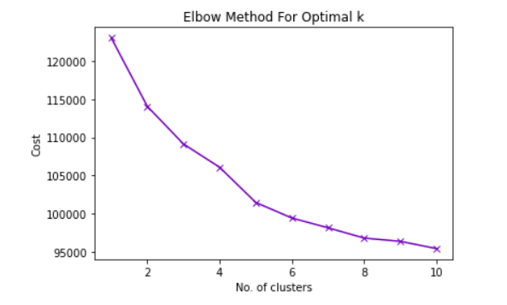
Relations between variables
Relations between the dependent variable and the other regressors have been evaluated using the Chi-square test and Cramer's Value.
"Direction_opp" and "direction_same" result to be independent respect to Y.
"Coupon" feature is the most relevant to explain Y.
Instances have been clustered using Kmodes and the number of clusters has been chosen using the elbow method:
6 clusters have been selected and variable "Cluster" has been added.

Slide 32
Final Cleaning and One-hot encoded dataset
Variable 'toCoupon_GEQ5min' has been dropped, since all the instances had the same value.
After having modified the dataset as discussed in the previous slides, the onehot-encoded dataset has been created,composed by 95 columns.
Correlation tests reported strong correlation between variables 'destination_Work' and 'time_7AM'. 'time_7AM' has been dropped.
The final dataset has a number of columns equal to the its rank (94).

Slide 33
Thank you

Slide 34
Feature engineering: recap
Feature Engineering: Recap
To improve on future model performances, two different methods of feature engineering have been tried and tested:
Binning of categories
Frequency Encoding
However, the two methods did not support the model performance.

Slide 35
Dealing with categorical variables
Categorical variables take values within a discrete set of values (either nominal or numeric).
In case of nominal levels, the raw format has to be modified in order to be worked by certain machine
learning algorithms (e.g. logistic regression). In the following some techniques are listed:
Converting nominal levels to a range of numbers (drawback: numerical values might not reflect the real relationaship within and across the features. The assigned numbers also implies an ordinal relationship of levels within the feature. It's a possible solution for ordinal variables).
One-Hot Encoding (drawback: a new feature for each level of each categorical variable lead to expansion of the feature space linearly in the number of levels. The presence of lots of categorical variables create a new sparse dataset. Dropping techniques can be exploited to reduce the number of new variables)
Additional implications: increasing the number of features might lead to a multi-collinearity problem to be analysed. Moreover, some categories are barely represented and they might be incorporated into other categories. Additionally, penalized regressions models can be applied for sparse data (e.g. regularization using Lasso or Ridge).

Slide 36
AGENDA
Agenda
RECAP:
Business case
Dataset
WHAT:
Context
Business questions
HOW:
Data Exploration
Data Issues
What comes ahead

