Slide 1
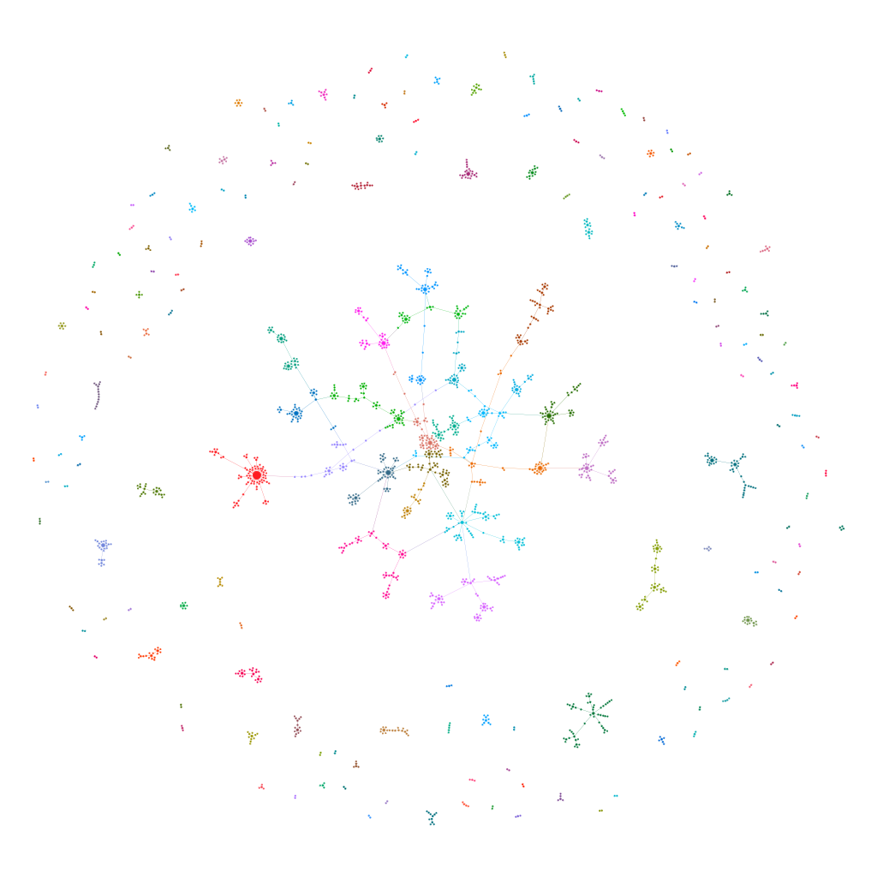
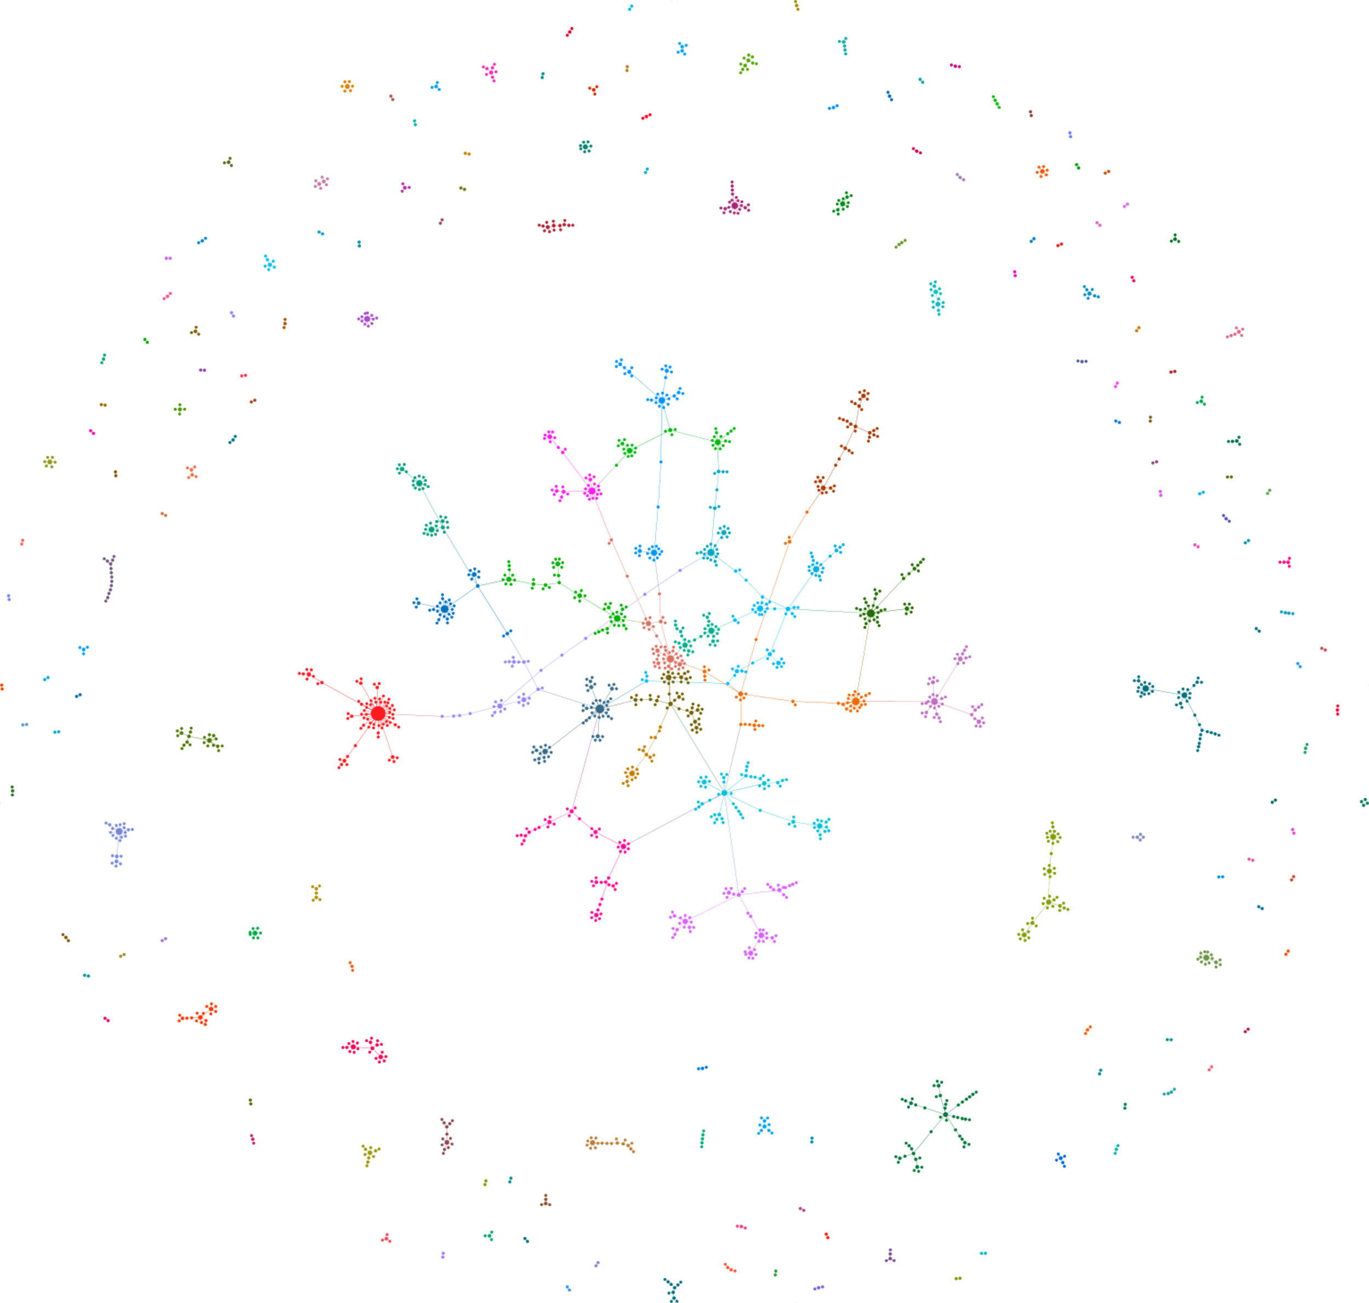
Dataset: CSphd
Nodes are linked if they had a Supervisor-PhD relation
 | Network | GiantCC | Random
Nodes | 1882 | 1025 | 1882
Edges | 1740 | 1043 | 1728
Avg degree | 1.85 | 2.04 | 1.84
Variance | 2.34 | 2.83 | 1.36
Min | 1 |  | 0
Max | 46 |  | 7
Density | 0.00098 | 0.00199 | 0.00098

Slide 2
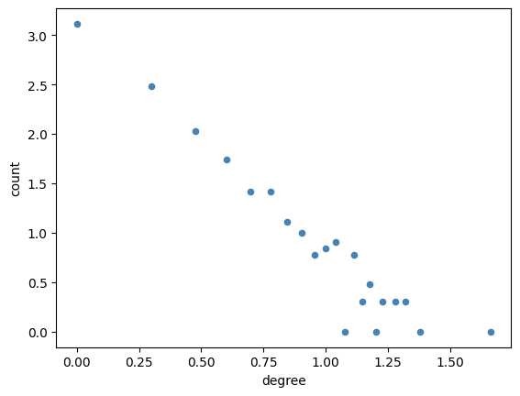
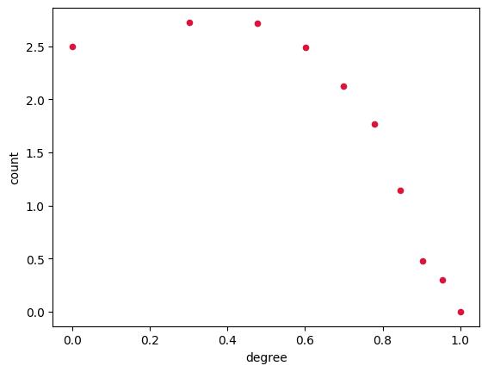
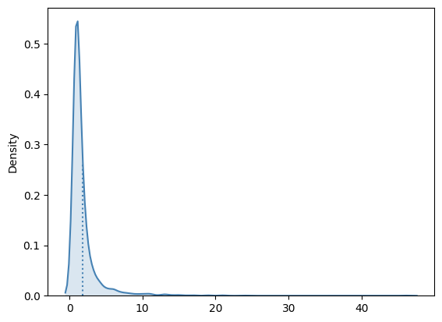
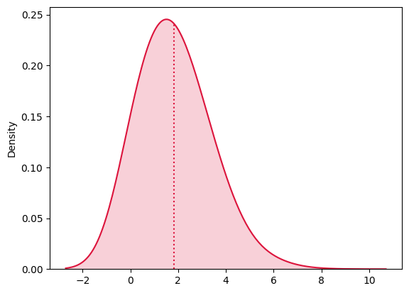
Social Network
Random Network
Degree
Distributions

Slide 3
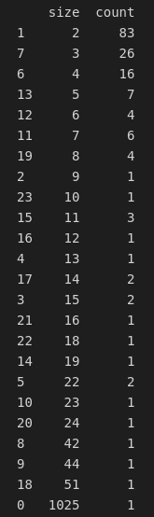
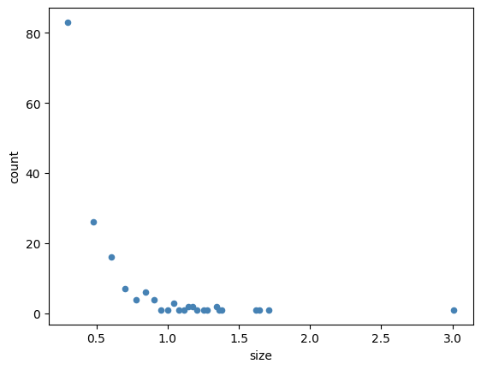
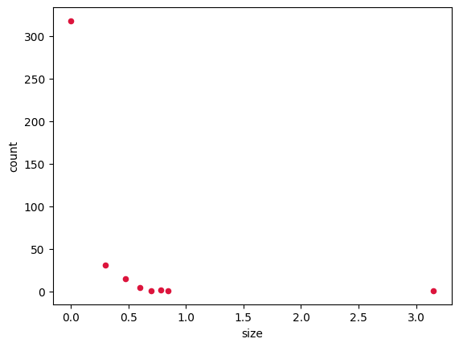
Connected components
​ | Network​ | Random​
Avg Degree​ | 1.85​ | 1.84​
Percentage of nodes in the biggest connected component:
Percentage of nodes in the biggest connected component:
0.545%
0.751%

Slide 4
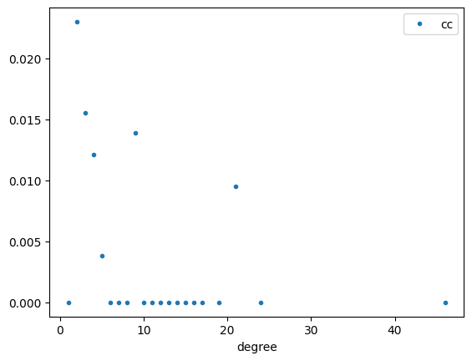
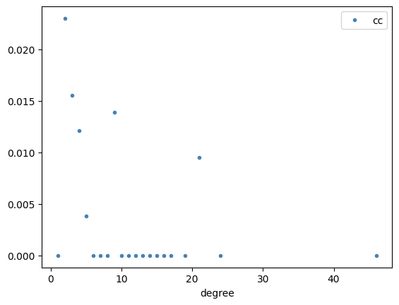
Clustering coefficient
 | Network | Giant CC | Random
Transitivity | 0.0036 | 0.0023 | 0.00094
Avg Clustering | 0.0051 | 0.0034 | 0.0006

Slide 5
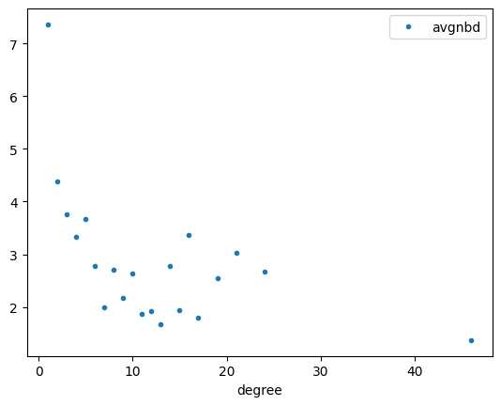
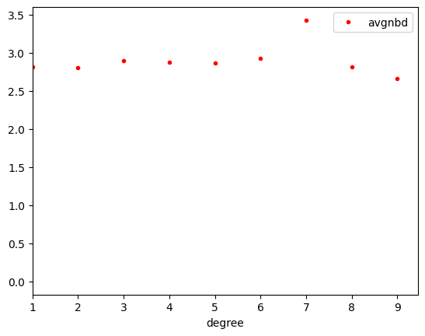
Assortativity
Degree Assortativity for the Social Network:
Degree Assortativity for the Random Network:
-0.19 (-0.25)
0.02

Slide 6
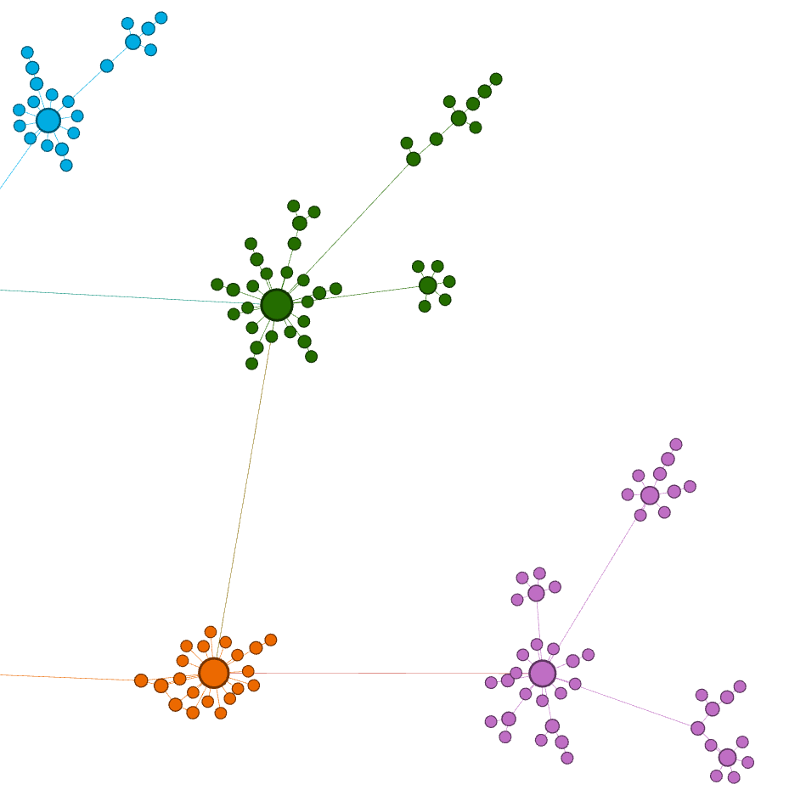
Degree Assortativity for the Social Network:
-0.19 (-0.25)

Slide 7
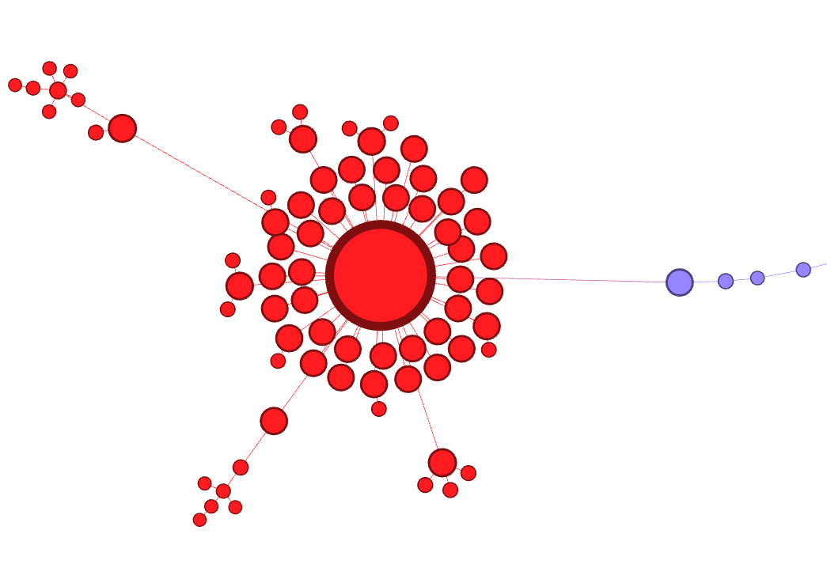
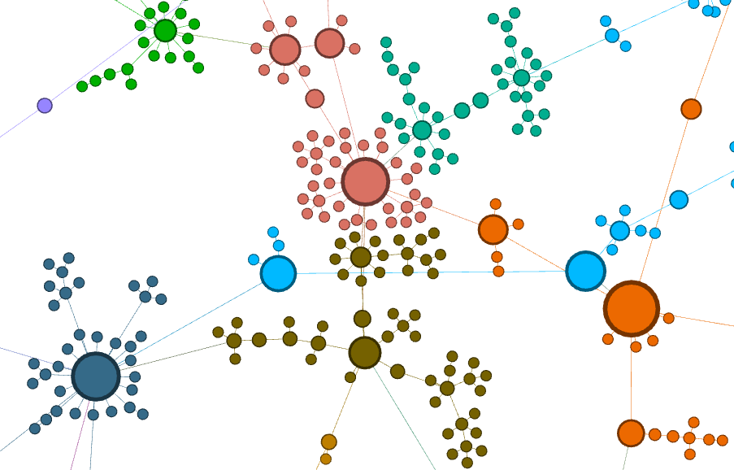
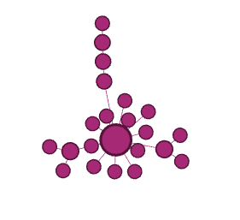
Centrality
Eigenvector Centrality
Betweeness Centrality
Degree Centrality

Slide 8
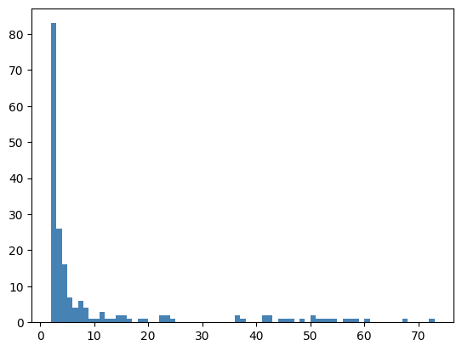
Shortest paths
ln(1887) = 7.5
 | Network | Random
Diameter | 28 | 29
Avg Shortest path | 11.7 | 10.6
Reciprocity
0.0 (No reciprocity found)
Community Detection
Maximizing Modularity Louvain
 | Network | GiantCC
Communities | 188 | 30
Modularity | 0.96 | 0.92
continue on Gephi ->

