Slide 1

Heart disease is the leading cause of death for men and women in the United States.
Every 36 seconds someone dies from a cardiovascular related disease.
Cause of 1 in 4 deaths.
Cost impact of the pathology on the USA economy is about $363 billion yearly¹.
¹Heart disease Facts, CDC https://www.cdc.gov/heartdisease/facts.html

Slide 2




The pathology might remain undiagnosed until the individual experiences major symptoms
Some lifestyle choices and medical conditions are shown to be drivers of risk.
Use of statistical methods for preemptive diagnosis.
Dataset: 319 795 individuals answering the
Behavioral Risk Factor Surveillance System (BRFSS) telephone survey, by the CDC.
18 Lifestyle and Medical information variables

Slide 3
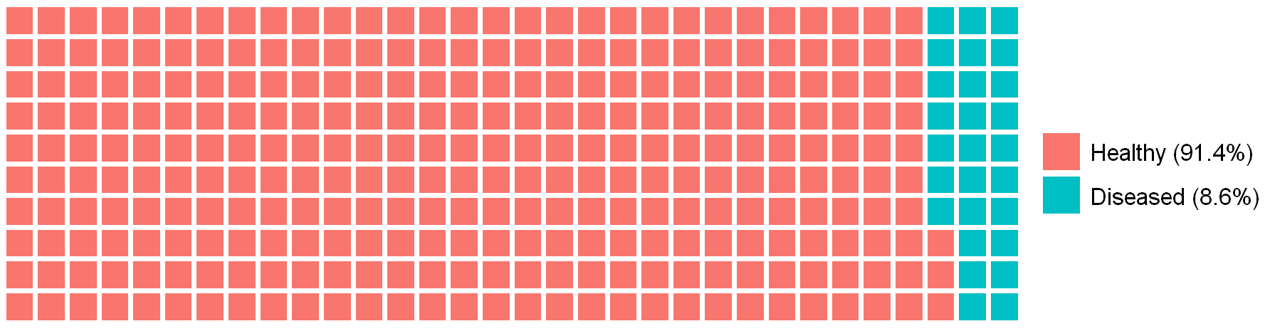

Data exploration
The data is unbalanced.
We will analyze the ties between the survey variables we have and the incidence of heart pathologies

Slide 4
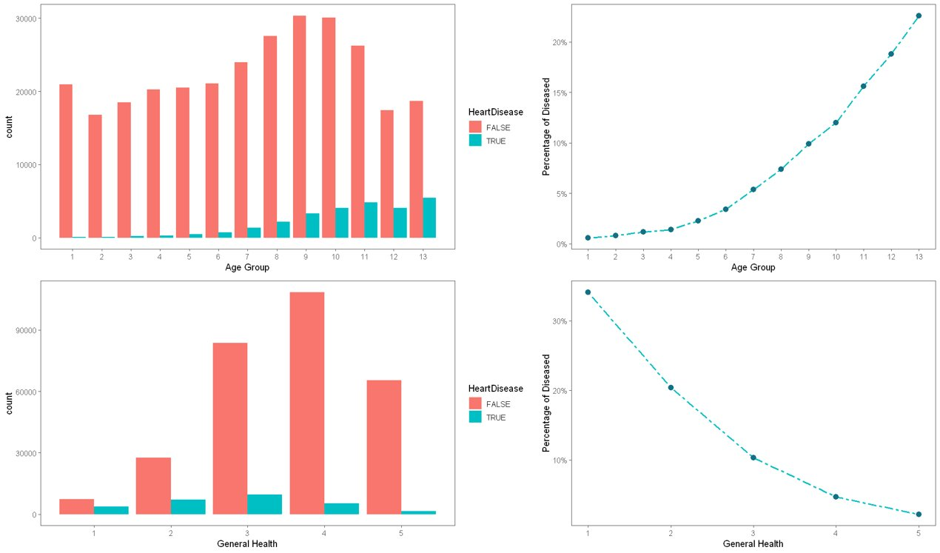

Slide 5
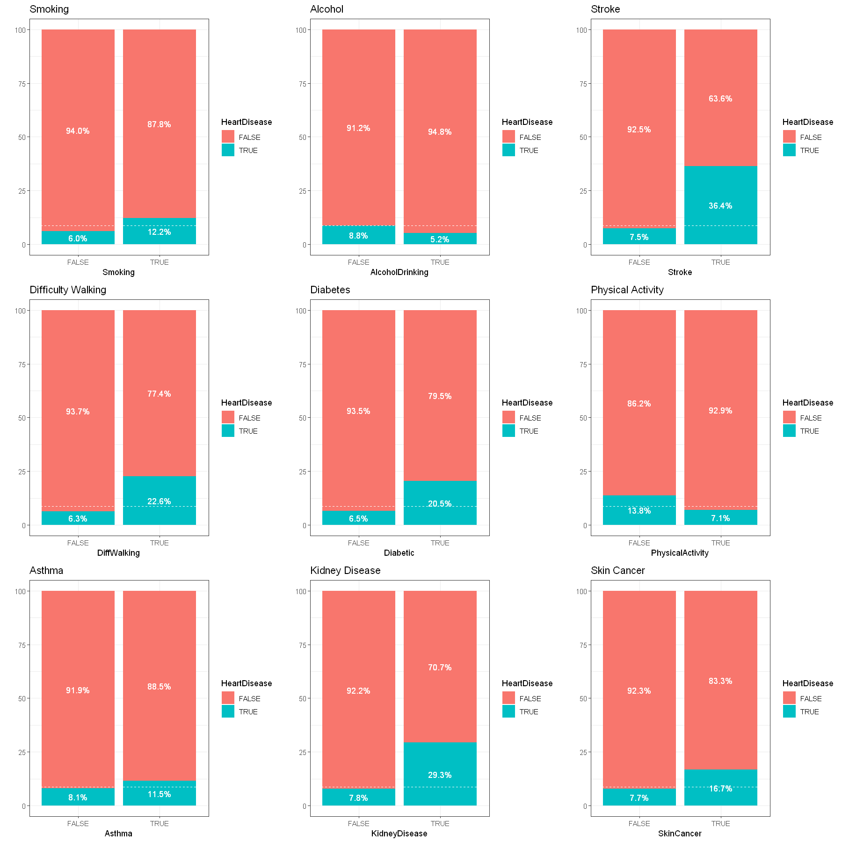
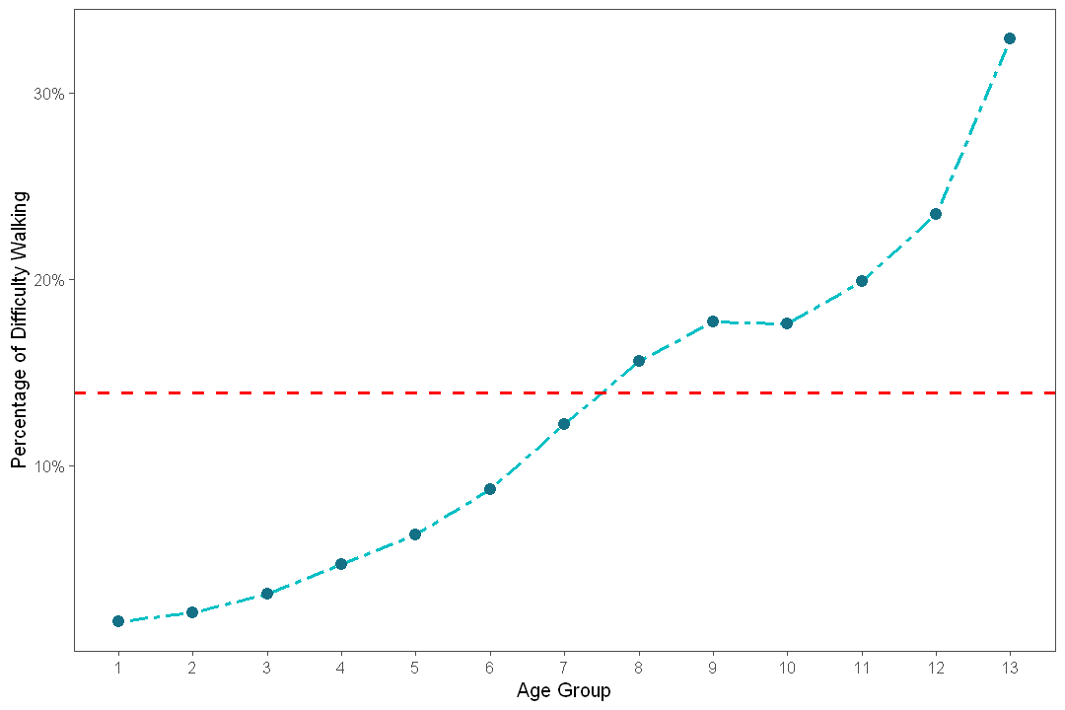
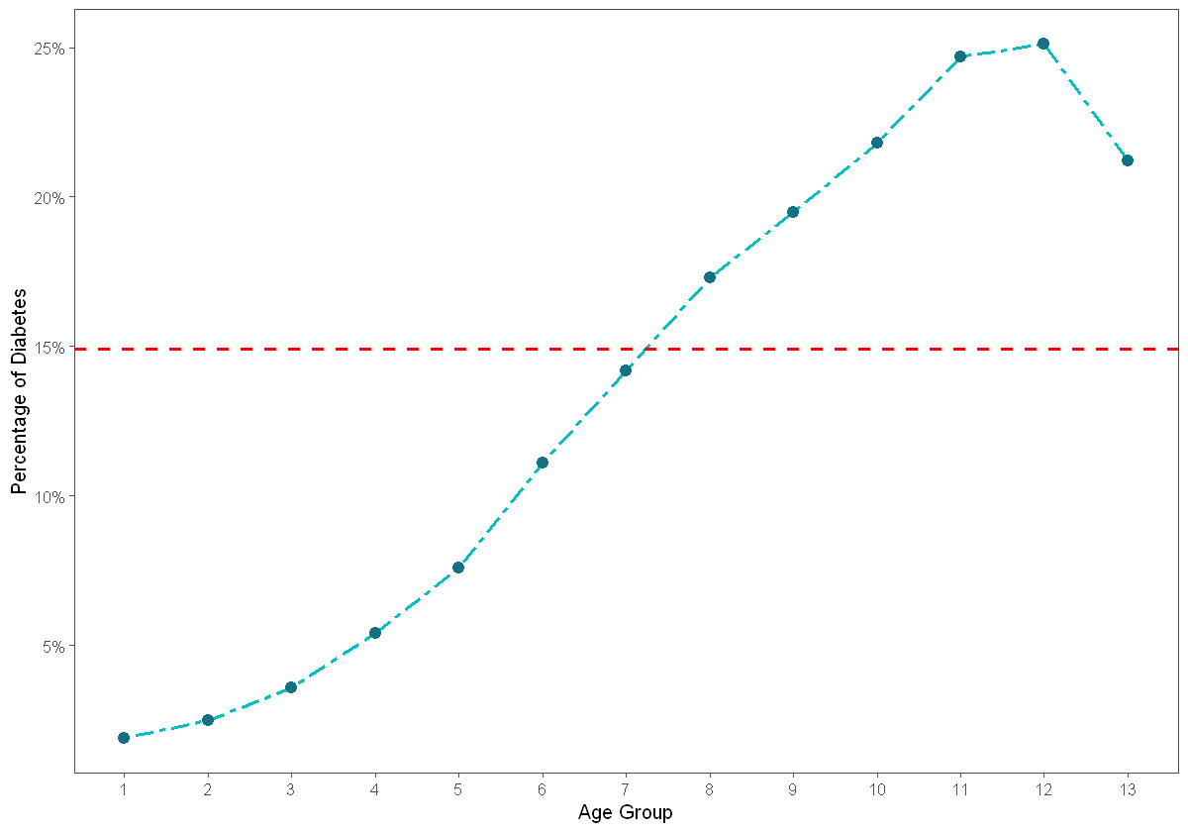
The link between age and pathologies
34% of diabetic respondents has reported difficulty walking.
(13% survey incidence)​
Older age groups than Age group 7 (50-54) show biggest incidences.

Slide 6
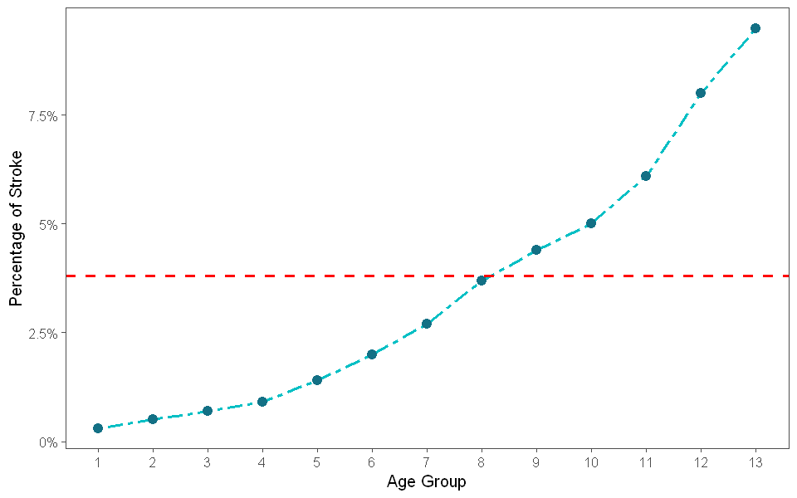
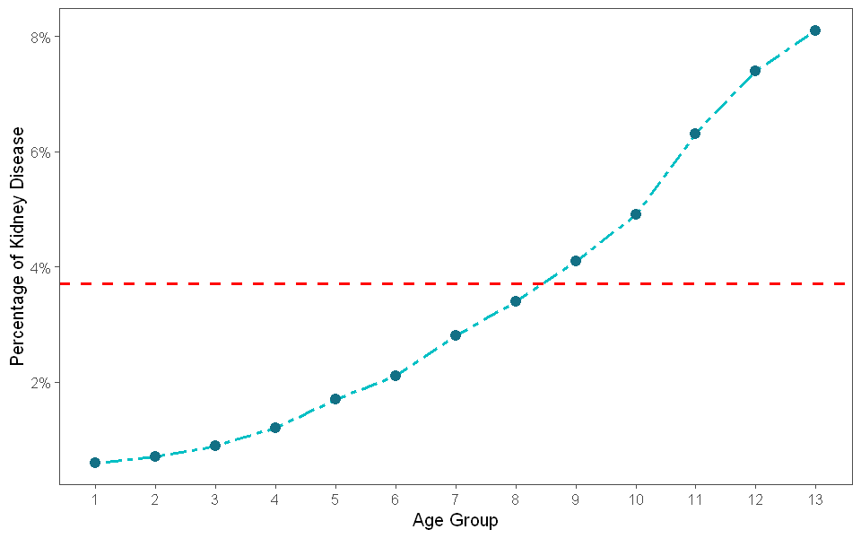
¹Stroke in Patients with Chronic Kidney Disease, Nayak-Rao S, Shenoy MP.
The link between age and pathologies
Chronic Kidney Disease leads to higher stroke risk, especially for those in dialysis.¹
If kidneys don’t work well, more stress is put on the heart.
High blood pressure is the principal cause of Strokes, which can also lead to heart complications and kidney problems.

Slide 7
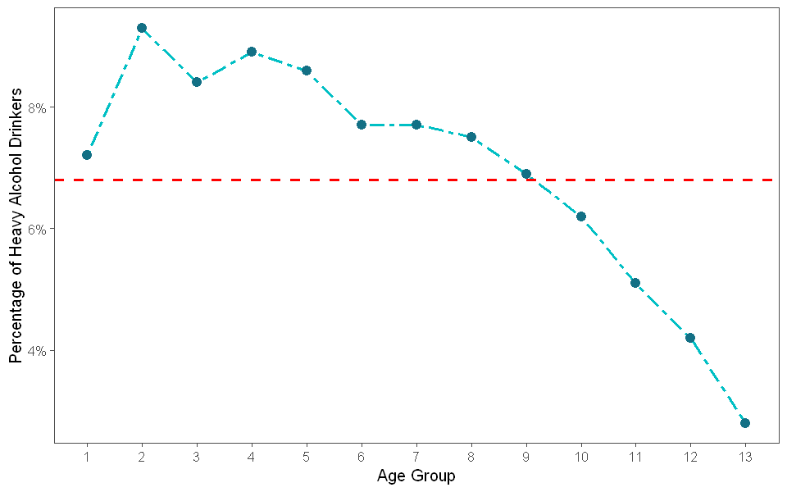
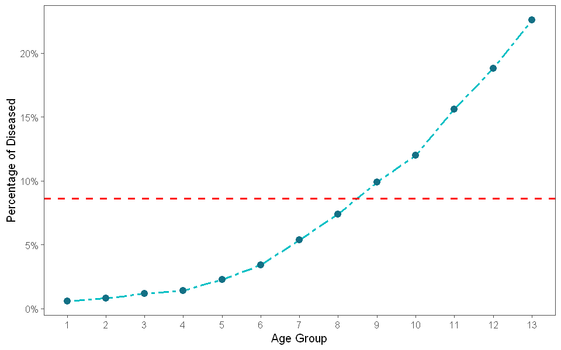

Will alcohol actually save your heart?
A first look seems to suggest binging alcohol might lead to lower heart disease incidence
Heavy Drinkers: men having more than 14 drinks per week and women having more than 7 drinks per week

Slide 8
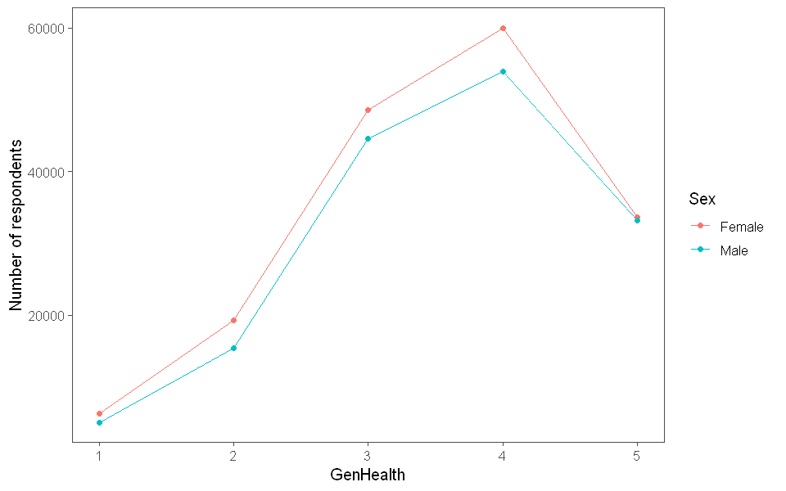
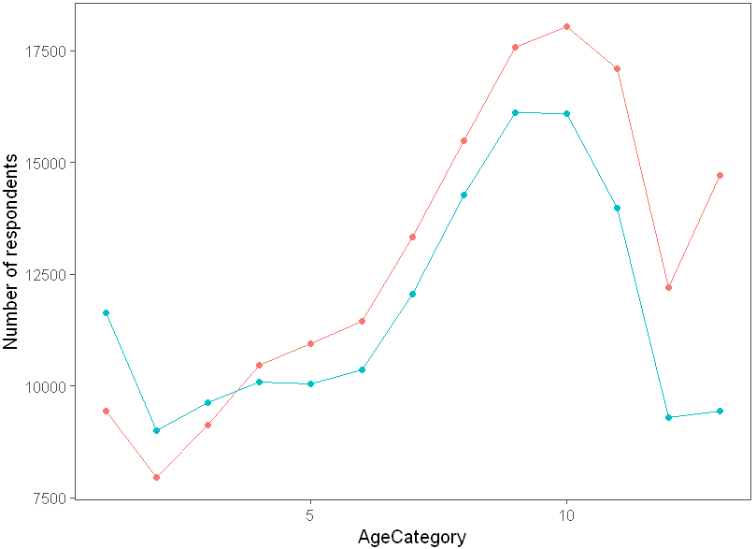
Female respondents report 6.7% incidence, while it's 10.6% for males (8.6% survey).
Even though they're older and they don’t seem to be any healthier.
Heart disease might have more incidence in males.

Slide 9
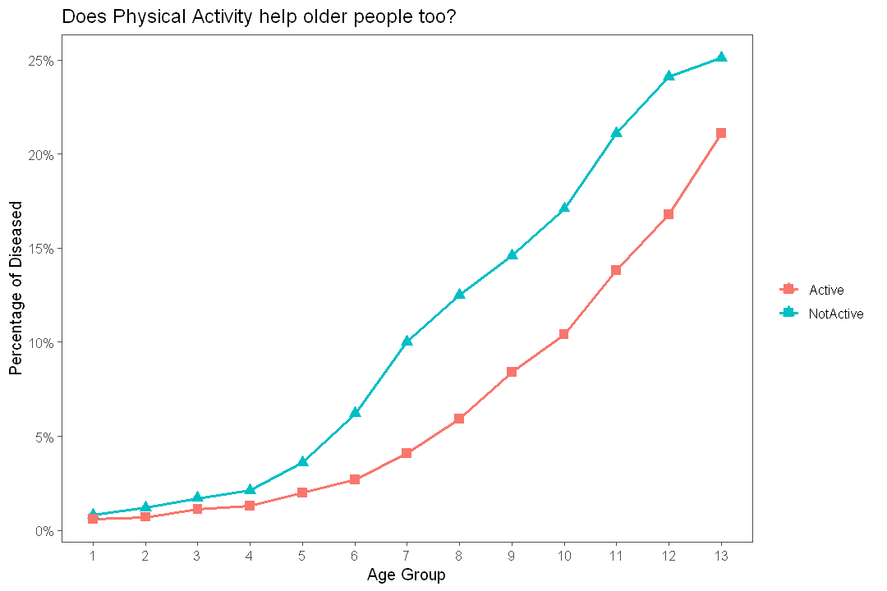
The importance of healthy habits
Does Physical Activity help older people too?
Average 3.9% less incidence for physically active people in all age groups
Especially important in older people, average 5.9% less incidence starting from Age Group 6 (45-49)

Slide 10
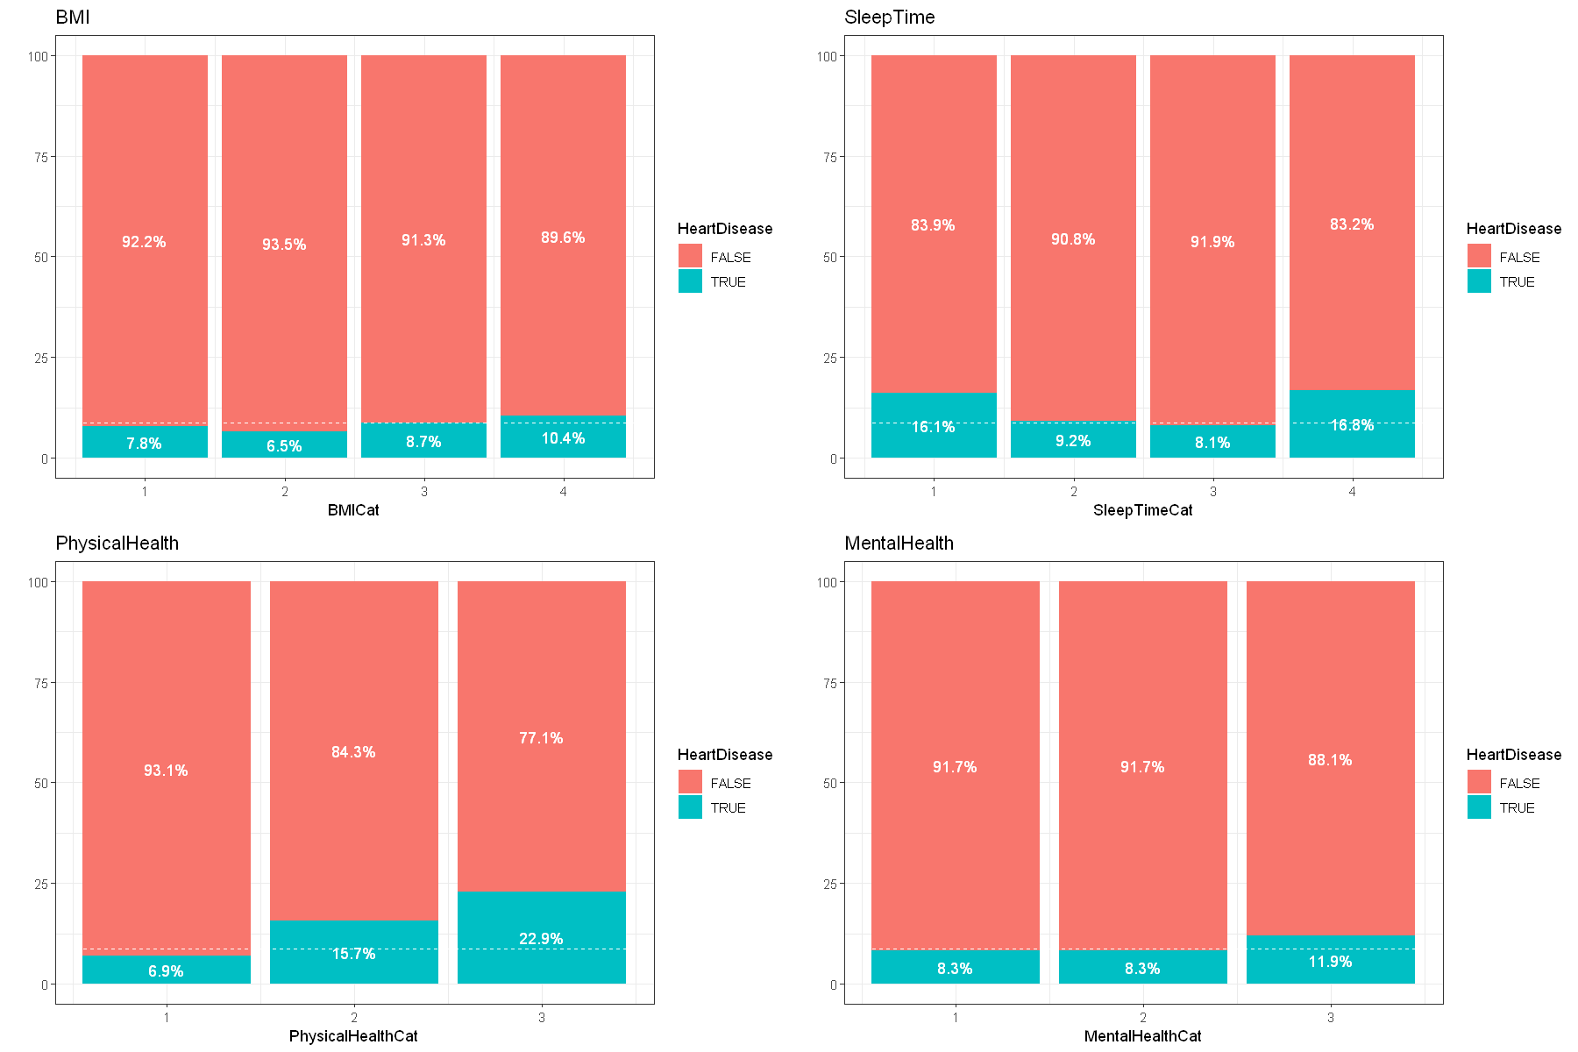
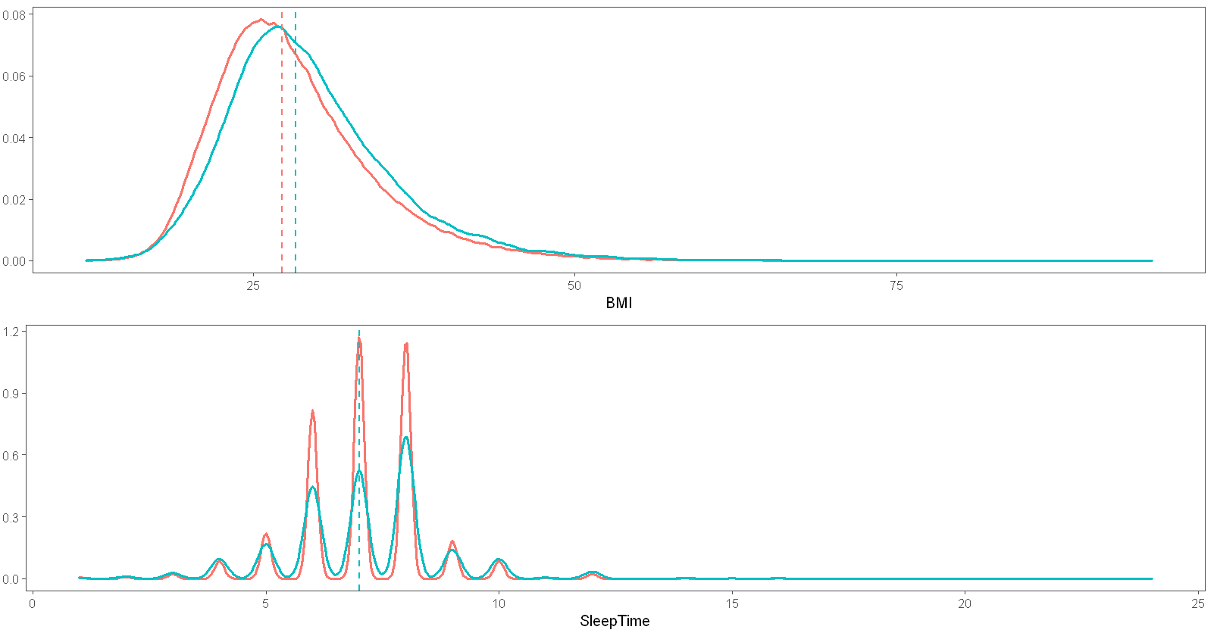
The importance of healthy habits
Data manipulation to let the patterns emerge
Sleep categories: 1[4- hrs], 2[5-7 hrs], 3[8-13 hrs], 4[13+ hrs]
BMI¹: Underweight[<18.5], Healthy[18.5 to <25], Overweight[25 to <30], Obese[30+]
¹Defining Adult Overweight Obesity, CDC https://www.cdc.gov/obesity/basics/adult-defining.html

Slide 11
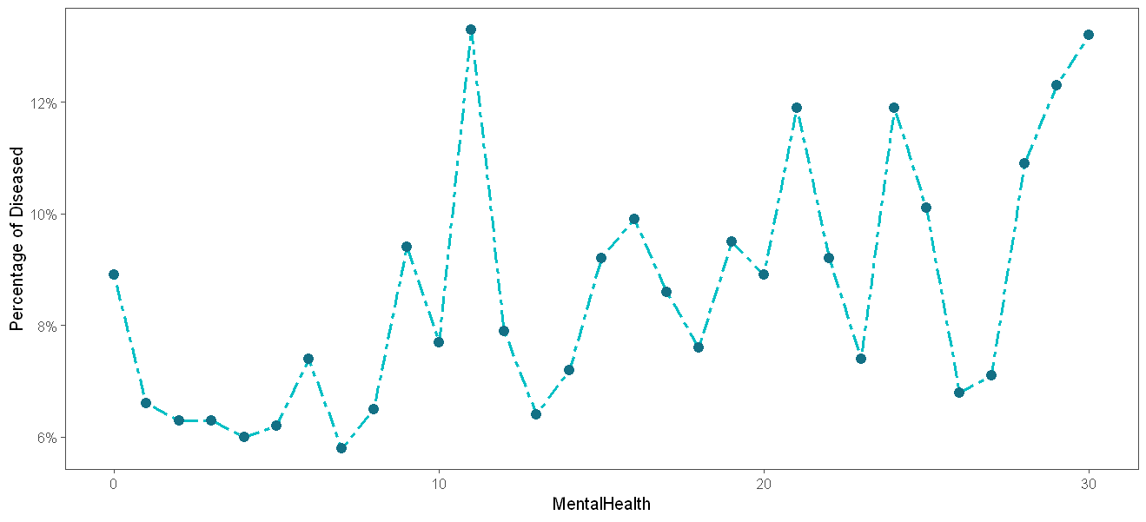
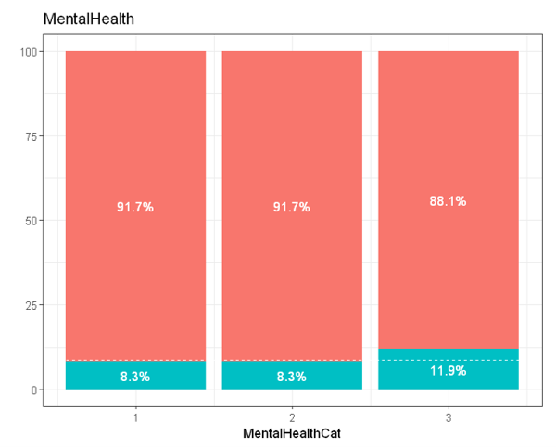
The importance of healthy habits
From a sparse variable to an important insight in people's lifestyle
Stress may lead to heightened blood pressure which is cause of heart attack and stroke¹.
Stress can possibly be cause of unhealthy lifestyle choices.
Respondents with bad mental health:
54.5% incidence of being smokers (compared to 39%)
6.7% have had a stroke (compared to 3.4%)
40% are obese (compared to 31%)
¹Chronic stress can cause heart trouble, Heart.org https://www.heart.org/en/news/2020/02/04/chronic-stress-can-cause-heart-trouble

Slide 12
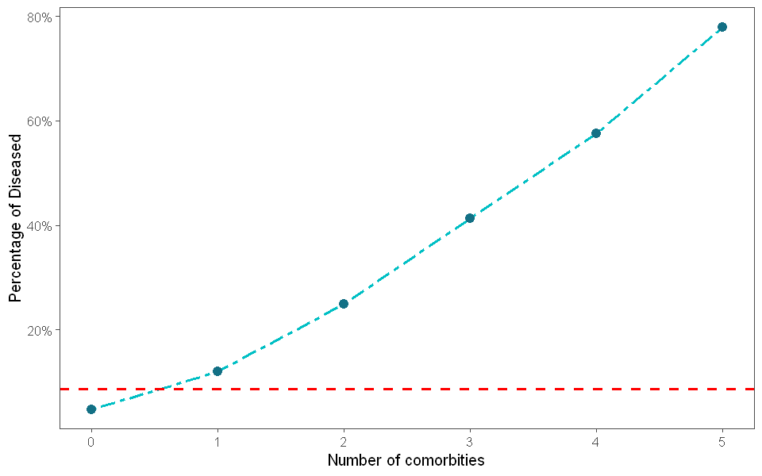
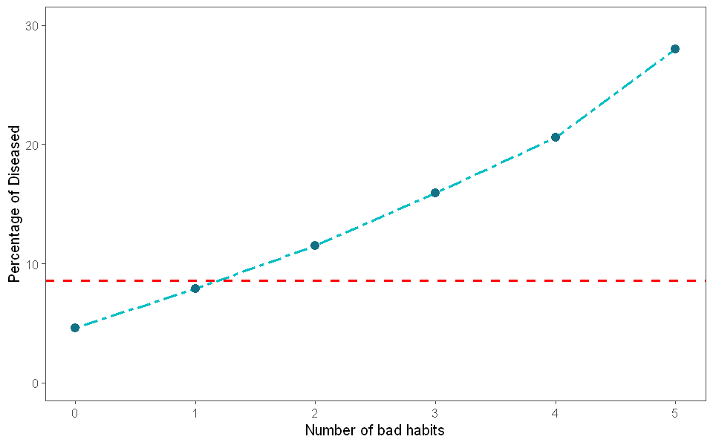
Co-existing comorbidities put the organism under pressure, causing higher incidence
Prolonged stress, smoking, physical inactivity​, obesity, insufficient sleep
Multiple unhealthy lifestyle choices lead to higher incidence, as much as 27%
The sum of the parts is greater than the whole

Slide 13
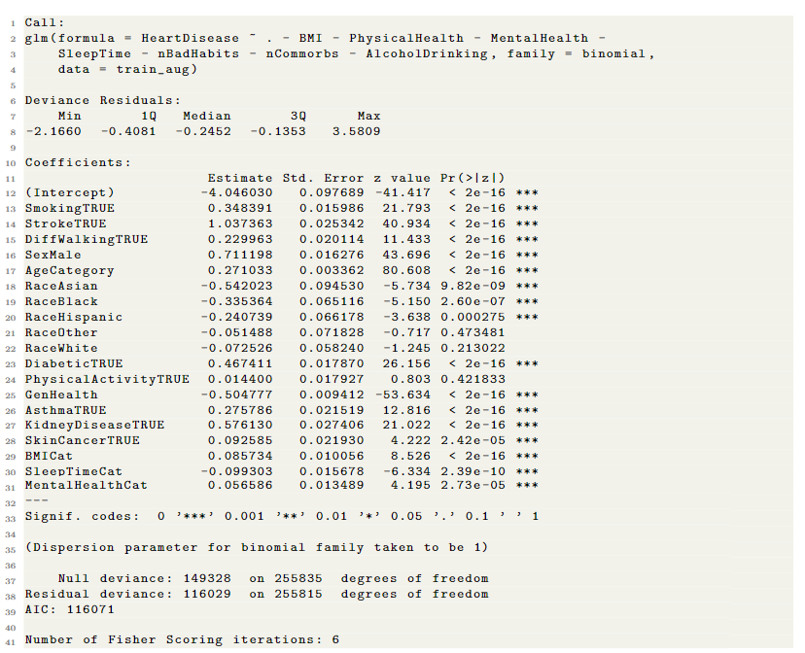
Logistic Regression
Stroke (+1.037)
Sex Male (+0.71)
Kidney Disease (+0.57)
Diabetes (+0.46)
Smoking (+0.34)

Slide 14
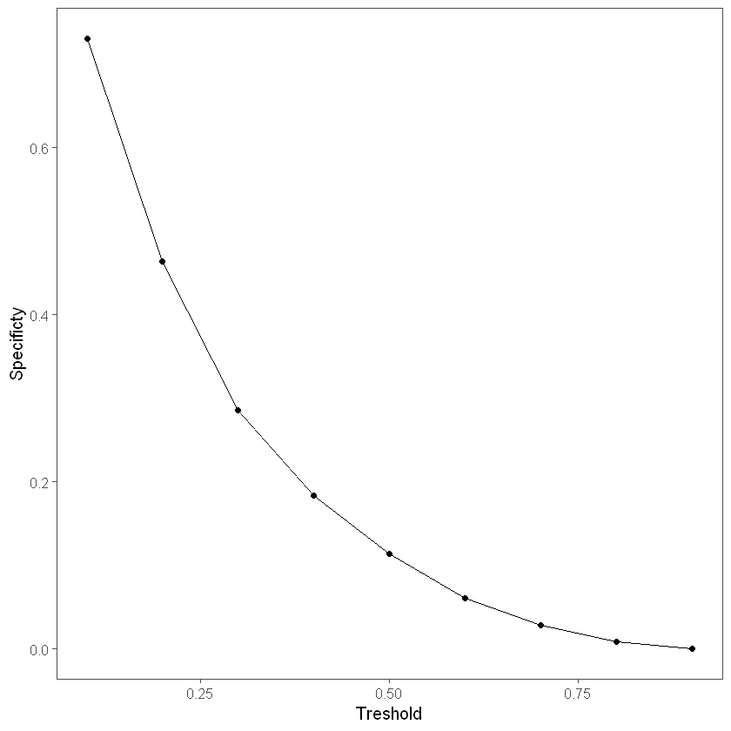
Finding the right threshold
Imbalance robust metrics are needed
Average best performing threshold 0.082.
Metrics on an 80/20 split.
Fold | Threshold | AUC
1 | 0.06 | 0.759
2 | 0.08 | 0.763
3 | 0.09 | 0.764
4 | 0.08 | 0.767
5 | 0.09 | 0.762
6 | 0.08 | 0.769
7 | 0.07 | 0.767
8 | 0.08 | 0.760
9 | 0.09 | 0.767
10 | 0.09 | 0.763
metric | value
Precision | 0.78
Recall | 0.21
F1 | 0.20
AUC | 0.759
 | TRUE | TRUE
FALSE | 42 896 | 1 182
TRUE | 15 547 | 4 334
Recall is still low, a risk category methodology might be a good approach
The Precision, ability of the model of correctly identify diseases, is highest at very small thresholds

Slide 15
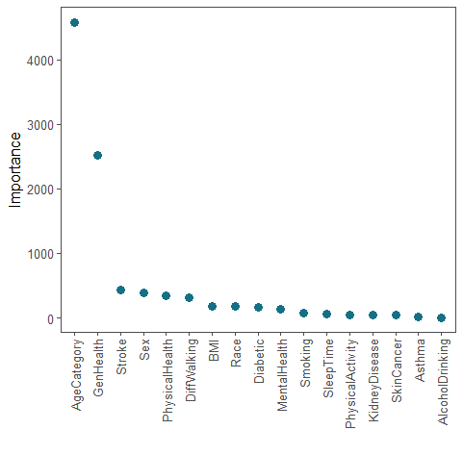
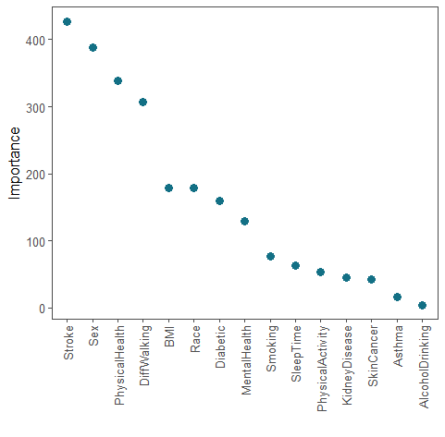
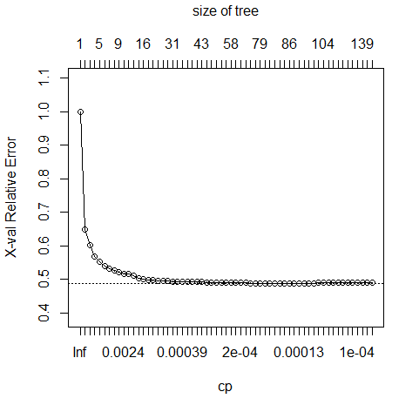
Decision Tree
Using the 1-SE rule we prune the tree at 81 splits, but the error is stable at around 16 splits already.
metric | value
Precision | 0.80 (.78)
Recall | 0.21 (.21)
F1 | 0.33 (0.20)
AUC | 0.76 (.75)
 | TRUE | TRUE
FALSE | 41 715 | 1 061
TRUE | 16 728 | 4 455

Slide 16
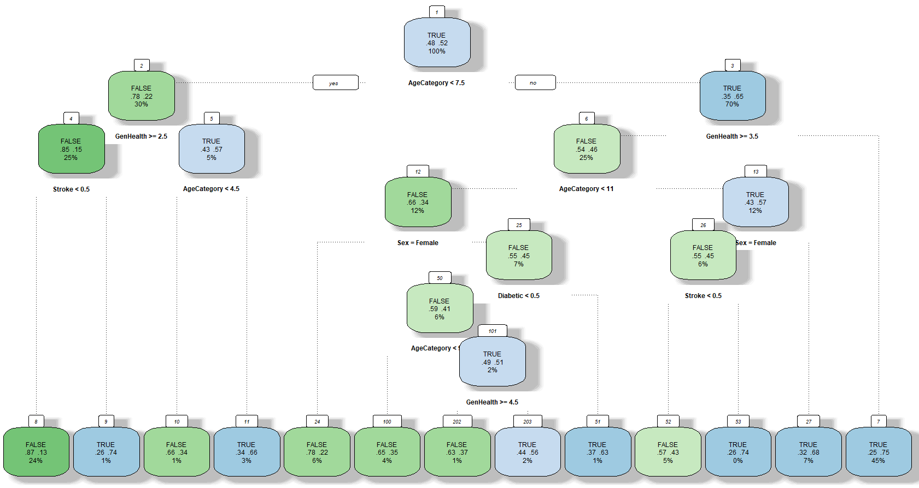
Tree pruned at suboptimal number of trees for visualization purposes

Slide 17
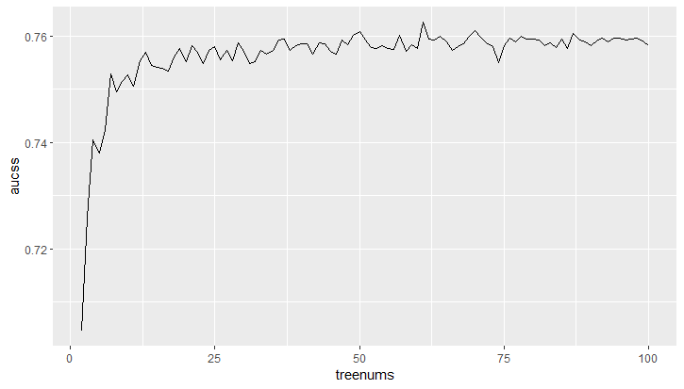
Random forests
Highest AUC observed 0.76

