Slide 1

Unsupervised Learning on world countries data
HELP International is an NGO interested in understanding poverty.
It's playing an active role in efforts to improve the quality of life of some of the most vulnerable populations in the world¹.
Objective: understanding characteristics and patterns of economic development between countries through markers
​¹HELP International, https://help-international.org/

Slide 2


Presentation of dataset
Socio-economic and health markers from 167 world countries.
Gdpp, GDP per capita in USD mlns
Income, net income per capita in USD
Inflation, change in CPI annually
Exports, exports per capita as %age of Gdpp
Imports, imports per capita as %age of Gdpp
Health, health expenditure per capita as %age of Gdpp
Life expectancy, life expectancy at birth in years
Child mortality, deaths of children under 5 y/o per 1k live births
Total fertility, fertility rate per woman
Added the Continent variable to observe continent-level patterns

Slide 3
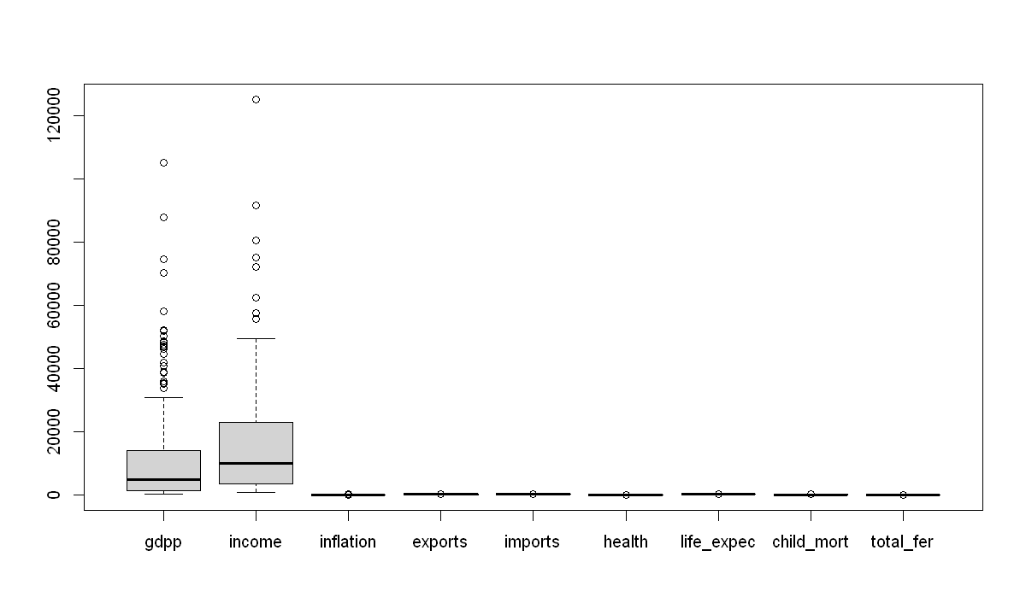
Heterogeneity of scale and outlier values
Use of standardized values and keeping outliers
We'll be using PCA and clustering techniques to analyse the data...

Slide 4
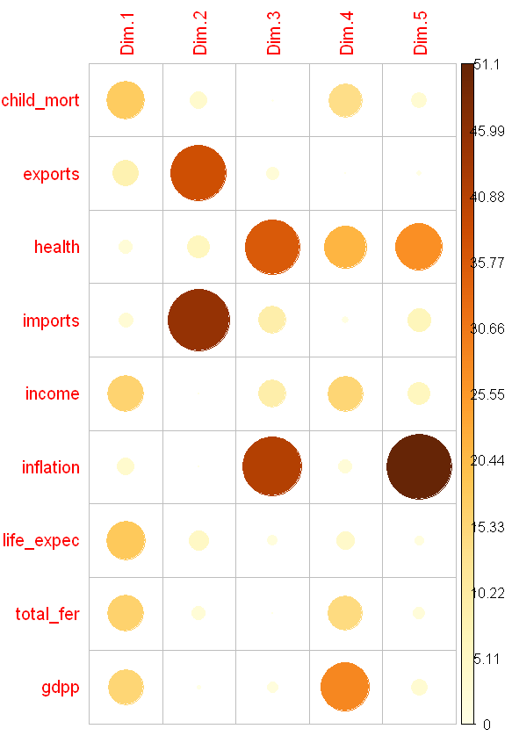
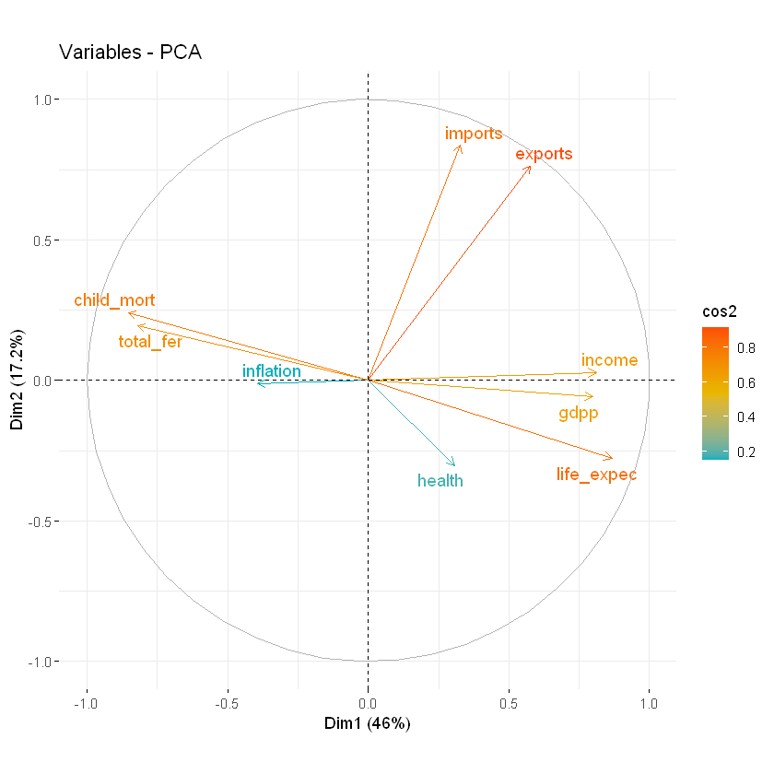
Relationship between variables and PCs

Slide 5
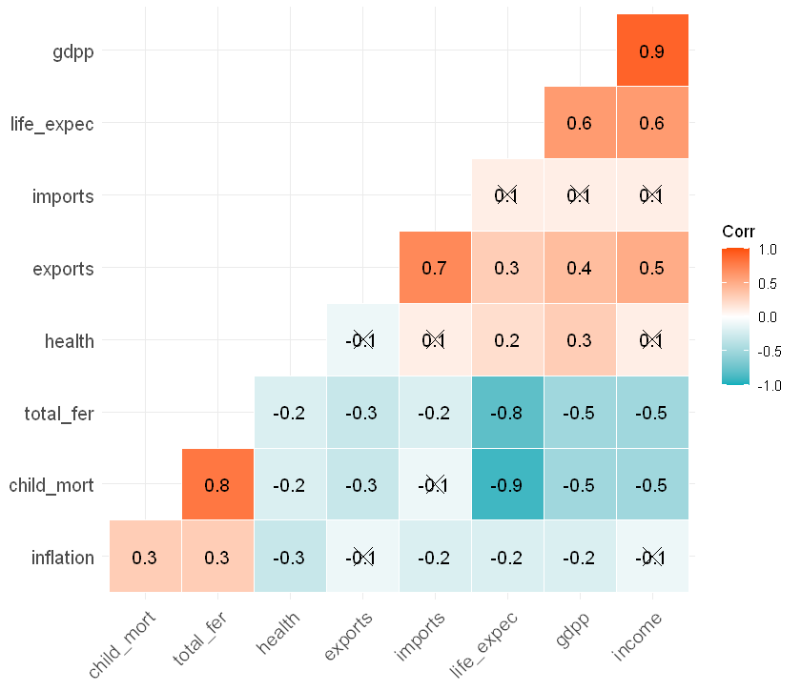
Correlations and loadings

Slide 6
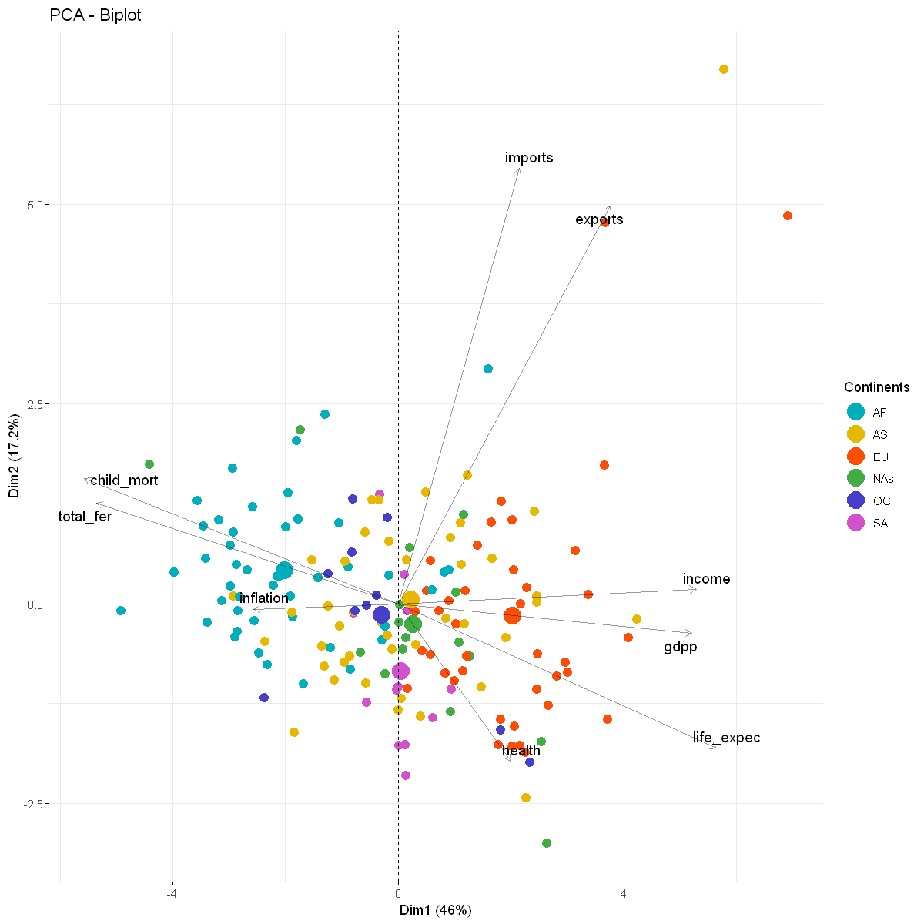
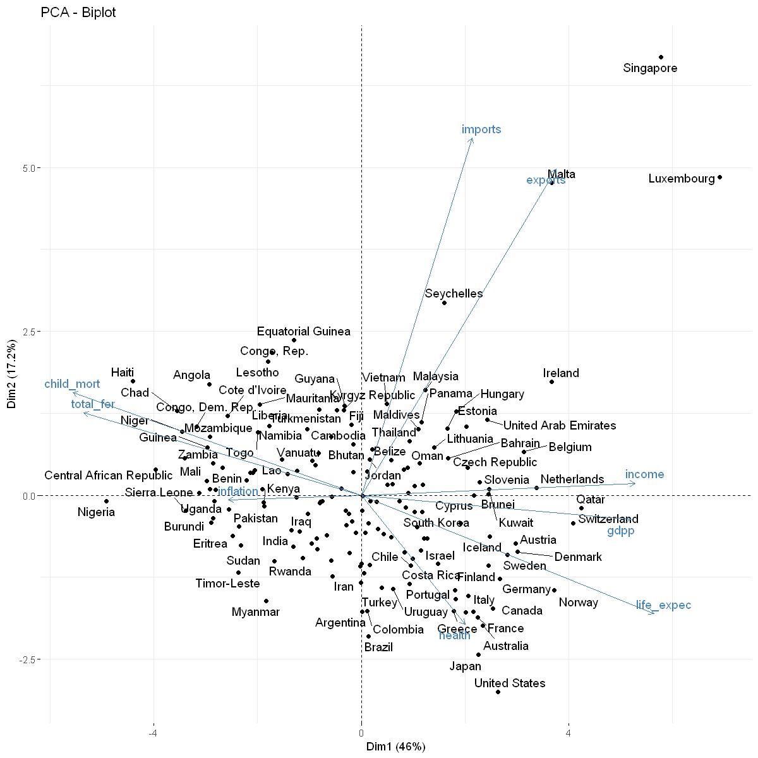

Slide 7
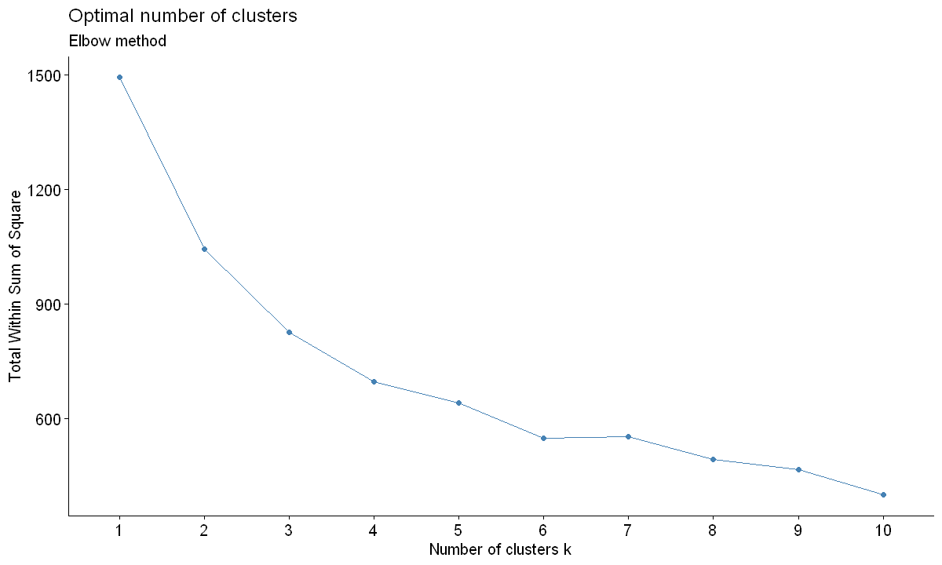
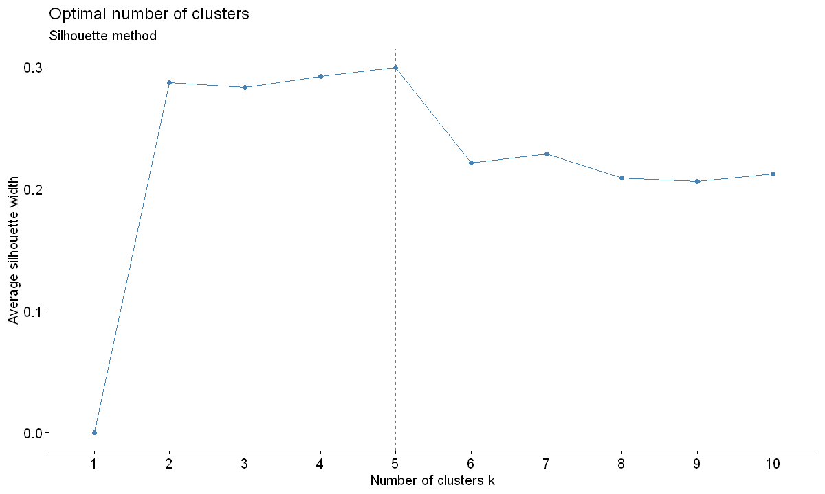
K-means

Slide 8
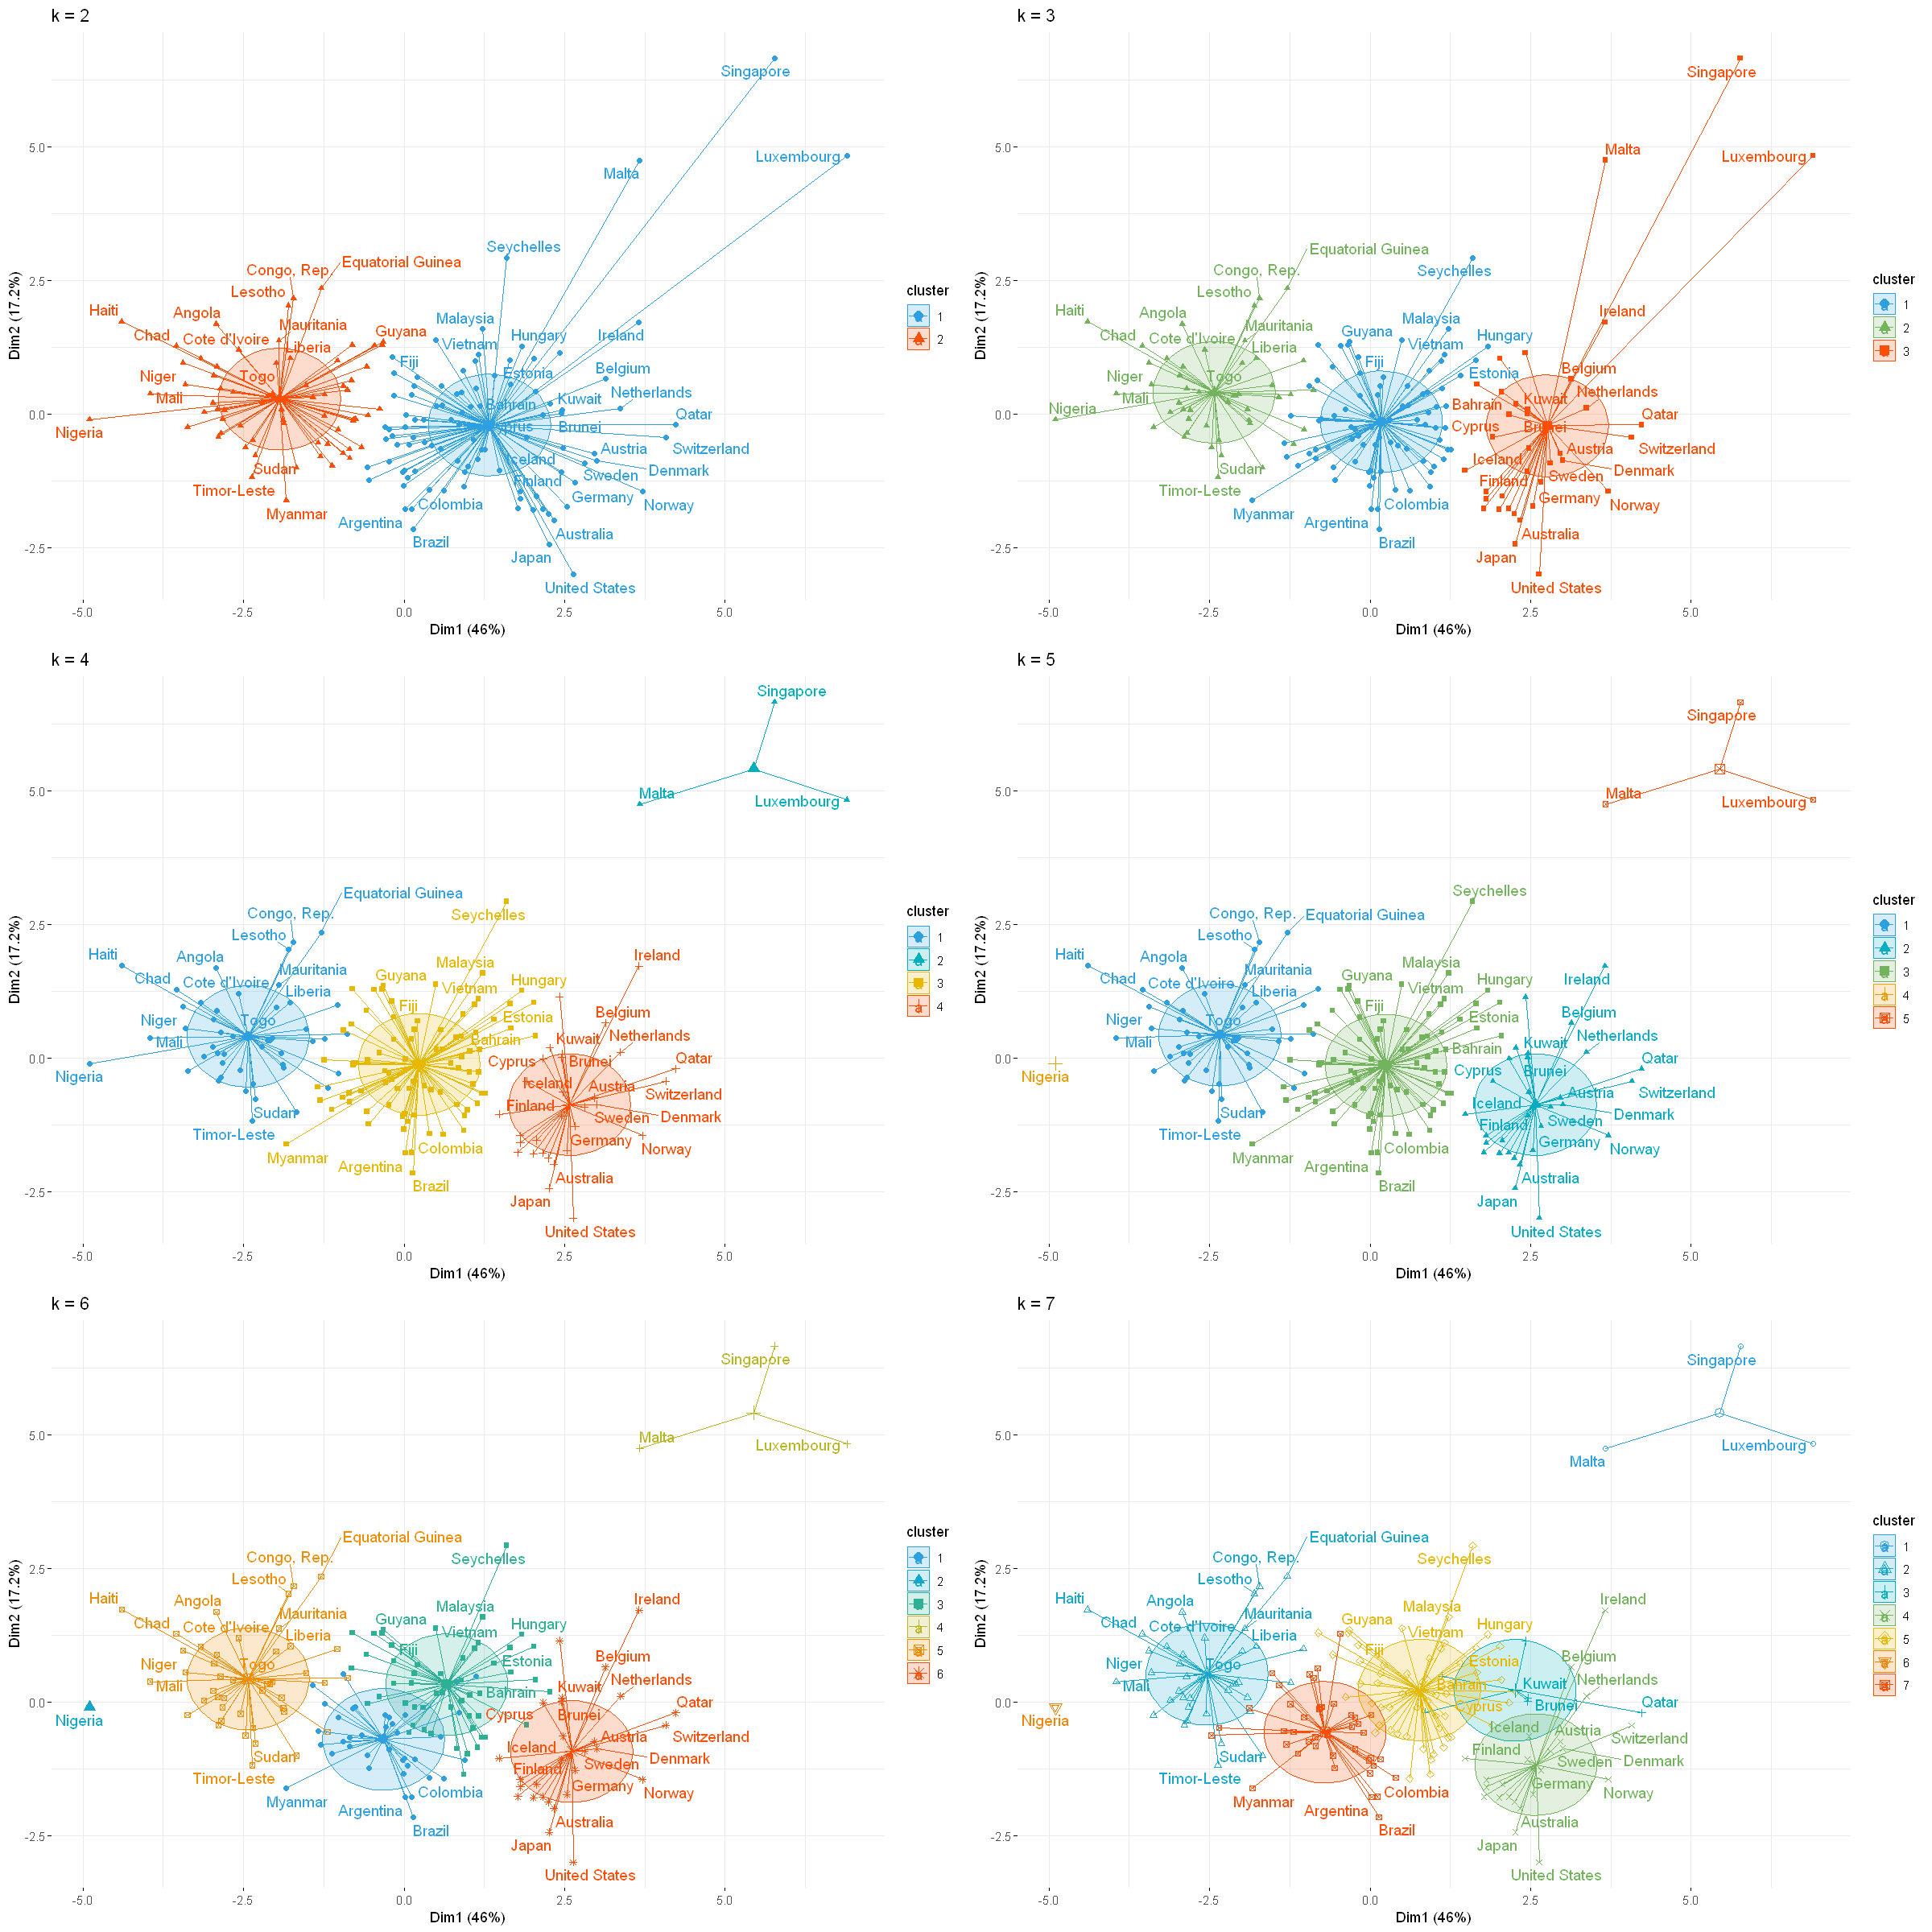

Slide 9
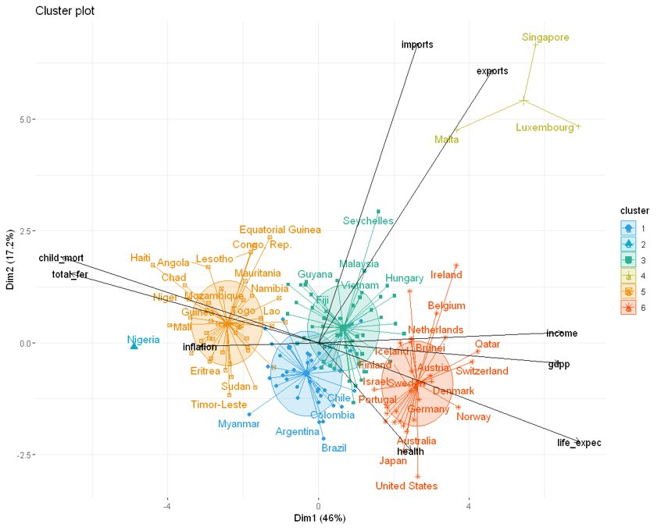
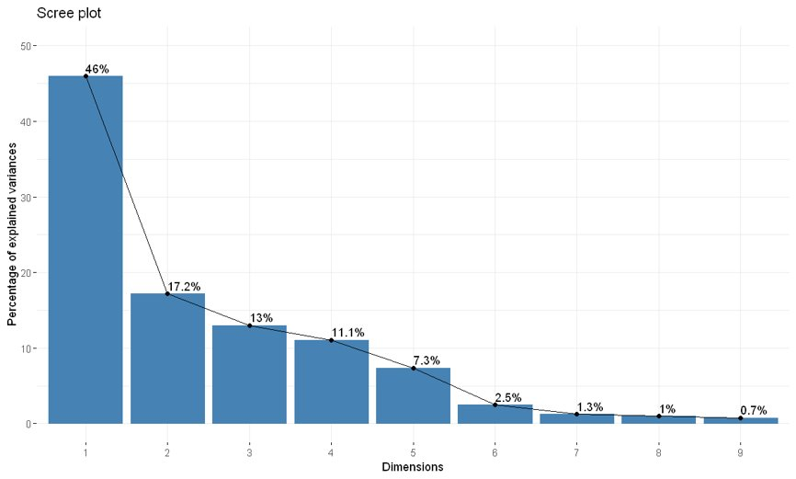

Slide 10
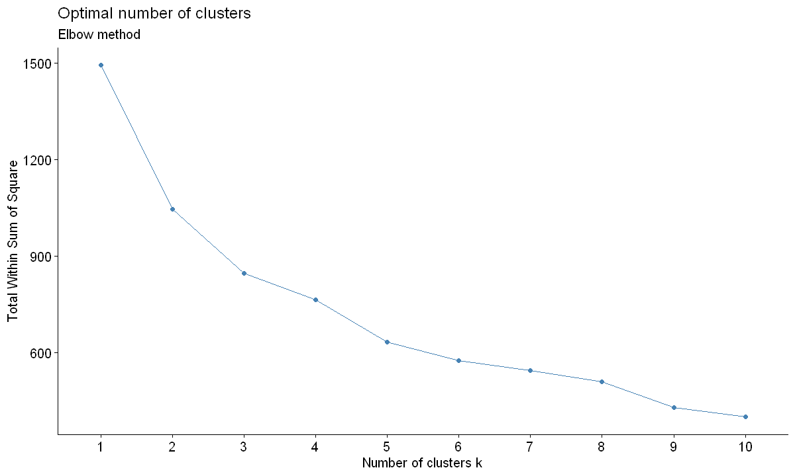
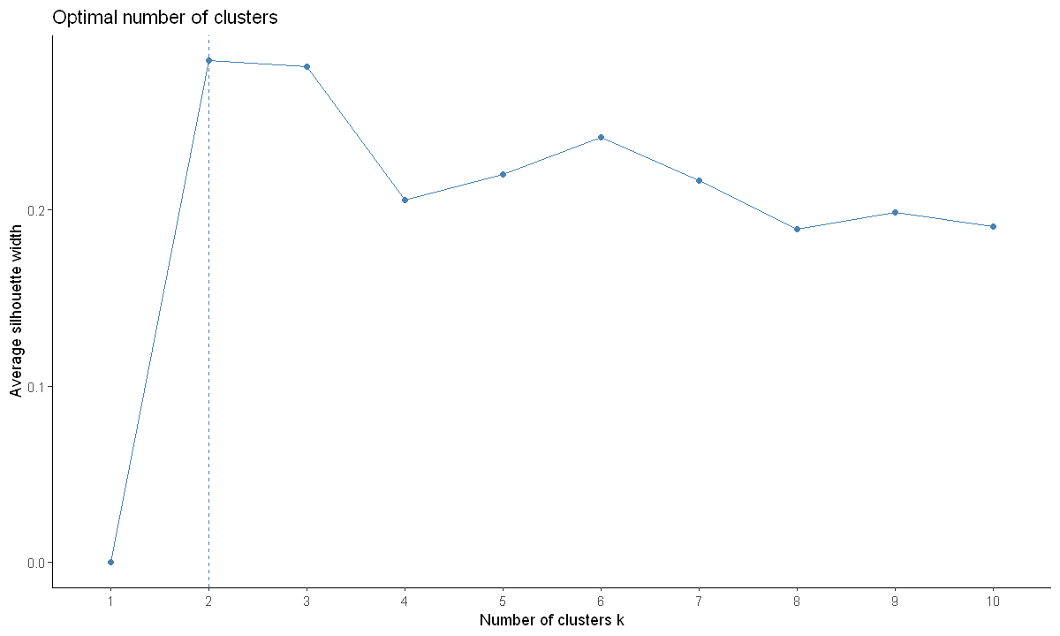
K-Medoids

Slide 11
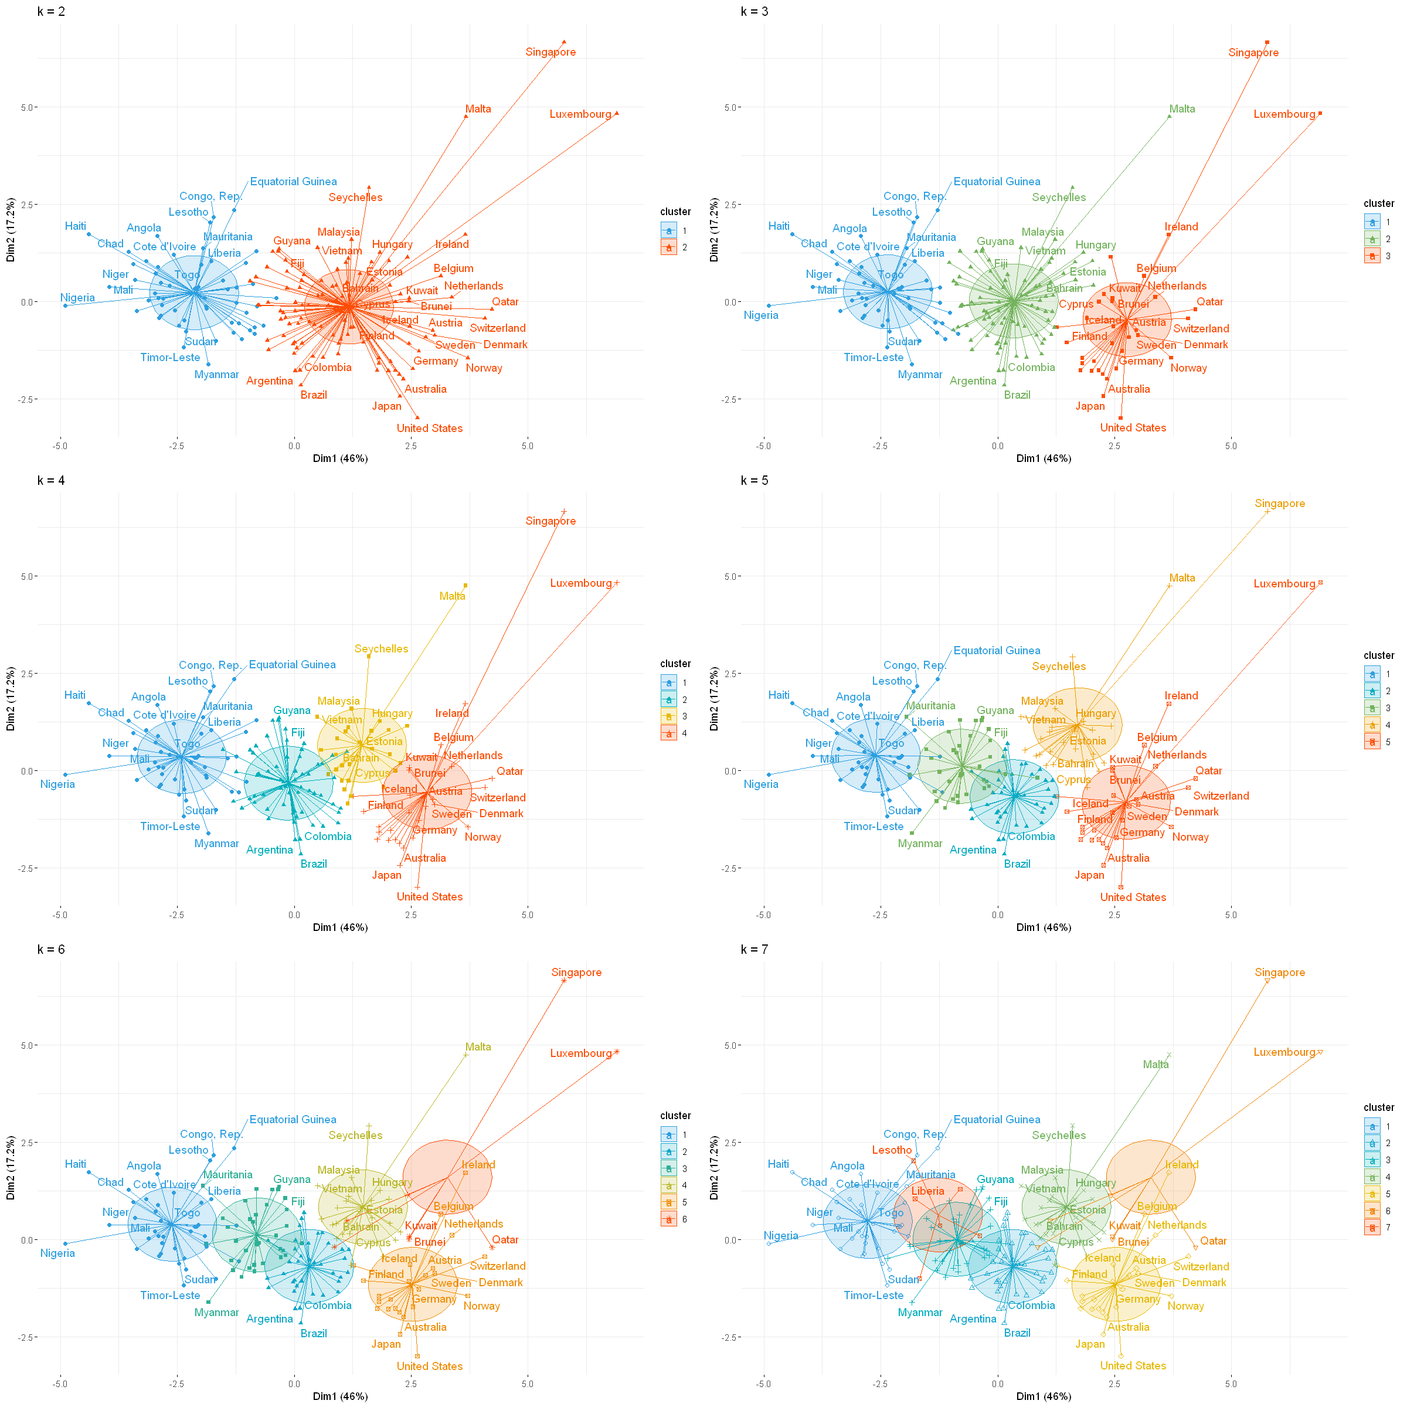

Slide 12
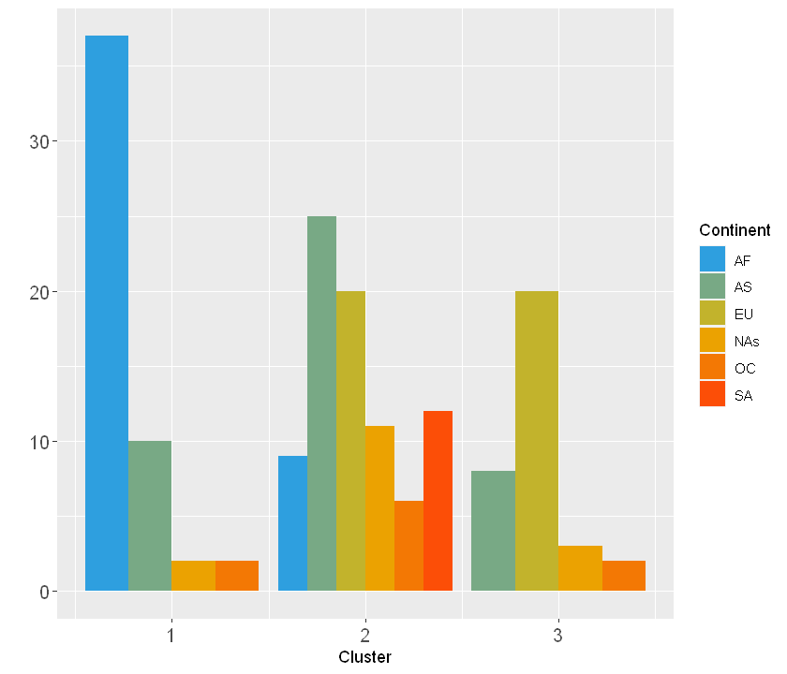

Slide 13
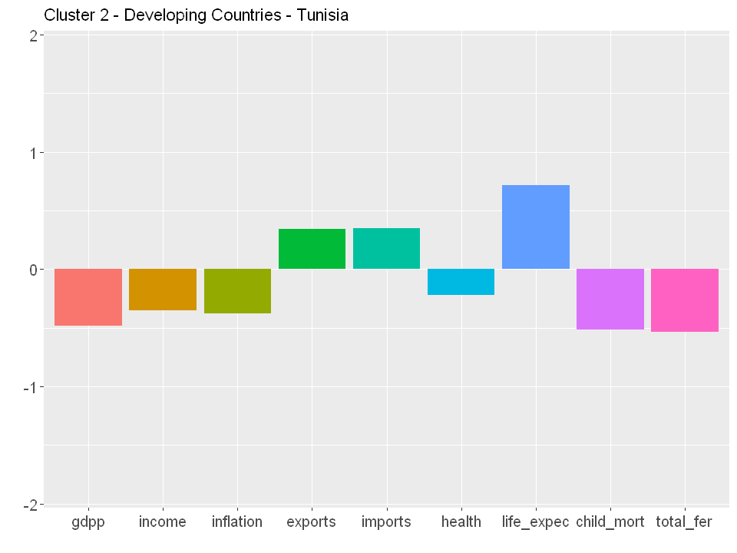
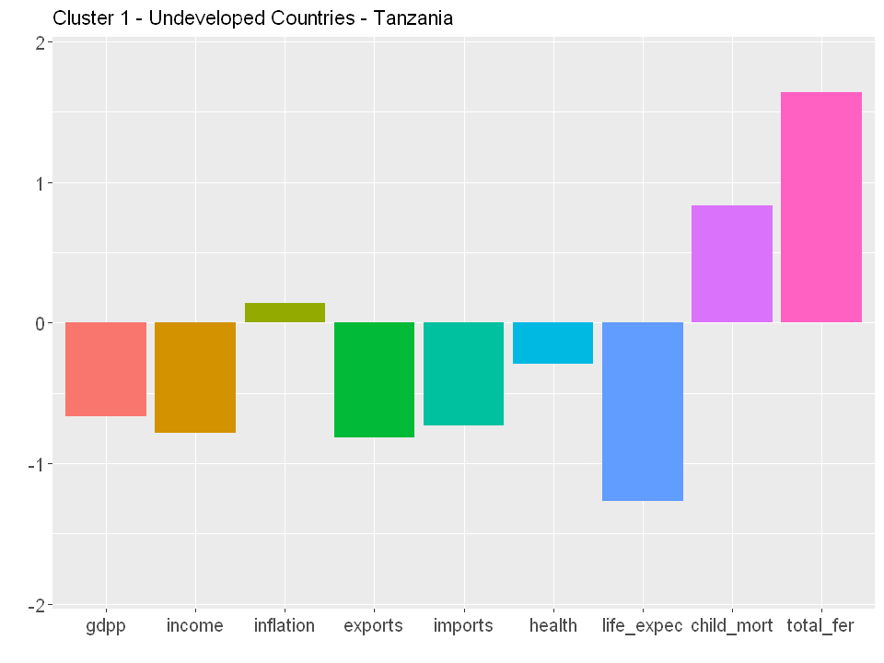
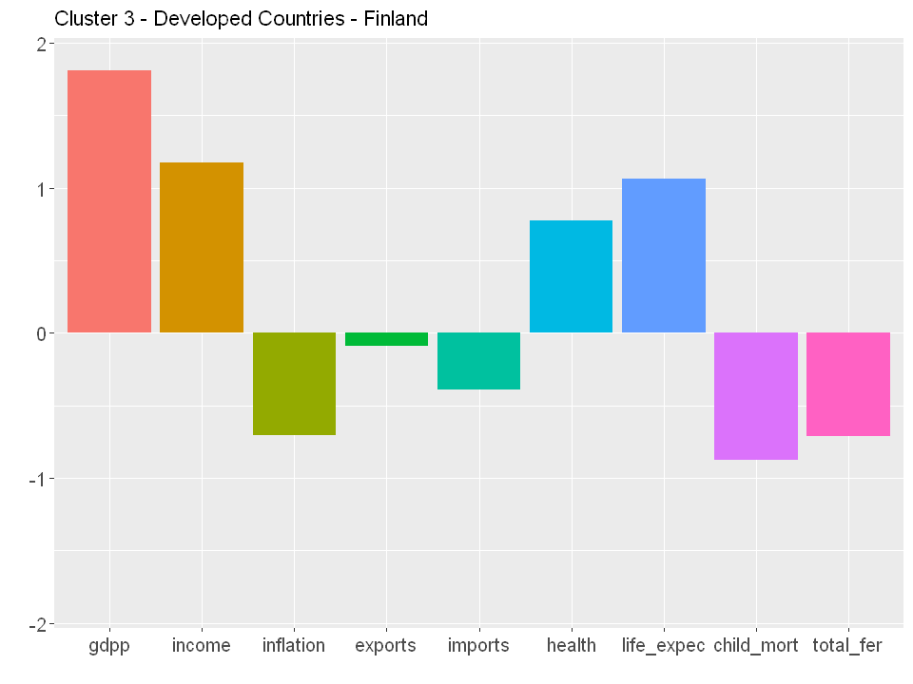
 | cluster | gdpp | income | inflation | exports | imports | health | life_expec | child_mort | total_fer
Tanzania | 1 | 702 | 2090 | 9.25 | 18.7 | 29.1 | 6.01 | 59.3 | 71.9 | 5.43
Tunisia | 2 | 4140 | 10400 | 3.82 | 50.5 | 55.3 | 6.21 | 76.9 | 17.4 | 2.14
Finland | 3 | 46200 | 39800 | 0.35 | 38.7 | 37.4 | 8.95 | 80.0 | 3.0 | 1.87

Slide 14
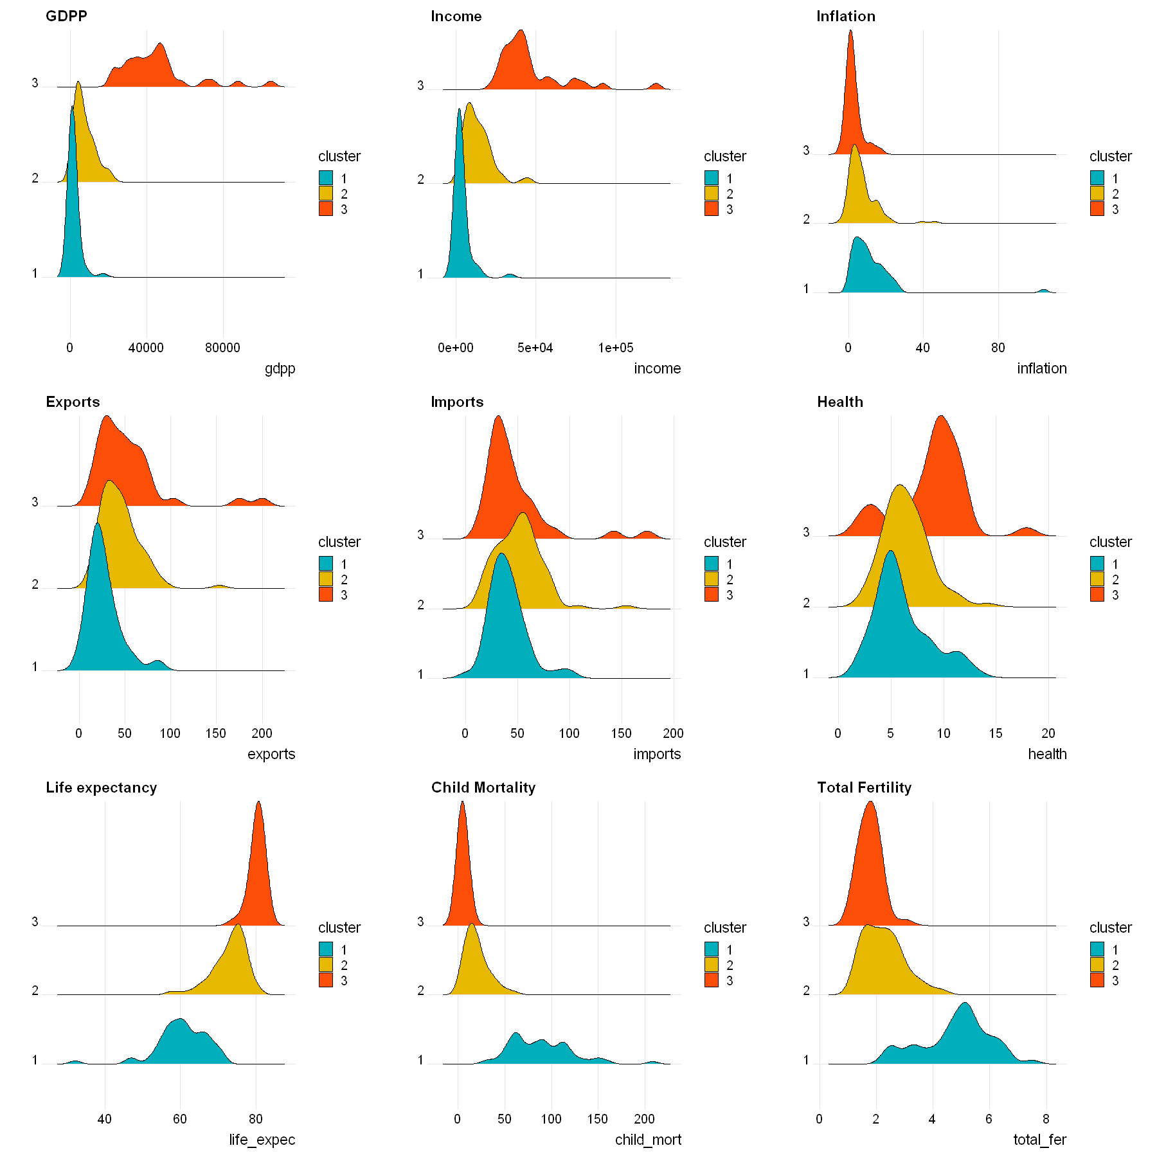

Slide 15
