Slide 1
Lex/Flex
Lex: a lexical analyzer generator
Input is a set of regular expression and associated actions (written in C)
Output is a table-driven scanner (lex.yy.c)
Flex(Fast Lexical Analyzer Generator):
an open source implementation of the original UNIX lex utility.

Slide 2
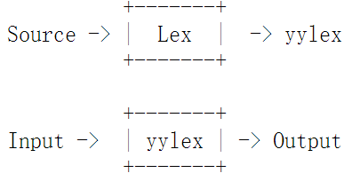
Lex - A Lexical Analyzer Generator
http://dinosaur.compilertools.net/lex/index.html
The generated function is named yylex
.l file

Slide 3
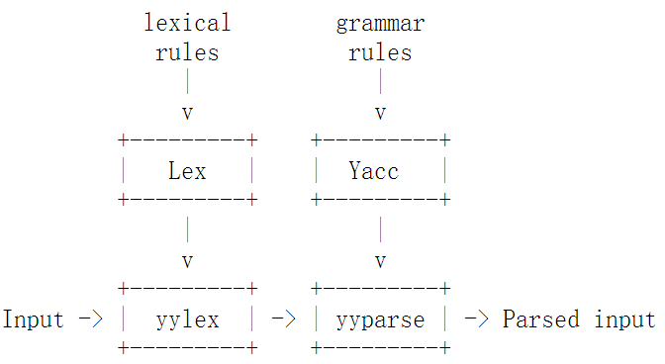
Lex - A Lexical Analyzer Generator
Lex is often used with a parser generator Yacc
yacc parsers expect to call a routine named yylex() to find the next input token

Slide 4
FLex
The general format of FLex source is:
%{
// Definitions optional
%}
%%
rules
%%
User code section optional

Slide 5
%{
// Definitions optional
%}
The definition section contains the declaration of variables, regular definitions, manifest constants.
Anything written in “%{ %}” is copied directly to the file lex.yy.c

Slide 6
%%
rules
%%
the rules are in the form: pattern action
pattern contains regular expressions
action contains actions, program fragments to be executed when the expressions are recognized. if the action takes more than a line, it should be enclosed in braces.

Slide 7
FLex
%%
rules
%%
User code section optional
User Code Section contain C statements and additional functions.
We can also compile these functions separately and load with the lexical analyzer.

Slide 8
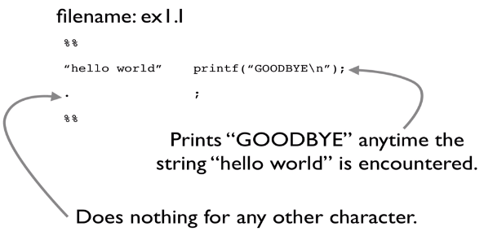
Lex input example

Slide 9
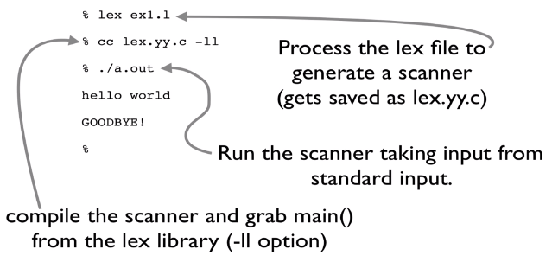
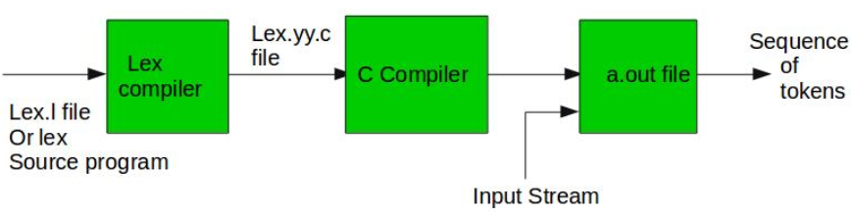

Slide 10
yylex( ) : function returns a token having the type of int.
yylval : values associated with the token are returned by lex in variable yylval.
yytext : an character array keeps the text matching some expression

Slide 11
yylex( ) is supposed to return the type of the next token as well as putting any associated value in the global yylval
%{
#include “y.tab.h“ (containing definitions of all the %tokens)
%}
%%
[0-9]+ yylval = atoi( yytext ); return INTEGER;

Slide 12
Example 1: Count the number of capital letters in a string
%{
int count = 0;
%}
%%
[A-Z] {printf("%s capital letter\n", yytext);
count++;}
. {printf("%s not a capital letter\n", yytext);}
\n {return 0;}
%%
int main(){
yylex();
printf("\nNumber of Captial letters in the given input - %d\n", count);
return 0;
}

Slide 13
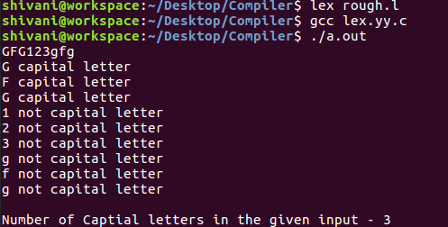
Output:

Slide 14
Flex--Conditions
flex provides a mechanism for conditionally activating rules.
Any rule whose pattern is prefixed with "<sc>" will only be active when the scanner is in the start condition named "sc".
For example
<STRING>[^"]* { /* eat up the string body ... */
...
}
will be active only when the scanner is in the "STRING" start condition

Slide 15
Flex--Conditions
For example
<INITIAL,STRING,QUOTE>\. { /* handle an escape ... */
...
}
will be active only when the current start condition is either "INITIAL", "STRING", or "QUOTE".

Slide 16
Flex--Conditions
Start conditions are declared in the definitions section of the input
using unindented lines beginning with either `%s' or `%x' followed by a list of names.
`%s' declares inclusive start conditions: rules with no start conditions at all will also be active
`%x' declares exclusive start conditions: only rules qualified with the start condition will be active

Slide 17
Flex--Conditions
%s example
%%
<example>foo do_something();
bar something_else();
is equivalent to
%x example
%%
<example>foo do_something();
<INITIAL,example>bar something_else();

Slide 18
Flex--Conditions
%s COMMENT
BEGIN(COMMENT) set the state to true
To perform an action only if an opening comment
was previously encountered
<COMMENT> {
// the rest of your rule ...
}

Slide 19
Flex--Conditions
INITIAL: a special default state which is active unless you explicitly indicate the beginning of a new state.
BEGIN(INITIAL): returns to the original state where only the rules with no start conditions are active

Slide 20
Flex--Conditions
Example: recognizes (and discards) C comments while maintaining a count of the current input line.
%x comment
int line_num = 1;
%%
"/*" BEGIN(comment);
<comment>[^*\n]* /* eat anything that's not a '*' */
<comment>"*"+[^*/\n]* /* eat up '*'s not followed by '/'s */
<comment>\n ++line_num;
<comment>"*"+"/" BEGIN(INITIAL);

Slide 21
Flex--Conditions
Example: match C-style quoted strings
%x str
%%
char string_buf[MAX_STR_CONST];
char *string_buf_ptr;
\" string_buf_ptr = string_buf; BEGIN(str);
<str>\" { /* saw closing quote - all done */
BEGIN(INITIAL);
*string_buf_ptr = '\0';
/* return string constant token type and
* value to parser
*/
}

Slide 22
<str>\n {
/* error - unterminated string constant */
/* generate error message */
}
<str>[^\\\n\"]+ {
char *yptr = yytext;
while ( *yptr )
*string_buf_ptr++ = *yptr++;
}

