Slide 1
Compilers
Yacc: Yet Another Compiler-Compiler
Syntax analyzer (parser) generator
Bison: more powerful open source YACC-compatible Parser Generator

Slide 2
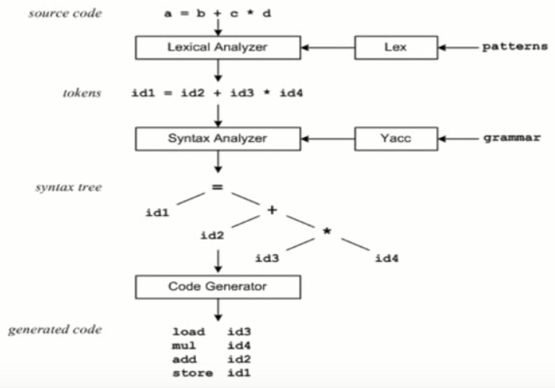
Compilers

Slide 3
YACC
Find the structure of the program
The input of Yacc are grammar rules, together with code to be invoked as each grammar rule is recognized.
The output of Yacc is a subroutine that parses the input

Slide 4
YACC
The class of specifications accepted : LALR(1) grammars with disambiguating rules.

Slide 5
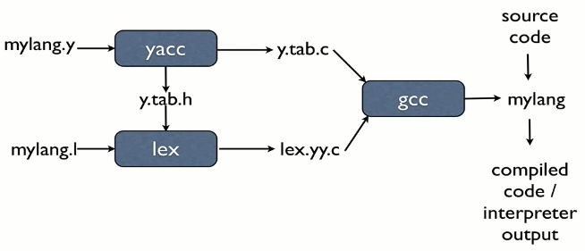
YACC
When the user inputs a specification(mylang.y) to Yacc, the output is a file of C programs, called y.tab.c

Slide 6
YACC
The specification file consists of three sections:
declarations
%%
production action
%%
subroutines

Slide 7
YACC--declarations
Declarations include:
C declarations enclosed in %{ %}
Yacc definitions
%start: declare the start symbol
%token: declare the terminals
%union: a union of all the types
%type: declare the types of the non-terminals

Slide 8
YACC--declarations
Yacc definitions
%start: declare the start symbol
%start S
%token: declare the terminals
%token DIGIT

Slide 9
YACC--declarations
Yacc definitions (continue)
%union: a union of all the types that can be the result of parsing actions.
%union {
int ival;
char chval;
double dval;
}
%type: declare the types of the non-terminals
%type<dval> expr
%token<ival> INTEGER

Slide 10
YACC--declarations
Declarations include (continue):
The precedences and associativities of tokens
%left
%right
%nonassoc
All of the tokens on the same line are assumed to have the same precedence level and associativity;
the lines are listed in order of increasing precedence or binding strength.

Slide 11
YACC--declarations
Declarations include:
The precedences and associativities of tokens
%nonassoc : is used to describe operators that may not associate with themselves

Slide 12
YACC--declarations
Example:
%right '='
%left '+' '-
%left '*' '/'
+ and - are left associative
* and / are left associative
+ and - have lower precedence than * and /

Slide 13
YACC--productions
A grammar rule has the form:
left : right ;
Multiple right-hand sides may follow separated by a ‘|’
Actions associated with a rule are enclosed in curly braces { and }.

Slide 14
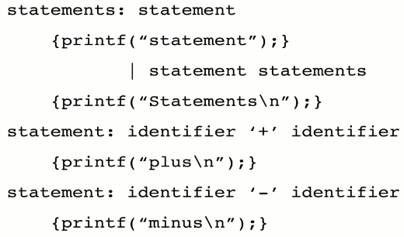
YACC example productions
Yacc permits an action to be written in the middle of a rule as well as at the end

Slide 15
YACC-- productions
Every symbol have a value associated with it (including token and non-terminals)
$1, $2…, $n can be refer to the values associated with symbols of the right side of a rule
for example A : B C D ;
$2 has the value returned by C
$3 the value returned by D.

Slide 16
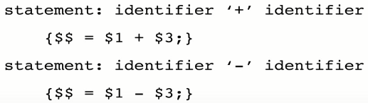
YACC-- productions
$$ refer to the value of the left
Default action: $$=$1

Slide 17
YACC-- productions
@: locations
The location of the nth component of the right hand side is @n
The location of the left hand side is @$.

Slide 18
Yacc– subroutines(third part)
Contains valid C code that supports the language processing
Symbol table implementation
Functions that might be called by actions associated with the productions in the second part

Slide 19
YACC
yyparse: the function produced by Yacc;
it is an integer valued function.
When it is called, it repeatedly calls yylex.
yyerror: prints a message when a syntax error is detected
yychar: the external integer variable, containing the lookahead token number at the time the error was detected;

Slide 20
Example: calculator
%{
#include <ctype.h>
extern void yyerror(char*);
%}
%token DIGIT
%%
stat : expr '\n' { printf("ans = %d\n", $1); }
| stat expr '\n' { printf("ans = %d\n", $2); }
;
expr : expr '+' DIGIT { $$ = $1 + $3; }
| DIGIT
;
%%

Slide 21
Example: calculator
int yylex() {
char ch;
while ((ch = getchar()) == ' ');
yylval = ch - ‘0';
return isdigit(ch) ? DIGIT : ch;
}
void yyerror(char* msg) { puts(msg); }
int main() {
yyparse();
return 0;
}

Slide 22
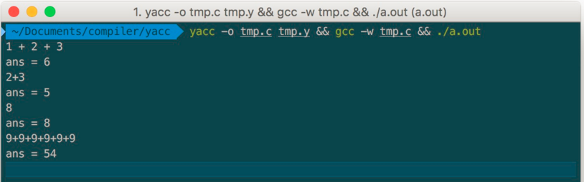
Example: calculator
yacc -o cal.c cal.y && gcc -w cal.c && ./a.out

Slide 23
Error Handling
It is not usually acceptable to have a program terminate on a syntax error.
A compiler should recover sufficiently to parse the rest of the input file and check it for errors;

Slide 24
Error Handling
You can define how to recover from a syntax error by writing rules to recognize the special token error
This is a terminal symbol that is always defined (you need not declare it) and reserved for error handling.
The Bison parser generates an error token whenever a syntax error happens;

Slide 25
Error Handling
if you have provided a rule to recognize this token in the current context, the parse can continue.
The purpose of error is to permit the parser to continue after some anticipated error. (error recovery)

Slide 26
Error Handling
To define how to recover from a syntax error by writing rules to recognize the special token error
For example:
stmts : exp '\n'
| stmts exp '\n'
| stmts error '\n’
An error followed by a newline makes a valid addition to any stmts

Slide 27
Error Handling
The choice of error rules in the grammar is a choice of strategies for error recovery.
A simple and useful strategy is simply to skip the rest of the current input line or current statement if an error is detected:
Example: stmt: error ';’
/* On error, skip until ';' is read. */

Slide 28
Error Handling
It is also useful to recover to the matching close-delimiter of an opening-delimiter that has already been parsed.
Exmaple: primary:
'(' expr ')’
| '(' error ')’
…
;

Slide 29
Error Handling
Error recovery strategies are necessarily guesses.
When they guess wrong, one syntax error often leads to another

