Slide 1
Compilers
2-The Cool Programming Language

Slide 2
Cool Programming Language
Cool programs are sets of classes.
A class encapsulates the variables and procedures (or methods) .
Instances of a class are objects.
Inheritance allows new classes to extend the existing classes.

Slide 3
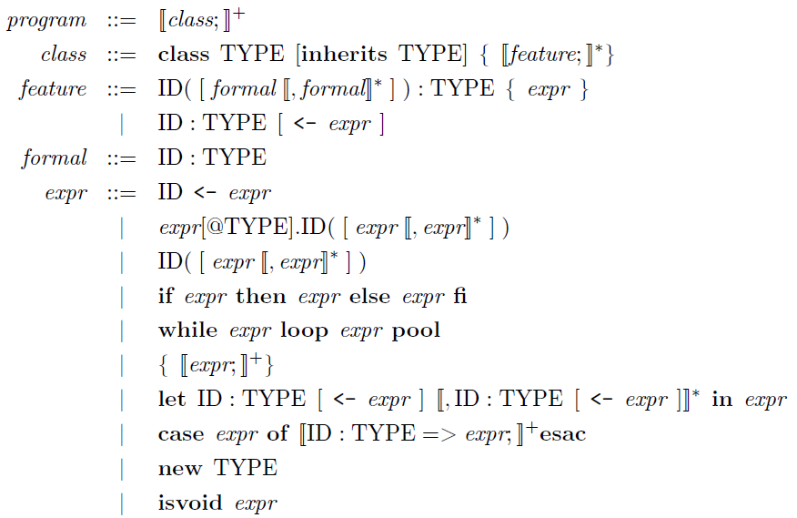
Cool Programming Language

Slide 4

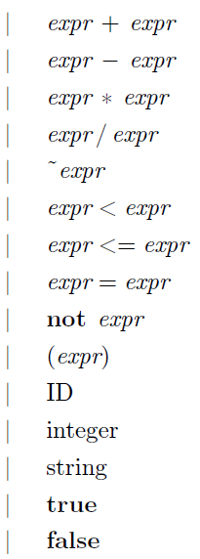
Cool Programming Language

Slide 5
Cool Programming Language
hello_world.cl
class Main inherits IO {
main(): SELF_TYPE {
out_string("Hello, World.\n")
};
};
The type SELF_TYPE is used to refer to the type of the object on which the method was dispatched.

Slide 6
Cool Programming Language
list.cl
class List {-- Define operations on empty lists
isNil() : Bool { true };
head() : Int { { abort( ); 0; } };
tail() : List { { abort( ); self; } };
cons(i : Int) : List {
(new Cons).init(i, self)
};
};
The special variable self refers to the object

Slide 7
Cool Programming Language
init(i : Int, rest : List) : List {
{
car <- i;
cdr <- rest;
self;
}
};
};
list.cl
class Cons inherits List {
-- handle non-empty lists
car : Int;
cdr : List;
isNil() : Bool { false };
head() : Int { car };
tail() : List { cdr };

Slide 8
list.cl
class Main inherits IO {
mylist : List;
print_list(l : List) : Object {
if l.isNil() then out_string("\n")
else {
out_int(l.head());
out_string(" ");
print_list(l.tail());
}
fi
};

Slide 9
list.cl
main() : Object {
{
mylist <- new
List.cons(1).cons(2).cons(3).cons(4).cons(5);
while (not mylist.isNil()) loop
{
print_list(mylist);
mylist <- mylist.tail();
}
pool;
} };};

Slide 10
How to run COOL programs
COOL
program( .c)
Assembly
code (.s)
Cool compiler
coolc
$ coolc hello_world.cl
$ spim hello_world.s
The coolc compiler generates MIPS assembly code，which are run on a MIPS simulator called spim

