Slide 1

Next generation sequencing
Dr. Cheng Zhang
Senior Lecturer
King’s College London
& Science for Life Laboratory (Sweden)

Slide 2
Content in this lecture
Introduction to Next Generation Sequencing (NGS) technology
Understanding NGS Data Outputs
Genome Sequencing Data Analysis
2

Slide 3
Introduction to Next Generation Sequencing (NGS)
First generation sequencing
Sanger Sequencing (1977)
Next generation sequencing
Pyrosequencing
Sequencing by synthesis
Sequencing by ligation
Ion semiconductor*
Introduction to sequencing methods

Slide 4
Content in this lecture
Introduction to Next Generation Sequencing (NGS) technology
Understanding NGS Data Outputs
Genome Sequencing Data Analysis
4

Slide 5
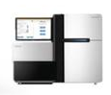
Understanding NGS Data Outputs
ATTCAAGTCATACG
CGAATTGTATGCGA
ATTAACGCCGATAG
AATATAGGACCCGC
AAAATTATGCGGCG
Materials
NGS
Data
Pros:
High-throughput
High accuracy
Cons:
Overwhelming data output
Computationally heavy

Slide 6
Understanding NGS Data Outputs
Raw data & QC
Alignment
Analysis

Slide 7
Fastq file
Understanding NGS Data Outputs
A text-based format for storing nucleotide sequences and associated quality scores
.fastq
or .fq
or .fastq.gz or .fq.gz
Sequence ID: flowcell lane and location in tile of flowcell
@DP8400009968BRL1C001R0030634050/1
CGGCGGGGGAATGGAGTTTTGCTCTTGTTGTCCTGGCTGGAGTGCAATAGCACAATCTTGGCTCACCACAACCTCCGCCTCCTGGGTTCTAGCAATTCTC
+
HFFB<??BB6GGBAFAFGGHHHGGHGEEII:1ECGAACB93H2G;FGG8G
F?HBFIHGI;G@GGEGIAH6FHHFIG1A-FGHG,>;F<H)D6GFGDF9IH
Nucleotide sequence: adenine (A), cytosine (C), guanine (G), and thymine (T)
Quality score using ASCII code from alphabet (best quality) to numbers (ok quality) and eventually symbols (worst quality)

Slide 8

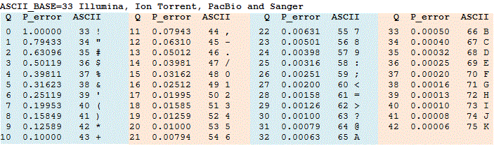
Understanding NGS Data Outputs
Quality score of base call (Q value)
P-value: base-calling error probabilities
If P-value is 0.001, Q-value is Q30.
Higher Q value, lower error and better quality in base-calling
To save space, transform Q-value to ASCII:
ASCII= Q-value +33 or ASCII= Q-value +64 (old)
Q30: 99.9% accuracy

Slide 9
Understanding NGS Data Outputs
This is how a sequencing report looks like
Number of million reads
NGI ID | User ID | Mreads | >=Q30
P13605_101 | L1 | 8.94 | 94.69
P13605_102 | L2 | 8.16 | 93.66
P13605_103 | L3 | 8.61 | 94.79
P13605_104 | L4 | 7.78 | 94
P13605_105 | L5 | 8.19 | 93.18
P13605_106 | L6 | 8.71 | 93.89
P13605_107 | L7 | 8.43 | 92.48
P13605_108 | L8 | 8.8 | 95.21
P13605_109 | L9 | 9.79 | 92.45
Q30: I’m here!
@SeqID
AACTGATTACAGCCGTT
+
BB6GGBAFA!=GHHHGA

Slide 10

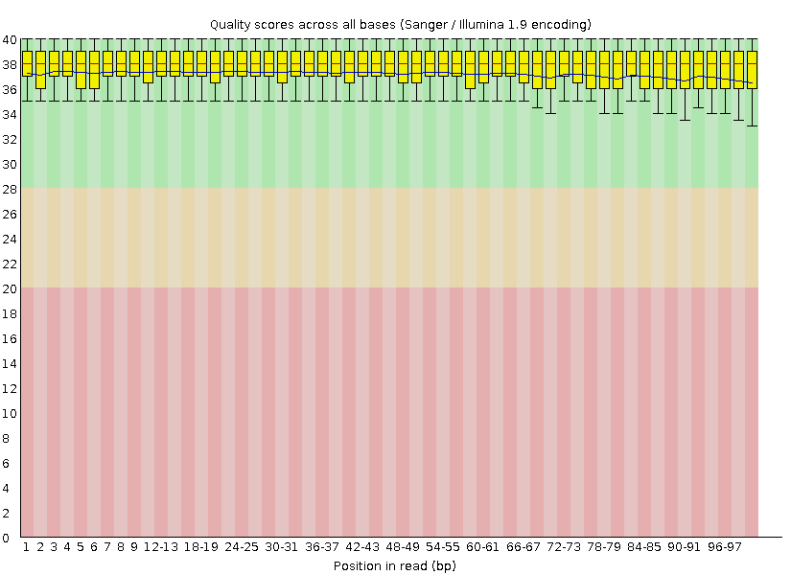
FastQC
Understanding NGS Data Outputs
Input: fastq file (*.fq.gz)
Per base sequence quality
Red line: median Q-value
Blue line: mean Q-value
Green region: very good quality
Orange region : reasonable quality
Red region : poor quality
Every read length: 101

Slide 11
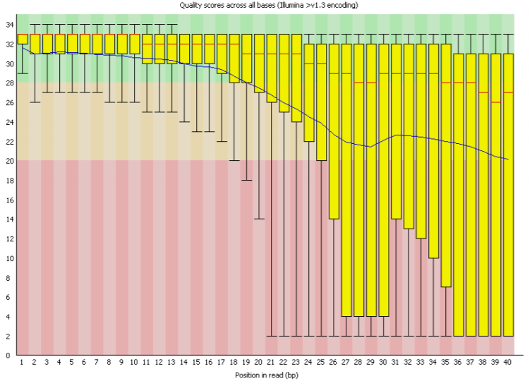
Poor quality
Understanding NGS Data Outputs

Slide 12
Understanding NGS Data Outputs
Raw data & QC
Alignment
Analysis

Slide 13
Understanding NGS Data Outputs
Alignment: align your sequencing data to a reference genome.
which is basically fastq without the Q!
Reference genome is saved as fasta file
Gene/transcript ID & annotation
>ENST00000319622.10 PKM-201 cdna:protein_coding
AGTCCCACCGAAAGGGCAACCTGCCCGCGCGTTCCGCCGCCGCCGCCGCGCTTCCTCCTG
AAGGTGACTGCGCCCGCGGGGACGCAGGGGGCGGGGCCCGGGTCGCCCGGAGCCGGGATT
GGGCAGAGGGCGGGGCGGCGGAGGGATTGCGGCGGCCCGCAGCGGGATAACCTTGAGGCT
GAGGCAGTGGCTCCTTGCACAGCAGCTGCACGCGCCGTGGCTCCGGATCTCTTCGTCTTT
GCAGCGTAGCCCGAGTCGGTCAGCGCCGGAGGTGAGCGGTGCAGGAGGCTACGCCATCAG
TCCCCACCAAGGGCCAGTCGCCCGGCTAGTGCGGAATCCCGGCGCGCCGGCCGGCCCCGG
GCACGCAGGCAGGGCGGCGCAGGATCCAGGGCGTCTGGGATGCAGTGGAGCTCAGAGAGA
GGAGAACGGCTCCTCACGCCTGGGGCCTGCTCTTCAGAAGTCCCCAGCGCCGTTCCTTCC
AGATCAGGACCTCAGCAGCCATGTCGAAGCCCCATAGTGAAGCCGGGACTGCCTTCATTC...
Reference nucleotide sequence of the reference gene/transcript

Slide 14
Understanding NGS Data Outputs
There are many different tools for alignment, and they all perform similarly. Here we recommend Burrows-Wheeler Aligner (BWA) as it is used in the GATK best practice.
BWA is a software package for mapping sequences against a reference genome, and three different algorithms are used:
BWA-backtrack: for very short reads
BWA-SW: for when there are alignment gaps
BWA-MEM: for standard Illumina sequencing

Slide 15

Understanding NGS Data Outputs
Even if there is reference genome, control sample is still needed!
In some cases, the background genotype could be difference from the reference genome (SNP)
Usually, control will match the reference genome
Sometimes, your sample might match the reference but not the control
Reference
Control
Experimental

Slide 16
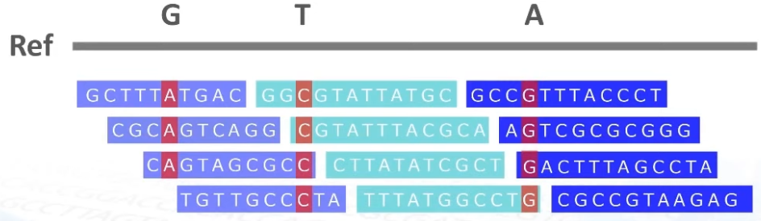
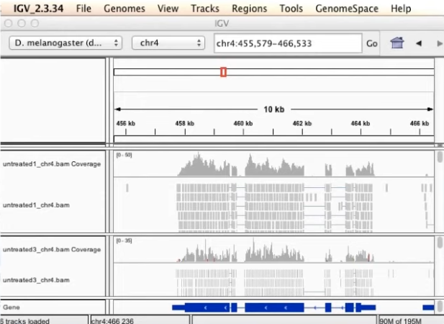
Genome sequencing data analysis
Which looks like this in the real world!

Slide 17
SAM file
Understanding NGS Data Outputs
Sequence Alignment Map (SAM) is the universal file format for mapped sequence reads.
contains the sequence and quality scores of each read
Provides more detailed information than fastq file
HWI-ST1025:8:2312:15236:40352#0 83 1 16755 40 11M92N90M = 16733 -123 ATCTTGTAGGTCTTGAGAGGCTCGGCTACCTCAGTGTGGAAGGTGGGCAGTTCTGGAATGGTGCCAGGGGCAGAGGGGGCAATGCCGGGGCCCAGGTCGGC
_ccccb`bcbb_bccccba[Xcacb_]T^cb_cccccccccccdceeeeegedgfggihhhiihhghihgdfhhiiihhgiihihiihfgeggeeeeebbb
AS:i:0 XN:i:0 XM:i:0 XO:i:0 XG:i:0 NM:i:0 MD:Z:101 YS:i:0 YT:Z:CP ZW:f:0.301882 XS:A:-
Integer (column 2) | Description (Paired Read Interpretation)
1 | template having multiple templates in sequencing (read is paired)
2 | each segment properly aligned according to the aligner (read mapped in proper pair)
4 | segment unmapped (read1 unmapped)
8 | next segment in the template unmapped (read2 unmapped)
16 | SEQ being reverse complemented (read1 reverse complemented)
32 | SEQ of the next segment in the template being reverse complemented (read2 reverse complemented)
64 | the first segment in the template (is read1)
128 | the last segment in the template (is read2)
256 | not primary alignment
512 | alignment fails quality checks
1024 | PCR or optical duplicate
2048 | supplementary alignment (e.g. aligner specific, could be a portion of a split read or a tied region)
Column 1: Read ID
Column 2: 83=1+2+16+64
Column 3: Mapped to chromosome 1
Column 4: Location in chromosome
Column 5: Alignemnt score
....
A BAM file is just the binary
version of a SAM file!

Slide 18
Content in this lecture
Introduction to Next Generation Sequencing (NGS) technology
Understanding NGS Data Outputs
Genome Sequencing Data Analysis
Raw data & QC
Alignment
Analysis
18

Slide 19
Genome sequencing data analysis
SNP/SNVs:
single nucleotide polymorphism/ single nucleotide variations
INDELs:
insertions & deletions
CNVs:
copy number variations

Slide 20
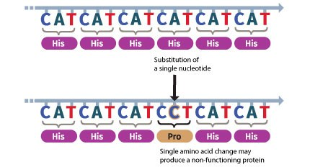
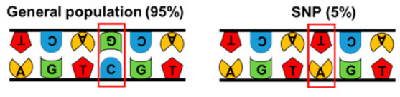
Genome sequencing data analysis
SNV
SNP
A single-nucleotide polymorphism (SNP) is a germline substitution of a single nucleotide at a specific position in the genome. A single-nucleotide variant (SNV) is a variation in a single nucleotide, and it differs from a SNP as the latter has to segregate in a species' population of organisms.

Slide 21
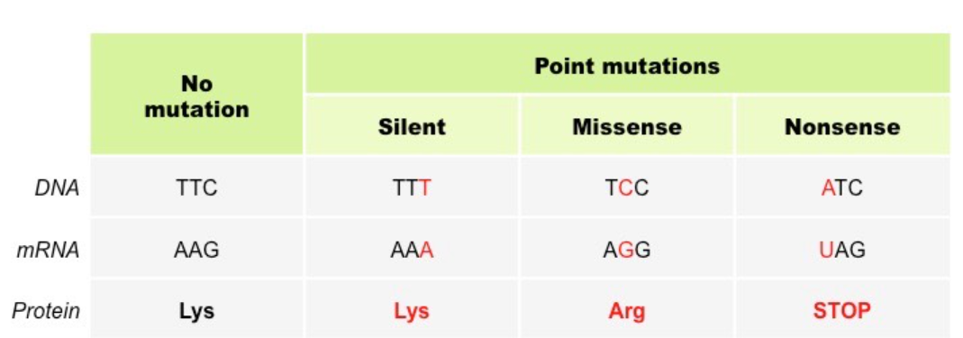
Genome sequencing data analysis
Why SNPs are so common and people are in general healthy?
SNP/SNV can be silent, that’s why it can be quite common!

Slide 22
Genome sequencing data analysis
A simple SNP application:
Can you know your height with only your DNA sequence?
Human height is almost completely decided by genetics!
Genetic difference between individual humans is only 0.1%!
Most of the inter individual genetic differences are SNPs!

Slide 23
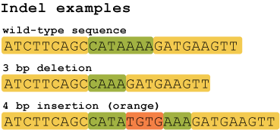



Genome sequencing data analysis
INDELs
CNVs
Reference
chromosome
Small scale changes at base pair level
Large scale changes at gene level

Slide 24
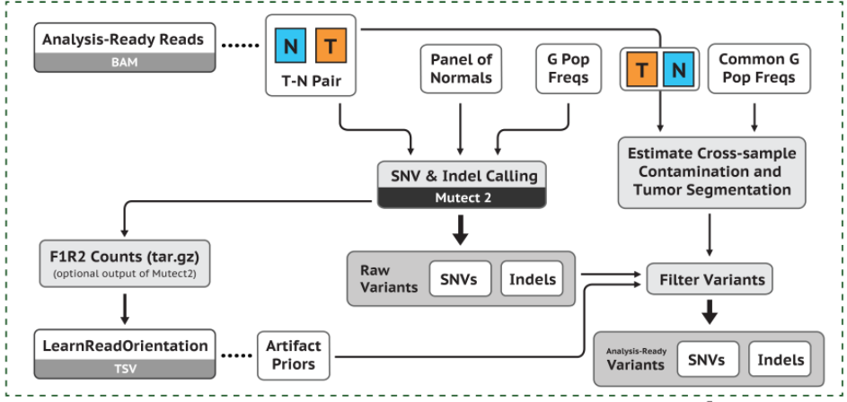
Genome sequencing data analysis
Genome analysis toolkits
SNV/SNPs + indels: GATK/VarScan2
CNVs: VarScan
GATK workflow

Slide 25
The end!
Thank you!

