Slide 1
SC1015 Mini Projects: Beyond the Box Office
PROD.
Subtitle:
Forecasting Successful Movies
Group Member:
Li You, Chan Zhao Yi, Tang Yutong
Notes:
Hello I’m Yutong, and my group members are Li You and Zhao Yi. Today we will be presenting our SC1015 Mini Project on Forecasting successful Movie.

Slide 2


Background & Motivation
After Pandemic
Educational values
a important way of entertainment
Stimulation of environmental change
A Important way for learning new things
The suppose for the future
Notes:
Here is the background and motivation for our theme.
As restrictions have eased and people are getting vaccinated, many movie theaters have reopened, and people are now eager to have the traditional movie-going experience. Additionally, some highly anticipated movies that were delayed due to the pandemic are now being released, which has generated a lot of excitement among moviegoers.
Also, movie is a good way to learn new things and forecasting future, which have a deep influence in society development.

Slide 3

Our Question
TAKE:
How can we predict if a successful blockbuster movie base on different variables?
Notes:
So this lead to our more thoughts about how the audience can avoid bad movies.
Movie is a multi-billion dollar industry, and predicting which movies will be successful can be a daunting task. Factors such as the genre, cast, budget, release date, and marketing can all influence a movie's performance at the box office. However, by analyzing historical data on movie performances, we can identify patterns and trends that can help us predict how well future movies might do. Then this brings out our question: how can we predict if a successful blockbuster movie base on different variables?

Slide 4
Contents
01
02
Data Collection & Preparation
Exploratory Data Analysis
03
04
Machine Learning
Summary & Reflection
SECTION:
SECTION:
SECTION:
SECTION:
Notes:
here is a quite look at the contents of our presentation on our project

Slide 5
01
Data Collection & Preparation
ROLL:
PROD.
TAKE:
Lay the basis for data analysis and predicting
From:
Kaggle
Notes:
The first thing to do is to collect data and prepare for our data analysis and prediction.

Slide 6
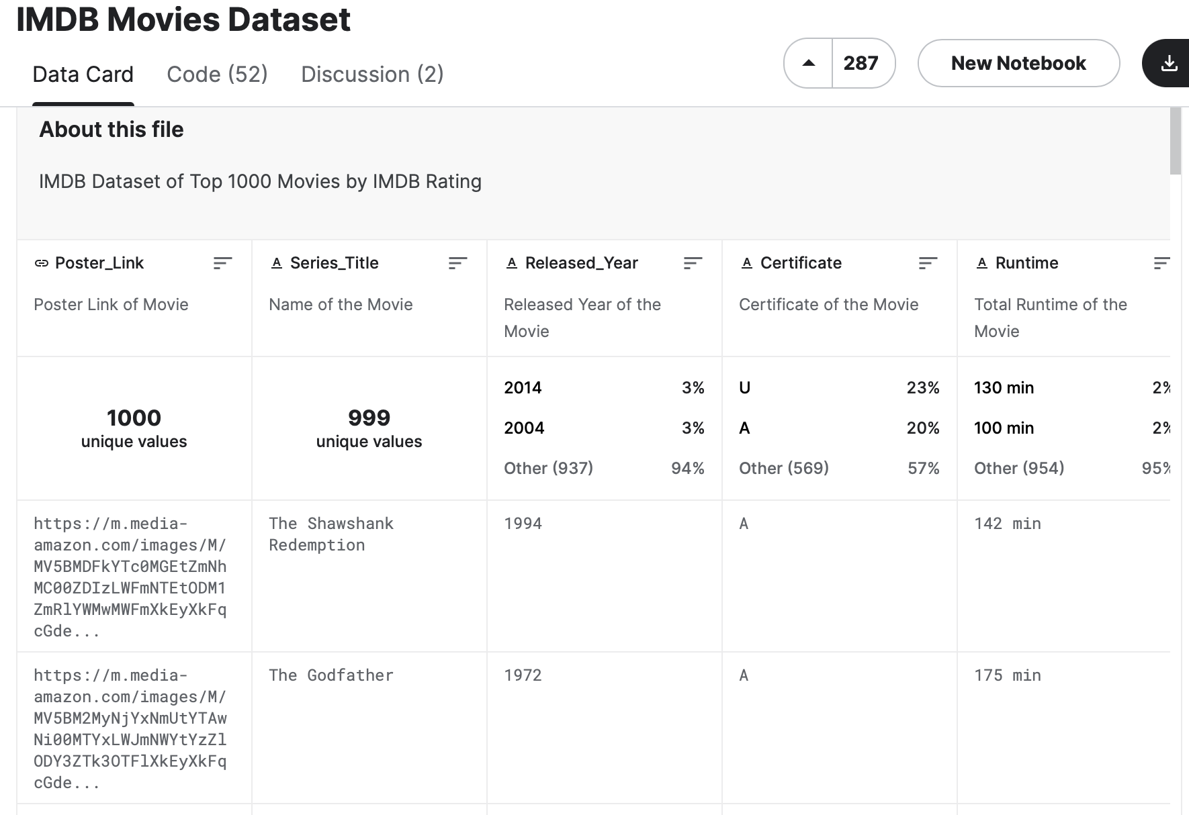
Dataset
You can give a brief description of the topic you want to talk about here. For example, if you want to talk about Mercury, you can say that it’s the smallest planet in the entire Solar System
--- IMDB Movie Dataset from Kaggle
Notes:
We chose the "IMDB Movies dataset --- top 1000 movies by IMDB Rating" from Kaggle. Firstly, IMDB is a popular and trusted source for movie ratings, and the top 1000 movies according to IMDB ratings are generally considered to be among the most successful and critically acclaimed movies of all time.
Secondly, the dataset includes a wide variety of factors, and this allowed us to explore different factors such as genre, directors. This also provided us with a rich set of features that we could use to train our machine learning model.

Slide 7
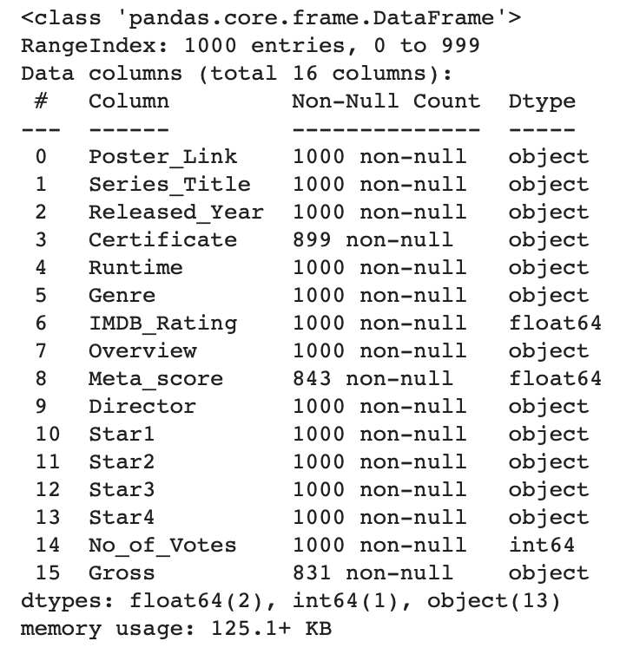
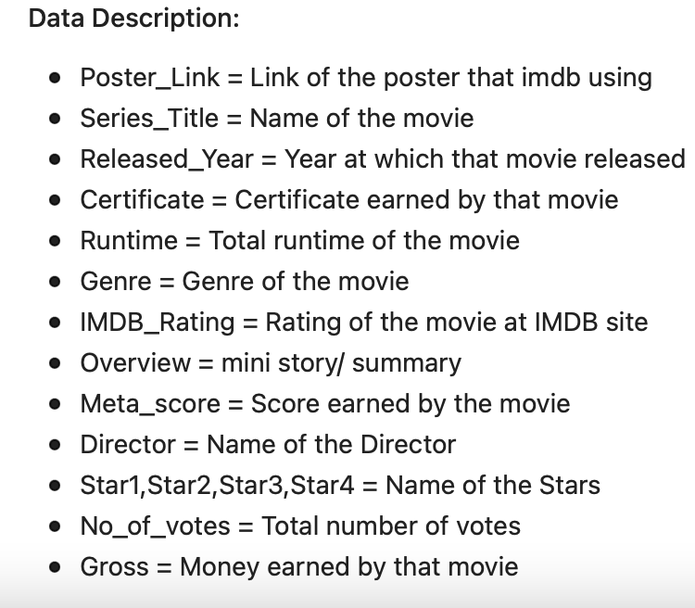
Data Cleaning
Based on the dataset Description, drop some of the variables:
Notes:
Here’s the basic information for our data. Based on the Data Description, Poster_Link and Overview is unnecessary. Therefore, we will drop it.

Slide 8
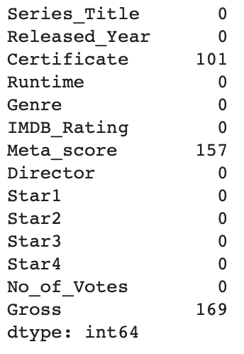
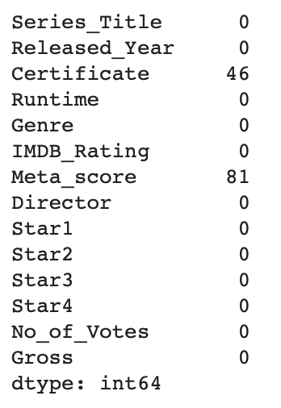
Before
After
Notes:
We can observe that there are missing values. Therefore, we will drop all rows with no information regarding Gross income as we are looking for successful movies. However, we will keep those rows that have no Metascore and Certificate as it is still relevant. Here’s a comparison for the before and after values.

Slide 9
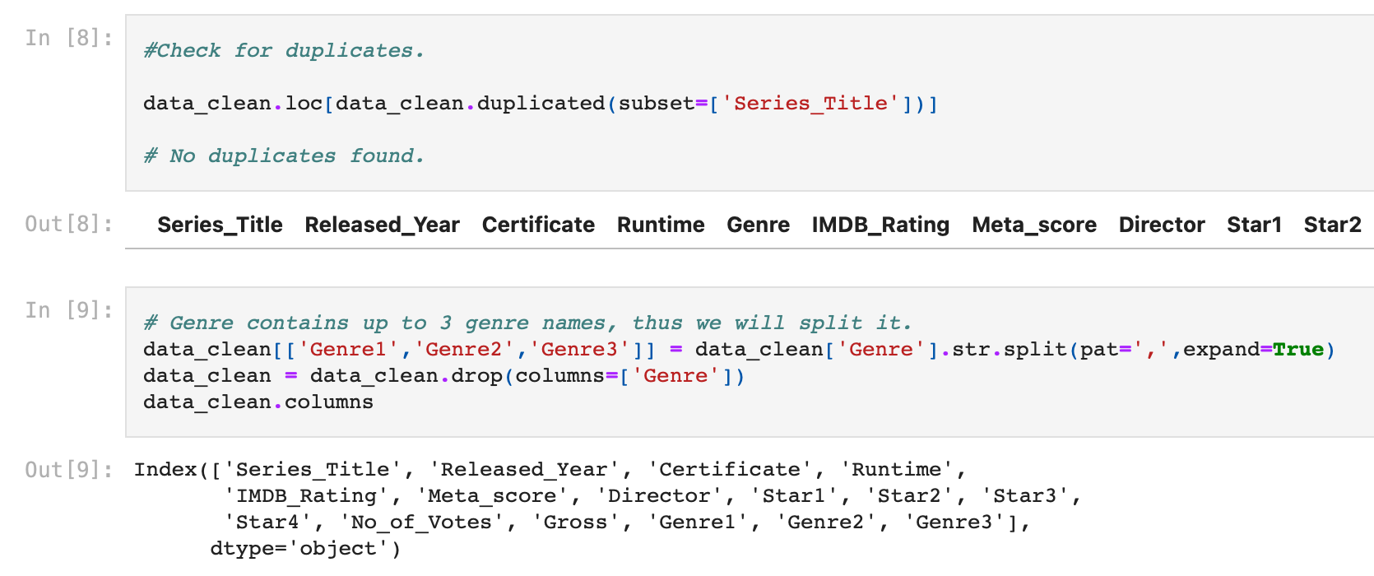
Check and Split
Notes:
Also, we check for the duplicates and split genre as it has 3 genre names.

Slide 10
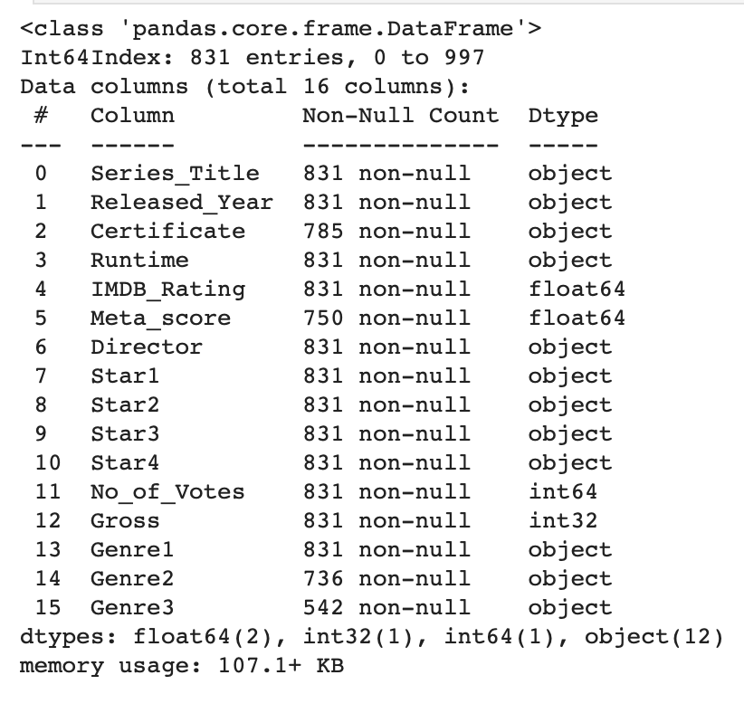
02
Exploratory Data analysis
TAKE:
ROLL:
PROD.
choosing our data and see relationships
Notes:
After the data collection and preparation, here comes the exploratory data analysis. The information of the cleaned data is shown on the right.

Slide 11
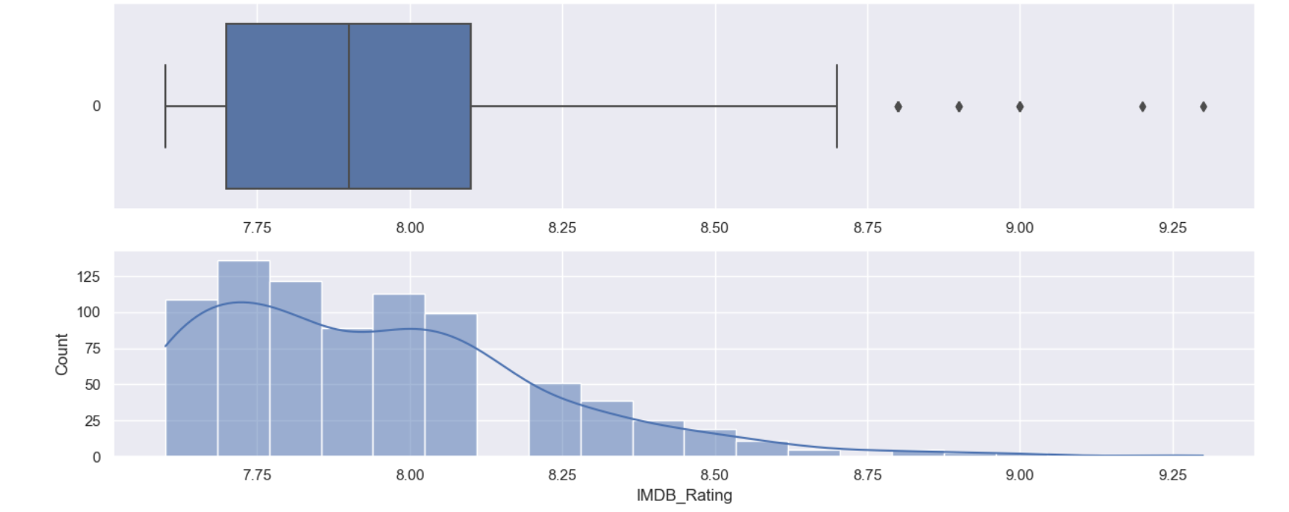
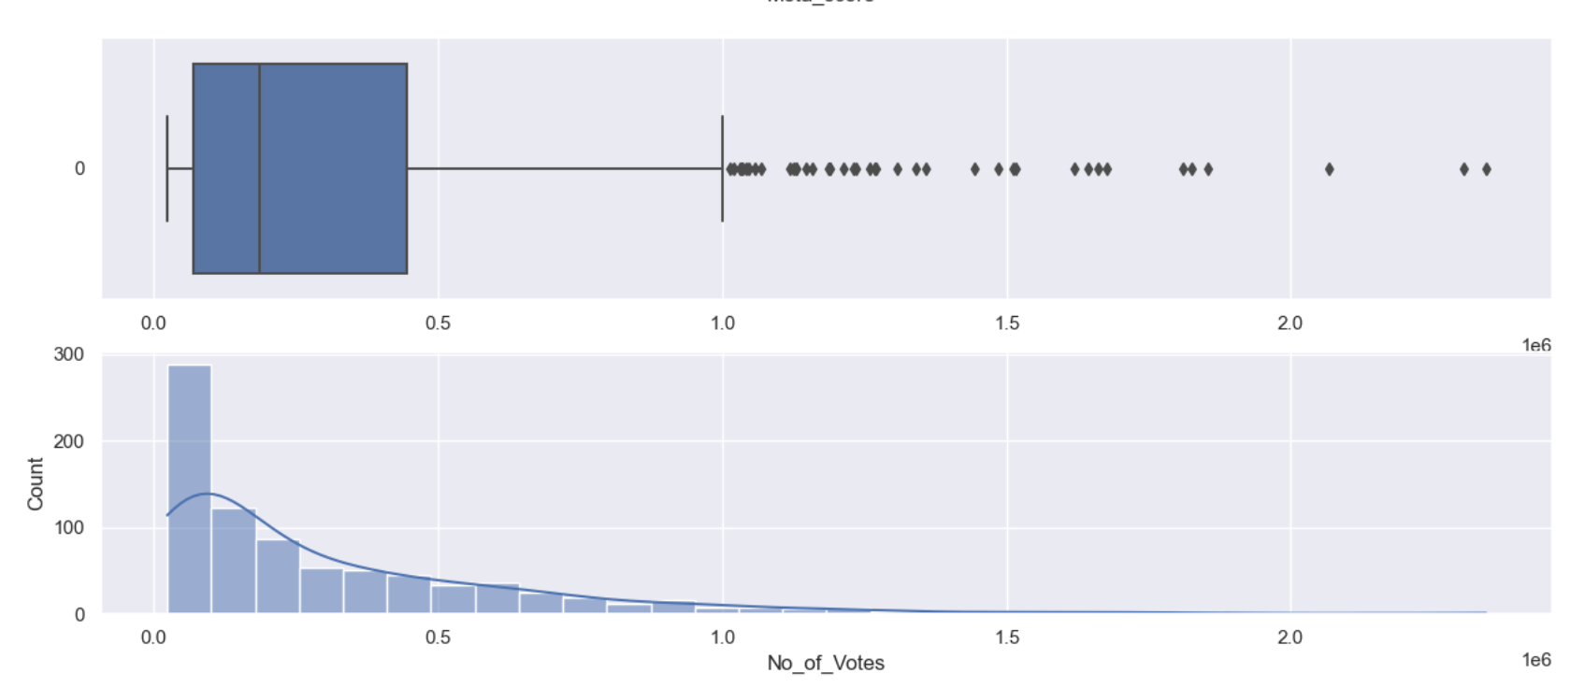
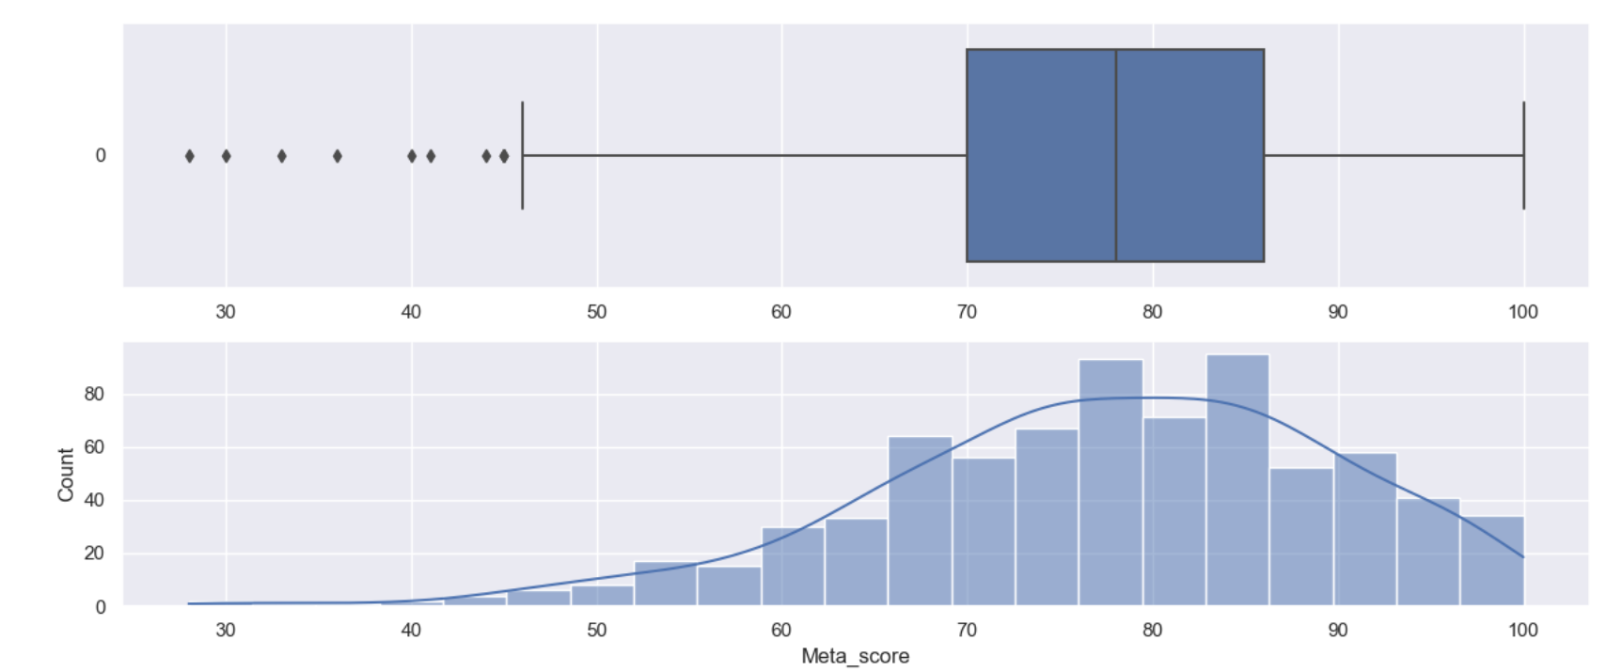
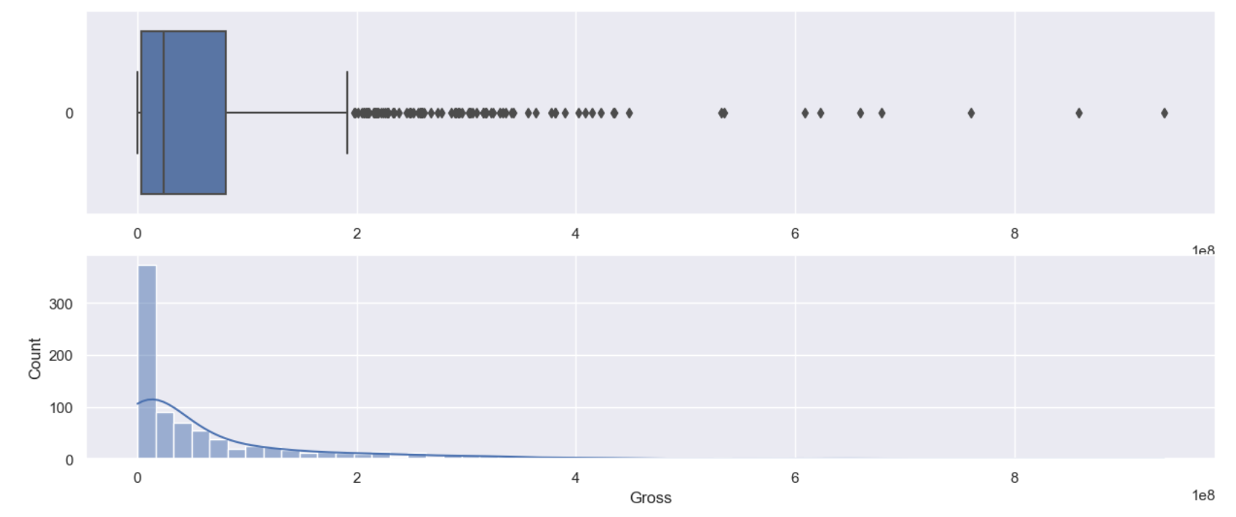
Numerical Variables: Overview
Notes:
Here is an overview of our factors, and we can see that IMDB Rating, No. of Votes and Gross are all Positive Skew while Metascore is Negative Skew.

Slide 12
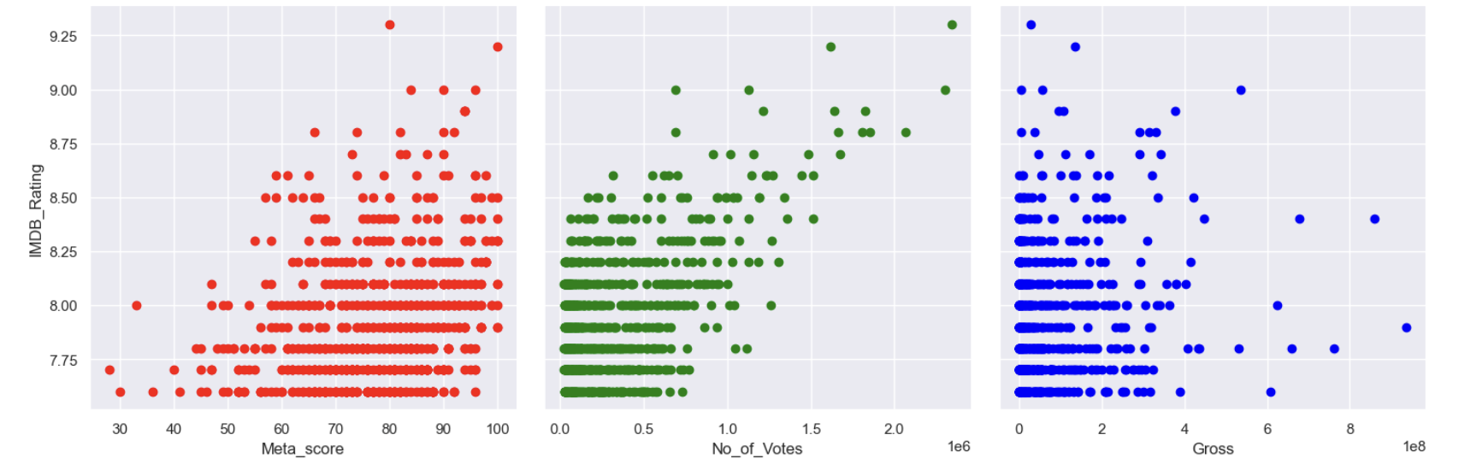
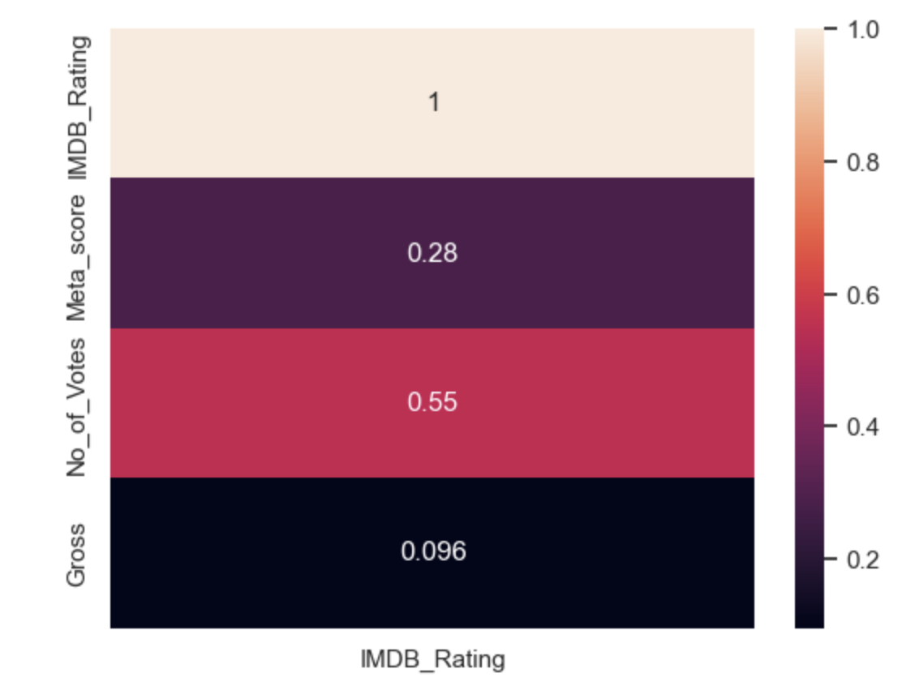
Numeric Variables
Heatmap:
Correlations with
IMDB Ratings
：Distributions
Notes:
Now let's see any of the factors correlate to IMDB Rating. From the distribution graph we can see that Metascore seems to have a low positive correlation with IMDB Rating. No. of Votes seems to have a better positive correlation with IMDB Rating compared to Metascore. And it appears Gross have no relation to IMDB Rating at all. And this is further illustrated from the heatmap. So We will be performing multi-variate regression with No_of_Votes and Meta_score.

Slide 13
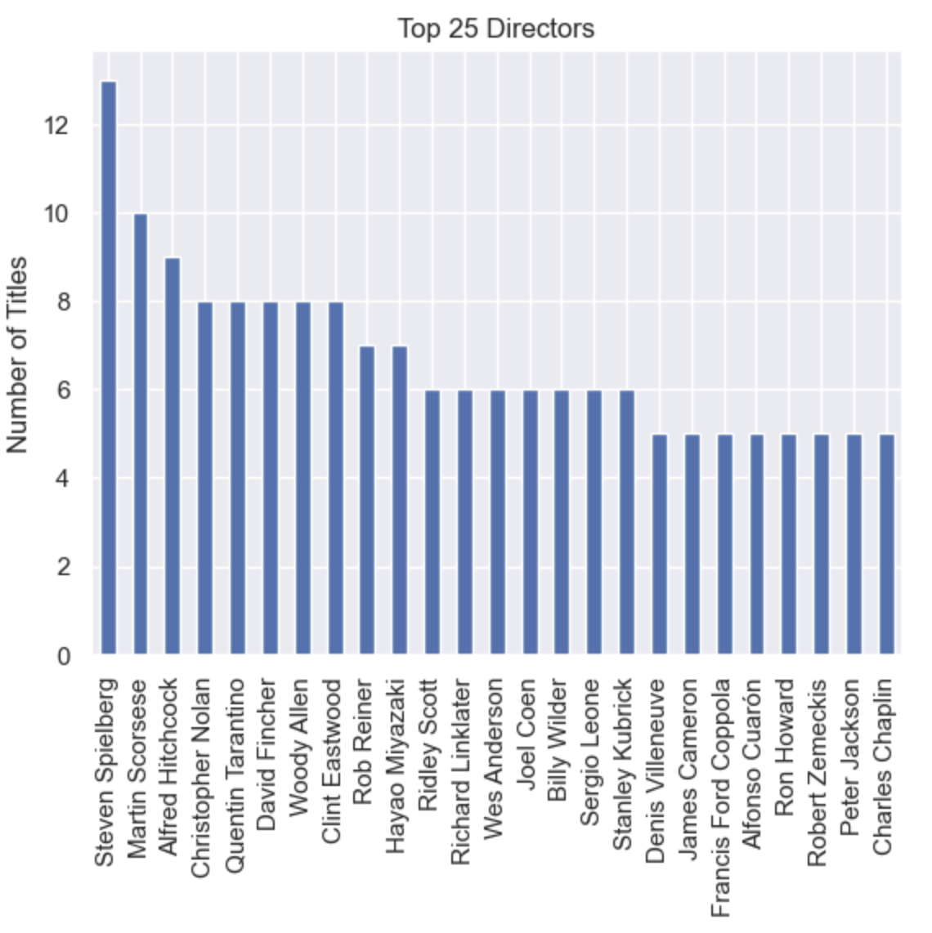
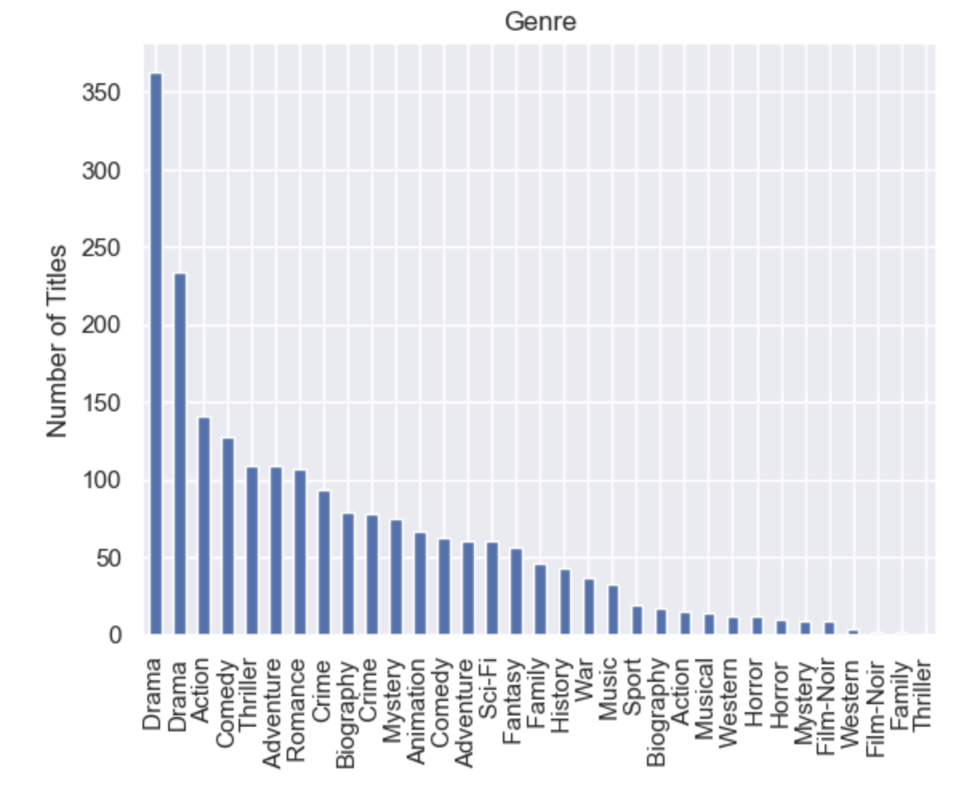
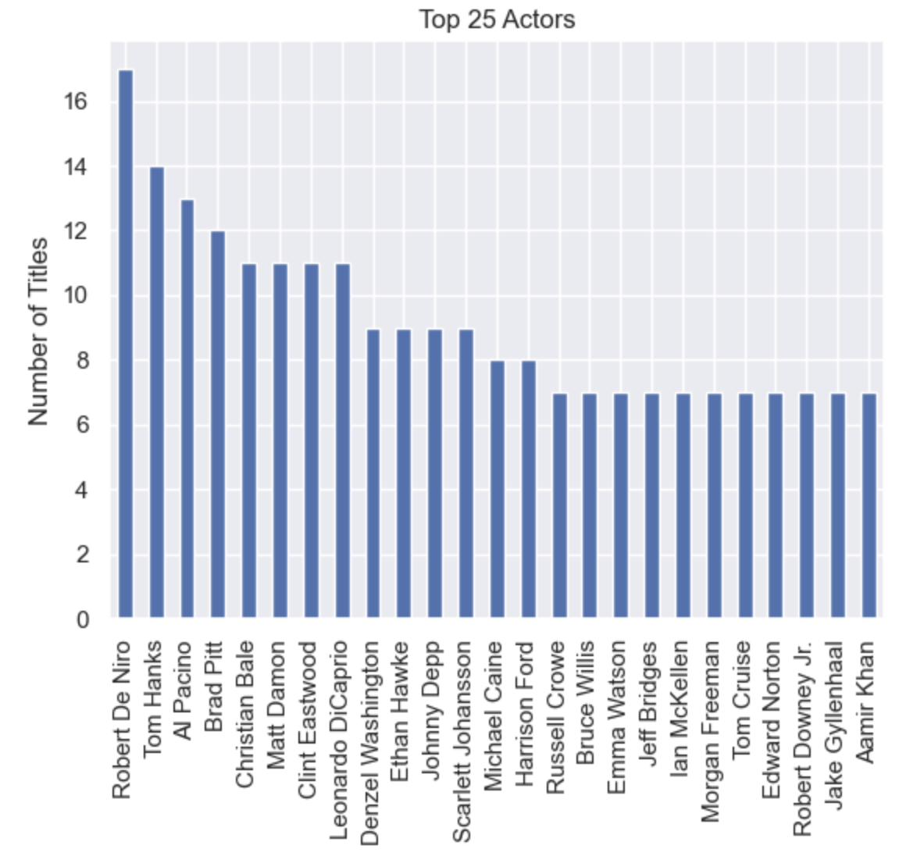
Categorical Variables
Genre:
Actors:
:Directors
Notes:
Then it’s the turn of categorical variables. We perform the result using bar chart to have a clear view. For the genre we assume that the first entry in the genre row is the main genre of the repective title. And for the directors and actors, we retrieve the most frequent 25 for each category.

Slide 14
EDA Conclusions
Numerical variables:
Categorical Variables:
We will be performing multi-variate regression with No-of-Votes and Meta_score.
- Drama
- Steven Spielberg
- Robert De Niro
Notes:
So here comes the conclusions for our exploratory data analysis. For the numerical variables, No. of Votes seems to have the best positive correlation with IMDB Rating, while metascore and gross have low or no relation with IMDB ratings. So we will be performing multi-variate regression with No-of-Votes and Meta_score.
For the categorical variables, 'Drama' is the most frequently occuring genre. 'Steven Spielberg' and ‘Robert De Niro’ has released and played the most movie in IMDB top 1000 respectively.

Slide 15
03
Machine Learning
:TAKE
:ROLL
To make predictions & check accuracy
:PROD
Notes:
Our question is to know how can we predict if a successful blockbuster movie base on genre and other variables using the top 1000 movie. Based on the EDA done before, predictors will be number of votes, gross, meta_scores, genres, actors and directors.

Slide 16

Machine Learning Libraries
Notes:
We involves a few numeric variables and a few categories variables, so we will do a numeric model with Linear Regression and a category model with Decision Tree to see how we can predict the success of a movie. For the machine learning library, we choose scikit-learn, as it has comprehensive set of algorithms, high-level abstractions and it is designed to scale well to enable us handling large datasets with ease.

Slide 17

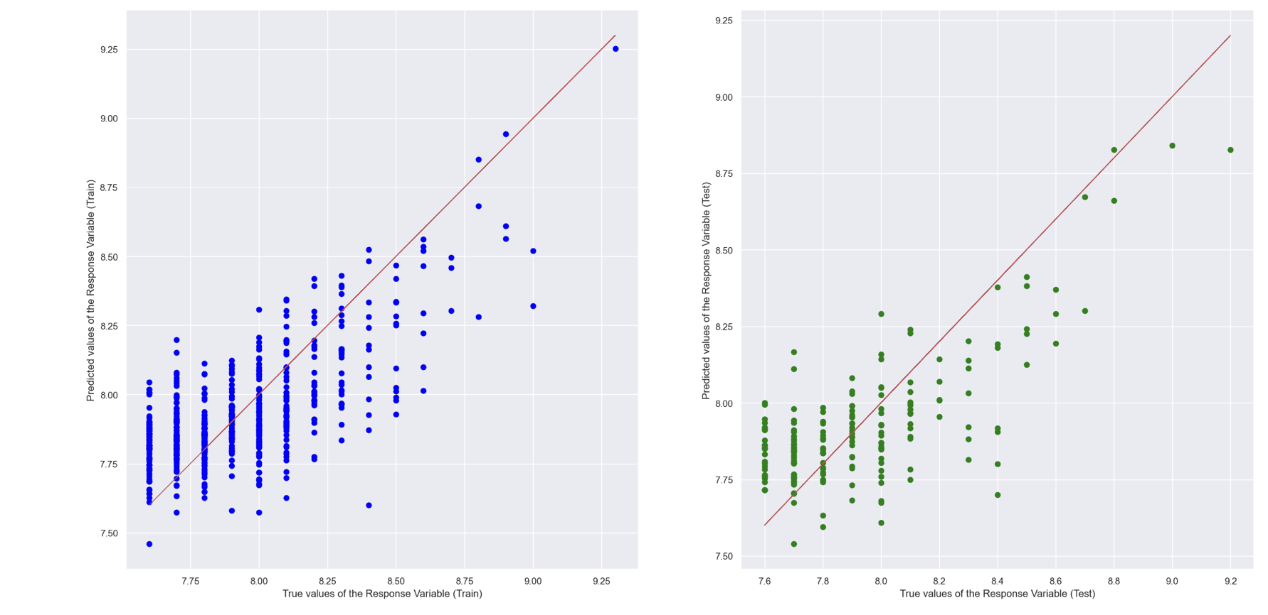
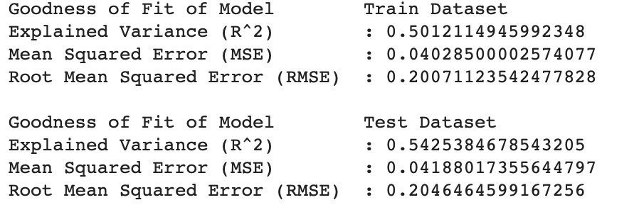
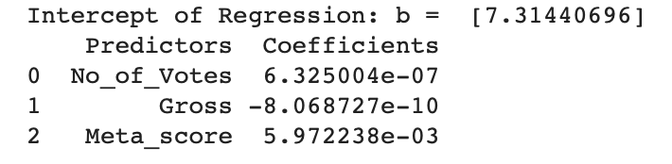
Numeric Model
Notes:
For the numeric model, we first do the spliting for train and test data set, and get the regression result. Then we check the goodness of fit on the train data and the test data. Both train set and the test set have similar accuracies. Next we will try to predict the IMDB Rating for some movies based on the numeric predictors.

Slide 18
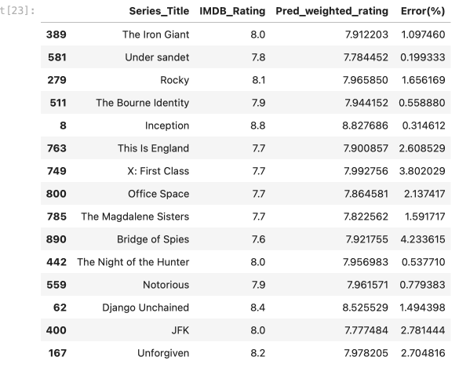

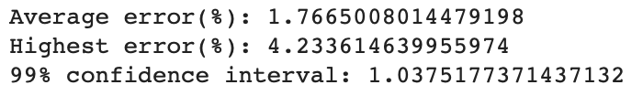
Predict IMDB Rating
TO DO:
 | sample
 | Mars is a red planet
 | check the confidence on prediction
 | Saturn is the ringed planet
 | We can see that the numeric model works well on the data.
Notes:
We can see the error for the numeric model is quite small for random samples. But to check the confidence on prediction, we still need to see the Distribution and Deviation of the Errors in prediction. We can see that the numeric model works well on the data, which means variables "No of Votes", "gross" and "Meta scores" are able to use to predict the success of a movie very well.

Slide 19

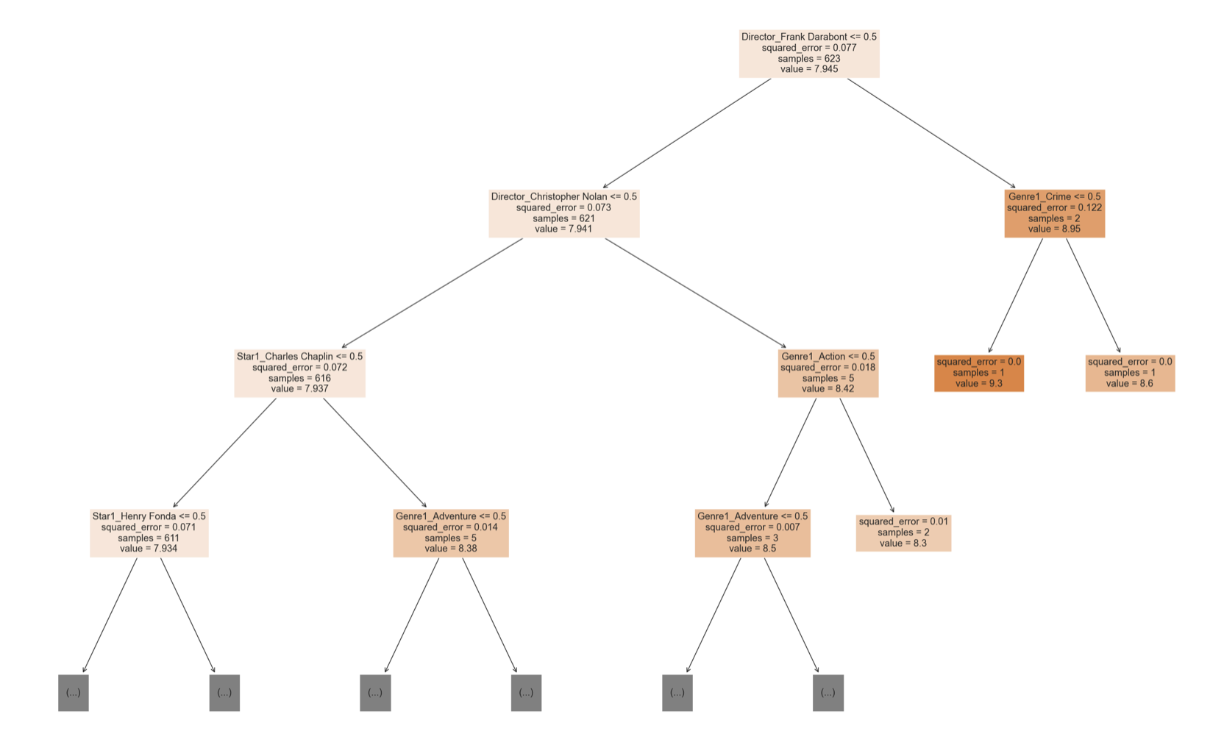
Category Model
Numbers
Decision Tree
check accuracy
Notes:
Now we do the same on category model first to spliting the data into train and test data sets. Here we choose decision trees. Decision trees are a popular choice for categorical models because they are simple to understand and interpret, and can handle both categorical and numerical features. In particular, decision trees can be useful for categorical models because they can handle non-linear relationships between features and target variables, and can capture complex interactions between features.

Slide 20
Machine Learning Conclusion
0.2000
0.3497
Numeric
Categorical
Lower RMSE
Higher RMSE
Notes:
It seems like the numerical model with the variables No of Votes, Gross, Meta_score has lower MSE than the categories model with variables Genre, Actor and director. So the numeric model, which involves number of votes, gross and meta scores is better to use to predict if a movie is successful or not. Compared to them, only depends on genre, actors and directors may not give assurance if a movie is successful or not.

Slide 21
04
Summary & Reflection
:TAKE
ROLL:
what we learn from the project
:PROD

Slide 22
Outcome of the Project
In order to predict a movie is successful, it really boils down to the number of vote from the public, gross income and score generated by professional reviewers. It is hard to predict a successful movie based on the genre, actors and directors involvement.

Slide 23
What we learn from the project
1:
Data Extraction & Cleaning
Data Visualization
:2
3:
Uni & Multi variate analysis
Machine Learning Approach
:4
Notes:
Here is out learning outcomes of the whole journey.

Slide 24
THANKS!
ROLL:
DO YOU HAVE ANY QUESTIONS?
TAKE:
SCENE:

