Slide 1
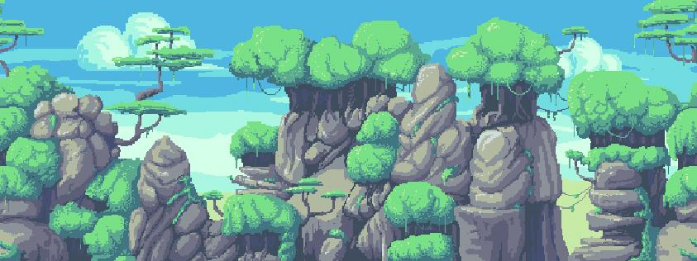







Up Key
Arrow shot
Left Key Down Key Right Key Sword Attack
Jump Key

Slide 2
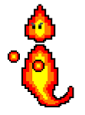
Level 1
First level monster , if u touch the monster it will decrease your health. Also if the monster touch the boss, it would increase boss’s health.
If the character’s offscreen, the game will end.

Slide 3
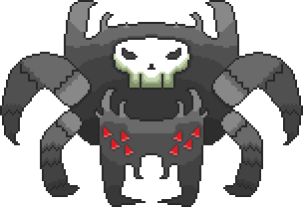
Level 1
Level boss,at first it will move at angle,after u have enough score,the boss will move to the right side and move up and down(also it will shot poision web,and cause damage)

Slide 4
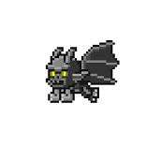
Level 2
Level 2,the monster change,but it is the same as level .

Slide 5
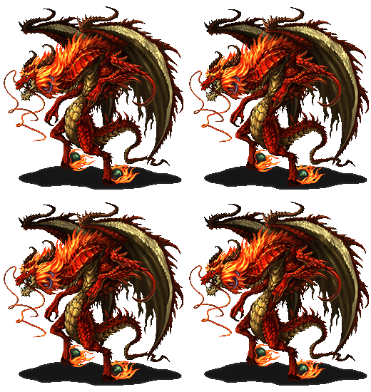
Level 2
The dragon boss will move up and down, then move forward and shot fire balls, and keep moving up, when it touch the top of the screen then moving down, repeat.

