Slide 1
GAN: Generative Adversarial Nets
Chen Zheng
czheng17@binghamton.edu

Slide 2
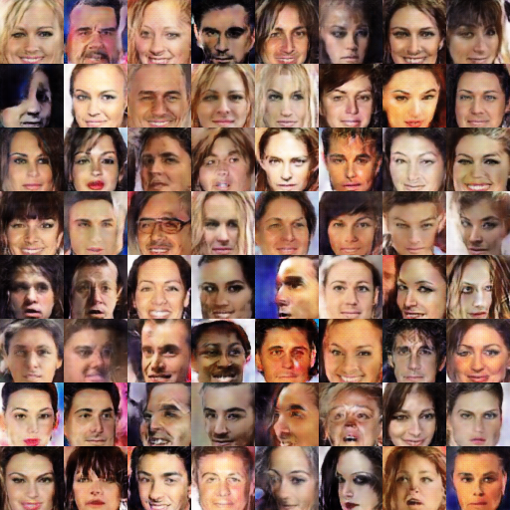
1. Understanding GANs
2. GANs: the evolution
3. DCGANs
4. Improved DCGANs
INDEX

Slide 3
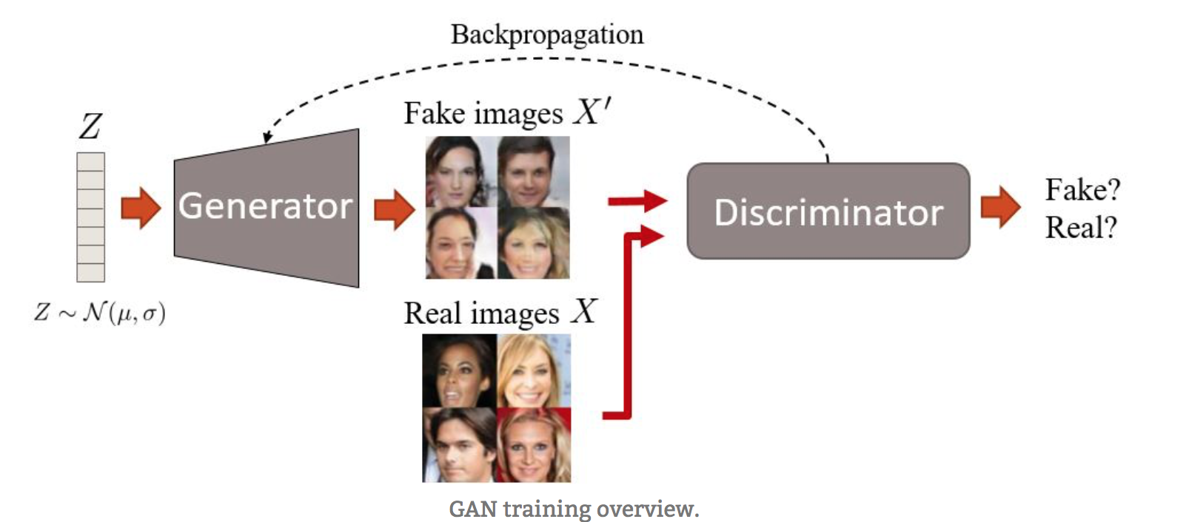
GANs — originally proposed by Ian Goodfellow — have two networks, a generator and a discriminator. They are both trained at the same time and compete again each other in a minimax game. The generator is trained to fool the discriminator creating realistic images, and the discriminator is trained not to be fooled by the generator.
Understanding GANs

Slide 4
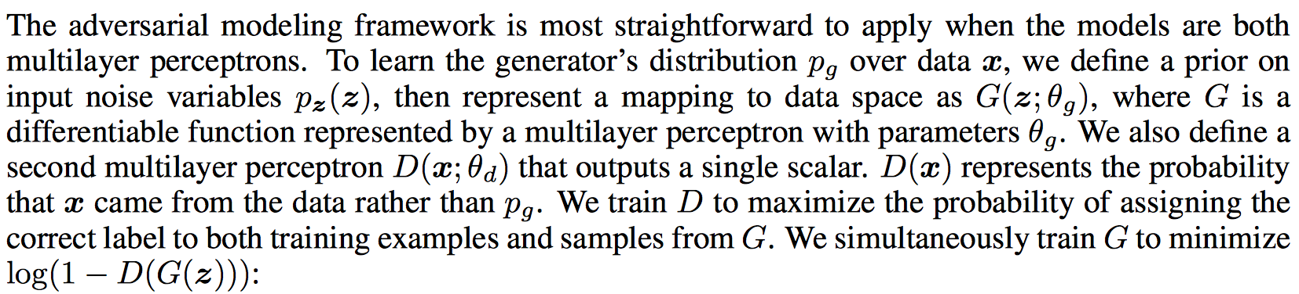
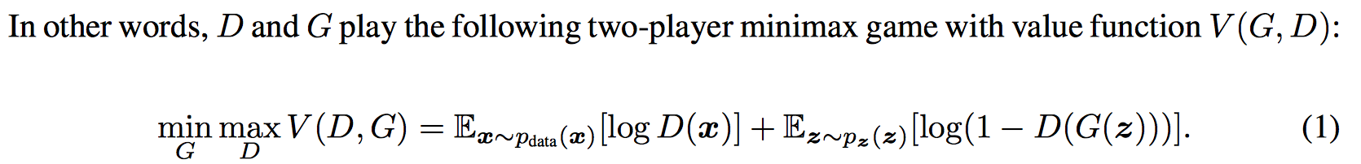
Understanding GANs

Slide 5
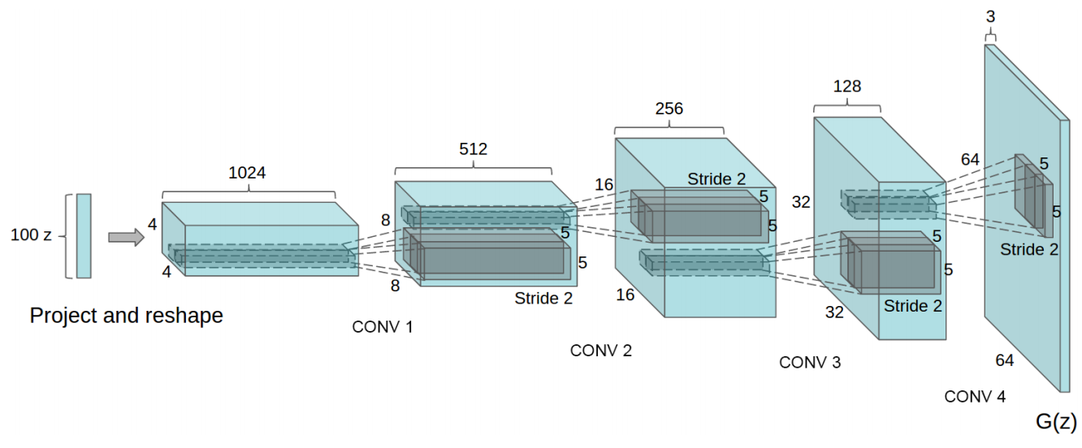
The framework of DCGAN
DCGANs were the first major improvement on the GAN architecture. They are more stable in terms of training and generate higher quality samples.

Slide 6
The framework of DCGAN
Batch normalization is a must in both networks.
Fully hidden connected layers are not a good idea.
Avoid pooling, simply stride your convolutions!
ReLU activations are your friend (almost always).

Slide 7
Batch normalization

Slide 8
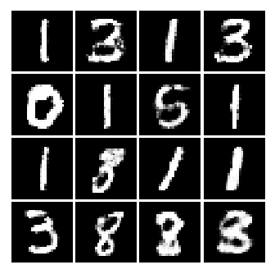
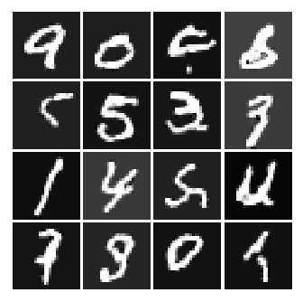
Result between GAN and DCGAN

Slide 9
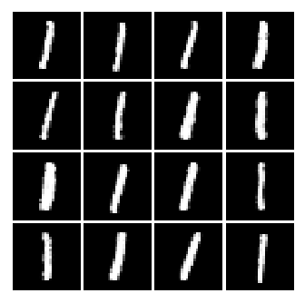
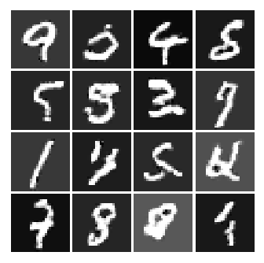
Result between GAN and DCGAN

Slide 10
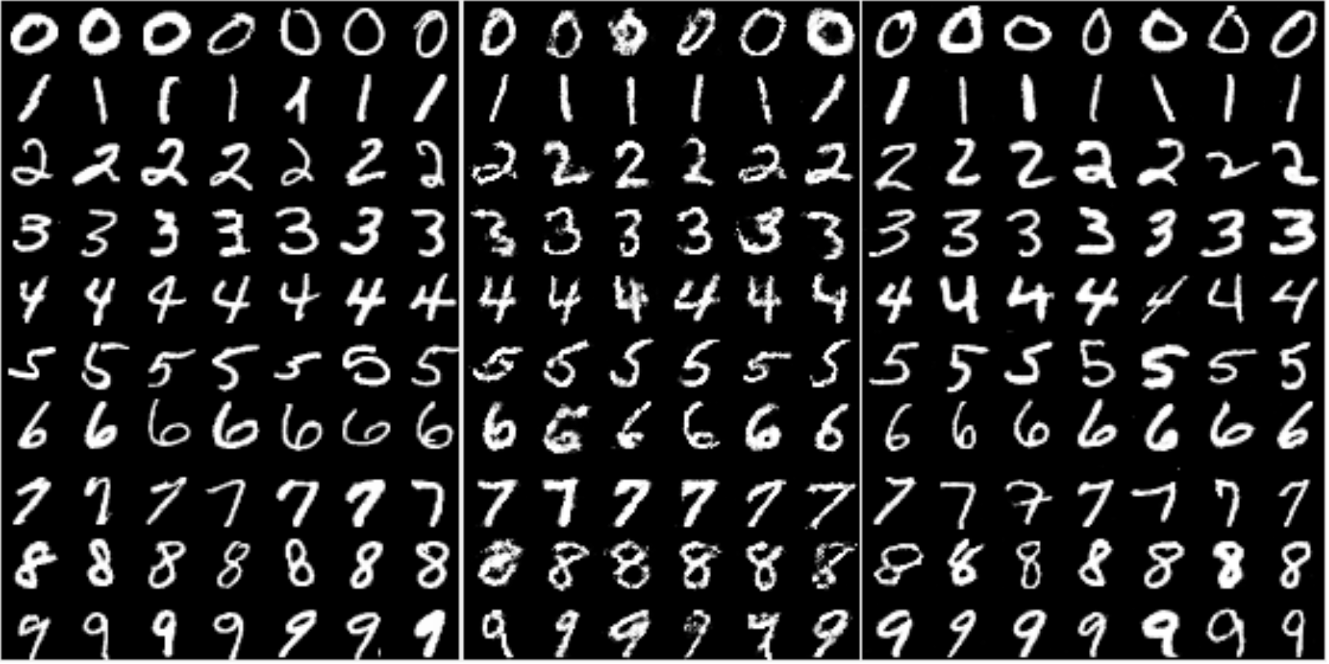
Result between GAN and DCGAN

Slide 11
Improved DCGANs
One of the main problems related to GANs is their convergence. It is not guaranteed and despite the architecture refinement of the DCGAN, the training can still be quite unstable.
Different enhancements on the GAN training. Here are some of them:
Feature matching
Historical averaging
One-sided label smoothing
Virtual batch normalization

Slide 12
Improved DCGANs
Feature matching: instead of having the generator trying to fool the discriminator as much as possible, they propose a new objective function. This objective requires the generator to generate data that matches the statistics of the real data. In this case, the discriminator is only used to specify which are the statistics worth matching.
Historical averaging: when updating the parameters, also take into account their past values.
One-sided label smoothing: this one is pretty easy: simply make your discriminator target output from [0=fake image, 1=real image] to [0=fake image, 0.9=real image]. Yeah, this improves the training.
Virtual batch normalization: avoid dependency of data on the same batch by using statistics collected on a reference batch. It is computationally expensive, so it’s only used on the generator.

Slide 13
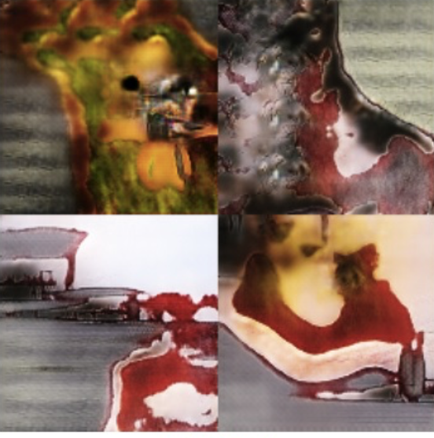
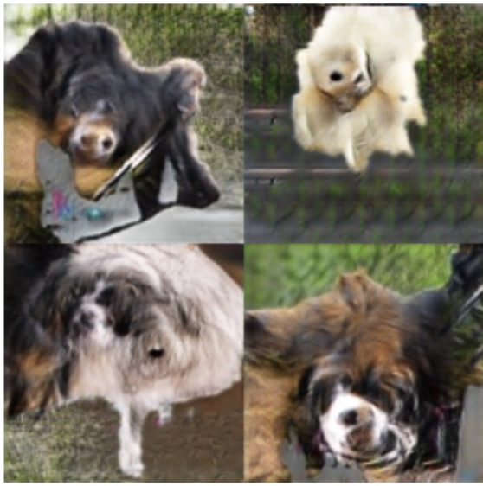
DCGAN VS. Improved DCGANs
All these techniques allow the model to be better at generating high resolution images, which is one of the weak points of GANs. As a comparison, see the difference between the original DCGAN and the improved DCGAN on 128x128 images:

Slide 14
Thank you!
Chen Zheng
czheng17@binghamton.edu

