Slide 1
W4111 – Introduction to Databases
Lecture 8: Module II (2), NoSQL (2)
© Donald F. Ferguson, 2024

Slide 2

Contents
2 | W4111-2024F-8-Module-II(2)-NoSQL(2) © Donald F. Ferguson, 2024

Slide 3
Module II (Cont.)
3 | W4111-2024F-8-Module-II(2)-NoSQL(2) © Donald F. Ferguson, 2024

Slide 4

Module II – DBMS Architecture and Implementation
Overview and Reminder
4 | W4111-2024F-8-Module-II(2)-NoSQL(2) © Donald F. Ferguson, 2024

Slide 5
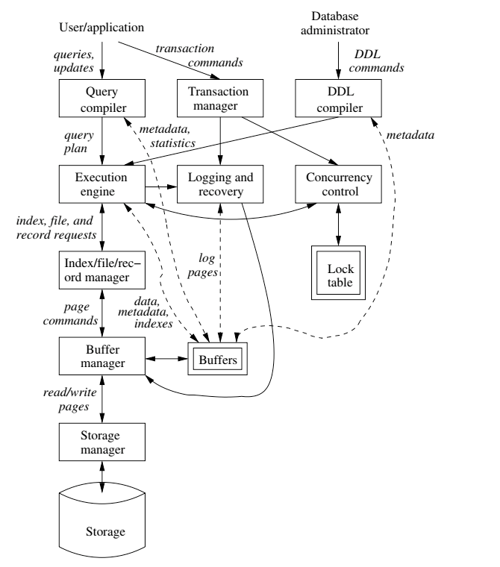
Data Management
Previously
  Load/save things quickly.
Today
  Storage Mgmt. (cont)
  Access data quickly.
  Find things quickly.
Database Systems: The Complete Book (2nd Edition)
by Hector Garcia-Molina (Author), Jeffrey D. Ullman (Author), Jennifer Widom (Author)

Slide 6
Data Storage Structures
(Database Systems Concepts, V7, Ch. 13)
6 | W4111-2024F-8-Module-II(2)-NoSQL(2) © Donald F. Ferguson, 2024

Slide 7
File Organization
The database is stored as a collection of files. Each file is a sequence of records. A record is a sequence of fields.
One approach
  Assume record size is fixed
  Each file has records of one particular type only
  Different files are used for different relations
  This case is easiest to implement;
  We will consider variable length records later
We assume that records are smaller than a disk block.
From: Database System Concepts, 7th Ed.

Slide 8
Terminology
A tuple in a relation maps to a record. Records may be
  Fixed length
  Variable length
  Variable format (which we will see in Neo4J, DynamoDB, etc).
A block
  Is the unit of transfer between disks and memory (buffer pools).
  Contains multiple records, usually but not always from the same relation.
The database address space contains
  All of the blocks and records that the database manages
  Including blocks/records containing data
  And blocks/records containing free space.

Slide 9
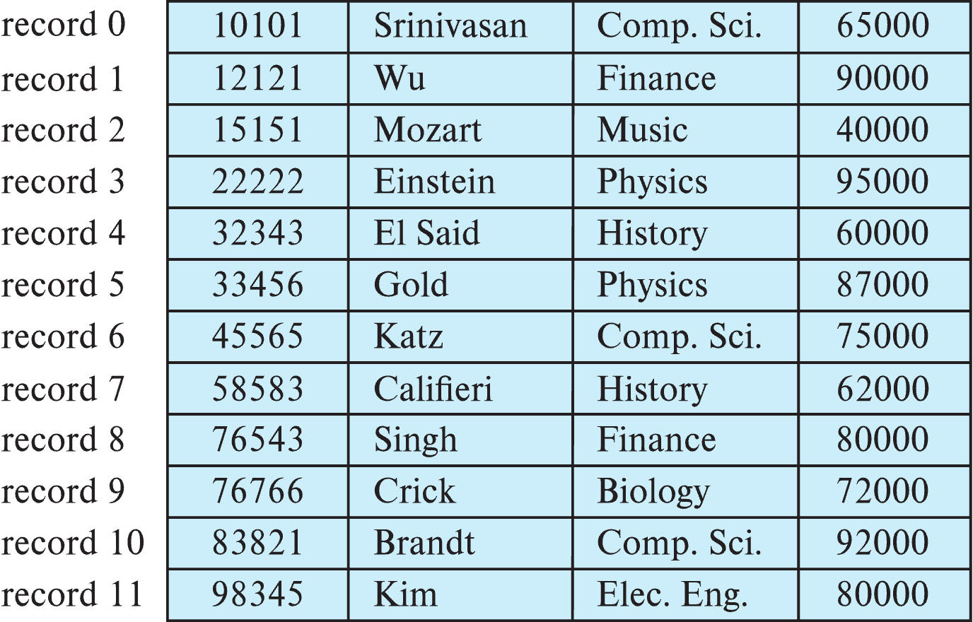
Fixed-Length Records
Simple approach:
  Store record i starting from byte n ∗ (i – 1), where n is the size of each record.
  Record access is simple but records may cross blocks
    Modification: do not allow records to cross block boundaries
From: Database System Concepts, 7th Ed.

Slide 10
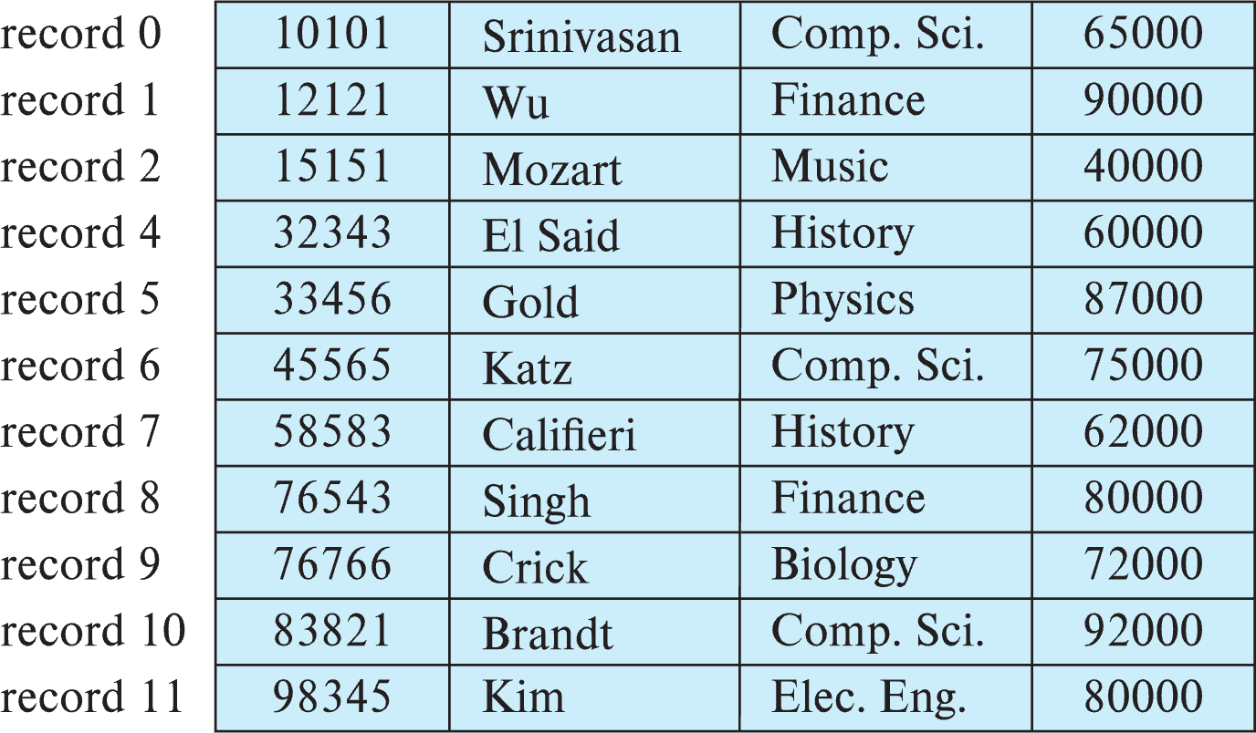
Fixed-Length Records
Deletion of record i: alternatives:
  move records i + 1, . . ., n to i, . . . , n – 1
  move record n to i
  do not move records, but link all free records on a free list
  Record 3 deleted
From: Database System Concepts, 7th Ed.

Slide 11
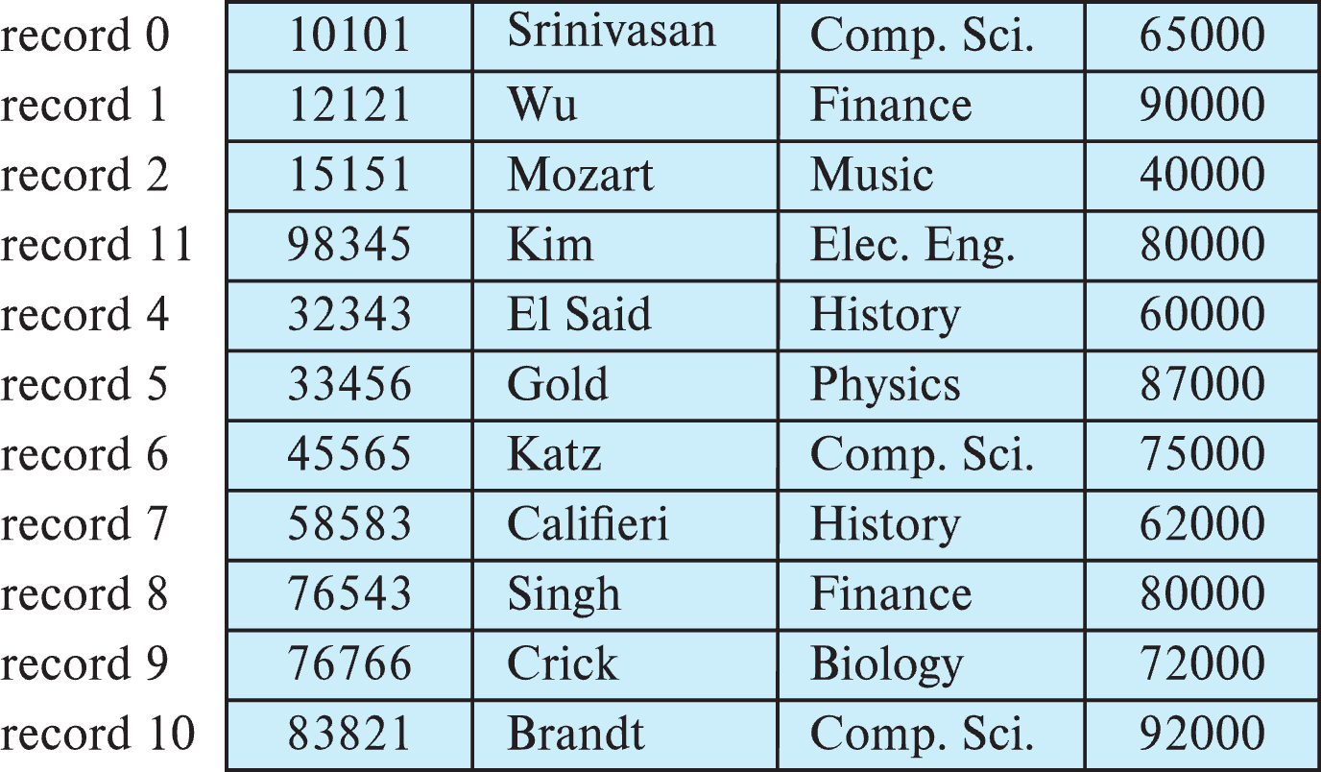
Fixed-Length Records
Deletion of record i: alternatives:
  move records i + 1, . . ., n to i, . . . , n – 1
  move record n to i
  do not move records, but link all free records on a free list
  Record 3 deleted and replaced by record 11
From: Database System Concepts, 7th Ed.

Slide 12
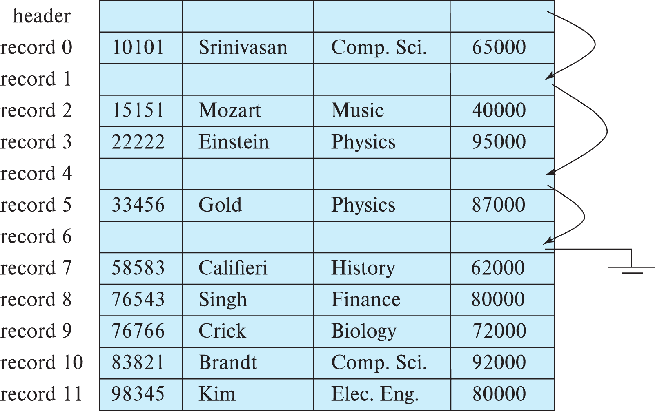
Fixed-Length Records
Deletion of record i: alternatives:
  move records i + 1, . . ., n to i, . . . , n – 1
  move record n to i
  do not move records, but link all free records on a free list
From: Database System Concepts, 7th Ed.

Slide 13
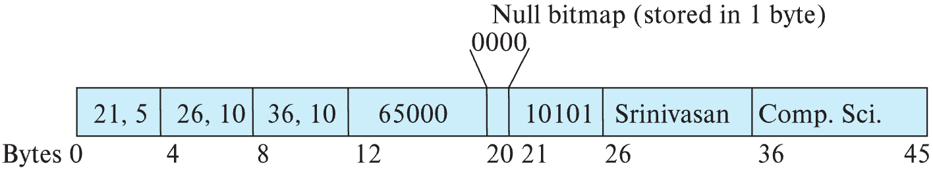
Variable-Length Records
Variable-length records arise in database systems in several ways:
  Storage of multiple record types in a file.
  Record types that allow variable lengths for one or more fields such as strings (varchar)
  Record types that allow repeating fields (used in some older data models).
Attributes are stored in order
Variable length attributes represented by fixed size (offset, length), with actual data stored after all fixed length attributes
Null values represented by null-value bitmap
From: Database System Concepts, 7th Ed.

Slide 14
Variable-Length Records: Slotted Page Structure
Slotted page header contains:
  number of record entries
  end of free space in the block
  location and size of each record
Records can be moved around within a page to keep them contiguous with no empty space between them; entry in the header must be updated.
Pointers should not point directly to record — instead they should point to the entry for the record in header.
From: Database System Concepts, 7th Ed.

Slide 15
Storing Large Objects
E.g., blob/clob types
Records must be smaller than pages
Alternatives:
  Store as files in file systems
  Store as files managed by database
  Break into pieces and store in multiple tuples in separate relation
    PostgreSQL TOAST
From: Database System Concepts, 7th Ed.

Slide 16
Organization of Records in Files
Heap – record can be placed anywhere in the file where there is space
Sequential – store records in sequential order, based on the value of the search key of each record
In a multitable clustering file organization records of several different relations can be stored in the same file
  Motivation: store related records on the same block to minimize I/O
B⁺-tree file organization
  Ordered storage even with inserts/deletes
  More on this in Chapter 14
Hashing – a hash function computed on search key; the result specifies in which block of the file the record should be placed
  More on this in Chapter 14
From: Database System Concepts, 7th Ed.

Slide 17
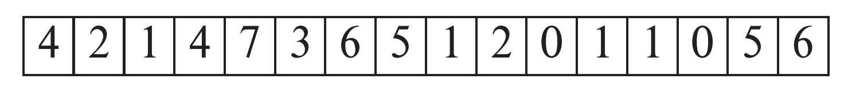
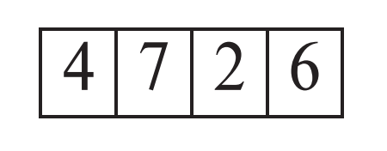
Heap File Organization
Records can be placed anywhere in the file where there is free space
Records usually do not move once allocated
Important to be able to efficiently find free space within file
Free-space map
  Array with 1 entry per block. Each entry is a few bits to a byte, and records fraction of block that is free
  In example below, 3 bits per block, value divided by 8 indicates fraction of block that is free
  Can have second-level free-space map
  In example below, each entry stores maximum from 4 entries of first-level free-space map
Free space map written to disk periodically, OK to have wrong (old) values for some entries (will be detected and fixed)
From: Database System Concepts, 7th Ed.

Slide 18
Sequential File Organization
Suitable for applications that require sequential processing of the entire file
The records in the file are ordered by a search-key
From: Database System Concepts, 7th Ed.

Slide 19
Sequential File Organization (Cont.)
Deletion – use pointer chains
Insertion –locate the position where the record is to be inserted
  if there is free space insert there
  if no free space, insert the record in an overflow block
  In either case, pointer chain must be updated
Need to reorganize the file
from time to time to restore
sequential order
From: Database System Concepts, 7th Ed.
From: Database System Concepts, 7th Ed.

Slide 20
Partitioning
Table partitioning: Records in a relation can be partitioned into smaller relations that are stored separately
E.g., transaction relation may be partitioned into
transaction_2018, transaction_2019, etc.
Queries written on transaction must access records in all partitions
  Unless query has a selection such as year=2019, in which case only one partition in needed
Partitioning
  Reduces costs of some operations such as free space management
  Allows different partitions to be stored on different storage devices
    E.g., transaction partition for current year on SSD, for older years on magnetic disk
From: Database System Concepts, 7th Ed.

Slide 21
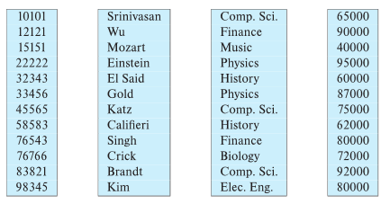
Column-Oriented Storage
Also known as columnar representation
Store each attribute of a relation separately
Example
From: Database System Concepts, 7th Ed.

Slide 22
Columnar Representation
Benefits:
  Reduced IO if only some attributes are accessed
  Improved CPU cache performance
  Improved compression
  Vector processing on modern CPU architectures
Drawbacks
  Cost of tuple reconstruction from columnar representation
  Cost of tuple deletion and update
  Cost of decompression
Columnar representation found to be more efficient for decision support than row-oriented representation
Traditional row-oriented representation preferable for transaction processing
Some databases support both representations
  Called hybrid row/column stores
From: Database System Concepts, 7th Ed.

Slide 23
Row vs Column
Columnar and Row are both
  Relational
  Support SQL operations
But differ in data storage
  Row keeps row data
  together in blocks.
  Columnar keys column
  data together in blocks.
This determines performance for different
types of query, e.g.
  Columnar is extremely powerful for BI scenarios
    Aggregation ops, e.g. SUM, AVG
    PROJECT (do not load all of the row) to get a few columns
  Row is powerful for OLTP. Transaction typically create
  and retrieve
    One row at a time
    All the columns of a single row.

Slide 24
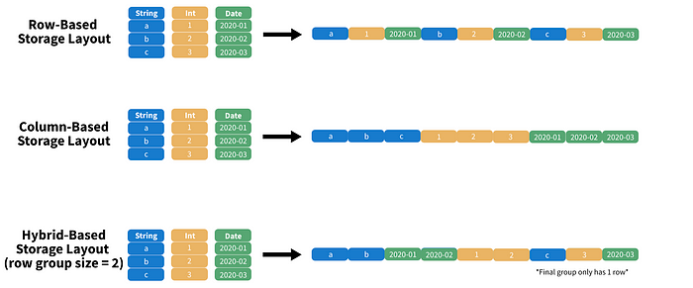
Columnar File Representation
https://towardsdatascience.com/demystifying-the-parquet-file-format-13adb0206705
Apache parquet is an open-source file format that provides efficient storage and fast read speed. It uses a hybrid storage format which sequentially stores chunks of columns, lending to high performance when selecting and filtering data. On top of strong compression algorithm support (snappy, gzip, LZO), it also provides some clever tricks for reducing file scans and encoding repeat variables.

Slide 25
Buffer Pool Management
25 | W4111-2024F-8-Module-II(2)-NoSQL(2) © Donald F. Ferguson, 2024

Slide 26
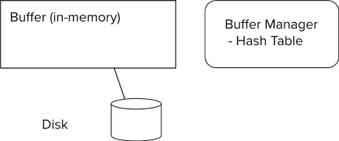
Storage Access
Blocks are units of both storage allocation and data transfer.
Database system seeks to minimize the number of block transfers between the disk and memory. We can reduce the number of disk accesses by keeping as many blocks as possible in main memory.
Buffer – portion of main memory available to store copies of disk blocks.
Buffer manager – subsystem responsible for allocating buffer space in main memory.
Notes:
26

Slide 27
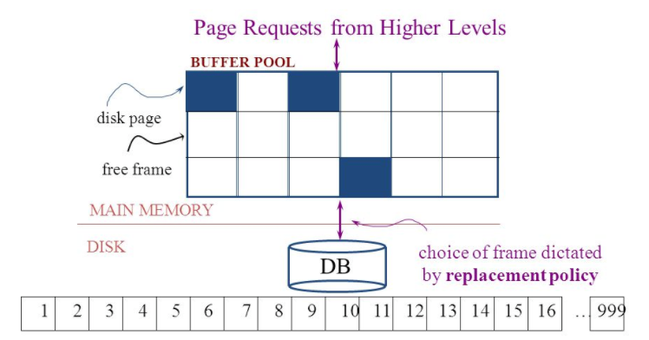
The Logical Concept
The DBMS and queries can only manipulate in-memory blocks and records.
A very, very, very small fraction of all blocks fit in memory.

Slide 28
Buffer Manager
Programs call on the buffer manager when they need a block from disk.
  If the block is already in the buffer, buffer manager returns the address of the block in main memory
  If the block is not in the buffer, the buffer manager
    Allocates space in the buffer for the block
      Replacing (throwing out) some other block, if required, to make space for the new block.
      Replaced block written back to disk only if it was modified since the most recent time that it was written to/fetched from the disk.
    Reads the block from the disk to the buffer, and returns the address of the block in main memory to requester.
Notes:
28

Slide 29
Buffer Manager
Buffer replacement strategy (details coming up!)
Pinned block: memory block that is not allowed to be written back to disk
  Pin done before reading/writing data from a block
  Unpin done when read /write is complete
  Multiple concurrent pin/unpin operations possible
    Keep a pin count, buffer block can be evicted only if pin count = 0
Shared and exclusive locks on buffer
  Needed to prevent concurrent operations from reading page contents as they are moved/reorganized, and to ensure only one move/reorganize at a time
  Readers get shared lock, updates to a block require exclusive lock
  Locking rules:
    Only one process can get exclusive lock at a time
    Shared lock cannot be concurrently with exclusive lock
    Multiple processes may be given shared lock concurrently

Slide 30
Buffer-Replacement Policies
Most operating systems replace the block least recently used (LRU strategy)
  Idea behind LRU – use past pattern of block references as a predictor of future references
  LRU can be bad for some queries
Queries have well-defined access patterns (such as sequential scans), and a database system can use the information in a user’s query to predict future references
Mixed strategy with hints on replacement strategy provided
by the query optimizer is preferable
  Example of bad access pattern for LRU: when computing the join of 2 relations r and s by a nested loops
  for each tuple tr of r do
  for each tuple ts of s do
  if the tuples tr and ts match …
Notes:
30

Slide 31
Buffer-Replacement Policies (Cont.)
Toss-immediate strategy – frees the space occupied by a block as soon as the final tuple of that block has been processed
Most recently used (MRU) strategy – system must pin the block currently being processed. After the final tuple of that block has been processed, the block is unpinned, and it becomes the most recently used block.
Buffer manager can use statistical information regarding the probability that a request will reference a particular relation
  E.g., the data dictionary is frequently accessed. Heuristic: keep data-dictionary blocks in main memory buffer
Operating system or buffer manager may reorder writes
  Can lead to corruption of data structures on disk
    E.g., linked list of blocks with missing block on disk
    File systems perform consistency check to detect such situations
  Careful ordering of writes can avoid many such problems
Notes:
31

Slide 32
Replacement Policy
The replacement policy is one of the most important factors in database management system implementation and configuration.
A very simple, introductory explanation is
(https://en.wikipedia.org/wiki/Cache_replacement_policies).
  There are a lot of possible policies.
  The most efficient caching algorithm would be to always discard the information that will not be needed for the longest time in the future. This optimal result is referred to as Bélády's optimal algorithm/simply optimal replacement policy or the clairvoyant algorithm.
All implementable policies are an attempt to approximate knowledge of the future based on knowledge of the past.
Least Recently Used is based on the simplest assumption
  The information that will not be needed for the longest time.
  Is the information that has not been accessed for the longest time.

Slide 33
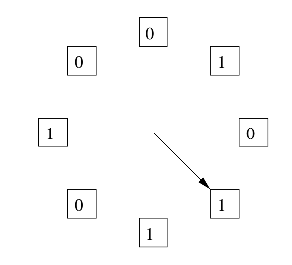
The “Clock Algorithm”
LRU is (perceived to be) expensive
  Maintain timestamp for each block.
  Update and resort blocks on access.
The “Clock Algorithm” is a less expensive approximation.
  Arrange the frames (places blocks can go) into a logical circle like the seconds on a clock face.
  Each frame is marked 0 or 1.
    Set to 1 when block added to frame.
    Or when application accesses a block in frame.
  Replacement choice
    Sweep second hand clockwise one frame at a time.
    If bit is 0, choose for replacement.
    If bit is 1, set bit to zero and go to next frame.
The basic idea is. On a clock face
  If the second hand is currently at 27 seconds.
  The 28 second tick mark is “the least recently touched mark.”

Slide 34
Replacement Algorithm
The algorithms are more sophisticated in the real world, e.g.
  “Scans” are common, e.g. go through a large query result in order
  (will be more clear when discussing cursors).
    The engine knows the current position in the result set.
    Uses the sort order to determine which records will be accessed soon.
    Tags those blocks as not replaceable.
    (A form of clairvoyance).
  Not all users/applications are equally “important.”
    Classify users/applications into priority 1, 2 and 3.
    Sub-allocate the buffer pool into pools P1, P2 and P3.
    Apply LRU within pools and adjust pool sizes based on relative importance.
    This prevents
      A high access rate, low-priority application from taking up a lot of frames
      Result in low access, high priority applications not getting buffer hits.

Slide 35
Optimization of Disk Block Access (Cont.)
Buffer managers support forced output of blocks for the purpose of recovery (more in Chapter 19)
Nonvolatile write buffers speed up disk writes by writing blocks to a non-volatile RAM or flash buffer immediately
  Writes can be reordered to minimize disk arm movement
Log disk – a disk devoted to writing a sequential log of block updates
  Used exactly like nonvolatile RAM
    Write to log disk is very fast since no seeks are required
Journaling file systems write data in-order to NV-RAM or log disk
  Reordering without journaling: risk of corruption of file system data

Slide 36
Indexes
36 | W4111-2024F-8-Module-II(2)-NoSQL(2) © Donald F. Ferguson, 2024

Slide 37
Basic Concepts
Indexing mechanisms used to speed up access to desired data.
  E.g., author catalog in library
Search Key - attribute to set of attributes used to look up records in a file.
An index file consists of records (called index entries) of the form
Index files are typically much smaller than the original file
Two basic kinds of indices:
  Ordered indices: search keys are stored in sorted order
  Hash indices: search keys are distributed uniformly across “buckets” using a “hash function”.
search-key
pointer
search-key
pointer
(“c:\”, LBN, offset)
search-key
pointer
search-key
pointer

Slide 38
search-key
pointer
search-key
pointer
search-key
pointer
search-key
pointer
search-key
pointer
search-key
pointer

Slide 39
Ordered Indices
In an ordered index, index entries are stored sorted on the search key value.
Clustering index: in a sequentially ordered file, the index whose search key specifies the sequential order of the file.
  Also called primary index
  The search key of a primary index is usually but not necessarily the primary key.
Secondary index: an index whose search key specifies an order different from the sequential order of the file. Also called
nonclustering index.
Index-sequential file: sequential file ordered on a search key, with a clustering index on the search key.

Slide 40
Dense Index Files
Dense index — Index record appears for every search-key value in the file.
E.g. index on ID attribute of instructor relation

Slide 41
Dense Index Files (Cont.)
Dense index on dept_name, with instructor file sorted on dept_name

Slide 42
Sparse Index Files
Sparse Index: contains index records for only some search-key values.
  Applicable when records are sequentially ordered on search-key
To locate a record with search-key value K we:
  Find index record with largest search-key value < K
  Search file sequentially starting at the record to which the index record points

Slide 43
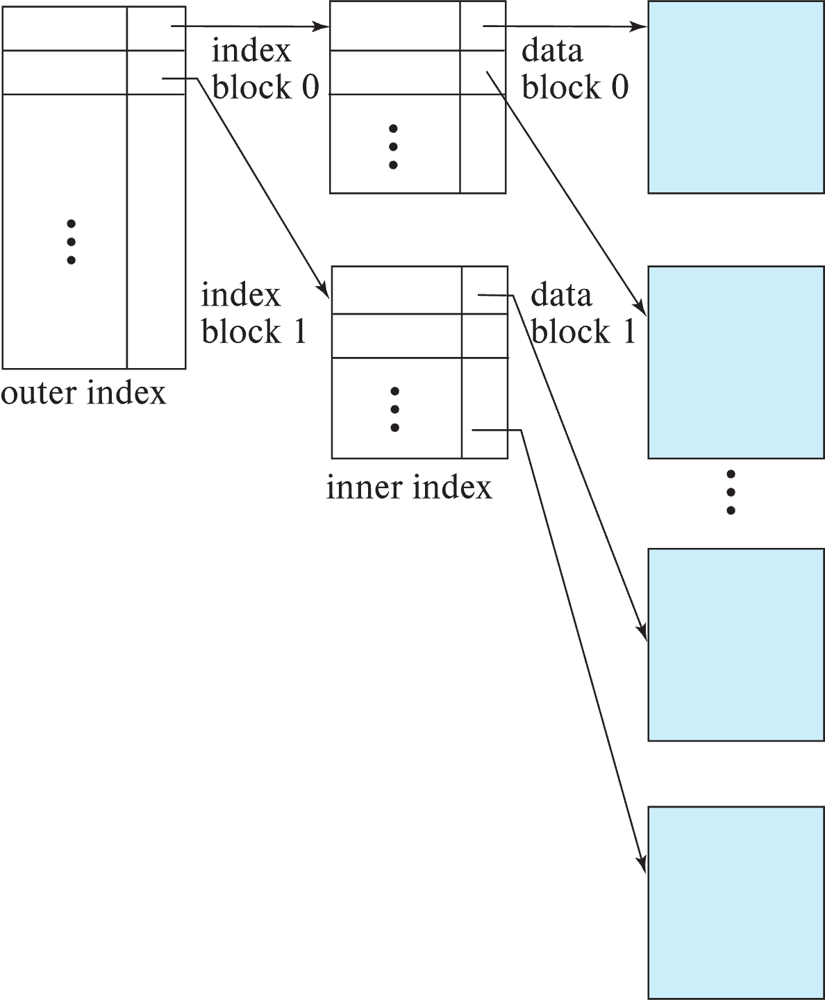
Sparse Index Files (Cont.)
Compared to dense indices:
  Less space and less maintenance overhead for insertions and deletions.
  Generally slower than dense index for locating records.
Good tradeoff:
  for clustered index: sparse index with an index entry for every block in file, corresponding to least search-key value in the block.
  For unclustered index: sparse index on top of dense index (multilevel index)

Slide 44
Secondary Indices Example
Secondary index on salary field of instructor
Index record points to a bucket that contains pointers to all the actual records with that particular search-key value.
Secondary indices have to be dense

Slide 45
Clustering vs Nonclustering Indices
Indices offer substantial benefits when searching for records.
BUT: indices imposes overhead on database modification
  when a record is inserted or deleted, every index on the relation must be updated
  When a record is updated, any index on an updated attribute must be updated
Sequential scan using clustering index is efficient, but a sequential scan using a secondary (nonclustering) index is expensive on magnetic disk
  Each record access may fetch a new block from disk
  Each block fetch on magnetic disk requires about 5 to 10 milliseconds

Slide 46
Indices on Multiple Keys
Composite search key
  E.g., index on instructor relation on attributes (name, ID)
  Values are sorted lexicographically
    E.g. (John, 12121) < (John, 13514) and
    (John, 13514) < (Peter, 11223)
  Can query on just name, or on (name, ID)
(nameLast, nameFirst, birthyear)
  nameLast [nameLast = “Ferguson”] [nameLast like “Fer%”]
  nameLast, nameFirst
  nameLast, nameFirst, birthyear
NOT and index on
  nameFirst, nameLast
  birthyear
  nameLast like [%er%]

Slide 47
B⁺-Tree Index Files
Disadvantage of indexed-sequential files
  Performance degrades as file grows, since many overflow blocks get created.
  Periodic reorganization of entire file is required.
Advantage of B⁺-tree index files:
  Automatically reorganizes itself with small, local, changes, in the face of insertions and deletions.
  Reorganization of entire file is not required to maintain performance.
(Minor) disadvantage of B⁺-trees:
  Extra insertion and deletion overhead, space overhead.
Advantages of B⁺-trees outweigh disadvantages
  B⁺-trees are used extensively

Slide 48
Example of B⁺-Tree

Slide 49
B⁺-Tree Index Files (Cont.)
A B⁺-tree is a rooted tree satisfying the following properties:
All paths from root to leaf are of the same length
Each node that is not a root or a leaf has between ⎡n/2⎤ and n children.
A leaf node has between ⎡(n–1)/2⎤ and n–1 values
Special cases:
  If the root is not a leaf, it has at least 2 children.
  If the root is a leaf (that is, there are no other nodes in the tree), it can have between 0 and (n–1) values.

Slide 50
B⁺-Tree Node Structure
Typical node
  K_{i} are the search-key values
  P_{i} are pointers to children (for non-leaf nodes) or pointers to records or buckets of records (for leaf nodes).
The search-keys in a node are ordered
K₁ < K₂ < K₃ < . . . < K_{n–1}
(Initially assume no duplicate keys, address duplicates later)

Slide 51
Leaf Nodes in B⁺-Trees
Properties of a leaf node:
For i = 1, 2, . . ., n–1, pointer P_{i} points to a file record with search-key value K_{i},
If L_{i}, L_{j} are leaf nodes and i < j, L_{i}’s search-key values are less than or equal to L_{j}’s search-key values
P_{n} points to next leaf node in search-key order

Slide 52
Non-Leaf Nodes in B⁺-Trees
Non leaf nodes form a multi-level sparse index on the leaf nodes. For a non-leaf node with m pointers:
  All the search-keys in the subtree to which P₁ points are less than K₁
  For 2 ≤ i ≤ n – 1, all the search-keys in the subtree to which P_{i} points have values greater than or equal to K_{i–1} and less than K_{i}
  All the search-keys in the subtree to which P_{n} points have values greater than or equal to K_{n–1}
  General structure

Slide 53
Example of B⁺-tree
B⁺-tree for instructor file (n = 6)
Leaf nodes must have between 3 and 5 values
(⎡(n–1)/2⎤ and n –1, with n = 6).
Non-leaf nodes other than root must have between 3 and 6 children (⎡(n/2⎤ and n with n =6).
Root must have at least 2 children.

Slide 54
Observations about B⁺-trees
Since the inter-node connections are done by pointers, “logically” close blocks need not be “physically” close.
The non-leaf levels of the B⁺-tree form a hierarchy of sparse indices.
The B⁺-tree contains a relatively small number of levels
    Level below root has at least 2* ⎡n/2⎤ values
    Next level has at least 2* ⎡n/2⎤ * ⎡n/2⎤ values
    .. etc.
  If there are K search-key values in the file, the tree height is no more than ⎡ log_{⎡n/2⎤}(K)⎤
  thus searches can be conducted efficiently.
Insertions and deletions to the main file can be handled efficiently, as the index can be restructured in logarithmic time (as we shall see).

Slide 55
Show the Simulator
https://www.cs.usfca.edu/~galles/visualization/BPlusTree.html

Slide 56
Hashing

Slide 57
Static Hashing
A bucket is a unit of storage containing one or more entries (a bucket is typically a disk block).
  we obtain the bucket of an entry from its search-key value using a hash function
Hash function h is a function from the set of all search-key values K to the set of all bucket addresses B.
Hash function is used to locate entries for access, insertion as well as deletion.
Entries with different search-key values may be mapped to the same bucket; thus entire bucket has to be searched sequentially to locate an entry.
In a hash index, buckets store entries with pointers to records
In a hash file-organization buckets store records

Slide 58
Handling of Bucket Overflows (Cont.)
Overflow chaining – the overflow buckets of a given bucket are chained together in a linked list.
Above scheme is called closed addressing (also called closed hashing or open hashing depending on the book you use)
  An alternative, called
  open addressing
  (also called
  open hashing or
  closed hashing
  depending on the book you use) which does not use over- flow buckets, is not suitable for database applications.

Slide 59
Example of Hash File Organization
Hash file organization of instructor file, using dept_name as key.

Slide 60
Deficiencies of Static Hashing
In static hashing, function h maps search-key values to a fixed set of B of bucket addresses. Databases grow or shrink with time.
  If initial number of buckets is too small, and file grows, performance will degrade due to too much overflows.
  If space is allocated for anticipated growth, a significant amount of space will be wasted initially (and buckets will be underfull).
  If database shrinks, again space will be wasted.
One solution: periodic re-organization of the file with a new hash function
  Expensive, disrupts normal operations
Better solution: allow the number of buckets to be modified dynamically.

Slide 61
Show the Simulator
http://iswsa.acm.org/mphf/openDSAPerfectHashAnimation/perfectHashAV.html
https://opendsa-server.cs.vt.edu/ODSA/AV/Development/hashAV.html

Slide 62
NoSQL
62 | W4111-2024F-8-Module-II(2)-NoSQL(2) © Donald F. Ferguson, 2024

Slide 63
Concepts
63 | W4111-2024F-8-Module-II(2)-NoSQL(2) © Donald F. Ferguson, 2024

Slide 64
Simplistic Classification (https://medium.com/swlh/4-types-of-NoSQL-databases-d88ad21f7d3b)
Relational is the
foundational model.
We will see OLAP
in a future lecture.
Subject of this
lecture and part of
HW3
We covered
graphs and examples.

Slide 65
GraphDB
65 | W4111-2024F-8-Module-II(2)-NoSQL(2) © Donald F. Ferguson, 2024

Slide 66
Graph Database
Exactly what it sounds like
Two core types
  Node
  Edge (link)
Nodes and Edges have
  Label(s) = “Kind”
  Properties (free form)
Query is of the form
  p1(n)-p2(e)-p3(m)
  n, m are nodes; e is an edge
  p1, p2, p3 are predicates on labels
N->R->M

Slide 67
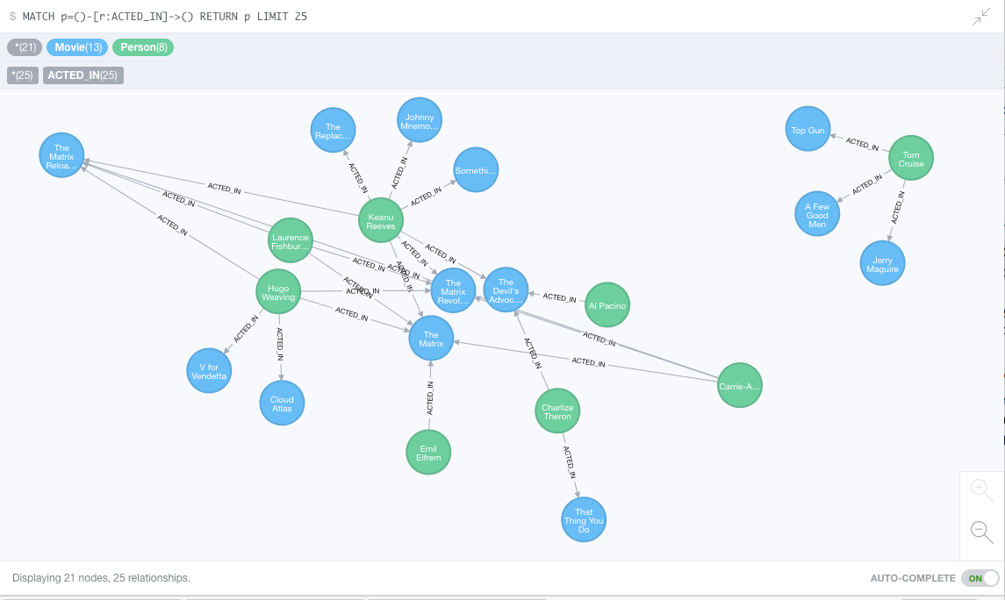
Neo4J Graph Query

Slide 68
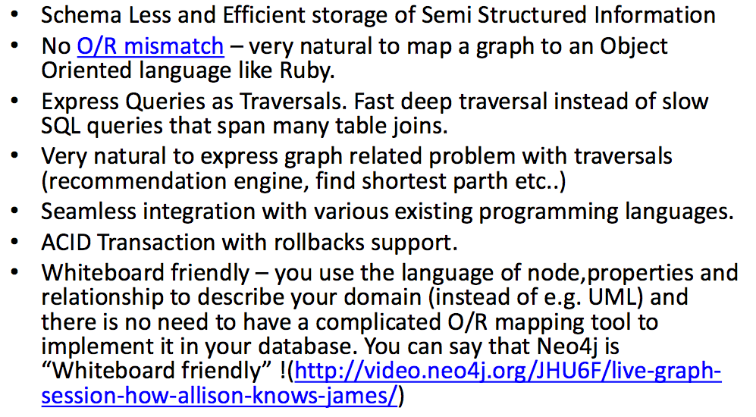
Why Graph Databases?

Slide 69
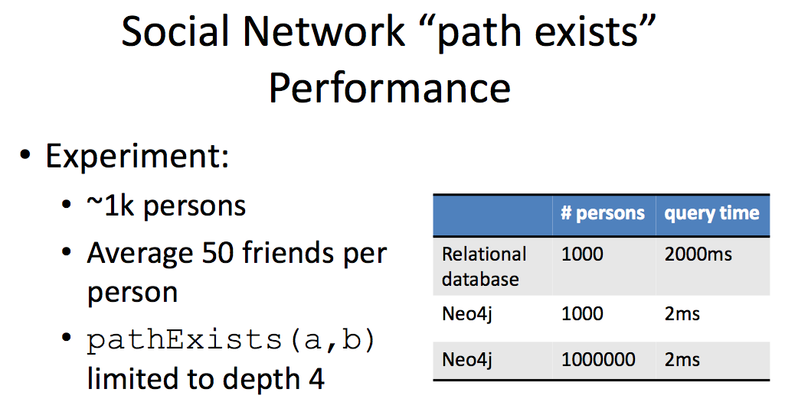
Graph Databases
Graph databases are
  Extremely fast for some queries and data models.
  Implement a language that vastly simplifies writing queries.

Slide 70
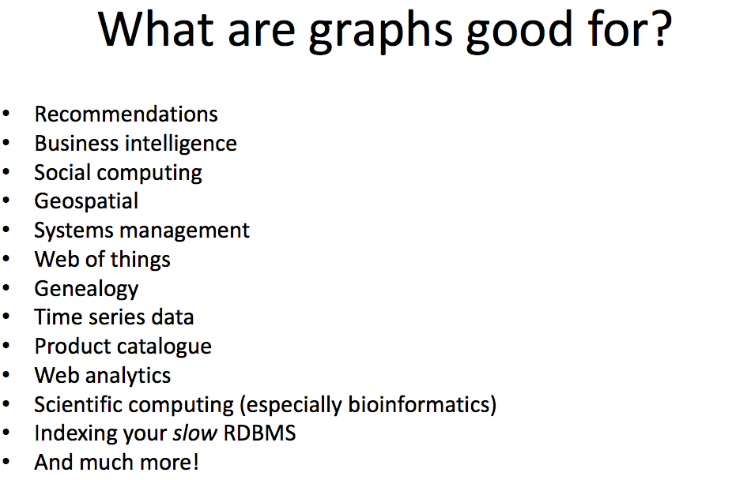

Slide 71
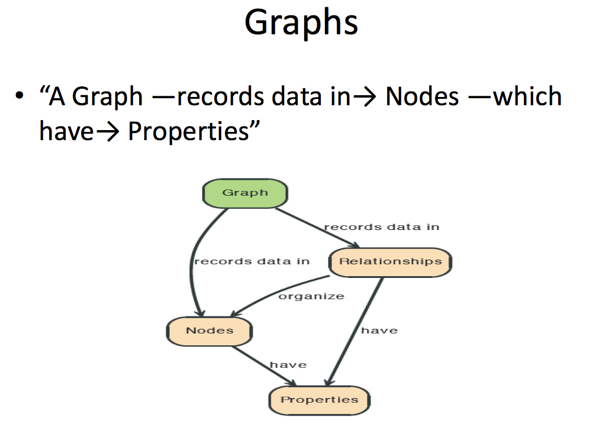

Slide 72
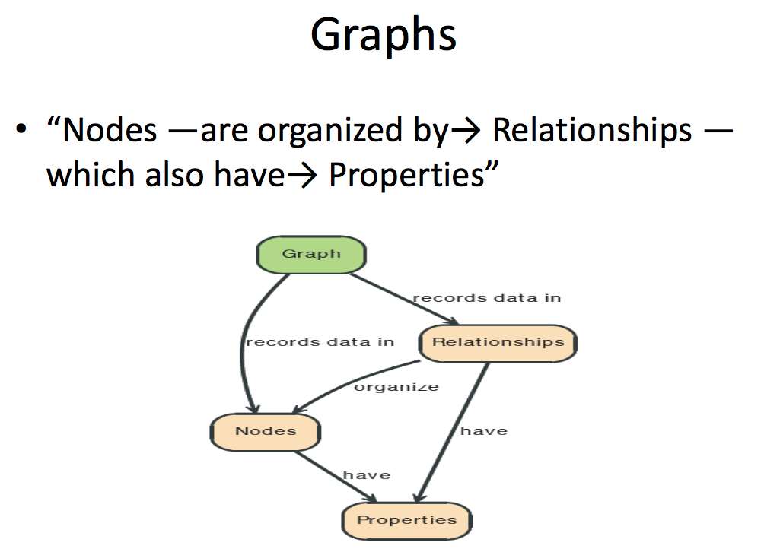

Slide 73
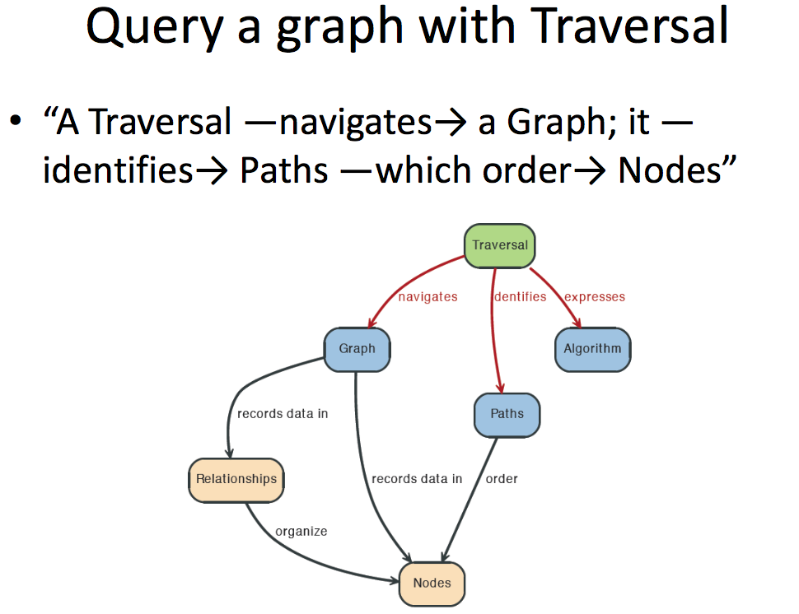

Slide 74
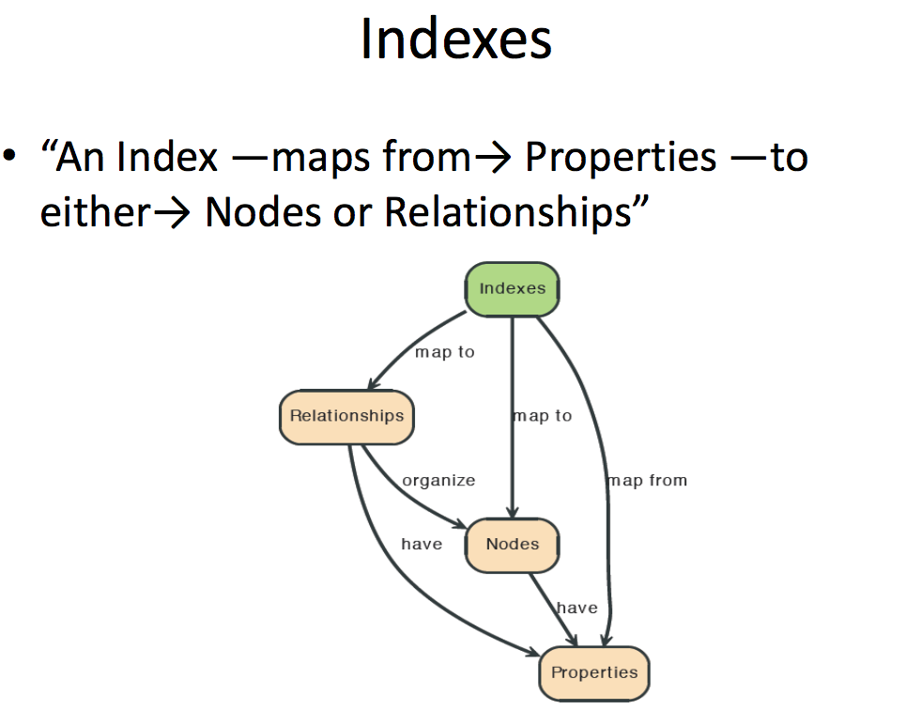

Slide 75
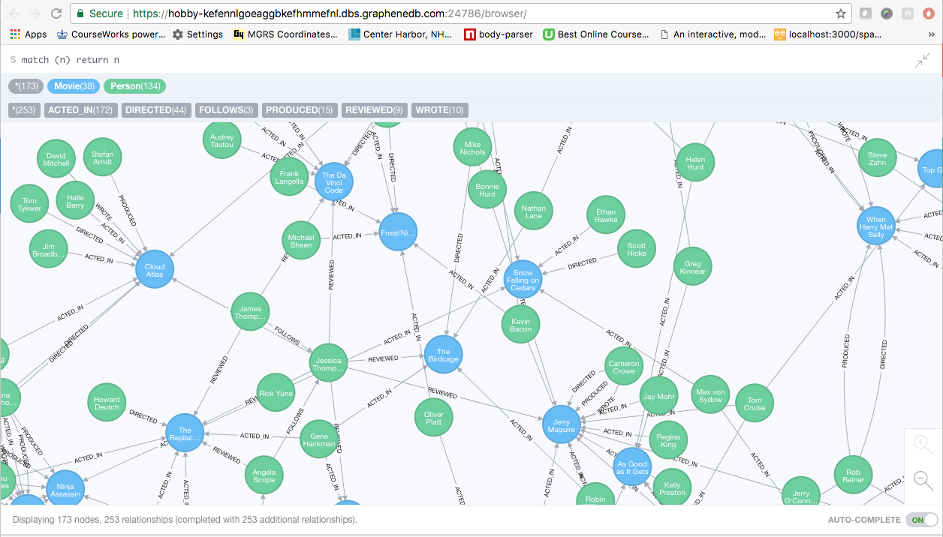
A Graph Database (Sample)

Slide 76
Neo4J Graph Query
Who acted in which movies?

Slide 77
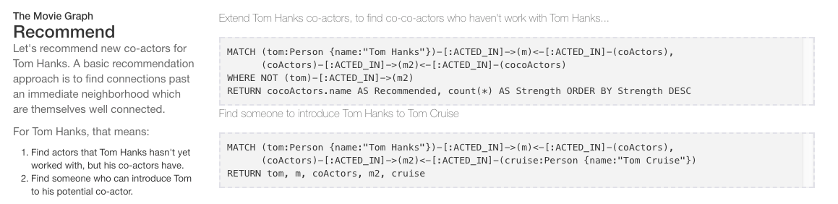
Big Deal. That is just a JOIN.
Yup. But that is simple.
Try writing the queries below in SQL.

Slide 78
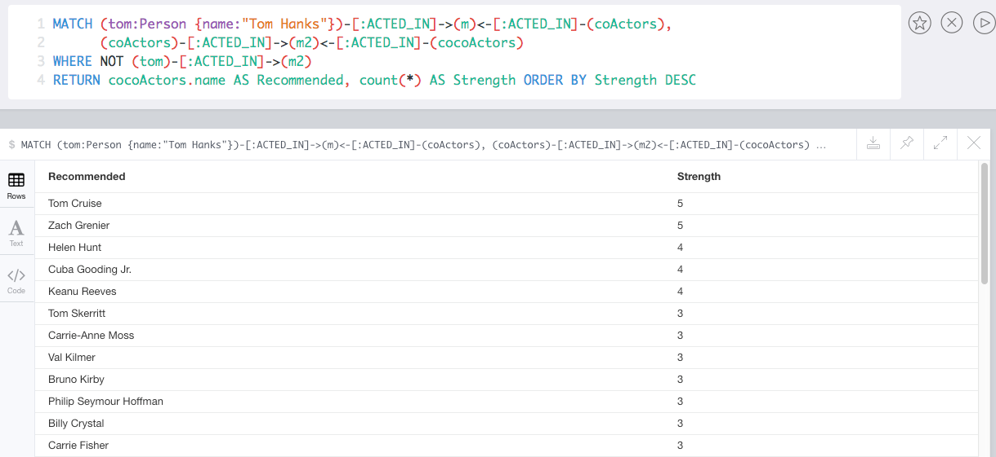
Recommend

Slide 79
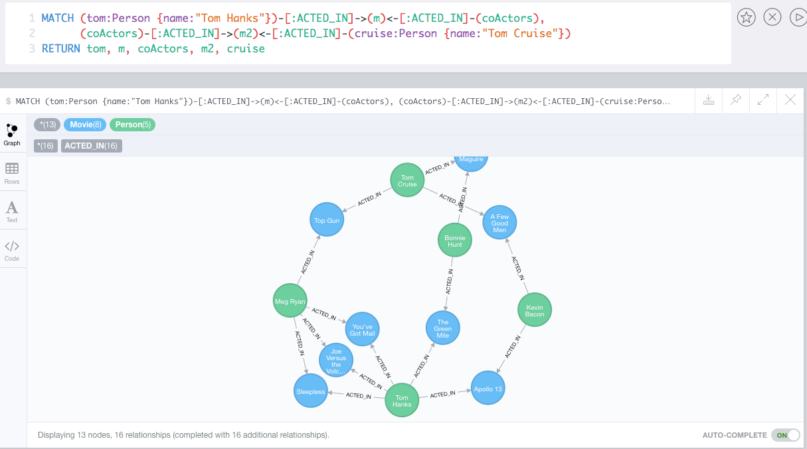
Which actors have
worked with both
Tom Hanks and
Tom Cruise?

Slide 80
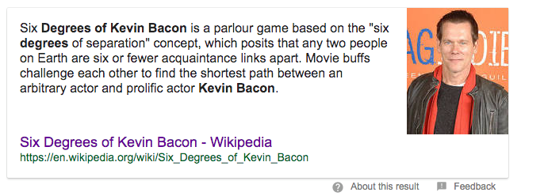
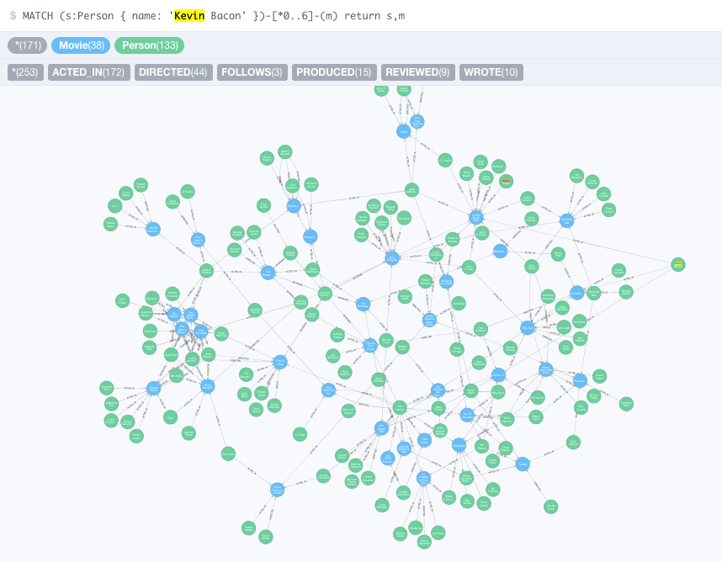


Slide 81
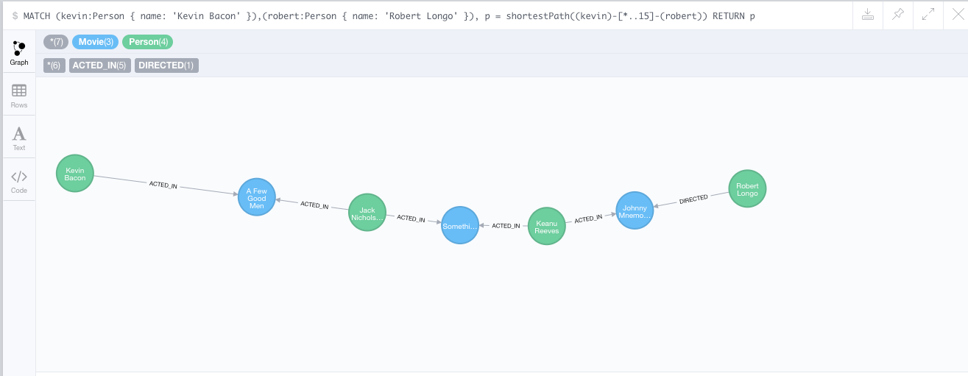
How do you get from
Kevin Bacon to
Robert Longo?

Slide 82
Update on Project
82 | W4111-2024F-8-Module-II(2)-NoSQL(2) © Donald F. Ferguson, 2024

Slide 83
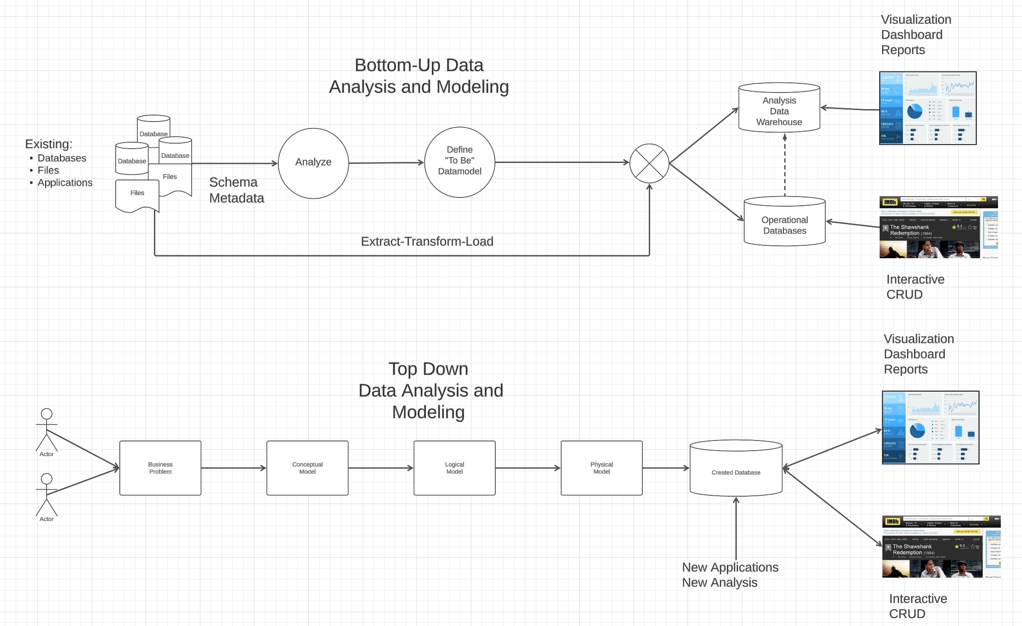
Vision

Slide 84
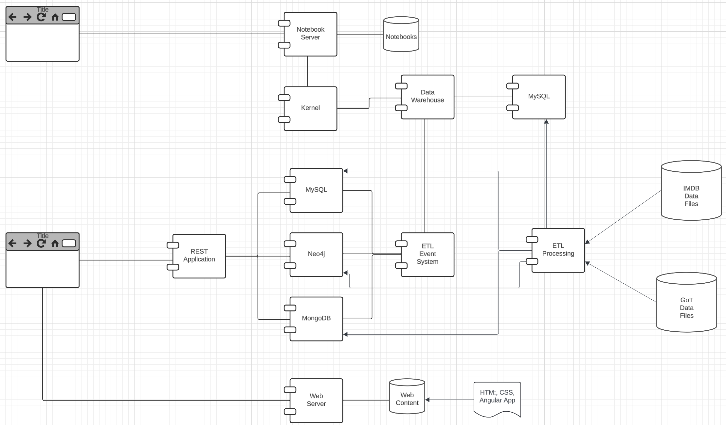
Vision

Slide 85
MongoDB Continued
85 | W4111-2024F-8-Module-II(2)-NoSQL(2) © Donald F. Ferguson, 2024

