Slide 1
Chips & Circuits
Tiancheng Guo
Zhongyu Chen

Slide 2
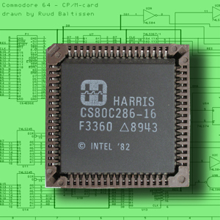
What is Chips & Circuits?
Chip: an integrated circuit
A list of connectable gates
A list of gates (gate list) and a list of wires (net list) that connect them
Notes:
First things first, what is Chips & Circuits?
I’m pretty sure that every one of you has a laptop and a smart phone. And I’m going to need you to take them apart. Yes, just take them apart.
And you should be able to found chips, like this one here.
A chip is actually an integrated circuit, and we can consider it as a list of connectable gates. And this is basically a list of gates and …

Slide 3

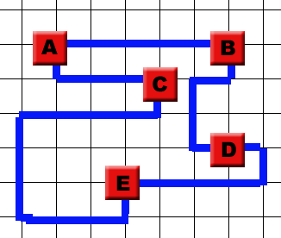
A simple example!
Notes:
Let’s look at a simple example here.
We have here, a grid with five gates ABCDE and a netlist.
A – B means there should a wire connecting A and B.
And this is the same for A and C, …

Slide 4
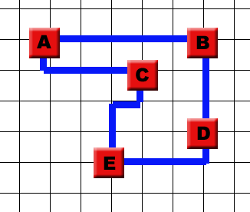
Good arrangements?
faster performance
lower expense
smaller total length of wires ->
Notes:
Given a netlist, we can lay down the wires in many different ways.
The wire connecting C and E can go like this, or like this.
The arrangement on the right, with a smaller total length of wires, is clearly better.
This can lead to a faster performance and lower expense.
So, the question is, how can we make good arrangements? And this is what we are trying to find out!

Slide 5
Constraints
Fixed gates at grid points
Fixed size
Given netlists
Manhattan style!
Wires don’t cross and don’t share grid intersection!
Distance: 1

Slide 6
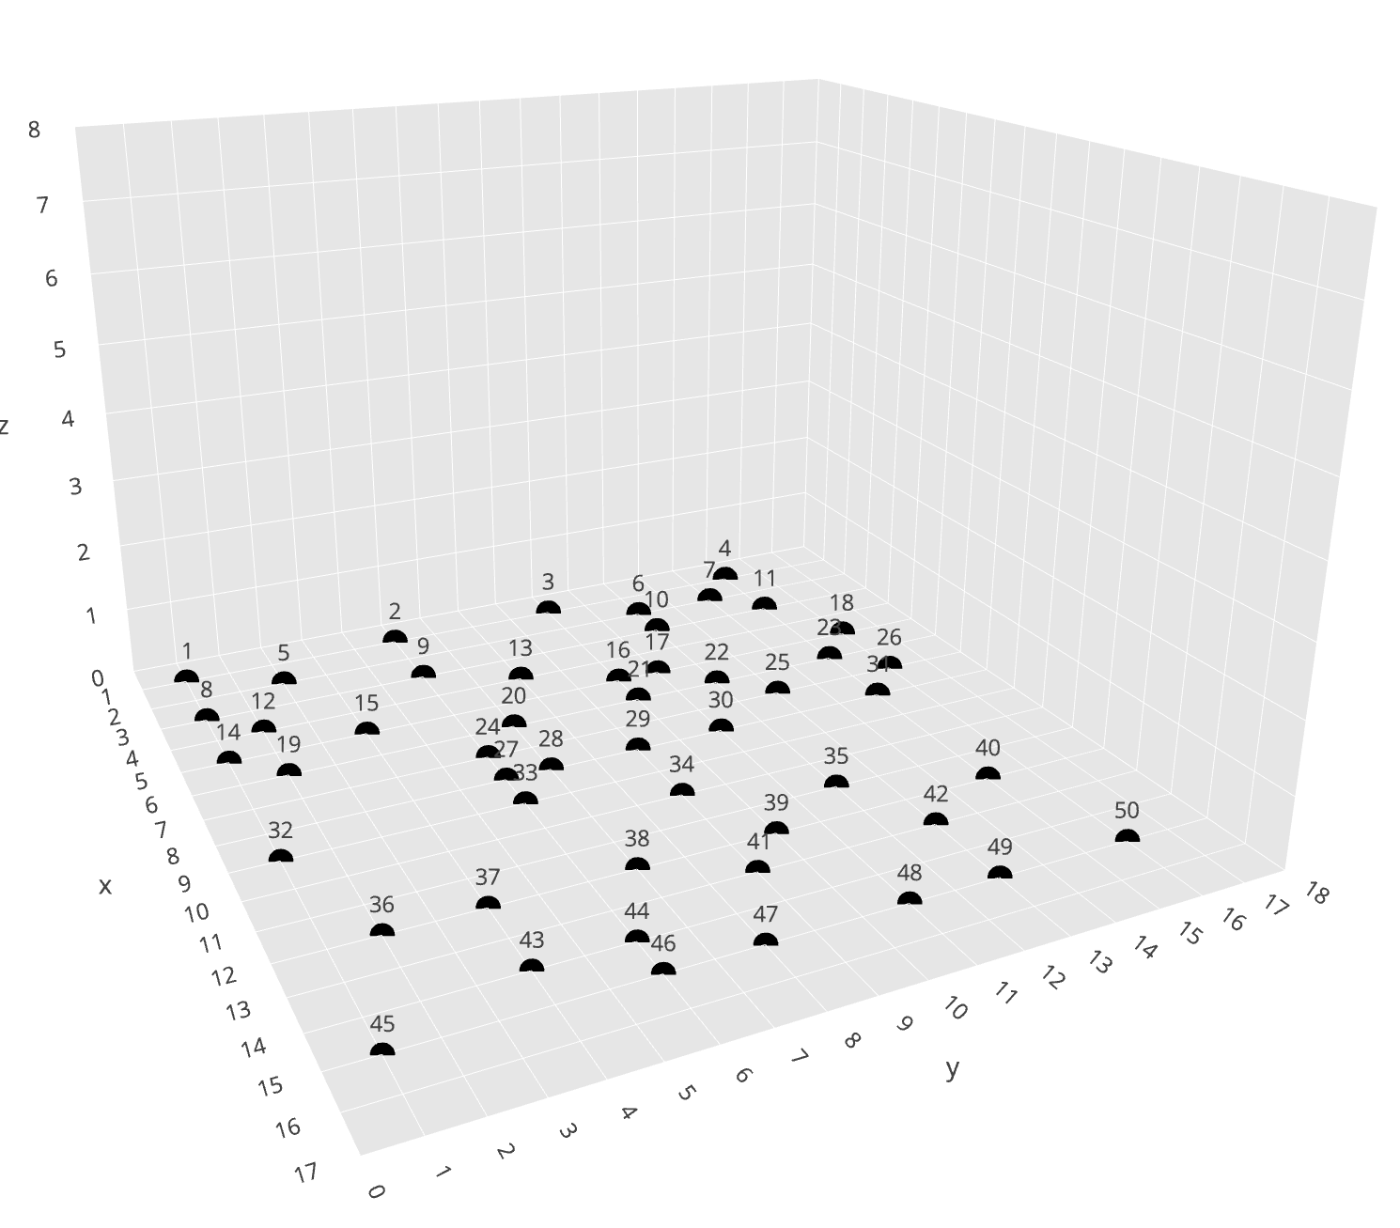
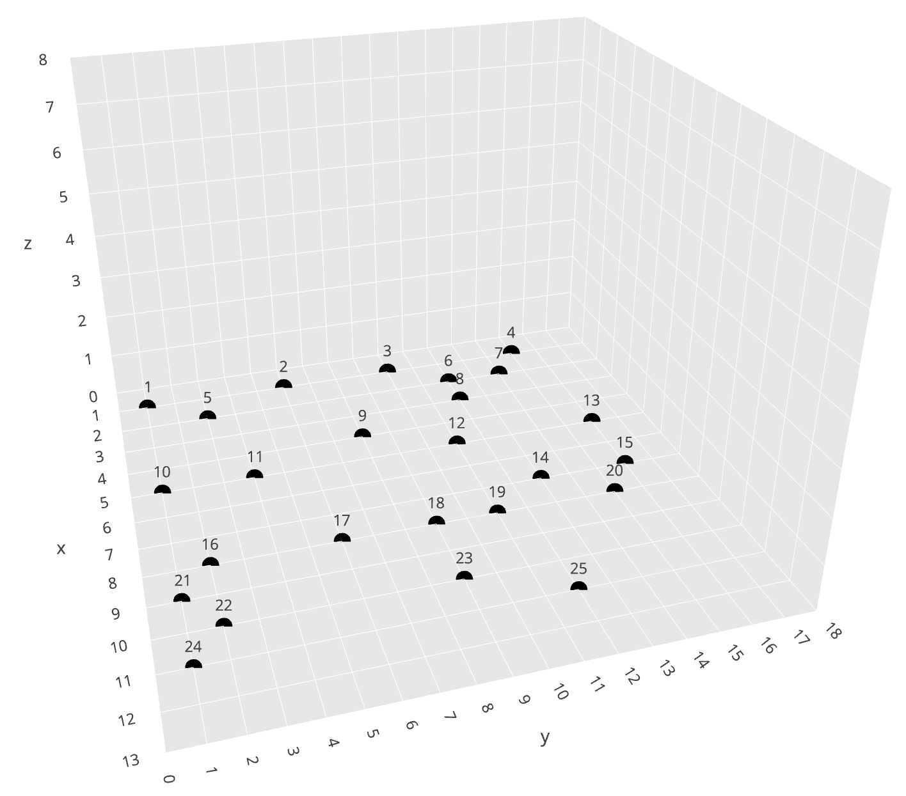
Constraints
Grid 1: 25 gates, 13x18x8
netlist 1, 2, 3 (30, 40, 50 wires)
Grid 2: 50 gates, 17x18x8
netlist 4, 5, 6 (50, 60, 70 wires)

Slide 7
Costs
Upper bound:
netlist_1 | netlist_2 | netlist_3 | netlist_4 | netlist_5 | netlist_6
1907 | 1927 | 1947 | 2498 | 2518 | 2538
Lower bound:
netlist_1 | netlist_2 | netlist_3 | netlist_4 | netlist_5 | netlist_6
291 | 341 | 475 | 600 | 578 | 761

Slide 8
States base
How many ways of connecting C and E?
Try to imagine a 17x18x8 grid with 50 gates and 70 connections!
A lot! It takes forever to brute force all the states!

Slide 9

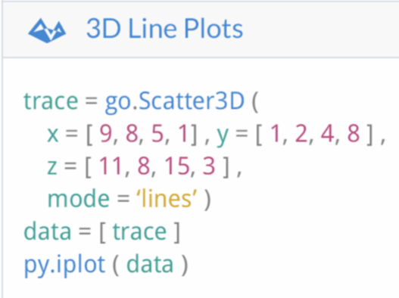
Visualization
Plotly: a python library for visualization
Bar chart, line chart, heat map, etc.
3D line plot!
Set up credentials
Trace
Layout
Generated on the website
Example: https://plot.ly/~zhongyuchen/18

Slide 10
progress

Slide 11
Version 1
Bfs
Start the project
We random shuffle the sequence of point pairs, and try to add shortest path with bfs in order.
Easy to get stuck with around 15 linked point pairs.
Link around 15(no more than 20) point pairs for table 1 netlist 1.

Slide 12
Version 2
Bfs + Heuristic
Use a easy heuristic and enlarge the number of connected point pairs
We try to solve the confliction (as explained in "why is it difficult"). After caculating the degree required for each point, we sort the sequence of point pairs, which key is the number of max required degrees for two points each pair, in descending order. Then use dfs to find the shortest path in order.
Easy to get stuck with around 20 linked point pairs
Link around 20(no more than 25) point pairs for table 1 netlist 1.

Slide 13
Version 3
Bfs + Heuristic(Astar)
Once stuck, attempt to delete one line and re add this line before adding the new line. Random shuffle the sequence of point pairs first. Once a conflict occurs, assume that at that time we intend to add line between A and B with bfs. The approach is that we delete one existed line next to A or B, and then add new line between A and B. After that, the deleted line will be added again. If getting stuck, revert to before the deleted state and try to delete another line.
With more point pairs(other than table 1 netlist 1), we cannot find a solution.
It works for table 1 netlist 1 within seconds.

Slide 14
Version 4
Bfs + Heuristic(Astar)
The linking rules of bfs switch from same level first to go up first.
As the conflict frequently occurs in the level 0, we think about forcing each gate use the entrance form 1st level prior. Other methods are in line with version 3.
It makes the cost larger. Also, finding a solution for table 1 netlist 2 takes a lot of time. Meanwhile, it cannot work for other 4 cases.
It works for table 1 netlist 1 within seconds, while taking minutes to find one solution for table 1 netlist 2

Slide 15
Version 5
Spfa + Heuristic(Astar)
Caculate the value of each grid and use spfa to find shortest path instead of bfs.
Due to the conflicts always happen near gates, a new method emerges, that assign the grid which enable the linking keep away from gates possible. To achieve this goal, we use an algorithm called SPFA(Similar to Dijkstra, an improvement of Bellman-Ford) to find the shortest way with weighted network.
The complexity of Spfa is higher than bfs.
It works for table 1 netlist 1, table 1 netlist 2 within seconds, while taking minutes to find one solution for table 2 netlist 4

Slide 16
Result, cost and explanations
The results are deposited in the website: https://plot.ly/~zhongyuchen#/
X-Y format means the result is for table X, netlist Y.

Slide 17
Conclusion
The biggest problem we encountered was that the line was blocked by other lines and could not find the way.
Thus, the update of each version is to better avoid this problem, using degrees, deleting and adding method, top-first strategy and weighted network.
The result is getting better step by step.

Slide 18
Future work
1. Reduce the cost of wires with existing solutions.
Hill Climb (new heuristic method):
Delete few random or longest paths and re-add them with different orders.
2. Find solutions for rest cases and accelerate solution searching.
Generic Algorithm (optimize the searching sequence of point pairs)
Get 50 top sequences out of 5000 (judge by number of connected point pairs) as parents, and do cycle crossover to get better searching sequences.

