Slide 1
计算机网络第三次实验
使用Wireshark软件分析TCP协议

Slide 2
Questions
浏览器访问http://gaia.cs.umass.edu/wiresharklabs/alice.txt 并下载文本文件保存到本地
浏览器访问http://gaia.cs.umass.edu/wireshark-labs/TCP-wireshark-file1.html 并在打开的页面中点击按钮选择刚刚下载的文本文件，注意此时不要点上传按钮
打开wireshark开始抓包
在网页中点击上传按钮，等待文件上传成功
Weireshark停止抓包
若由于网络原因无法抓到包的，可以尝试直接下载包跟踪文件
http://gaia.cs.umass.edu/wireshark-labs/wireshark-traces.zip
然后在wireshark中打开

Slide 3
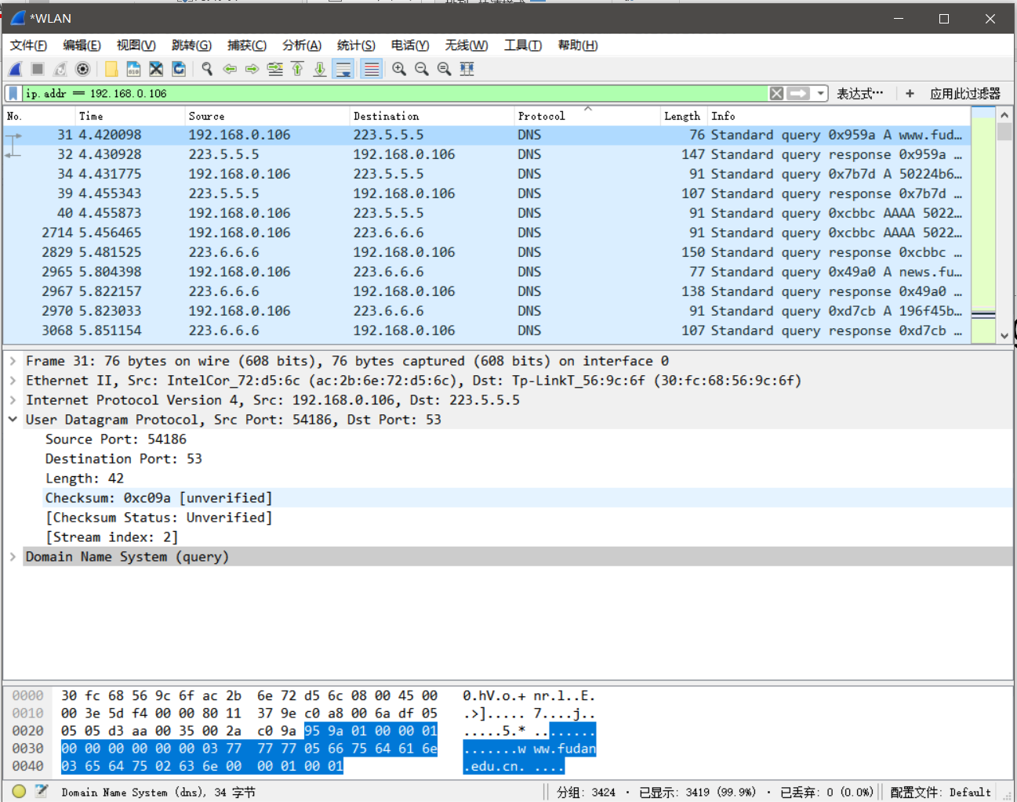
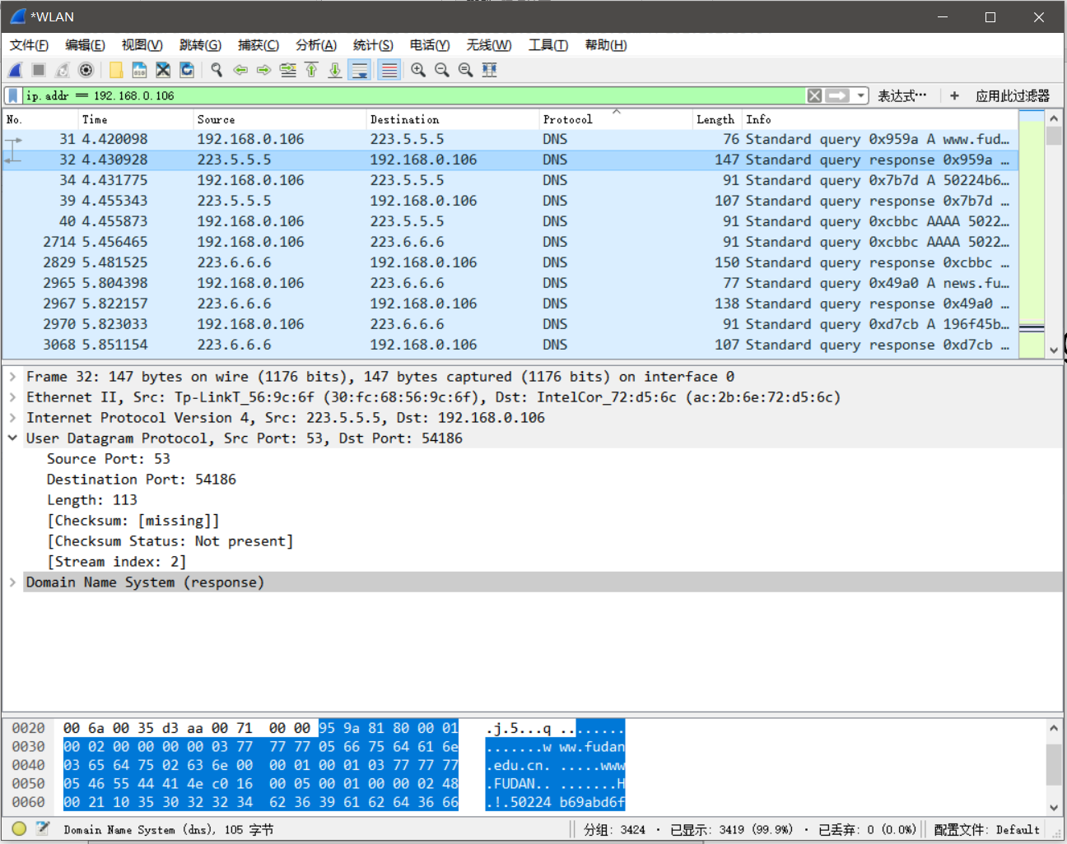
答题样例: 截图+说明
Question: Locate the DNS query and response messages. Are they sent over UDP or TCP?
Query
Response
ANSWER: They are sent over UDP

Slide 4
Questions
What is the IP address and TCP port number used by your client computer (source) to transfer the file to gaia.cs.umass.edu?
What is the IP address of gaia.cs.umass.edu? On what port number is it sending and receiving TCP segments for this connection?
What is the sequence number of the TCP SYN segment that is used to initiate the TCP connection between the client computer and gaia.cs.umass.edu? What is it in the segment that identifies the segment as a SYN segment?

Slide 5
Questions
What is the sequence number of the SYNACK segment sent by gaia.cs.umass.edu to the client computer in reply to the SYN? What is the value of the Acknowledgement field in the SYNACK segment? How did gaia.cs.umass.edu determine that value? What is it in the segment that identifies the segment as a SYNACK segment?
What is the sequence number of the TCP segment containing the HTTP POST command? Note that in order to find the POST command, you’ll need to dig into the packet content field at the bottom of the Wireshark window, looking for a segment with a “POST” within its DATA field.

