Slide 1
fc
log softmax
fc
ReLU
conv
ReLU
max pool
conv
ReLU
max pool

Slide 2


Slide 3
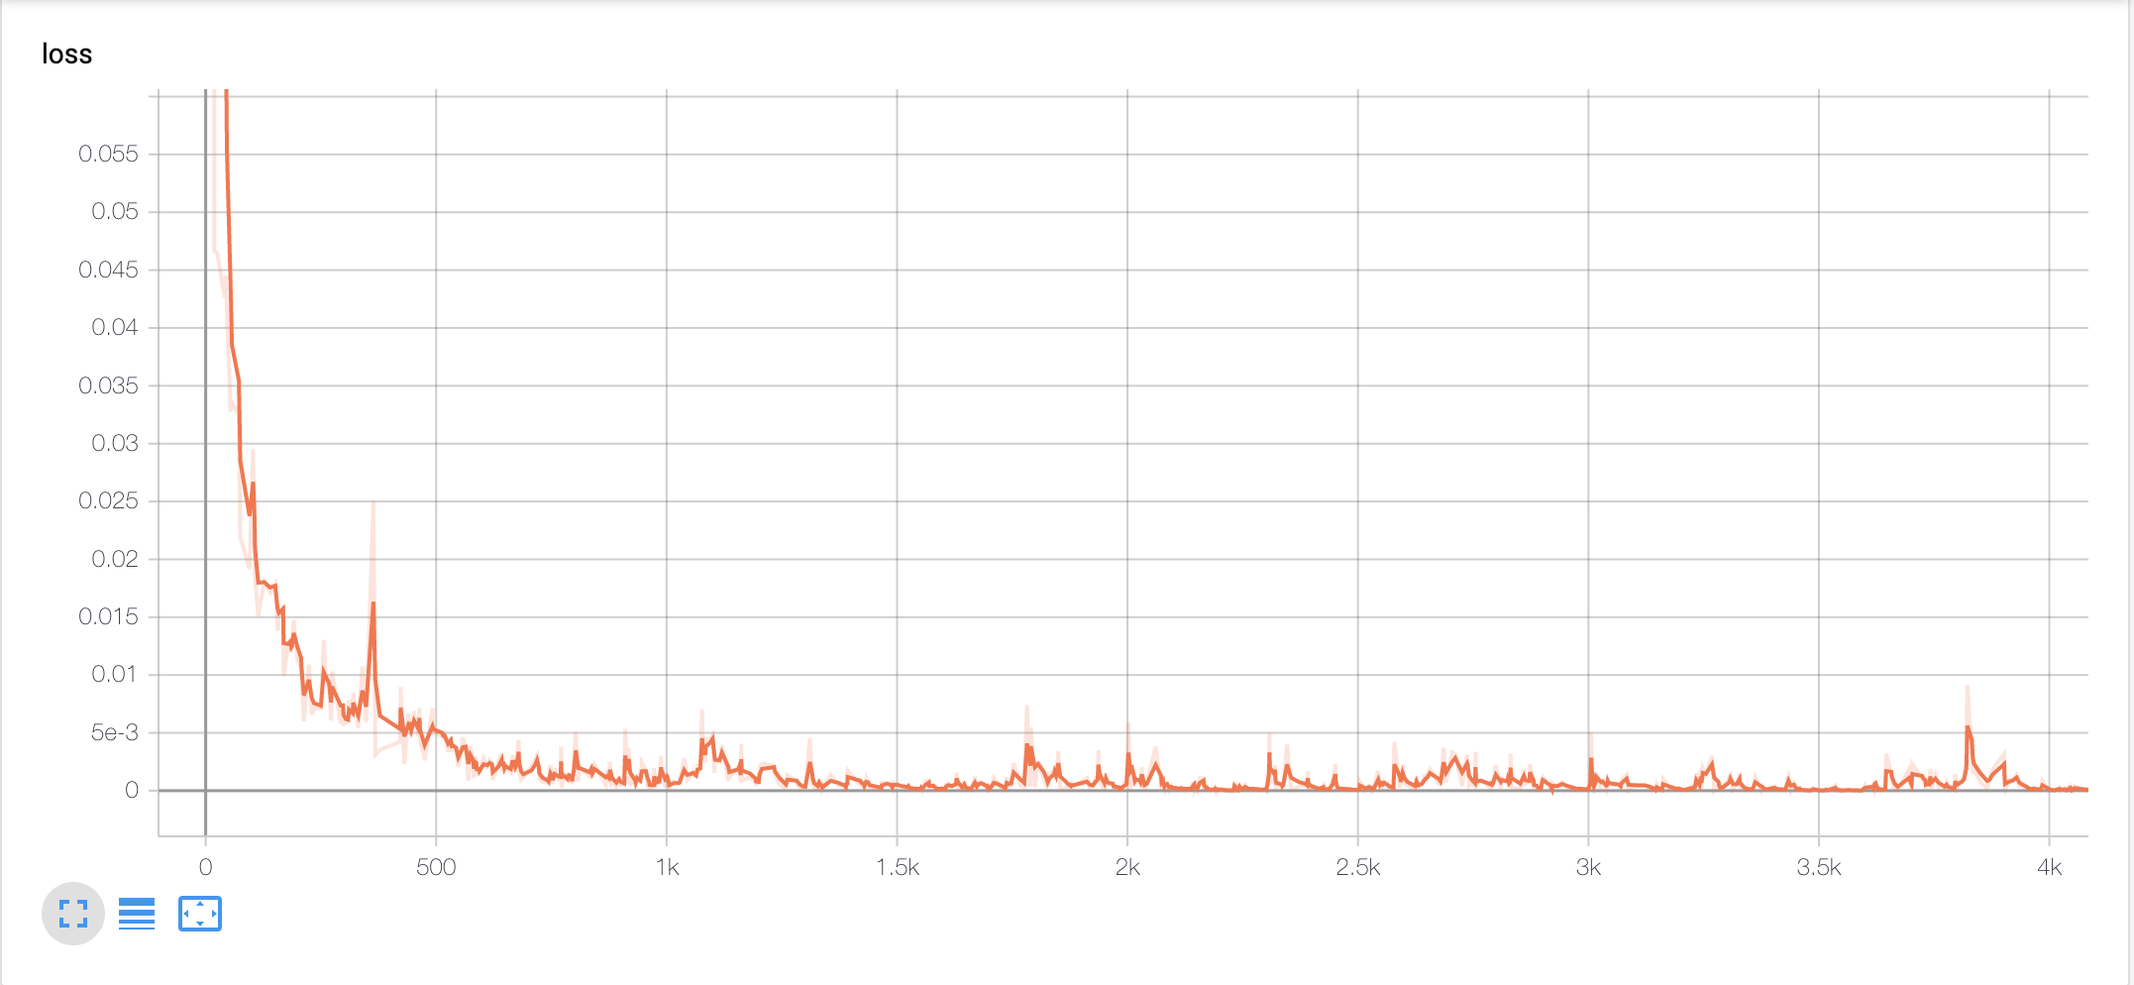
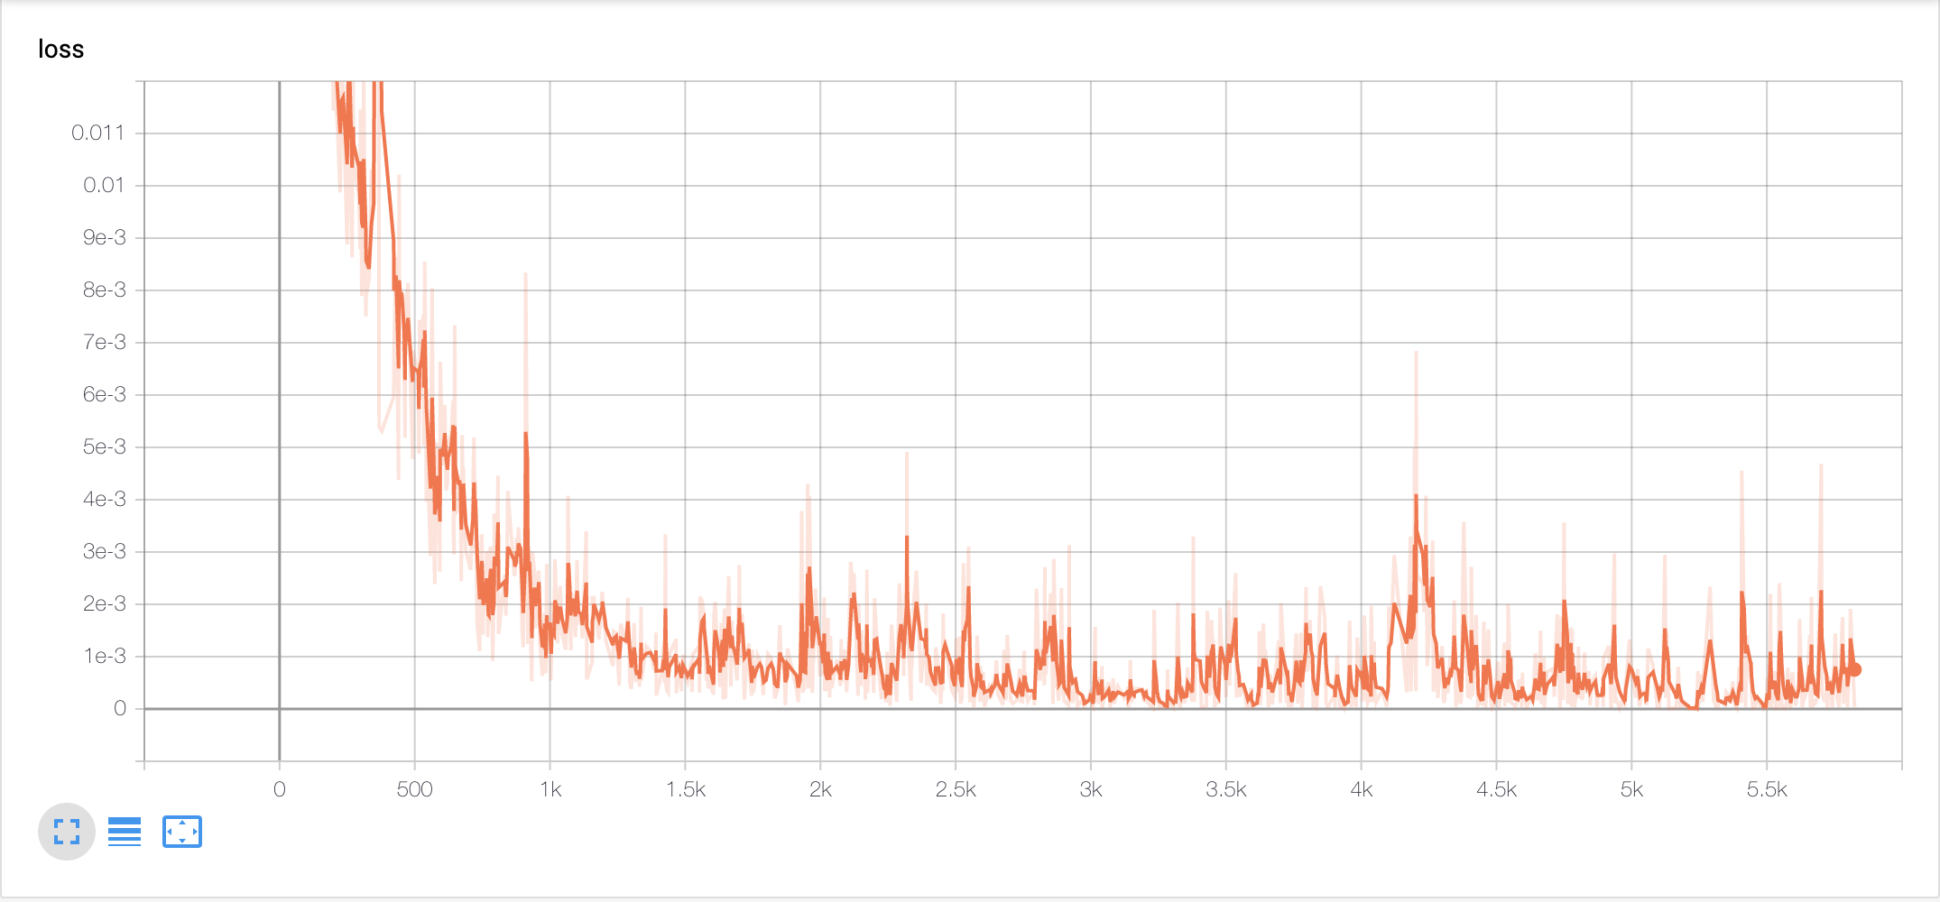
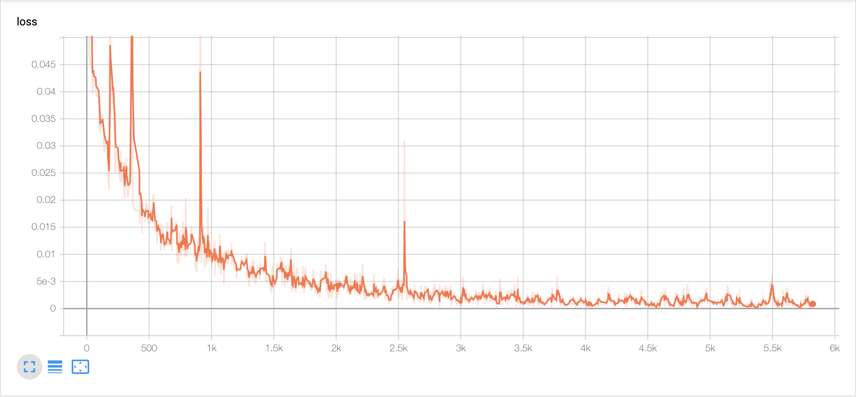
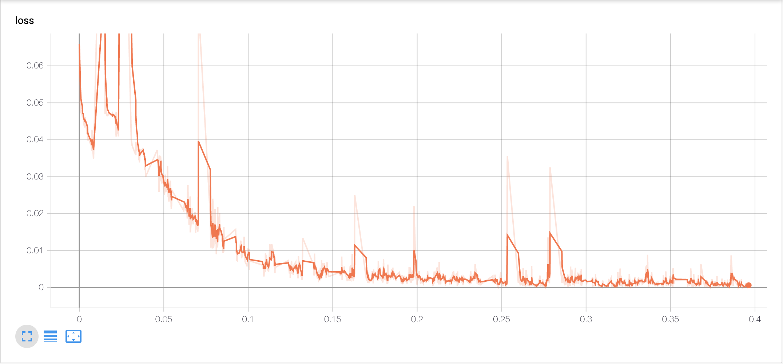

Slide 4
