Slide 1
LAEMA
Dev Tournament 2026 Pitch

Slide 2
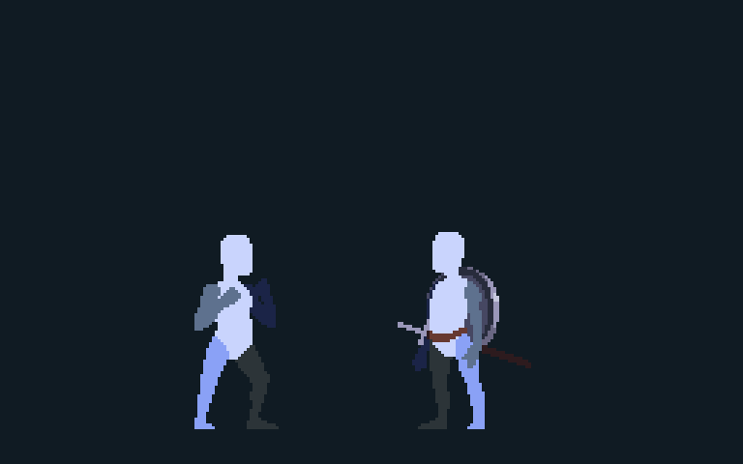
Melee combo
A familiar five-hit chain
X1
X1
X2
X2
X3
X3
X4
X4
X5
X5
01
Notes:
You asked for a toy. I began there. At the foundation, this starts with a familiar melee chain: X1 through X5.
[Sources] Enemy hit-reaction frames: assets/prototype/enemy/medieval_fighter/Hurt.png, four cells, mirrored to match Idle. Fire bolt: assets/prototype/vfx/fire/fire1.png through fire10.png in numeric order, Craftpix Fantasy Platformer bundle per assets/README.md. Art confirmed dimensions/facing. Presentation timing is illustrative.
Current docs/GAME_DESIGN.md: Six-Slot Chain; Orb Queue. Current player.gd Fire mapping: fire_x1.png, fire_x2.png, fire_x3.png, fire_x4_opposite_limb_trial.png, fire_x4.png; target medieval_fighter/Idle.png; provenance in assets/README.md. Animation uses the existing frames, retimed for explanation. Not recorded gameplay.

Slide 3
Generating orbs
Every landed hit generates one Fire orb
X1
X1
X2
X2
X3
X3
X4
X4
X5
X5
Generated orbs
F
F
F
F
F
02
Notes:
Now watch the same chain again. Each landed attack also generates an orb. These are Fire attacks, so each one generates a Fire orb. The melee sequence is building a resource that I can use for Magic.
[Sources] Enemy hit-reaction frames: assets/prototype/enemy/medieval_fighter/Hurt.png, four cells, mirrored to match Idle. Fire bolt: assets/prototype/vfx/fire/fire1.png through fire10.png in numeric order, Craftpix Fantasy Platformer bundle per assets/README.md. Art confirmed dimensions/facing. Presentation timing is illustrative.
Current docs/GAME_DESIGN.md: Six-Slot Chain; Orb Queue. Current player.gd Fire mapping: fire_x1.png, fire_x2.png, fire_x3.png, fire_x4_opposite_limb_trial.png, fire_x4.png; target medieval_fighter/Idle.png; provenance in assets/README.md. Animation uses the existing frames, retimed for explanation. Not recorded gameplay.

Slide 4
Charging and Casting
Hold R2 to charge. Release R2 to Cast.
Fire Lv.5
Charged orbs
F
F
F
F
F
HOLD R2
RELEASE R2
03
Notes:
These five Fire orbs came from the hits we just saw. Holding R2 charges them for the next Cast. The gold outlines show which are charged. Once all five are ready, I release R2. The Cast consumes those five orbs and resolves at Fire level five.
[Sources] Enemy hit-reaction frames: assets/prototype/enemy/medieval_fighter/Hurt.png, four cells, mirrored to match Idle. Fire bolt: assets/prototype/vfx/fire/fire1.png through fire10.png in numeric order, Craftpix Fantasy Platformer bundle per assets/README.md. Art confirmed dimensions/facing. Presentation timing is illustrative.
Current docs/GAME_DESIGN.md: Orb Queue; R2 Pressure and Charging; Casting Outcomes. Five is the worked example, not the current maximum of eight. Sprite sources: assets/prototype/player/animation/shared_cast.png and fire_x1.png, plus assets/prototype/enemy/medieval_fighter/Idle.png. Craftpix provenance in assets/README.md. Retimed illustration, not captured gameplay.

Slide 5
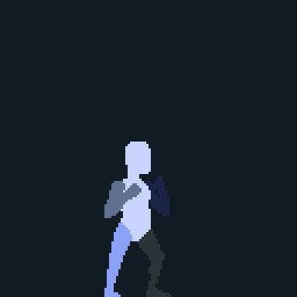
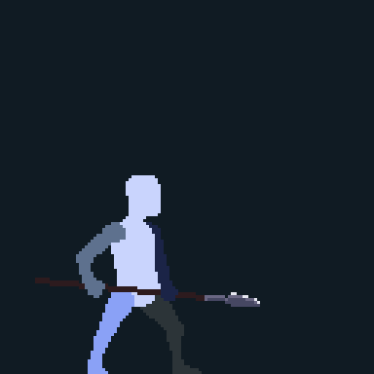
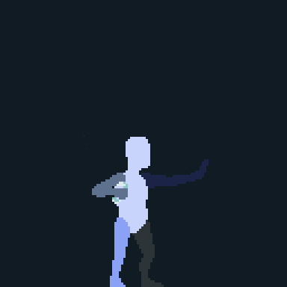
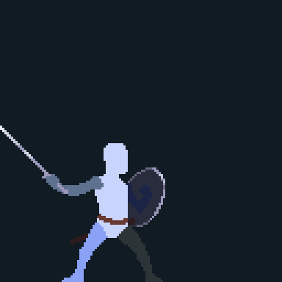
Four schools. Four fighting styles.
Four distinct fighting styles are the direction.
Switch on the fly; each school generates its own orb.
Fire
Water
Air
Earth
F
W
A
E
04
Notes:
Four schools are intended as four distinct fighting styles. I can switch on the fly, and each school generates its corresponding orb. Fire, Water, Air and Earth fighting-style identities remain design direction, not completed design.
Sources: Cleanup Pass A slide 5; approved v0.3 Section 2; current GAME_DESIGN.md Schools and Character Presentation and Orb Queue. Existing Craftpix prototype animations remain illustrative, not final school identity or runtime validation.

Slide 6
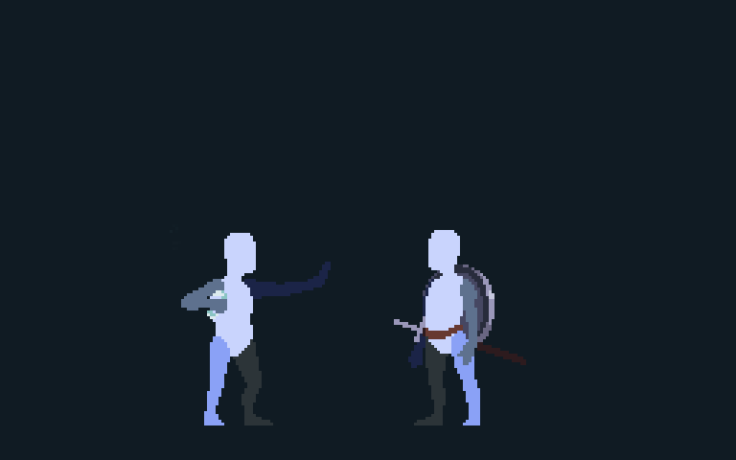
Mixing elements
Two Air hits, then two Water hits
Water Lv.4
+ Air Lv.2
Last orb: Water
Air X1
Air X1
Air X2
Air X2
Water X3
Water X3
Water X4
Water X4
Orb queue
A
A
W
W
HOLD R2
RELEASE R2
05
Notes:
Two Air hits generate A A. Switching to Water gives W W from the next two hits. I charge the four orbs, then release. The final consumed orb is Water, so Water is primary at level four. The two Air orbs contribute Air level two. One Cast carries both layers.
[Sources]
docs/GAME_DESIGN.md: Mixed-School Resolution. Current Air X1/X2 and Water X3/X4 PNG sheets; shared_cast.png; enemy Idle/Hurt; water1.png through water11.png. Craftpix provenance in assets/README.md. Presentation-retimed sprite illustration, not runtime capture; Water VFX illustrates the projectile, not approved school-specific spell effects.

Slide 7

The obvious interpretation
Finish the melee chain, then prepare and Cast
Melee
X1
X1
X2
X2
X3
X3
X4
X4
X5
X5
CAST
CAST
Generated orbs
F
F
F
F
F
HOLD R2
RELEASE R2
06
Notes:
At this point, you could reasonably imagine the system like this: each hit generates a Fire orb, then I finish the melee chain, charge those five orbs, and Cast.
[Sources]
User-approved V0.3 presentation arc, Section 3, with the user-approved update to X1-X5 followed by the optional endpoint Cast. docs/GAME_DESIGN.md: Six-Slot Chain; R2 Pressure and Charging; Casting Outcomes. The animation combines existing presentation-retimed Fire X1-X5, shared Cast, enemy reaction, and Fire VFX assets. It is an explanatory mockup, not recorded gameplay.

Slide 8
Charging underneath the fight
The melee chain continues while R2 charges the orbs
TWO THINGS AT ONCE
Melee
X1
X1
X2
X2
X3
X3
X4
X4
X5
X5
CAST
CAST
Generated orbs
F
F
F
F
F
HOLD R2
RELEASE R2
07
Notes:
But Charging does not wait for combat to stop. It happens underneath the fight.
So while I am fighting normally, I am also paying attention to how my Magic is Charging.
The enemy is still asking for my attention while that second process is running.
[Sources]
User-approved V0.3 presentation arc, Section 4. docs/GAME_DESIGN.md: R2 Pressure and Charging; Six-Slot Chain. Charging can begin at any time and continues while Laema attacks. The animation uses presentation-retimed prototype assets and is not recorded gameplay.

Slide 9
Magic enters the combo
Cast occupies position 3, then the chain continues with X4 and X5
MAGIC IS PART OF THE COMBO
Melee
X1
X1
X2
X2
CAST
CAST
X4
X4
X5
X5
Generated orbs
F
F
F
F
HOLD R2
RELEASE R2
08
Notes:
And when I release, Cast can take the place of an X inside the chain.
Casting is not a separate magic action sitting beside melee. It is part of the combo.
I prepare Magic underneath the fight, then weave it directly back into the chain.
[Sources]
User-approved V0.3 presentation arc, Section 5. docs/GAME_DESIGN.md: Six-Slot Chain; R2 Pressure and Charging. In X1-X2-Cast-X-X, the Cast takes position 3 and the following attacks use the X4 and X5 presentations. The animation is presentation-retimed prototype art, not recorded gameplay.

Slide 10
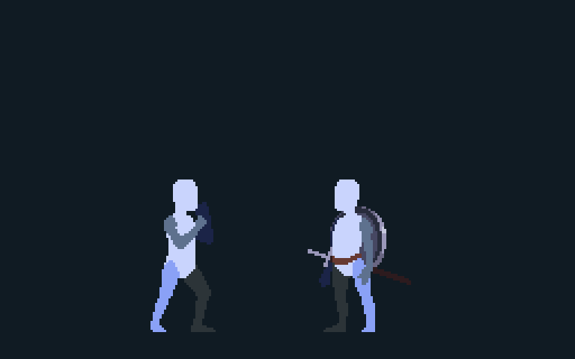
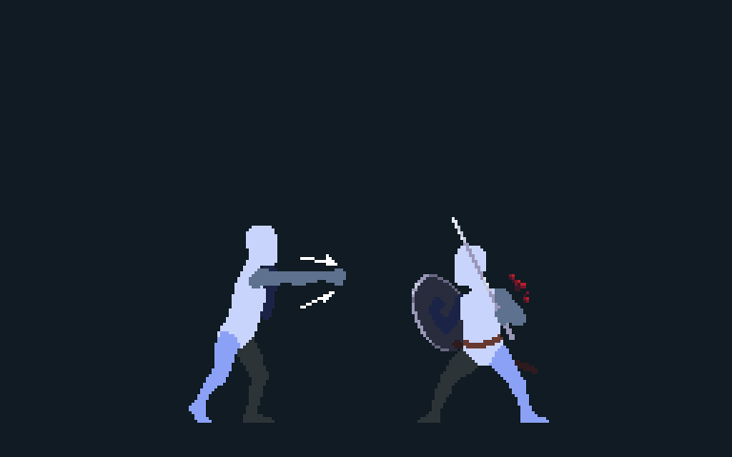
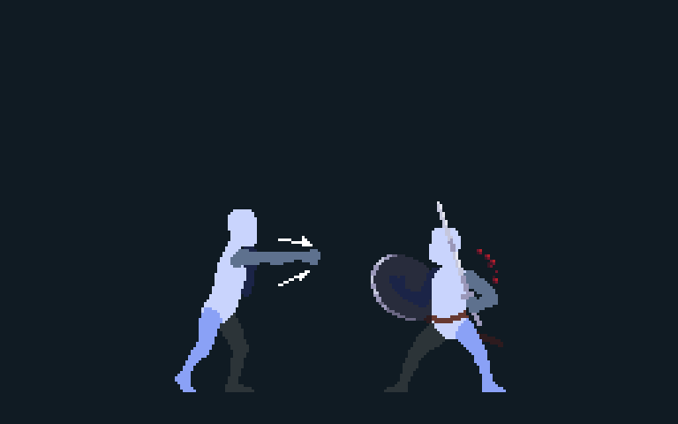
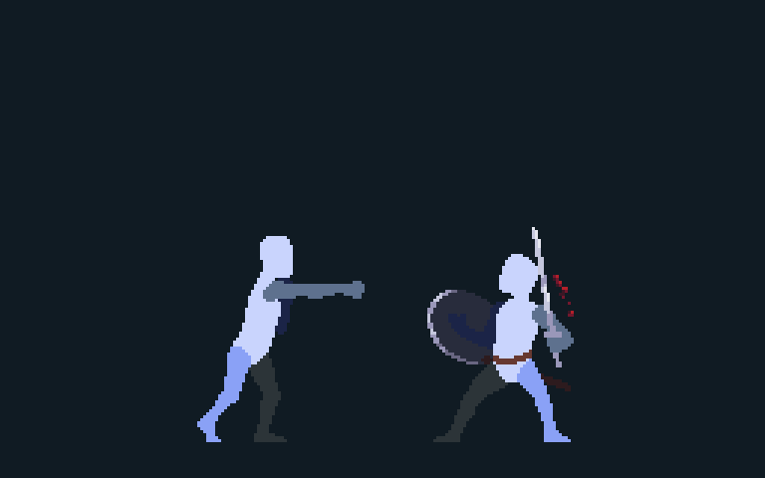
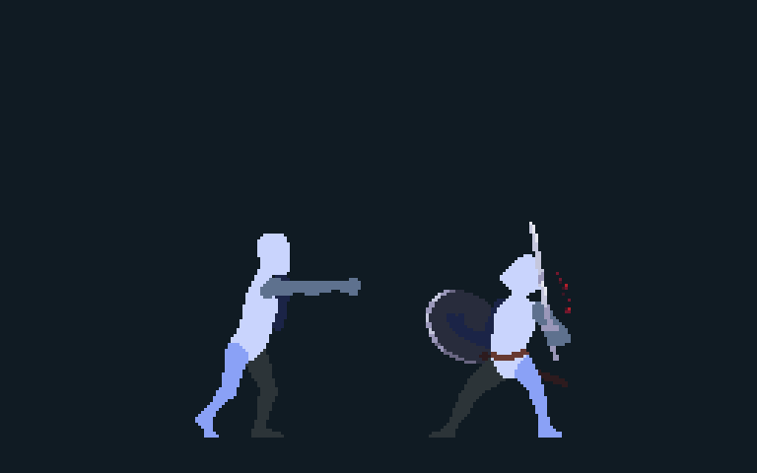
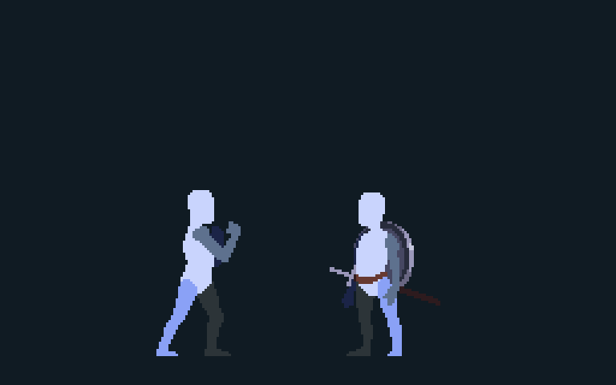
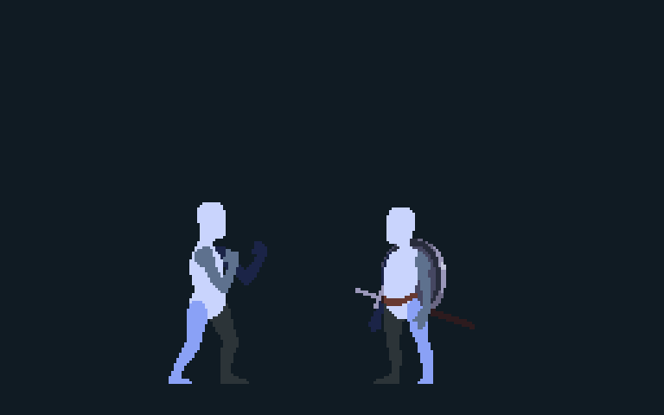
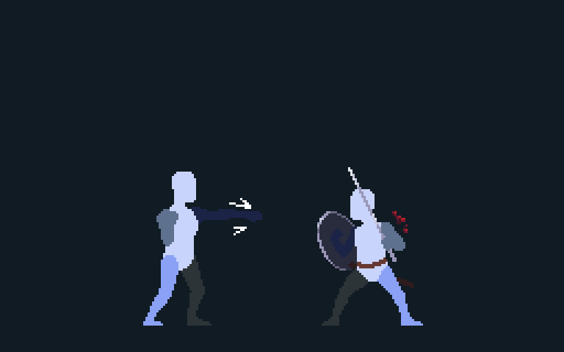
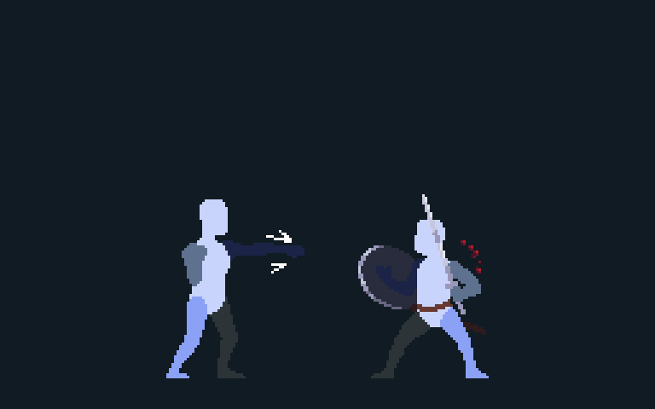
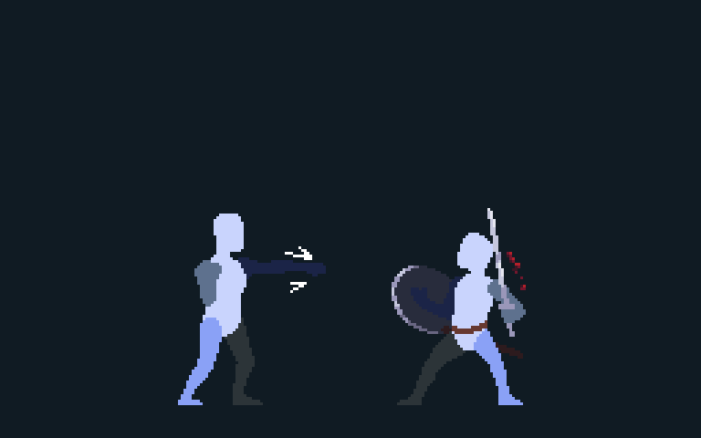
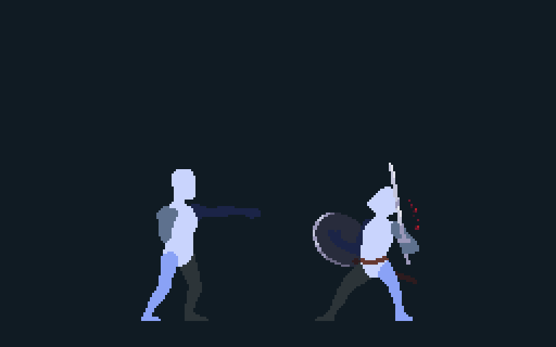
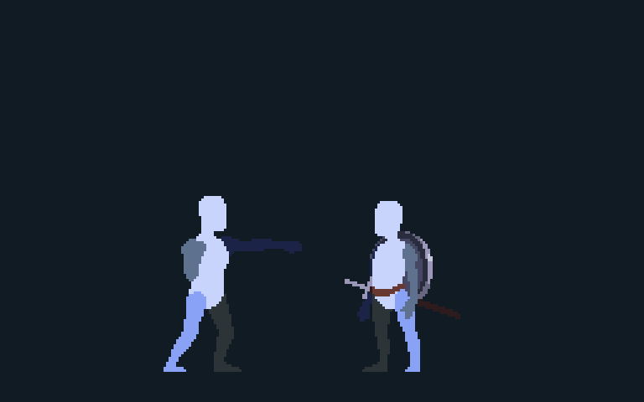
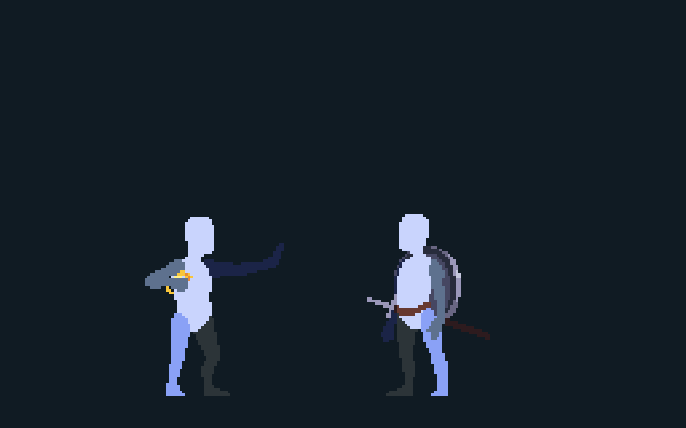
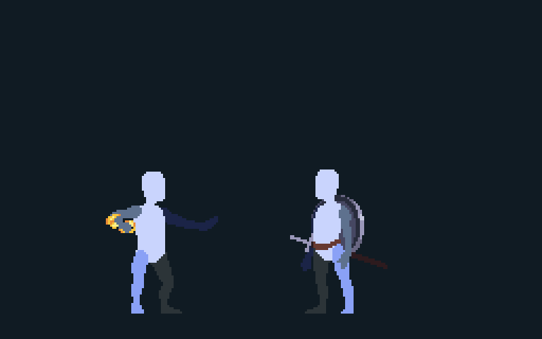
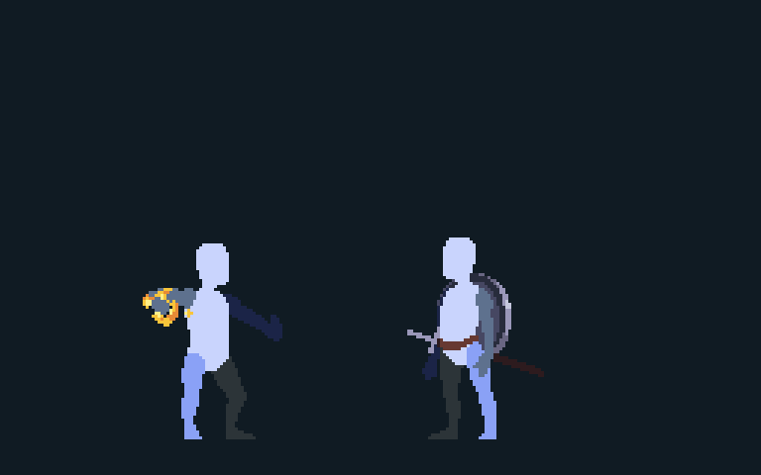
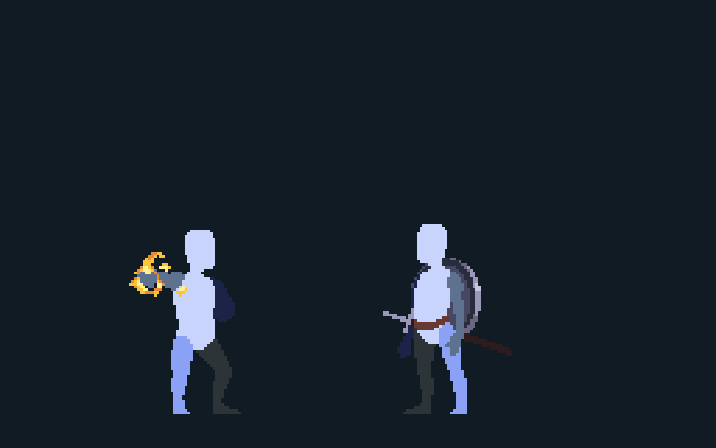
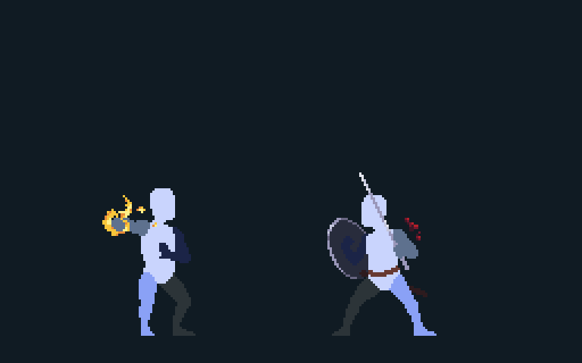
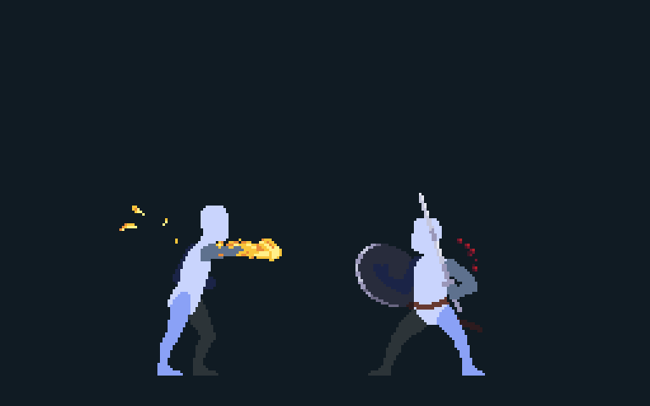
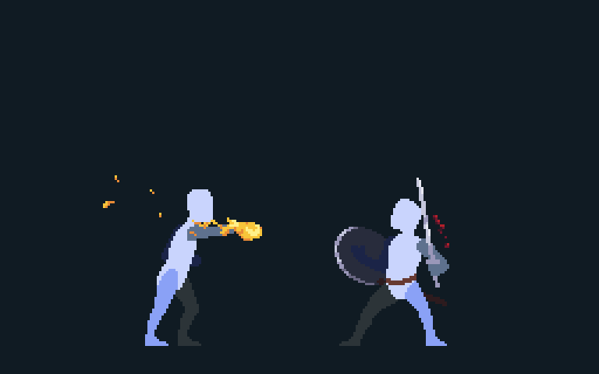
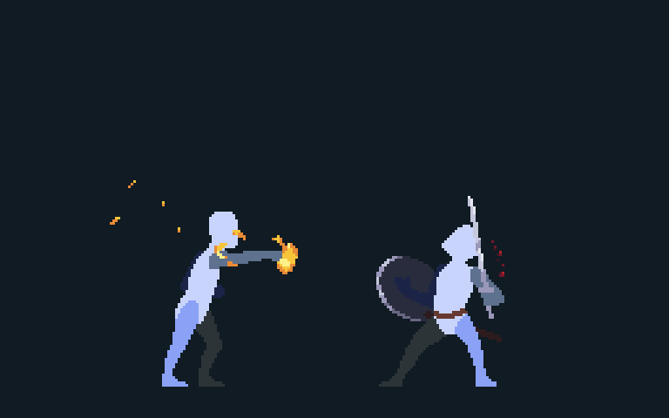
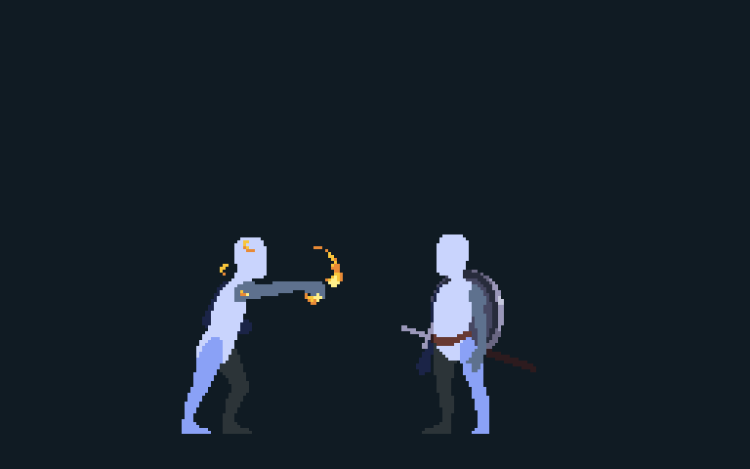
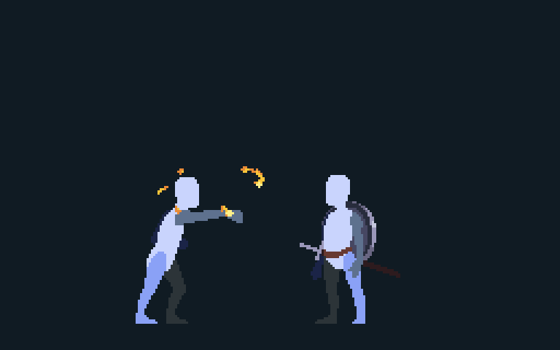
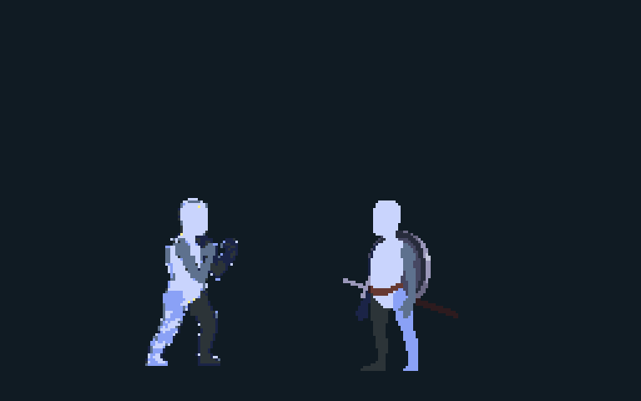
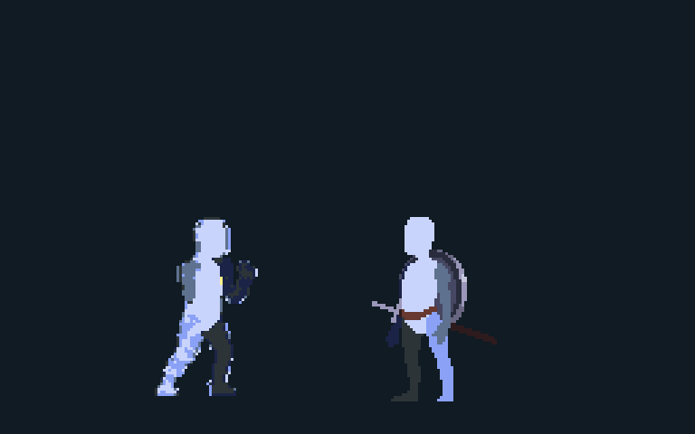
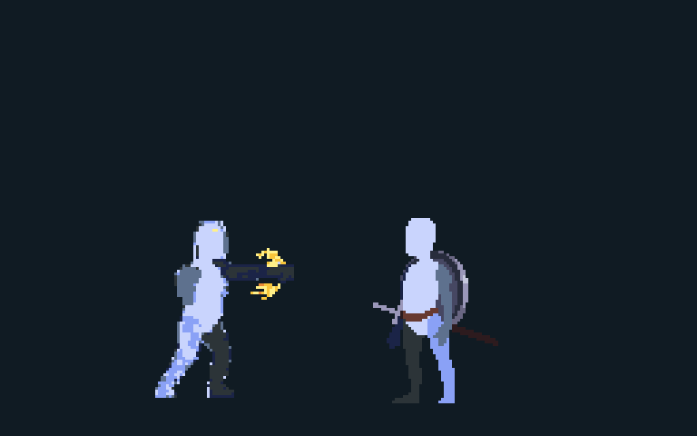
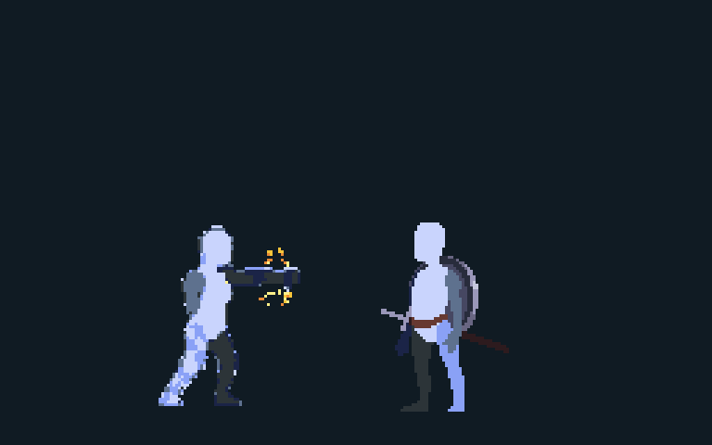
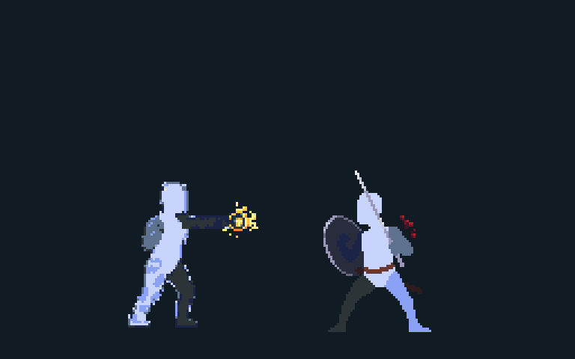
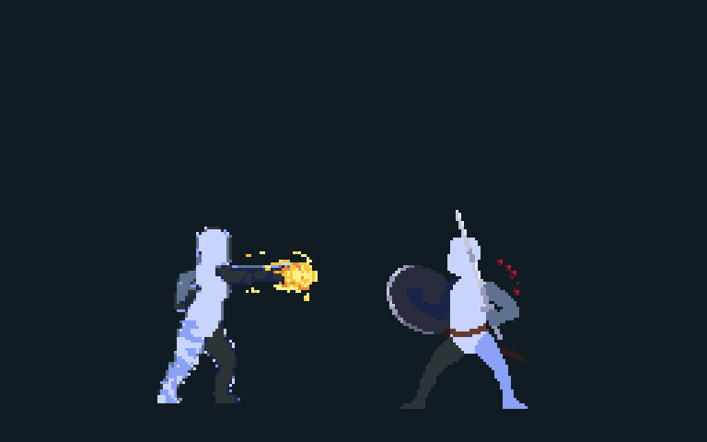
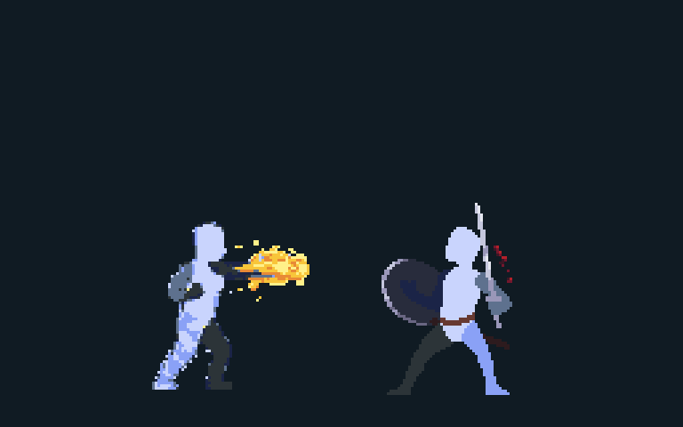
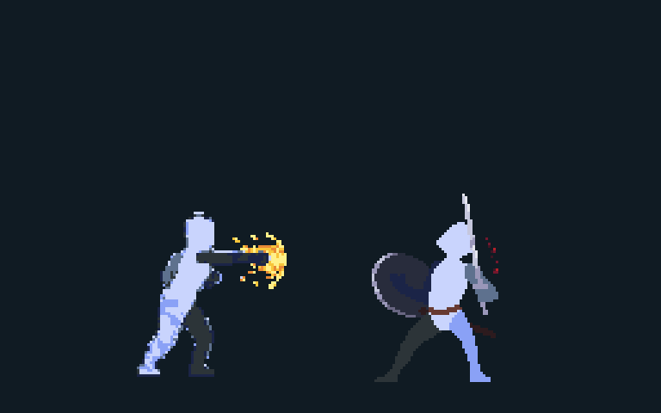
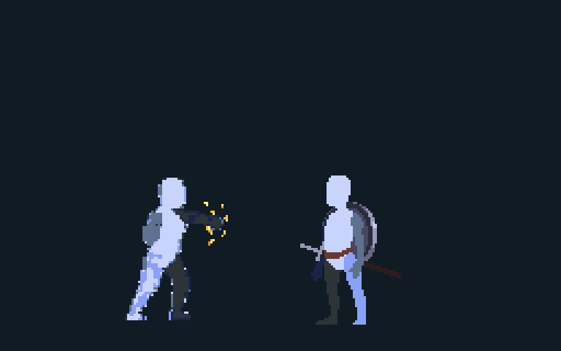
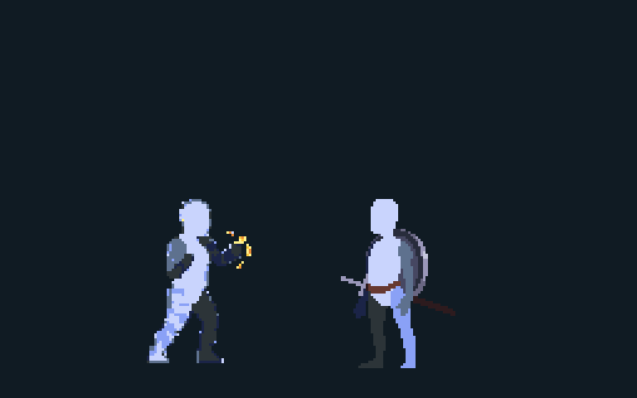
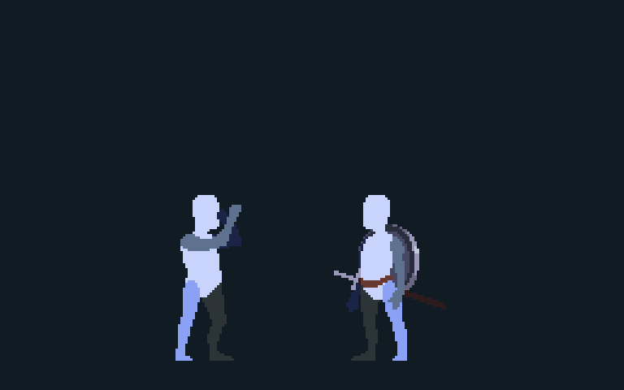
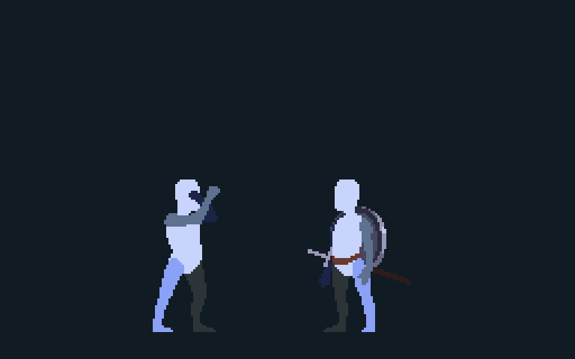
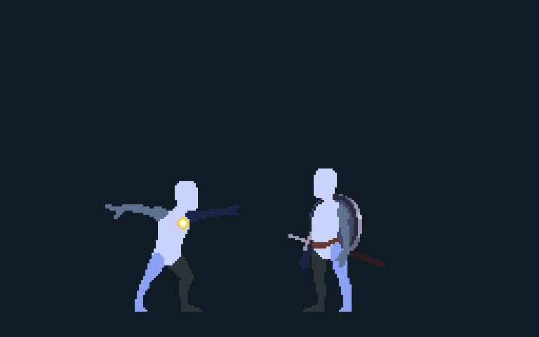
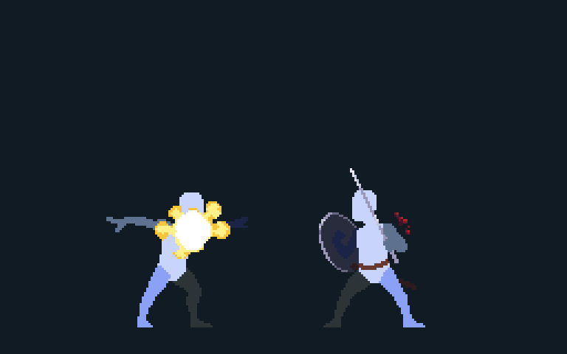
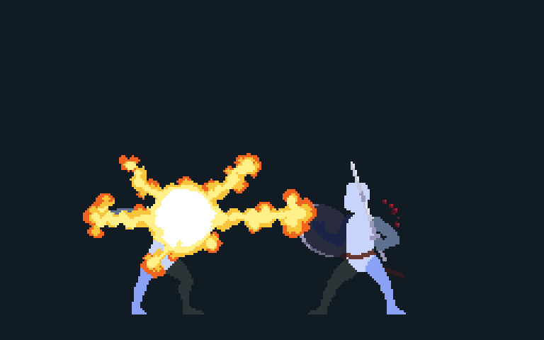
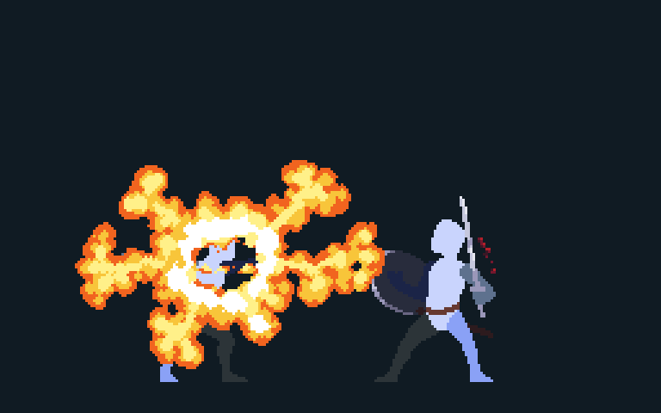
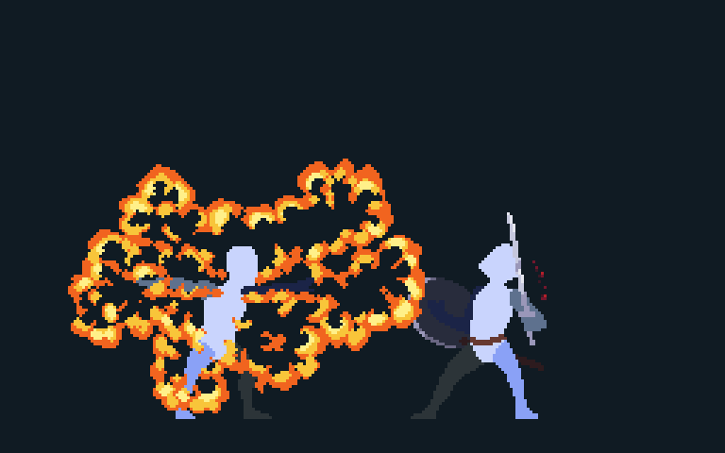
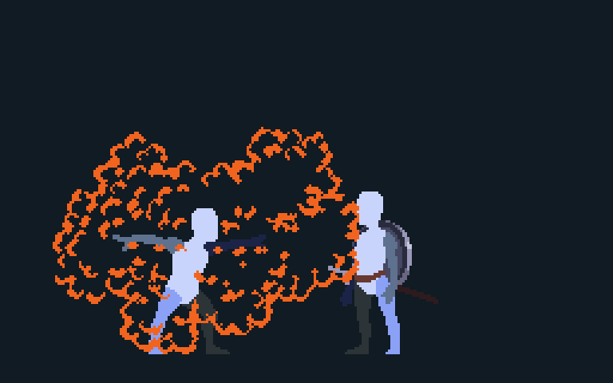
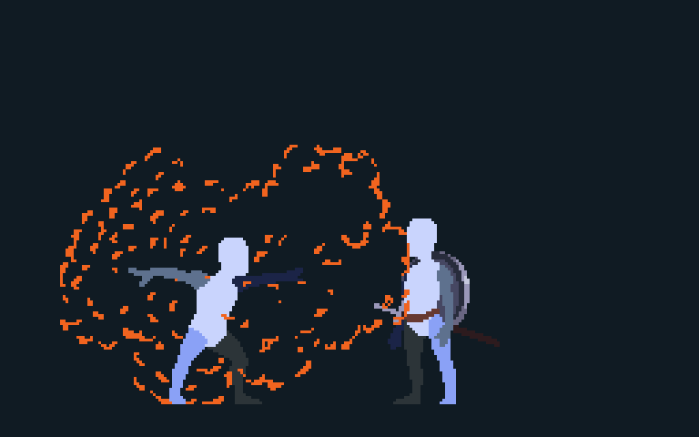
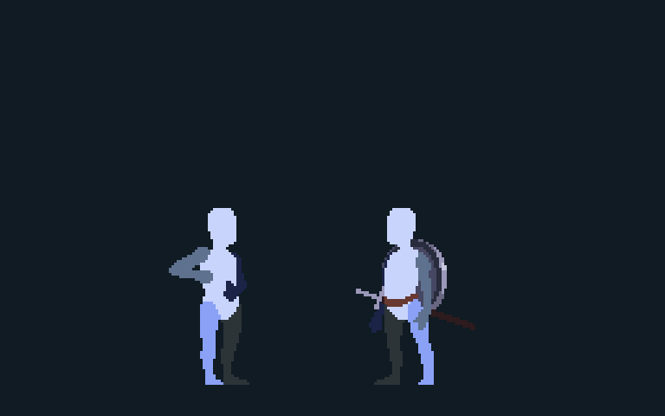
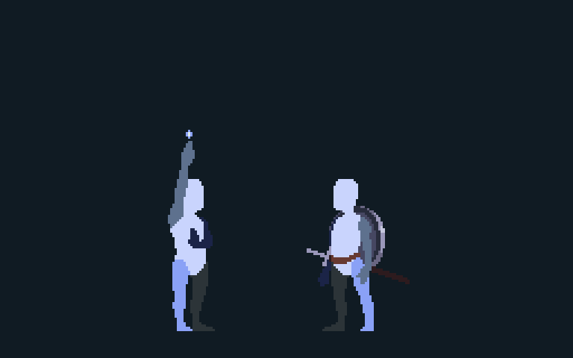

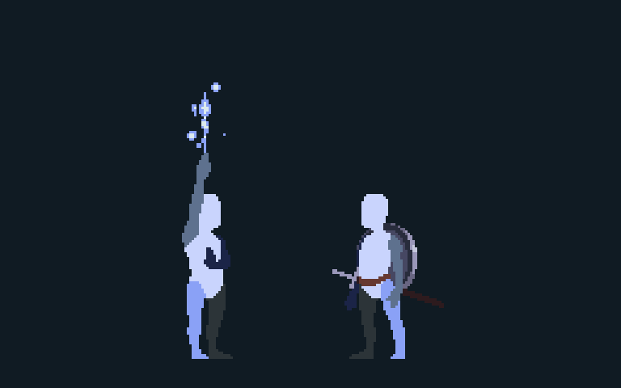



















Same system. More mastery
BEGINNER
INTERMEDIATE
SKILLED
Charge while fighting
Weave Cast into combo
Control the charge. Wait for the opening.
Fight → prepare Magic
CHARGE STATE /
PROGRESS
→
→
RELEASE + OPENING
3 CHARGED ORBS
3 CHARGED ORBS
↓
→
CAST
ADVANCING
PROGRESS HELD
BRIEFLY
↓
↓
R2 PRESSURE
→
→
X1
FULL PRESS
HALF PRESS
RELEASE
X1
X2
X2
X3
X3
X4
X4
X5
X5
CAST
CAST
X1
X1
X2
X2
CAST
CAST
X4
X4
X5
X5
Keep charging
Stop progress briefly
Cast
F
F
F
F
F
F
F
F
F
↓
↓
FIGHT
✓
ENEMY ATTACKING
→
→
HOLD R2
RELEASE R2
HOLD R2
RELEASE R2
WAIT FOR
THE OPENING
OPENING /
RECOVERY
FIGHTER + MAGE, AT THE SAME TIME
Notes:
CLICK 1 — BEGINNER: Fight, then prepare Magic. CLICK 2 — INTERMEDIATE: Charge while fighting and weave Cast into the combo. CLICK 3 — SKILLED: Build charge toward the desired state, ease off R2, briefly hold it, and wait for the combat opening. This is a qualitative pressure-control illustration, not a timing specification or an indefinite pause. CLICK 4: Fighter and mage at the same time. Sources: approved v0.3 script and GAME_DESIGN.md R2 Pressure and Charging.

Slide 11
HEAT = MOMENTUM
SPEND ORBS → HEAT ↑
MORE HEAT → FASTER COMBAT
Attack speed ↑
Cast speed ↑
Charge rate ↑
MAGIC FUELS THE MOMENTUM
STAY IN THE ZONE
Notes:
PAGE SHOWN: Heat is momentum. CLICK 1: Spending charged orbs builds Heat. CLICK 2: More Heat means faster attacks, faster Casting, and faster Charging. CLICK 3: Magic fuels the momentum of the whole combat loop. CLICK 4: Heat encourages the player to stay in the zone.
Sources: Cleanup Pass A, slide 13; approved v0.3 Section 9; current GAME_DESIGN.md Health, Impact, and Heat. This slide intentionally omits numeric tunables and detailed examples.

Slide 12
MIGHT + MAGIC
MIGHT CREATES MAGIC
↓
IT IS A
MIGHT & MAGIC
SYSTEM.
PREPARE WHILE FIGHTING
↓
WEAVE MAGIC INTO THE COMBO
↓
MAGIC BUILDS HEAT
ONE CONTINUOUS SKILL
Notes:
Might creates Magic. Prepare while fighting. Weave Magic into the combo. Magic builds Heat. One continuous skill. It is a Might & Magic system.

Slide 13
What kind of game
deserves this toy?
Notes:
What kind of game deserves this toy?
Pause, then advance into the ground-level Heroes town fantasy.
Source: approved V0.3 presentation script, Section 11, Bridge.

Slide 14


Live in a Heroes town
LOOKING DOWN
LIVING WITHIN
Heroes III Castle town reference
STRATEGY VIEW TO GROUND LEVEL
Notes:
PAGE SHOWN: I have always wanted to walk into an actual Heroes of Might & Magic town and live there.
CLICK: Instead of only looking down at that world, I want to experience it from inside.
Sources: approved V0.3 Section 12, Ground-zero Fantasy; docs/presentation/assets/marketing-town/HANDOFF.md, latest Castle pairing. Authentic reference: https://heroes.thelazy.net/images/5/57/Castle-in.png and https://heroes.thelazy.net/index.php/Castle ; Heroes of Might and Magic III / Ubisoft game art, community-hosted reproduction. Right image: existing AI-generated illustrative concept concept-castle-03-established.png. Castle is a pitch visual reference, not an assertion of specific Laema geography, implemented environments, or final art.

Slide 15


Live there. Watch it grow.
BUILD IT OVER TIME
SEE THE PROGRESS WHEN YOU RETURN
Notes:
PAGE SHOWN: And I want the town-building fantasy to come with me.
CLICK 1: Like classic Heroes, the town develops building by building.
CLICK 2: Construction takes time, and every return lets you see that progress physically in the settlement.
Sources: approved V0.3 Section 13 and approved slide blueprint. Existing Castle concept sequence from docs/presentation/assets/marketing-town/HANDOFF.md. Three AI illustrative concepts, same camera and foreground district progression. Specific construction authority, resources, timers, ownership, player agency and economy remain open. These are not implemented Laema environments or final art.

Slide 16
A local mystery
THE TRAIL LEADS OUTWARD
The poison that will kill
King Nicolas Gryphonheart
Notes:
PAGE SHOWN: The story begins close to home, with suspicious activity the protagonist starts investigating.
CLICK 1: As that investigation grows, it naturally takes the player beyond the town.
CLICK 2: Eventually, that trail connects to the poison that will kill King Nicolas Gryphonheart.
Sources: user-approved V0.3 Section 14 and the approved slide blueprint. The exact suspicious activity, investigation structure, antagonist and middle narrative remain unresolved. Existing illustrative Castle town concept from docs/presentation/assets/marketing-town/HANDOFF.md; AI concept, not implemented Laema geography or final art.

Slide 17


Explore the Heroes world
ON THE ADVENTURE MAP
A PLACE TO EXPLORE
Heroes III map object
SAME WORLD.
NEW PERSPECTIVE.
INVESTIGATION
DRIVES EXPLORATION
Notes:
PAGE SHOWN: That investigation gives the player a reason to move through the wider Heroes world.
CLICK 1: The familiar points of interest become actual places the player travels to and explores.
CLICK 2: Places we once interacted with from the strategy map are now experienced from ground level.
CLICK 3: The story gives the player a reason to visit them rather than using them only as nostalgia.
Sources: approved V0.3 Section 15 and approved slide blueprint. Existing Art handoff docs/presentation/assets/marketing-town/HANDOFF.md. Authentic windmill object: https://heroes.thelazy.net/images/7/77/Windmill.webp ; source page https://heroes.thelazy.net/index.php/Windmill ; Heroes III / Ubisoft game art, community-hosted reference. This is an isolated map object, not a full map screenshot. Ground-level image is existing AI illustrative concept concept-windmill-ground-level.png, not implemented Laema content.

Slide 18
The story behind the ruins
THE NEARBY CITY FALLS
The second-to-last major battle
SURVIVORS RETREAT HOME
FINAL DEFENCE: THE TOWN
The town you lived in and watched grow
LATER…
The ruined city in the original opening
HEROES III BEGINS
Notes:
PAGE SHOWN: Eventually, this local story collides with the larger catastrophe that begins Heroes III.
CLICK 1: The invasion reaches the nearby city, which becomes our second-to-last major battle.
CLICK 2: The survivors fall back toward the town we have lived in and watched grow.
CLICK 3: That town becomes the final battlefield.
CLICK 4: Only afterward does the original Heroes III opening take place at the ruined city.
CLICK 5: That is where our story hands the timeline back to The Restoration of Erathia.
Sources: approved V0.3 Section 16, Historical Framing, and user-approved slide blueprint. This is proposed narrative framing. Existing AI illustrative Castle town concept from docs/presentation/assets/marketing-town/HANDOFF.md, not a depiction of implemented Laema battles or approved final geography. No new narrative events or battle artwork added.

Slide 19
LAEMA
MASTER MIGHT & MAGIC
AS ONE COMBAT SYSTEM
LIVE INSIDE
A HEROES WORLD
X1 X2 CAST X4 X5 CAST
Notes:
PAGE SHOWN: Laema brings together two things I want from a Might & Magic game.
CLICK 1: First, a toy where physical combat and Magic are designed to be mastered together.
CLICK 2: Second, a world where I can live inside a Heroes town, watch it grow, and explore the places I used to see on the adventure map.
FINAL LINE, NO CLICK: That is Laema.
Sources: user-approved V0.3 Section 17 and approved closing-slide plan. The user explicitly deferred 20-hour framing. Existing presentation combat animation uses prototype art and is not runtime capture. Existing AI Castle town concept: docs/presentation/assets/marketing-town/concept-castle-03-established.png, provenance in HANDOFF.md.

Slide 20
Q&A
Notes:
Questions and discussion.

Slide 21
Two Casts in one combo
A mid-chain Cast can lead into an endpoint Cast
TWO CASTS. ONE CHAIN.
Melee
X1
X1
X2
X2
CAST
CAST
X4
X4
X5
X5
CAST
CAST
Generated orbs
F
F
F
F
HOLD R2
HOLD R2
RELEASE R2
RELEASE R2
HOLD R2
HOLD R2
RELEASE R2
R2
RELEASE R2
09
Notes:
The chain can contain more than one Cast. The first release places a Cast in position three.
X4 and X5 continue the chain and generate new orbs while I charge again.
The second release uses the optional Cast-only sixth slot and finishes the chain.
[Sources]
User decision for slide 10. docs/GAME_DESIGN.md: Six-Slot Chain; Orb Queue; R2 Pressure and Charging. A mid-chain Cast occupies a progression slot and slot six accepts an endpoint Cast only. The animation is presentation-retimed prototype art, not recorded gameplay.

Slide 22
What if I'm about to overcharge?
Control the charge while reading the fight
KEEP FIGHTING
WAIT FOR THE OPENING
Charging
FULL HOLD
→
EASE OFF
→
BRIEF HOLD
→
THEN DEPLETE
Notes:
PAGE SHOWN: A skilled player may not always want the charge to keep advancing. CLICK 1: Ease off full R2 pressure. Charge is preserved only briefly, then starts to deplete if I stay there. CLICK 2: And I keep fighting. CLICK 3: I am still looking for the opening. The pressure strip is a conceptual sequence, not a timing ruler tied to X4 or X5.
Sources: Cleanup Pass A, slide 11; approved v0.3 Section 7; current GAME_DESIGN.md R2 Pressure and Charging. Existing prototype animation is an illustration, not runtime evidence.

