Slide 1
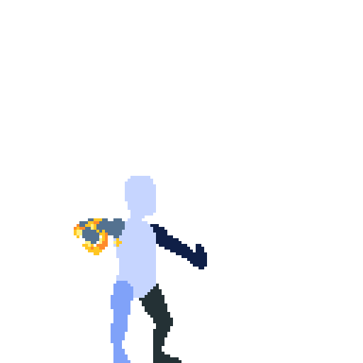
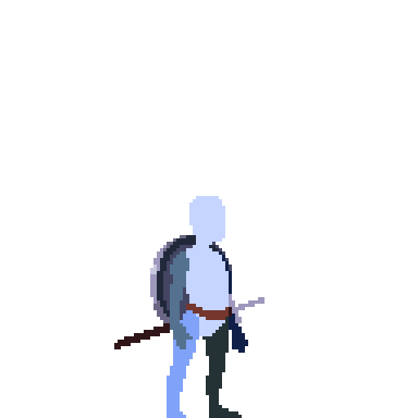
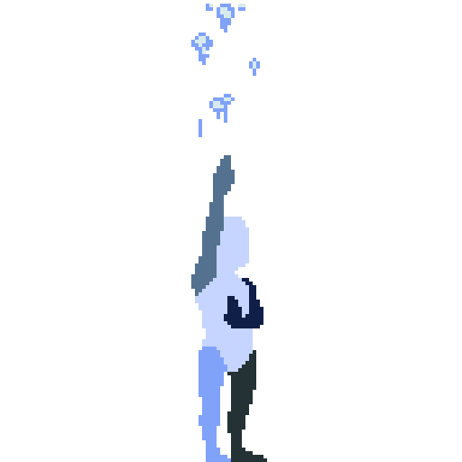
YOU ASKED FOR A TOY.
FAMILIAR ACTION COMBAT
Attack Defend Evade Openings
HITS GENERATE ELEMENTAL ORBS
F
CHARGE → CAST → CONSUME
F
Release R2
MIGHT CREATES MAGIC
1
Notes:
v0.3 §1 — FOUNDATION
Rehearsal budget 100 seconds.
PAGE SHOWN: You asked for a toy. I began there.
CLICK 1: At the foundation, this starts from something familiar: attack, defend, evade, and look for openings.
CLICK 2: Every physical attack that connects also generates an elemental orb.
CLICK 3: Charge those orbs, release R2, and the Cast consumes what you prepared.
CLICK 4: So the basic relationship is simple: Might creates Magic.
[Sources]
Approved content: user v0.3 attachment, section 1.
Current main-checkout docs/GAME_DESIGN.md: Orb Queue; R2 Pressure and Charging; Casting Outcomes.
Craftpix prototype sprite cells: current Laema assets/prototype/player/animation; assets/README.md. Project presentation use.

Slide 2
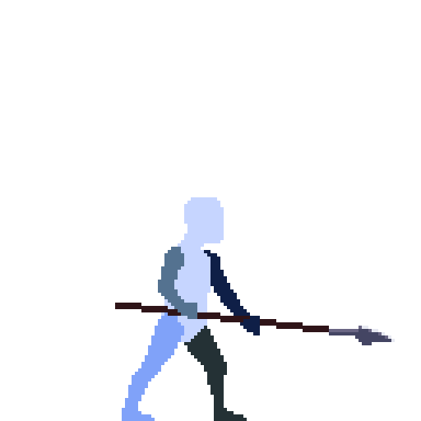
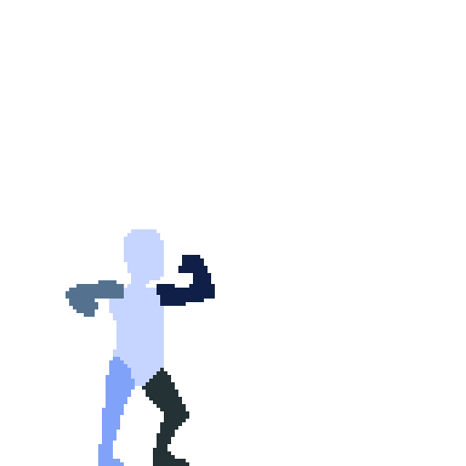
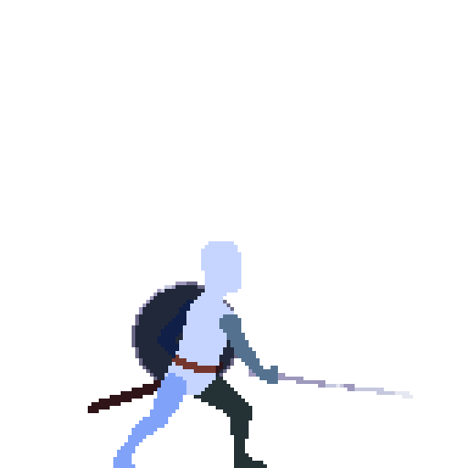
FOUR SCHOOLS. FOUR FIGHTING STYLES.
Fire
Water
Air
Earth
LAST ORB → PRIMARY SCHOOL
EACH HIT GENERATES THAT SCHOOL’S ORB
COMPOUND CASTING
Air X
Air X
Water X
Water X
A
A
W
W
Water Lv.4
+ Air Lv.2
Consumed sequence
Primary
HOW I FIGHT SHAPES THE MAGIC I CAST
Prototype character assets • fighting-style direction
2
Notes:
v0.3 §2 — SCHOOL SWITCHING + COMPOUND CASTING
Rehearsal budget 110 seconds.
PAGE SHOWN: The direction is four distinct fighting styles that I can switch between on the fly.
CLICK 1: Because each landed attack generates an orb from the active school, switching also changes the elemental sequence I’m building.
CLICK 2: A mixed sequence can resolve as a compound Cast with a primary and a secondary school.
CLICK 3: The last orb defines the primary school, while the earlier sequence can contribute a secondary school.
CLICK 4: So changing fighting styles also changes the Magic I’m preparing.
[Sources]
Approved content: user v0.3 attachment, section 2.
Current main-checkout docs/GAME_DESIGN.md: Schools and Character Presentation; Mixed-School Resolution.
Craftpix prototype sprite cells: current Laema assets/prototype/player/animation; assets/README.md. Project presentation use.

Slide 3
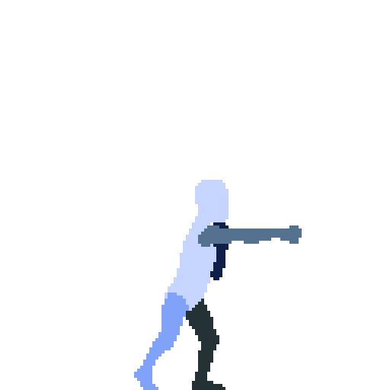
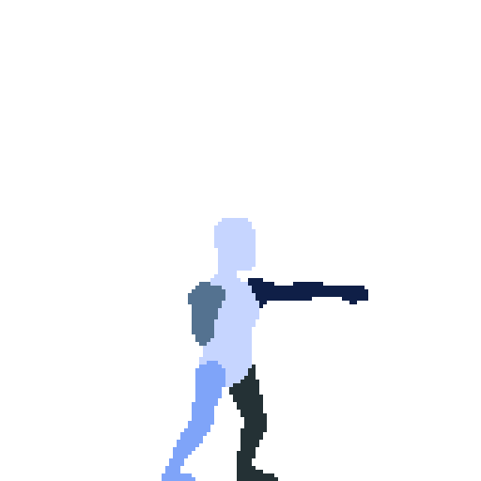
X → X → X → CAST
The first interpretation
COMBAT
X
X
X
CAST
R2
HOLD · WAIT
RELEASE
3
Notes:
v0.3 §3 — MULTITASKING — THE OBVIOUS INTERPRETATION
Rehearsal budget 35 seconds.
PAGE SHOWN: At this point, you could reasonably imagine the system like this: fight first, then prepare and Cast.
[Sources]
Approved content: user v0.3 attachment, section 3.
Current main-checkout docs/GAME_DESIGN.md: Normal Cast.
Craftpix prototype sprite cells: current Laema assets/prototype/player/animation; assets/README.md. Project presentation use.

Slide 4
CHARGING UNDERNEATH THE FIGHT
COMBAT
X
X
X
CAST
R2
HOLD
RELEASE
TWO THINGS AT ONCE
ATTACK / DEFEND / EVADE
TRACK CHARGING
4
Notes:
v0.3 §4 — MULTITASKING — REVEAL THE OVERLAP
Rehearsal budget 70 seconds.
PAGE SHOWN: But charging doesn’t wait for combat to stop—it happens underneath the fight.
CLICK 1: So while I’m fighting normally, I’m also paying attention to how my Magic is charging.
CLICK 2: The enemy is still asking for my attention while that second process is running.
[Sources]
Approved content: user v0.3 attachment, section 4.
Current main-checkout docs/GAME_DESIGN.md: R2 Pressure and Charging; Controls and Movement.
Craftpix prototype sprite cells: current Laema assets/prototype/player/animation; assets/README.md. Project presentation use.

Slide 5
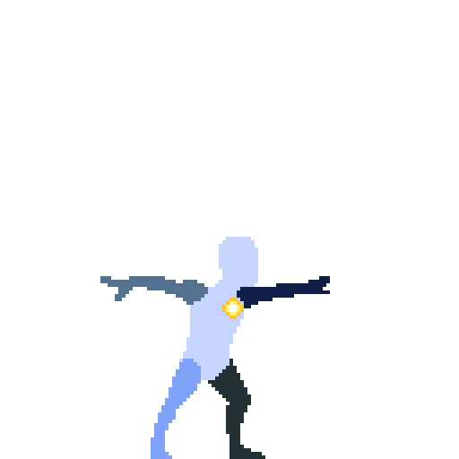
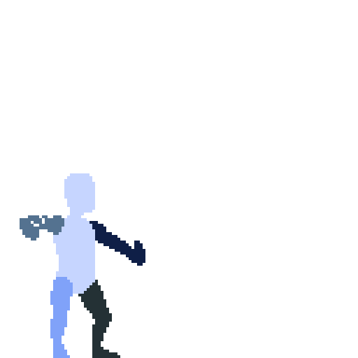
X → X → CAST → X → X
POSITION
1
2
3
4
5
COMBAT
X
X
CAST
X
X
R2
HOLD
RELEASE
MAGIC IS PART OF THE COMBO
PREPARE UNDERNEATH → WEAVE BACK IN
5
Notes:
v0.3 §5 — MULTITASKING — MAGIC ENTERS THE COMBO
Rehearsal budget 80 seconds.
PAGE SHOWN: And when I release, Cast can take the place of an X inside the chain.
CLICK 1: So Casting isn’t a separate ‘cast magic’ action sitting beside melee.
CLICK 2: I prepare Magic underneath the fight, then weave it directly back into the combo.
[Sources]
Approved content: user v0.3 attachment, section 5.
Current main-checkout docs/GAME_DESIGN.md: Six-Slot Chain.
Craftpix prototype sprite cells: current Laema assets/prototype/player/animation; assets/README.md. Project presentation use.

Slide 6
ONE FIGHT. TWO THINGS TO TRACK.
THE FIGHT DOESN’T WAIT
MAGIC READY
COMBAT OPENING
1
1
2
2
3
3
4
4
5
POSITION
5
POSITION
X
X
X
X
X
X
?
CAST
X
COMBAT
X
COMBAT
R2
R2
HOLD
HOLD
RELEASE
CHARGE
MAGIC READY + COMBAT OPENING
Schematic sequence; stored orbs available
6
Notes:
v0.3 §6 — MULTITASKING — WORKED EXAMPLE
Rehearsal budget 140 seconds.
PAGE SHOWN: Now let’s look at what this actually asks from the player.
CLICK 1: The fight is continuing while the spell I want is still charging underneath it.
CLICK 2: I still have to read the enemy and decide whether to attack, defend, evade, or reposition.
CLICK 3: Then the Magic reaches the state I want.
CLICK 4: Now I also need the fight to give me the right opportunity to use it.
CLICK 5: When those two things line up, I release and weave the Cast into the chain.
CLICK 6: The skill is getting my spell preparation and the combat situation to line up.
[Sources]
Approved content: user v0.3 attachment, section 6.
Current main-checkout docs/GAME_DESIGN.md: Six-Slot Chain; R2 Pressure and Charging; Empowered Cast.
Craftpix prototype sprite cells: current Laema assets/prototype/player/animation; assets/README.md. Project presentation use.

Slide 7
WHAT IF I’M ABOUT TO OVERCHARGE?
EASE OFF R2
INTERMEDIATE HOLD
F
F
F
F
FULL HOLD
Partial fourth charge
0.3 s hold
then depletion
KEEP FIGHTING
WAIT FOR THE OPENING
Explanatory snapshots • overcharge = exceeding the intended count
7
Notes:
v0.3 §7 — MULTITASKING — SKILLED CHARGE CONTROL
Rehearsal budget 120 seconds.
PAGE SHOWN: But a skilled player may not always want the charge to keep advancing.
CLICK 1: Suppose I want this Cast at three charged orbs, but the next orb is about to finish.
CLICK 2: I can ease off full pressure to briefly catch the charge before I overshoot.
CLICK 3: And I’m still managing the enemy while I do it.
CLICK 4: That gives me a brief opportunity to preserve the spell I want until the fight gives me the right moment.
[Sources]
Approved content: user v0.3 attachment, section 7.
Current main-checkout docs/GAME_DESIGN.md: R2 Pressure and Charging.
Craftpix prototype sprite cells: current Laema assets/prototype/player/animation; assets/README.md. Project presentation use.

Slide 8
SAME SYSTEM. MORE MASTERY.
BEGINNER
Hold → Charge → Release
INTERMEDIATE
Charge while fighting → Weave Cast into combo
SKILLED
Control the charge → Wait for the opening
DEPTH FROM THE SAME INPUT
FIGHTER + MAGE, AT THE SAME TIME
8
Notes:
v0.3 §8 — MULTITASKING — MASTERY PROGRESSION
Rehearsal budget 85 seconds.
PAGE SHOWN: And the same controls support different levels of mastery.
CLICK 1: At first, I can simply generate some orbs, hold R2 until they’re ready, and release.
CLICK 2: As I improve, I keep charging underneath normal combat and weave the Cast directly into my chain.
CLICK 3: At higher skill, I can control the charge itself while I’m still managing the fight.
CLICK 4: The system gets deeper without asking the player to learn another set of buttons.
CLICK 5: The player isn’t alternating between being a fighter and a mage—they’re learning to do both at once.
[Sources]
Approved content: user v0.3 attachment, section 8.
Current main-checkout docs/GAME_DESIGN.md: R2 Pressure and Charging; Six-Slot Chain.
Craftpix prototype sprite cells: current Laema assets/prototype/player/animation; assets/README.md. Project presentation use.

Slide 9
HEAT = MOMENTUM
F
W
CAST
HEAT
MORE HEAT → FASTER COMBAT
Attack ↑
Cast ↑
Charge ↑
Duration: baseline / higher Heat
MAGIC FUELS THE MOMENTUM
STAY IN THE ZONE
9
Notes:
v0.3 §9 — HEAT
Rehearsal budget 80 seconds.
PAGE SHOWN: Casting consumes charged orbs, and spending those orbs builds Heat.
CLICK 1: More Heat means faster attacks, faster Casting, and faster Charging.
CLICK 2: So using Magic accelerates the whole combat system instead of letting the player settle into melee-only play.
CLICK 3: Heat is there to build momentum and keep the player in the zone.
[Sources]
Approved content: user v0.3 attachment, section 9.
Current main-checkout docs/GAME_DESIGN.md: Health, Impact, and Heat.
Craftpix prototype sprite cells: current Laema assets/prototype/player/animation; assets/README.md. Project presentation use.

Slide 10
MIGHT + MAGIC
IT IS A
MIGHT & MAGIC
SYSTEM.
MIGHT CREATES MAGIC
PREPARE WHILE FIGHTING
WEAVE INTO THE COMBO
MAGIC BUILDS HEAT
ONE CONTINUOUS SKILL
10
Notes:
v0.3 §10 — COMBAT CONCLUSION
Rehearsal budget 80 seconds.
PAGE SHOWN: Everything we’ve seen comes back to one relationship.
CLICK 1: Physical combat creates the resources for Magic.
CLICK 2: Magic is prepared underneath ordinary combat.
CLICK 3: The Cast goes directly back into the chain.
CLICK 4: And using Magic creates the momentum that accelerates the whole loop.
CLICK 5: So the player isn’t mastering Might and Magic separately—they’re learning to use them as one continuous combat skill.
CLICK 6: It is a Might & Magic system.
[Sources]
Approved content: user v0.3 attachment, section 10.
Current main-checkout docs/GAME_DESIGN.md: Overview; Health, Impact, and Heat.
Craftpix prototype sprite cells: current Laema assets/prototype/player/animation; assets/README.md. Project presentation use.

Slide 11
WHAT KIND OF GAME
DESERVES THIS TOY?
11
Notes:
v0.3 §11 — BRIDGE
Rehearsal budget 15 seconds.
PAGE SHOWN: What kind of game deserves this toy?
[Sources]
Approved content: user v0.3 attachment, section 11.
Craftpix prototype sprite cells: current Laema assets/prototype/player/animation; assets/README.md. Project presentation use.

Slide 12
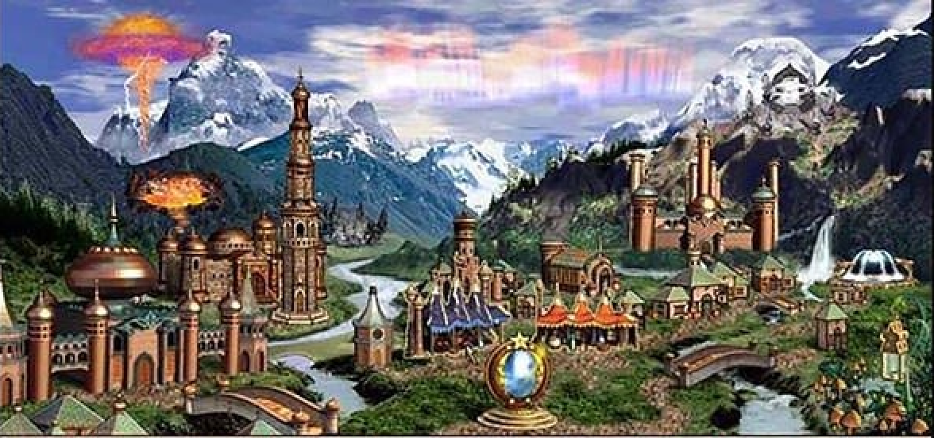
LIVE IN A HEROES TOWN
STRATEGY VIEW → GROUND LEVEL
LOOKING DOWN
LIVING WITHIN
Heroes III town reference • proposed change of perspective
12
Notes:
v0.3 §12 — GROUND-ZERO FANTASY
Rehearsal budget 40 seconds.
PAGE SHOWN: I’ve always wanted to walk into an actual Heroes of Might & Magic town and live there.
CLICK 1: Instead of only looking down at that world, I want to experience it from inside.
[Sources]
Approved content: user v0.3 attachment, section 12.
Wider-game presentation intent. Not a claim of implemented environments or franchise approval.
Craftpix prototype sprite cells: current Laema assets/prototype/player/animation; assets/README.md. Project presentation use.
Heroes III town screenshot sourced by Art from Ubisoft product media: https://staticctf.ubisoft.com/J3yJr34U2pZ2Ieem48Dwy9uqj5PNUQTn/2MRalCw0pfjYWmUlnebDll/2044a8ddf09ce544463740775f225b86/575ffd9ba3be1633568b4d8c-1.jpg . This is a Conflux town reference, not Mirham, Cloudfire, or Laema gameplay. Town scenery cropped mechanically from supplied screenshot; source retained.

Slide 13
LIVE THERE. WATCH IT GROW.
BUILD IT
OVER TIME
SEE THE PROGRESS
WHEN YOU RETURN
Heroes III town reference • town growth is proposed game direction
13
Notes:
v0.3 §13 — TOWN
Rehearsal budget 55 seconds.
PAGE SHOWN: And I want the town-building fantasy to come with me.
CLICK 1: Like classic Heroes, the town develops building by building.
CLICK 2: But now construction takes time, and every return lets you see that progress physically in the settlement.
[Sources]
Approved content: user v0.3 attachment, section 13.
Wider-game presentation intent. Not a claim of implemented environments or franchise approval.
Craftpix prototype sprite cells: current Laema assets/prototype/player/animation; assets/README.md. Project presentation use.
Heroes III town screenshot sourced by Art from Ubisoft product media: https://staticctf.ubisoft.com/J3yJr34U2pZ2Ieem48Dwy9uqj5PNUQTn/2MRalCw0pfjYWmUlnebDll/2044a8ddf09ce544463740775f225b86/575ffd9ba3be1633568b4d8c-1.jpg . This is a Conflux town reference, not Mirham, Cloudfire, or Laema gameplay. Town scenery cropped mechanically from supplied screenshot; source retained.

Slide 14
A LOCAL MYSTERY
THE TRAIL LEADS OUTWARD
A FAMILIAR
HISTORICAL CONSEQUENCE
The poison that will kill
King Nicolas Gryphonheart
Close to home
Heroes III town reference • proposed narrative
14
Notes:
v0.3 §14 — NARRATIVE NATURALLY PULLS THE PLAYER OUTWARD
Rehearsal budget 40 seconds.
PAGE SHOWN: The story begins close to home, with suspicious activity the protagonist starts investigating.
CLICK 1: As that investigation grows, it naturally takes the player beyond the town.
CLICK 2: Eventually, that trail connects to the poison that will kill King Nicolas Gryphonheart.
[Sources]
Approved content: user v0.3 attachment, section 14.
Wider-game presentation intent. Not a claim of implemented environments or franchise approval.
Craftpix prototype sprite cells: current Laema assets/prototype/player/animation; assets/README.md. Project presentation use.
Heroes III town screenshot sourced by Art from Ubisoft product media: https://staticctf.ubisoft.com/J3yJr34U2pZ2Ieem48Dwy9uqj5PNUQTn/2MRalCw0pfjYWmUlnebDll/2044a8ddf09ce544463740775f225b86/575ffd9ba3be1633568b4d8c-1.jpg . This is a Conflux town reference, not Mirham, Cloudfire, or Laema gameplay. Town scenery cropped mechanically from supplied screenshot; source retained.

Slide 15
EXPLORE THE HEROES WORLD
ADVENTURE-MAP POIs
→ REAL PLACES
Point of interest
Place to explore
SAME WORLD. NEW PERSPECTIVE.
INVESTIGATION DRIVES EXPLORATION
Schematic relationship • Heroes III town reference
15
Notes:
v0.3 §15 — WORLD / EXPLORATION
Rehearsal budget 45 seconds.
PAGE SHOWN: That investigation gives the player a reason to move through the wider Heroes world.
CLICK 1: The familiar points of interest from Heroes III become actual places the player travels to and explores.
CLICK 2: Places we once interacted with from the strategy map are now experienced from ground level.
CLICK 3: The story gives the player a reason to visit them rather than using them only as nostalgia.
[Sources]
Approved content: user v0.3 attachment, section 15.
Wider-game presentation intent. Not a claim of implemented environments or franchise approval.
Craftpix prototype sprite cells: current Laema assets/prototype/player/animation; assets/README.md. Project presentation use.
Heroes III town screenshot sourced by Art from Ubisoft product media: https://staticctf.ubisoft.com/J3yJr34U2pZ2Ieem48Dwy9uqj5PNUQTn/2MRalCw0pfjYWmUlnebDll/2044a8ddf09ce544463740775f225b86/575ffd9ba3be1633568b4d8c-1.jpg . This is a Conflux town reference, not Mirham, Cloudfire, or Laema gameplay. Town scenery cropped mechanically from supplied screenshot; source retained.

Slide 16
THE STORY BEHIND THE RUINS
LATER...
THE NEARBY
CITY FALLS
SURVIVORS
RETREAT HOME
FINAL DEFENCE:
THE TOWN
HEROES III
BEGINS
THE RUINED
CITY
Nearby city
Retreat
Home town
The Restoration of Erathia
16
Notes:
v0.3 §16 — HISTORICAL FRAMING
Rehearsal budget 75 seconds.
PAGE SHOWN: Eventually, this local story collides with the larger catastrophe that begins Heroes III.
CLICK 1: The invasion reaches the nearby city, which becomes our second-to-last major battle.
CLICK 2: The survivors fall back toward the town we’ve lived in and watched grow.
CLICK 3: That town becomes the final battlefield.
CLICK 4: Only afterward does the original Heroes III opening take place at the ruined city.
CLICK 5: That is where our story hands the timeline back to The Restoration of Erathia.
[Sources]
Approved content: user v0.3 attachment, section 16.
Wider-game presentation intent. Not a claim of implemented environments or franchise approval.
Craftpix prototype sprite cells: current Laema assets/prototype/player/animation; assets/README.md. Project presentation use.
Heroes III town screenshot sourced by Art from Ubisoft product media: https://staticctf.ubisoft.com/J3yJr34U2pZ2Ieem48Dwy9uqj5PNUQTn/2MRalCw0pfjYWmUlnebDll/2044a8ddf09ce544463740775f225b86/575ffd9ba3be1633568b4d8c-1.jpg . This is a Conflux town reference, not Mirham, Cloudfire, or Laema gameplay. Town scenery cropped mechanically from supplied screenshot; source retained.

Slide 17
LAEMA
MASTER MIGHT & MAGIC
AS ONE COMBAT SYSTEM
LIVE INSIDE A HEROES WORLD
17
Notes:
v0.3 §17 — PITCH CONCLUSION
Rehearsal budget 30 seconds.
PAGE SHOWN: Laema brings together two things I want from a Might & Magic game.
CLICK 1: First, a toy where physical combat and Magic are designed to be mastered together.
CLICK 2: Second, a world where I can live inside a Heroes town, watch it grow, and explore the places I used to see on the adventure map.
FINAL LINE (no click): That is Laema.
[Sources]
Approved content: user v0.3 attachment, section 17.
Wider-game presentation intent. Not a claim of implemented environments or franchise approval.
Craftpix prototype sprite cells: current Laema assets/prototype/player/animation; assets/README.md. Project presentation use.
Heroes III town screenshot sourced by Art from Ubisoft product media: https://staticctf.ubisoft.com/J3yJr34U2pZ2Ieem48Dwy9uqj5PNUQTn/2MRalCw0pfjYWmUlnebDll/2044a8ddf09ce544463740775f225b86/575ffd9ba3be1633568b4d8c-1.jpg . This is a Conflux town reference, not Mirham, Cloudfire, or Laema gameplay. Town scenery cropped mechanically from supplied screenshot; source retained.

