Slide 1

01
LAEMA
A SINGLE-PLAYER ACTION RPG
IN THE HEROES OF MIGHT & MAGIC UNIVERSE
SAME WORLD. A NEW PERSPECTIVE.
Notes:
Beat 1
A SINGLE-PLAYER ACTION RPG
IN THE HEROES OF MIGHT & MAGIC UNIVERSE
SAME WORLD. A NEW PERSPECTIVE.

Slide 2
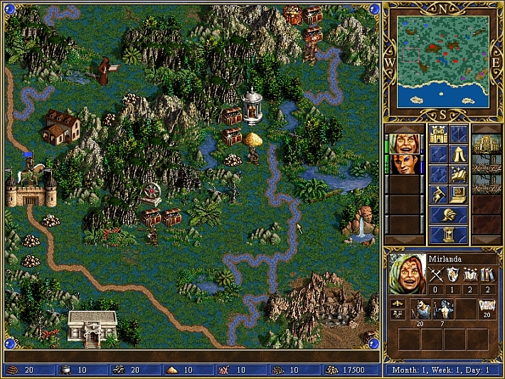


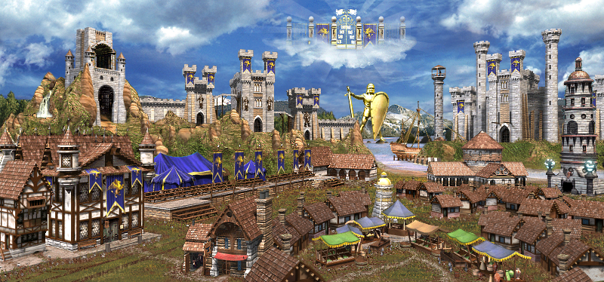
A WORLD I'VE KNOWN FROM ABOVE
02
HEROES III · SOURCE
LAEMA · CONCEPT
WHAT'S IT LIKE DOWN THERE?
TOWNS
HEROES
CREATURES
Notes:
Beat 1
TOWNS · HEROES · CREATURES
FROM THE STRATEGY LAYER
Beat 2
WHAT'S IT LIKE DOWN THERE?
Original Heroes III source audit: https://github.com/czhou2822/Laema/blob/8043baf7e2096381817897c849133eedf5c9543e/docs/presentation/decks/laema-html-draft/assets/AUTHENTIC-SOURCES.md

Slide 3
LAEMA'S ANSWER
03
A LIVING TOWN
A COMBAT TOY
PEOPLE · NEEDS · CONTRIBUTION
LEARN · MANAGE · MASTER
Notes:
Beat 1
A LIVING TOWN
PEOPLE · NEEDS · CONTRIBUTION
Beat 2
A COMBAT TOY
LEARN · MANAGE · MASTER

Slide 4

FROM TOWN SCREEN → REAL PLACE
04
THE MARKET
BECOMES A PLACE
THE BLACKSMITH
BECOMES A PERSON
THE STREETS
CONNECT IT ALL
Notes:
Beat 1
THE MARKET BECOMES A PLACE
Beat 2
THE BLACKSMITH BECOMES A PERSON
Beat 3
THE STREETS CONNECT IT ALL

Slide 5


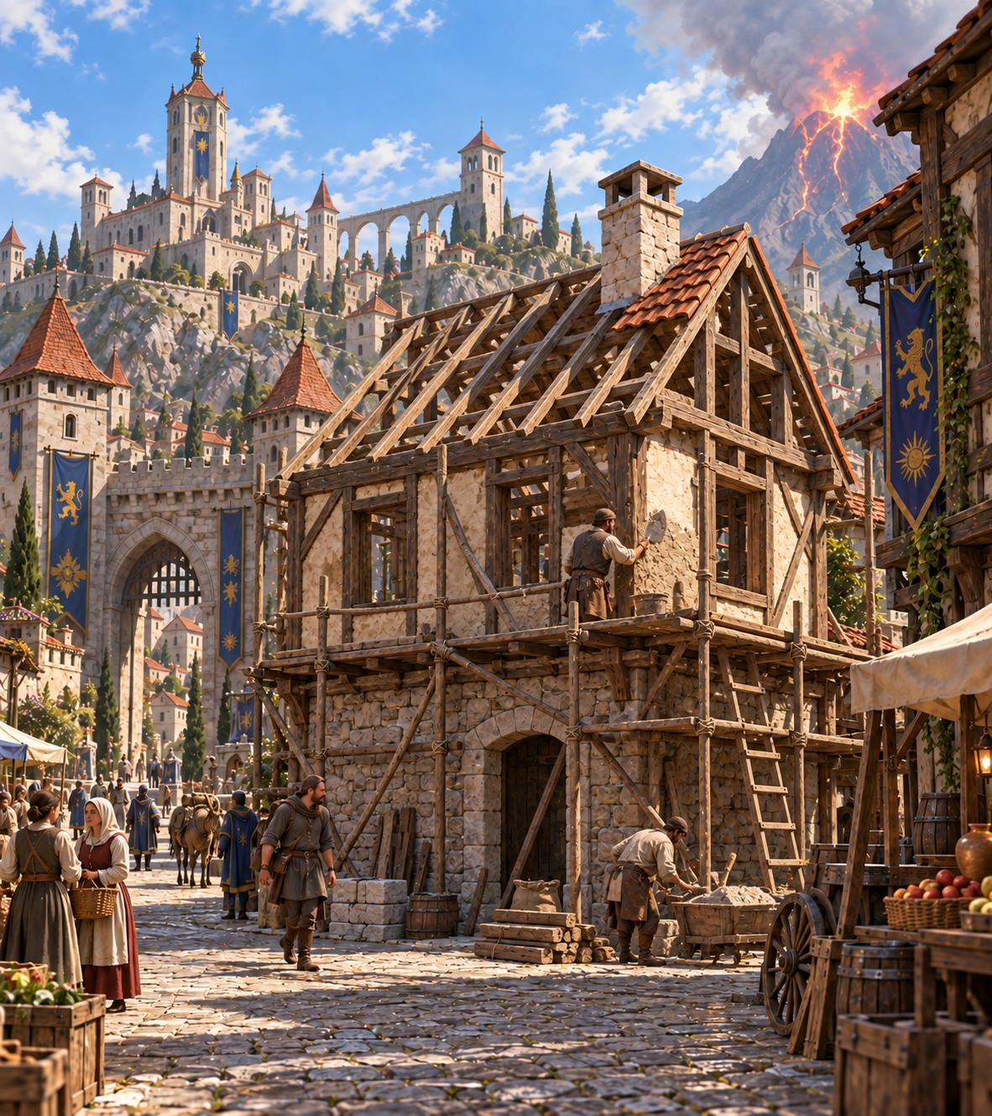

CONTRIBUTION → CONSTRUCTION → CHANGE
05
→
→
→
THE TOWN NEEDS
A BUILDING
I BRING
THE RESOURCES
CONSTRUCTION
TAKES TIME
MY CONTRIBUTION
BECOMES VISIBLE
FOUNDATION → UNDER CONSTRUCTION → FINISHED
Notes:
Beat 1
THE TOWN NEEDS A BUILDING
Beat 2
I BRING THE RESOURCES
Beat 3
CONSTRUCTION TAKES TIME
Beat 4
MY CONTRIBUTION BECOMES VISIBLE

Slide 6

FROM UNIT → CREATURE
06
LAEMA · GRIFFIN CONCEPT
HEROES III · GRIFFIN
→
LITTLE UNITS AND
ATTACK ANIMATIONS
PART OF THE WORLD
Notes:
Beat 1
FROM UNIT → CREATURE
LITTLE UNITS AND ATTACK ANIMATIONS
Beat 2
WHAT IS IT LIKE UP CLOSE?
Beat 3
FACE IT MYSELF
Beat 4
PART OF THE WORLD
Original Heroes III source audit: https://github.com/czhou2822/Laema/blob/8043baf7e2096381817897c849133eedf5c9543e/docs/presentation/decks/laema-html-draft/assets/AUTHENTIC-SOURCES.md

Slide 7
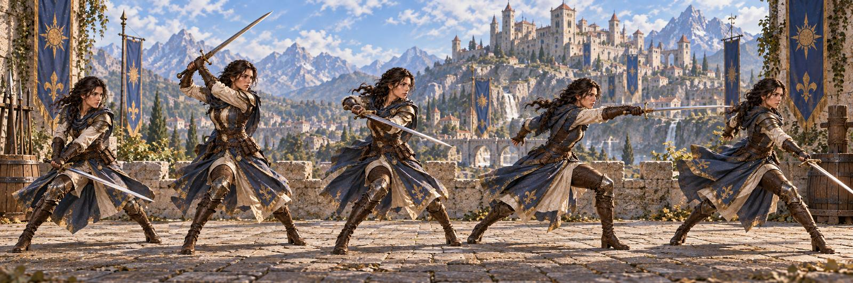
ATTACK CHAIN
07
X1
X2
X3
X4
X5
DELIBERATELY SIMPLE
Notes:
Beat 1
SOMETHING FAMILIAR
Beat 2
A FIVE-HIT MELEE CHAIN
Beat 3
DELIBERATELY SIMPLE

Slide 8
ATTACKS CREATE ORBS
08
X1
X2
X3
X4
X5
FIVE HITS → FIVE ORBS
Notes:
Beat 1
LANDED HIT → ORB
Beat 2
FIVE HITS → FIVE ORBS

Slide 9
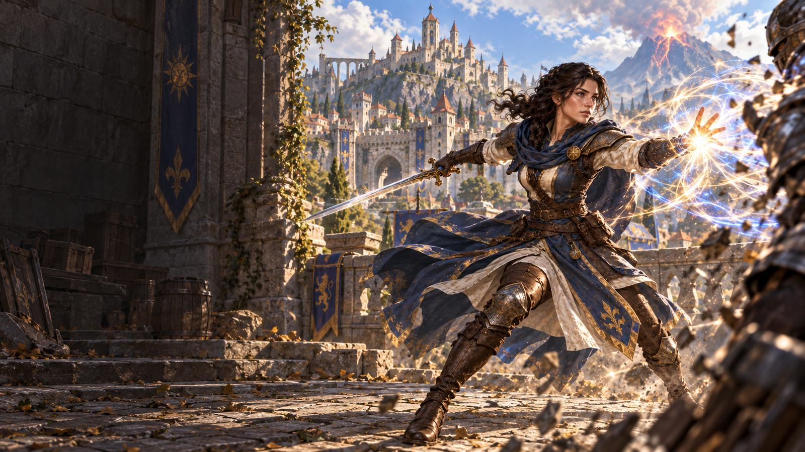
ORBS BECOME MAGIC
09
R2
→
CAST PREPARATION
HOLD
R2
RELEASE
RELEASE R2 TO CAST
Notes:
Beat 1
ORBS FEED THE CAST
Beat 2
HOLD R2 TO CHARGE
Beat 3
RELEASE R2 TO CAST

Slide 10
THE OBVIOUS WAY TO PLAY
10
FIGHT
PREPARE
CAST
R2
→
→
HOLD
X1
X2
X3
X4
X5
R2 RELEASE
Notes:
Beat 1
FIGHT
Beat 2
PREPARE
Beat 3
CAST

Slide 11
SIMPLE INPUTS. PARALLEL DECISIONS.
11
FIGHT
X1
X2
X3
X4
X5
R2
→
R2
PREPARE
HOLD
RELEASE
TWO THINGS TO MANAGE AT ONCE
Notes:
Beat 1
SIMPLE INPUTS.
PARALLEL DECISIONS.
Beat 2
FIGHT and PREPARE coexist
Beat 3
TWO THINGS TO MANAGE AT ONCE

Slide 12
THE CHALLENGE MOVES
FROM INPUTS TO ATTENTION
12
ONE COMMON WAY TO ADD DEPTH
LAEMA'S APPROACH
X → X → Y → ↓ + X → Y
X R2
SIMPLE COMMANDS
LESS INPUT COMPLEXITY
→
MORE ATTENTION MANAGEMENT
Notes:
Beat 1
ONE COMMON WAY TO ADD DEPTH
MORE TO EXECUTE IN SEQUENCE
Beat 2
LAEMA'S APPROACH
SIMPLE COMMANDS
Beat 3
LESS INPUT COMPLEXITY → MORE ATTENTION MANAGEMENT

Slide 13
WHY MULTITASKING FEELS DIFFERENT
13
⚔
◉
⛨
↻
NORMAL
COMBAT
ATTACK
READ ENEMY
DEFEND / AVOID
RE-ENGAGE
R2
SPELL STAYS ALIVE
R2
CAST
PREPARATION
HOLD
RELEASE
YOU ARE NOT PERFORMING A HARDER COMBO.
YOU ARE MAINTAINING A SECOND OFFENSIVE LAYER WHILE FIGHTING NORMALLY.
Notes:
Beat 1
KEEP FIGHTING
Beat 2
THE ENEMY STILL DEMANDS A REACTION
Beat 3
BUT THE CAST IS STILL THERE
Beat 4
YOU ARE NOT PERFORMING A HARDER COMBO.
YOU ARE MAINTAINING A SECOND OFFENSIVE LAYER WHILE FIGHTING NORMALLY.

Slide 14
14
I KEPT BOTH
UNDER CONTROL.
A TOY AT HEART
Notes:
Beat 1
A CAST WELL EARNED
Beat 2
THE FIGHT NEVER STOPPED.
THE CAST STAYED ALIVE.
Beat 3
I KEPT BOTH
UNDER CONTROL.
Beat 4
A TOY AT HEART

Slide 15
WEAVE MAGIC INTO THE COMBO
15
X1
X2
CAST
X4
X5
WEAVE MAGIC INTO THE COMBO
Notes:
Beat 1
CAST IS A COMBO INPUT
Beat 2
THE CHAIN CONTINUES
Beat 3
WEAVE MAGIC INTO THE COMBO

Slide 16
FOUR SCHOOLS
16
♨
◇
≋
△
FIRE
WATER
AIR
EARTH
SPELL + MOVES
HEAVY · SLOW · POWERFUL
↔
FAST · LIGHT
FIRE EARTH WATER AIR
CONCEPTUAL SPECTRUM · SCHOOL POSITIONS ARE PROVISIONAL
AFFECTS BOTH SPELLS AND MOVES
Notes:
Beat 1
FOUR SCHOOLS
Beat 2
AFFECTS BOTH SPELLS AND MOVES

Slide 17
SWITCH MID-CHAIN
17
SWITCH
X1
X2
X3
X4
X5
FIRE
FIRE
AIR
AIR
AIR
F
F
A
A
A
SAME CHAIN.
DIFFERENT FIGHTING STYLE.
Notes:
Beat 1
SWITCH MID-CHAIN
Beat 2
THE SWITCH COSTS NO COMBO POSITION
Beat 3
SAME CHAIN.
DIFFERENT FIGHTING STYLE.

Slide 18
THE ATTACKS WRITE THE SPELL
18
F
F
A
A
A
↓
5 ORBS
AIR Lv.5
+ FIRE Lv.2
ATTACK NOW.
SHAPE THE NEXT CAST.
Notes:
Beat 1
THE SAME ATTACKS BECOME THE CAST
Beat 2
LAST ORB → PRIMARY SCHOOL
Beat 3
ALL ORBS → PRIMARY LEVEL
Beat 4
SECOND SCHOOL → SECONDARY LAYER
Beat 5
ATTACK NOW.
SHAPE THE NEXT CAST.
Last orb selects primary school. Total consumed orbs select its level. Strongest remaining school supplies the secondary layer. F F A A A → AIR Lv.5 + FIRE Lv.2.

Slide 19
CASTING BUILDS HEAT
19
AIR Lv.5 + FIRE Lv.2
R2 RELEASE
CAST
↓
HEAT ↑
SPEND ORBS
→ BUILD HEAT
Notes:
Beat 1
CAST SPENDS THE ORBS
Beat 2
SPEND ORBS → BUILD HEAT

Slide 20
HEAT MAKES COMBAT FASTER
20
TIME →
ATTACK FASTER
LOW HEAT
X1 X2 X3 X4 X5
LATER
HIGH HEAT
X1 X2 X3 X4 X5
SOONER
CAST FASTER
LOW HEAT
R2 RELEASE
CAST
LATER
HIGH HEAT
R2 RELEASE
CAST
SOONER
CHARGE FASTER
LOW HEAT
R2 HOLD
CHARGED
LATER
HIGH HEAT
R2 HOLD
CHARGED
SOONER
SAME START · SAME ENDPOINT · EARLIER ARRIVAL
Notes:
Beat 1
ATTACK FASTER
Beat 2
CAST FASTER
Beat 3
CHARGE FASTER
Low and high Heat share the same start and action endpoint. Only arrival time changes.

Slide 21
STAY IN THE ZONE
21
ATTACK
GENERATE ORBS
→
↑
STAY IN
THE ZONE.
FASTER COMBAT
CAST
ATTACK FASTER
CAST FASTER
CHARGE FASTER
SPEND ORBS
HEAT ↑
←
Notes:
Beat 1
ATTACK
GENERATE ORBS
Beat 2
CAST
SPEND ORBS
HEAT ↑
Beat 3
FASTER COMBAT
ATTACK FASTER · CAST FASTER · CHARGE FASTER
Beat 4
STAY IN THE ZONE.

Slide 22

SPELLS ARE COLLECTIBLES
22
BUILD YOUR LOADOUT
OUTSIDE COMBAT · SCHOOL + LEVEL
F
F
A
A
A
SCHOOL | Lv.1 | Lv.2 | Lv.3 | Lv.4 | Lv.5
FIRE | ◇ | ◇ | ◇ | ◇ | ◇
WATER | ◇ | ◇ | ◇ | ◇ | ◇
AIR | ◇ | ◇ | ◇ | ◇ | ◇
EARTH | ◇ | ◇ | ◇ | ◇ | ◇
↓
AIR Lv.5
+ FIRE Lv.2
→
TEACHING MODEL · COLLECTION SIZE NOT DEFINED
TEST YOUR LOADOUT DURING COMBAT
Notes:
Beat 1
FIND THEM IN THE WORLD
Beat 2
BUILD YOUR LOADOUT
Beat 3
TEST YOUR LOADOUT DURING COMBAT
Collected spells are configured outside combat in school-and-level slots. This 4 × 5 table is a teaching model.

Slide 23
SAME CONTROLS.
MORE POSSIBILITIES.
23
SAME SIMPLE INPUTS
THE COMPLEXITY
MOVES INTO ATTENTION.
X R2
HOLD → RELEASE
Notes:
Beat 1
MORE POSSIBILITIES.
Beat 2
NOT MORE TO EXECUTE.
MORE TO MANAGE.
Beat 3
THE COMPLEXITY
MOVES INTO ATTENTION.

Slide 24
THE TOWN SENDS ME OUT
24
HOME HAS A NEED
HOME CHANGES
GO OUT
NEW BUILDING · NEW PEOPLE
NEW POSSIBILITIES
EXPLORE · FIGHT · DISCOVER
MIRHAM
HOME
BRING IT HOME
RESOURCE · DISCOVERY · QUEST RESULT
HOME CHANGES.
Notes:
Beat 1
HOME HAS A NEED.
Beat 2
GO OUT.
Beat 3
BRING IT HOME.
Beat 4
HOME CHANGES.

Slide 25




FROM MAP ICON → REAL PLACE
25
LAEMA · CONCEPT
HEROES III · SOURCE
→
FROM MAP ICON
→ REAL PLACE.
MILL / FIELDS
TOWER
RUIN
CAVE
FAMILIAR FROM ABOVE.
NEW FROM THE GROUND.
Notes:
Beat 1
THE MAP IS ALREADY FULL
OF FAMILIAR PLACES.
Beat 2
FROM MAP ICON
→ REAL PLACE.
Original Heroes III source audit: https://github.com/czhou2822/Laema/blob/8043baf7e2096381817897c849133eedf5c9543e/docs/presentation/decks/laema-html-draft/assets/AUTHENTIC-SOURCES.md

Slide 26
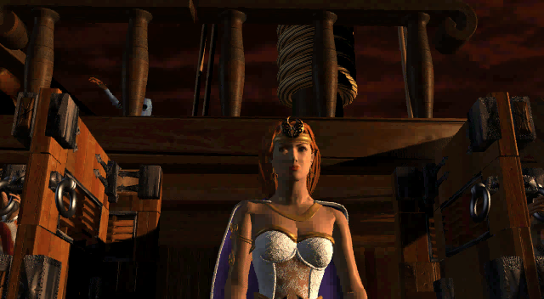
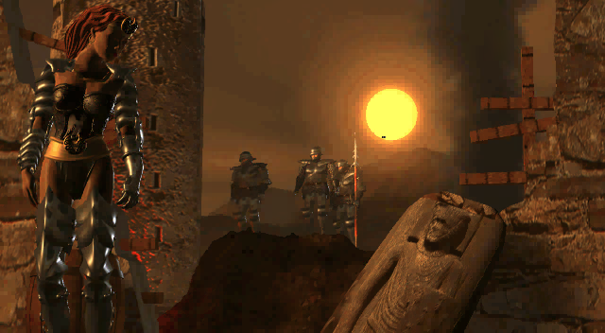
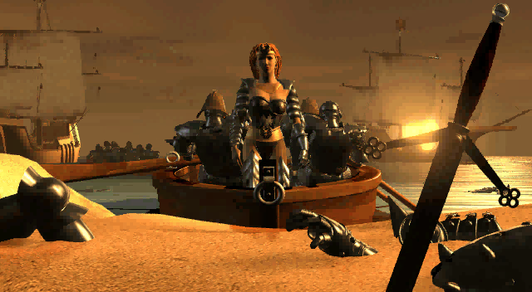
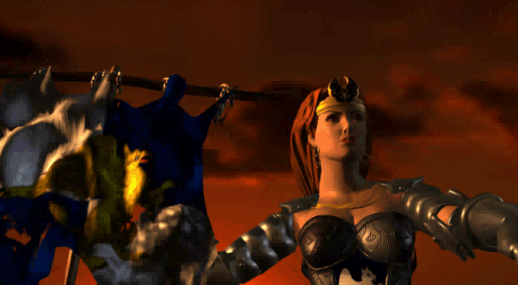
THE OPENING PLAYERS ALREADY KNOW
26
HEROES III · SOURCE
01
02
HEROES III — AFTERMATH
WE ARRIVE
AFTER IT HAPPENED.
04
Notes:
Beat 1
THIS IS WHERE
HEROES III BEGINS.
Beat 2
WE ARRIVE
AFTER IT HAPPENED.
Original Heroes III source audit: https://github.com/czhou2822/Laema/blob/8043baf7e2096381817897c849133eedf5c9543e/docs/presentation/decks/laema-html-draft/assets/AUTHENTIC-SOURCES.md
Opening source timestamps: 00:17.998 Catherine aboard ship; 00:31.997 landing; 00:49.995 Cloudfire aftermath; 02:30.052 Catherine and banner. The full film is not part of the main pitch.

Slide 27

NOW YOU LIVE THROUGH IT
27
CLOUDFIRE FALLS · LAEMA CONCEPT
FALLEN KING
→ COLLAPSED KINGDOM
HEROES III · SOURCE
THE OPENING CG
BECOMES A MEMORY.
Notes:
Beat 1
LAEMA IS LOCAL.
Beat 2
THE STORY STARTS
WITH SOMETHING SMALL.
Beat 3
THE SAME POISON
LATER KILLS THE KING.
Beat 4
FALLEN KING
→ COLLAPSED KINGDOM
Original Heroes III source audit: https://github.com/czhou2822/Laema/blob/8043baf7e2096381817897c849133eedf5c9543e/docs/presentation/decks/laema-html-draft/assets/AUTHENTIC-SOURCES.md

Slide 28

THE LAST STAND IS AT HOME
28
MIRHAM · LAEMA CONCEPT
THE FINAL BATTLE
IS AT HOME.
Notes:
Beat 1
THE WAR REACHES HOME.
Beat 2
THE TOWN I BUILT
BECOMES THE TOWN I DEFEND.
Beat 3
THE FINAL BATTLE
IS AT HOME.
Original Heroes III source audit: https://github.com/czhou2822/Laema/blob/8043baf7e2096381817897c849133eedf5c9543e/docs/presentation/decks/laema-html-draft/assets/AUTHENTIC-SOURCES.md

Slide 29

THE KNOWN STORY TAKES OVER
29
CATHERINE · HEROES III SOURCE
LAEMA · CONCEPT
CLOUDFIRE
HEROES III OPENING
SAME HISTORY.
GROUND-LEVEL POINT OF VIEW.
Notes:
Beat 1
OUR STORY ENDS
AT THE OPENING.
Beat 2
FOR CATHERINE,
THIS IS THE BEGINNING.
Beat 3
SAME HISTORY.
GROUND-LEVEL POINT OF VIEW.
Original Heroes III source audit: https://github.com/czhou2822/Laema/blob/8043baf7e2096381817897c849133eedf5c9543e/docs/presentation/decks/laema-html-draft/assets/AUTHENTIC-SOURCES.md

Slide 30
WHO IS THIS FOR?
30
MIGHT & MAGIC
HEROES
LAEMA
→
→
RPG
STRATEGY
ACTION RPG
A MODERN ACTION-RPG VIEW
OF MIGHT & MAGIC.
PREMIUM SINGLE-PLAYER ACTION RPG · ~20 HOURS · ONE-TIME PURCHASE
Notes:
Beat 1
FOR PLAYERS
WHO ALREADY KNOW THIS WORLD.
Beat 2
BUT YOU DON'T NEED
TO KNOW HEROES FIRST.
Beat 3
A MODERN ACTION-RPG VIEW
OF MIGHT & MAGIC.
Original Heroes III source audit: https://github.com/czhou2822/Laema/blob/8043baf7e2096381817897c849133eedf5c9543e/docs/presentation/decks/laema-html-draft/assets/AUTHENTIC-SOURCES.md

Slide 31
31
LAEMA
Q&A
SAME WORLD.
A NEW PERSPECTIVE.
Notes:
Q&A.
SAME WORLD. A NEW PERSPECTIVE.

