Slide 1
Data Analytics Demystified Know What and Know How

Slide 2

Why Data Analytics?

Slide 3
What is Data Analytics?
Actually, it is not as “高大上” as you might think.
Think it as “数学应用题” as we did in primary school.
It includes many sub-areas:
Data Mining
Machine Learning
Network Analysis
Optimization (Operations Research)
……

Slide 4
Predicting Car Prices

Slide 5
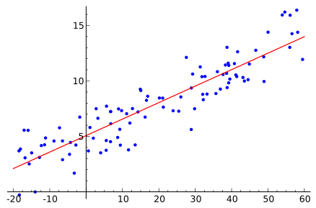
Linear Regression （线性回归）

Slide 6
Multiple Linear Regression Equation

Slide 7
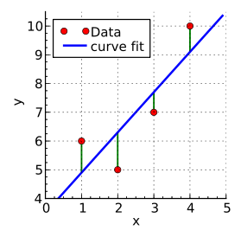
Ordinary Least Squares

Slide 8
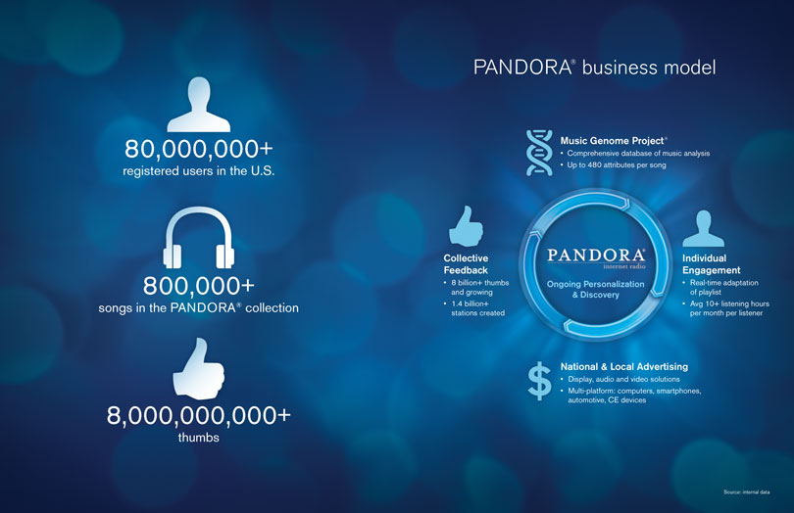
Pandora Media

Slide 9
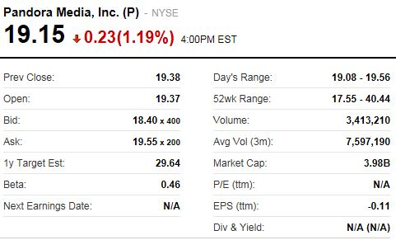
Pandora Media

Slide 10
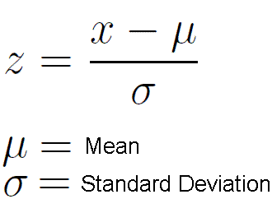
Review Some Simple Math
Euclidean Distance (欧几里得距离)
Centroid (几何中心 http://en.wikipedia.org/wiki/Centroid)
z-Score (z分数 http://en.wikipedia.org/wiki/Standard_score)

Slide 11
Clustering （聚类）
Company | Fixed | RoR | Cost | Load | Demand | Sales | Nuclear | Fuel Cost
Arizona Public Service | 1.06 | 9.2 | 151 | 54.4 | 1.6 | 9,077 | 0 | 0.628
Boston Edison Co. | 0.89 | 10.3 | 202 | 57.9 | 2.2 | 5,088 | 25.3 | 1.555
Central Louisiana Co. | 1.43 | 15.4 | 113 | 53 | 3.4 | 9,212 | 0 | 1.058
Commonwealth Edison Co. | 1.02 | 11.2 | 168 | 56 | 0.3 | 6,423 | 34.3 | 0.7
Consolidated Edison Co. (NY) | 1.49 | 8.8 | 192 | 51.2 | 1 | 3,300 | 15.6 | 2.044
Florida Power & Light Co. | 1.32 | 13.5 | 111 | 60 | −2.2 | 11,127 | 22.5 | 1.241
Hawaiian Electric Co. | 1.22 | 12.2 | 175 | 67.6 | 2.2 | 7,642 | 0 | 1.652
Idaho Power Co. | 1.1 | 9.2 | 245 | 57 | 3.3 | 13,082 | 0 | 0.309
Kentucky Utilities Co. | 1.34 | 13 | 168 | 60.4 | 7.2 | 8,406 | 0 | 0.862
Madison Gas & Electric Co. | 1.12 | 12.4 | 197 | 53 | 2.7 | 6,455 | 39.2 | 0.623
Nevada Power Co. | 0.75 | 7.5 | 173 | 51.5 | 6.5 | 17,441 | 0 | 0.768
New England Electric Co. | 1.13 | 10.9 | 178 | 62 | 3.7 | 6,154 | 0 | 1.897
Northern States Power Co. | 1.15 | 12.7 | 199 | 53.7 | 6.4 | 7,179 | 50.2 | 0.527
Oklahoma Gas & Electric Co. | 1.09 | 12 | 96 | 49.8 | 1.4 | 9,673 | 0 | 0.588
Pacific Gas & Electric Co. | 0.96 | 7.6 | 164 | 62.2 | −0.1 | 6,468 | 0.9 | 1.4
Puget Sound Power & Light Co. | 1.16 | 9.9 | 252 | 56 | 9.2 | 15,991 | 0 | 0.62
San Diego Gas & Electric Co. | 0.76 | 6.4 | 136 | 61.9 | 9 | 5,714 | 8.3 | 1.92
The Southern Co. | 1.05 | 12.6 | 150 | 56.7 | 2.7 | 10,140 | 0 | 1.108
Texas Utilities Co. | 1.16 | 11.7 | 104 | 54 | −2.1 | 13,507 | 0 | 0.636
Wisconsin Electric Power Co. | 1.2 | 11.8 | 148 | 59.9 | 3.5 | 7,287 | 41.1 | 0.702
United Illuminating Co. | 1.04 | 8.6 | 204 | 61 | 3.5 | 6,650 | 0 | 2.116
Virginia Electric & Power Co. | 1.07 | 9.3 | 174 | 54.3 | 5.9 | 10,093 | 26.6 | 1.306

Slide 12
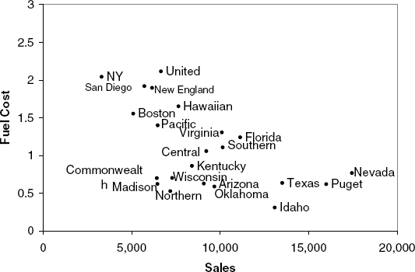
Clustering （聚类）

Slide 13
k-Means Clustering（k平均聚类算法）
With the five utilities and two measurements, let us assume that k = 2 and that the initial clusters are A = {Arizona, Boston} and B = {Central, Commonwealth, Consolidated}.
Each point’s Euclidian distances from Centroid A and B:
 | Distance from Centroid A | Distance from Centroid B
Arizona | 1.0052 | 1.3887
Boston | 1.0052 | 0.6216
Central | 0.6029 | 0.8995
Commonwealth | 0.7281 | 1.0207
Consolidated | 2.0172 | 1.6341

Slide 14
k-Nearest Neighbors （最邻近结点算法）
Household Number | Income ($000s) | Lot Size (000s ft²) | Ownership of Riding Mower
1 | 60.0 | 18.4 | Owner
2 | 85.5 | 16.8 | Owner
3 | 4.8 | 21.6 | Owner
4 | 61.5 | 20.8 | Owner
5 | 87.0 | 23.6 | Owner
6 | 110.1 | 19.2 | Owner
7 | 108.0 | 17.6 | Owner
8 | 82.8 | 22.4 | Owner
9 | 69.0 | 20.0 | Owner
10 | 93.0 | 20.8 | Owner
11 | 51.0 | 22.0 | Owner
12 | 81.0 | 20.0 | Owner
13 | 75.0 | 19.6 | Nonowner
14 | 52.8 | 20.8 | Nonowner
15 | 64.8 | 17.2 | Nonowner
16 | 43.2 | 20.4 | Nonowner
17 | 84.0 | 17.6 | Nonowner
18 | 49.2 | 17.6 | Nonowner
19 | 59.4 | 16.0 | Nonowner
20 | 66.0 | 18.4 | Nonowner
21 | 47.4 | 16.4 | Nonowner
22 | 33.0 | 18.8 | Nonowner
23 | 51.0 | 14.0 | Nonowner
24 | 63.0 | 14.8 | Nonowner

Slide 15
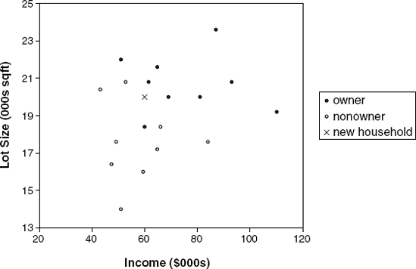
k-Nearest Neighbors （最邻近结点算法）

Slide 16
So, how does Pandora work?
1. Pandora has established hundreds of variables on which a song can be measured on a scale from 0 to 5. Four such variables from the beginning of the list are
Acid Rock Qualities
Accordion Playing
Acousti-Lectric Sonority
Acousti-Synthetic Sonority
2. Pandora pays musicians to analyze tens of thousands of songs and rate each song on each of these attributes. Each song will then be represented by a row vector of values between 0 and 5, for example, for Led Zeppelin's Kashmir:
Kashmir 4 0 3 3 ...(high on acid rock attributes, no accordion, etc.)
This step represents a costly investment and lies at the heart of Pandora's value because these variables have been tested and selected because they accurately reflect the essence of a song and provide a basis for defining highly individualized preferences.

Slide 17
So, how does Pandora work?
3. The online user specifies a song that he/she likes (the song must be in Pandora's database).
4. Pandora then calculates the statistical distance between the user's song and the songs in its database. It selects a song that is close to the user-specified song and plays it.
5. The user then has the option of saying "I like this song," "I don't like this song," or saying nothing.
6. If "like" is chosen, the original song, plus the new song are merged into a two-song cluster[] that is represented by a single vector, comprised means of the variables in the original two-song vectors.
7. If "don't like" is chosen, the vector of the song that is not liked is stored for future reference. (If the user does not express an opinion about the song, in our simplified example here the new song is not used for further comparisons.)
8. Pandora looks in its database for a new song, one whose statistical distance is close to the "like" song cluster[] and not too close to the "don't like" song. Depending on the user's reaction, this new song might be added to the "like" cluster or "don't like" cluster.

Slide 18
About The Music Genome Project
http://www.pandora.com/about/mgp
http://en.wikipedia.org/wiki/Music_Genome_Project
Each song in the Music Genome Project is analyzed using up to 450 distinct musical characteristics by a trained music analyst.
The typical music analyst working on the Music Genome Project has a four-year degree in music theory, composition or performance, has passed through a selective screening process and has completed intensive training in the Music Genome's rigorous and precise methodology.
The Music Genome Project's database is built using a methodology that includes the use of precisely defined terminology, a consistent frame of reference, redundant analysis, and ongoing quality control to ensure that data integrity remains reliably high.

Slide 19
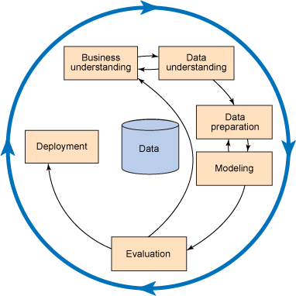
Data Mining Process: CRISP - DM
Cross Industry Standard Process for Data Mining

Slide 20
Netflix
To be continued…

Slide 21
Amazon Product Rating
To be continued…

Slide 22
Google PageRank
To be continued…

Slide 23
Now, you know some how!

