Slide 1
Mongo DB

Slide 2




Slide 3
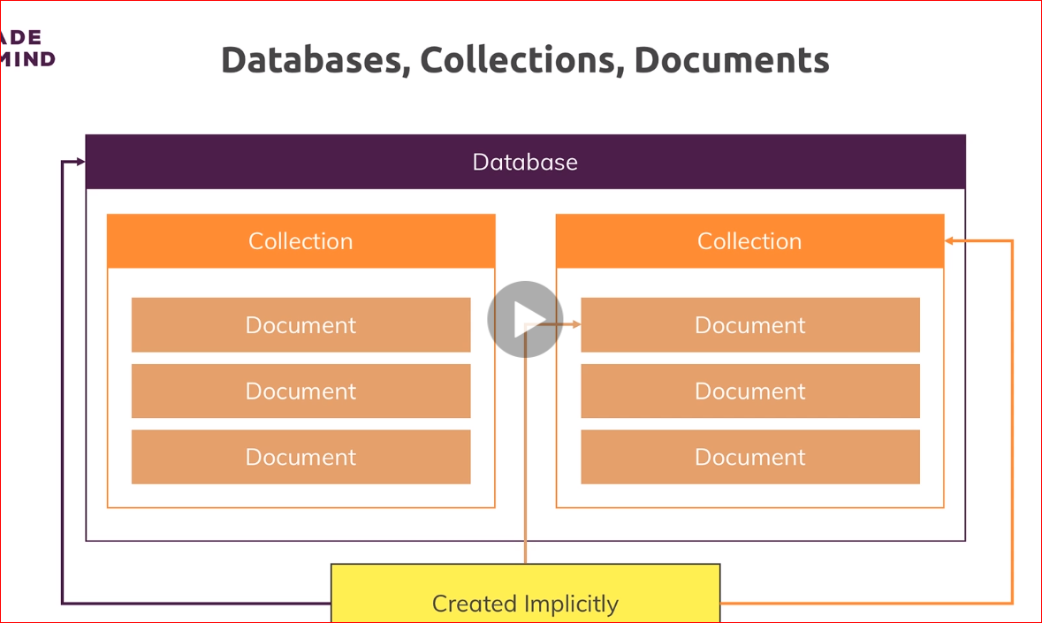
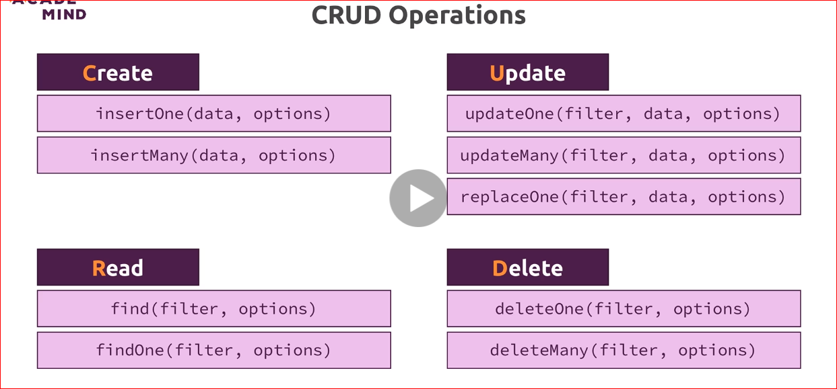
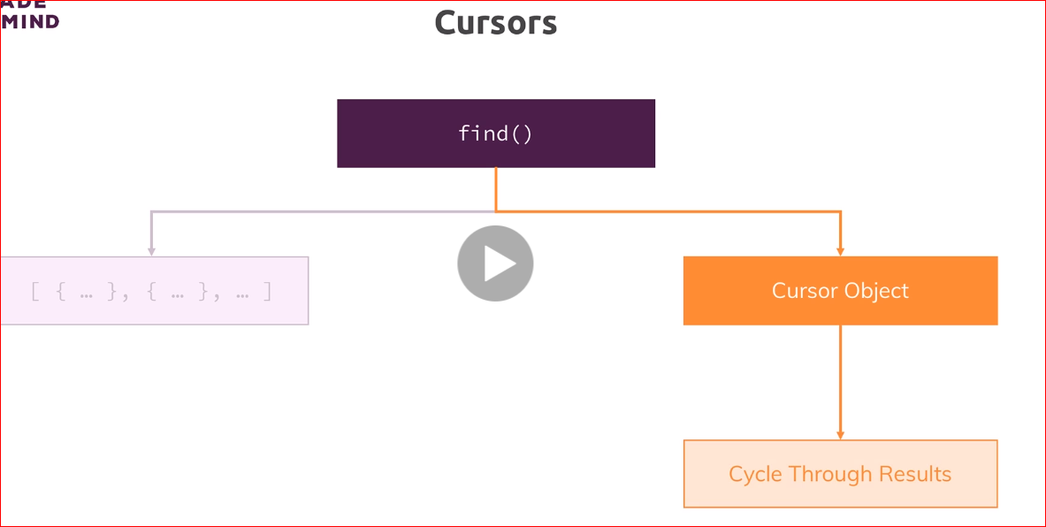
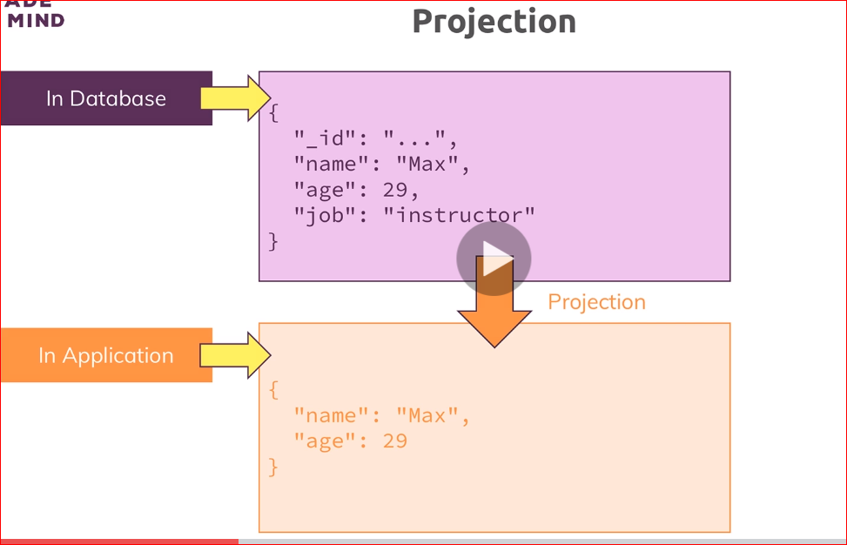
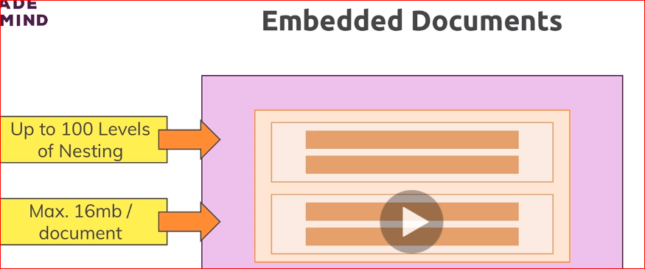
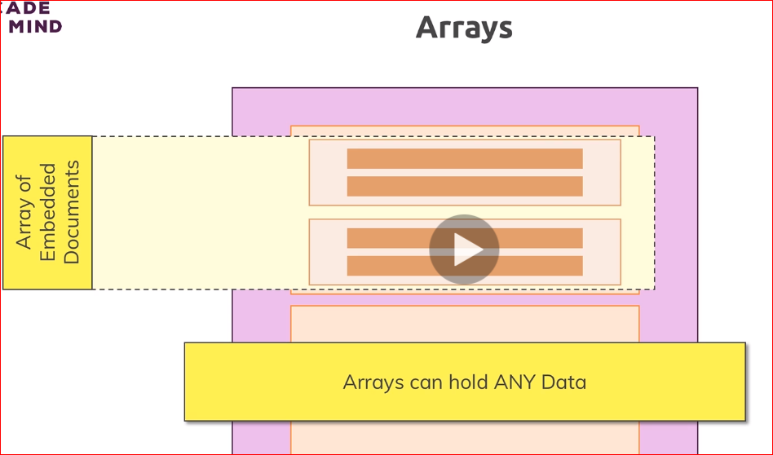

Slide 4
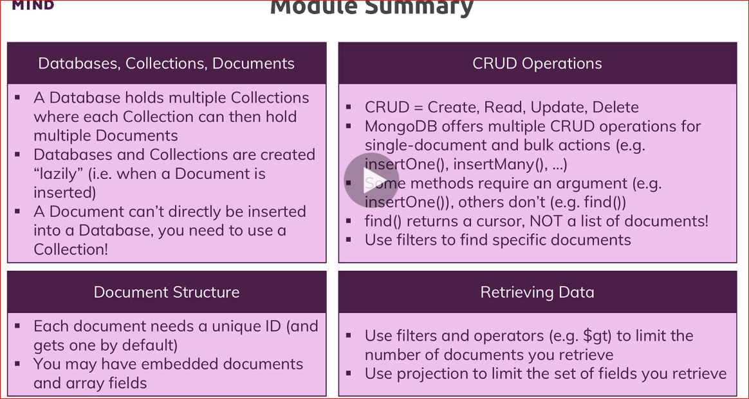
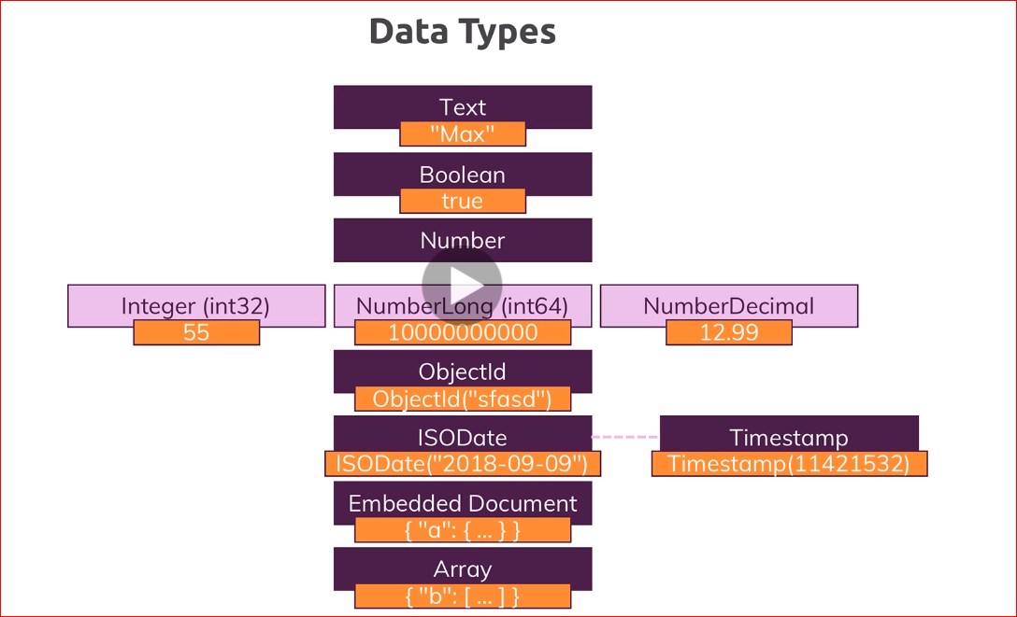
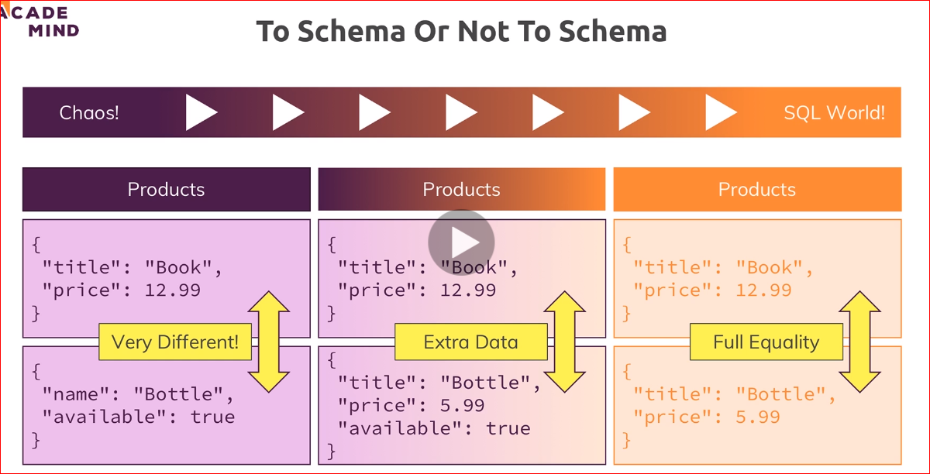
Useful Articles/ Docs:
Learn more about the MongoDB Drivers: https://docs.mongodb.com/ecosystem/drivers/
Dive into the official Getting Started Docs: https://docs.mongodb.com/manual/tutorial/getting-started/
Important: We will regularly start with a clean database server (i.e. all data was purged) in this course.
To get rid of your data, you can simply load the database you want to get rid of (use databaseName) and then execute db.dropDatabase().
Similarly, you could get rid of a single collection in a database via db.myCollection.drop()

Slide 5

Data Types & Limits
MongoDB has a couple of hard limits - most importantly, a single document in a collection (including all embedded documents it might have) must be <= 16mb. Additionally, you may only have 100 levels of embedded documents.
You can find all limits (in great detail) here: https://docs.mongodb.com/manual/reference/limits/
For the data types, MongoDB supports, you find a detailed overview on this page: https://docs.mongodb.com/manual/reference/bson-types/
Important data type limits are:
Normal integers (int32) can hold a maximum value of +-2,147,483,647
Long integers (int64) can hold a maximum value of +-9,223,372,036,854,775,807
Text can be as long as you want - the limit is the 16mb restriction for the overall document
It's also important to understand the difference between int32 (NumberInt), int64 (NumberLong) and a normal number as you can enter it in the shell. The same goes for a normal double and NumberDecimal.
NumberInt creates a int32 value => NumberInt(55)
NumberLong creates a int64 value => NumberLong(7489729384792)
If you just use a number (e.g. insertOne({a: 1}), this will get added as a normal double into the database. The reason for this is that the shell is based on JS which only knows float/ double values and doesn't differ between integers and floats.
NumberDecimal creates a high-precision double value => NumberDecimal("12.99") => This can be helpful for cases where you need (many) exact decimal places for calculations.
When not working with the shell but a MongoDB driver for your app programming language (e.g. PHP, .NET, Node.js, ...), you can use the driver to create these specific numbers.
Example for Node.js: http://mongodb.github.io/node-mongodb-native/3.1/api/Long.html
This will allow you to build a NumberLong value like this:
const Long = require('mongodb').Long;
db.collection('wealth').insert( {
value: Long.fromString("121949898291")
});
By browsing the API docs for the driver you're using, you'll be able to identify the methods for building int32s, int64s etc

Slide 6
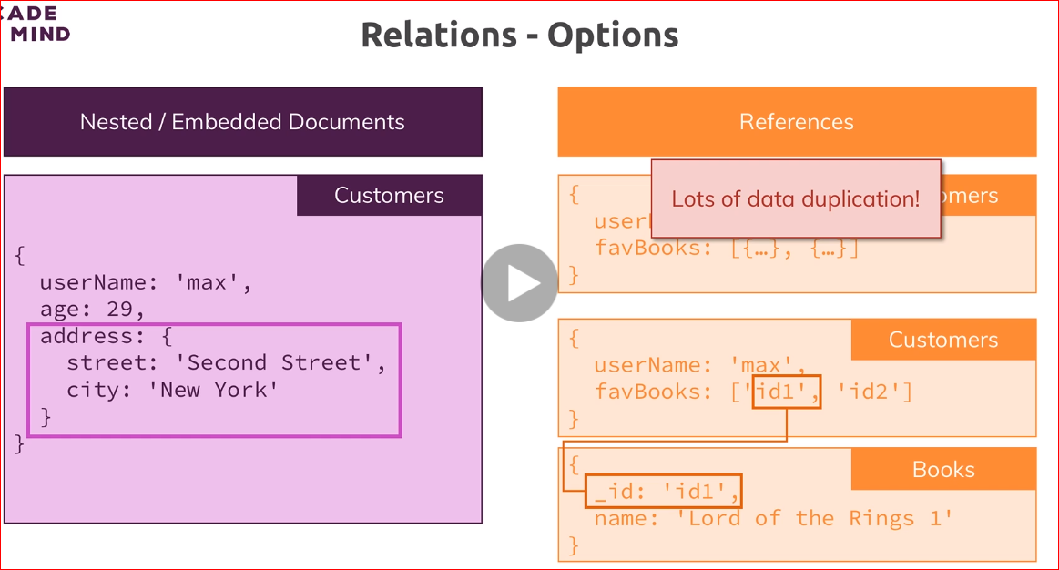

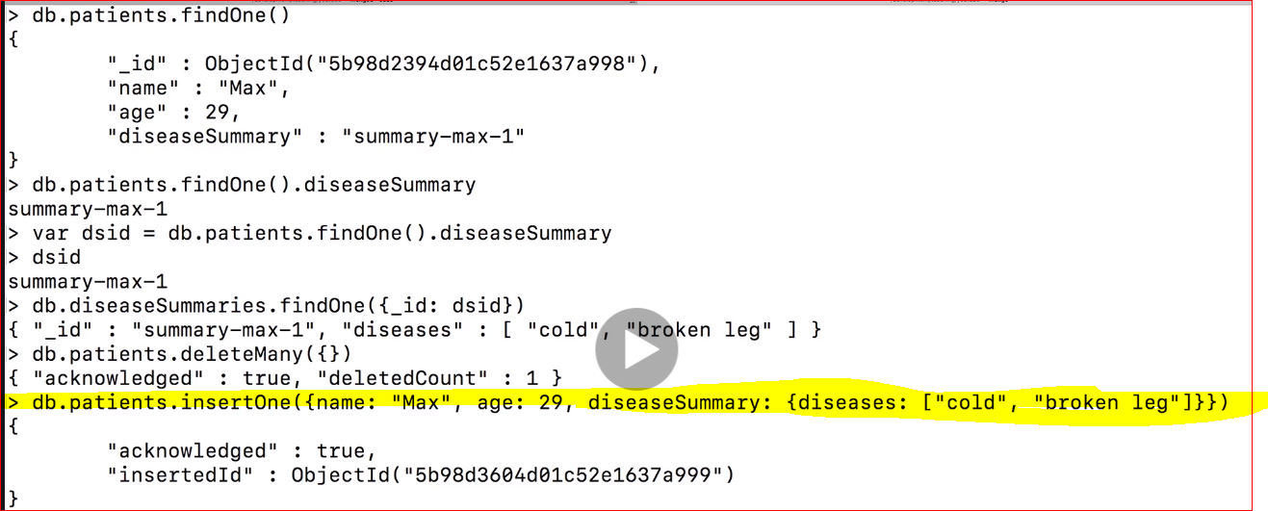

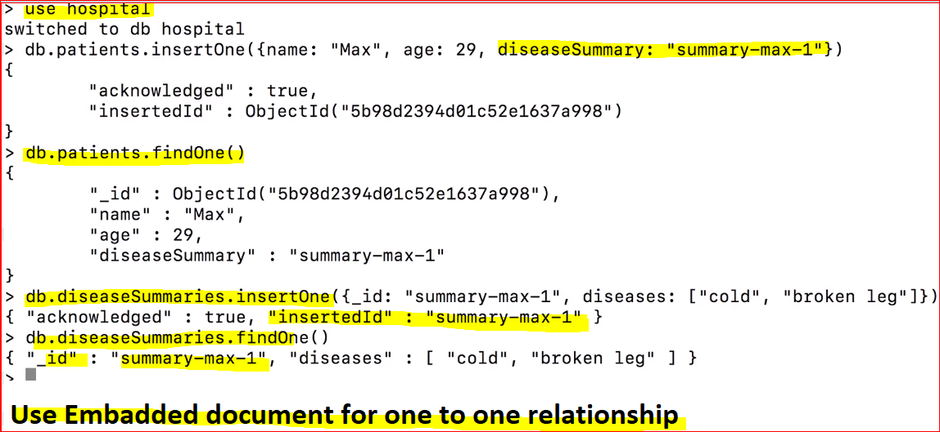
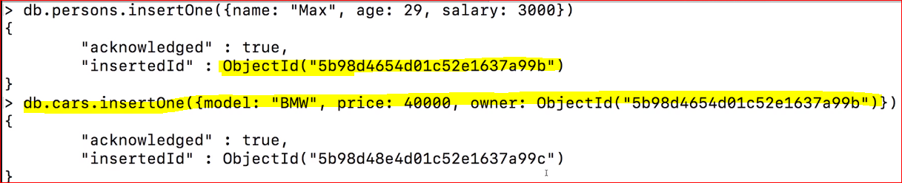

Slide 7
